Slide 1
FPGA vs. ASIC
Speaker: Po-Yueh Chen (陳伯岳)
國立彰化師範大學資訊工程系

Slide 2
Outline
What is FPGA
What is ASIC
Summary

Slide 3
What is an FPGA?
Field Programmable Gate Array
An IC with a flexible design style
An IC with many I/O pins
Basic cell is called CLB (Configurable Logic Block)
Various digital circuits can be implemented with different design codes downloaded.

Slide 4
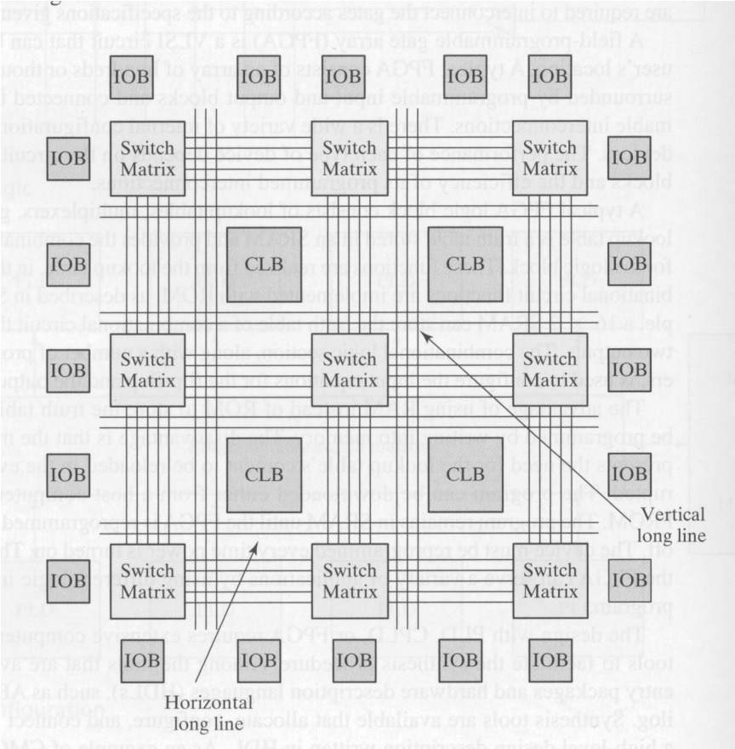
An Overview of an FPGA Chip

Slide 5
What is an FPGA? (cont.)
Short Time-to-Market
Less risk
100% hardware utility is impossible
High unit price
For early stage and small amount of demand

Slide 6
What is an ASIC?
Application Specific ICs
Fixed, not flexible
Many I/O pins
High risk
High manufacturing fee for Masks

Slide 7
What is an ASIC? (cont.)
Cost down process
Low unit price (mask fee not counted)
Long Time-to-Market
For mature stage and large amount of demand

Slide 8
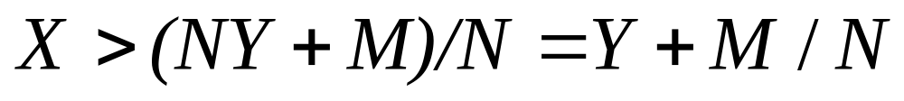
The Timing for Cost Down
X: Unit price for purchasing one FPGA chip
Y: Unit cost for manufacturing one ASIC chip
M: The Masks development fee
N: The demand amount
Check if

Slide 9
Summary
 | FPGA | ASIC
Chip Area | Large | Small
Unit Cost* | High | Low
Time-to-Market | Short | Long
Flexibility | High | Non
HW Utility | 85% up is good | 100%
Stage | Early | Mature
Amount | Small | Large

