Slide 1
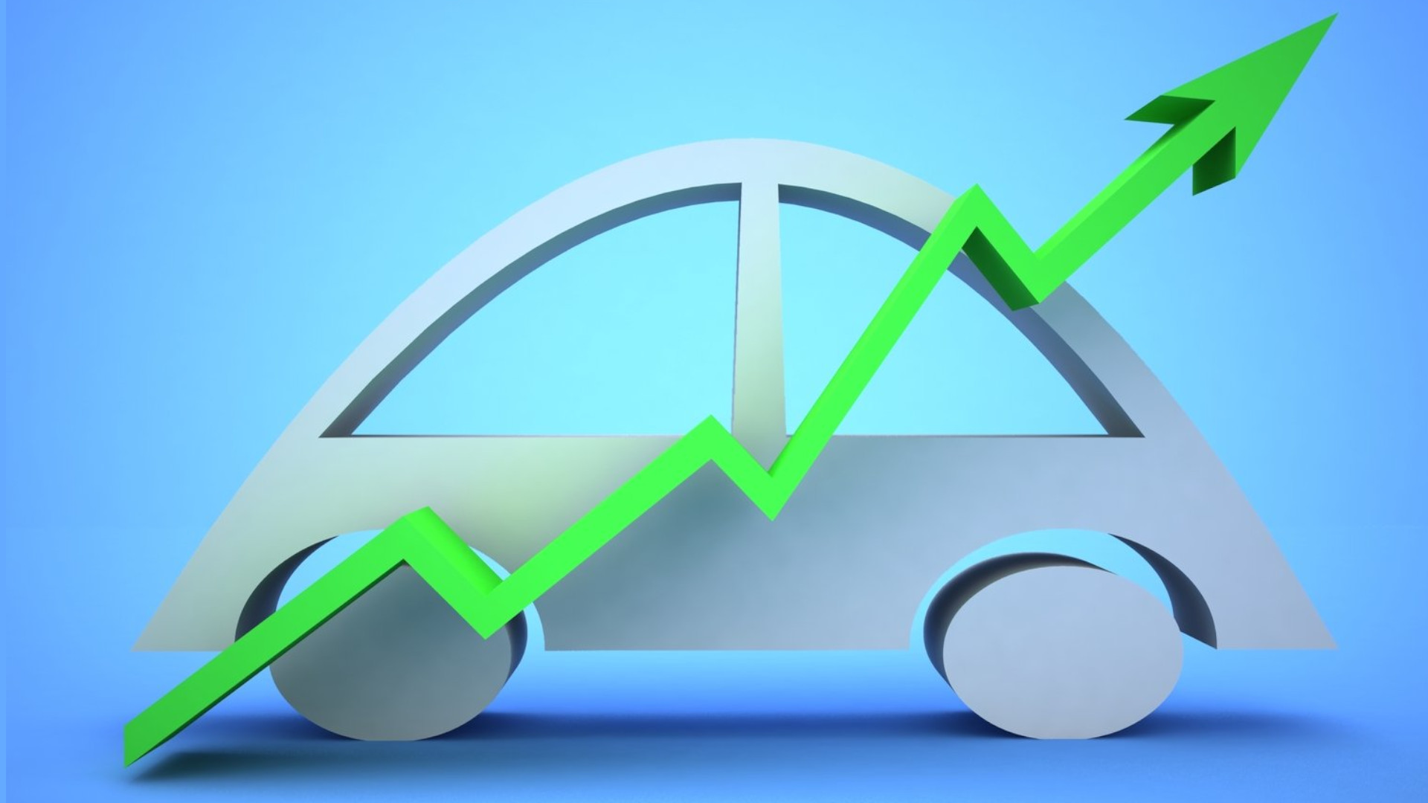
Car Price Prediction

Slide 2
Problem statement
With the covid 19 impact in the market, we have seen lot of changes in the car market. Now some cars are in demand hence making them costly and some are not in demand hence cheaper. One of our clients works with small traders, who sell used cars. With the change in market due to covid 19 impact, our client is facing problems with their previous car price valuation machine learning models. So, they are looking for new machine learning models from new data. We have to make car price valuation model.

Slide 3
Business Goal
We are required to model the price of cars with the available independent variables. This model will then be used by the management to understand how exactly the prices vary with the variables. They can accordingly manipulate the strategy of the firm and concentrate on areas that will yield high returns. Further, the model will be a good way for the management to understand the pricing dynamics of a new market.

Slide 4
Understanding
Step 1: After importing the data, first we do is check the shape of the datset followed by the data while checking for any null values.

Slide 5
Step 2: The next step we take is treat the data for the null values and make the data complete. In this case we drop the rows containing the null values. It produces a percentage loss of 1.8% data.

Slide 6
Step 3: Now we treat the data to make it appropriate data type, such as converting the price, km driven column to numerical type instead of the object data type.

Slide 7
Step 4: Now we treat the object data type columns, and then encode them for model purpose.

Slide 8
Step 5: Now we move to the correlation matric to understand how various variables interact with the target column

Slide 9
Step 6: Now we treat the data for skewness before comencing the model fitting.

Slide 10
Step 7: Now we move to the model phase, here we try 6 different models to check which works the best

Slide 11
Step 8: Now we do a cross validation check to understand which model performs best

Slide 12
Step 9: The last step is to do a hyperparameter tuning for the best fit model to marginally increase its efficiency.

Slide 13
Step 10: Now since the tuning of the model is done, we save the best model.

Slide 14
Conclusion
From the data we can see that various qualities of a car such as the model, transmission and km driven are of the most importance for the people in terms of the price of the car. On the other hand, features such as the brand, ownership produces a correlation of near to 0
correlation and hence, least importance.
This concludes that cars with great model, preferred transmission and less km driven should be given more importance while procuring whereas the other factors that has low importance can be used to
reduce the price of the car while buying.

Slide 15
Thank You
Made By: Jiby John

