Slide 1
Course Theme: Abstraction Is Good But Don’t Forget Reality
Carnegie Mellon
CIS courses often emphasize abstraction
Abstract data types
Asymptotic analysis
These abstractions have limits
Need to understand details of underlying implementations
Useful outcomes
Become more effective programmers
Able to write code that’s easy to reason about
Able to understand and tune for program performance
Able to find and eliminate bugs efficiently
Prepare for later “systems” classes in CIS
Compilers, Operating Systems, Networks, Computer Architecture

Slide 2
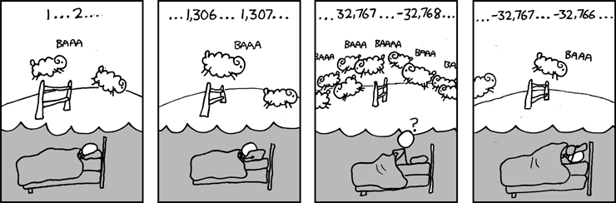
Great Reality #1: Ints are not Integers, Floats are not Reals
Carnegie Mellon
Example 1: Is x² ≥ 0?
Float’s: Yes!
Int’s:
40000 * 40000 ➙ 1600000000
50000 * 50000 ➙ ??
Example 2: Is (x + y) + z = x + (y + z)?
Unsigned & Signed Int’s: Yes!
Float’s:
(1e20 + -1e20) + 3.14 --> 3.14
1e20 + (-1e20 + 3.14) --> ??
Source: xkcd.com/571

Slide 3
Great Reality #2: You’ve Got to Know Assembly
Carnegie Mellon
Chances are, you’ll never write programs in assembly
Compilers are much better & more patient than you are
But: Understanding assembly is key to machine-level execution model
Tuning program performance
Understand optimizations done / not done by the compiler
Understanding sources of program inefficiency
Implementing system software
Compiler has machine code as target
Operating systems must manage process state
Creating / fighting malware
x86 assembly is the language of choice!
Google says so

Slide 4
Great Reality #3: Memory Matters Random Access Memory Is an Unphysical Abstraction
Carnegie Mellon
Memory is not unbounded
It must be allocated and managed
Many applications are memory dominated
Memory referencing bugs especially pernicious
Effects are distant in both time and space
Memory performance is not uniform
Cache and virtual memory effects can greatly affect program performance
Adapting program to characteristics of memory system can lead to major speed improvements

Slide 5
Memory System Performance Example
Carnegie Mellon
void copyij(int src[2048][2048],
int dst[2048][2048])
{
int i,j;
for (i = 0; i < 2048; i++)
for (j = 0; j < 2048; j++)
dst[i][j] = src[i][j];
}
void copyji(int src[2048][2048],
int dst[2048][2048])
{
int i,j;
for (j = 0; j < 2048; j++)
for (i = 0; i < 2048; i++)
dst[i][j] = src[i][j];
}
21 times slower
Hierarchical memory organization
Performance depends on access patterns
Including how step through multi-dimensional array

Slide 6
An Example Memory Hierarchy
L0:
CPU registers hold words retrieved from L1 cache
Registers
L1:
L1 cache
(SRAM)
Smaller,
faster,
costlier
per byte
L1 cache holds cache lines retrieved from L2 cache
L2:
L2 cache
(SRAM)
L2 cache holds cache lines retrieved from main memory
L3:
Larger,
slower,
cheaper
per byte
Main memory
(DRAM)
Main memory holds disk blocks retrieved from local disks
L4:
Local secondary storage
(local disks)
Local disks hold files retrieved from disks on remote network servers
Remote secondary storage
(tapes, distributed file systems, Web servers)
L5:

Slide 7
The Memory Mountain
Carnegie Mellon
Intel Core i7
2.67 GHz
32 KB L1 d-cache
256 KB L2 cache
8 MB L3 cache

Slide 8
Great Reality #4: There’s more to performance than asymptotic complexity
Carnegie Mellon
Constant factors matter too!
And even exact op count does not predict performance
Easily see 10:1 performance range depending on how code written
Must optimize at multiple levels: algorithm, data representations, procedures, and loops
Must understand system to optimize performance
How programs compiled and executed
How to measure program performance and identify bottlenecks
How to improve performance without destroying code modularity and generality

Slide 9
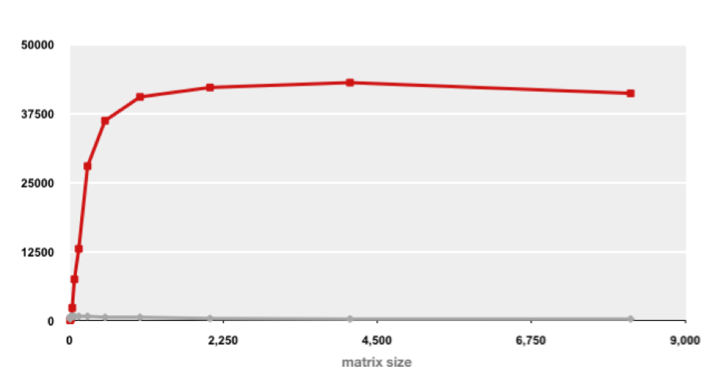
Example Matrix Multiplication
Carnegie Mellon
Matrix-Matrix Multiplication (MMM) on 2 x Core 2 Duo 3 GHz (double precision)
Gflop/s
Best code
320x
Triple loop
Standard desktop computer, vendor compiler, using optimization flags
Both implementations have exactly the same operations count (2n³)
What is going on?

Slide 10
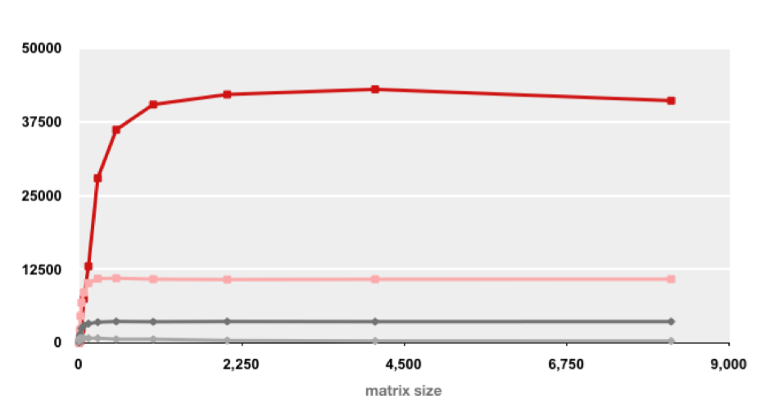
MMM Plot: Analysis
Carnegie Mellon
Matrix-Matrix Multiplication (MMM) on 2 x Core 2 Duo 3 GHz
Gflop/s
Multiple threads: 4x
Vector instructions: 4x
Memory hierarchy and other optimizations: 20x
Reason for 20x: Blocking or tiling, loop unrolling, instruction scheduling
Effect: fewer register spills and L1/L2 cache misses

Slide 11
Great Reality #5: Performance ALWAYS Matters
Carnegie Mellon
Apps
Games
Servers
Web pages
OS
Libs
Can anyone think of a case where performance DOESN’T matter? ☺

