Slide 1
CIS471/571, Fall 2018
Introduction to Artificial Intelligence
Instructor: Dejing Dou
Office Hours: Monday 4:00-5:30pm (hw6 returns)
Final Exam: Tuesday 14:45-16:45pm
Project Demos: Friday 4:00-5:00pm

Slide 2
Robotics
Types of Robots
Robot Hardware
  Sensors, Effectors, DOF (degree of freedom)
Localization of Robots
Configuration Space
Reactive Control
Robot Software Architecture

Slide 3
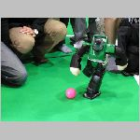
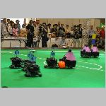
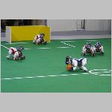
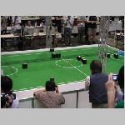
Robocup
By the year 2050, develop a team of fully autonomous humanoid robots that can win against the human world soccer champion team.

Slide 4
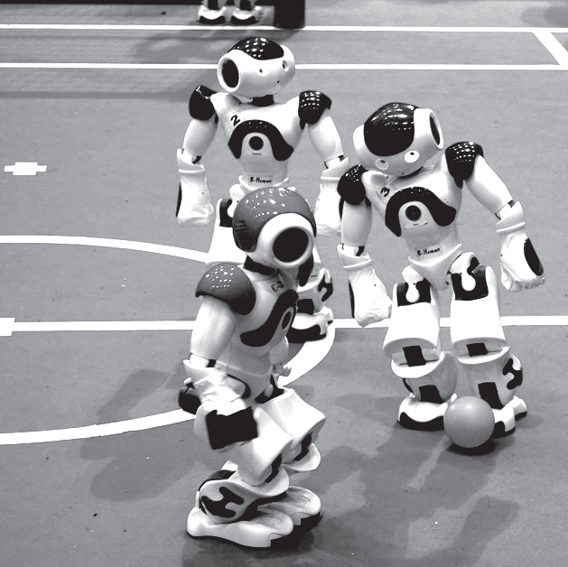
Robocup
By the year 2050, develop a team of fully autonomous humanoid robots that can win against the human world soccer champion team

Slide 5
Application of Robots
Industry and Agriculture
  Assembly line, harvesting, mining
Transportation
  Transporting food, water, drugs, files in hospital and offices
Hazardous environments and exploration
  Cleaning nuclear waste, rescue and search people after earthquake
  International space station, Mars
Health care
  Surgeon assistant
Personal service
  Autonomous vacuum cleaners
Entertainment and sports
  Robocup (soccer)

Slide 6
A Definition
Robots are physical agents that perform tasks by manipulating the physical world. That means:
  They have effectors (e.g., legs, wheels) to assert physical forces on the environment
  They have sensors (e.g., cameras, ultrasound) to measure the environment and own motion.

Slide 7
Types of Robots
Manipulators
  E.g., robot arms are physically anchored to their workplace in a factory assembly line, hospital or the international space station
Mobile robots
  Sonydog, autonomous driving cars (google car), planetary rovers
Humanoid robots
  The physical design mimics the human torso

Slide 8
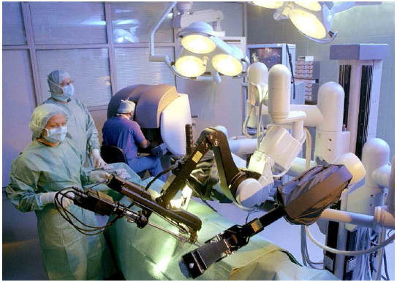
Manipulator for hospital

Slide 9
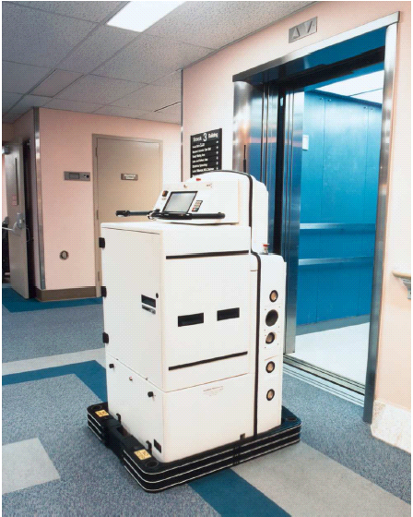
Helpmate for hospital

Slide 10
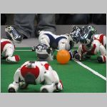
Sony Dogs

Slide 11
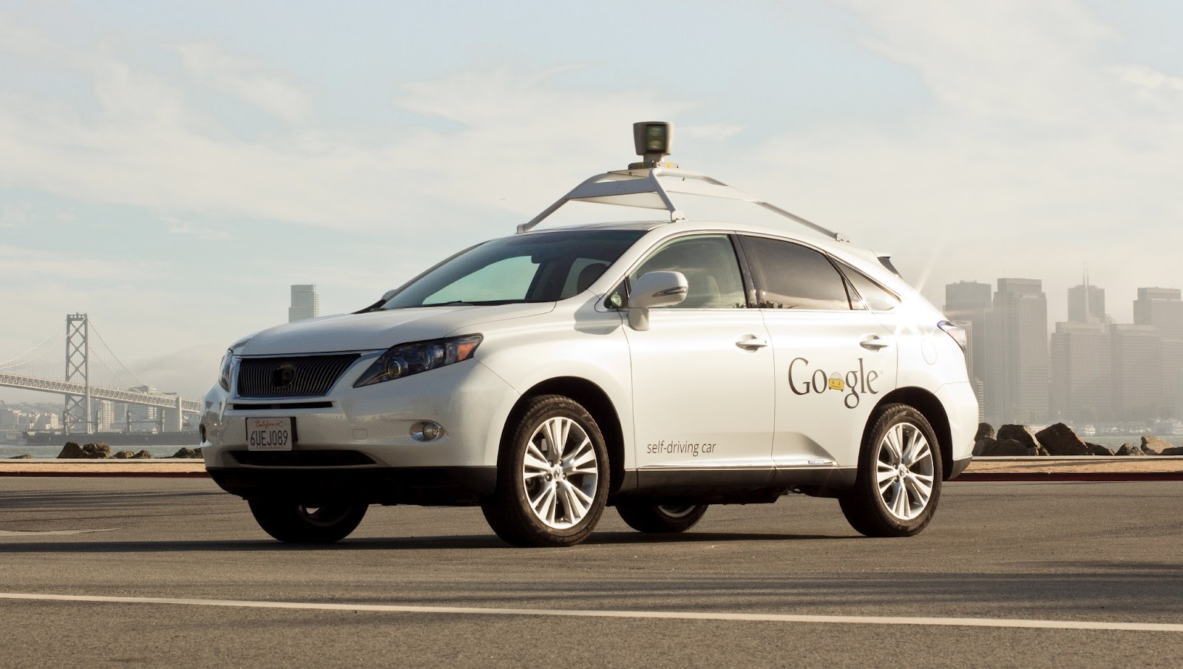
Google Car

Slide 12
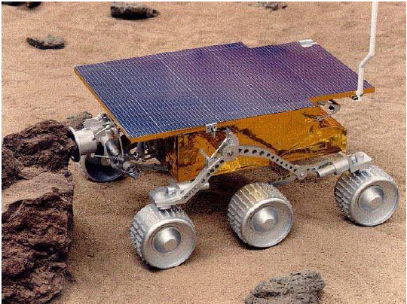
NASA’s Sojouner in Mars

Slide 13
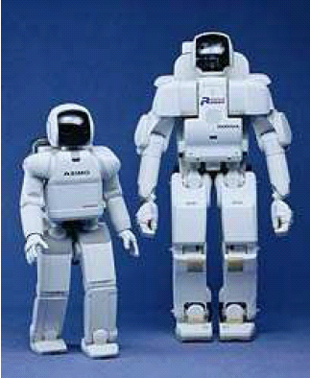
Humanoid Robots

Slide 14
Sensors
Passive Sensors
  E.g., cameras which are observers of the environment
  Odometry measures the change of locations over time.
Active Sensors
  E.g., Sonar which can send energy into the environment and rely on the fact that this energy is reflected back to the sensor.
  Others like Ranger Finder, GPS,

Slide 15
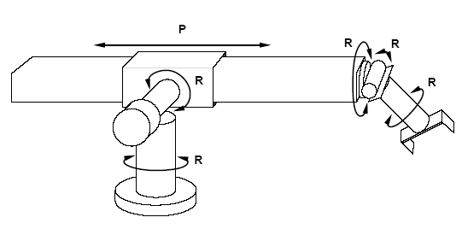
Effectors and Degree of Freedom
One degree of freedom means each independent direction the effectors can move.
The Stanford Manipulator have five revolute joints (R) and one prismatic joint (P) DOFs.

Slide 16
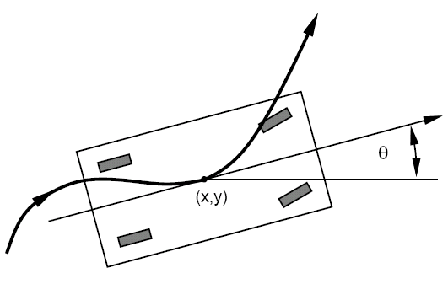
DOF for mobile robots
The DOFs of mobile robots are not necessarily the same as the number of actuated elements.
The robot car has 2 controllable DOFs (move forward and backward, turn) and 3 effective DOFs, because kinematic configuration of a robot car is 3 dimensional (x, y, z) location.

Slide 17
Localization
It is a generic example of robot perception. For example, robot cars must know where they are to find a way to goal location.
If the initial location of object is known, localization problem is a tracking problem
If the initial location is unknown, it is a global localization problem. However, it can turn into tracking problem once the object has been localized

Slide 18
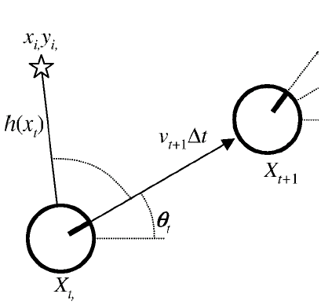
Tracking and Motion
In deterministic model:
X_{t+1} = f (X_{t},v_{t}, ω_{t}) = X_{t} + [v_{t} Δt cosθ_{t}, v_{t} Δt sinθ_{t}, ω_{t} Δt ]
In common model, we have to use a Gaussian distribution with mean f (X_{t},v_{t}, ω_{t}) and some covariance Σ_{x}:
P(X_{t+1}| X_{t} ,v_{t}, ω_{t}) = N (f (X_{t},v_{t}, ω_{t}) , Σ_{x})
Notes:
w: small Omega

Slide 19
Planning to Move
For robots, decisions ultimately involve motion of effectors.
The first step to move is to get a good presentation of problems. Similar like search spaces or planning worlds.

Slide 20
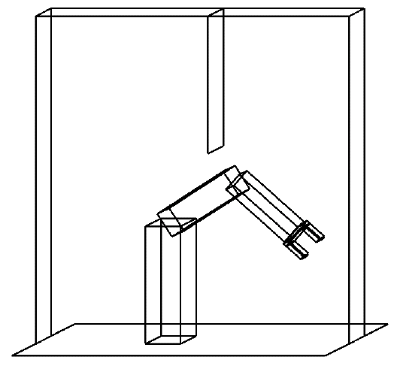
Configuration Space
ϕ_{elb}
ϕ_{shou}
The robot arm has two joints and move independently. Moving the joints alters the (x,y) coordinates of the elbow and the gripper. Suppose the z coordinate doesn’t change. (x_{g},y_{g}) and (x_{e},y_{e}) can be used as 4 coordinates

Slide 21

Configuration Space
ϕ_{elb}
table
table
Left wall
Vertical obstable
ϕ_{shou}
Notes:
psi

Slide 22
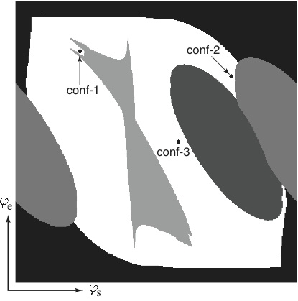
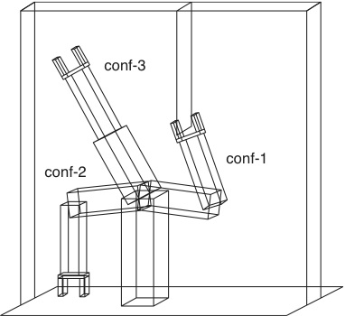
Configuration Space
Notes:
psi

Slide 23
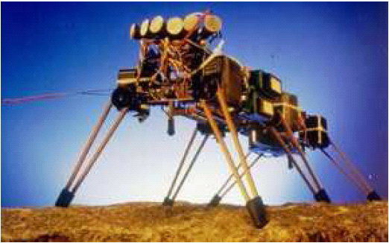
Moving by control
Six legs and 12 DOF (two for each leg)

Slide 24
Reactive Control
retract, lift higher
yes
Move forward
no
S₃
Stuck?
S₄
Lift up
Set down
Push backward
S₂
S₁
An augmented finite state machine (AFSM) for the control of a single leg

Slide 25
Robotic Software Architectures
Hybrid architecture combine reactive control (low level decision and sensor driven) and deliberative control (high level decision based on information which can not be sensed at the time of decision making. E.g, path planner)
  Subsumption architecture based on finite machines
  Three layer architecture: reactive layer, executive layer and deliberate layer.
Robotic programming languages
  rule-based language complied in AFSMs
  functional programming language for control system, e.g, GRL
  Reactive action plan system (RAPS)
  Reasoning and learning (e.g., GOLOG, CES, ALisp)

Slide 26
Final Review
Uncertainty and Reasoning
  Bayes Rule, Bayes Network
Machine Learning
  Decision Tree, Neural Network, Deep Learning
NLP, Information Retrieval, Information Extraction
Robotics

Slide 27
Uncertainty
Handling Uncertain Knowledge
Syntax for Probability
  Axioms of Probability
  Prior Probability
  Conditional Probability
Inference and Independence
Bayes’ Rule

Slide 28
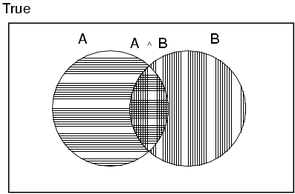
Axioms of probability
For any propositions A, B
  0 ≤ P(A) ≤ 1
  P(true) = 1 and P(false) = 0
  P(A ∨ B) = P(A) + P(B) - P(A ∧ B)

Slide 29
Conditional probability
Conditional or posterior probabilities
  e.g., P(cavity | toothache) = 0.8
  i.e., given that toothache is all I know
(Notation for conditional distributions:
  P(Cavity | Toothache) = 2-element vector of 2-element vectors)
If we know more, e.g., cavity is also given, then we have
  P(cavity | toothache,cavity) = 1
New evidence may be irrelevant, allowing simplification, e.g.,
  P(cavity | toothache, sunny) = P(cavity | toothache) = 0.8
This kind of inference, conducted by domain knowledge, is crucial

Slide 30
Conditional probability
Definition of conditional probability:
  P(a | b) = P(a ∧ b) / P(b) if P(b) > 0
Product rule gives an alternative formulation:
  P(a ∧ b) = P(a | b) P(b) = P(b | a) P(a)
A general version holds for whole distributions, e.g.,
  P(Weather,Cavity) = P(Weather | Cavity) P(Cavity)
(View as a set of 4 × 2 equations, not matrix mult.)
Chain rule is derived by successive application of product rule:
  P(X₁, …,X_{n}) = P(X₁,...,X_{n-1}) P(X_{n} | X₁,...,X_{n-1})
  = P(X₁,...,X_{n-2}) P(X_{n-1} | X₁,...,X_{n-2}) P(X_{n} | X₁,...,X_{n-1})
  = …
  = π_{i= 1} P(X_{i} | X₁, … ,X_{i-1})
_{n}

Slide 31

Inference by enumeration
Start with the joint probability distribution:
For any proposition φ, sum the atomic events where it is true: P(φ) = Σ_{ω:ω╞φ} P(ω)
P(toothache) = 0.108 + 0.012 + 0.016 + 0.064 = 0.2

Slide 32
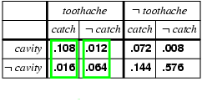
Normalization
Denominator can be viewed as a normalization constant α
P(Cavity | toothache) = α, P(Cavity,toothache)
  = α, [P(Cavity,toothache,catch) + P(Cavity,toothache,¬ catch)]
  = α, [<0.108,0.016> + <0.012,0.064>]
  = α, <0.12,0.08> = <0.6,0.4>
General idea: compute distribution on query variable by fixing evidence variables and summing over hidden variables

Slide 33
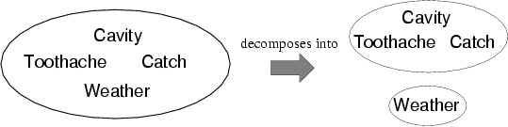
Independence
A and B are independent iff
P(A|B) = P(A) or P(B|A) = P(B) or P(A, B) = P(A) P(B)
  P(Toothache, Catch, Cavity, Weather)
  = P(Toothache, Catch, Cavity) P(Weather)
Absolute independence powerful but rare

Slide 34
Bayes' Rule
Product rule P(a∧b) = P(a | b) P(b) = P(b | a) P(a)
⇒ Bayes' rule: P(a | b) = P(b | a) P(a) / P(b)
or in distribution form
P(Y|X) = P(X|Y) P(Y) / P(X) = αP(X|Y) P(Y)
Useful for assessing diagnostic probability from causal probability:
  P(Cause|Effect) = P(Effect|Cause) P(Cause) / P(Effect)
  E.g., let M be meningitis, S be stiff neck:
    P(m|s) = P(s|m) P(m) / P(s) = 0.8 × 0.0001 / 0.1 = 0.0008
  Note: posterior probability of meningitis still very small!

Slide 35
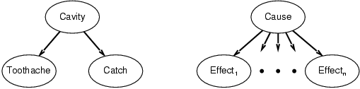
Bayes' Rule and conditional independence
P(Cavity | toothache ∧ catch)
  = αP(toothache ∧ catch | Cavity) P(Cavity)
  = αP(toothache | Cavity) P(catch | Cavity) P(Cavity)
This is an example of a naïve Bayes model:
  P(Cause,Effect₁, … ,Effect_{n}) = P(Cause) π_{i}P(Effect_{i}|Cause)
Total number of parameters is linear in n

Slide 36
Bayesian networks
A simple, graphical notation for conditional independence assertions and hence for compact specification of full joint distributions
Syntax:
  a set of nodes, one per variable
  a directed, acyclic graph (link ≈ "directly influences")
  a conditional distribution for each node given its parents:
    P (X_{i} | Parents (X_{i}))
In the simplest case, conditional distribution represented as a conditional probability table (CPT) giving the distribution over X_{i} for each combination of parent values

Slide 37

Example
Topology of Bayesian network encodes conditional independence assertions:
Weather is independent of the other variables
Toothache and Catch are conditionally independent given Cavity

Slide 38
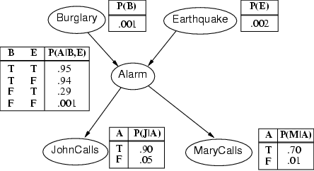
Example

Slide 39
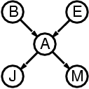
Semantics
The full joint distribution is defined as the product of the local conditional distributions:
P (X₁, … ,X_{n}) = π_{i = 1} P (X_{i} | Parents(X_{i}))
e.g., P(j ∧ m ∧ a ∧ ¬b ∧ ¬e)
= P (j | a) P (m | a) P (a | ¬b, ¬e) P (¬b) P (¬e)
_{n}

Slide 40
Learning
Decision Tree Learning
Neural Network

Slide 41
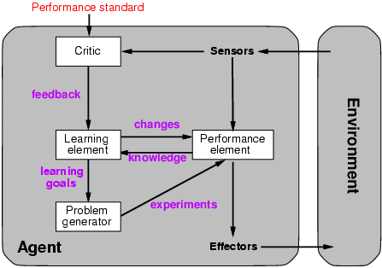
Learning agents
Notes:
Performance element: collection of knowledge and procedures.

Slide 42
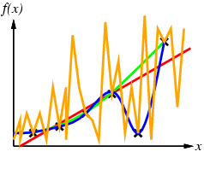
Inductive learning method
Construct/adjust h to agree with f on training set
  (h is consistent if it agrees with f on all examples)
  E.g., curve fitting:
Occam’s razor: prefer the simplest hypothesis consistent with data

Slide 43
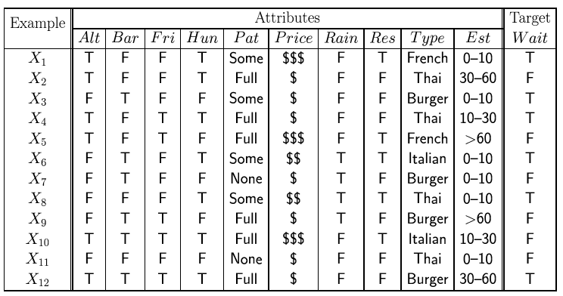
Attribute-based representations
Examples described by attribute values (Boolean, discrete, continuous)
  E.g., situations where I will/won't wait for a table:
Classification of examples is positive (T) or negative (F)

Slide 44
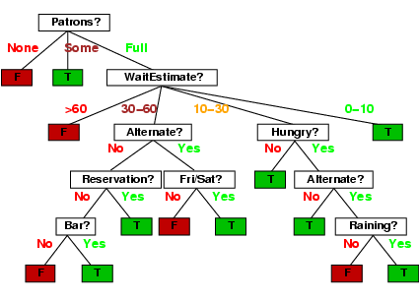
Decision trees
One possible representation for hypotheses
  E.g., here is the “true” tree for deciding whether to wait:

Slide 45
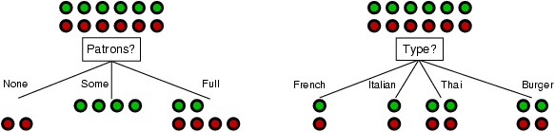
Choosing an attribute
Idea: a good attribute splits the examples into subsets that are (ideally) "all positive" or "all negative"
Patrons? is a better choice

Slide 46
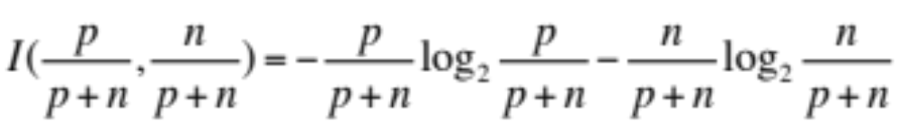
Using information theory
To implement Choose-Attribute in the DTL algorithm
Information Content (Entropy):
I(P(v₁), … , P(v_{n})) = Σ_{i=1} -P(v_{i}) log₂ P(v_{i})
For a training set containing p positive examples and n negative examples:

Slide 47
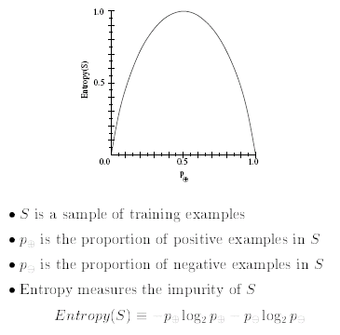
Entropy (Impurity)
_{P+}
_{P-}
₋
_{P+}
_{P+}
₋
_{P-}
_{P-}
Notes:
"är-kE-'ä-l&-jE/

Slide 48
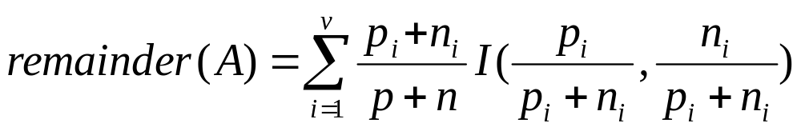
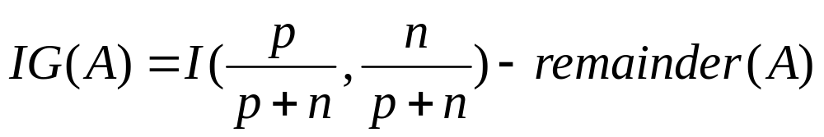
Information gain
A chosen attribute A divides the training set E into subsets E₁, … , E_{v} according to their values for A, where A has v distinct values.
Information Gain (IG) or reduction in entropy from the attribute test:
Choose the attribute with the largest IG

Slide 49
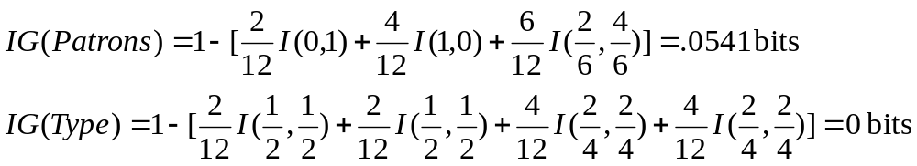
Information gain
For the training set, p = n = 6, I(6/12, 6/12) = 1 bit
Consider the attributes Patrons and Type (and others too):
Patrons has the highest IG of all attributes and so is chosen by the DTL algorithm as the root

Slide 50
Neural Network
Basic Concepts and Units
Single Layer NN Learning
Multilayer NN Learning
  Back-propagation

Slide 51
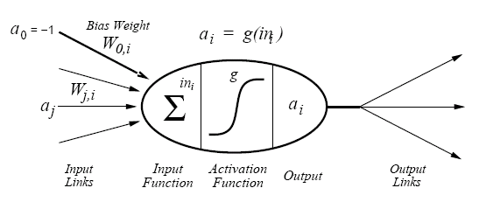
A Simple Mathematical Model
a_{i} = g(Σ_{j}^{n}₌₀ W_{j,i}a_{j})

Slide 52
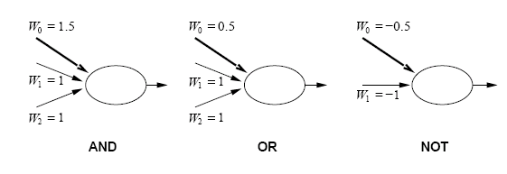
Acting as Logic Gates
a₁ + a₂ – 1.5 a₁ + a₂ – 0.5 -a₁ + 0.5

Slide 53
Perceptron vs. decision tree
_{a0= -1}
_{a1}
_{W0}
.
.
.
_{an}
_{Wj}
A majority function (outputs 1 only if more than half of its n inputs are 1) can be a perceptron network with some W_{j} and W₀, what they are?
A decision tree need O(2^{n}) nodes to represent this function

Slide 54
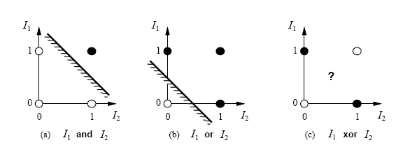
Hyperplane
Σ_{j}^{n}₌₀ W_{j}x_{j} > 0 then g(Σ_{j}^{n}₌₀ W_{j}x_{j}) = 1
W•X = 0 defines a hyperplane in the input space, so the perceptron with threshold function returns 1 if and only if the input is on one side of that hyperplane.
(a) and (b) is linearly separable but (c) is not.

Slide 55
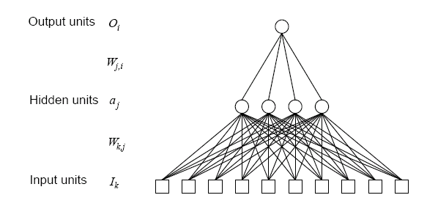
Multilayer feed-forward NN

Slide 56
Learning by Multilayer NN
It may have several outputs, so we need an output vector h_{w}(x) and a true value output vector y (gold standard).
The error y - h_{w}(x) at output layer is clear, but the error at the hidden layers seems mysterious.
However, we can use back-propagate the error from the output layer to the hidden layer.

Slide 57
Back Propagation
Let Err_{i} be ith component of the error vector y - h_{w}(x) . Define Δ_{i} = Err × g’(in), so the weight update rule for output layer is:
W_{j,i} <= W_{j,i} + α × Δ_{i} × a_{j}
The hidden node j is “responsible” for some faction of the error Δ_{i} in each of the output nodes to which it connects.

Slide 58
Back Propagation
The Δ_{i} Values are divided according to the strength of connection between the hidden node and the output node and are propagated back to provide Δ_{j} values for the hidden layer:
Δ_{j} = g’(in) Σ W_{j,i} Δ_{i}
W_{k,j} <= W_{k,j} + α × Δ_{j} × I_{k}
By using math, we get:
∂E/∂W_{j,i} = - a_{j} Δ_{i} ∂E/∂W_{k,j} = - I_{k} Δ_{j}

Slide 59
Back Propagation
It can be summarized as follows:
Compute the Δ values for the output units, using the observed errors.
Starting with the output layer, repeat the following for each layer in the network, until the earliest hidden layer is reached
    Propagate the Δ values back to the previous layer
    Update the weights between the two layers

Slide 60
NLP
Natural Language Processing
Information Retrieval
Information Extraction

Slide 61
Formal Language and Grammar
Grammar specifies the compositional structure of complex messages.
  e.g., speech, text
A formal language is a set of strings of terminal symbols. Each string in the language can be analyzed/generated by the grammar. The grammar is a set of rewrite rules, e.g.,
  S → NP VP
  Article → the | a | an | . . .
Here S is the sentence symbol, NP (Noun Phrase) and VP (Verb Phrase) are nonterminals

Slide 62
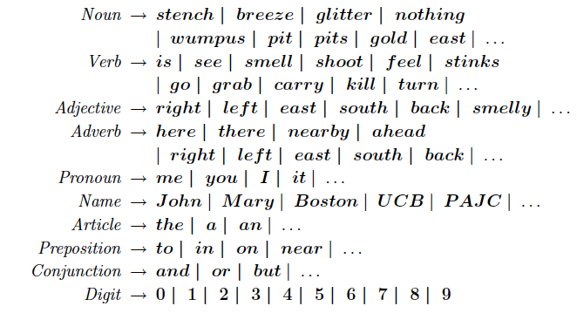
Wumpus Lexicon

Slide 63
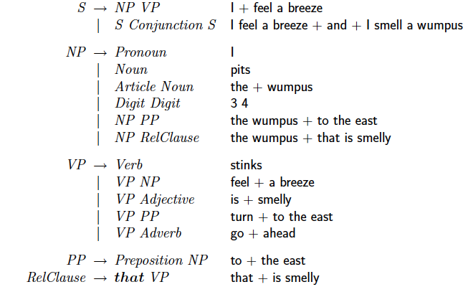
Wumpus Grammar

Slide 64
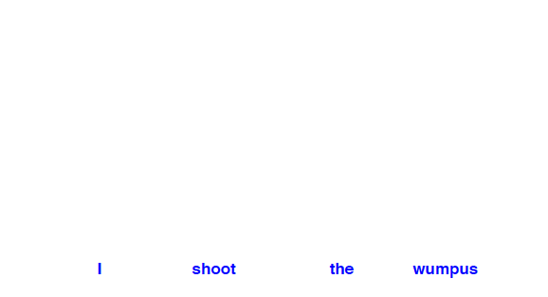
Parse Tree
Exhibit the grammatical structure of a sentence

Slide 65
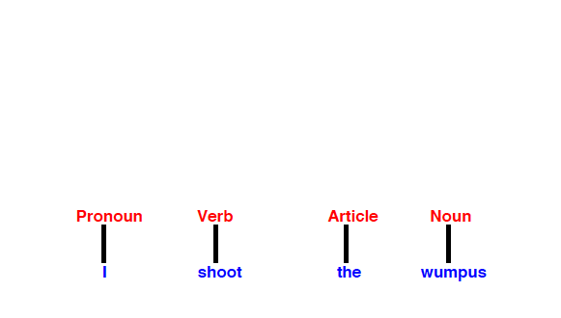
Parse Tree
Exhibit the grammatical structure of a sentence

Slide 66
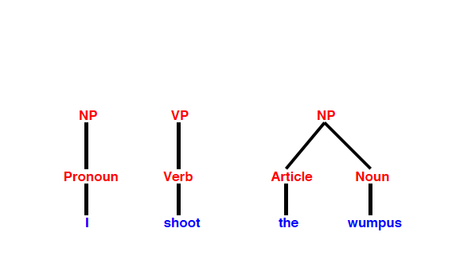
Parse Tree
Exhibit the grammatical structure of a sentence

Slide 67
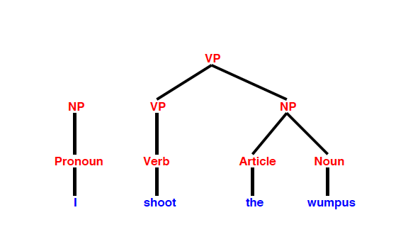
Parse Tree
Exhibit the grammatical structure of a sentence

Slide 68
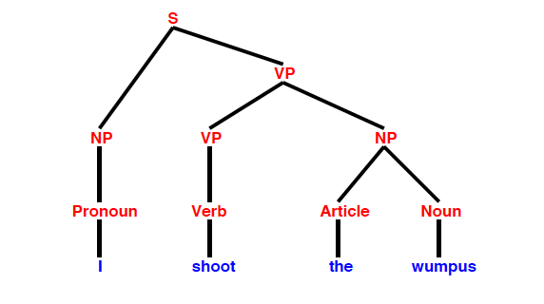
Parse Tree
Exhibit the grammatical structure of a sentence

Slide 69
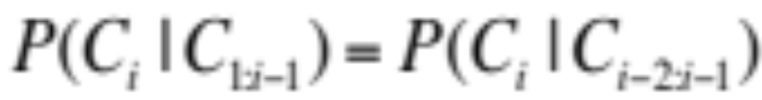
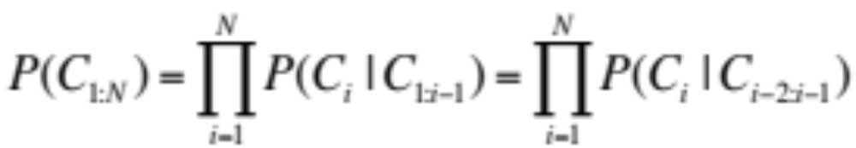
N-gram character Model
A model of the probability distribution of n-letter sequences is called an n-gram model: P(C_{1:N}) is the probability of a sequence of N characters.
An n-gram model is defined as a Markov Chain of order n-1. In a Markov chain, the probability of character C_{i} depends only on the immediately preceding characters, not on any other characters. So in a trigram model:

Slide 70
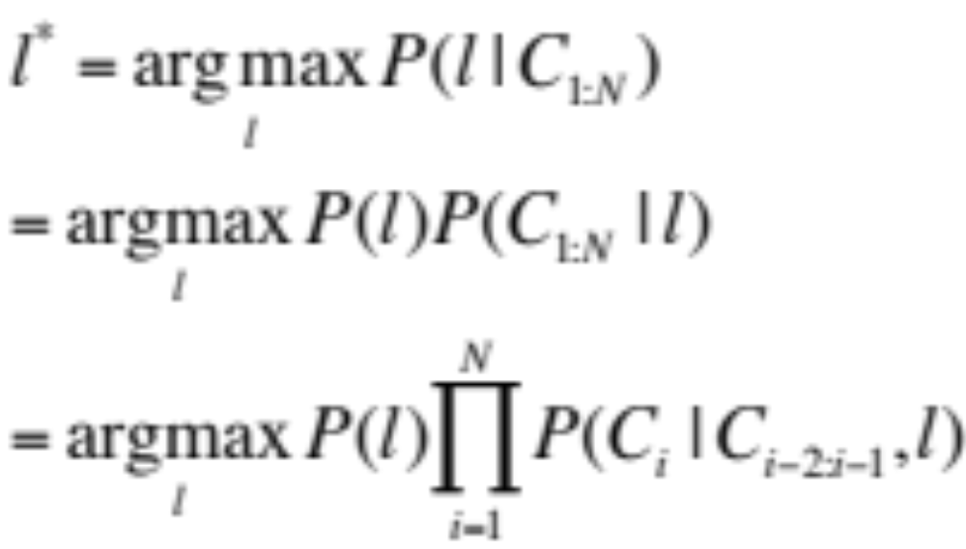
Language Identification
Given a text, determine what natural language it is written in.
One approach: first build a trigram character model of each candidate language l, P(C_{i} | C _{i-2:i-1,} l). We want to select most probable language given the text, so we apply Bayes’ rule:

Slide 71
N-gram word Model
An n-gram model can be over words rather than characters: P(W_{1:N}) is the probability of a sequence of N words.
An n-gram word model has much larger set of symbols (vocabulary) than character model. So it is possible we need to handle a new word that was not seen in the training corpus.
  Add a new word to the vocabulary: <UNK>
  Go through the training corpus, the first time any individual word appears it is previously unknown, so replace it with the symbol <UNK>. E.g., any string of digits might be replaced with <NUM>, any email address with <EMALL>.
  When an unknown word appears in a test set, we look up its probability under <UNK>.

Slide 72
Text Classification
Also known as text categorization: given a text of some kind, decide which of a predefined set of classes it belongs to.
  Sentiment analysis: e.g., classify a movie or product review as positive or negative
  Spam detection: Spam vs. Ham

Slide 73
Spam Detection
We first define an n-gram language model for P(message | spam) by training on the spam folder and define an n-gram model for P(message | ham) by training on the inbox (i.e., hams). The we can use the Bayes’ rule:

Slide 74
Features of Messages
We can represent the message as a set of feature/value pairs and apply a classification algorithm h to the feature vector X. We can think n-grams as features.
In unigram model, the features are the words in the vocabulary, e.g., “a,”, “sale”… and the values are the number of times each word appears in the message. It is also called the bag of words model.
What is the drawback of bag of words model? How about using bigrams and trigrams?

Slide 75
Information Retrieval
A task to find documents that are relevant to a user’s need (e.g., a search query) for information.
  Best known examples of IR systems are web search engines
An IR system can be characterized by:
  A corpus of documents.
  Queries posed in a query language
  A result set represented in a different ways, e.g., a ranked list of relevant documents
Earliest IR system: a Boolean keyword model: whether a keyword is in a document or not.

Slide 76
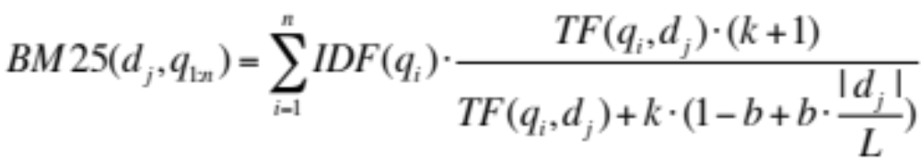
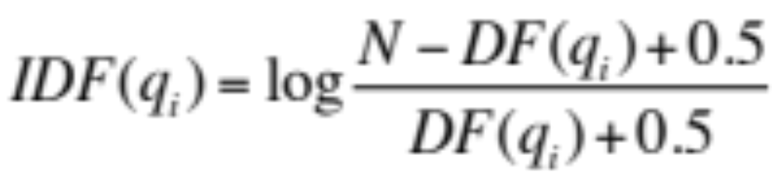
BM25 Function
Given a document d_{j} and a query with words q_{1:n},
where |d_{j}| is the length of document d_{j} in words, and L is the average document length in the corpus: L=Σ_{i}|d_{i}|/N. N is the number of documents in corpus. Two parameters k and b can be tuned by cross-validation. Typical values k = 2.0 and b = 0.75
where DF(q_{i}) is the number of documents that contains q_{i}

Slide 77
Precision and Recall
Precision: the proportion of documents in the result set that are actually relevant (i.e., accuracy):
P = (results ∧ relevant) / results = 30/(30+10) = 0.75
Recall: the proportion of all relevant documents in the collection which are also in the results (i.e., completeness):
R = (results ∧ relevant) / relevant = 30/(30+20)=0.6

Slide 78
F1 score
It’s possible a system can return every document in the collection (100% recall) but has low precision. Or a system could return a single document (low recall) but a decent chance at 100% precision.
A harmonic mean of P and R:
  F₁ = 2×P×R/(P+R) or more general
  F_{β} = (1+β²) ×P×R/(β²×P + R)

Slide 79

PageRank algorithm
The PageRank for a page p is defined as:
PR(p) is the PageRank of p, N is the total number of pages in the corpus, in_{i} are the pages that link in to p, and C(in_{i}) is the count of the total number of out-links on page in_{i}. The constant d is a damping factor. With probability (e.g., d = 0.85) a web surfer clicks on one of the links on the page and with probability (1-d) the surfer gets bored with the page and restarts on a random page.
Then PR(p) is the probability that a random surfer will be at page p at any point in time. So we can start with PR(p) = 1, then iterate until converge.

Slide 80
Information Extraction
A process to acquire knowledge by looking for occurrences of a particular class of objects and looking for relationships among objects, e.g.,
  Instances of street addresses from web pages
  Instances of storms from weather reports
  Instances of directors of movies
  Instances of co-authors of papers
  Instances of coach-player relationships

Slide 81
Attribute-based Extraction
It assumes the entire text refers to a single object and the task is to extract attributes of that object.
We can define a template for each attribute (e.g., price) we would like to extract, e.g., regular expression in Unix commands or programming language like Perl:
  [0 – 9] match any digit from 0 to 9
  [0 – 9] + match one or more digits
  [ . ] [0 - 9] [0 – 9] match a period followed by two digits
  [$][0-9]+([.][0-9][0-9]) match $345.99 or $1.23 or ….

Slide 82
Relational Extraction
It deals with multiple objects and their relationships.
  e.g., which object has a price as “$345.99”? which two persons co-write the PageRank paper?
FASTUS system:
  Tokenization
  Complex-word handling
  Basic-group handling
  Complex-phrase handling
  Structure merging

Slide 83
Conditional Random Fields
Basic idea: a text is a discriminative model, one that models the conditional probability of the hidden attributes given the observations (text):
  Given a text e_{1:N}, the conditional model finds the hidden state sequence X_{1:N} (e.g., the prefix, target, and postfix states) that maximizes P (X_{1:N} | e_{1:N}).
  E.g., There will be a seminar by Dr. Dejing Dou on Fri
  Speaker: - - - - Pre Pre Target T T Post
  Date: - - - - - - - - - - Pre T

Slide 84


Linear Chain CRF
where α is a normalization factor (to make sure the probabilities sum to 1) and F is the feature function defined as the weighted sum of a collection of k component feature function:
The λ_{k} parameter values are learned to maximizes the conditional likelihood of the training data.

