Slide 1
CIS471/571, Fall 2017
Introduction to Artificial Intelligence
Instructor: Dejing Dou
Office hours: this Wednesday 3:30pm-5:00pm
Oct. 4 and Oct. 6, 2017
GE-T: Sabin Kafle

Slide 2
What is AI?
Views of AI fall into four categories:
Thinking humanly: The cognitive modeling approach
Acting humanly: The Turing Test
Thinking rationally: Logic and Reasoning
Acting rationally: The retional agent (e.g., a robot)
The textbook advocates “acting rationally”, however, “thinking rationally” is more like what computer itself can do. “Acting humanly” (total Turing test) is more like what ordinary people expect from AI.
Thinking humanly | Thinking rationally
Acting humanly | Acting rationally

Slide 3

Agents and environments
The agent function maps from percept histories to actions:
[f: P* → A]
The agent program runs on the physical architecture to implement f
agent = architecture + program

Slide 4
PEAS
PEAS: Performance measure, Environment, Actuators, Sensors
Must first specify the setting for intelligent agent design
Consider, e.g., the task of designing an automated taxi driver (e.g., google car):
  Performance measure: Safe, fast, legal, comfortable trip, maximize profits
  Environment: Roads, other traffic, pedestrians, customers
  Actuators: Steering wheel, accelerator, brake, signal, horn
  Sensors: Cameras, sonar, speedometer, GPS, odometer, engine sensors, keyboard

Slide 5
PEAS
Agent: Medical diagnosis system (softbot)
Performance measure: Healthy patient, minimize costs, lawsuits
Environment: Patient, hospital, staff
Actuators: Screen display (questions, tests, diagnoses, treatments, referrals)
Sensors: Keyboard (entry of symptoms, findings, patient's answers)

Slide 6
PEAS
Agent: Instructors (human agent) (e.g., Dejing)
Performance measure: Maximize student's score on exams and knowledge students get
Environment: Set of students, Classroom, Office
Actuators: Lectures, Exercises, Office hours. (Can “make exams easy” work?)
Sensors: Anyway can be used to judge performance of students (e.g., grading)

Slide 7
Environment types
Fully observable (vs. partially observable): An agent's sensors give it access to the complete state of the environment at each point in time.
Deterministic (vs. stochastic): The next state of the environment is completely determined by the current state and the action executed by the agent.
Episodic (vs. sequential): The agent's experience is divided into atomic "episodes" (each episode consists of the agent perceiving and then performing a single action), and the choice of action in each episode depends only on the episode itself.

Slide 8
Environment types (cont’d)
Static (vs. dynamic): The environment is unchanged while an agent is deliberating.
Discrete (vs. continuous): A limited number of distinct, clearly defined percepts and actions.
Single agent (vs. multiagent): An agent operating by itself in an environment.

Slide 9
Agent functions and programs
An agent is completely specified by the agent function mapping percept sequences to actions
[f: P* → A]
The agent program runs on the physical architecture to implement f
One agent function (or a small equivalence class) should be rational
Aim: find a way to implement the rational agent function concisely (by agent program)

Slide 10
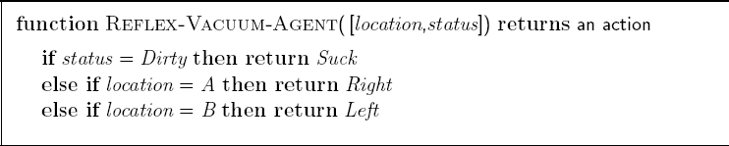
Agent program for a vacuum-cleaner agent

Slide 11
Agent types
Four basic types in order of increasing generality:
  Simple reflex agents
  Model-based reflex agents
  Goal-based agents
  Utility-based agents
Learning agents

Slide 12

Simple reflex agents
state <= Interpret-Input (percept)
rule <= Rule-Match (state, rules)
action <= Rule-Action [rule]

Slide 13

Model-based reflex agents
state <= Update-State (state, action, percept)
rule <= Rule-Match (state, rules)
action <= Rule-Action [rule]

Slide 14

Goal-based agents

Slide 15

Utility-based agents
A utility function maps a state(s) to onto a real number

Slide 16

Learning agents
Note: Performance element selects actions and Problem generator suggests actions that will lead to new experience.

Slide 17
Chapter 3: Solving Problems by Search
Problem-solving agents
Problem types
Problem formulation
Example problems
Uninformed Search (Blind Search) Strategies
  Breadth-first search
  Depth-first search and Depth-limited search
  Iterative deepening depth-first search
  Bi-directional search and Graph Search

Slide 18

Problem-solving agents
Notes:
One kind of goal-based agent

Slide 19
Example: Romania
On holiday in Romania; currently in Arad.
Flight leaves tomorrow from Bucharest
Formulate goal:
  be in Bucharest
Formulate problem:
  states: various cities
  actions: drive between cities
Find solution:
  sequence of cities, e.g., Arad, Sibiu, Fagaras, Bucharest

Slide 20

A simplified road map of Romania

Slide 21
Single-state problem formulation
A problem is defined by four items:
initial state e.g., "at Arad”
actions or successor function S(x) = set of action–state pairs
  e.g., S(Arad) = {<Arad → Zerind, Zerind>, … }
goal test, can be
  explicit, e.g., x = "at Bucharest"
  implicit, e.g., Checkmate(x)
path cost (additive)
  e.g., sum of distances, number of actions executed, etc.
  c(x,a,y) is the step cost, assumed to be ≥ 0
A solution is a sequence of actions leading from the initial state to a goal state

Slide 22
Selecting a state space
Real world is absurdly complex
  state space must be abstracted for problem solving
(Abstract) state = set of real states
(Abstract) action = complex combination of real actions
  e.g., "Arad → Zerind" represents a complex set of possible routes, detours, rest stops, etc.
(Abstract) solution =
  set of real paths that are solutions in the real world
Each abstract action should be "easier" than the original problem

Slide 23

Vacuum world state space graph
states?
actions?
goal test?
path cost?

Slide 24
Vacuum world state space graph
states? <“dirt” or “clean”, robot location>
actions? Left, Right, Suck
goal test? no dirt at all locations
path cost? 1 per action

Slide 25

Example: The 8-puzzle
states?
actions?
goal test?
path cost?

Slide 26
Example: The 8-puzzle
states? locations of tiles
actions? move blank tile left, right, up, down
goal test? = goal state (given)
path cost? 1 per move
Note: optimal solution of n-Puzzle family is NP-hard, e.g., 24-puzzle (5*5 board) has 10²⁵ states.

Slide 27

Tree search algorithms
Basic idea:
  offline, simulated exploration of state space by generating successors of already-explored states (a.k.a.~expanding states)

Slide 28
Tree search example

Slide 29

Tree search example

Slide 30

Tree search example

Slide 31

Implementation: states vs. nodes
A state is a (representation of) a physical configuration
A node is a data structure constituting part of a search tree includes
  state,
  parent node,
  action (e.g., right)
  path cost g(x), depth (from initial state to the node)

Slide 32
Search strategies
A search strategy is defined by picking the order of node expansion
Strategies are evaluated along the following dimensions:
  completeness: does it always find a solution if one exists?
  time complexity: number of nodes generated
  space complexity: maximum number of nodes in memory
  optimality: does it always find a least-cost solution?
Time and space complexity are measured in terms of
  b: maximum branching factor of the search tree
  d: depth of the least-cost solution
  m: maximum depth of the state space (may be ∞)

Slide 33
Uninformed search strategies
Uninformed search strategies use only the information available in the problem definition
  Breadth-first search
  Uniform-cost search
  Depth-first search and Depth-limited search
  Iterative deepening search

Slide 34
Breadth-first search
Expand shallowest unexpanded node
Implementation:
  fringe (the collection of nodes that have been generated but not yet expanded) is a FIFO queue, i.e., new successors go at end

Slide 35

Breadth-first search
Expand shallowest unexpanded node
Implementation:
  fringe is a FIFO queue, i.e., new successors go at end

Slide 36
Properties of breadth-first search
Complete? Yes (if b is finite)
Time? 1+b+b²+b³+… +b^{d} + b(b^{d}-1) = O(b^{d+1})
Space? O(b^{d+1}) (keeps every node in memory)
Optimal? Yes (if cost = 1 per step)
Space is the bigger problem (more than time): with d = 12, one may wait for several days for solution but no PC has PB size memory.

Slide 37
Uniform-cost search
Expand least-cost unexpanded node
Implementation:
  fringe = queue ordered by path cost
Equivalent to breadth-first if step costs all equal
Complete? Yes, if step cost ≥ ε (some small positive constant)
Time? # of nodes with g ≤ cost of optimal solution, O(b^{1+[C*/ ε]}) where C* is the cost of the optimal solution
Space? # of nodes with g ≤ cost of optimal solution, O(b^{1+[C*/ ε]})
Optimal? Yes – nodes expanded in increasing order of g(n)
Notes:
[x] floor function: I<=x, 1+[x]: ]x[, ceiling function

Slide 38

Depth-first search
Expand deepest unexpanded node
Implementation:
  fringe = LIFO queue, i.e., put successors at front

Slide 39

Depth-first search
Expand deepest unexpanded node
Implementation:
  fringe = LIFO queue, i.e., put successors at front

Slide 40

Depth-first search
Expand deepest unexpanded node
Implementation:
  fringe = LIFO queue, i.e., put successors at front

Slide 41

Depth-first search
Expand deepest unexpanded node
Implementation:
  fringe = LIFO queue, i.e., put successors at front

Slide 42

Depth-first search
Expand deepest unexpanded node
Implementation:
  fringe = LIFO queue, i.e., put successors at front

Slide 43

Depth-first search
Expand deepest unexpanded node
Implementation:
  fringe = LIFO queue, i.e., put successors at front

Slide 44

Depth-first search
Expand deepest unexpanded node
Implementation:
  fringe = LIFO queue, i.e., put successors at front

Slide 45

Depth-first search
Expand deepest unexpanded node
Implementation:
  fringe = LIFO queue, i.e., put successors at front

Slide 46

Depth-first search
Expand deepest unexpanded node
Implementation:
  fringe = LIFO queue, i.e., put successors at front

Slide 47

Depth-first search
Expand deepest unexpanded node
Implementation:
  fringe = LIFO queue, i.e., put successors at front

Slide 48
Properties of depth-first search
Complete? No: fails in infinite-depth spaces, spaces with loops
  Modify to avoid repeated states along path
    → complete in finite spaces
Time? O(b^{m}): where m is the maxim depth of any node, terrible if m is much larger than d (the depth of the shallowest solution)
  but if solutions are dense, may be much faster than breadth-first
Space? O(bm), i.e., linear space!
Optimal? No
Notes:
d, shallowest depth for goal node, maximum length of any path in the state space.

Slide 49

Depth-limited search
= depth-first search with depth limit l,
i.e., nodes at depth l have no successors
Recursive implementation:

Slide 50

Iterative deepening search

Slide 51

Iterative deepening search l =0

Slide 52

Iterative deepening search l =1

Slide 53

Iterative deepening search l =2

Slide 54

Iterative deepening search l =3

Slide 55
Iterative deepening search
Number of nodes generated in a depth-limited search to depth d with branching factor b:
N_{DLS} = b⁰ + b¹ + b² + … + b^{d-2} + b^{d-1} + b^{d}
Number of nodes generated in an iterative deepening search to depth d with branching factor b:
N_{IDS} = (d+1)b⁰ + d b^¹ + (d-1)b^² + … + 3b^{d-2} +2b^{d-1} + 1b^{d}
For b = 10, d = 5,
  N_{DLS} = 1 + 10 + 100 + 1,000 + 10,000 + 100,000 = 111,111
  N_{IDS} = 6 + 50 + 400 + 3,000 + 20,000 + 100,000 = 123,456
Overhead = (123,456 - 111,111)/111,111 = 11%

Slide 56
Properties of iterative deepening search
Complete? Yes
Time? (d+1)b⁰ + d b¹ + (d-1)b² + … + b^{d} = O(b^{d})
Space? O(bd)
Optimal? Yes, if step cost = 1

Slide 57

Summary of algorithms
Bidirectional search: run two simultaneous searches – one forward from the initial state and the other backward from the goal. (b^{d/2)}
In general, iterative deepening search is the preferred uninformed search method when there is a large search space and the depth of the solution is not known.

Slide 58

Repeated states
Failure to detect repeated states can turn a linear problem into an exponential one!

Slide 59
Tree search

Slide 60

Graph search
Newly generated nodes that match previously generated nodes (i.e., in the explored or the fringe/frontier), can be discarded instead of being added to the fringe/frontier. It means at most one copy of each state.

Slide 61
Informed Search (Chapter 3 & 4)
Greedy best-first search
A* search
Heuristics functions: admissible
Local search algorithms
  Hill-climbing search and Simulated annealing search
  Local beam search and Genetic algorithms (reading)
Online search agents

Slide 62
Best-first search
Idea: use an evaluation function f(n) based on problem specific knowledge for each node besides the problem definition
  estimate of "desirability”
  Expand most desirable unexpanded node
Implementation:
Order the nodes in fringe/frontier in decreasing order of desirability
Special cases:
  greedy best-first search
  A* search

Slide 63

Romania with step costs in km

Slide 64
Greedy best-first search
Evaluation function f(n) = h(n) (heuristic)
= estimate of cost from n to goal
  e.g., h_{SLD}(n) = straight-line distance from n to Bucharest
Greedy best-first search expands the node that appears to be the closest to goal

Slide 65

Greedy best-first search example

Slide 66

Greedy best-first search example

Slide 67

Greedy best-first search example

Slide 68

Greedy best-first search example

Slide 69
Properties of greedy best-first search
Complete? No – can get stuck in loops, e.g., find a path from Iasi to Fagaras. Iasi → Neamt → Iasi → Neamt →
Time? O(b^{m}), but a good heuristic can give dramatic improvement
Space? O(b^{m}) -- keeps all nodes in memory
Optimal? No (homework)

Slide 70
Properties of greedy best-first search

Slide 71
A* search
Idea: combine the cost reach the node and the estimate cost from the node to the goal (avoid expanding paths that are already expensive)
Evaluation function f(n) = g(n) + h(n)
g(n) = cost so far to reach n
h(n) = estimated cost from n to goal
f(n) = estimated total cost of path through n to goal

Slide 72

A* search example

Slide 73

A* search example

Slide 74

A* search example

Slide 75

A* search example

Slide 76

A* search example

Slide 77

A* search example

Slide 78
Admissible heuristics
A heuristic h(n) is admissible if for every node n, h(n) ≤ h*(n), where h*(n) is the true cost to reach the goal state from n.
An admissible heuristic never overestimates the cost to reach the goal, i.e., it is optimistic
Example: h_{SLD}(n) (never overestimates the actual road distance)
Theorem: If h(n) is admissible, A* using TREE-SEARCH is optimal

Slide 79

Optimality of A* (proof)
Suppose some suboptimal goal G₂ has been generated and is in the fringe. Let n be an unexpanded node in the fringe such that n is on a shortest path to an optimal goal G.
f(G₂) = g(G₂) since h(G₂) = 0
g(G₂) > g(G) since G₂ is suboptimal
f(G) = g(G) since h(G) = 0
f(G₂) > f(G) from above

Slide 80
Optimality of A* (proof)
Suppose some suboptimal goal G₂ has been generated and is in the fringe. Let n be an unexpanded node in the fringe such that n is on a shortest path to an optimal goal G.
f(G₂) > f(G) from above
h(n) ≤ h*(n) since h is admissible
g(n) + h(n) ≤ g(n) + h*(n)
f(n) ≤ f(G)
Hence f(n) < f(G₂), and A* will never select G₂ for expansion. However, it does not mean A* will never select n₂ for expansion because it is possible f(n) > f(n₂).
n₂

Slide 81

Consistent heuristics
A heuristic is consistent if for every node n, every successor n' of n generated by any action a,
h(n) ≤ c(n,a,n') + h(n')
If h is consistent, we have
f(n') = g(n') + h(n')
= g(n) + c(n,a,n') + h(n')
≥ g(n) + h(n)
= f(n)
i.e., f(n') ≥ f(n), f(n) is non-decreasing along any path.
Theorem: If h(n) is consistent, A* using GRAPH-SEARCH is optimal

Slide 82

Optimality of A*
A* expands nodes in order of increasing f value
Gradually adds "f-contours" of nodes
Contour i has all nodes with f=f_{i}, where f_{i} < f_{i+1}
Notes:
'kän-"tur

Slide 83
Properties of A*
Complete? Yes (unless there are infinitely many nodes with f ≤ f(G) )
Time? Exponential
Space? Keeps all nodes in memory: not perfect
Optimal? Yes (proved)

Slide 84
Memory-bounded heuristic search
Iterative-deepening A* can reduce memory requirement by setting the cutoff not as depth but as f-cost(g+h).
  At each iteration, the cutoff value is the smallest f-cost of any node that exceeded the cutoff on the previous iteration.
Recursive best-first search (RBFS): linear space
Simplified A*: when the memory is full, drop the worst leaf node – the one with the highest f-value.

Slide 85
Admissible heuristics
E.g., for the 8-puzzle:
h₁(n) = number of misplaced tiles
h₂(n) = total Manhattan distance
(i.e., number of squares from desired location of each tile)
h₁(S) = ?
h₂(S) = ?

Slide 86
Admissible heuristics
E.g., for the 8-puzzle:
h₁(n) = number of misplaced tiles
h₂(n) = total Manhattan distance
(i.e., no. of squares from desired location of each tile)
h₁(S) = 8
h₂(S) = 3+1+2+2+2+3+3+2 = 18

Slide 87
Dominance
If h₂(n) ≥ h₁(n) for all n (both admissible), then h₂ dominates h₁ , h₂ is better for search
Typical search costs (average number of nodes expanded):
d=12 IDS = 3,644,035 nodes (worst case: (d+1)b⁰ + d b¹ + (d-1)b² + … + b^{d} )
A*(h₁) = 227 nodes
A*(h₂) = 73 nodes
d=24 IDS = too many nodes
A*(h₁) = 39,135 nodes
A*(h₂) = 1,641 nodes

Slide 88
Relaxed problems
A problem with fewer restrictions on the actions is called a relaxed problem
The cost of an optimal solution to a relaxed problem is an admissible heuristic for the original problem
If the rules of the 8-puzzle are relaxed so that a tile can move anywhere, then h₁(n) gives the shortest solution
If the rules are relaxed so that a tile can move to any adjacent square, then h₂(n) gives the shortest solution

Slide 89
Local search algorithms
In many optimization problems, the path to the goal is irrelevant; the goal state itself is the solution
State space = set of "complete" configurations
Find configuration satisfying constraints, e.g., n-queens
In such cases, we can use local search algorithms
keep a single "current" state, try to improve it

Slide 90

Example: n-queens
Put n queens on an n × n board with no two queens on the same row, column, or diagonal (i.e., not attacked to each other)

Slide 91

Hill-climbing search
It is simply a loop that continually moves in the direction of increasing value – that is, up hill. It terminates when it reaches a “peak”, no higher neighbor.

Slide 92

Hill-climbing search
Problem: depending on initial state, can get stuck in local maxima

Slide 93

Hill-climbing search: 8-queens problem
h = number of pairs of queens that are attacking each other, either directly or indirectly
h = 17 for the above state

Slide 94

Hill-climbing search: 8-queens problem
A local minimum with h = 1

Slide 95

Simulated annealing search
Idea: escape local maxima by allowing some "bad” moves but gradually decrease their frequency. In stead of picking the “best” move, it picks a random move.

Slide 96
Properties of simulated annealing search
One can prove: If T decreases slowly enough, then simulated annealing search will find a global optimum with probability approaching 1
Widely used in VLSI layout, airline scheduling, etc

Slide 97
Online search agents
Previous search algorithms are offline search
In more real world, the agent operates by interleaving computation and action
  First it take the action
  Then it observes the environment and compute the next action
Online search is a good idea in dynamic or semidynamic domains, where there is a penalty for sitting around and computing too long.

Slide 98
Online search problems
What the agent knows:
  Actions(s): return a list of actions allowed in state s;
  The step-cost function c(s, a, s'): it cannot be used until the s' is the outcome
  Goal-Test (s)
The agent cannot access the successors of a state except by actually trying all the actions in that state

Slide 99
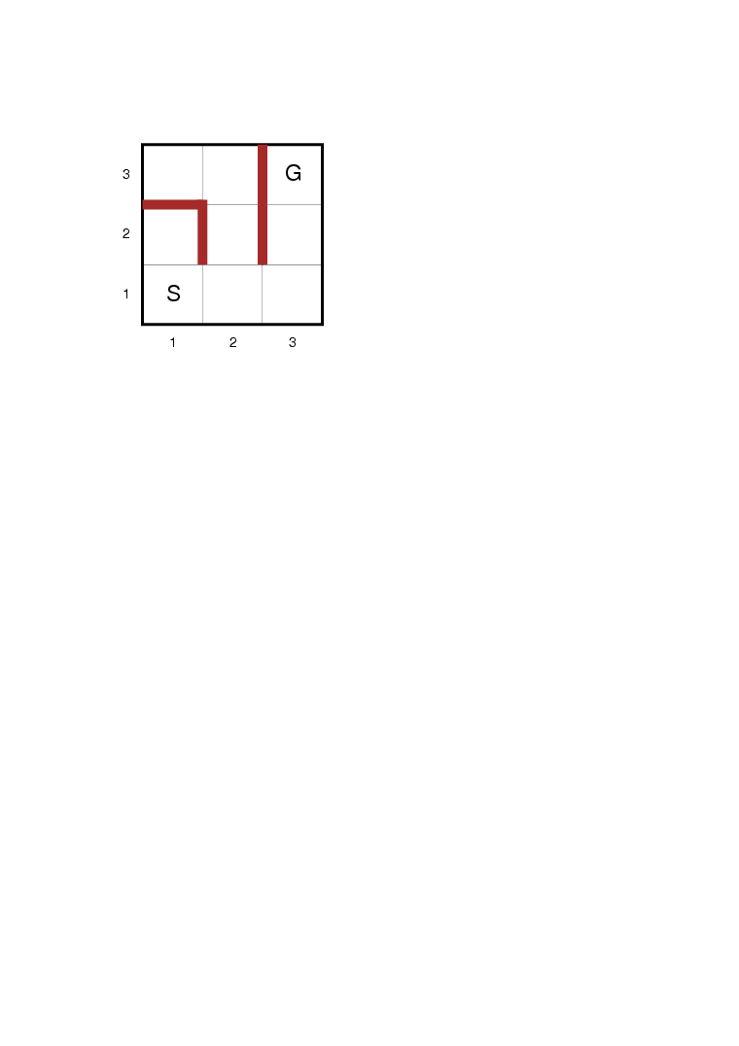
Online search problems

Slide 100
Competitive Ratio
Competitive ratio
  It is common to compare the actual path cost with the cost of the path would follow if it knew the search space in advance.
We would like competitive ratio as small as possible.

Slide 101
Online vs. offline
Offline algorithms such as A* have the ability to expand a node in one part of the space and then immediately expand a node in another space.
Online algorithms can only expand a node that it physically occupies.

Slide 102
Some online search algorithms
To avoid traveling all the way across the tree to expand the next node, it seems better to expand nodes in the local order ➔ depth-first search, but has to backtrack physically.
Hill-climbing search is already an online search, but simplest form is not very useful. It will leave the agents at local maxima with nowhere to go
Random walk to actions that has not yet been tried. It will eventually find a goal.
Augmenting hill-climbing with memory to store a “current best estimate” h(s) of the cost to reach the goal from each state that has been visited. H(s) starts out been heuristic and it updated as the agent gains experience.

