Slide 1
CIS471/571, Fall 2018
Introduction to Artificial Intelligence
Instructor: Dejing Dou
Office hours: Monday 4:00pm-5:00pm
Oct. 24 and Oct. 26, 2018

Slide 2
Forward vs. backward chaining
FC is data-driven, automatic, unconscious processing,
  e.g., object recognition, routine decisions
May do lots of work that is irrelevant to the goal
BC is goal-driven, appropriate for problem-solving,
  e.g., Where are my keys? How do I get a A in CIS571?
Complexity of BC can be much less than linear in size of KB

Slide 3
Hard satisfiability problems
Consider random 3-CNF sentences. e.g.,
(¬D ∨ ¬B ∨ C) ∧ (B ∨ ¬A ∨ ¬C) ∧ (¬C ∨ ¬B ∨ E) ∧ (E ∨ ¬D ∨ B) ∧ (B ∨ E ∨ ¬C)
  m = number of clauses
  n = number of symbols

Slide 4
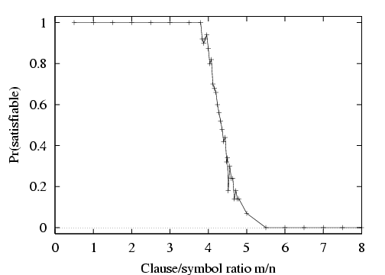
Hard satisfiability problems

Slide 5
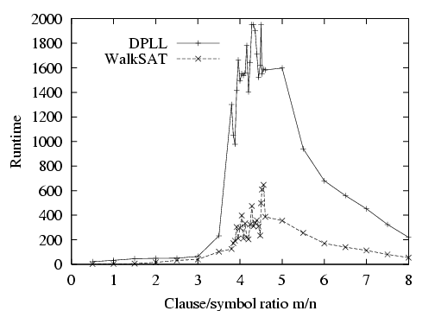
Hard satisfiability problems
Median runtime for 100 satisfiable random 3-CNF sentences, n = 50

Slide 6

Inference-based agents in the wumpus world
A wumpus-world agent using propositional logic:
  ¬P_{1,1}
  ¬W_{1,1}
  B_{x,y} ⇔ (P_{x,y+1} ∨ P_{x,y-1} ∨ P_{x+1,y} ∨ P_{x-1,y})
  S_{x,y} ⇔ (W_{x,y+1} ∨ W_{x,y-1} ∨ W_{x+1,y} ∨ W_{x-1,y})
  W_{1,1} ∨ W_{1,2} ∨ … ∨ W_{4,4}
  ¬W_{1,1} ∨ ¬W_{1,2}
  ¬W_{1,1} ∨ ¬W_{1,3}
  …
⇒ 64 distinct proposition symbols, 155 sentences

Slide 7
Chapter 8: FOL
Why first order logic?
Syntax and semantics of FOL
Using FOL
Wumpus world in FOL
Knowledge engineering in FOL

Slide 8
Adv. and Limit of Propositional logic
Propositional logic is declarative
Propositional logic allows partial/disjunctive/negated information
  (unlike most data structures and databases)
Propositional logic is compositional:
  meaning of B_{1,1} ∧ P_{1,2} is derived from meaning of B_{1,1} and of P_{1,2}
Meaning in propositional logic is context-independent
  (unlike natural language, where meaning depends on context)
Propositional logic has very limited expressive power
  (unlike natural language)
  E.g., cannot say “any pit cause breezes in adjacent squares“
    except by writing one sentence for each square, but the wumpus world can have many squares.
    P_{1,1} ⇒ B_{1,2} ∧ B_{2,1 …}

Slide 9
First-order logic
Whereas propositional logic assumes the world contains facts (True and False),
first-order logic (like natural language) assumes the world contains
  Objects: people, houses, numbers, colors, baseball games, wars, …
  Relations: red, round, prime, brother of, bigger than, part of, comes between, …
  Functions: father of, best friend, one more than, plus, …

Slide 10
Syntax of FOL: Basic elements
Constants KingJohn, 2, DeepBlue,...
Predicates Brother, >,...
Functions Sqrt, LeftLegOf,...
Variables x, y, a, b,...
Connectives ¬, ⇒, ∧, ∨, ⇔
Equality =
Quantifiers ∀, ∃

Slide 11
Atomic sentences
Atomic sentence = predicate (term₁,...,term_{n}) or term₁ = term₂
Term = function (term₁,...,term_{n}) or constant or variable
E.g., Brother(KingJohn,RichardTheLionheart), >(Length(LeftLegOf(Richard)), Length(LeftLegOf(KingJohn)))

Slide 12
Complex sentences
Complex sentences are made from atomic sentences using connectives and quantifiers
¬S, S₁ ∧ S₂, S₁ ∨ S₂, S₁ ⇒ S₂, S₁ ⇔ S₂,
E.g. Sibling(KingJohn,Richard) ⇒ Sibling(Richard,KingJohn)
>(1,2) ∨ ≤ (1,2)
∀x Pit(x) ⇒ [∀y Adjacent(x,y) ⇒ Breezy(y) ]

Slide 13
Semantics in first-order logic
Sentences are true with respect to a model and an interpretation.
  What domain (D) is involved for the quantifiers to quantify for.
  What is the interpretation (I) for the constant, function and predicate with respect to the domain.
  Domain and Interpretation specify Model (M = <D, I>).
  The assignment of values to variables when defining the truth of a formula and satisfaction of formulas.
Model contains objects (domain elements) and relations (interpretation of predicates and functions) among them.
  E.g. All squares are the domain of x in ∀x Pit(x) ⇒ [∀y Adjacent(x,y) ⇒ Breezy(y) ], the interpretation of Adjacent(x,y) only about the relations (pairs) of those squares they are adjacent.

Slide 14
Semantics in first-order logic
Interpretation specifies references for
  constant symbols → objects
  predicate symbols → relations
  function symbols → functional relations
An atomic sentence predicate(term₁,...,term_{n}) is true iff the objects referred to by term₁,...,term_{n}
are in the relation referred to by predicate

Slide 15
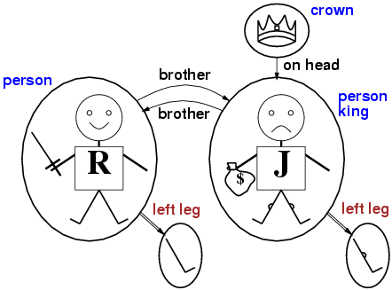
Models for FOL: Example

Slide 16
Universal quantification
∀<variables> <sentence>
Everyone at UO is smart:
∀x At(x, UO) ⇒ Smart(x)
∀x P is true in a model m iff P is true with x being each possible object in the model
Roughly speaking, equivalent to the conjunction of instantiations of P
    At(KingJohn, UO) ⇒ Smart(KingJohn)
    ∧ At(Richard, UO) ⇒ Smart(Richard)
    ∧ At(Michal, UO) ⇒ Smart(Michal)
    ∧ ...

Slide 17
A common mistake to avoid
Typically, ⇒ is the main connective with ∀
Common mistake: using ∧ as the main connective with ∀:
  ∀x At(x, UO) ∧ Smart(x)
  means “Everyone is at UO and everyone is smart” – too strong

Slide 18
Existential quantification
∃<variables> <sentence>
Someone at UO is smart:
∃x At(x, UO) ∧ Smart(x)
∃x P is true in a model m iff P is true with x being some possible object in the model
Roughly speaking, equivalent to the disjunction of instantiations of P
  At(KingJohn, UO) ∧ Smart(KingJohh)
  ∨ At(Richard, UO) ∧ Smart(Richard)
  ∨ At(Michal, UO) ∧ Smart(Michal)
  ∨ ...

Slide 19
Another common mistake to avoid
Typically, ∧ is the main connective with ∃
Common mistake: using ⇒ as the main connective with ∃:
∃x At(x, UO) ⇒ Smart(x)
is true for anyone who is not at UO! – too easy. Because it is same as:
∃x ¬ At(x, UO) ∨ Smart(x)

Slide 20
Properties of quantifiers
∀x ∀y is the same as ∀y ∀x
∃x ∃y is the same as ∃y ∃x
∃x ∀y is not the same as ∀y ∃x
∃x ∀y Loves(x,y)
  “There is a person who loves everyone in the world”
∀y ∃x Loves(x,y)
  “Everyone in the world is loved by at least one person (someone)”
Quantifier duality: each can be expressed using the other
∀x Likes(x,IceCream) ¬∃x ¬Likes(x, IceCream)
∃x Likes(x, Broccoli) ¬∀x ¬Likes(x, Broccoli)

Slide 21
Equality
term₁ = term₂ is true under a given interpretation if and only if term₁ and term₂ refer to the same object
  E.g., definition of Sibling in terms of Parent:
  ∀x,y Sibling(x,y) ⇔ [¬(x = y) ∧ ∃m,f ¬ (m = f) ∧ Parent(m,x) ∧ Parent(f,x) ∧ Parent(m,y) ∧ Parent(f,y)]
  Or ∀x,y Sibling(x,y) ⇔ [¬(x = y) ∧ ∃m,f Mother (m,x) ∧ Father(f,x) ∧ Mother(m,y) ∧ Father(f,y)]
Sometime, equality be viewed as a predicate as in math (1+1 = 2).

Slide 22
Using FOL
The kinship domain:
Brothers are siblings
  ∀x,y Brother(x,y) => Sibling(x,y)
One's mother is one's female parent
  ∀m,c Mother(c) = m ⇔ (Female(m) ∧ Parent(m,c))
“Sibling” is symmetric
  ∀x,y Sibling(x,y) ⇔ Sibling(y,x)

Slide 23
Knowledge base for the wumpus world
Perception
  ∀t,s,b Percept([s,b,Glitter],t) ⇒ Glitter(t)
Reflex
  ∀t Glitter(t) ⇒ BestAction(Grab,t)

Slide 24
Deducing hidden properties
∀x,y,a,b Adjacent([x,y],[a,b]) ⇔
[a,b] ∈ {[x+1,y], [x-1,y],[x,y+1],[x,y-1]}
Properties of squares:
∀s,t At(Agent,s,t) ∧ Breeze(t) ⇒ Breezy(s)
Squares are breezy near a pit:
  Diagnostic rule---infer cause from effect
    ∀s Breezy(s) ⇒ ∃r Adjacent(r,s) ∧ Pit(r)
  Causal rule---infer effect from cause
    ∀r Pit(r) ⇒ [∀s Adjacent(r,s) ⇒ Breezy(s)], same as:
    ∀r s Pit(r) ∧ Adjacent(r,s) ⇒ Breezy(s)

Slide 25
Knowledge engineering in FOL
Identify the task
Assemble the relevant knowledge
Decide on a vocabulary of predicates, functions, and constants
Encode general knowledge about the domain
Encode a description of the specific problem instance
Pose queries to the inference procedure and get answers
Debug the knowledge base

Slide 26
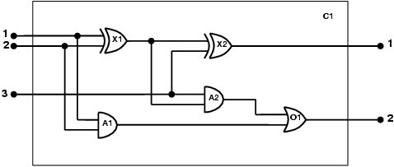
The electronic circuits domain
One-bit full adder

Slide 27
The electronic circuits domain
Identify the task
  Does the circuit actually add properly? (circuit verification)
Assemble the relevant knowledge
  Composed of wires and gates; Types of gates (AND, OR, XOR, NOT)
  Irrelevant: size, shape, color, cost of gates
Decide on a vocabulary
  Alternatives:
    Type(X₁) = XOR Type(X₁, XOR) XOR(X₁)

Slide 28
The electronic circuits domain
Encode general knowledge of the domain
  ∀t₁,t₂ Connected(t₁, t₂) ⇒ Signal(t₁) = Signal(t₂)
  ∀t Signal(t) = 1 ∨ Signal(t) = 0
  1 ≠ 0
  ∀t₁,t₂ Connected(t₁, t₂) ⇒ Connected(t₂, t₁)
  ∀g Type(g) = OR ⇒ Signal(Out(1,g)) = 1 ⇔ ∃n Signal(In(n,g)) = 1
  ∀g Type(g) = AND ⇒ Signal(Out(1,g)) = 0 ⇔ ∃n Signal(In(n,g)) = 0
  ∀g Type(g) = XOR ⇒ Signal(Out(1,g)) = 1 ⇔ Signal(In(1,g)) ≠ Signal(In(2,g))
  ∀g Type(g) = NOT ⇒ Signal(Out(1,g)) ≠ Signal(In(1,g))

Slide 29
The electronic circuits domain
Encode the specific problem instance
  Type(X₁) = XOR Type(X₂) = XOR
  Type(A₁) = AND Type(A₂) = AND
  Type(O₁) = OR
  Connected(Out(1,X₁),In(1,X₂)) Connected(In(1,C₁),In(1,X₁))
  Connected(Out(1,X₁),In(2,A₂)) Connected(In(1,C₁),In(1,A₁))
  Connected(Out(1,A₂),In(1,O₁)) Connected(In(2,C₁),In(2,X₁))
  Connected(Out(1,A₁),In(2,O₁)) Connected(In(2,C₁),In(2,A₁))
  Connected(Out(1,X₂),Out(1,C₁)) Connected(In(3,C₁),In(2,X₂))
  Connected(Out(1,O₁),Out(2,C₁)) Connected(In(3,C₁),In(1,A₂))

Slide 30
The electronic circuits domain
Pose queries to the inference procedure
  What are the possible sets of values of all the terminals for the adder circuit?
∃i₁,i₂,i₃,o₁,o₂ Signal(In(1,C_1)) = i₁ ∧ Signal(In(2,C₁)) = i₂ ∧ Signal(In(3,C₁)) = i₃ ∧ Signal(Out(1,C₁)) = o₁ ∧ Signal(Out(2,C₁)) = o₂
Debug the knowledge base
  May have omitted assertions like 1 ≠ 0

Slide 31
Chapter 9: Inference in FOL
Reducing first-order inference to propositional inference
Unification
Generalized Modus Ponens
Forward chaining
Backward chaining
Resolution

Slide 32
Universal instantiation (UI)
Every instantiation of a universally quantified sentence is entailed by it:
∀v α
Subst({v /g}, α)
for any variable v in sentence α and ground term (e.g., constant) g, which is a term without variable.
E.g., ∀x King(x) ∧ Greedy(x) ⇒ Evil(x) yields:
  King(John) ∧ Greedy(John) ⇒ Evil(John)
  King(Richard) ∧ Greedy(Richard) ⇒ Evil(Richard)
  King(Father(John)) ∧ Greedy(Father(John)) ⇒ Evil(Father(John))
  .
  .
  .

Slide 33
Existential instantiation (EI)
For any sentence α, variable v, and constant symbol k that does not appear elsewhere in the knowledge base:
∃v α
Subst({v/k}, α)
E.g., ∃x Crown(x) ∧ OnHead(x,John) yields:
Crown(C₁) ∧ OnHead(C₁,John)
provided C₁ is a new constant symbol, called a Skolem constant. C₁ is a new one which must not already belong to another object.
  Math example, we can give е as the name of a number that is a little bigger than 2.71828 and satisfies d(x^{y})/dy = x^{y} for x, but we can not use л which is already a name of another number (3.1415926…).

Slide 34
Reduction to propositional inference
Suppose the KB contains just the following:
  ∀x King(x) ∧ Greedy(x) ⇒ Evil(x)
  King(John)
  Greedy(John)
  Brother(Richard, John)
Instantiating the universal sentence in all possible ways, we have:
  King(John) ∧ Greedy(John) ⇒ Evil(John)
  King(Richard) ∧ Greedy(Richard) ⇒ Evil(Richard)
  King(John)
  Greedy(John)
  Brother(Richard, John)
The new KB is propositionalized: proposition symbols are
  King(John), Greedy(John), Evil(John), King(Richard), etc.
  similar as: K₁ , G₁, E₁, K₂….

Slide 35
Reduction cont’d
Every FOL KB can be propositionalized so as to preserve entailment
Idea: propositionalize KB and query, apply resolution, return result
Problem: with function symbols, there are infinitely many ground terms,
  e.g., Father(Father(Father(John)))
(A ground sentence is entailed by new KB iff entailed by original KB)

Slide 36
Reduction cont’d
Theorem: Herbrand (1930). If a sentence α is entailed by an FOL KB, it is entailed by a finite subset of the propositionalized KB
Idea: For n = 0 to ∞ do
  create a propositional KB by instantiating with depth-n terms
  see if α is entailed by this KB
Problem: works if α is entailed, loops if α is not entailed
Theorem: Turing (1936), Church (1936) Entailment for FOL is
semidecidable (algorithms exist that say yes to every entailed sentence (if the system is complete), but no algorithm exists that also says no to every nonentailed sentence (the system can not guarantee to find one inference to prove a sentence is not entailed by KB.)

Slide 37
Problems with propositionalization
Propositionalization seems to generate lots of irrelevant sentences.
E.g., from:
  ∀x King(x) ∧ Greedy(x) ⇒ Evil(x)
  King(John)
  ∀y Greedy(y)
  Brother(Richard,John)
If the goal of inference is to find who is evil, it seems obvious that Evil(John), but propositionalization produces lots of facts such as Greedy(Richard) that are irrelevant
With p k-ary predicates and n constants, there are p·n^{k} instantiations.

Slide 38
Unification
We can get the inference immediately if we can find a substitution θ such that King(x) and Greedy(x) match King(John) and Greedy(y)
θ = {x/John,y/John} works
Unify(α,β) = θ if Subst(θ, α) = Subst(θ, β)
α β θ
Knows(John,x) Knows(John,Jane) ?
Knows(John,x) Knows(y,OJ) ?
Knows(John,x) Knows(y,Mother(y)) ?
Knows(John,x) Knows(x,OJ) ?

Slide 39
Unification
We can get the inference immediately if we can find a substitution θ such that King(x) and Greedy(x) match King(John) and Greedy(y)
θ = {x/John,y/John} works
Unify(α,β) = θ if Subst(θ, α) = Subst(θ, β)
α β θ
Knows(John,x) Knows(John,Jane) {x/Jane}
Knows(John,x) Knows(y,OJ) ?
Knows(John,x) Knows(y,Mother(y)) ?
Knows(John,x) Knows(x,OJ) ?

Slide 40
Unification
We can get the inference immediately if we can find a substitution θ such that King(x) and Greedy(x) match King(John) and Greedy(y
θ = {x/John,y/John} works
Unify(α,β) = θ if Subst(θ, α) = Subst(θ, β)
α β θ
Knows(John,x) Knows(John,Jane) {x/Jane}
Knows(John,x) Knows(y,OJ) {x/OJ, y/John}
Knows(John,x) Knows(y,Mother(y)) ?
Knows(John,x) Knows(x,OJ) ?

Slide 41
Unification
We can get the inference immediately if we can find a substitution θ such that King(x) and Greedy(x) match King(John) and Greedy(y)
θ = {x/John,y/John} works
Unify(α,β) = θ if Subst(θ, α) = Subst(θ, β)
α β θ
Knows(John,x) Knows(John,Jane) {x/Jane}
Knows(John,x) Knows(y,OJ) {x/OJ, y/John}
Knows(John,x) Knows(y,Mother(y)) {y/John,x/Mother(John)}
Knows(John,x) Knows(x,OJ) ?

Slide 42
Unification
We can get the inference immediately if we can find a substitution θ such that King(x) and Greedy(x) match King(John) and Greedy(y)
θ = {x/John,y/John} works
Unify(α,β) = θ if Subst(θ, α) = Subst(θ, β)
α β θ
Knows(John,x) Knows(John,Jane) {x/Jane}
Knows(John,x) Knows(y,OJ) {x/OJ, y/John}
Knows(John,x) Knows(y,Mother(y)) {y/John,x/Mother(John)}
Knows(John,x) Knows(x,OJ) fail ?
Standardizing apart eliminates overlap of variables, e.g., Knows(x,OJ) ==> Knows(z₁₇,OJ)

Slide 43
Unification
We can get the inference immediately if we can find a substitution θ such that King(x) and Greedy(x) match King(John) and Greedy(y)
θ = {x/John,y/John} works
Unify(α,β) = θ if Subst(θ, α) = Subst(θ, β)
α β θ
Knows(John,x) Knows(John,Jane) {x/Jane}
Knows(John,x) Knows(y,OJ) {x/OJ, y/John}
Knows(John,x) Knows(y,Mother(y)) {y/John,x/Mother(John)}
Knows(John,x) Knows(x,OJ) {x/OJ, z₁₇/John}
Standardizing apart eliminates overlap of variables, e.g., Knows(x,OJ) ==> Knows(z₁₇,OJ)
==> {x/OJ, z17/John}

Slide 44
Unification
To unify Knows(John,x) and Knows(y,z),
θ = {y/John, x/z } or θ = {y/John, x/John, z/John}
The first unifier is more general than the second, which make little sense although it is true.
There is a single most general unifier (MGU) that is unique up to renaming of variables.
  MGU = { y/John, x/z }

Slide 45
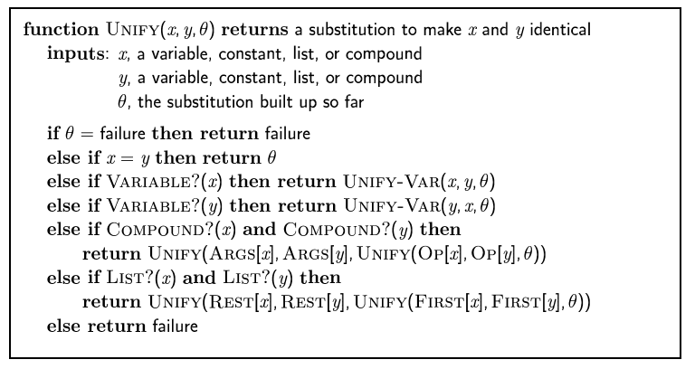
The unification algorithm

Slide 46
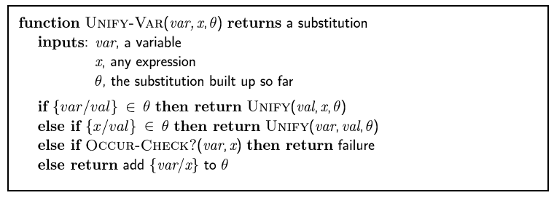
The unification algorithm

Slide 47
Generalized Modus Ponens (GMP)
p₁', p₂', … , p_{n}', ( p₁ ∧ p₂ ∧ … ∧ p_{n} ⇒q)
Subst(θ, q)
p₁' is King(John) p₁ is King(x)
p₂' is Greedy(y) p₂ is Greedy(x)
θ is {x/John,y/John} q is Evil(x)
Subst(θ, q) is Evil(John)
GMP used with KB of definite clauses (exactly one positive literal, similar as Horn form in propo)
All variables assumed universally quantified
where Subst(θ, p_{i}‘) = Subst(θ p_{i})
for all i

Slide 48
Soundness of GMP
Need to show that
p₁', …, p_{n}', (p₁ ∧ … ∧ p_{n} ⇒ q) ╞ qθ
provided that p_{i}'θ = p_{i}θ for all I, where p_{i}θ means Subst(θ, p_{i})
Lemma: For any sentence p, we have p ╞ pθ by UI
  (p₁ ∧ … ∧ p_{n} ⇒ q) ╞ (p₁ ∧ … ∧ p_{n} ⇒ q)θ = (p₁θ ∧ … ∧ p_{n}θ ⇒ qθ)
  p₁',…, p_{n}' ╞ p₁' ∧ … ∧ p_{n}' ╞ p₁'θ ∧ … ∧ p_{n}'θ
  From 1 and 2, qθ follows by ordinary Modus Ponens

Slide 49
Example knowledge base
The law says that it is a crime for an American to sell weapons to hostile nations. The country Nono, an enemy of America, has some missiles, and all of its missiles were sold to it by Colonel West, who is American.
Prove that Col. West is a criminal

Slide 50
Example knowledge base cont’d
... it is a crime for an American to sell weapons to hostile nations:
  American(x) ∧ Weapon(y) ∧ Sells(x,y,z) ∧ Hostile(z) ⇒ Criminal(x)
Nono … has some missiles, i.e., ∃x Owns(Nono,x) ∧ Missile(x):
  Owns(Nono,M₁) and Missile(M₁)
… all of its missiles were sold to it by Colonel West
  Missile(x) ∧ Owns(Nono,x) ⇒ Sells(West,x,Nono)
Missiles are weapons:
  Missile(x) ⇒ Weapon(x)
An enemy of America counts as "hostile“:
  Enemy(x,America) ⇒ Hostile(x)
West, who is American …
  American(West)
The country Nono, an enemy of America …
  Enemy(Nono,America)

Slide 51
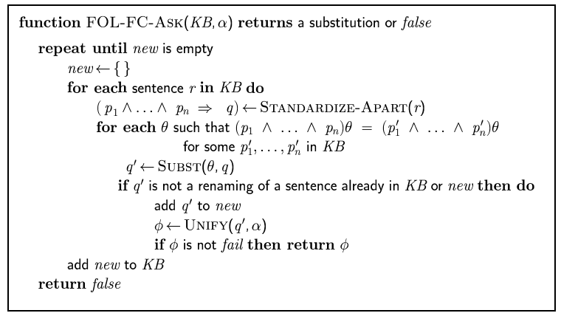
Forward chaining algorithm

Slide 52
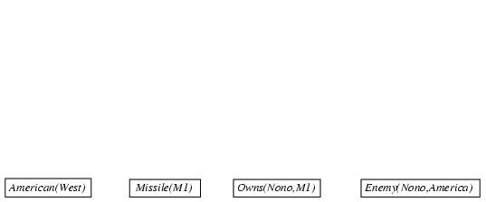
Forward chaining proof

Slide 53
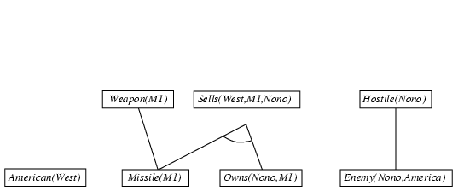
Forward chaining proof

Slide 54
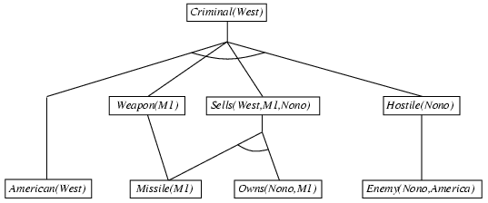
Forward chaining proof

Slide 55
Properties of forward chaining
Sound and complete for first-order definite clauses
Datalog = first-order definite clauses + no functions
FC terminates for Datalog (fixed point) in finite number of iterations
May not terminate in general if α is not entailed
This is unavoidable: entailment with definite clauses is semidecidable

Slide 56
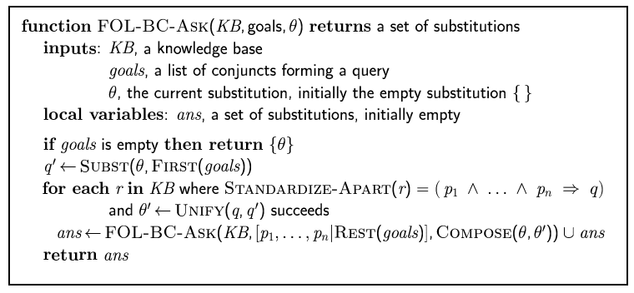
Backward chaining algorithm
SUBST(COMPOSE(θ₁, θ₂), p) = SUBST(θ₂, SUBST(θ₁, p))

Slide 57

Backward chaining example

Slide 58
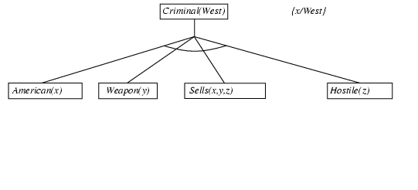
Backward chaining example

Slide 59
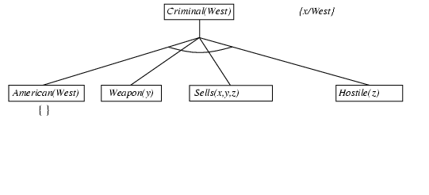
Backward chaining example

Slide 60
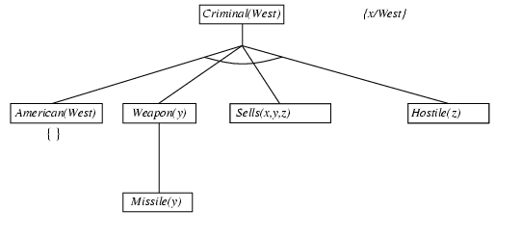
Backward chaining example

Slide 61
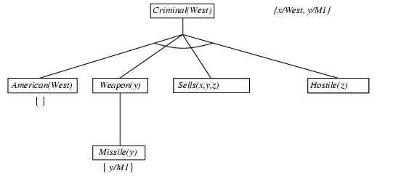
Backward chaining example

Slide 62
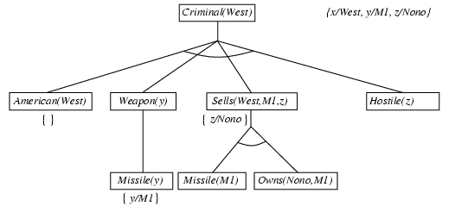
Backward chaining example

Slide 63
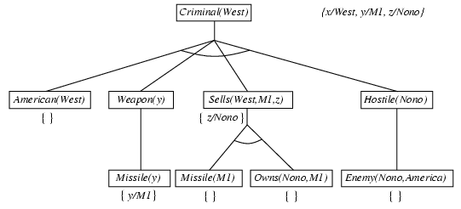
Backward chaining example

Slide 64
Properties of backward chaining
Depth-first recursive proof search: space is linear in size of proof
Incomplete due to infinite loops
  ⇒ fix by checking current goal against every goal on stack
Inefficient due to repeated subgoals (both success and failure)
  ⇒ fix using caching of previous results (extra space)
Widely used for logic programming

Slide 65
Logic programming: Prolog
Algorithm = Logic + Control
Basis: backward chaining with Horn clauses + bells & whistles
Widely used in Europe, Japan (basis of 5th Generation project) and compiling techniques.
Program = set of clauses = head :- literal₁, … literal_{n}.
criminal(X) :- american(X), weapon(Y), sells(X,Y,Z), hostile(Z).
Depth-first, left-to-right backward chaining
Built-in predicates for arithmetic etc., e.g., X is Y*Z+3
Built-in predicates that have side effects (e.g., input and output
predicates, assert/retract predicates, facts are asserted in a branch of the proof tree that eventually failed)
Closed-world assumption ("negation as failure")
  e.g., given alive(X) :- not dead(X).
  alive(joe) succeeds if dead(joe) fails

Slide 66
Prolog
Appending two lists to produce a third:
append([],Y,Y).
append([X|L],Y,[X|Z]) :- append(L,Y,Z).
query: append(A,B,[1,2]) ?
answers: A=[] B=[1,2]
A=[1] B=[2]
A=[1,2] B=[]

Slide 67
Resolution: brief summary
Full first-order version:
l₁ ∨ ··· ∨ l_{k}, m₁ ∨ ··· ∨ m_{n}
(l₁ ∨ ··· ∨ l_{i-1} ∨ l_{i+1} ∨ ··· ∨ l_{k} ∨ m₁ ∨ ··· ∨ m_{j-1} ∨ m_{j+1} ∨ ··· ∨ m_{n})
where Unify(l_{i}, ¬m_{j}) = θ.
The two clauses are assumed to be standardized apart so that they share no variables.
For example,
¬Rich(x) ∨ Unhappy(x), Rich(Ken)
Unhappy(Ken)
with θ = {x/Ken}
Apply resolution steps to CNF(KB ∧ ¬α); complete for FOL

Slide 68
Conversion to CNF
Everyone who loves all animals is loved by someone:
  ∀x [∀y Animal(y) ⇒ Loves(x,y)] ⇒ [∃y Loves(y,x)]
1. Eliminate biconditionals and implications
  ∀x [¬∀y ¬Animal(y) ∨ Loves(x,y)] ∨ [∃y Loves(y,x)]
2. Move ¬ inwards: ¬∀x p ≡ ∃x ¬p, ¬ ∃x p ≡ ∀x ¬p
  ∀x [∃y ¬(¬Animal(y) ∨ Loves(x,y))] ∨ [∃y Loves(y,x)]
  ∀x [∃y ¬¬Animal(y) ∧ ¬Loves(x,y)] ∨ [∃y Loves(y,x)]
  ∀x [∃y Animal(y) ∧ ¬Loves(x,y)] ∨ [∃y Loves(y,x)]

Slide 69
Conversion to CNF cont’d.
Standardize variables: each quantifier should use a different one
  ∀x [∃y Animal(y) ∧ ¬Loves(x,y)] ∨ [∃z Loves(z,x)
Skolemize: a more general form of existential instantiation.
  Each existential variable is replaced by a Skolem function of the enclosing universally quantified variables:
  ∀x [Animal(F(x)) ∧ ¬Loves(x,F(x))] ∨ Loves(G(x),x)
  [Animal(F(x)) ∧ ¬Loves(x,F(x))] ∨ Loves(G(x),x)
Distribute ∨ over ∧ :
  [Animal(F(x)) ∨ Loves(G(x),x)] ∧ [¬Loves(x,F(x)) ∨ Loves(G(x),x)]
  Drop universal quantifiers:

Slide 70
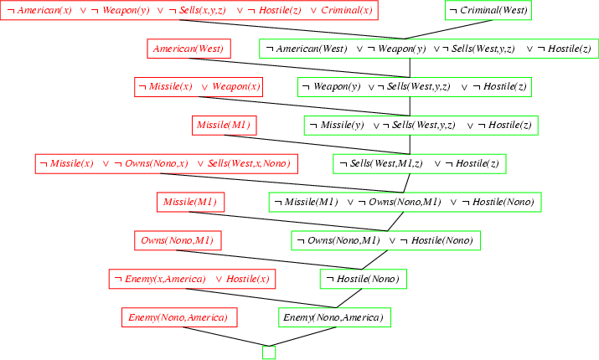
Resolution proof: definite clauses

Slide 71
Knowledge Representation
What content will be put into knowledge bases <==> How to present facts about the world by using logics?
Ontologies and Ontology Engineering
  Categories, Objects, Actions, Situations, Events

Slide 72
Definition of Ontology
Formal specification of a vocabulary of concepts and relationships relating them.

Slide 73
The upper ontology of the world
Anything
AbstractObject
GeneralizedEvents
Sets
Numbers
RepresentationalObjects
Interval
Places
Physical Objects
Processes
Sentences
Measurements
Categories
Moments
Times
Things
Stuffs
Weights
solid
Gas
Animal
Agents
liquid

Slide 74
Organizing Objects into Categories
Categories organize KB through inheritance
  E.g. Fruit is subclass of Food, and Apples is subclass of Fruit….
  Individual apple inherit the property of Fruit, and so Food.
Categories with subclass relations is called taxonomy hierarchy.

Slide 75
State Category facts in FOL
is-a(Apple001, Apple), subclassof(Apple, Fruit)
∀x is-a(x, Basketball) ⇒ Round(x)
∀x Orange(x) ∧ Round(x) ∧ Diameter(x) = 9.5” ∧ is-a(x, Ball) ⇒ is-a(x, Basketball)

Slide 76
Physical Composition
Idea: one object can be part of another.
For example, one’s nose is part of one’s head.
  Partof(Nose001, Head001), Partof(Bucharest, Romania)
  Partof(Romania, Europe)
Partof relation is transitive and reflexive:
  ∀x,y,z Partof(x,y) ∧ Partof(y,z) ⇒ Partof(x,z)
  Partof(x, x)

Slide 77
Measurements
Objects have height, mass, cost…
Measures assign values for those properties
Logically, it can be done by combining a unit functions with a number
  Lengh(L₁) = Inches(1.5) = Centimeters(3.81)
  Is-a(d, days) ⇒ Duration(d) = Hours(24)
  Conversions: Centimeters(2.54*d) = Inches(d)

Slide 78
Substances and objects
Objects can be counted as “count nouns”
  Basketball(s), apple(s)..
Substances cannot be divided into distinct objects
  Named as Stuff in upper ontology: water, oil, butter
  It can be solid, liquid, gas
is-a(x, Butter) ∧ Partof(y, x) ⇒ is-a(y, Butter)
is-a(x, Butter) ⇒ MeltingPoint(x, Centigrate(30)) ∧ color(x, Yellow)
does <= works?

Slide 79
A Genealogy Ontology
Individual
birth
sex
childIn
Gender
Event
Family
husband
marriage
BirthEvent
Male
MarriageEvent
wife
DeathEvent
Female
divorce
DivorceEvent
Classes: Individual, Male,Female, Family, MarriageEvent…
Properties: sex, husband, wife, birth……
Axioms(Logic Rules): If there is a MarriageEvent, there will be a Family related to the husband and wife properties.

Slide 80
Database and Database Schemas
Individual-name | title | sex
Henry_VI | King of England | “M”
Margaret of Anjou | Queen of England | “F”
The Individual relation
Famliy | MarriageEvent
F1305 | ME1306
F1307 | ME1308
Individual-name | Family
Henry_VI | F1305
Henry_V | F1307
The marriage relation
The husband relation

Slide 81
Definition in SQL (Structured Query Language)
For those three relations:
create table Individual
(Individual-name char(20) not null,
title char(30),
sex char(20),
primary key (Individual-name))
create table marriage
(Family char(20) not null,
MarriageEvent char(20) not null,
primary key (Family, MarriageEvent))
create table husband
(Family char(20) not null,
Individual-name char(20) ,
primary key (Family))

Slide 82
Outline
Other logics and systems
  Semantic networks
  Description logics
  Nonmonotonic logics
The Semantic Web

Slide 83
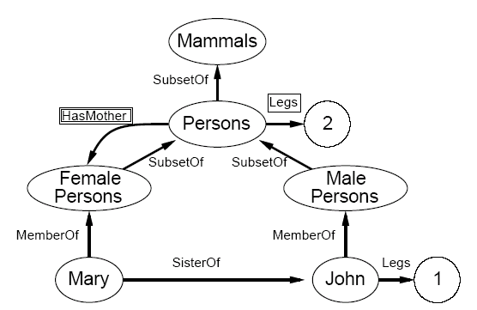
Semantic Networks
A graphical notation of nodes and arcs. Semantic Networks = Logic ?

Slide 84
Semantic Networks
Variants of semantic networks, but all are capable of representing individual objects, categories of objects and relations among objects. They are more human interface friendly and can have multiple inheritance and inverse links.
  Professor is both a teacher and a researcher
  ∀x, y HasSister(x, y) ⬄ SisterOf(y, x)
Well defined semantics are a form of logic:
∀x MemberOf(x, Person) ⇒
[∀y HasMother(x,y) ⇒ MemberOf(y, FemalePersons)]
∀x MemberOf(x, Person) ⇒ Legs(x, 2)

Slide 85
Description Logics
The syntax of FOL is designed to make it easy to say things about Objects
Description logics are notations that are designed to describe definitions and properties of categories.
FOL: ∀x Bachelor(x) ⇒ Unmarried(x) ∧ Adult(x) ∧Male(x)
DL: Bachelor = And(Unmarried, Adult, Male)
And(Man, Atleast(1, Son), AtMost(2, Daughter),
All(Daughter, And(Student, Fills(College, UO, OSU))))

Slide 86
Trade off of Description Logics
The inference of DL is tractable. But in standard FOL system, predicting the solution time is often impossible. The subsumption-testing can be solved in time polynomial in the size of the description.
The expressivity of Description logics is limited. It is the subset of FOL. Hard problem can not be stated or require exponentially large descriptions.
  For example, DL usually lack negation and disjunctions. Classic (one type of DL) can allow disjunction over explicitly enumerated individuals but not over descriptions. Disjunctions definition ➔ exponential number of alternative routes.

Slide 87
Open and Closed Worlds
In closed world assumption, we assume the information provided is complete, so that grounded atomic sentences not asserted to be true are assumed to be false.
In open world assumption, we can not assume the information provided is complete, so that we don’t know grounded atomic sentences not asserted to be true are false or not.

Slide 88
Nonmonotonic Logics
Monotonicity requires all entailed sentences to remain entailed after new sentences are added to the KB:
KB╞ α, then KB ∧ b╞ α
In nonmonotonic logic, the set of beliefs does not goes monotonically over time as new evidence arrives.
Bird(x) ∧ ¬Abnormal₁(x) ⇒ Flies (x)
e.g., Penguin

Slide 89
The Semantic Web
Knowledge Representation for Web
  Ontologies, Data (facts), Queries
Agents
  Web services, broker Agents, Search Agents
  Human
Evolution of Knowledge

Slide 90
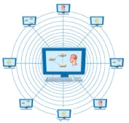

Current WWW
The majority of data resources in WWW are in human readable format only (e.g. HTML).
human
WWW

Slide 91
XML: Extensible Markup Language
Defined by the WWW Consortium (W3C)
Originally intended as a document markup language not a database language
The ability to specify new tags, and to create nested tag structures made XML a great way to exchange data, not just documents
XML has become the basis for many new generation data interchange formats.
A wide variety of tools is available for parsing, browsing and querying XML documents/data

Slide 92
XML (Cont’d)
The ability to specify new tags, and to create nested tag structures made XML a great way to exchange data, not just documents.
  Much of the use of XML has been in data exchange applications, not as a replacement for HTML. Some XML docs use DTD or XML Schemas
Tags make data (relatively) self-documenting
  E.g.
  <bank>
  <account>
    <account-number> A-101 </account-number>
    <branch-name> Downtown </branch-name>
    <balance> 500 </balance>
  </account>
  <depositor>
    <account-number> A-101 </account-number>
    <customer-name> Johnson </customer-name>
  </depositor>
</bank>
Notes:
Don’t need to consult the schema to understand the meaning of the text.

Slide 93


The Semantic Web
One major goal of the Semantic Web is that web-based agents can process and “understand” data[Berners-Lee etal01].
Ontologies formally describe the semantics of data and web-based agents can take web documents (e.g. in RDF, OWL) as a set of assertions and draw inferences from them.
Web-based agents
human
SW

Slide 94
RDF and OWL
Resource Description Framework (RDF) goes a step further to describe the “semantics” of data.
  RDF use XML syntax but mark up data more formally into a set of “triples”.
  Each triple, an RDF statement, is composed of a subject, a property and an object. The subject and property are each identified by a URI as RDF ID.
  <Student rdf:ID = “js226”>
  <name> John Smith </name>
  <inDepartment rdf:resource = “#UO_CIS”/>
  </Student>
  …
  <Department rdf:ID = “UO_CIS”>
  <Phone>541-346-1375</Phone>
  …
  </Department>

Slide 95
The Genealogy Ontology in OWL
The genealogy ontology in OWL (Web Ontology Language, DL based) looks like:
  <owl:Class rdf:ID="Individual">
  <owl:subClassOf rdf:resource=“drc#Person" />
  </owl:Class>
  <owl:Class rdf:ID="Male">
  <owll:subClassOf rdf:resource="#Individual" />
  <owl:subClassOf>
  <owl:Restriction>
  <owl:onProperty rdf:resource="#sex" />
  ……

Slide 96
Approaches for Semantic Search
TAP, an application framework on Semantic Search [Guha et al].
  All web documents have been marked up by RDF based languages. Therefore, each web data resource has a URI or value and whole web document can be represents as a graph with nodes (classes, values) and arcs (property relation).
Yo-Yo Ma
type
birthplace
Musician
author
birthdate
Tavener
10/07/55
Paris, France
http://tap.stanford.edu/data/MusicianMa,_Yo_Yo
http://tap.stanford.edu/data/CityParis,_France

Slide 97
Review for Midterm
Intelligent Agents
  agent function maps from percept histories to actions: [f: P* → A]
  PEAS (Performance measure, Environment, Actuators, Sensors)
Environment types
  Fully observable (vs. partially observable), Deterministic (vs. stochastic), Episodic (vs. sequential)….
Agent types
  Simple reflex agents, Model-based reflex agents, Goal-based agents,Utility-based agents,Learning agents

Slide 98
Review for Midterm
Problem-solving agents and Problem formulation
Uninformed Search Strategies
  Breadth-first search
  Depth-first search and Depth-limited search
  Iterative deepening depth-first search
Informed Search
  Best-first search and Greedy best-first search
  A* search
  Heuristics functions
  Local search algorithms
  Online search

Slide 99
Review for Midterm
Game Playing
  Optimal decisions (minimax algorithms)
  α-β pruning
Constraint Satisfaction Problems (CSP)
  Backtracking search for CSPs
    Minimum Remaining Values, Most Constraining Variable, Least ConstrainingValue, Forward Checking and Arc Consistency
  Local search for CSPs

Slide 100
Review for Midterm
Knowledge-based agents
Logic in general – models and entailment
  Soundness and Completeness
Propositional (Boolean) logic
  Equivalence, validity, satisfiability
Inference rules and Reasoning
  forward chaining
  backward chaining
  CNF and resolution

Slide 101
Review for Midterm
Syntax and semantics of FOL
Knowledge engineering in FOL
Inference in FOL
  Reducing first-order inference to propositional inference
  Unification
  forward chaining
  backward chaining
  CNF and resolution

Slide 102
Review for midterm
KR and Ontology Engineering
  Ontologies, upper ontology of the world
Categories and Objects
  Inheritance
  Physical composition
  Measurement
  Substances
Semantic Web and Semantic Search

