Slide 1
CIS471/571, Fall 2018
Introduction to Artificial Intelligence
Instructor: Dejing Dou
Office hours: Monday 4pm-5:00pm
Nov 21, 2018

Slide 2
Outline of Chapter 22/23
Natural Language Processing
Information Retrieval
Information Extraction

Slide 3
Natural Language Processing
Computer agents process natural language. There are two reasons:
  Communicate with humans
  Acquire information from written language
    Information Retrieval
    Information Extraction

Slide 4
Why NLP is difficult?
One has to have a lot of specific knowledge about the words and the grammar rules of a language.
One must be able to integrate this knowledge with other knowledge about the world.
There are other agents in the world who have their own beliefs, goals, and plans.

Slide 5
Different Levels of Language Analysis
phonological knowledge — relates words and sounds; crucial for speech-based systems
morphological knowledge — relates morphemes (implied context) and words (friend ---> friendly)
syntactic knowledge — words to sentences; structural roles of words in sentences
semantic knowledge — meaning of words and sentences;
pragmatic knowledge — how do situations affect the interpretation

Slide 6
Communications
“Classical" view (pre-1953): language consists of sentences that are true/false (i.e., logic)
“Modern" view (post-1953): language is a form of action
  Wittgenstein (1953) Philosophical Investigations
  Austin (1962) How to Do Things with Words
  Searle (1969) Speech Acts
Why? To change the actions of other agents

Slide 7
Speech Acts
Speech acts achieve the speaker's goals:
  Inform: “There's a pit in front of you"
  Query: “Can you see the gold?"
  Command “Pick it up"
  Promise “I'll share the gold with you"
  Acknowledge “OK"
Speech act planning requires knowledge of
  Situation
  Semantic and syntactic conventions
  Hearer's goals, knowledge base, and rationality

Slide 8
Stages in Communications
Processes of Speaker:
  Intention: S wants to inform H that P
  Generation: S selects words W to express P in context C
  Synthesis: S utters words W
Processes of Hearer:
  Perception: H perceives W’ in context C’
  Analysis: H infers possible meanings P₁ , … P_{n}
  Disambiguation: H infers intended meaning P_{i}
  Incorporation: H incorporates P_{i} into KB

Slide 9
Formal Language and Grammar
Grammar specifies the compositional structure of complex messages.
  e.g., speech, text
A formal language is a set of strings of terminal symbols. Each string in the language can be analyzed/generated by the grammar. The grammar is a set of rewrite rules, e.g.,
  S → NP VP
  Article → the | a | an | . . .
Here S is the sentence symbol, NP (Noun Phrase) and VP (Verb Phrase) are nonterminals

Slide 10
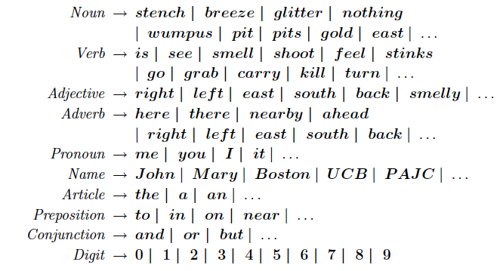
Wumpus Lexicon

Slide 11
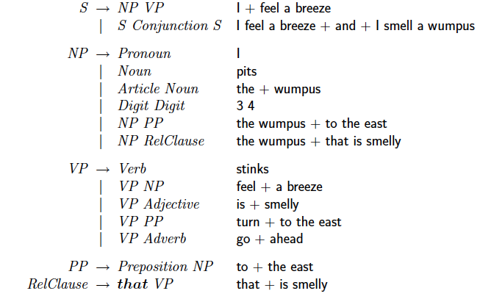
Wumpus Grammar

Slide 12
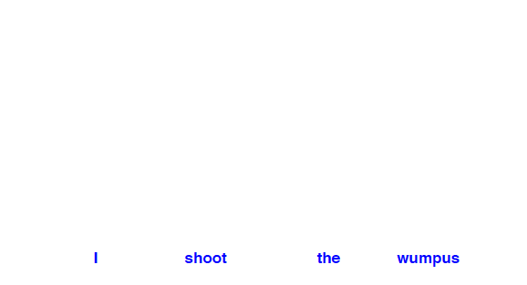
Parse Tree
Exhibit the grammatical structure of a sentence

Slide 13
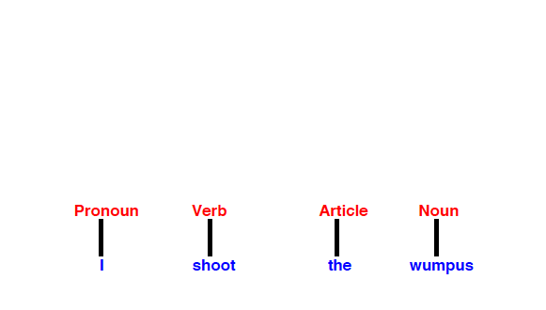
Parse Tree
Exhibit the grammatical structure of a sentence

Slide 14
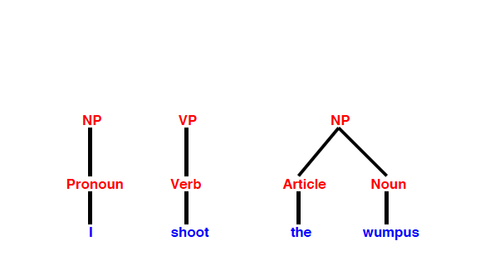
Parse Tree
Exhibit the grammatical structure of a sentence

Slide 15
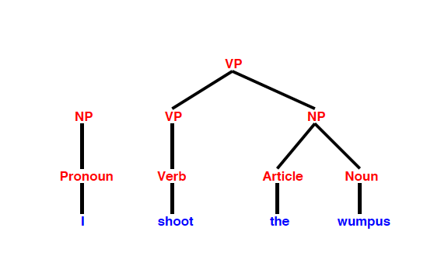
Parse Tree
Exhibit the grammatical structure of a sentence

Slide 16
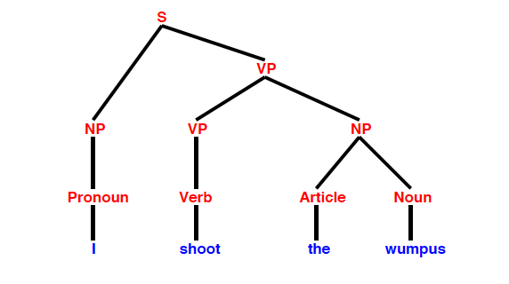
Parse Tree
Exhibit the grammatical structure of a sentence

Slide 17
Example of Understanding
Question: What are the meanings?
  I saw the Grand Canyon flying to new York.
  I saw the man in the park with the telescope.
Question: What does the “they” refer to?
  The city councilmen refused to give the women a permit for a demonstration, because they feared violence.
  The city councilmen refused to give the women a permit for a demonstration, because they advocated violence.

Slide 18
Language Model
Natural language cannot be characterized as a definitive set of sentences. It is more fruitful to define a natural language model as a probability distribution over sentences rather than a definite set.
  Rather than asking a string of words is or is not a member of the set defining the language, we instead ask for P(S = words) – what is the probability that a random sentence would be words.
  Our language models are, at best, an approximation.

Slide 19
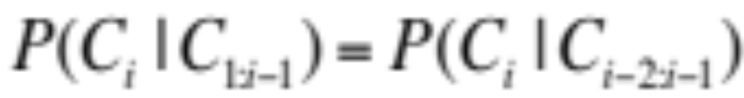
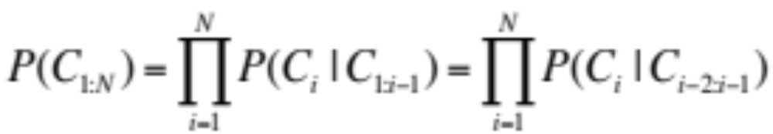
N-gram character Model
A model of the probability distribution of n-letter sequences is called an n-gram model: P(C_{1:N}) is the probability of a sequence of N characters.
An n-gram model is defined as a Markov Chain of order n-1. In a Markov chain, the probability of character C_{i} depends only on the immediately preceding characters, not on any other characters. So in a trigram model:

Slide 20
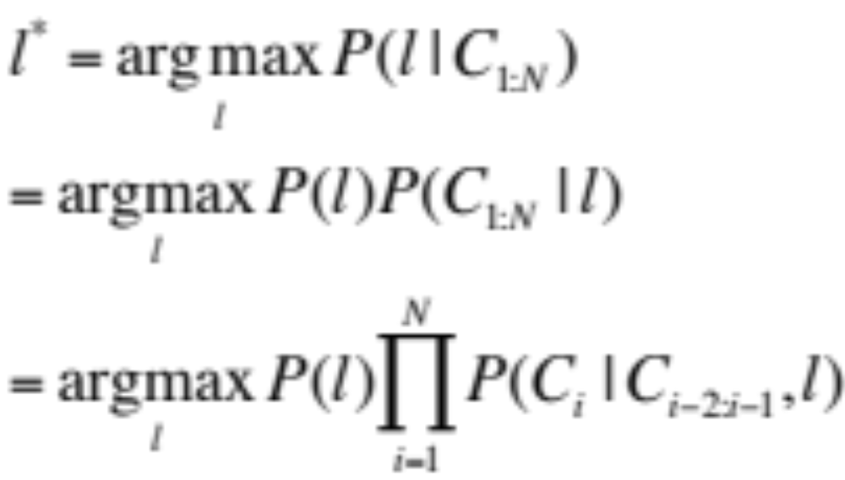
Language Identification
Given a text, determine what natural language it is written in.
One approach: first build a trigram character model of each candidate language l, P(C_{i} | C _{i-2:i-1,} l). We want to select most probable language given the text, so we apply Bayes’ rule:

Slide 21
N-gram word Model
An n-gram model can be over words rather than characters: P(W_{1:N}) is the probability of a sequence of N words.
An n-gram word model has much larger set of symbols (vocabulary) than character model. So it is possible we need to handle a new word that was not seen in the training corpus.
  Add a new word to the vocabulary: <UNK>
  Go through the training corpus, the first time any individual word appears it is previously unknown, so replace it with the symbol <UNK>. E.g., any string of digits might be replaced with <NUM>, any email address with <EMALL>.
  When an unknown word appears in a test set, we look up its probability under <UNK>.

Slide 22
Apply N-gram in text book
Unigram: logical are as are confusion a may right tries agent goal the was…
Bigram: systems are very similar computational approach would be represented…
Trigram: planning and scheduling are integrated the success of naïve bayes model is

Slide 23
Text Classification
Also known as text categorization: given a text of some kind, decide which of a predefined set of classes it belongs to.
  Sentiment analysis: e.g., classify a movie or product review as positive or negative
  Spam detection: Spam vs. Ham

Slide 24
Spam Detection
We first define an n-gram language model for P(message | spam) by training on the spam folder and define an n-gram model for P(message | ham) by training on the inbox (i.e., hams). The we can use the Bayes’ rule:

Slide 25
Features of Messages
We can represent the message as a set of feature/value pairs and apply a classification algorithm h to the feature vector X. We can think n-grams as features.
In unigram model, the features are the words in the vocabulary, e.g., “a,”, “sale”… and the values are the number of times each word appears in the message. It is also called the bag of words model.
What is the drawback of bag of words model? How about using bigrams and trigrams?

Slide 26
Information Retrieval
A task to find documents that are relevant to a user’s need (e.g., a search query) for information.
  Best known examples of IR systems are web search engines
An IR system can be characterized by:
  A corpus of documents.
  Queries posed in a query language
  A result set represented in a different ways, e.g., a ranked list of relevant documents
Earliest IR system: a Boolean keyword model: whether a keyword is in a document or not.

Slide 27
IR Scoring Functions
Most IR systems have abandoned the Boolean model and use models based on the statistics of word counts.
BM25 scoring function: the score is a linear weighted combination of scores for each of the words that make up the query.
  TF: the frequency with which a query term appears in a document
  IDF: the inverse document frequency of the term (e.g., “at” are in most documents, DF is high, IDF is low)
  The length of the document.

Slide 28
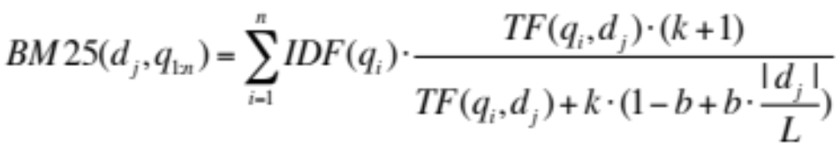
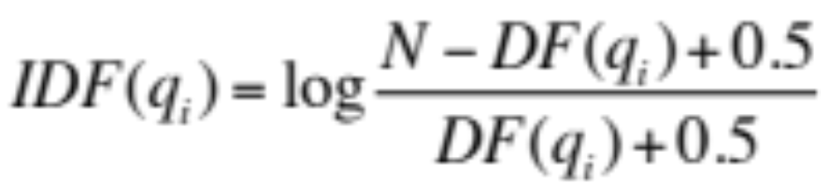
BM25 Function
Given a document d_{j} and a query with words q_{1:n},
where |d_{j}| is the length of document d_{j} in words, and L is the average document length in the corpus: L=Σ_{i}|d_{i}|/N. N is the number of documents in corpus. Two parameters k and b can be tuned by cross-validation. Typical values k = 2.0 and b = 0.75
where DF(q_{i}) is the number of documents that contains q_{i}

Slide 29
IR System Evaluation
Assume an IR system has returned a result set for a query q from a corpus of 100 documents. We know which documents are and are not relevant (i.e., we have gold standard):
 | In result set | Not in result set
Relevant | 30 | 20
Not relevant | 10 | 40

Slide 30
Precision and Recall
Precision: the proportion of documents in the result set that are actually relevant (i.e., accuracy):
P = (results ∧ relevant) / results = 30/(30+10) = 0.75
Recall: the proportion of all relevant documents in the collection which are also in the results (i.e., completeness):
R = (results ∧ relevant) / relevant = 30/(30+20)=0.6

Slide 31
F1 score
It’s possible a system can return every document in the collection (100% recall) but has low precision. Or a system could return a single document (low recall) but a decent chance at 100% precision.
A harmonic mean of P and R:
  F₁ = 2×P×R/(P+R) or more general
  F_{β} = (1+β²) ×P×R/(β²×P + R)

Slide 32
PageRank algorithm
PageRank was invented to solve the problem of the tyranny of TF scores: if the query is “IBM,” how do we make sure that IBM’s home page (ibm.com) is the first result, even if another page mentions the term “IBM” more frequently?
The idea is that ibm.com has many in-links (links to the page), so it should be ranked higher: each in-link is a vote for the quality of the linked-to page. But spammer can create a network of pages which point to a chosen page. So quality of the page/site matters besides the numbers.
What is high quality site? One that linked to other high-quality sites. ➔ recursive definition

Slide 33
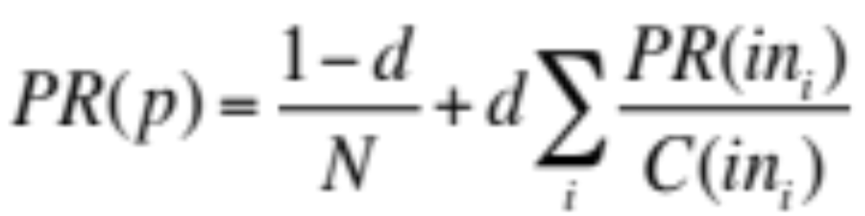
PageRank algorithm
The PageRank for a page p is defined as:
PR(p) is the PageRank of p, N is the total number of pages in the corpus, in_{i} are the pages that link in to p, and C(in_{i}) is the count of the total number of out-links on page in_{i}. The constant d is a damping factor. With probability (e.g., d = 0.85) a web surfer clicks on one of the links on the page and with probability (1-d) the surfer gets bored with the page and restarts on a random page.
Then PR(p) is the probability that a random surfer will be at page p at any point in time. So we can start with PR(p) = 1, then iterate until converge.

Slide 34
Information Extraction
A process to acquire knowledge by looking for occurrences of a particular class of objects and looking for relationships among objects, e.g.,
  Instances of street addresses from web pages
  Instances of storms from weather reports
  Instances of directors of movies
  Instances of co-authors of papers
  Instances of coach-player relationships

Slide 35
Attribute-based Extraction
It assumes the entire text refers to a single object and the task is to extract attributes of that object.
We can define a template for each attribute (e.g., price) we would like to extract, e.g., regular expression in Unix commands or programming language like Perl:
  [0 – 9] match any digit from 0 to 9
  [0 – 9] + match one or more digits
  [ . ] [0 - 9] [0 – 9] match a period followed by two digits
  [$][0-9]+([.][0-9][0-9]) match $345.99 or $1.23 or ….

Slide 36
Relational Extraction
It deals with multiple objects and their relationships.
  e.g., which object has a price as “$345.99”? which two persons co-write the PageRank paper?
FASTUS system:
  Tokenization
  Complex-word handling
  Basic-group handling
  Complex-phrase handling
  Structure merging

Slide 37
Example
Bridgestone Sports Co. said Friday it has set up a joint venture in Taiwan with a local concern and a Japanese trading house to produce golf clubs to be shipped to Japan.
1. Tokenization: segments the stream of characters into tokens (words, numbers, and punctuation).
  For English, just separate characters at white spaces or punctuations.

Slide 38
Example
Bridgestone Sports Co. said Friday it has set up a joint venture in Taiwan with a local concern and a Japanese trading house to produce golf clubs to be shipped to Japan.
2. Complex words: e.g., “set up” and “joint venture”
  Rule/pattern for a company name:
  CapitalWord + (“Company” | “Co” | “Inc” | “Ltd”)

Slide 39
Example
Bridgestone Sports Co. said Friday it has set up a joint venture in Taiwan with a local concern and a Japanese trading house to produce golf clubs to be shipped to Japan.
3. Basic groups: Noun groups and verb groups, e.g.,
NG: Bridgestone Sports Co.
VG: said
NG: Friday
NG: it
VG: had set up …

Slide 40
Example
Bridgestone Sports Co. said Friday it has set up a joint venture in Taiwan with a local concern and a Japanese trading house to produce golf clubs to be shipped to Japan.
4. Complex phrases: e.g.,
  Rule/pattern for capturing one way to describe the formation of a joint venture:
  Company + SetUp JointVenture (“with” Company+)?

Slide 41
Example
Bridgestone Sports Co. said Friday it has set up a joint venture in Taiwan with a local concern and a Japanese trading house to produce golf clubs to be shipped to Japan.
5. Merge structures: combine multiple complex phrases to one, e.g., one more sentence:
The joint venture will start production in January.

Slide 42
Disadvantages
Rule-based extraction works well in restricted domain in which it is possible to pre-determine what subjects will be discussed, and how they will be mentioned.
However, it doesn’t perform well in a variable domain or format.
It is better to use a probabilistic model rather than a rule-based model.

Slide 43
Conditional Random Fields
Basic idea: a text is a discriminative model, one that models the conditional probability of the hidden attributes given the observations (text):
  Given a text e_{1:N}, the conditional model finds the hidden state sequence X_{1:N} (e.g., the prefix, target, and postfix states) that maximizes P (X_{1:N} | e_{1:N}).
  E.g., There will be a seminar by Dr. Dejing Dou on Fri
  Speaker: - - - - Pre Pre Target T T Post
  Date: - - - - - - - - - - Pre T

Slide 44
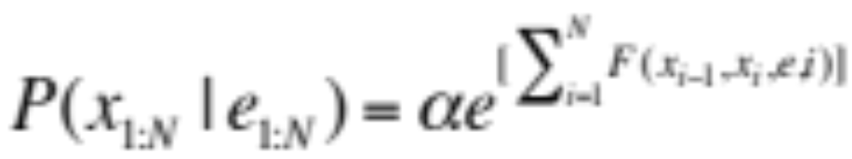
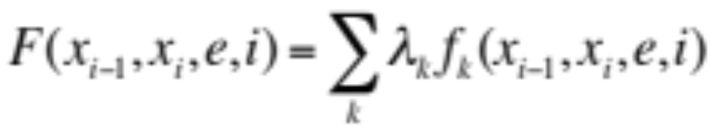
Linear Chain CRF
where α is a normalization factor (to make sure the probabilities sum to 1) and F is the feature function defined as the weighted sum of a collection of k component feature function:
The λ_{k} parameter values are learned to maximize the conditional likelihood of the training data.

Slide 45
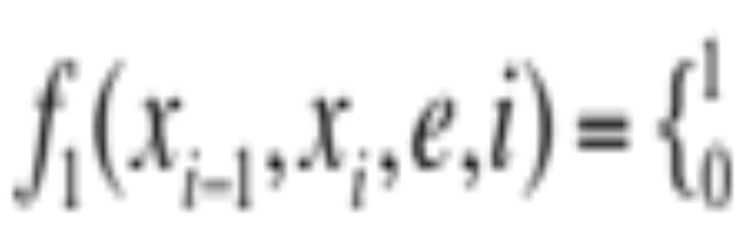
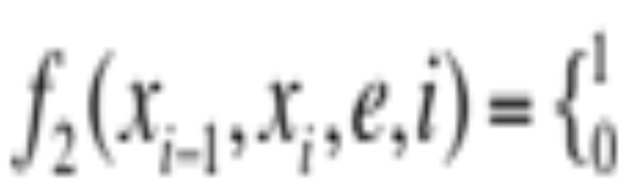
CRF and features
_{If xi=SPEAKER and} _{ei = DEJING}
_{otherwise}
_{If xi=SPEAKER and ei+1 = SAID}
_{otherwise}

Slide 46
Ontology Extraction
Building a large knowledge base or ontology of facts from a corpus.
NP such as NP (, NP)* (,)? ((and | or) NP)?
where * means repetition of zero or more
Matches
“disease such as rabies affect your dog”
“supports network protocols such as DNS”
“students such as undergraduates and graduate students”

Slide 47
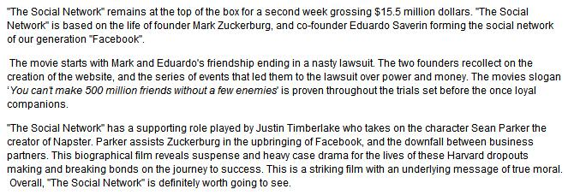
Ontology-Based Information Extraction
The general idea of ontology-based information extraction is to use ontologies to guide the information extraction process.
_{Thing}
_{Thing}
_{Actor}
_{Actor}
_{Character}
_{Movie}
_{Character}
_{Movie}
Ontology-based information extraction
_{hasActor}
_{hasActor}
_{hasCharacter}
_{hasCharacter}
_{The Social Network}
_{Justin Timberlake}
_{Mark Zuckerburg}
_{Eduardo Saverin}
_{Sean Parker}

Slide 48
Robotics
Types of Robots
Robot Hardware
  Sensors, Effectors, DOF (degree of freedom)
Localization of Robots
Configuration Space
Reactive Control
Robot Software Architecture

Slide 49
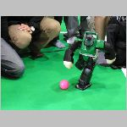
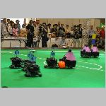
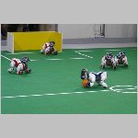
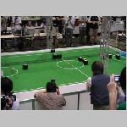
Robocup
By the year 2050, develop a team of fully autonomous humanoid robots that can win against the human world soccer champion team.

Slide 50
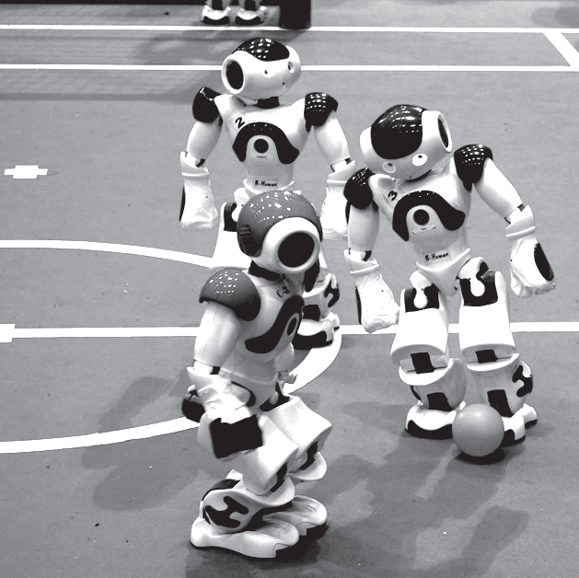
Robocup
By the year 2050, develop a team of fully autonomous humanoid robots that can win against the human world soccer champion team

Slide 51
Application of Robots
Industry and Agriculture
  Assembly line, harvesting, mining
Transportation
  Transporting food, water, drugs, files in hospital and offices
Hazardous environments and exploration
  Cleaning nuclear waste, rescue and search people after earthquake
  International space station, Mars
Health care
  Surgeon assistant
Personal service
  Autonomous vacuum cleaners
Entertainment and sports
  Robocup (soccer)

Slide 52
A Definition
Robots are physical agents that perform tasks by manipulating the physical world. That means:
  They have effectors (e.g., legs, wheels) to assert physical forces on the environment
  They have sensors (e.g., cameras, ultrasound) to measure the environment and own motion.

Slide 53
Types of Robots
Manipulators
  E.g., robot arms are physically anchored to their workplace in a factory assembly line, hospital or the international space station
Mobile robots
  Sonydog, autonomous driving cars (google car), planetary rovers
Humanoid robots
  The physical design mimics the human torso

Slide 54
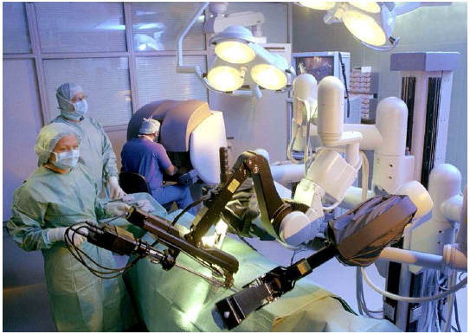
Manipulator for hospital

Slide 55
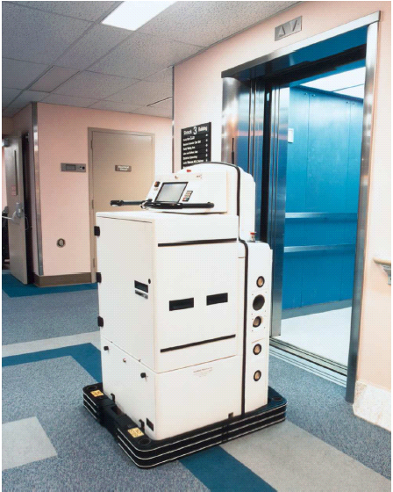
Helpmate for hospital

Slide 56
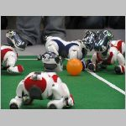
Sony Dogs

Slide 57
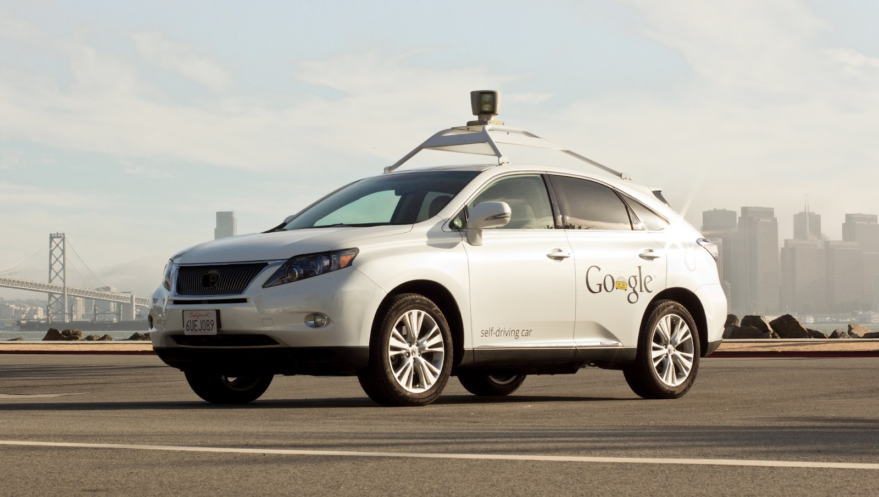
Google Car

Slide 58
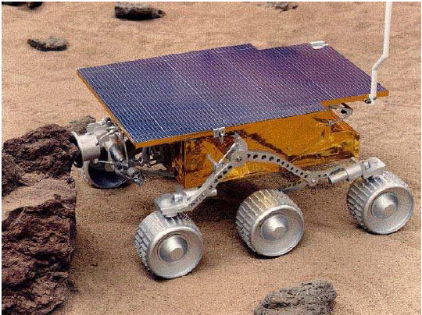
NASA’s Sojouner in Mars

Slide 59
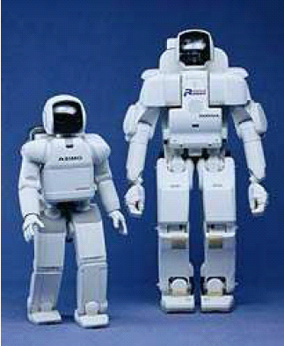
Humanoid Robots

Slide 60
Sensors
Passive Sensors
  E.g., cameras which are observers of the environment
  Odometry measures the change of locations over time.
Active Sensors
  E.g., Sonar which can send energy into the environment and rely on the fact that this energy is reflected back to the sensor.
  Others like Ranger Finder, GPS,

Slide 61
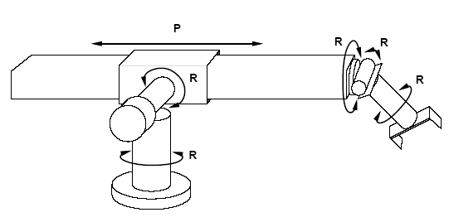
Effectors and Degree of Freedom
One degree of freedom means each independent direction the effectors can move.
The Stanford Manipulator have five revolute joints (R) and one prismatic joint (P) DOFs.

Slide 62
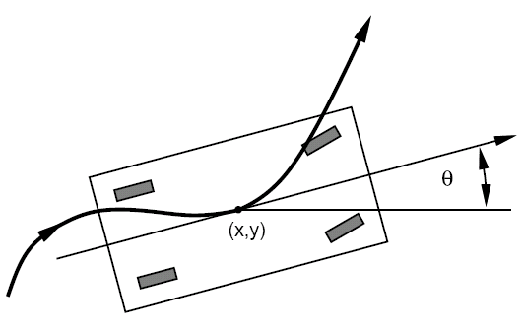
DOF for mobile robots
The DOFs of mobile robots are not necessarily the same as the number of actuated elements.
The robot car has 2 controllable DOFs (move forward and backward, turn) and 3 effective DOFs, because kinematic configuration of a robot car is 3 dimensional (x, y, z) location.

Slide 63
Localization
It is a generic example of robot perception. For example, robot cars must know where they are to find a way to goal location.
If the initial location of object is known, localization problem is a tracking problem
If the initial location is unknown, it is a global localization problem. However, it can turn into tracking problem once the object has been localized

Slide 64
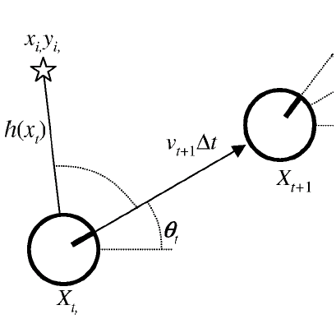
Tracking and Motion
In deterministic model:
X_{t+1} = f (X_{t},v_{t}, ω_{t}) = X_{t} + [v_{t} Δt cosθ_{t}, v_{t} Δt sinθ_{t}, ω_{t} Δt ]
In common model, we have to use a Gaussian distribution with mean f (X_{t},v_{t}, ω_{t}) and some covariance Σ_{x}:
P(X_{t+1}| X_{t} ,v_{t}, ω_{t}) = N (f (X_{t},v_{t}, ω_{t}) , Σ_{x})
Notes:
w: small Omega

Slide 65
Planning to Move
For robots, decisions ultimately involve motion of effectors.
The first step to move is to get a good presentation of problems. Similar like search spaces or planning worlds.

Slide 66
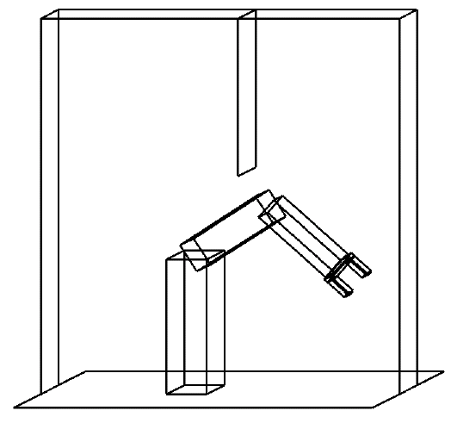
Configuration Space
ϕ_{elb}
ϕ_{shou}
The robot arm has two joints and move independently. Moving the joints alters the (x,y) coordinates of the elbow and the gripper. Suppose the z coordinate doesn’t change. (x_{g},y_{g}) and (x_{e},y_{e}) can be used as 4 coordinates

Slide 67

Configuration Space
ϕ_{elb}
table
table
Left wall
Vertical obstable
ϕ_{shou}
Notes:
psi

Slide 68
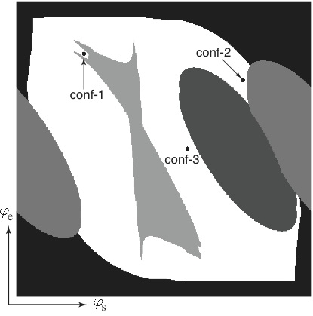
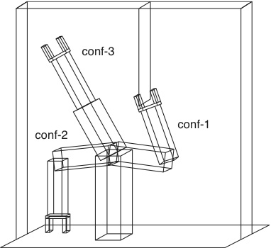
Configuration Space
Notes:
psi

Slide 69
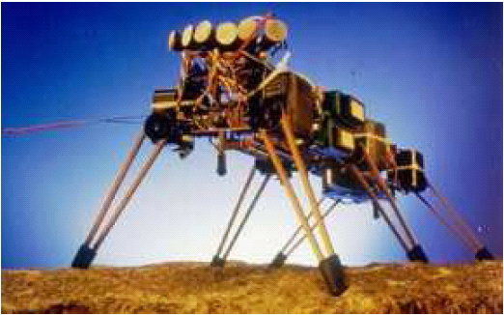
Moving by control
Six legs and 12 DOF (two for each leg)

Slide 70
Reactive Control
retract, lift higher
yes
Move forward
no
S₃
Stuck?
S₄
Lift up
Set down
Push backward
S₂
S₁
An augmented finite state machine (AFSM) for the control of a single leg

Slide 71
Robotic Software Architectures
Hybrid architecture combine reactive control (low level decision and sensor driven) and deliberative control (high level decision based on information which can not be sensed at the time of decision making. E.g, path planner)
  Subsumption architecture based on finite machines
  Three layer architecture: reactive layer, executive layer and deliberate layer.
Robotic programming languages
  rule-based language complied in AFSMs
  functional programming language for control system, e.g, GRL
  Reactive action plan system (RAPS)
  Reasoning and learning (e.g., GOLOG, CES, ALisp)

