Slide 1

SOFE2715 Data Structures and Algorithms
K-Means and Convex Hull
Group 1 Course Project
Justin Kaipada 100590167
Anna Safonov 100601514
George Zakharov 100588814
Riley Stephens 100589185

Slide 2
System Specifications and Dependencies
Both K-Means and Convex Hull are written in Python 2.7
Python Dependencies:
matplotlib – for plotting the data,
csv – for parsing the csv test exercise files,
timeit – for the timer

Slide 3
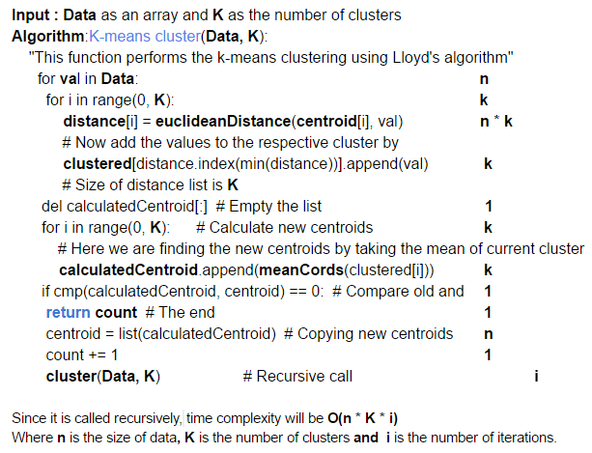
K-Means
Data Structures and Algorithms
Lloyd’s algorithm

Slide 4
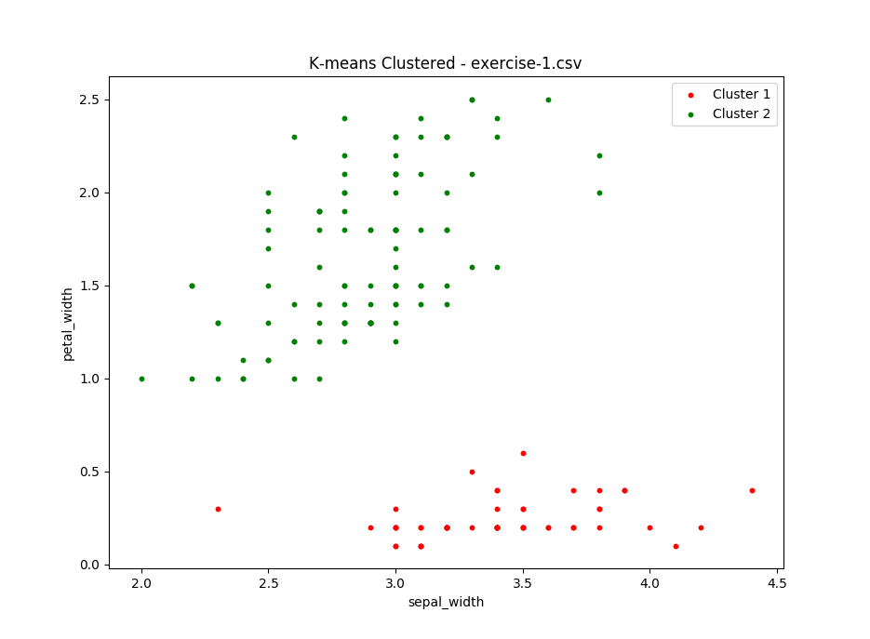
K-Means
Solution to test exercise 1

Slide 5
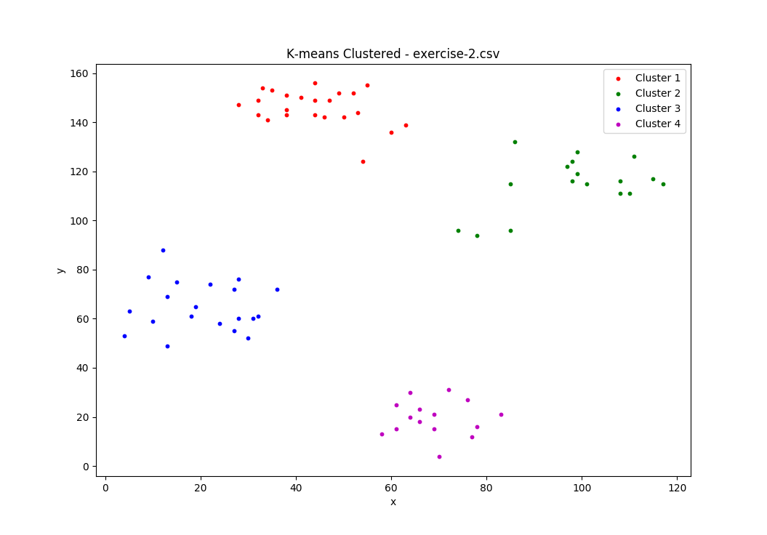
K-Means
Solution to test exercise 2

Slide 6
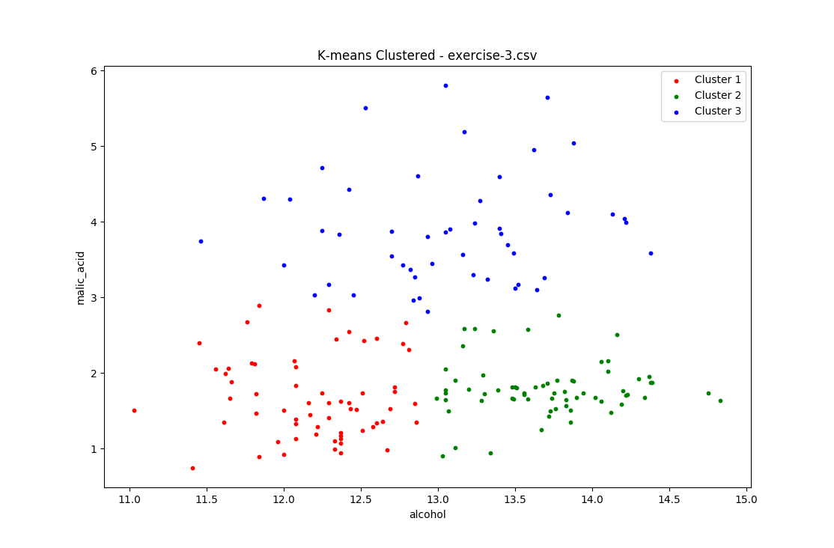
K-Means
Solution to test exercise 3

Slide 7
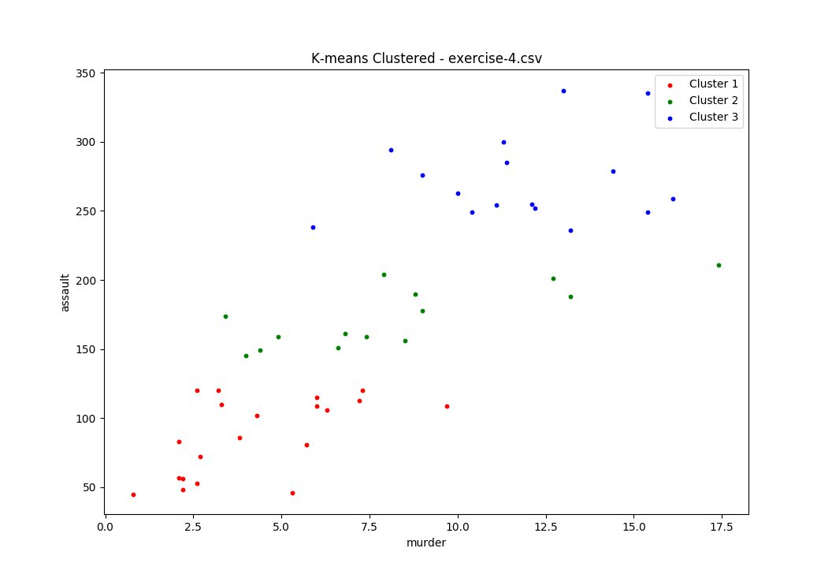
K-Means
Solution to test exercise 4

Slide 8
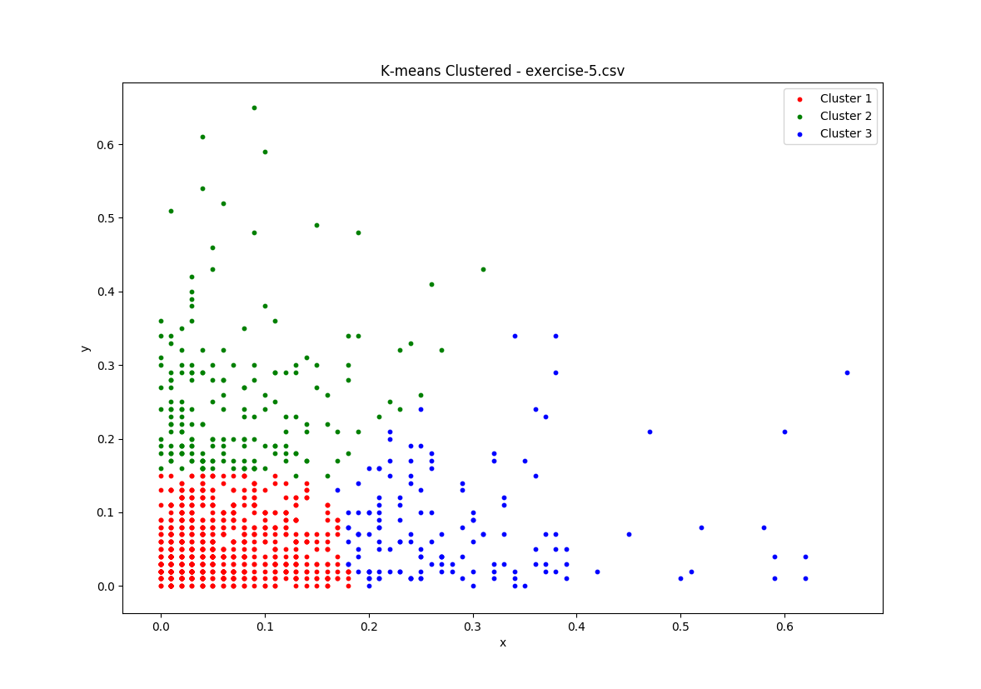
K-Means
Solution to test exercise 5

Slide 9
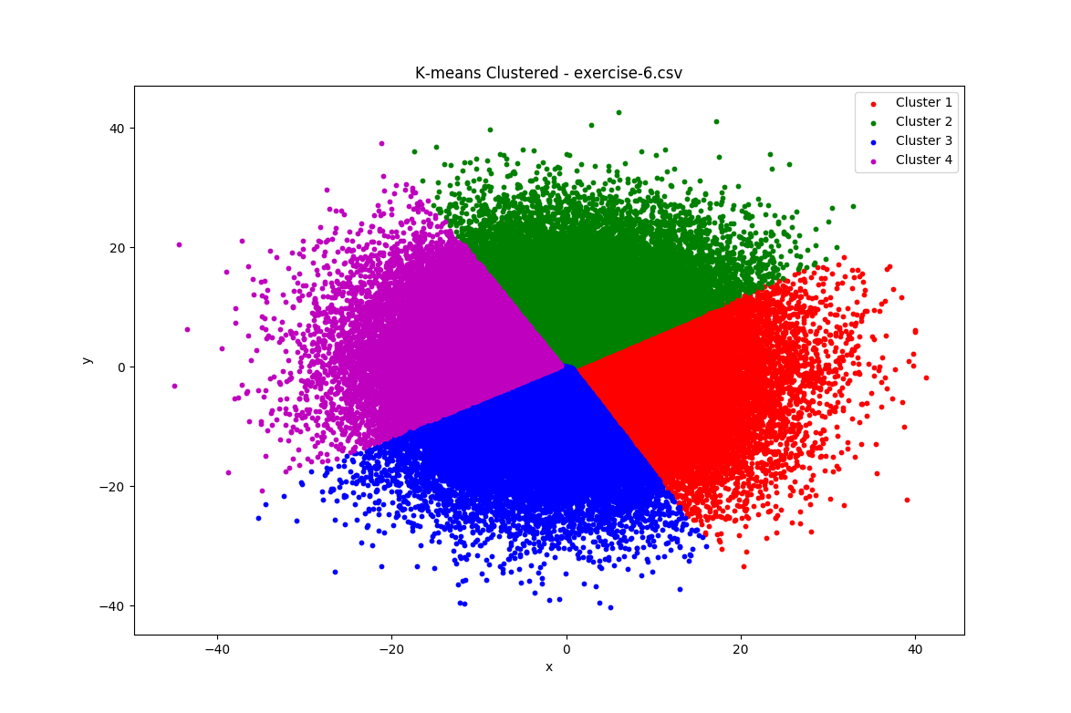
K-Means
Solution to test exercise 6

Slide 10
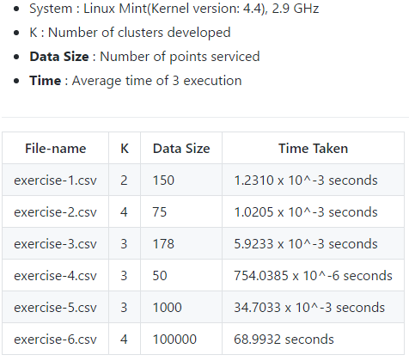
K-Means
Performance and Analysis

Slide 11
Convex Hull
Data Structures and Algorithms
Graham scan algorithm
We used Heapsort to sort the points based on the slope.
Our implementation of stack in Python to store and operate on X and Y coordinates of the hull

Slide 12
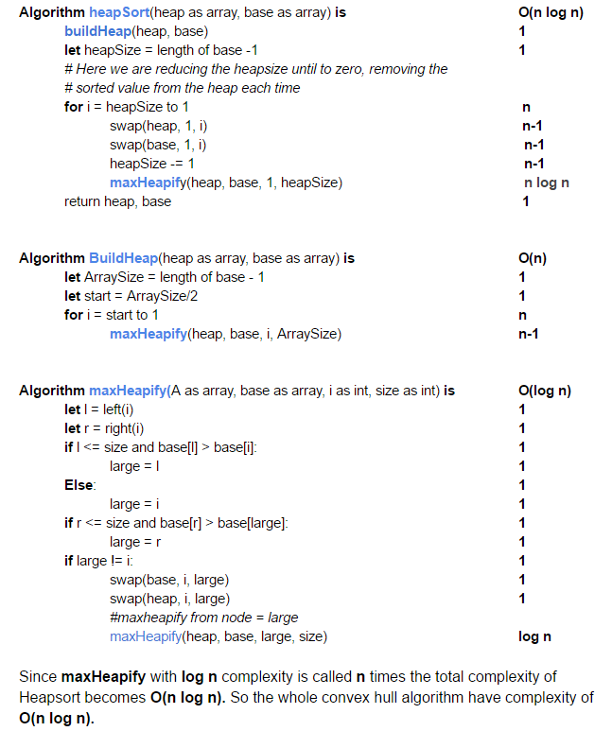
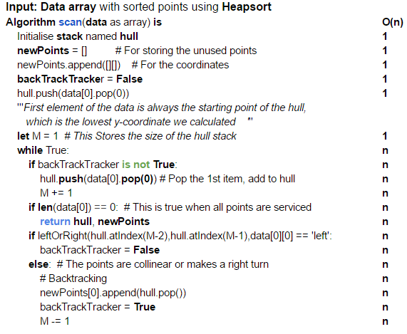
Convex Hull
Time Complexity

Slide 13
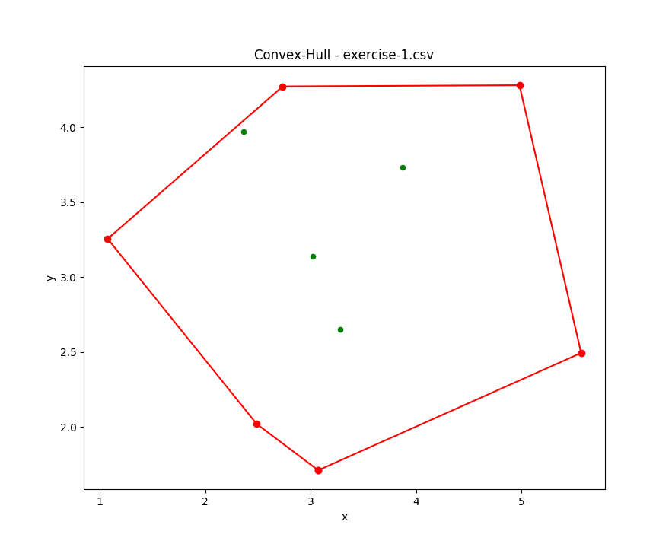
Convex Hull
Solution to test exercise 1

Slide 14
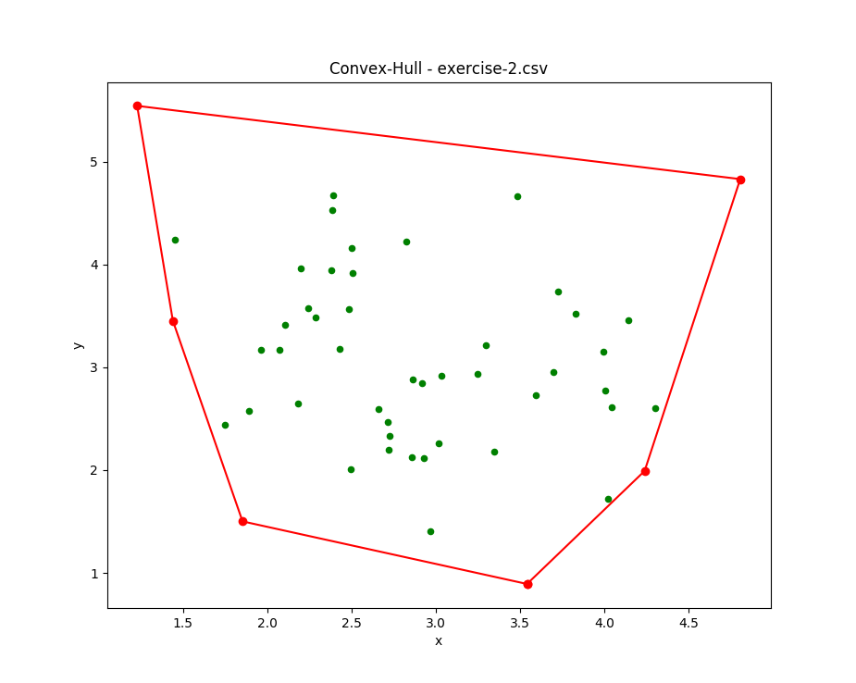
Convex Hull
Solution to test exercise 2

Slide 15
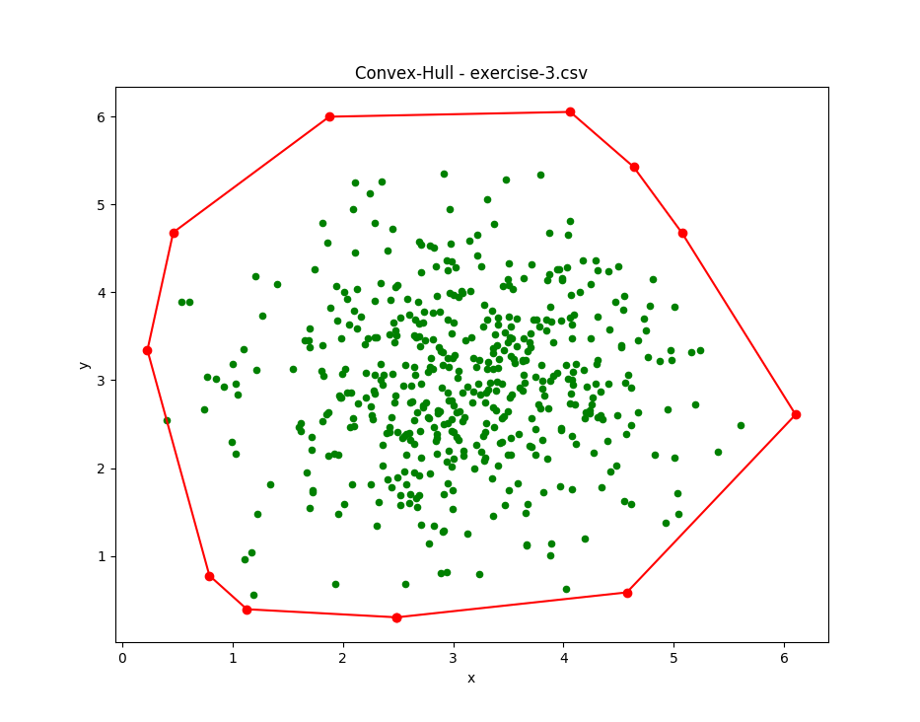
Convex Hull
Solution to test exercise 3

Slide 16
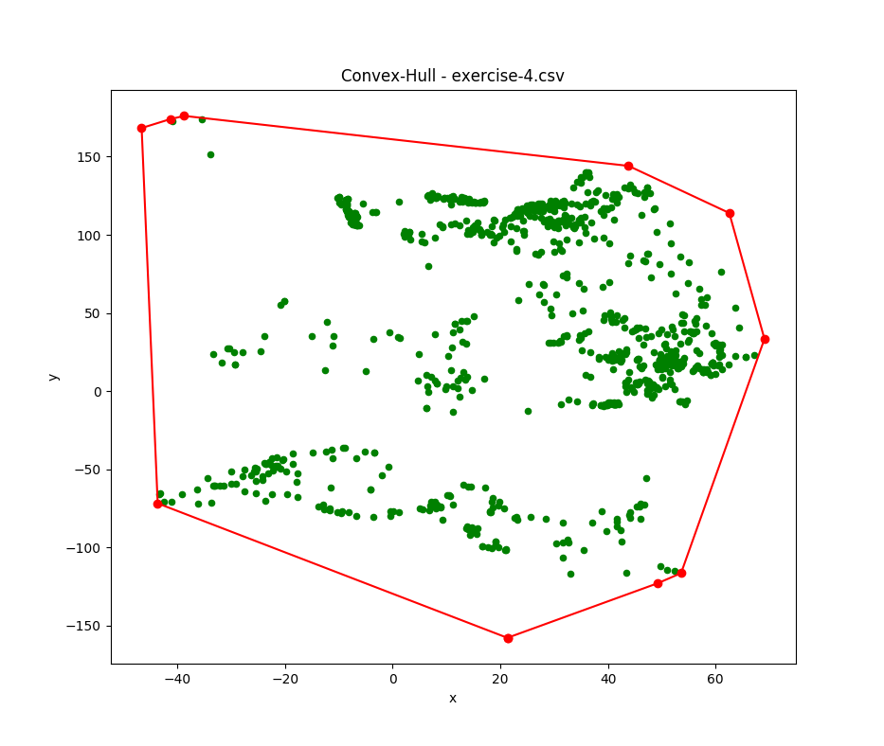
Convex Hull
Solution to test exercise 4

Slide 17
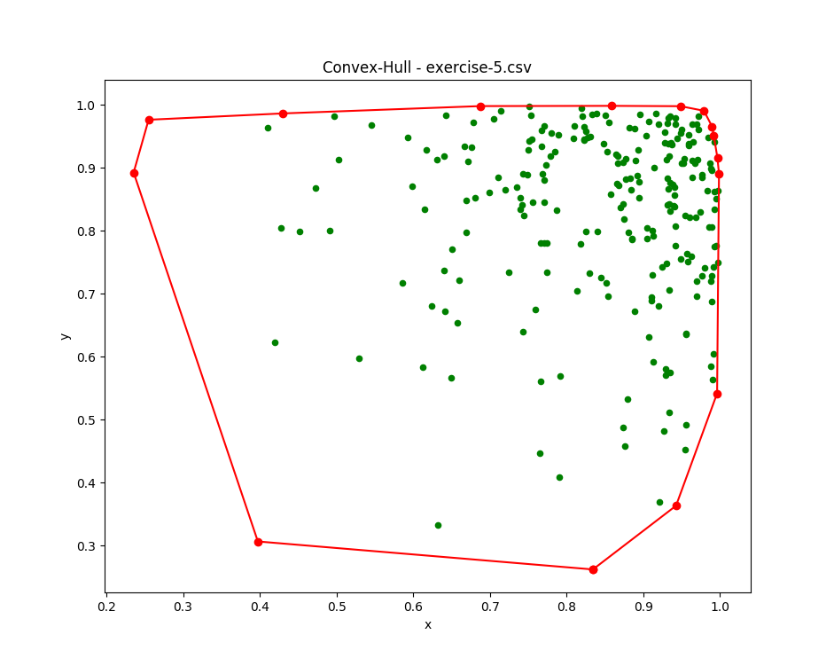
Convex Hull
Solution to test exercise 5

Slide 18
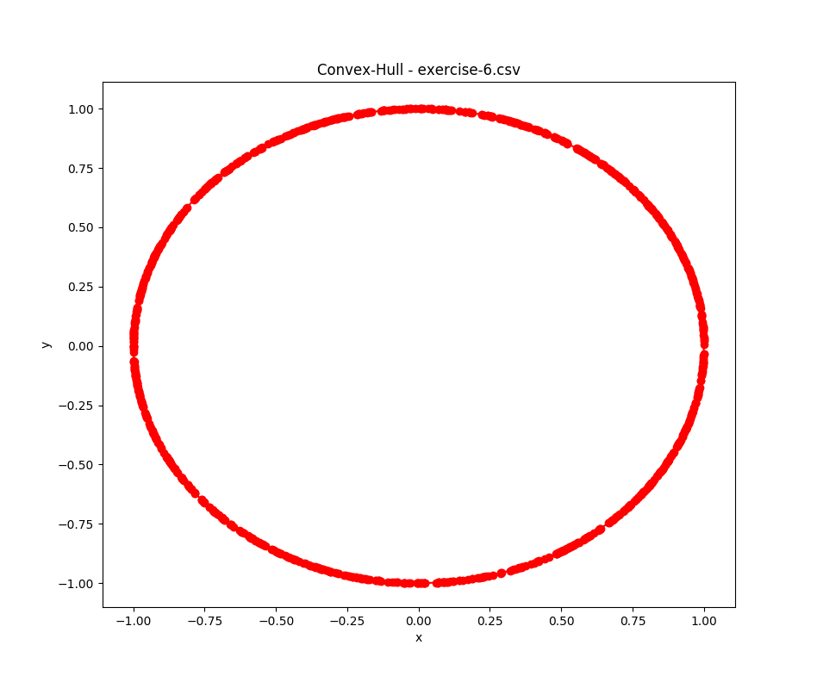
Convex Hull
Solution to test exercise 6

Slide 19
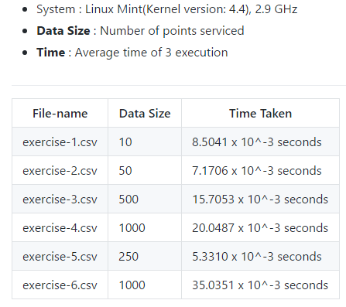
Convex Hull
Performance and Analysis

Slide 20
FINITO

