Slide 1

SOFE2715 Data Structures and Algorithms
K-Means and Convex Hull
Group 1 Course Project
Justin Kaipada 100590167
Anna Safonov 100601514
George Zakharov 100588814
Riley Stephens 100589185

Slide 2
System Specifications and Dependencies
Linux Mint, Kernel version 4.4, 2.9 GHz
Both K-Means and Convex Hull are written in Python 2.7
Python Dependencies:
matplotlib – for plotting the data,
csv – for parsing the csv test exercise files,
timeit – for the timer

Slide 3
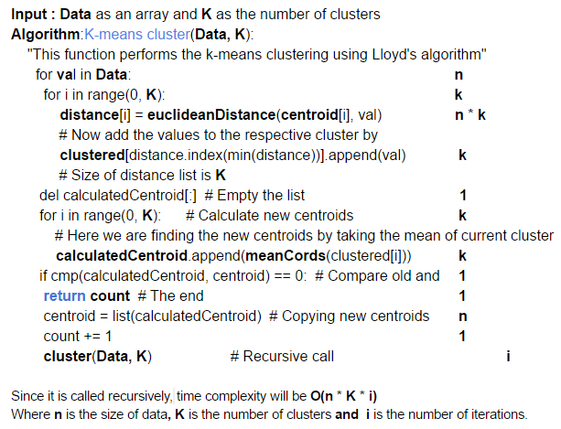
K-Means Data Structures and Algorithms
Lloyd’s algorithm

Slide 4
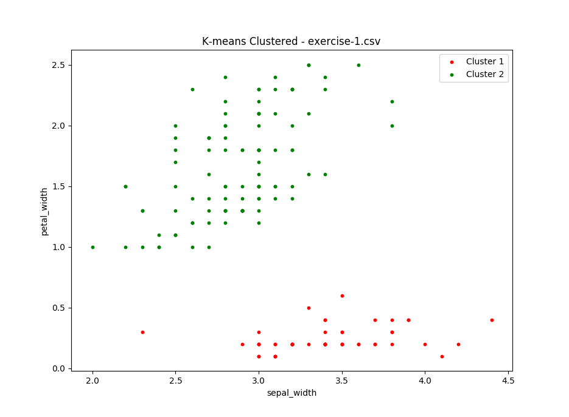
K-Means Solution to test exercise 1

Slide 5
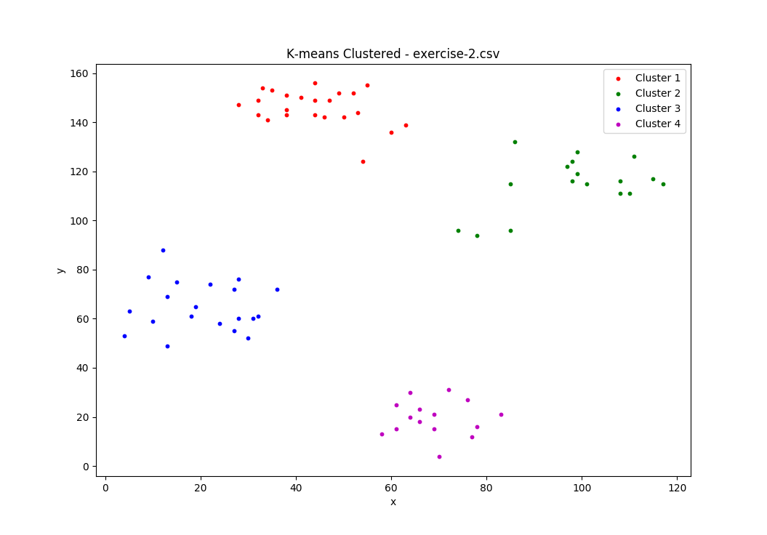
K-Means Solution to test exercise 2

Slide 6
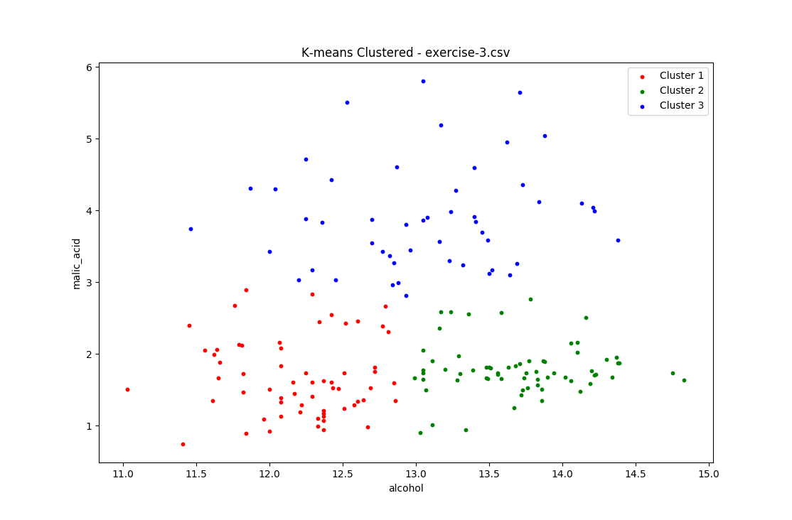
K-Means Solution to test exercise 3

Slide 7
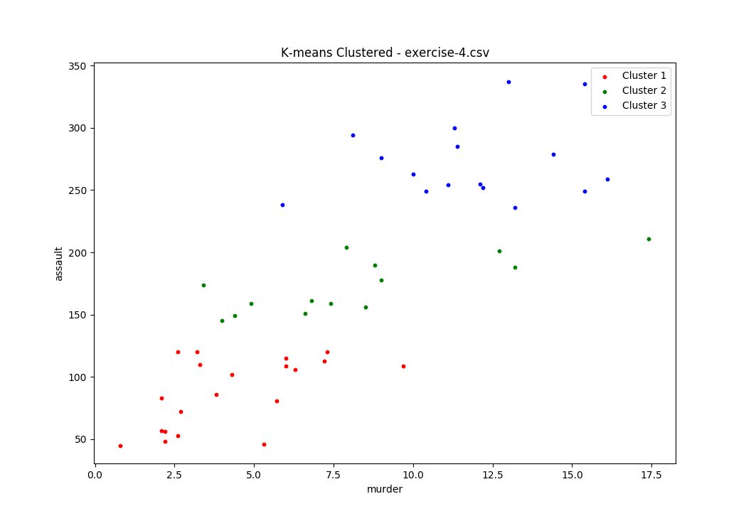
K-Means Solution to test exercise 4

Slide 8
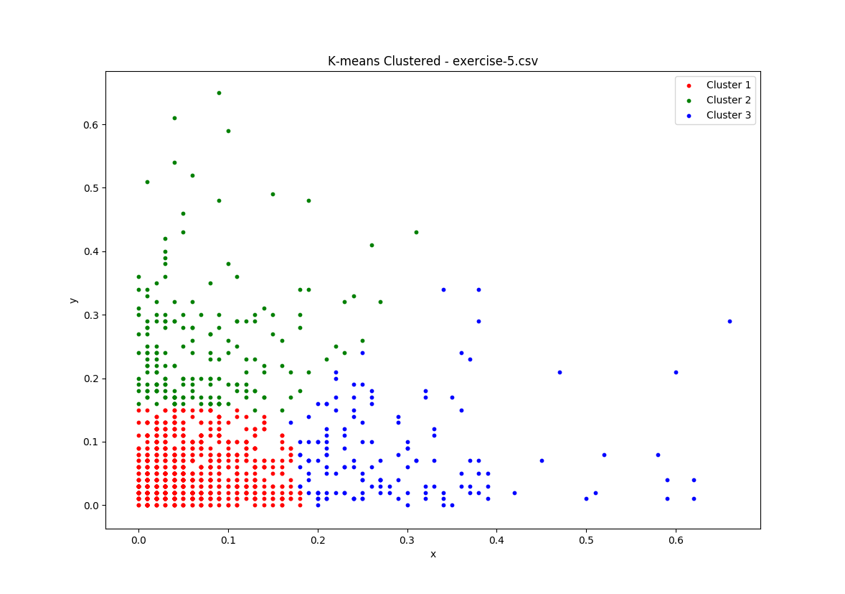
K-Means Solution to test exercise 5

Slide 9
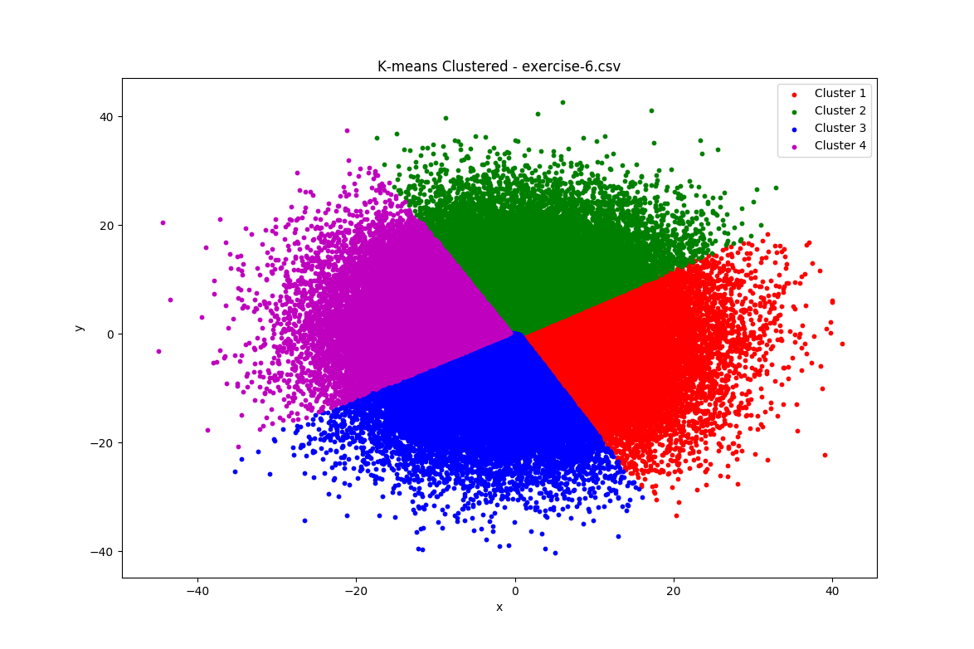
K-Means Solution to test exercise 6

Slide 10
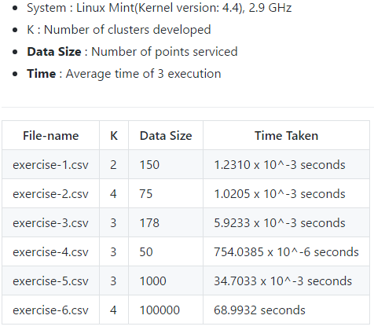
K-Means Performance and Analysis

Slide 11
Convex Hull Data Structures and Algorithms
Graham scan algorithm
Our implementation of stack in Python to store and operate on X and Y coordinates of the hull

Slide 12
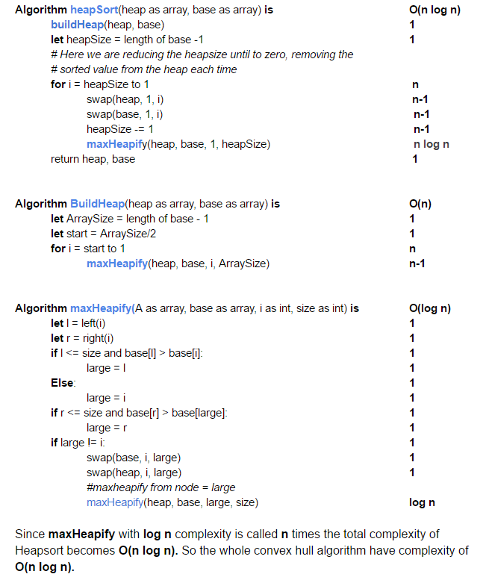
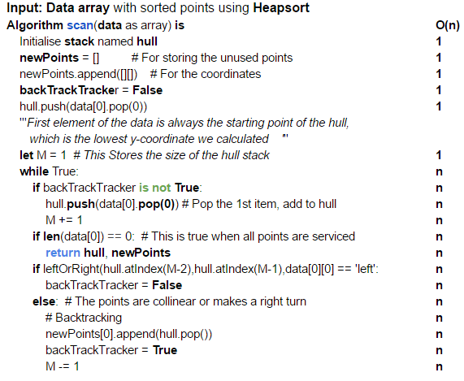
Convex Hull Time Complexity

Slide 13
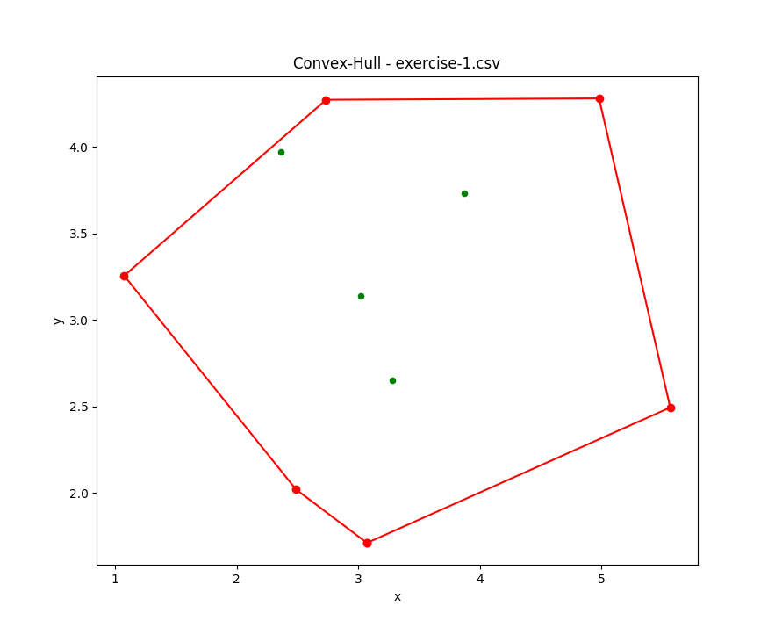
Convex Hull Solution to test exercise 1

Slide 14
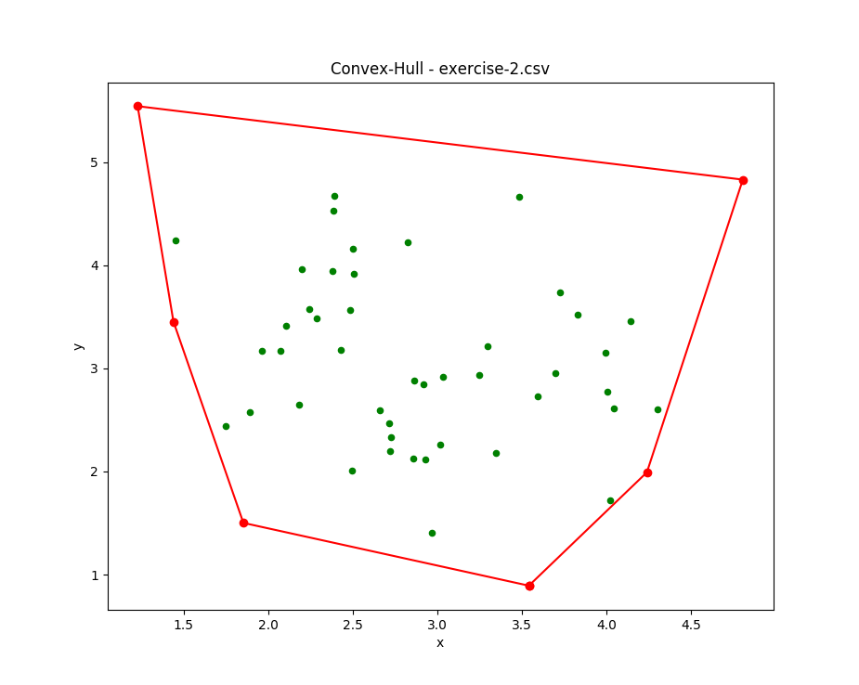
Convex Hull Solution to test exercise 2

Slide 15
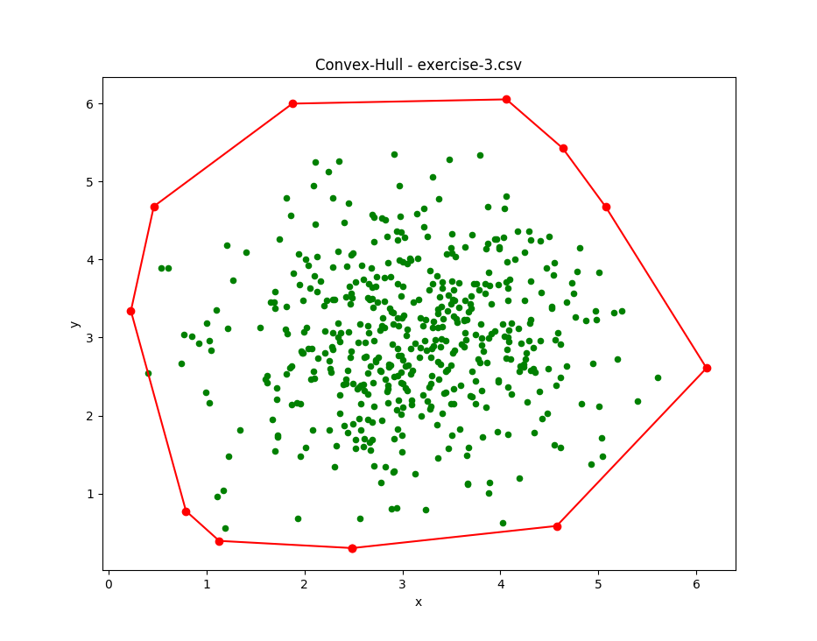
Convex Hull Solution to test exercise 3

Slide 16
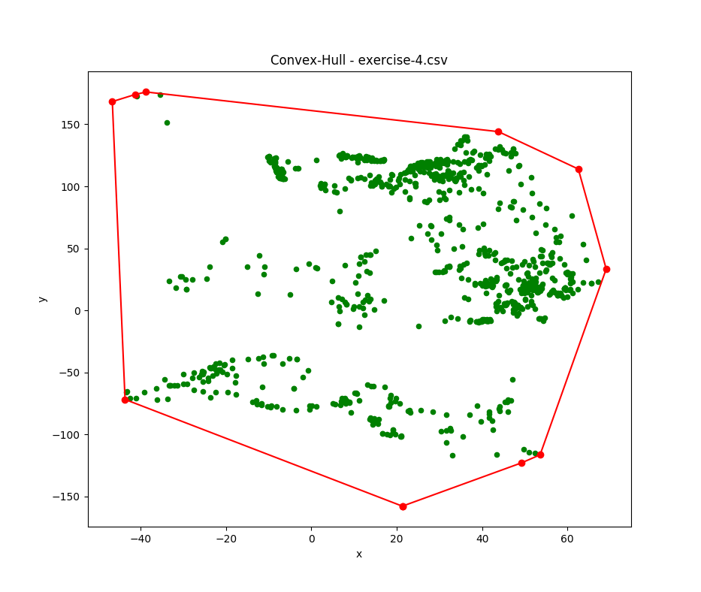
Convex Hull Solution to test exercise 4

Slide 17
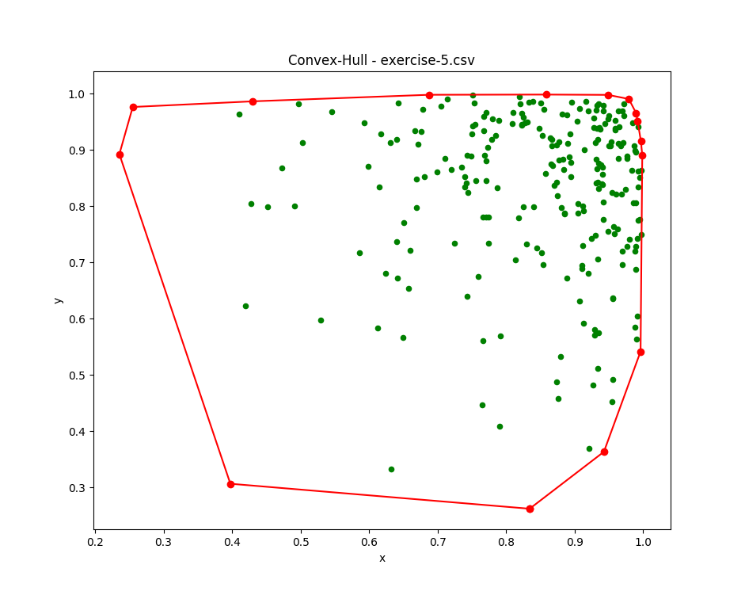
Convex Hull Solution to test exercise 5

Slide 18
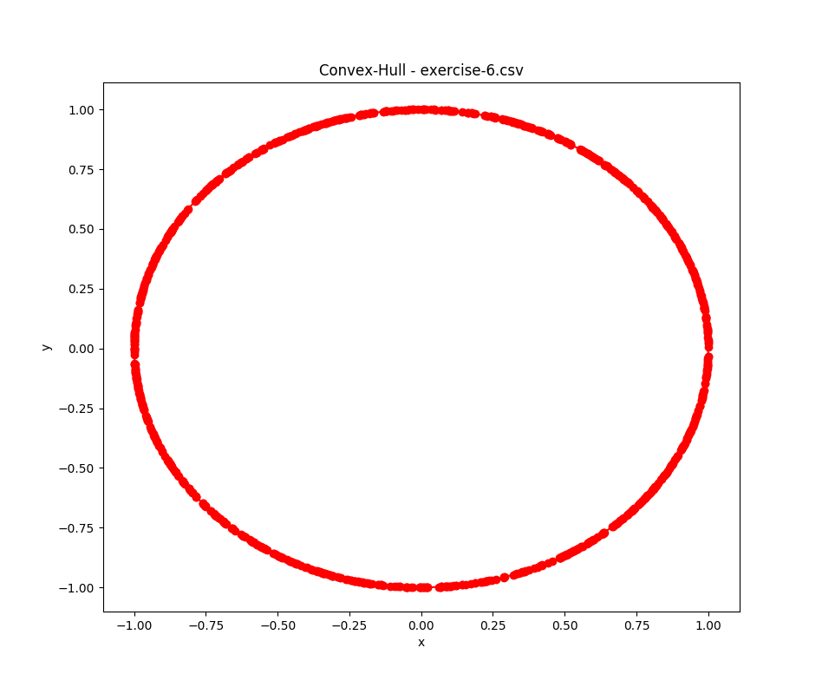
Convex Hull Solution to test exercise 6

Slide 19
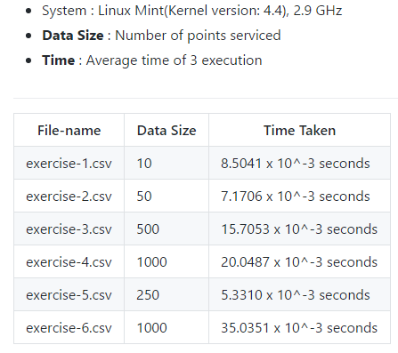
Convex Hull Performance and Analysis

Slide 20
FINITO

