Slide 1
AI & ML CONNECTED COMMUNITY CALL
FROM PROMPT
>
Make a 60-second launch video about agentic AI.
TO PREMIERE
Agentic video production with Slate
SCRIPT
SCENES
VOICE
RENDER
ISHAN BHATT / AUGUST 6, 2026
Notes:
Opening (30 seconds)
Start with the promise, not the architecture:
"Today I want to show you a different way to make video. Not a faster editor. An AI agent that can direct the production."
Pause on the title. Then: "And I will show it working, not just describe it."

Slide 2
THE PROBLEM
Video is not one task.
It is a relay race across specialized skills, tools, and approvals.
01
Story
02
Design
03
Voice
What is the point?
What should we see?
How should it sound?
04
Edit
05
Review
06
Deliver
How does it move?
Is it accurate and safe?
Can anyone reproduce it?
The bottleneck is not generation. It is orchestration.
AI & ML Connected Community Call
02
Notes:
Tell (2 minutes)
Ask for a show of hands: who has made a video for work in the last year?
The hard part is rarely a single model call. The hard part is coordinating a creative workflow where each step changes the next one.
Transition: "That is exactly the shape of problem agents are becoming good at."

Slide 3
WHY NOW
Four curves crossed.
Agentic video became practical when creation, orchestration, rendering, and governance matured together.
1
MULTIMODAL MODELS
Image, speech, transcription, and short video are callable tools.
2
CODING AGENTS
Agents can read files, run tools, inspect results, and iterate.
3
DETERMINISTIC RENDERING
HTML, GSAP, and headless capture make motion reproducible.
4
ENTERPRISE CONTROLS
Approval gates, cost limits, brand rules, and audit trails.
NOW
AI & ML Connected Community Call
03
Notes:
Tell (3 minutes)
Do not present this as "one magical model."
Emphasize the convergence:
1. Models produce useful raw material.
2. Coding agents can orchestrate real software.
3. Deterministic renderers turn plans into repeatable frames.
4. Governance makes the workflow usable for enterprise scenarios.

Slide 4
ORIGIN
Open-source spark. Enterprise reimagination.
Slate was inspired by the popularity and lessons of OpenMontage, created by the same author.
OPEN SOURCE
ENTERPRISE
OpenMontage
Slate
>
Proved the appetite for turning a coding assistant into a production studio.
Reimagined the patterns for Azure, brand governance, auditability, and human approval.
Clean-room implementation. No OpenMontage source code is used.
AI & ML Connected Community Call
04
Notes:
Tell (3 minutes)
Be precise about lineage:
- Same author.
- OpenMontage demonstrated community interest in agentic production.
- Slate is an independent, proprietary, clean-room implementation.
- Shared concepts were reimagined for Azure-native enterprise needs.
Reference: https://github.com/calesthio/OpenMontage

Slide 5
THE IDEA
Slate is an AI video director.
Not a single generator. Not a timeline editor. An agent coordinating a production.
1
2
3
4
5
6
7
BRIEF
SCRIPT
PLAN
ASSETS
COMPOSE
REVIEW
MP4
Intent
Story
Shots
Media
SCF
Quality
Delivery
Creative freedom inside each stage. Human control at every boundary.
AI & ML Connected Community Call
05
Notes:
Tell (2 minutes)
This is the mental model for the rest of the talk.
Slate externalizes production state to files and pauses at meaningful creative gates.
The workflow is structured; the content remains creative.

Slide 6
UNDER THE HOOD
Creative judgment on top. Deterministic machinery below.
DIRECTOR AGENT
Intent, research, script, art direction, decisions
SLATE ENGINE
Tools, capability registry, costs, trace, SCF compiler
CREATIVE SERVICES
Azure AI Foundry: image, speech, transcription, video
LOCAL PRODUCTION
HyperFrames + GSAP + headless Chrome + FFmpeg
INDEPENDENT REVIEWER
Validation, frame/audio inspection, governance
AI & ML Connected Community Call
06
Notes:
Tell (4 minutes)
Walk down the stack quickly.
Key distinction: generative models create some assets; local deterministic systems compose the final video.
SCF is the version-controllable recipe connecting creative decisions to rendering.
Independent review is a second agent, not the director grading its own homework.

Slide 7
LIVE DEMO
LET'S MAKE ONE.
WHAT WE WATCH
A product launch video from one prompt.
Brief -> script -> storyboard -> assets -> MP4
WHAT WE DECIDE
>
Create a 60-second launch video for a new AI product. Audience: developers. Tone: bold, credible, and cinematic. Show the workflow.
Audience, claims, pacing, visual treatment
WHAT WE MEASURE
Time, cost, quality, and where guidance enters
AI & ML Connected Community Call
07
Notes:
Demo (transition, 1 minute)
State the demo contract before leaving PowerPoint.
"I am going to use a deliberately short prompt. Watch where Slate acts autonomously, and where it asks me to make a judgment."
Keep this slide ready as the return point if the live demo has latency.

Slide 8
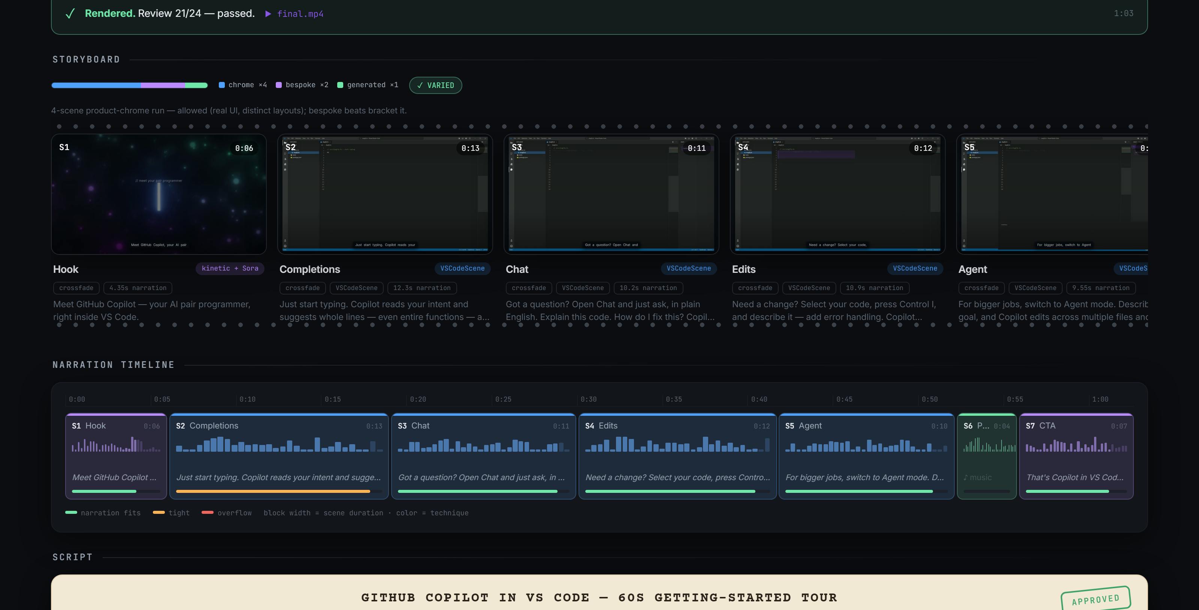
DEMO CHECKPOINT 1
The production becomes visible before it becomes expensive.
Soundstage turns files, decisions, timing, and approval gates into a living storyboard.
SEE THE PLAN
Script, scenes, narration, and costs are on the wall.
CATCH IT EARLY
Pacing and sameness issues appear before render.
APPROVE WITH INTENT
The agent waits at creative boundaries.
AI & ML Connected Community Call
08
Notes:
Demo backup / explanation (3 minutes)
If live: switch to Soundstage and point out the stage rail, script, scene wall, narration timing, decision trail, and cost.
If demo is delayed: use this screenshot and narrate the same flow.
Core point: chat describes intent; Soundstage displays production truth derived from disk.

Slide 9
DEMO CHECKPOINT 2
Generated does not mean guessed.
Slate routes each visual to the treatment that can represent it faithfully.
REUSE
CRAFT
GENERATE
PRODUCT CHROME
DESIGN VISUALS
GENERATED MEDIA
VS Code, terminal, Teams, Outlook, Azure Portal
Diagrams, charts, kinetic type, concept metaphors
People, places, illustration, cinematic motion
1
2
3
Rule of thumb: never ask an image model to draw exact code, UI, charts, or numbers.
AI & ML Connected Community Call
09
Notes:
Demo (3 minutes)
Explain routing while assets generate.
- Real product surfaces should be deterministic and reusable.
- Explanatory visuals should be art-directed and composed from primitives.
- Generative models are strongest for imagery and selected motion.
This is one of the most important "where it needs guidance" lessons.

Slide 10
DEMO CHECKPOINT 3
The director does not grade its own film.
A second agent reviews the final render across creative and technical dimensions.
OK
Brand compliance
OK
Caption accuracy
OK
Audio quality
OK
Visual consistency
OK
Pacing
OK
Content accuracy
OK
Redundancy
OK
Narration timing
If any dimension fails, Slate fixes, re-renders, and re-reviews before delivery.
AI & ML Connected Community Call
10
Notes:
Demo (2 minutes)
Show the review report if available.
Explain the two phases:
1. Pre-compose validation catches missing assets and timing errors.
2. Post-render review inspects the actual MP4.
Be candid: automated review reduces obvious failures; it does not replace human editorial judgment.

Slide 11
WHERE IT FITS
The sweet spot: repeatable video with real information.
Especially when accuracy, customization, and turnaround matter more than handcrafted cinema.
01
PRODUCT
02
ENGINEERING
03
ENABLEMENT
Feature reveals Release recaps Roadmaps
Architecture API explainers CLI demos
Onboarding Workflow training Policy updates
04
COMMUNICATION
05
CUSTOMER
06
OPERATIONS
Org updates Event recaps Executive briefs
Personalized demos Health summaries QBR videos
Incident reviews Audit evidence Status narratives
AI & ML Connected Community Call
11
Notes:
Tell (3 minutes)
Pick two examples relevant to the audience rather than reading all six.
Recommended examples:
- Architecture explainer from a design doc.
- Synthetic workflow demo without recording a real tenant.
- Release recap generated from notes or a deck.

Slide 12
HONEST SCORECARD
Where Slate shines. Where it still needs a director.
SHINES
NEEDS GUIDANCE
+
Turning structured source material into a coherent first cut
!
Choosing the strongest story and what to leave out
+
Synthetic product and workflow demos
!
Verifying factual claims and sensitive context
+
Consistent brand, captions, and narration
!
Judging taste, humor, emotion, and executive nuance
+
Fast variants, localization, and repeatable updates
!
Handling hero creative that demands bespoke craft
AI & ML Connected Community Call
12
Notes:
Tell (4 minutes)
This slide builds credibility. Do not rush it.
Slate is strongest when there is a clear source, defined audience, repeatable format, and a human willing to make editorial calls.
It is not a replacement for taste, accountability, or domain expertise.

Slide 13
GETTING STARTED
A production studio inside your coding environment.
Local rendering plus optional Azure-backed generation.
1
LOCAL
2
AGENT
3
AZURE
4
PROMPT
Python 3.11+ Node.js 24+ FFmpeg
VS Code + GitHub Copilot
Azure CLI + AI Foundry models
Audience + goal + duration + tone
Slate detects capability gaps and presents a setup plan before changing Azure resources.
AI & ML Connected Community Call
13
Notes:
Tell (2 minutes)
Keep prerequisites practical.
The local stack handles composition and rendering.
Azure services provide generated imagery, speech, transcription, and optional video.
No Azure resource should be created or changed without an explicit plan and approval.

Slide 14
RESOURCES
Explore the engine. Study the open-source inspiration.
1
SLATE
github.com/gim-home/SlateStudio
Code, architecture, use cases, components
FIRST PROMPT
"Turn this deck into a 60-second video for..."
2
OPENMONTAGE
github.com/calesthio/OpenMontage
Public open-source inspiration and examples
3
START HERE
README.md -> docs/EXAMPLE_USE_CASES.md
Then run setup.ps1 and describe a video
AI & ML Connected Community Call
14
Notes:
Tell (1 minute)
Invite people to explore the examples and begin with a small internal video.
Current positioning: Slate is in early development and intended for internal testing/showcasing; external use requires appropriate legal and governance review.

Slide 15
Q&A
THE FUTURE OF VIDEO
IS DIRECTED,
NOT JUST EDITED.
What would you ask an AI director to make?
ISHAN BHATT
Notes:
Close (30 seconds)
"The big idea is not that AI can generate a clip. It is that an agent can coordinate the full production while people retain creative and accountable control."
Open Q&A with: "What part of your current content workflow would you most want to turn into a repeatable production?"

