Slide 1
A broader question
BEYOND CODE
What else can an agent harness solve?
WORKSPACE
LIVE WEB
Files + project context
CODING HARNESS
Research current facts
Reason + act
inside a real workspace
LOCAL TOOLS
SUB-AGENTS
Run real applications
Delegate specialist work
HUMAN LOOP
Review · redirect · approve
ONE SUCH PROBLEM
Video production
creative · tool-heavy · multi-stage · reviewed
The rest of this talk is one answer.

Slide 2
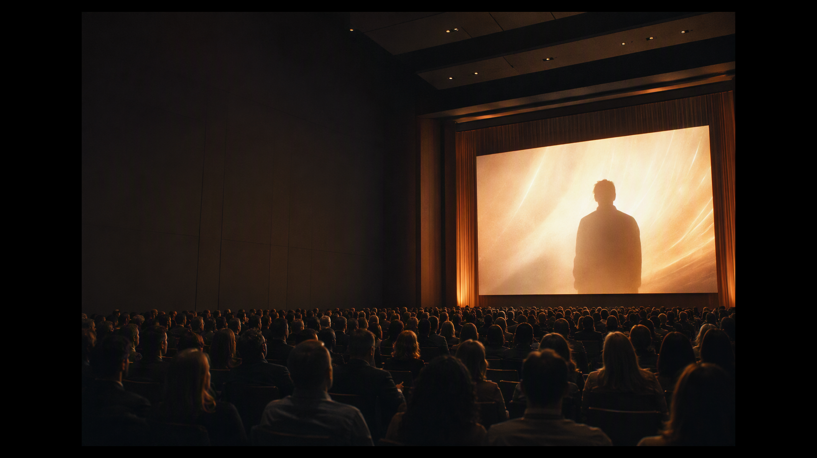
Why Slate?
Video stays with people.
Seen • Felt • Remembered • Shared
PMs
Engineers
Trainers
Leaders
Launches · roadmaps
Architecture · demos
Onboarding · readiness
Strategy · updates

Slide 3
The barrier
01
02
03
One video. Ten crafts.
Story
Craft
Finish
Script Scene plan
Narration Images + clips Motion graphics Animation Transitions
Music + captions Edit + render Web + mobile cuts
You
GitHub Copilot
Finished video
→
→
Creative head
Director
Web · mobile · stage

Slide 4
How Slate came about
Open Source Project. Same creator.
Inspired by
The question
OpenMontage
Why stop at creators?
World’s first open-source agentic video production system
Real-world need
+
Open-source signal
50K+
6.3K
GitHub stars
forks
PMs · Engineers · Trainers · Leaders
Viral across social media
Slate
github.com/calesthio/OpenMontage ↗
Agentic video for business

Slide 5
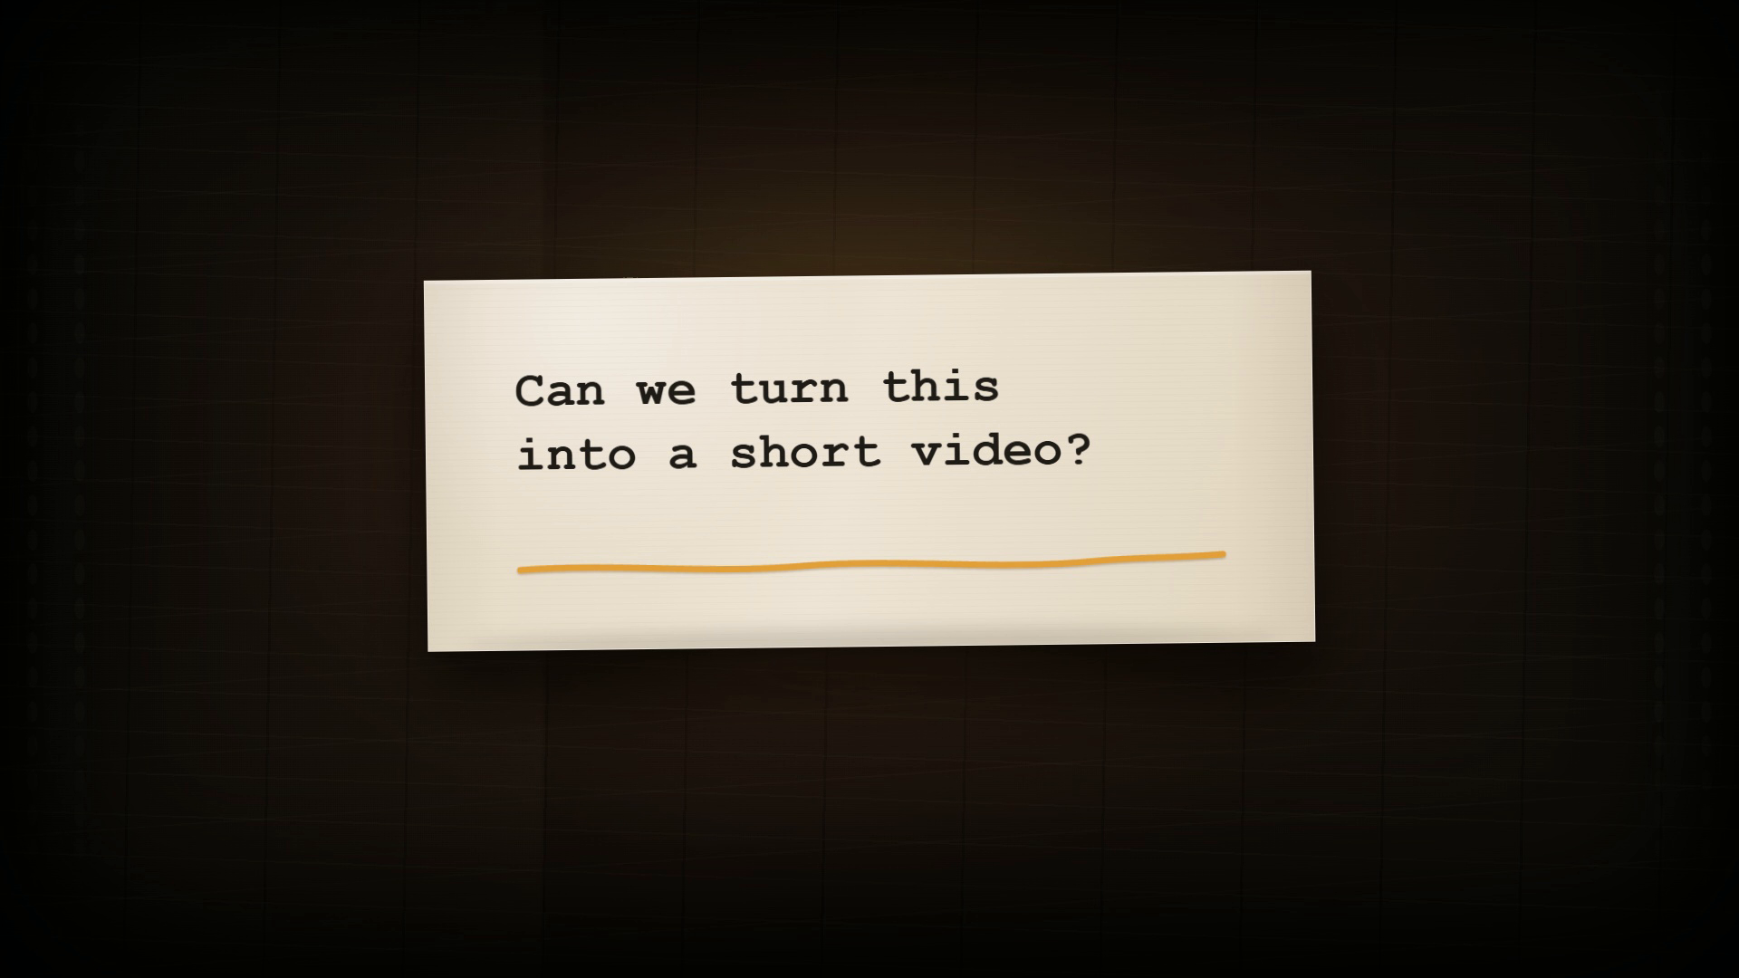

Slide 6
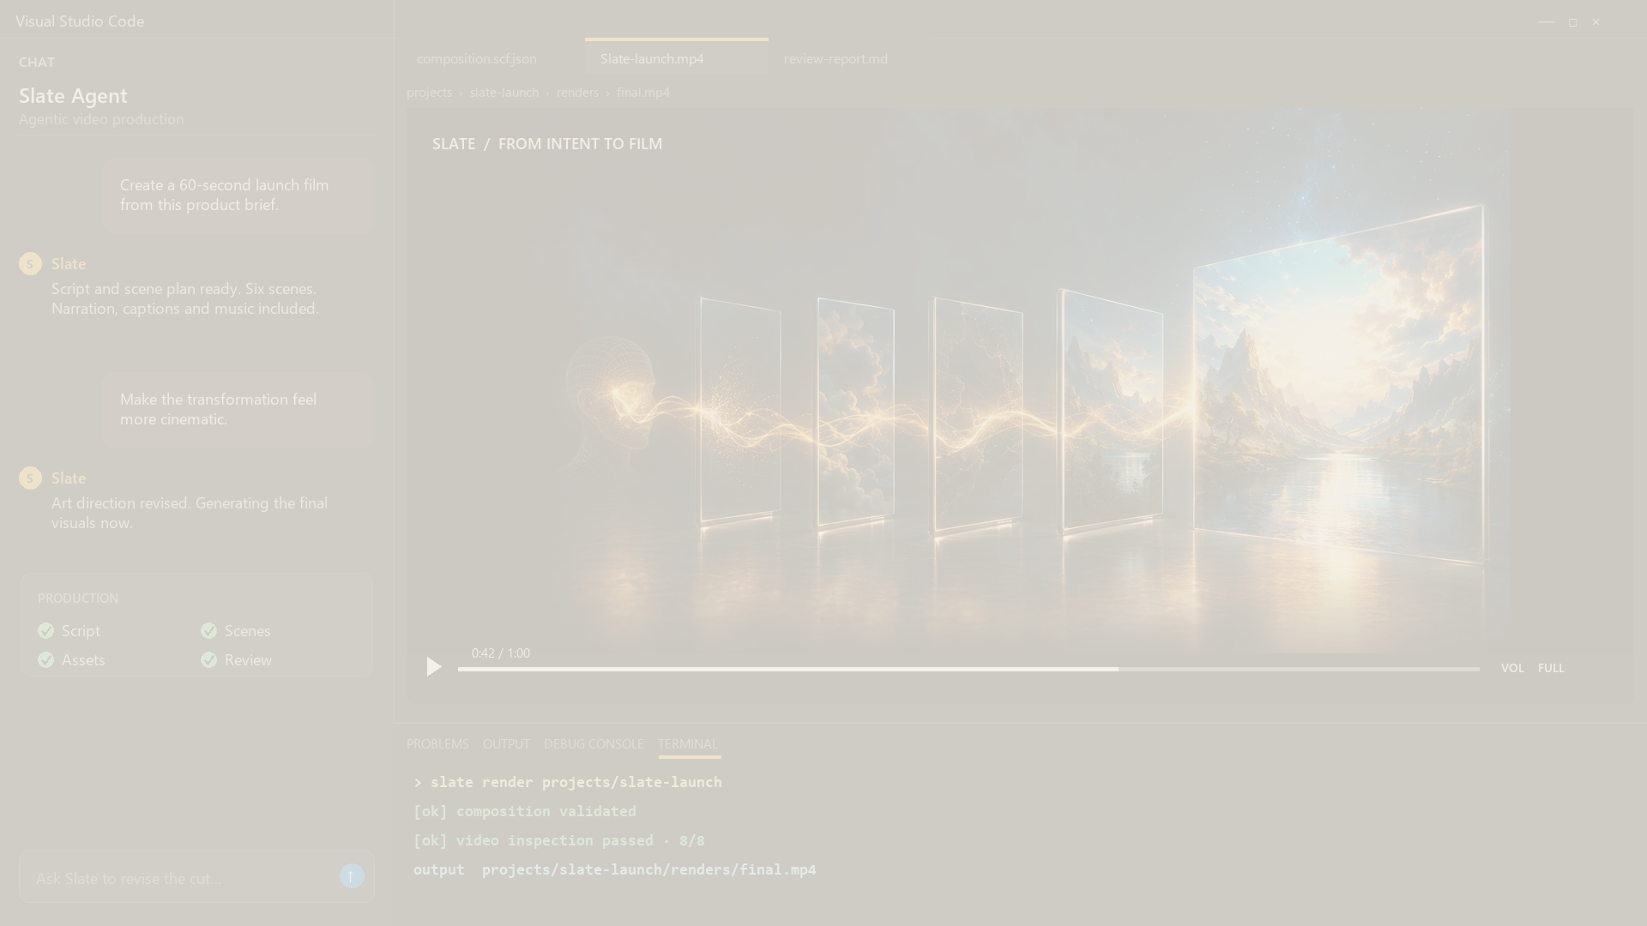
High-level architecture
From an idea to a reviewed video
Direct
Plan
Create
Assemble
Inspect
Deliver
You + Copilot
Research · script Scene plan
Images · video Voice · captions
Motion · music Edit
Quality review
Video
Azure AI Foundry
Inspection + review
Images · video Narration · captions
Video · audio Captions · brand
revise
Human approvals
Brand
Cost controls
Audit trail

Slide 7
The operating model
EASY
HARD
Creative freedom. Production discipline.
Tools + skills
End-to-end video
Agent creativity
Deterministic production
01
Meaning
What should this say?
S
✓
Facts verified
Sources captured
L
02
Emotion
What should it feel like?
✓
Direction approved
Human checkpoint
A
03
Story
How should it unfold?
✓
Assets present
Nothing imaginary
T
04
Visual world
How should it look?
E
✓
Timing valid
Audio fits the scene
05
Treatment
Which idea is strongest?
✓
Video inspected
Pass before delivery
No reliance on agent memory
Choices become visible · approved · checked · repeatable

Slide 8
Walkthrough

Slide 9
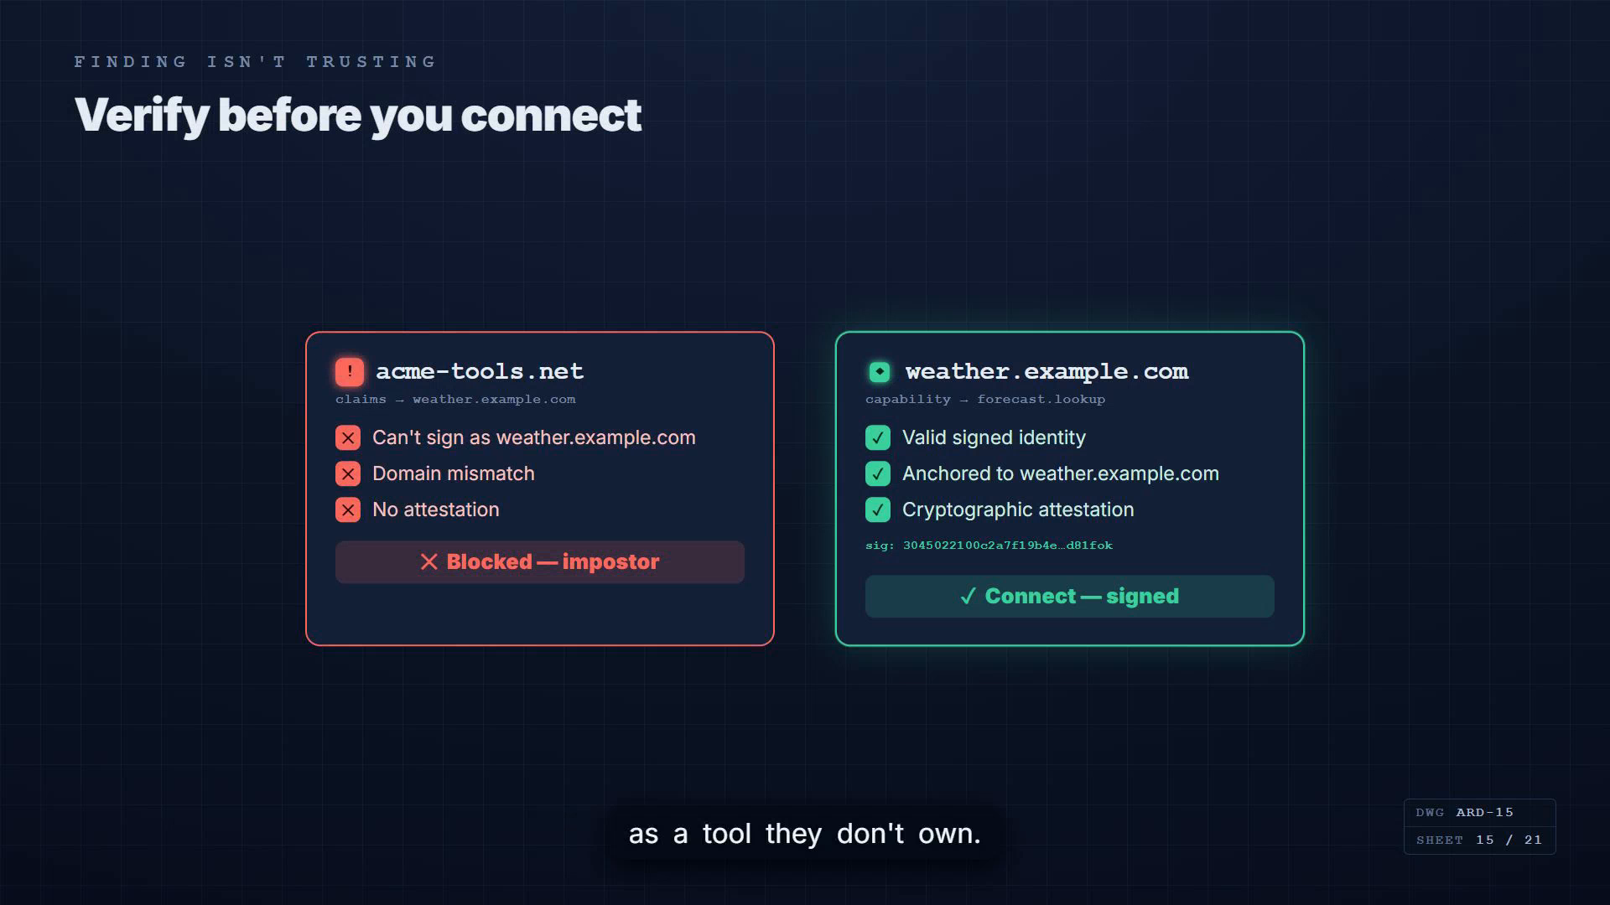
How durability works
The plan survives the conversation
One scene, three layers of evidence
01
02
03
Preserved artifacts
Scene blueprint
Rendered evidence
BRIEF
SCENE 04
Engineering leaders
PRODUCTION BLUEPRINT
APPROVED SCRIPT
Window
12.6 sec
Verify before you connect.
Voice
12.1 sec
SCENE PLAN
Visual
Trust reveal
Genuine green · Fake red
Motion
5 beats
DECISION
Next
Soft fade
Treatment approved
Media
All found
TIMING
MEDIA
INSPECTION
PASS
PASS
PASS
READY TO RENDER
Resume
Revise
Reproduce
without the original agent or chat history

Slide 10
SLATE TODAY
Current Operating Realities
01
02
03
PROJECT
AZURE AI FOUNDRY
A project, not yet a product
Azure infrastructure required
Production takes time
Built for exploration and extension, not turnkey adoption.
Foundry resources and model deployments power generated media and speech.
Advanced models, video generation, and rendering can take several minutes.
Clear expectations make the experiment stronger.
09

Slide 11
NEXT STEPS
Get started today
Four ways into the project
START
Point Copilot or your coding agent to the repository and ask it to set up the workspace.
01
Clone SlateStudio
Open repository →
WATCH
See complete examples created through the Slate production workflow.
02
Some reference videos made using Slate
View videos →
JOIN
Connect with the Slate community for questions, updates, and production notes.
03
General | Slate
Open Teams channel →
OFFICE HOURS
Bring a project, a production question, or simply watch Slate work.
04
Every Wednesday · 11:00 AM PST
Join office hours →
SLATE
11

