Slide 1

Web-Scraping
Chao Wang, Justin Lee, Michelle Fairow

Slide 2


Overview: know your connections

Slide 3
Features
We don’t store username or password
We can work with 1 ~ 100 connections
We make the scraping process observable
Interactive output

Slide 4
Web-Scraping Methods
RSelenium: Use of Selenium server/remote driver to log in and navigate LinkedIn in R
PhantomJS: Headless browser; PhantomJS scripts executed in R to save page content as “Page.html”
remDr$navigate(URL[[i]]) Sys.sleep(3) remDr$phantomExecute("var page = this; var path = 'Page.html'; var fs = require('fs'); var content = page.content; fs.write(path,content,'w') ");

Slide 5
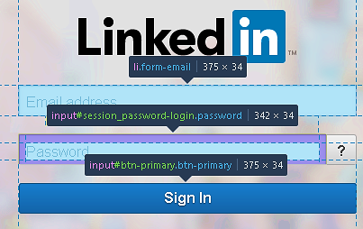
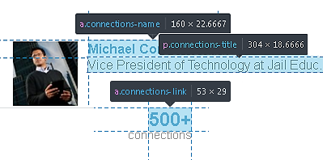
Web-Scraping Methods
rvest: Extracted information from “Page.html” file using ID, class, etc., or using pseudo CSS selectors
remDr$findElement(using = "id", "session_key-login") remDr$findElement(using = "id", "session_password-login") remDr$findElement(using = "id", "btn-primary")

Slide 6

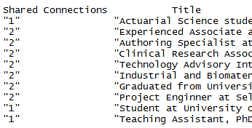

Web-Scraping Results
Connection’s name, job, and page URL
Connection education, experience, industry, and number of connections
People you may know: title and number of shared connections

Slide 7
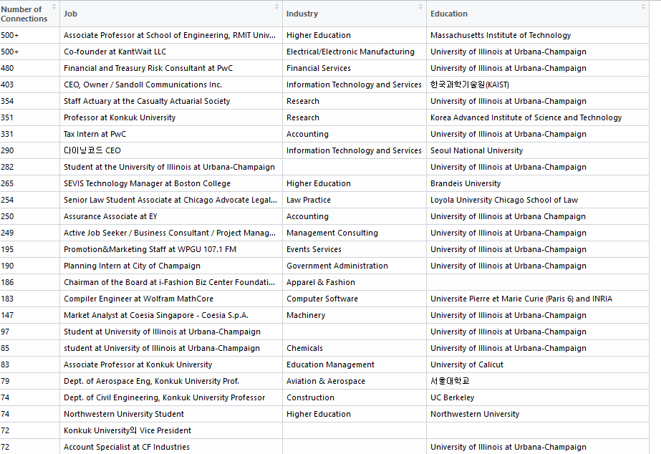
Output: Connection Data.frame
Features:
Number of Connections, Job, Industry, Education
Observations:
Number of User’s Connections
Sorted by:
Number of Connections

Slide 8
Output: Word Cloud
tm: do text mining
wordcloud: generate word cloud
RColorBrewer: generate colorful word cloud

Slide 9


Justin’s Connections

Slide 10
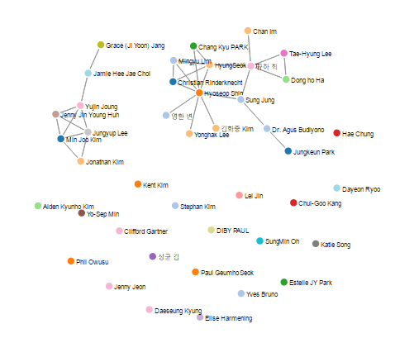
Output: Possible Improvements
Recommendation System
Network Web
library(ggplot2)
Barplot
Piechart
library(igraph)
adjacency list

Slide 11
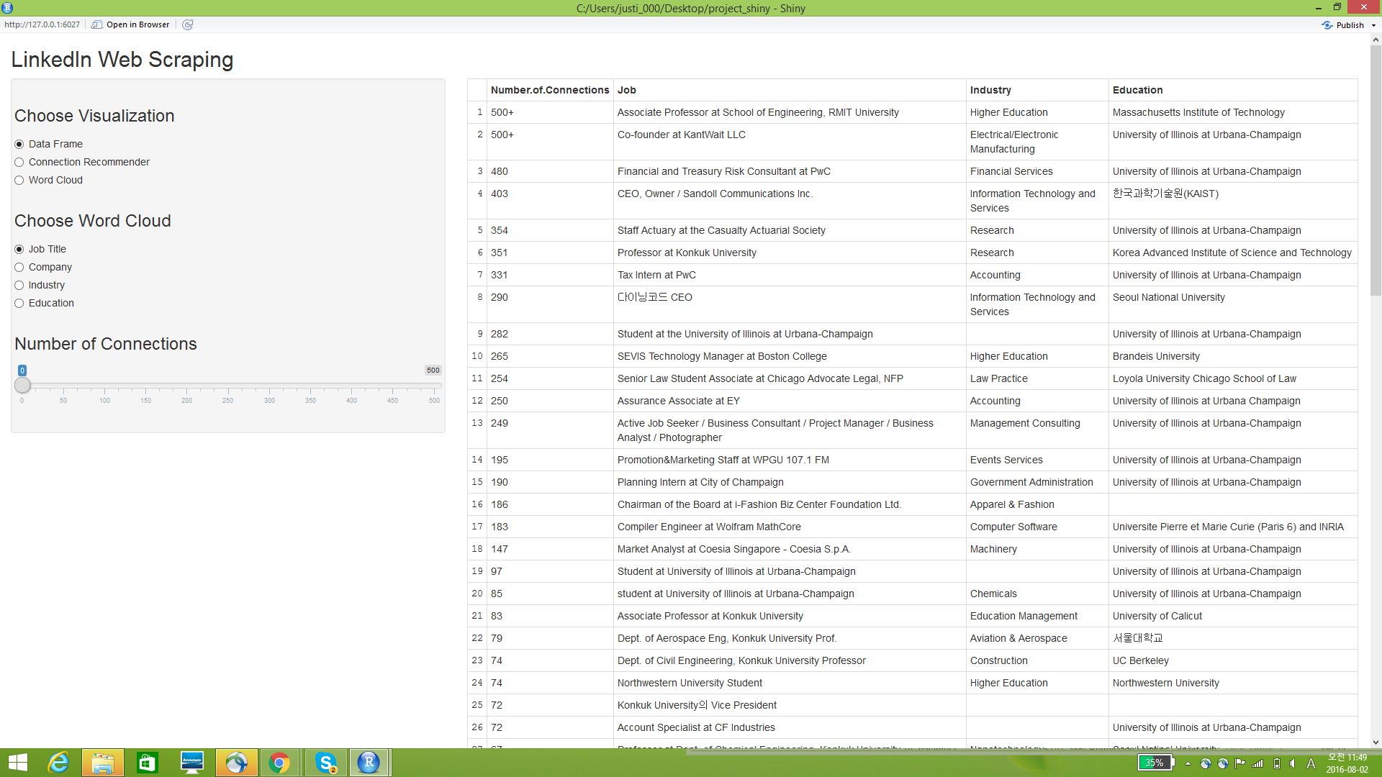
Output: Shiny
After running functions
(Saves files in wd)

Slide 12
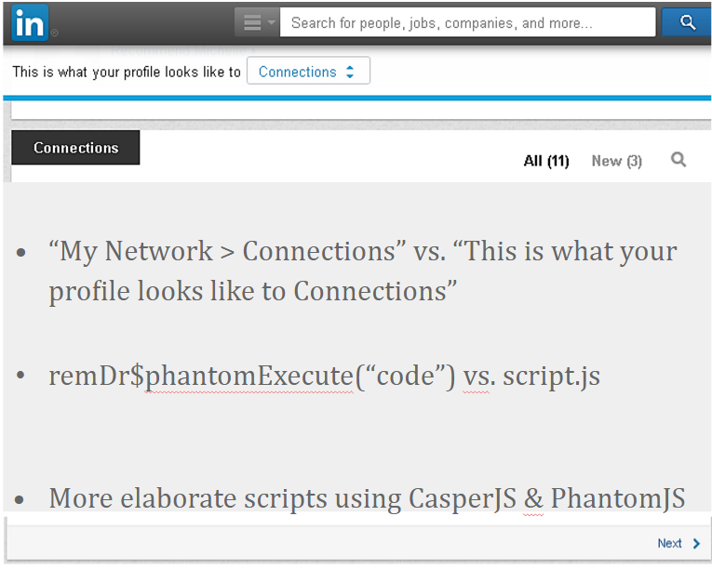
Obstacles
RSelenium & Phantomjs
Other Issues
Connections of Connections
Extremely Long Runtime
Interactively Sharing Code
Comprehending a variety of new packages
“igraph”, "rvest", "RSelenium", "ggplot2", "grid", "dplyr", "tm", "SnowballC", "wordcloud", "RColorBrewer"
“My Network > Connections” vs. “This is what your profile looks like to Connections
remDr$phantomExecute(“code”) vs. script.js
More elaborate scripts using CasperJS & PhantomJS
But with struggle, came knowledge...

Slide 13
References
PhantomJS
RSelenium basics
rvest
wordcloud
tm
RColorBrewer
Ggplot2
Igraph
Shiny
LinkedIn

