Slide 1
ADK

Slide 2
Installation
\\winbuilds\release\<branch>\<build>\Other\kit_bundles\adk adksetp.exe
Installed to directory "%ProgramFiles(x86)%\Windows Kits\10\Assessment and Deployment Kit\Windows Assessment Toolkit"
Basic Framework is under following subdirectories - amd64 arm arm64 x86 universal legacy
Other subdirectories is for different assessments.
One asmtx for one assessment.
One job could include multiple assessments

Slide 3
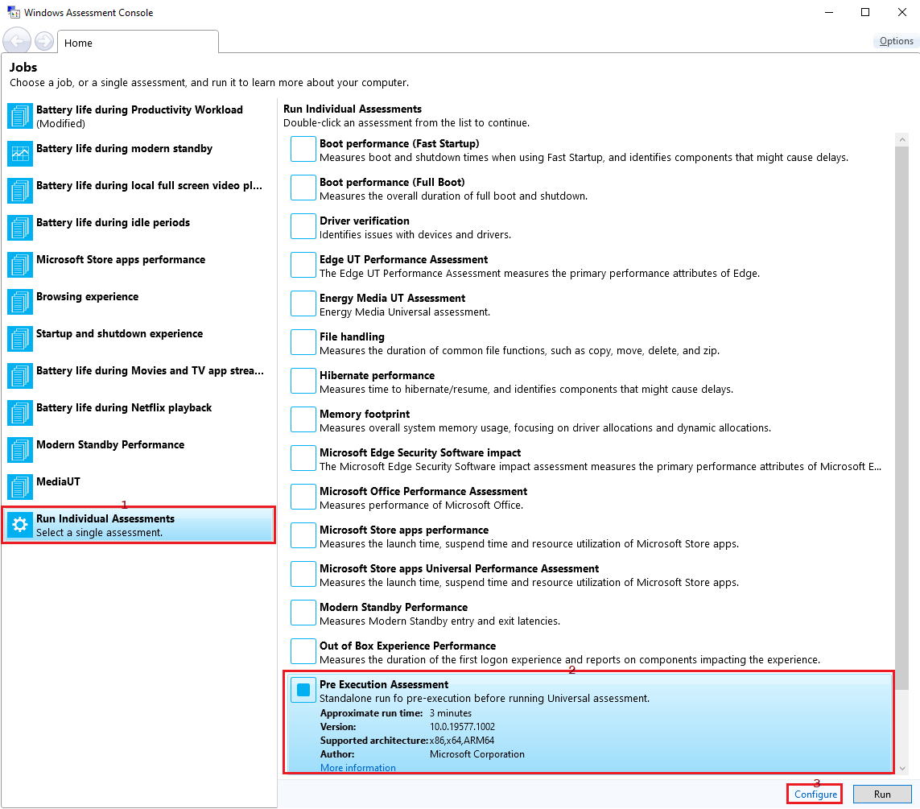
Job - select assessment(s)

Slide 4
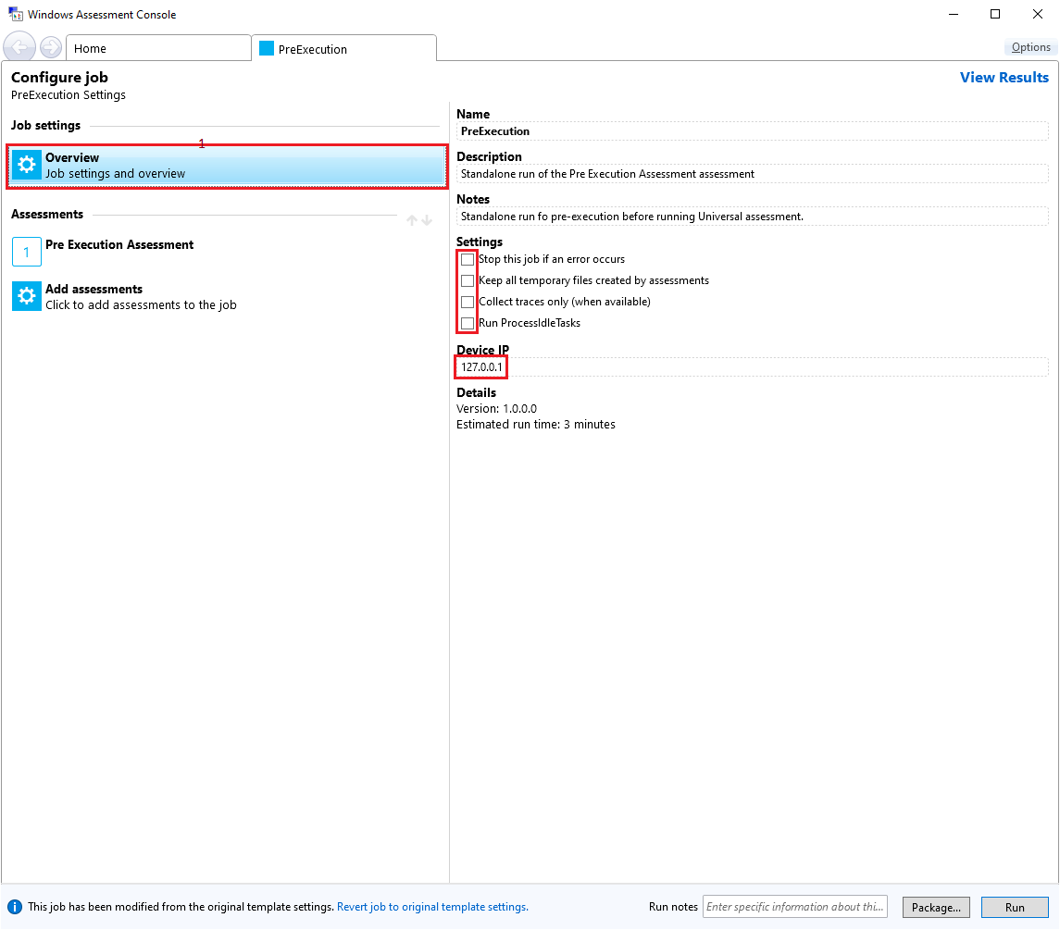
Job – job settings

Slide 5
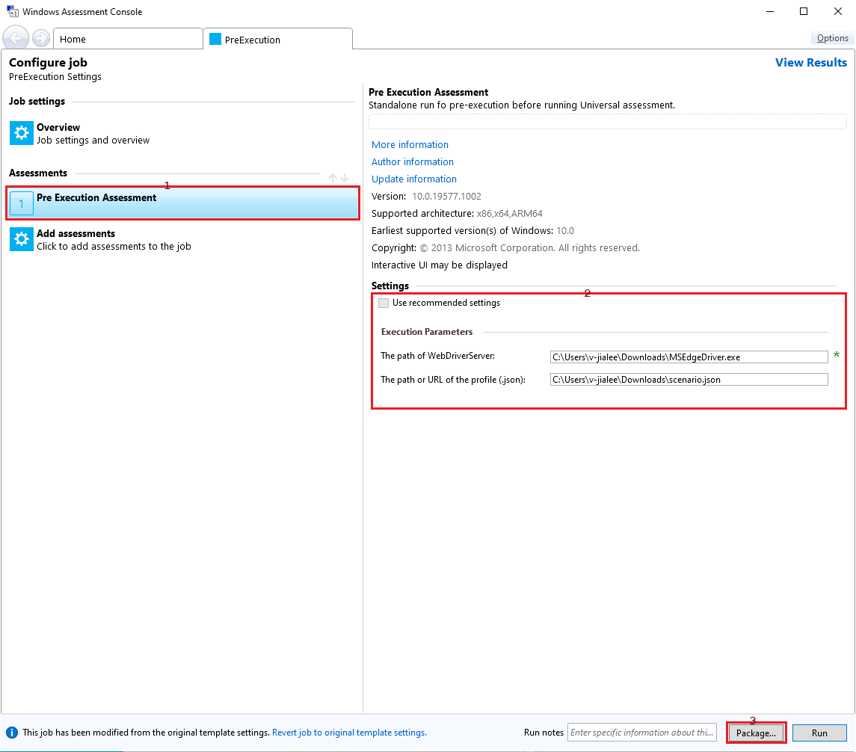
Job – assessment settings & package

Slide 6
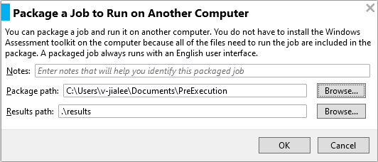
Job – package

Slide 7
Job.xml
The Job.xml is composed from .asmtx of different assessemnts. You can find different .asmtx under subdirectories of "%ProgramFiles(x86)%\Windows Kits\10\Assessment and Deployment Kit\Windows Assessment Toolkit"
<AxeJobManifest> <JobParameters> </JobParameters> <AssessmentManifests> <AxeAssessmentManifest> … … <ApplicationName>%SystemRoot%\SysWOW64\WindowsPowerShell\v1.0\powershell.exe -ExecutionPolicy bypass -Command .\PreExecution.ps1</ApplicationName> </AxeAssessmentManifest> </AssessmentManifests> <AssessmentRuns> <AssessmentRun> <ParameterValues> <ParameterValue> <ProgrammaticName>WebDriverServer</ProgrammaticName> <Value>C:\Users\v-jialee\Downloads\msedgedriver.exe</Value> </ParameterValue> <ParameterValue> <ProgrammaticName>BrowsingProfile</ProgrammaticName> <Value>C:\Users\v-jialee\Downloads\scenario.json</Value> </ParameterValue> </ParameterValues> <CommandLine>-WebDriverServer "C:\Users\v-jialee\Downloads\msedgedriver.exe" -BrowsingProfile "C:\Users\v-jialee\Downloads\scenario.json"</CommandLine> </AssessmentRun> </AssessmentRuns> </AxeJobManifest>
你可以修改<AxeJobManifest>/<JobParameters>中的值來變更job settings。可以修改<AxeJobManifest>/<AssessmentRuns>/<AssessmentRun>綠色部分來變更assessment settings

Slide 8
Debug from Powershell
A package job is started from RunJob.cmd, please check this file.
If not ARM, start "" "%~dp0%PROCESSOR_ARCHITECTURE%\AXE.exe" "%~dp0Job.xml“
If ARM, start "" "%~dp0%PROCESSOR_ARCHITECTURE%\AL.exe" "%~dp0Job.xml"
If powershell.exe under <AxeAssessmentManifest>/<ApplicationName> of job.xml has <CreateNoWindow/>, you can remove it to show powershell script console.
Change the .ps1 from $debugFlag = $false to $debugFlag = $true, the script will pause for reading key before the .ps1 terminated.
%SystemRoot%\SysWOW64\WindowsPowerShell\v1.0\powershell.exe == SysWOW64 32-bit powershell.exe
%AssessmentSystemPath%\WindowsPowerShell\v1.0\powershell.exe == architecture dependent powershell.exe on x86 == 32-bit x86 powershell.exe on x64 == 64-bit amd64 powershell.exe on ARM64 == 32-bit x86 powershell.exe (with <AxeAssessmentManifest>/<Properties>/<RequiresX86EmulationOnArm>)

Slide 9
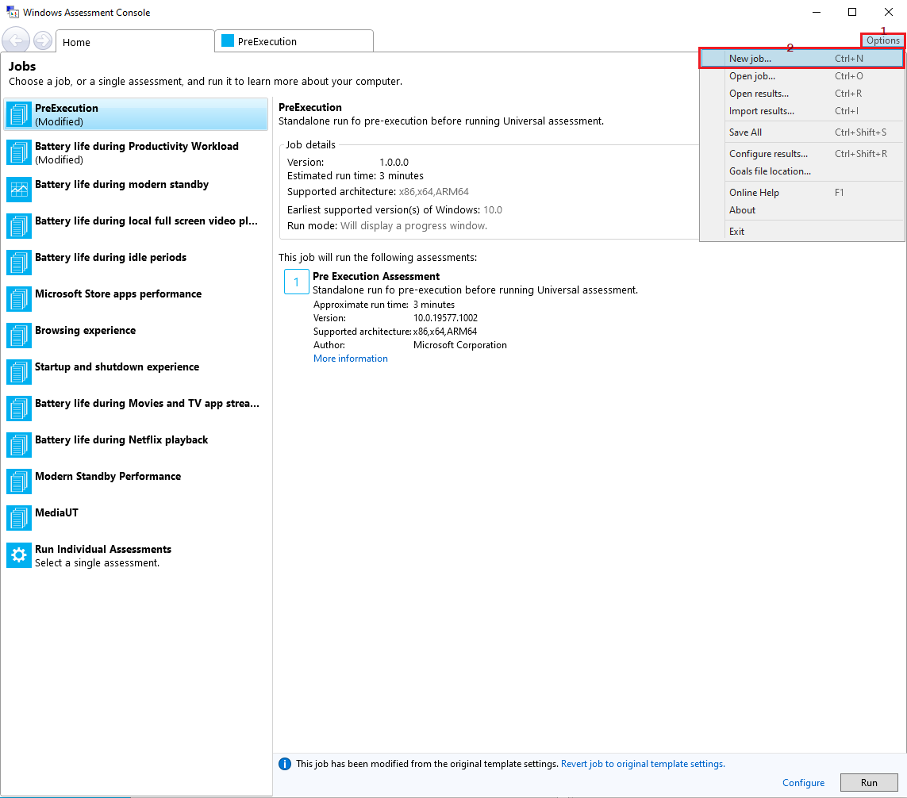
Energy Job

Slide 10
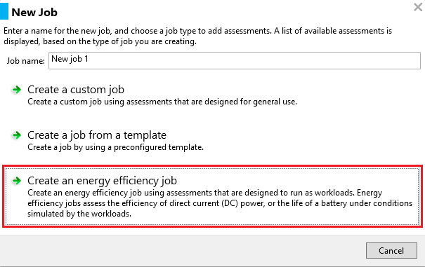
Energy Job – and job settings

Slide 11
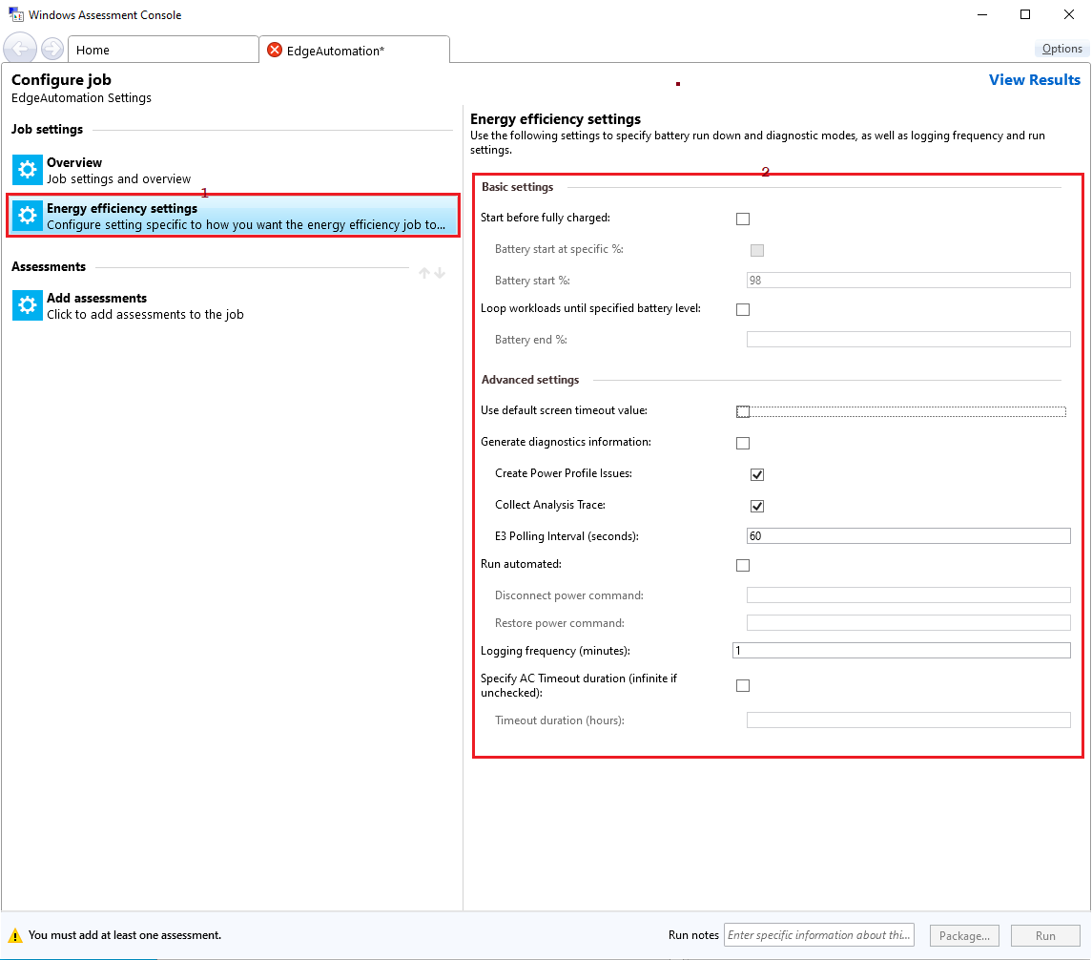
Energy Job – energy settings

Slide 12
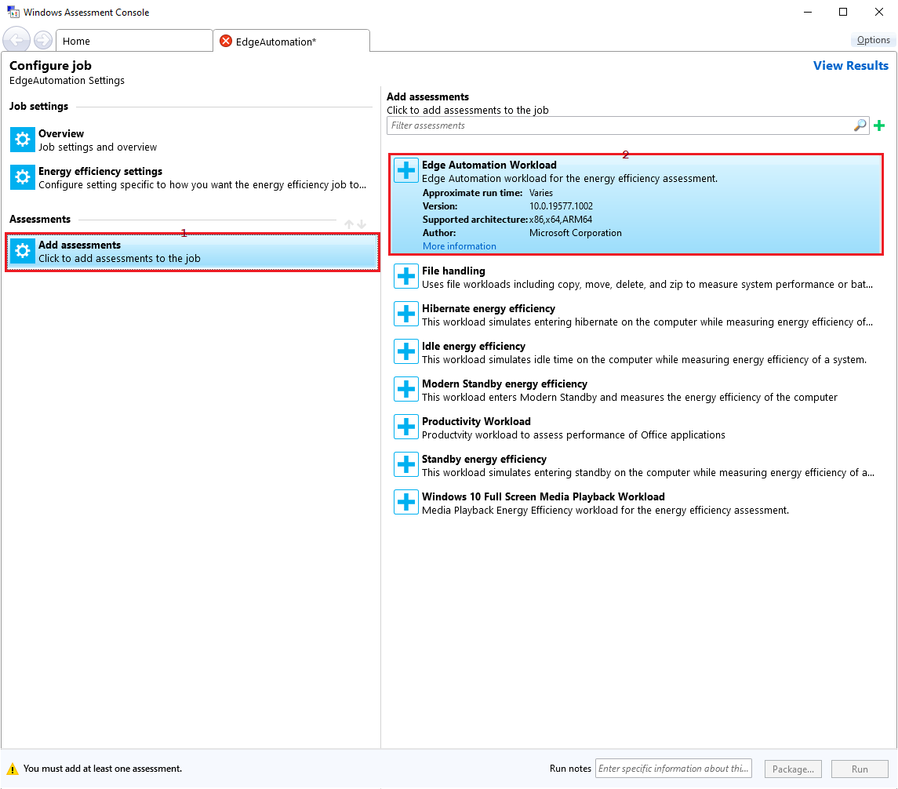
Energy Job – add assessments (workload)

Slide 13
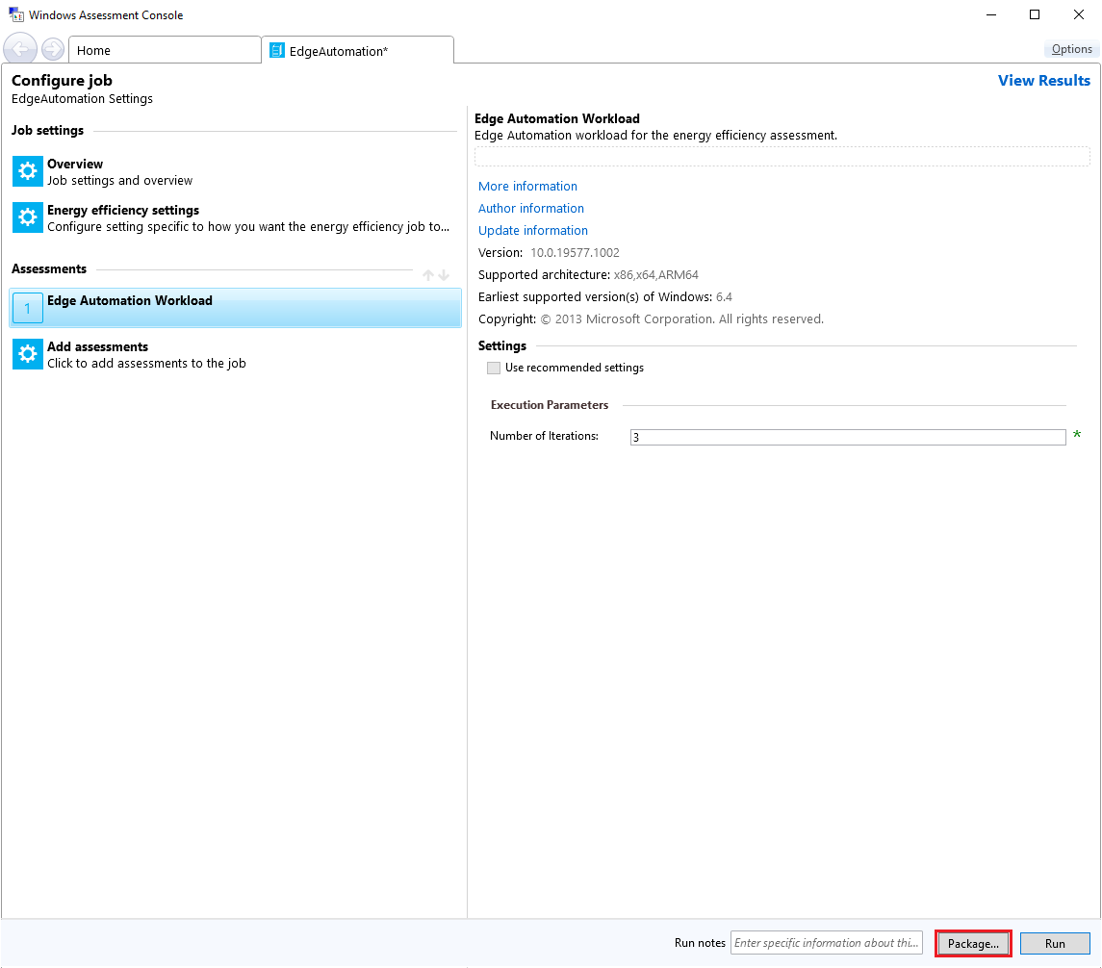
Energy Job – assessment setting & package

Slide 14

Energy Job – package

Slide 15
Job.xml of Energy
<AxeJobManifest>/<AssessmentManifests>/<AxeAssessmentManifest> 中第一個<AxeAssessmentManifest>是與energy.exe相關的。第二個以後的<AxeAssessmentManifest>才是你加入的assessment(或是workload)。
<AxeJobManifest> <JobParameters> </JobParameters> <AssessmentManifests> <AxeAssessmentManifest> … … <ApplicationName>%PROCESSOR_ARCHITECTURE%\Energy.exe /ExecuteOnly /Job “%AssessmentJobFile%” /RunIndex 0 /Temp “%AssessmentTempPath%” /Results “%AssessmentResultsPath%” /AxeCore “%AssessmentAxeBinPath%\axecore.dll”</ApplicationName> … … <ApplicationName>%PROCESSOR_ARCHITECTURE%\Energy.exe /mode 3 /AnalysisOnly /ExecutionPath %AssessmentExecutionPath% /RunIndex 0 /Temp “%AssessmentTempPath%” /Results “%AssessmentResultsPath%” /AxeCore “%AssessmentAxeBinPath%\axecore.dll”</ApplicationName> </AxeAssessmentManifest> <AxeAssessmentManifest> … <ApplicationName>%AssessmentSystemPath%\WindowsPowerShell\v1.0\powershell.exe -ExecutionPolicy bypass -Command .\EdgeAutomation.ps1</ApplicationName> </AxeAssessmentManifest> </AssessmentManifests> … </AxeJobManifest>
你可以修改<AxeJobManifest>/<JobParameters>中的值來變更job settings。

Slide 16
Job.xml of Energy
<AxeJobManifest> … <AssessmentRuns> <AssessmentRun> <ParameterValues> … <ParameterValue> <ProgrammaticName>DiagMode</ProgrammaticName> <Value>False</Value> </ParameterValue> <ParameterValue> <ProgrammaticName>Logging</ProgrammaticName> <Value>1</Value> </ParameterValue> </ParameterValues> <CommandLine>/Diag /LogFreq 1</CommandLine> … </AssessmentRun> </AssessmentRuns> </AxeJobManifest>
可以修改<AxeJobManifest>/<AssessmentRuns>/<AssessmentRun>綠色部分來變更energy.exe settings

Slide 17
Job.xml of Energy
<AxeJobManifest> … <AssessmentRuns> <AssessmentRun> … <AssessmentRuns> <AssessmentRun> <ParameterValues> <ParameterValue> <ProgrammaticName>Iterations</ProgrammaticName> <Value>3</Value> </ParameterValue> </ParameterValues> <CommandLine>-Iterations 3</CommandLine> … </AssessmentRun> </AssessmentRuns> </AssessmentRun> </AssessmentRuns> </AxeJobManifest>
可以修改<AxeJobManifest>/<AssessmentRuns>/<AssessmentRun>/<AssessmentRuns>/<AssessmentRun>銘黃色部分來變更workload settings

Slide 18
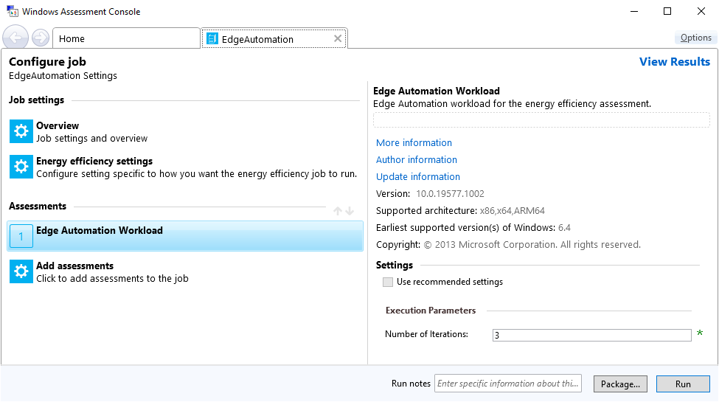
Workload of Energy
在 .asmtx 檔案中 <AxeJobManifest>/<Properties>/<JobKind> 是 <BatteryLife/> 的才是 energy.exe 的 workload。

Slide 19
Workload of Energy
EdgeAutomation.asmtx … <ParameterDefinitions> <ParameterDefinition> <Description> <ProgrammaticName>Iterations</ProgrammaticName> <DisplayName>Number of Iterations</DisplayName> <ToolTip>Specify the number of iterations the assessment should perform. Default value is 3.</ToolTip> <Categories> <Category>Execution Parameters</Category> </Categories> </Description> <Type> <Int32/> </Type> <Inclusion> <Required/> </Inclusion> <DefaultValue>3</DefaultValue> <Constraints> <MinimumConstraint>1</MinimumConstraint> <MaximumConstraint>20</MaximumConstraint> </Constraints> <CommandLineFormat>-Iterations {0}</CommandLineFormat> </ParameterDefinition> </ParameterDefinitions>

Slide 20
.asmtx of Energy
EdgeAutomation.asmtx … <Execution> <CreateProcess> <ApplicationName>%AssessmentSystemPath%\WindowsPowerShell\v1.0\powershell.exe -ExecutionPolicy bypass -Command .\EdgeAutomation.ps1</ApplicationName> </CreateProcess> </Execution>

Slide 21
Development environment
https://osgwiki.com/ search “install tools”
Install GVFS and Git
Install WAVE
Clone the os repro
Git International
Southeast Asia / Taiwan
Check Git Branch - official/rs_fun_phdi1_dev01
Favorite the branch
Checkout the branch
Create a topic branch
https://osgwiki.com/ search “Razzle.cmd” Run Razzle

Slide 22
Decide Windows Performance Tool needed files
Run Job to collect performance data
Please collect
etl
regions.xml
wpaProfile
RawPerformanceDataMapping.xml
Post process script is in the universal\cabs\amd64\Microsoft.Windows.Performance.Winperf.External.cab
Extract the post process files
WPT is from \\winbuilds\release\<branch>\<build>\Other\kit_bundles\wpt\Installers\*.msi For example, \\winbuilds\release\RS_PRERELEASE\19615.1000.200421-1420\Other\kit_bundles\wpt\Installers\
msiexec /a <pathToMsiFile> /qb TARGETDIR=<pathToTargetFolder>
We expand WPT from the msi and remove unneeded file one by one

