Slide 1
ADK

Slide 2
安裝
\\winbuilds\release\<branch>\<build>\Other\kit_bundles\adk adksetp.exe
Installed to directory "%ProgramFiles(x86)%\Windows Kits\10\Assessment and Deployment Kit\Windows Assessment Toolkit"
Basic Framework is under following subdirectories - amd64 arm arm64 x86 universal legacy
Other subdirectories is for different assessments.
One asmtx for one assessment.
One job could include multiple assessments

Slide 3
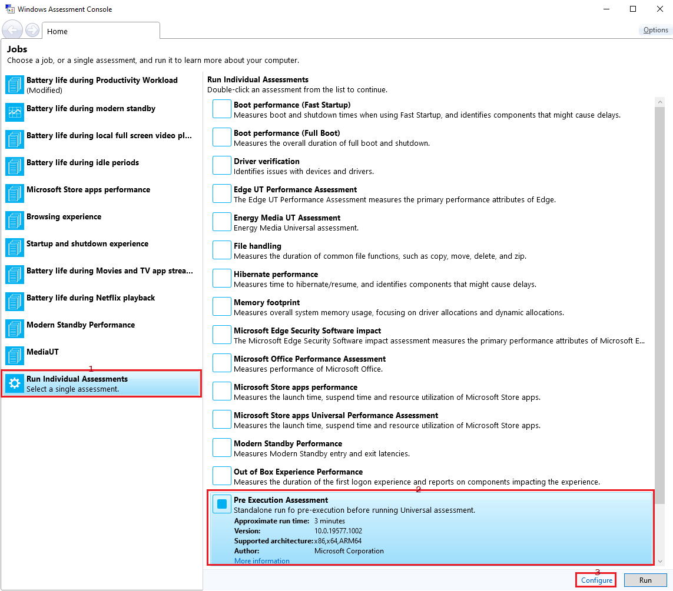
Job - select assessment(s)

Slide 4
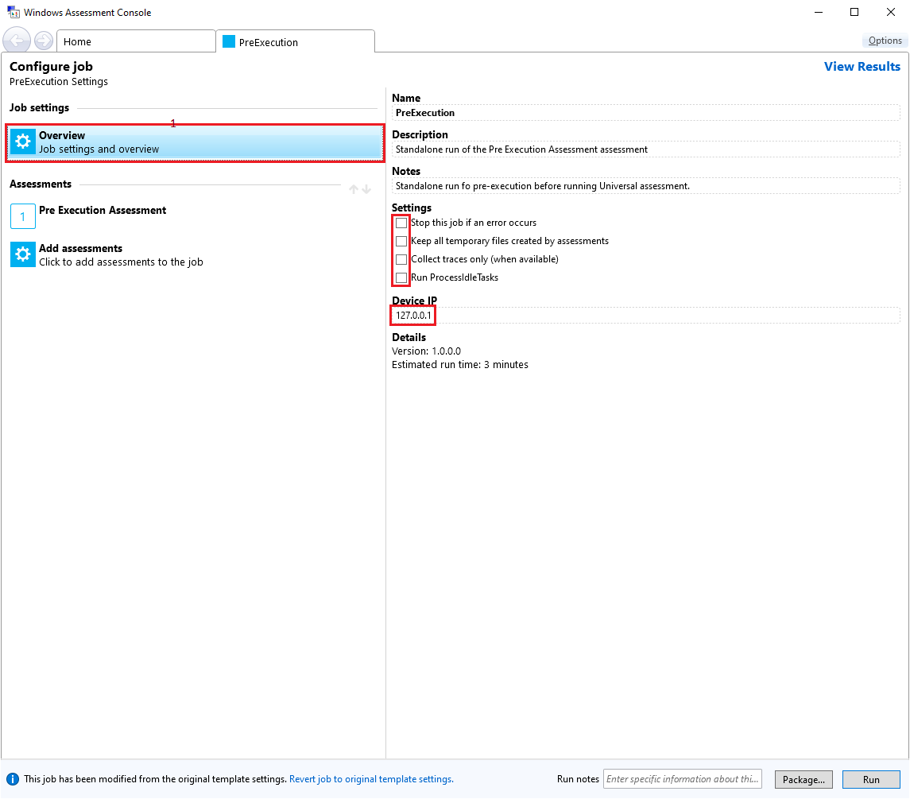
Job – job settings

Slide 5
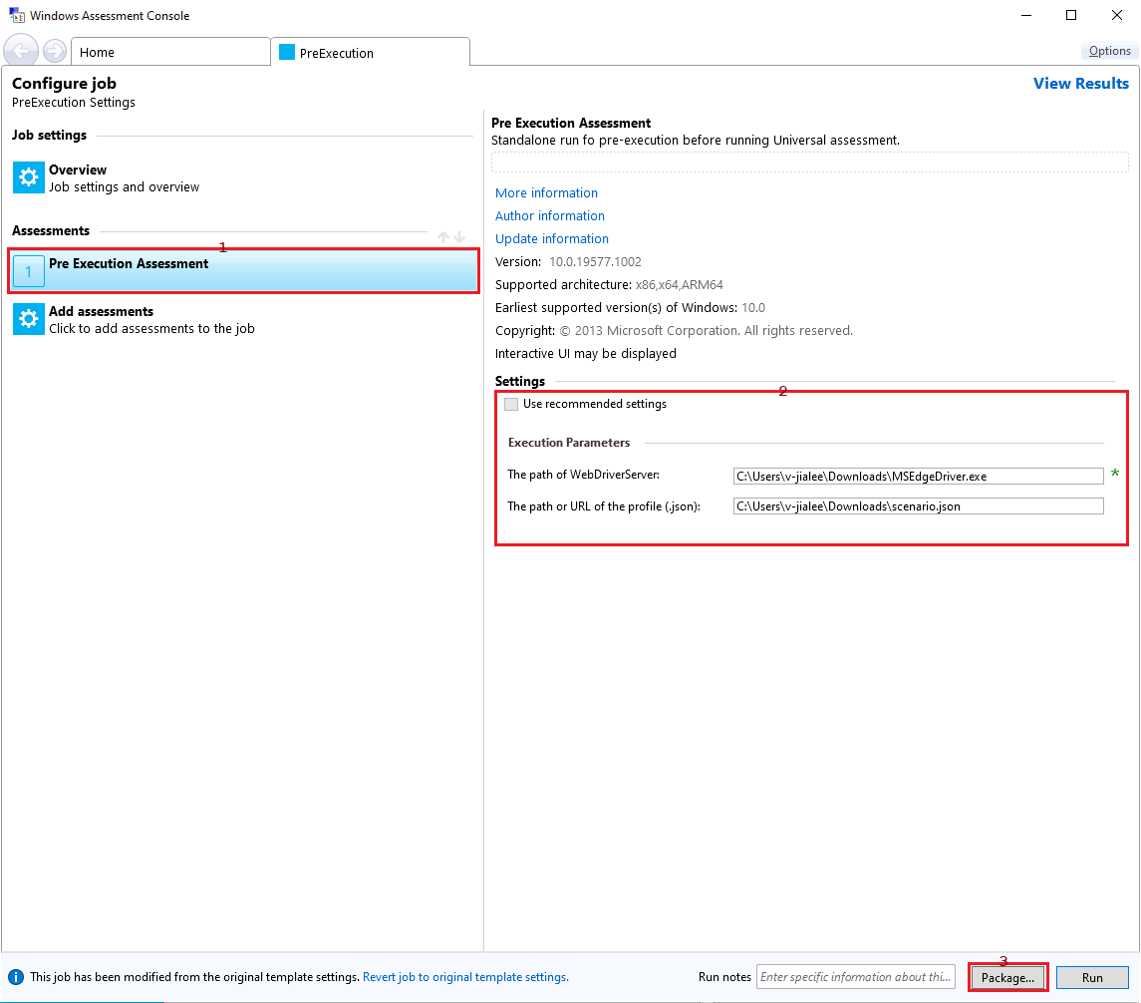
Job – assessment settings & package

Slide 6
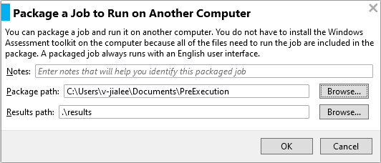
Job – package

Slide 7
Job.xml
The Job.xml is composed from .asmtx of different assessemnts. You can find different .asmtx under subdirectories of "%ProgramFiles(x86)%\Windows Kits\10\Assessment and Deployment Kit\Windows Assessment Toolkit"
<AxeJobManifest> <JobParameters> </JobParameters> <AssessmentManifests> <AxeAssessmentManifest> … … <ApplicationName>%SystemRoot%\SysWOW64\WindowsPowerShell\v1.0\powershell.exe -ExecutionPolicy bypass -Command .\PreExecution.ps1</ApplicationName> </AxeAssessmentManifest> </AssessmentManifests> <AssessmentRuns> <AssessmentRun> <ParameterValues> <ParameterValue> <ProgrammaticName>WebDriverServer</ProgrammaticName> <Value>C:\Users\v-jialee\Downloads\msedgedriver.exe</Value> </ParameterValue> <ParameterValue> <ProgrammaticName>BrowsingProfile</ProgrammaticName> <Value>C:\Users\v-jialee\Downloads\scenario.json</Value> </ParameterValue> </ParameterValues> <CommandLine>-WebDriverServer "C:\Users\v-jialee\Downloads\msedgedriver.exe" -BrowsingProfile "C:\Users\v-jialee\Downloads\scenario.json"</CommandLine> </AssessmentRun> </AssessmentRuns> </AxeJobManifest>
你可以修改<AxeJobManifest>/<JobParameters>中的值來變更job settings。可以修改<AxeJobManifest>/<AssessmentRuns>/<AssessmentRun>綠色部分來變更assessment settings

Slide 8
Powershell Debug
If powershell.exe under <AxeAssessmentManifest>/<ApplicationName> of job.xml has <CreateNoWindow/>, you can remove it to show powershell script console.
Change the .ps1 from $debugFlag = $false to $debugFlag = $true, the script will pause for reading key before the .ps1 terminated.
%SystemRoot%\SysWOW64\WindowsPowerShell\v1.0\powershell.exe == 32-bit powershell.exe
%AssessmentSystemPath%\WindowsPowerShell\v1.0\powershell.exe == architecture dependent powershell.exe on x86 == 32-bit x86 powershell.exe on x64 == 64-bit amd64 powershell.exe on ARM64 == 32-bit x86 powershell.exe (with <AxeAssessmentManifest>/<Properties>/<RequiresX86EmulationOnArm>)

Slide 9
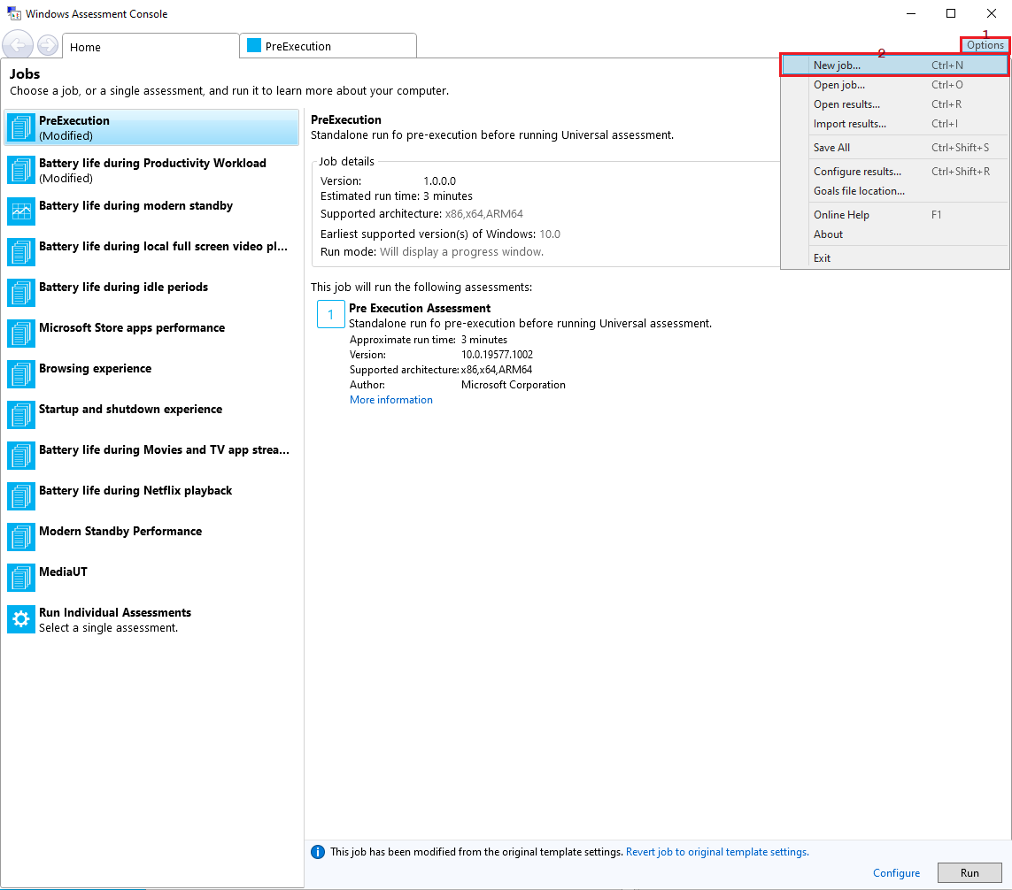
Energy Job

Slide 10
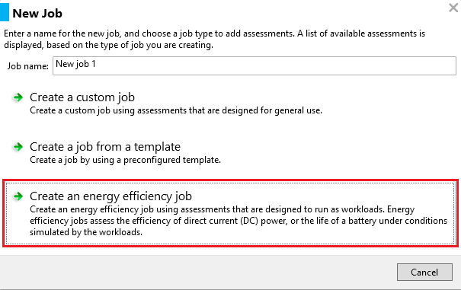
Energy Job – and job settings

Slide 11
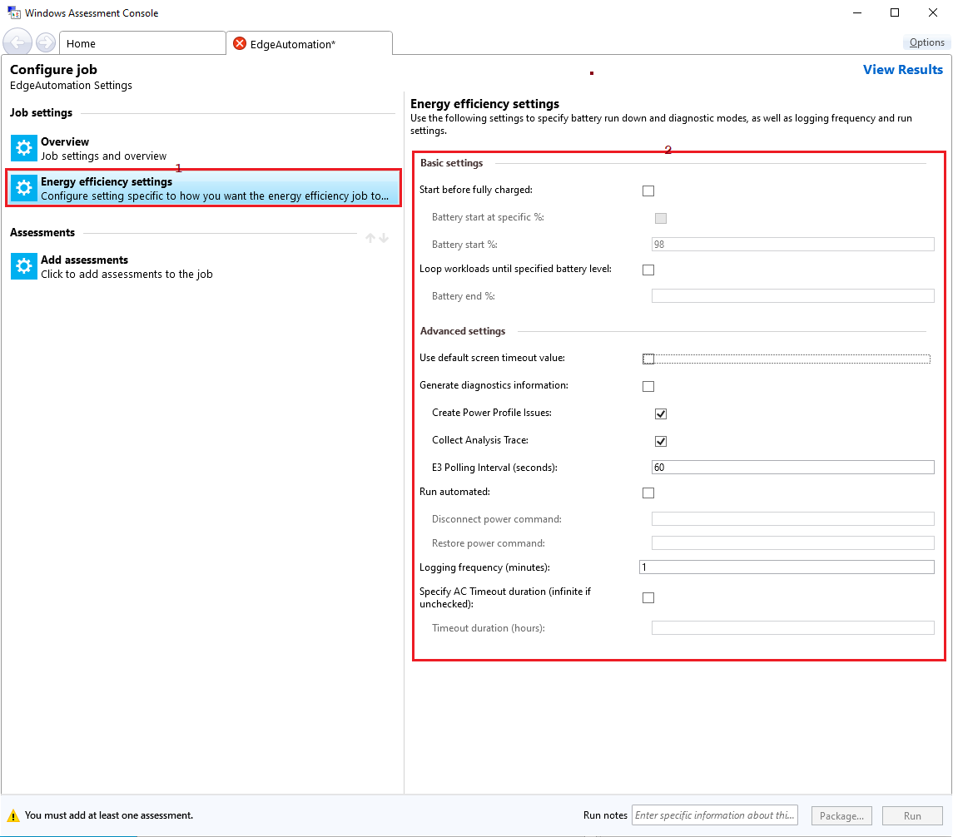
Energy Job – energy settings

Slide 12
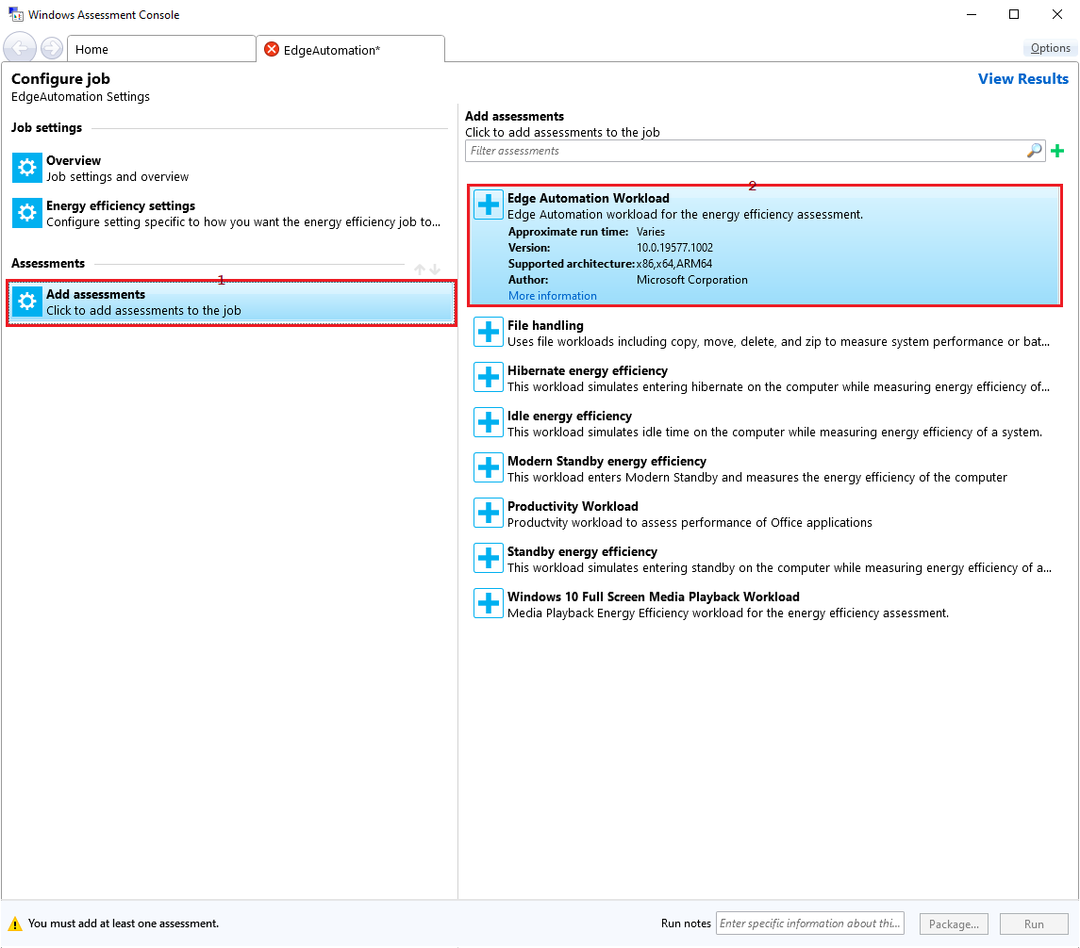
Energy Job – add assessments (workload)

Slide 13
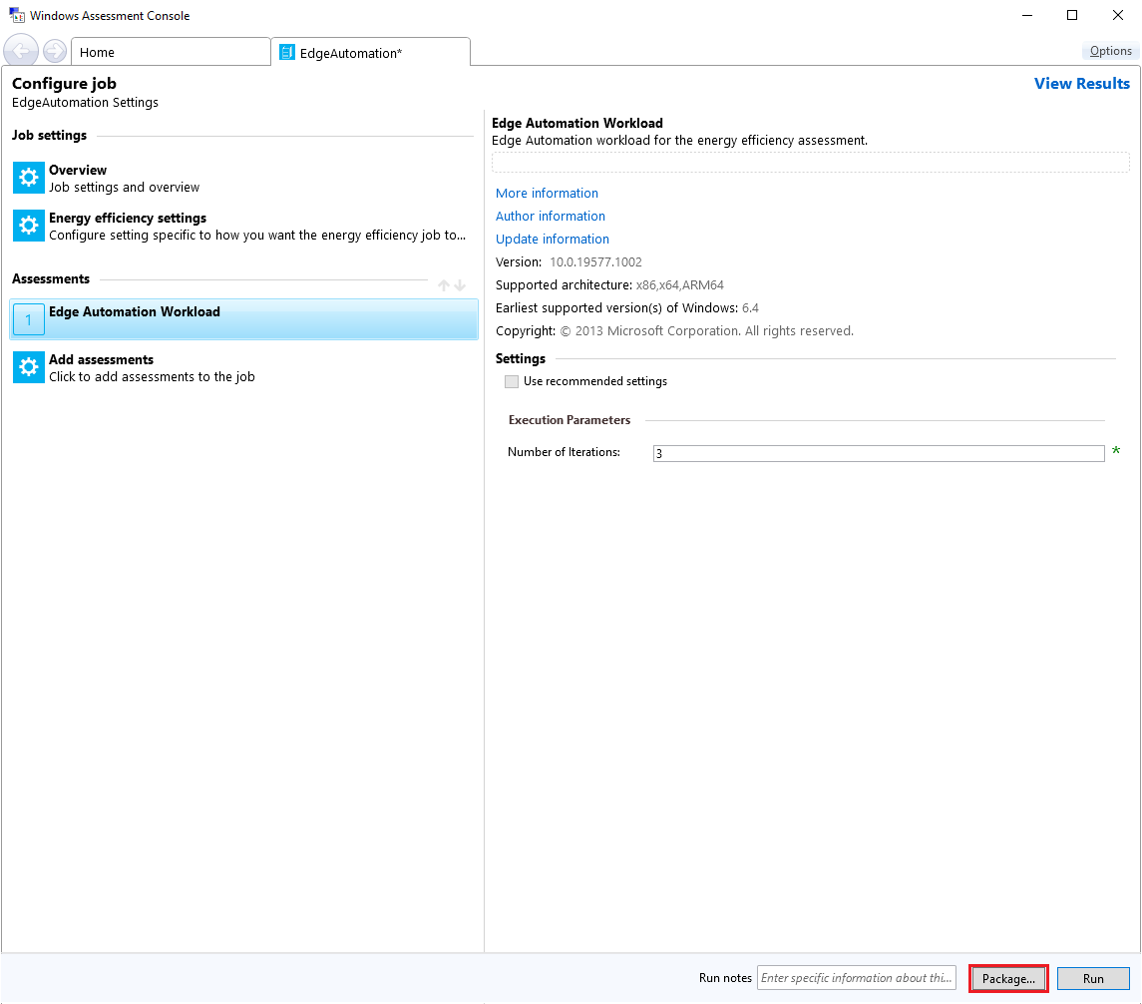
Energy Job – assessment setting & package

Slide 14

Energy Job – package

Slide 15
Job.xml of Energy
<AxeJobManifest>/<AssessmentManifests>/<AxeAssessmentManifest> 中第一個<AxeAssessmentManifest>是與energy.exe相關的。第二個以後的<AxeAssessmentManifest>才是你加入的assessment(或是workload)。
<AxeJobManifest> <JobParameters> </JobParameters> <AssessmentManifests> <AxeAssessmentManifest> … … <ApplicationName>%PROCESSOR_ARCHITECTURE%\Energy.exe /ExecuteOnly /Job “%AssessmentJobFile%” /RunIndex 0 /Temp “%AssessmentTempPath%” /Results “%AssessmentResultsPath%” /AxeCore “%AssessmentAxeBinPath%\axecore.dll”</ApplicationName> … … <ApplicationName>%PROCESSOR_ARCHITECTURE%\Energy.exe /mode 3 /AnalysisOnly /ExecutionPath %AssessmentExecutionPath% /RunIndex 0 /Temp “%AssessmentTempPath%” /Results “%AssessmentResultsPath%” /AxeCore “%AssessmentAxeBinPath%\axecore.dll”</ApplicationName> </AxeAssessmentManifest> <AxeAssessmentManifest> … <ApplicationName>%AssessmentSystemPath%\WindowsPowerShell\v1.0\powershell.exe -ExecutionPolicy bypass -Command .\EdgeAutomation.ps1</ApplicationName> </AxeAssessmentManifest> </AssessmentManifests> … </AxeJobManifest>
你可以修改<AxeJobManifest>/<JobParameters>中的值來變更job settings。

Slide 16
Job.xml of Energy
<AxeJobManifest> … <AssessmentRuns> <AssessmentRun> <ParameterValues> … <ParameterValue> <ProgrammaticName>DiagMode</ProgrammaticName> <Value>False</Value> </ParameterValue> <ParameterValue> <ProgrammaticName>Logging</ProgrammaticName> <Value>1</Value> </ParameterValue> </ParameterValues> <CommandLine>/Diag /LogFreq 1</CommandLine> … </AssessmentRun> </AssessmentRuns> </AxeJobManifest>
可以修改<AxeJobManifest>/<AssessmentRuns>/<AssessmentRun>綠色部分來變更energy.exe settings

Slide 17
Job.xml of Energy
<AxeJobManifest> … <AssessmentRuns> <AssessmentRun> … <AssessmentRuns> <AssessmentRun> <ParameterValues> <ParameterValue> <ProgrammaticName>Iterations</ProgrammaticName> <Value>3</Value> </ParameterValue> </ParameterValues> <CommandLine>-Iterations 3</CommandLine> … </AssessmentRun> </AssessmentRuns> </AssessmentRun> </AssessmentRuns> </AxeJobManifest>
可以修改<AxeJobManifest>/<AssessmentRuns>/<AssessmentRun>/<AssessmentRuns>/<AssessmentRun>銘黃色部分來變更workload settings

Slide 18
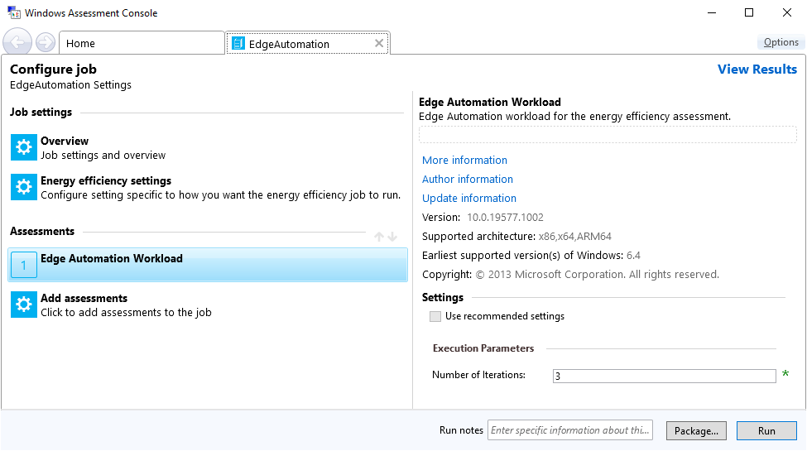
Workload of Energy
在 .asmtx 檔案中 <AxeJobManifest>/<Properties>/<JobKind> 是 <BatteryLife/> 的才是 energy.exe 的 workload。

Slide 19
Workload of Energy
EdgeAutomation.asmtx … <ParameterDefinitions> <ParameterDefinition> <Description> <ProgrammaticName>Iterations</ProgrammaticName> <DisplayName>Number of Iterations</DisplayName> <ToolTip>Specify the number of iterations the assessment should perform. Default value is 3.</ToolTip> <Categories> <Category>Execution Parameters</Category> </Categories> </Description> <Type> <Int32/> </Type> <Inclusion> <Required/> </Inclusion> <DefaultValue>3</DefaultValue> <Constraints> <MinimumConstraint>1</MinimumConstraint> <MaximumConstraint>20</MaximumConstraint> </Constraints> <CommandLineFormat>-Iterations {0}</CommandLineFormat> </ParameterDefinition> </ParameterDefinitions>

Slide 20
.asmtx of Energy
EdgeAutomation.asmtx … <Execution> <CreateProcess> <ApplicationName>%AssessmentSystemPath%\WindowsPowerShell\v1.0\powershell.exe -ExecutionPolicy bypass -Command .\EdgeAutomation.ps1</ApplicationName> </CreateProcess> </Execution>

Slide 21
Development environment
https://osgwiki.com/ search “install tools”
Install GVFS and Git
Install WAVE
Clone the os repro
Git International
Southeast Asia / Taiwan
Check Git Branch - official/rs_fun_phdi1_dev01
Favorite the branch
Checkout the branch
Create a topic branch
https://osgwiki.com/ search “Razzle.cmd” Run Razzle
msiexec /a <pathToMsiFile> /qb TARGETDIR=<pathToTargetFolder>

Slide 22
Windows Performance Tool
msiexec /a <pathToMsiFile> /qb TARGETDIR=<pathToTargetFolder>

