Slide 1
2019 Sep 6
Searchlight AFC

Slide 2
Reviewing Observations from Emily Johnson
PT36 with default Searchlight training, kernel radius, BOLD frames, significance thresholds

Slide 3
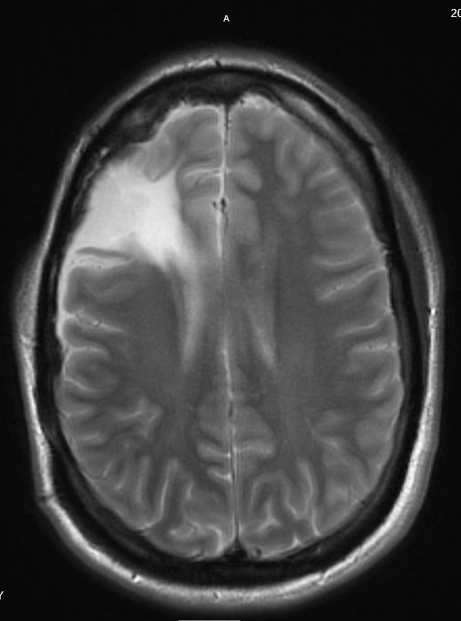
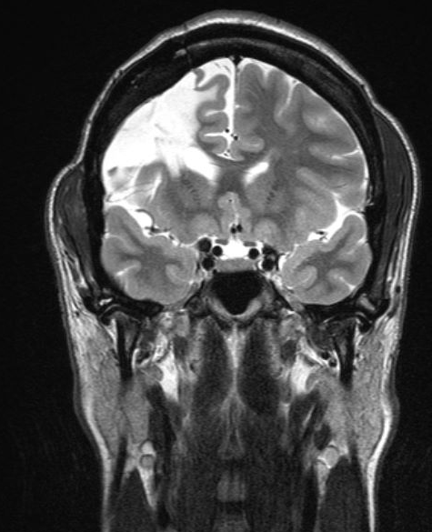
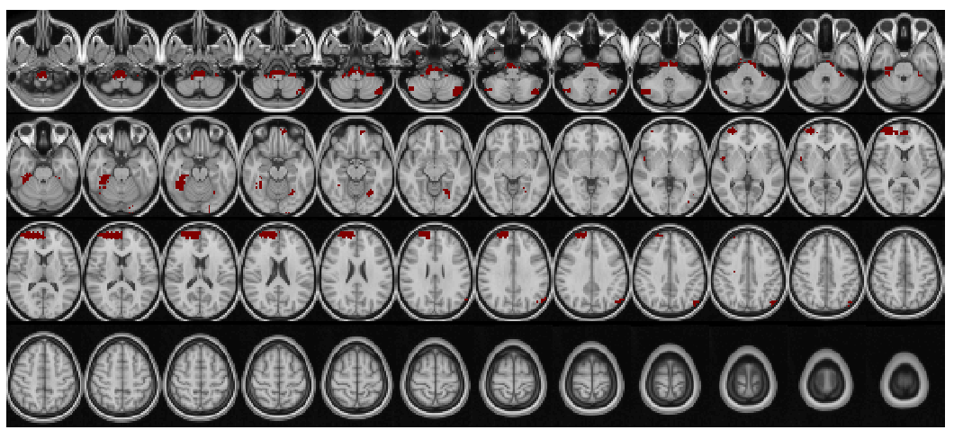
PT36
Patient Profile
Clinically determined R frontal lobe seizure onset
No abnormal findings noted on pre-op MRI
Seizure free at 1 year post-epilepsy resection.
R L
SD Threshold = 3
Notes:
Top left image = coronal post-op image showing R fronal lobe resection
Top right image = axial post-op image illustrating the region of resection in this patient
Bottom image = searchlight generated overlay of lesion regions

Slide 4
PT36 searchlight overlay with CT

Slide 5
New observations
PT36 with default Searchlight training, kernel radius; varying BOLD frames; no thresholds

Slide 6
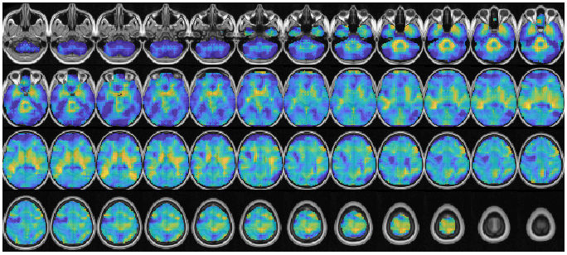
SL(pt) – E[SL(GSP)], 1349 frames

Slide 7
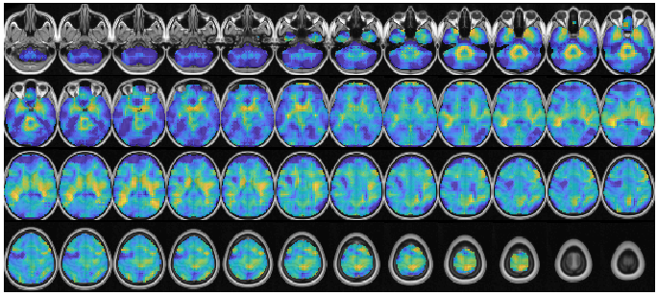
SL(pt) – E[SL(GSP)], 1200 frames

Slide 8
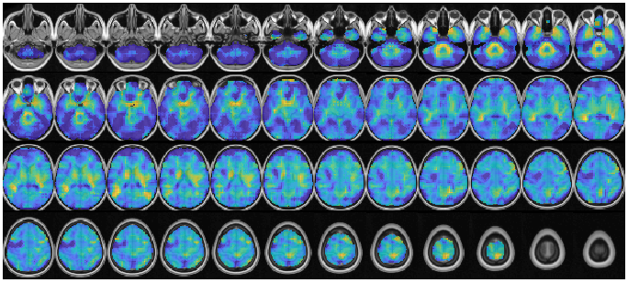
SL(pt) – E[SL(GSP)], 900 frames

Slide 9
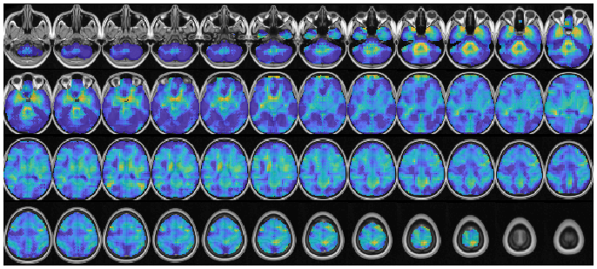
SL(pt) – E[SL(GSP)], 600 frames

Slide 10
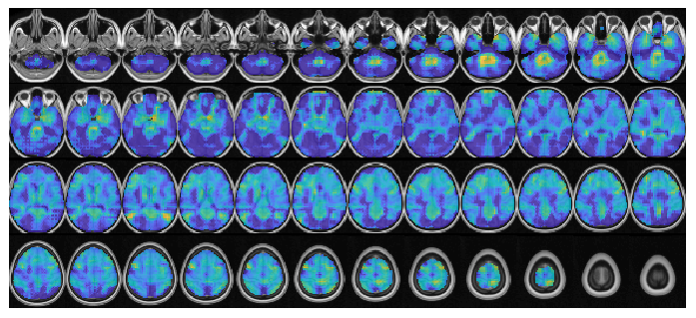
SL(pt) – E[SL(GSP)], 300 frames

Slide 12
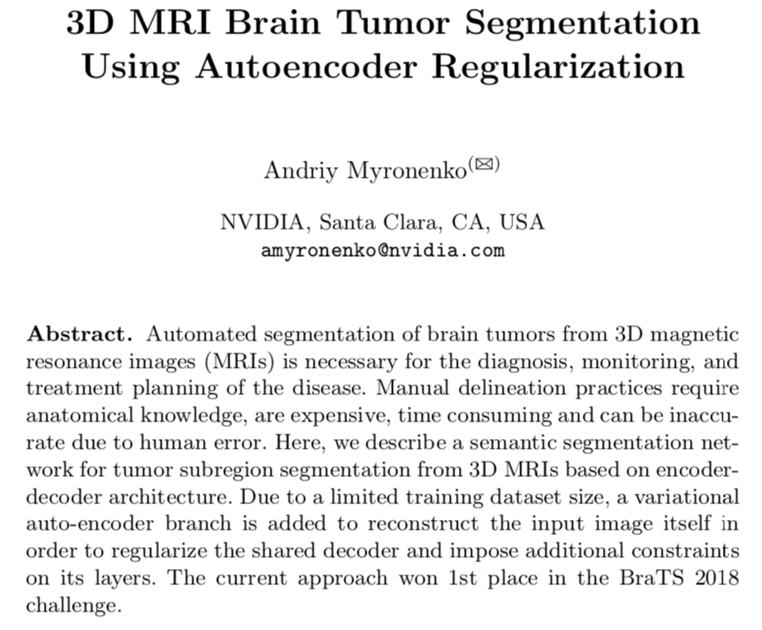

Slide 13
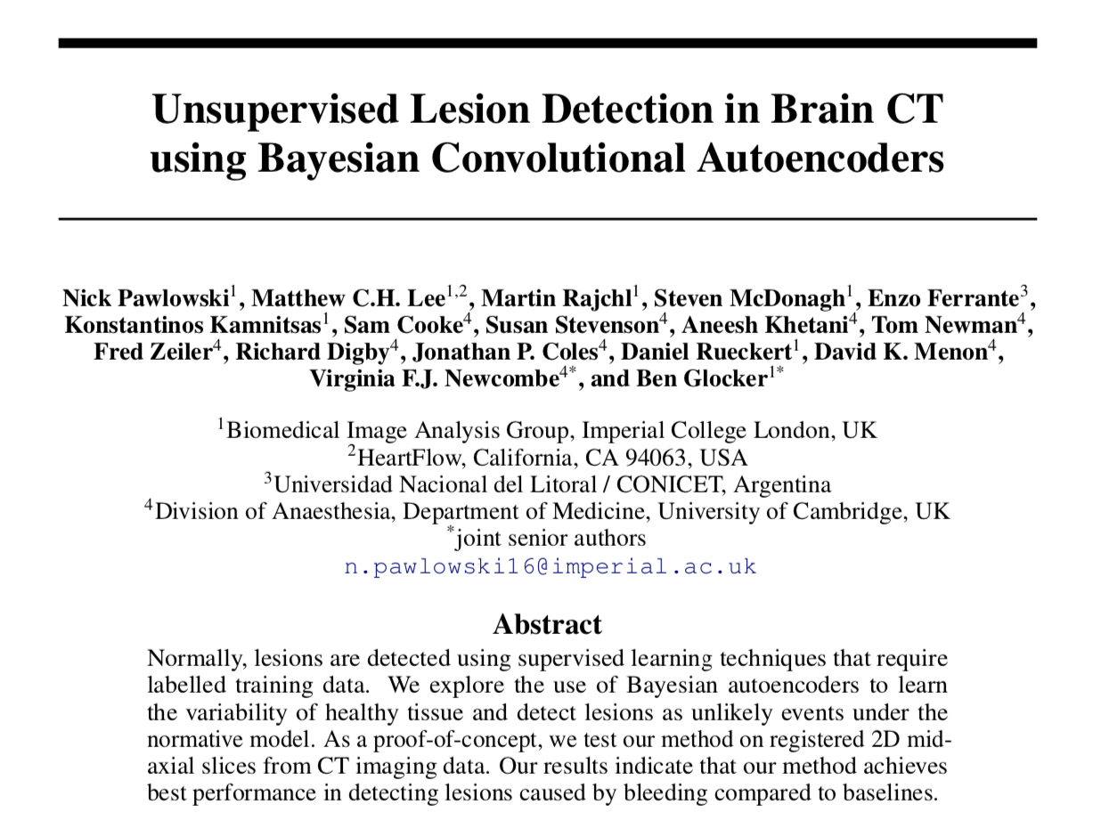

Slide 14
