Slide 1
K-Nearest Neighbor
Marcel van Velzen
Junior Marte Garcia

Slide 2
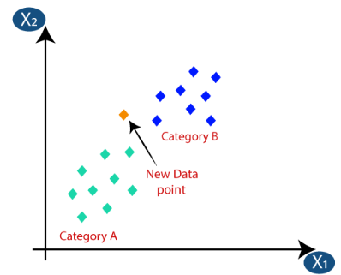
K-Nearest Neighbor
The k-nearest neighbor algorithm is based on the principle of similarity, where it classifies new data points by comparing them to the labeled data points in the training set and is used for classification and regression tasks.
For classification tasks, the algorithm assigns the class label of the majority of the k nearest neighbors to the new data point. In regression tasks, it predicts the value of the new data point based on the average or weighted average of the values of its k nearest neighbors.
Benefits | Drawbacks
Simple and effective | Does not produce a model
Makes no assumptions about the underlying data distribution | Slow classification phase
Fast training phase | Requires a large amount of memory
 | Nominal features and missing data require additional processing

Slide 3
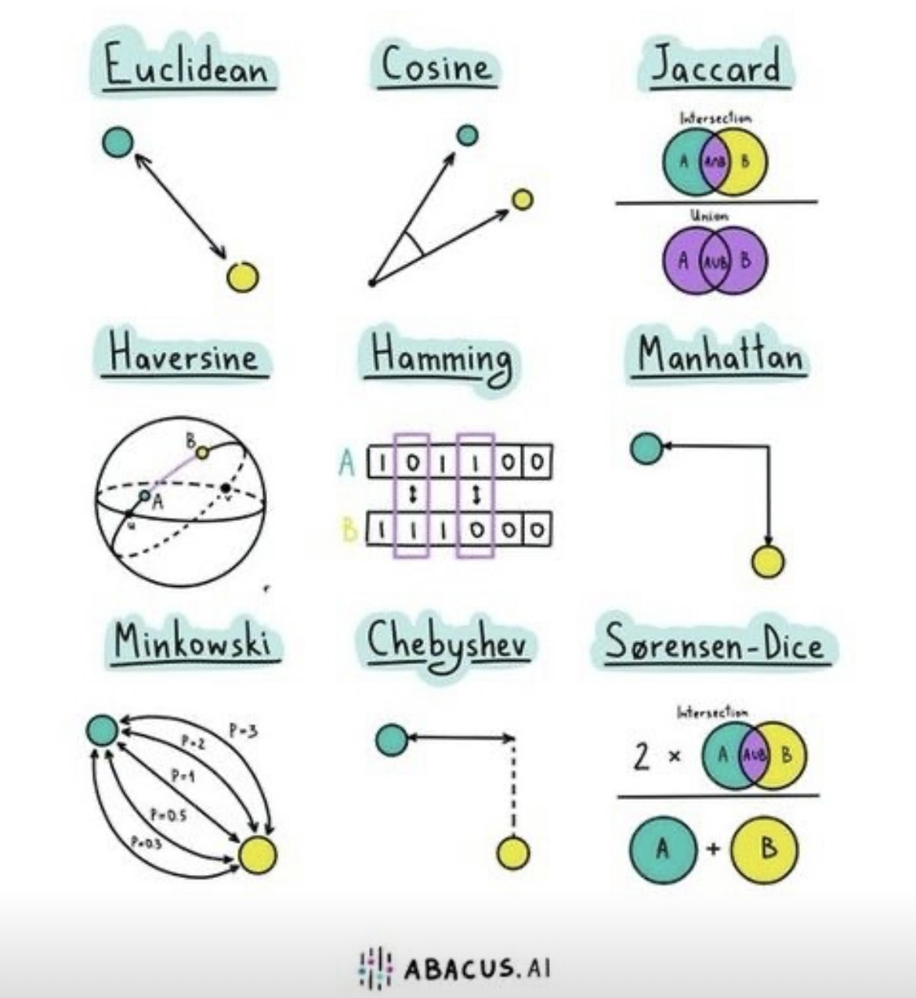
Calculating distance
In order to determine which data points are closest to a given query point, the distance between the query point and the other data points will need to be calculated.

Slide 4
Choosing an appropriate k
Deciding how many neighbors to use for the kNN determines how well the model generalize future data. The balance between overfitting and underfitting the training data is a problem known as the bias-variance tradeoff.
Smaller values of k in k-NN have low bias and high variance and larger values of k in k-NN have high bias and low variance.
A common practise is to set k equal to the square root of the number of training examples.
To determine the optimal value of k in k-nearest neighbors (k-NN) for both regression and classification problems, you can use the following techniques:
Cross-validation: Evaluate the performance of k-NN using techniques like k-fold cross-validation, stratified k-fold cross-validation, or leave-one-out cross-validation, and select the value of k that yields the best performance metric.
Grid search: Define a range of possible values for k, evaluate the performance of k-NN for each value using an appropriate performance metric, and select the value of k that gives the highest performance metric.
Domain knowledge and experimentation: Leverage insights or prior knowledge about the data, experiment with different values of k, and observe the model's performance to determine the optimal value of k based on the specific problem and dataset.

Slide 5
Preparing data
Feature scaling: When features have different scales, as it avoids dominance of a single feature in distance calculation, mitigating bias and improving overall performance.
The traditional method of rescaling features for kNN is min-max normalization. Another common transformation is called z-score normalization.
Feature engineering: Transforming features to reveal patterns, enhance class separability, or strengthen the relationship with the target variable using techniques like feature extraction, dimensionality reduction, or creating new derived features based on domain knowledge.
Handling categorical features: They should be encoded into numerical representations through techniques like one-hot encoding or label encoding before utilizing the algorithm.
Common approaches for categorical variables in KNN include label encoding for ordinal variables, one-hot encoding for non-ordinal variables, and feature hashing for high-cardinality variables.

Slide 6
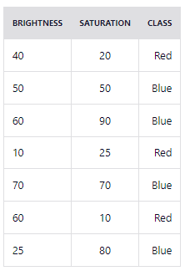

Example
The table represents our data set and has two columns — Brightness and Saturation. Each row in the table has a class of either Red or Blue and the Euclidean distance is used as the distance measure. We have a new entry but it doesn't have a class yet. Suppose k=3.
Calculated distances in ascending order
BRIGHTNESS | SATURATION | CLASS | FORMULA | DISTANCE
10 | 25 | Red | SQRT((20-10)^2 + (35-25)^2) | 14,1
40 | 20 | Red | SQRT((20-40)^2 + (35-20)^2) | 25,0
50 | 50 | Blue | SQRT((20-50)^2 + (35-50)^2) | 33,5
25 | 80 | Blue | SQRT((20-25)^2 + (35-80)^2) | 45,3
60 | 10 | Red | SQRT((20-60)^2 + (35-10)^2) | 47,2
70 | 70 | Blue | SQRT((20-70)^2 + (35-70)^2) | 61,0
60 | 90 | Blue | SQRT((20-60)^2 + (35-90)^2) | 68,0
k=3
The majority class within the 3 nearest neighbors to the new entry is Red. Therefore, we'll classify the new entry as Red.

Slide 7
Business applications
Customer Segmentation: KNN can group customers based on similarities in purchasing behavior or demographics, allowing businesses to tailor marketing strategies and offerings to specific customer segments.
Recommender Systems: KNN can power personalized recommendations by finding similarities between users and suggesting items that similar users have shown interest in, improving customer engagement and sales.
Fraud Detection: KNN can identify suspicious transactions or activities by comparing them to known fraudulent patterns or similar historical instances, helping businesses prevent financial losses due to fraudulent behavior.
Credit Scoring: KNN can assess creditworthiness by comparing the financial profiles of loan applicants to those of existing customers, assisting in the decision-making process for loan approvals and managing credit risk.
Image Recognition: KNN can classify images into categories or identify similar images by comparing their pixel values or extracted features, enabling applications in e-commerce, healthcare, security, and more.
Anomaly Detection: KNN can identify anomalies in data, such as detecting faulty equipment or network intrusions, aiding in proactive maintenance and ensuring system security.
Predictive Maintenance: KNN can predict equipment failures or maintenance needs by analyzing historical patterns and similarities with current operating conditions, reducing downtime and optimizing maintenance schedules.
Market Basket Analysis: KNN can analyze customer purchase patterns to identify frequently co-occurring items, enabling businesses to optimize product placements, cross-selling, and targeted promotions.

Slide 8

References
Abba, I. V. (2023). KNN Algorithm – K-Nearest Neighbors Classifiers and Model Example. freeCodeCamp.org. https://www.freecodecamp.org/news/k-nearest-neighbors-algorithm-classifiers-and-model-example/
K-Nearest Neighbor(KNN) Algorithm for Machine Learning - Javatpoint. (n.d.-b). www.javatpoint.com. https://www.javatpoint.com/k-nearest-neighbor-algorithm-for-machine-learning
Lantz, B. (2013). Machine learning with R: Learn how to use R to apply powerful machine learning methods and gain an insight into real-world applications. Packt Publishing.

