Slide 1
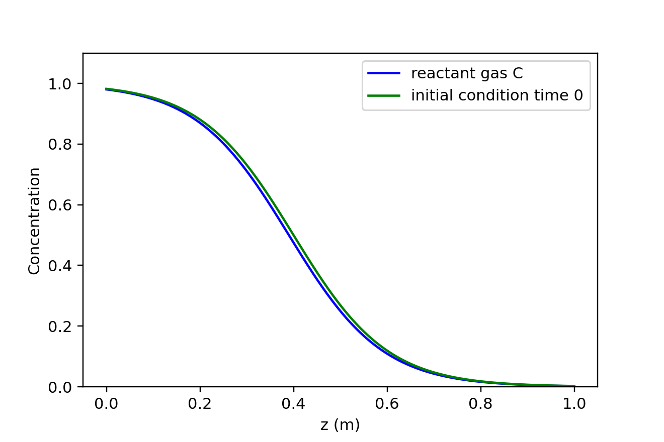
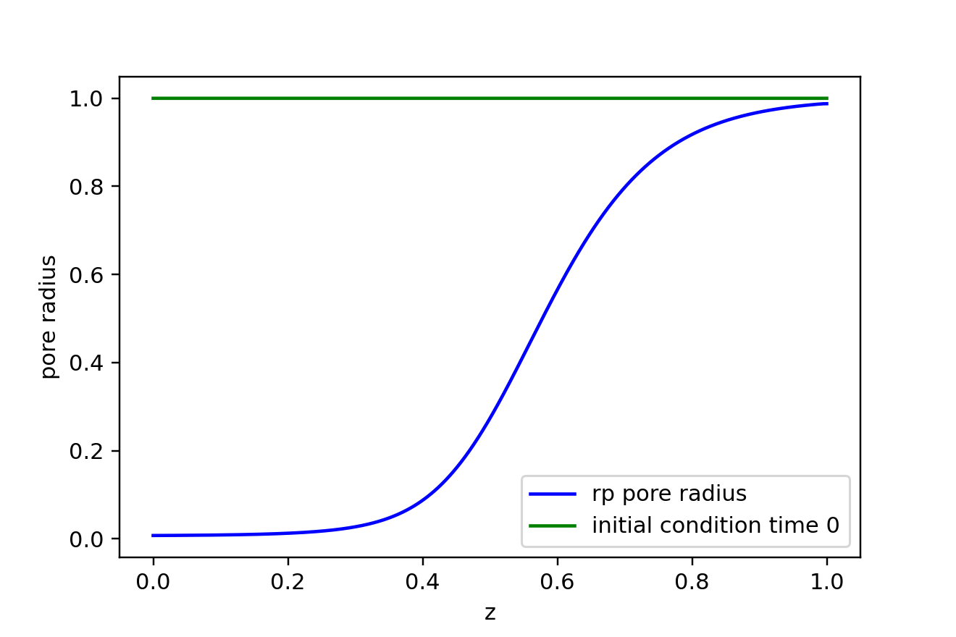
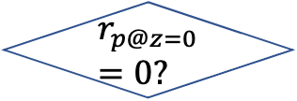

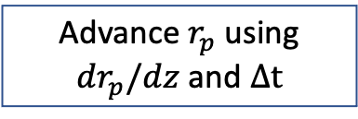
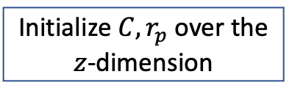
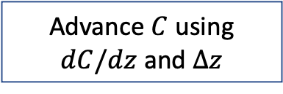
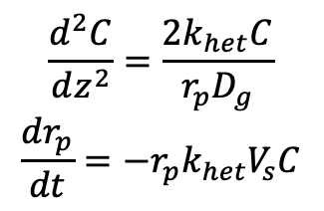
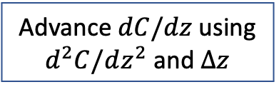
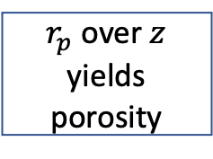
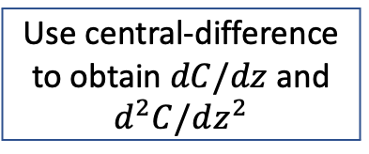

Initialize $C,r_{p}$ over the $z$-dimension
$$\frac{d^{2}C}{dz^{2}}=\frac{2k_{het}C}{r_{p}D_{g}}$$
$$\frac{dr_{p}}{dt}=−r_{p}k_{het}V_{s}C$$
$$t=0$$
Use central-difference to obtain $dC/dz$ and
$$d^{2}C/dz^{2}$$
Advance $dC/dz$ using $d^{2}C/dz^{2}$ and $Δz$
$$t=t+Δt$$
Advance $C$ using $dC/dz$ and $Δz$
Advance $r_{p}$ using $dr_{p}/dz$ and $Δt$
$$r_{p@z=0}=0?$$
$r_{p}$ over $z$ yields porosity
no
yes

