Slide 1
GloBox A/B Test Results
Food And Drink Banner

Slide 2
GloBox A/B Test Overview
Objective: Evaluate the impact of a redesigned homepage with a banner (B) compared to the existing one(no banner) (A) on user engagement and conversion rates.
Goals:
- Increase average spent.
- Improve conversion rates.
Duration: The A/B test was conducted from [2023-01-25] to [2023-02-06].

Slide 3
GloBox A/B Test Overview
Sample Size: The test included a random sample of 48943 users from our target audience.
Variations:
- A: Existing Homepage(Control Group)
- B: Redesigned Homepage(Treatment Group)
Success Criteria: A statistically significant improvement in click-through rates and conversion rates for Variation B compared to Variation A.

Slide 4
Conversion rates and Average amount spent between the two groups

Slide 5
Variations of the metrics in the groups
Group B had 257 more users compared to A
Average spent is a bit higher in B
Conversion rate is a bit higher for B as well
Having more users than A, this can be the reason for the variations of the metrics in B
 | Control(A) | Treatment(B)
Number of users | 24343 | 24600
Average spent | 3.37452 | 3.3908
Conversion rate | 3.9% | 4.6%

Slide 6
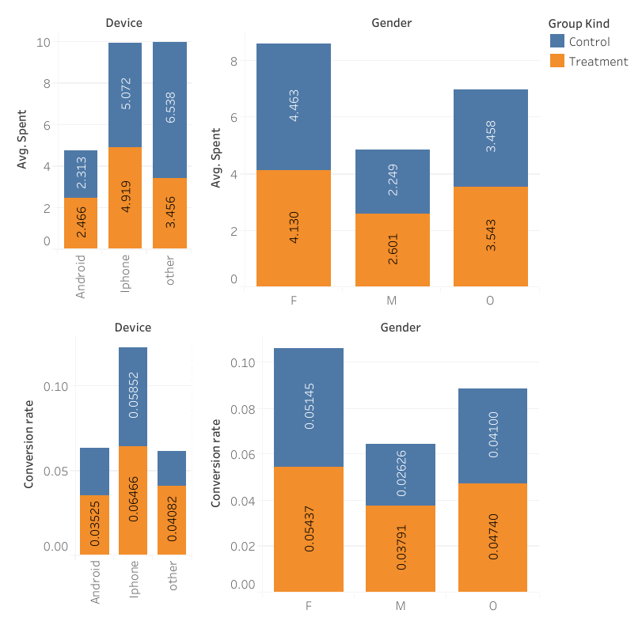
Diagram shows how other features affect the test metrics, Average amount spent and conversion rate.
iphone users show a higher amount spent and higher conversion rate too, meaning more iphone users visit and buy from the company.
Even though females in the control group spend more than those in the treatment group, the ones who see the banner seems to be more likely to spend than those who don’t.

Slide 7
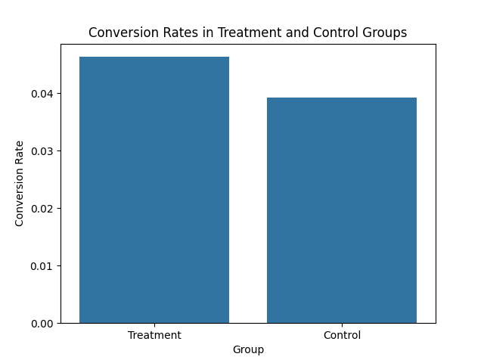
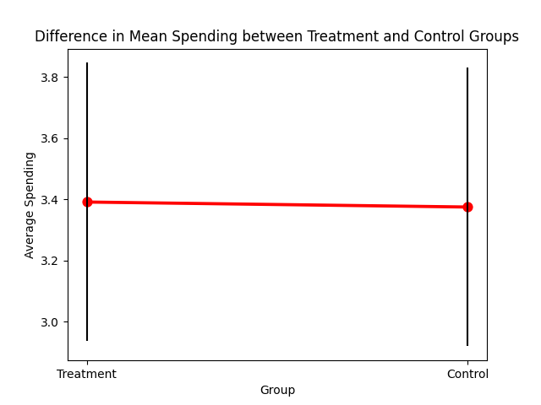
Conversion rates and Mean spending compared there is not so much of a difference between the two groups, but a small enough to make a positive impact to the business

Slide 8
Recommendation:
Since we saw a statistically significant increase in both success metrics(average spending and conversion rate), we can feel confident that the banner will lead to more revenue earnings in the business.

