Slide 1
Predicting Crude Oil Price
Could we predict the price of oil into the future by identifying correlated data

Slide 2
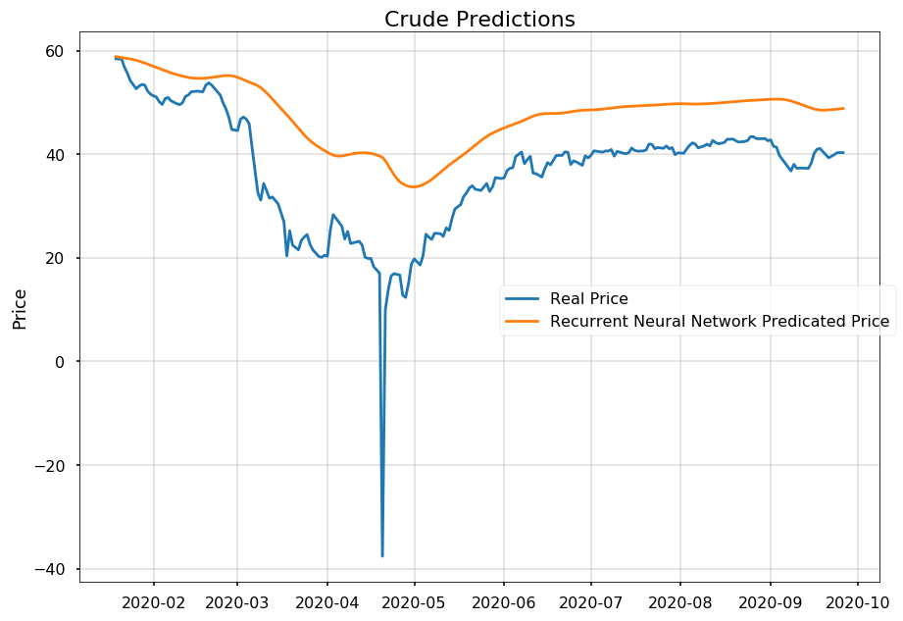
The End Result ?
Notes:
This slide will have Weidong’s graph. The talking points will explain that the chart was where we ended and that we will walk them through our journey of:
Data acquisition and prep
Correlation Had to pivot due to no correlation
Pivot from linear regression to classification (determine if we could predict up/down)
Ran through 18 classification models
Ran RNN feeding to random forest
What we can do from that point?

Slide 3
Data Acquisition
Data | Location
Crude Oil Price (CL) | Yahoo Finance
Supply
Oil Production | OECD
Demand
Housing Starts | Macrotrends.net
GDP | Macrotrends.net
Other
Tweets (top 10 oil experts) | Twitter
Dollar Bullish Index (UUP) | Yahoo Finance

Slide 4
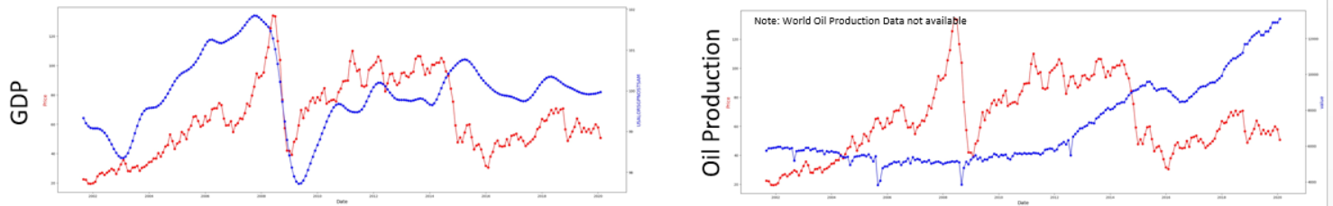
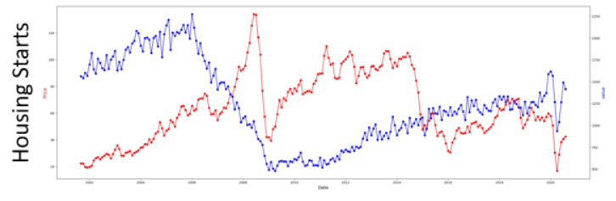
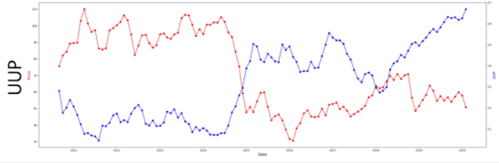
Correlated?
Notes:
What we ran to determine correlation
(visually, random walk, adFuller/trend)
Based on visually plotting those as you can see and running a random walk and adFuller
No linear trend

Slide 5
Our Pivot: Linear Problem to Classification
Could we at least predict whether it was going to go up or down
Linear Discriminant Analysis | Quadratic Discriminant Analysis
AdaBoost Classifier | Bagging Classifier
Extra Trees Classifier | Gradient Boosting Classifier
Random Forest Classifier | Ridge Classifier
SGD Classifier | Bernoulli NB
Gaussian NB | K-Neighbors Classifier
MLP Classifier | Linear SVC
NuSVC | SVC
Decision Tree Classifier | ETC
Notes:
Explain the model
Ran it daily and monthly and for each ran it binary and continuous
Used Random Forest as the base model and to get AUC curve and to get feature importance
Then iterate through models to determine the best parameters
Output: best AUC score, classification report, and feature importance

Slide 6
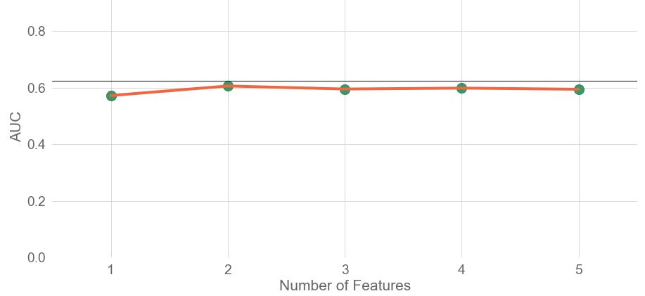
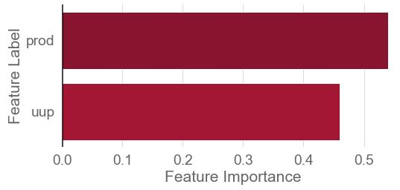
Random Forest: Performance Curve
Notes:
AUC for based model (Random Forest)
Recursive feature selection with cross validation

Slide 7
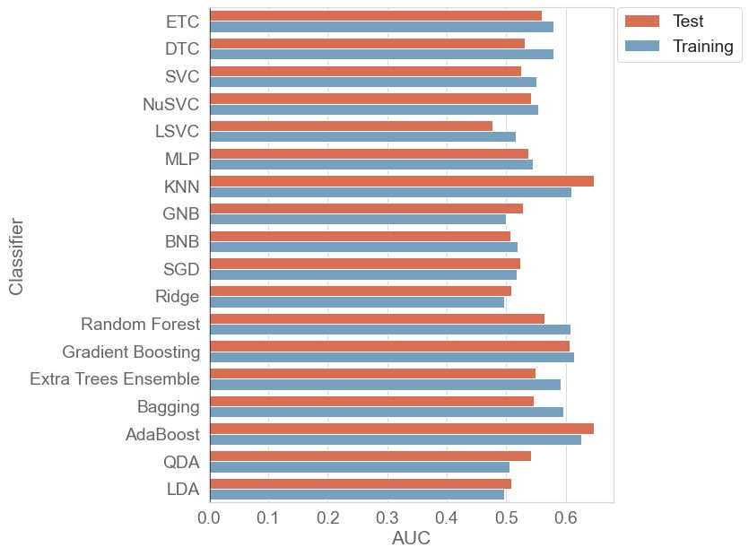
Performance Curve Scores
Notes:
AUC scores for

Slide 8
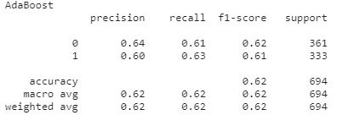
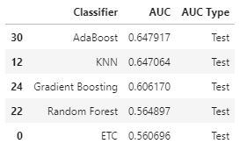
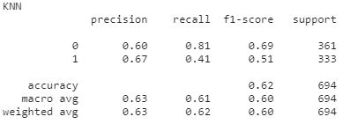
Top Performance Scores & Classification Reports

Slide 9
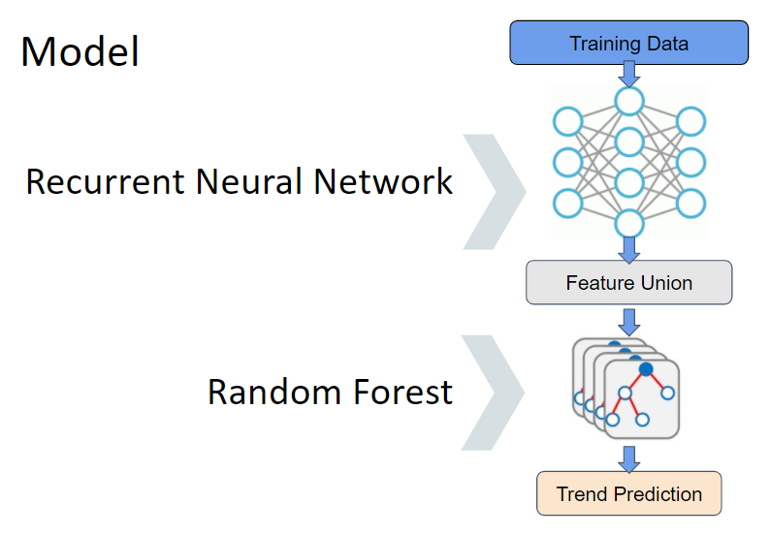
RNN Model, Evaluation and Performance

Slide 10
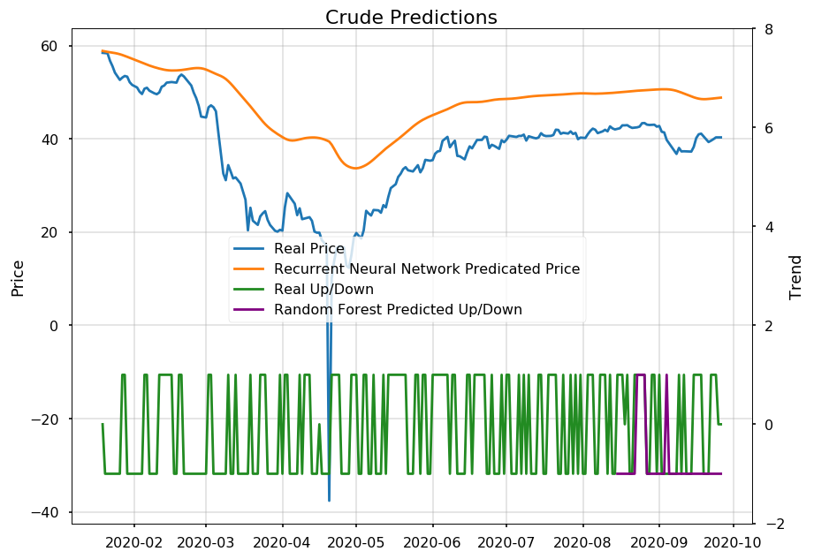
Putting IT All Together

Slide 11
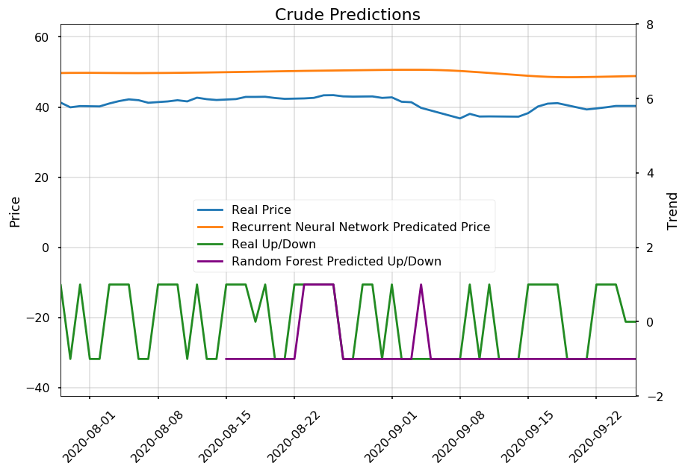
Zooming Into the Predictions
Notes:
Where green is showing the we predicted wrong

Slide 12
Final Consideration
Data
Casual/Correlated
Over / Under - Correlated
Linear / Nonlinear
More Useful Prediction
Monthly / Weekly / Daily
Adding Useful Features

Slide 13
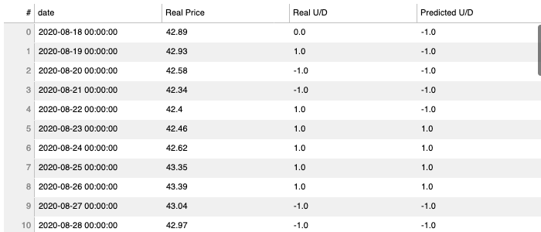
Real and Predicted Values

