Slide 3




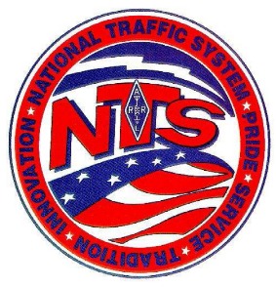

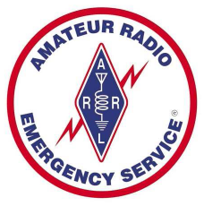

NWS
Michigan Section ARRL
Amateur Radio Public Service Corps
Guidelines
Version 1.0 September 2007

Slide 4

Amateur Radio Public Service Corps
Mission
"Develop the Michigan Amateur Radio Public Service Corp (ARPSC) program into a fully integrated communications team, ready, willing and able to provide radio communications support to Public Service Agencies and the citizens of Michigan."

Slide 5
Amateur Radio Public Service Corps
Mission
Introduction
A Dynamic System
Minimum Standards
Future Technology

Slide 6
Amateur Radio Public Service Corps
One of the basic
purposes of amateur
radio is public service,
especially during an
emergency.

Slide 7
Amateur Radio Public Service Corps
Objectives
Develop unified orgn.
Standards thru guidelines
Establish and coordinate
Michigan Section ARPSC

Slide 8
The ultimate goal of
Michigan Section ARPSC
Strong Leadership
Common Training

Slide 9
Michigan Section ARPSC
Intendment
Provide Supplemental / back-up emergency communications
Health and welfare - NTS
Develop and annually review emergency / operational plans with served agency

Slide 10
Michigan Section ARPSC
Intendment
Most Important
Active
Visible
Organized
Professional

Slide 11
Michigan Section ARPSC
Key Leadership
The key leadership is from the Emergency Coordinator (EC) of local municipalities, counties & across the state. This person is in the key position to provide for a successful ARPSC

Slide 12
Michigan Section ARPSC
Administrative Staff
ARRL Section Manager
Michigan State Police EM HSD Representative
Section Emergency Coordinator

Slide 13
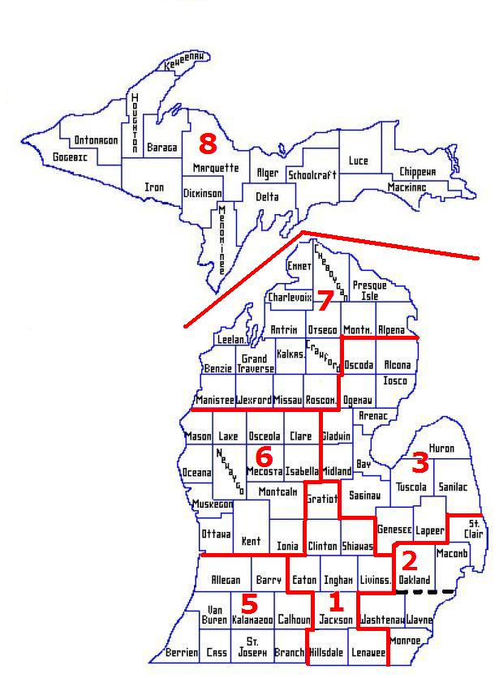
Michigan Section ARPSC
Section Emergency Coordinator
District Emergency Coordinator (11) DEC
County / Municipal Emergency Coordinator / ARPSC

Slide 14
Michigan Section ARPSC
Membership in ARPSC
Open to all volunteer amateur operators, who desire to serve
Applicants complete form with qualifications (license class, training courses) & capabilities (CW, packet, emer. power etc)
Background checks could be requested by served agency

Slide 15
Michigan Section ARPSC
Members of ARPSC
Applicant required to have a minimum amount of FEMA Training of selected courses
Currently entry level training IS-100 & IS-700
Additional courses to become RACES certified IS-22 & IS-200

Slide 16
Michigan Section ARPSC
ARPSC Communications
All EOC at state level thru municipal level requirements.
  Local Tactical & written message traffic
  Medium / long distance comm.
  Personnel trained in all comm. in line with license class

Slide 17
Michigan Section ARPSC
Concept of Operations
SEC/SRO activates ARPSC opr. to provide back-up and / or supplemental communications from State EOC.
SEC/SRO coordinates the comm. & op’s as designated by the Operations Group Chief.

Slide 18
Michigan Section ARPSC
Concept of Operations
Gateway Station
  Designated by:
    Section Staff & SEC / SRO
  Responsibility
    Establish inter state comm. when needed

Slide 19
Michigan Section ARPSC
Concept of Operations
Drills & Exercises
  District Emergency Response Teams

Slide 20
Michigan Section ARPSC
Identifications & Security
Background Checks
  Responsibility of Emergency Manager / Served agency
Purpose
  Ensure security of organization & state are maintained

Slide 21
Michigan Section ARPSC
Identifications & Security
Photo ID Card
  Issued after completing minimum requirements such as training
  ID Cards are exclusive property of Authority issuing them

Slide 22
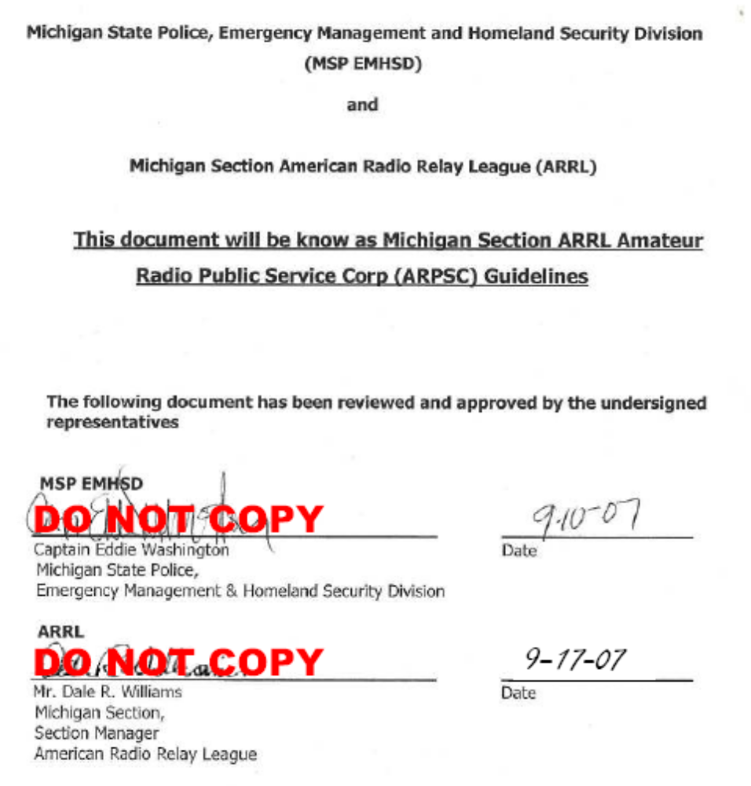

Slide 23
NWS
Questions
Questions
Michigan Section ARRL
Amateur Radio Public Service Corps
Guidelines
Version 1.0 September 2007

