Slide 1
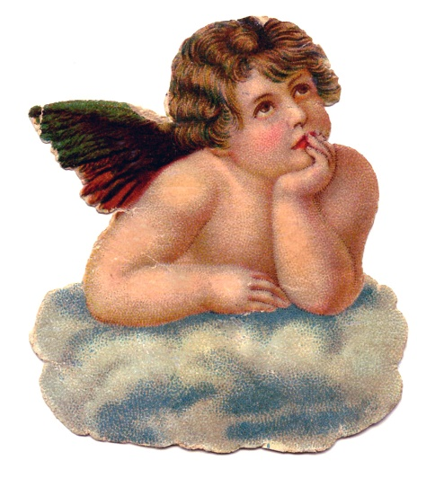
BM 2018

Slide 2
The Work
H6 is the most accurate timepiece ever conceived, let alone constructed. It is demonstrably more accurate than any other timepiece, including the strontium lattice atomic clock developed at the University of Colorado which claims an accuracy to one second in 3.7 billion years.
It is believed (but not proven) H6 is perpetually accurate to within one Planck unit of time.

Slide 3
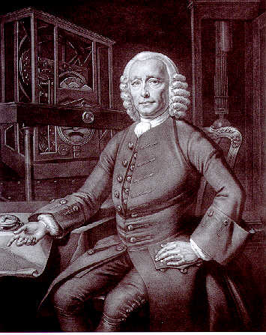
The Concept
H6 is the brainchild of John Harrison, 18th century inventor of the Marine Chronometer.

Slide 4
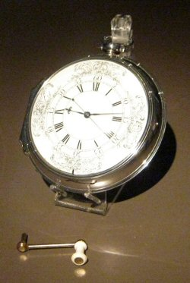
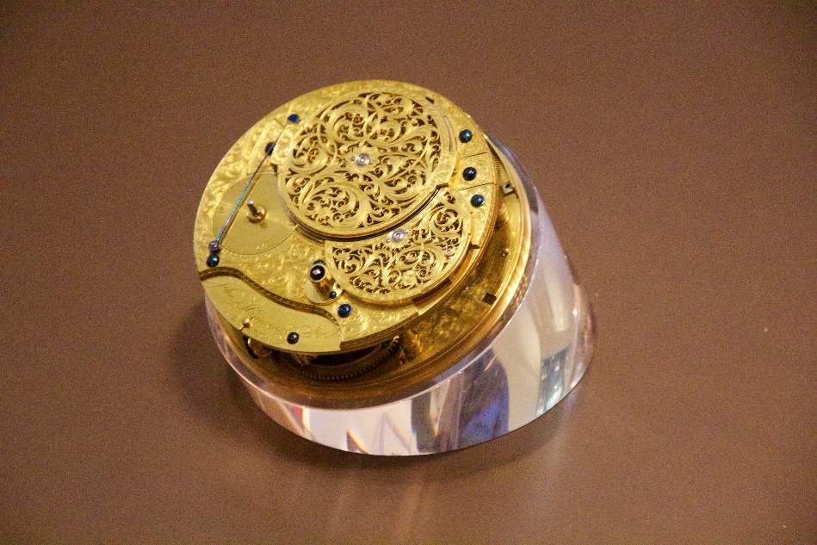
Harrison famously constructed four chronometers which he numbered successively H1 - H4 in order to meet the challenge of accurately calculating longitude at sea.
H4, the culmination of Harrison’s efforts (or so we thought)
The works ofH4

Slide 5
And that was the end of Harrison’s story. Or so we believed until the recent discovery of missing pages from his notebook wherein Harrison describes a timepiece so revolutionary and ahead of its time that he expressed doubts as to whether he should build it.
What terrible consequences might ensue?
It would tell time far more accurately than observation of celestial bodies.
Would he be accused of blasphemy?
What if it fell into the wrong hands?

Slide 6
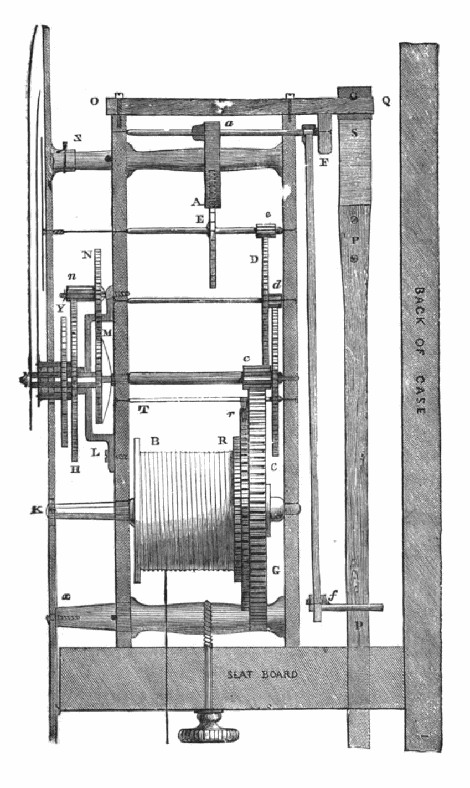
The engineering secret behind H6's accuracy is all natural hardwood construction. Harrison's original profession was carpenter, and he built wooden clockworks before he began work on marine chronometers. Three of Harrison's early wooden clocks have survived.

Slide 7
The Missing Pages
We have only the word of a shadowy figure calling himself Merlin for the discovery of the missing Harrison notebook and the story behind it, although to date every detail of his story has survived independent scrutiny.
He told his tale in a single interview, insisting on meeting in a public place. Becoming ever more agitated over the course of the interview he descended into paranoid ramblings and bolted. All attempts at contact since then have failed.

Slide 8
Broke’s hat
The morning after the Temple Burn at Burning Man 2015 Merlin found a discarded Wellington hat in a pile of moop. Its antique silk lining badly ripped, and the hat itself quite battered.
Branded into the interior headband on one side the initials P.B.V.B., and on the other the name Shannon.
Reaching his fingers under the ripped lining, Merlin retrieved Harrison's missing notes.

Slide 9
Through carbon-14 dating Merlin determined the hat's felt came from a North American beaver living at the turn of the 19th century. He also found microscopic crystals of a nitrate found only in Mammoth Cave Kentucky, and traces of the extraordinarily rare 70-fullerene (a type of Buckyball) whose only known means of production is from the soot produced burning charcoal from English oak.
Therefore the hat had been exposed to both American and British black powder smoke from the era of the War of 1812.
There could be no doubt. He had found Broke's hat.

Slide 10
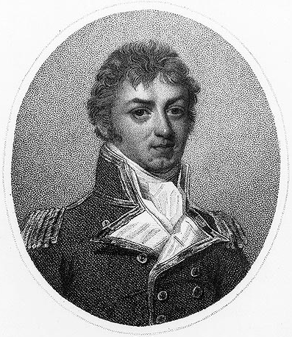
Philip Bowes Vere Broke was born the year of Harrison's death, 1776.
He is distinguished as the Captain of H.M.S. Shannon during the frigate duel with U.S.S. Chesapeake on June 1, 1813.
The battle was short (15 minutes), but particularly violent with over 200 casualties on both sides.
Broke chose to wear a Wellington hat into battle, rather than the Cocked hat preferred by naval officers in those days. In any event the hat did not save him from a near fatal head wound while leading a boarding party. (His counterpart on the American side was mortally wounded.)
The enduring results of his wounds prevented Broke from serving at sea again.

Slide 11
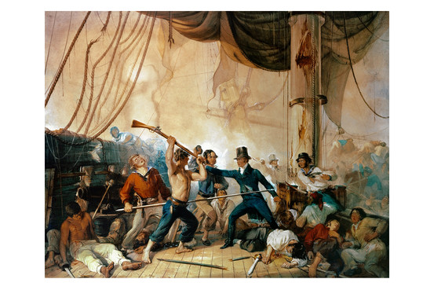
Depiction of Broke boarding the Chesapeake. Note unusual naval head attire, and he’s just about to get clocked in the head.

Slide 12
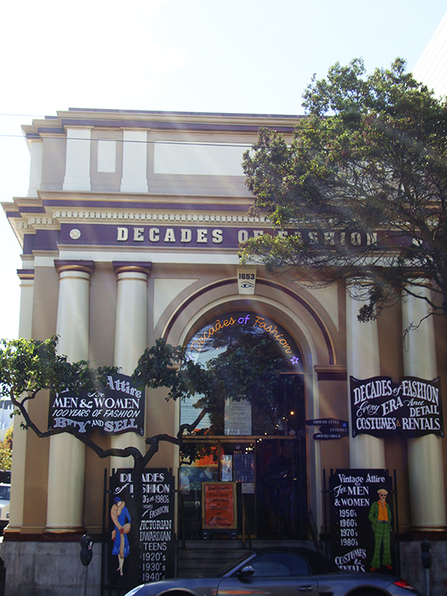
Broke’s hat was last sold at Decades of Fashion on Haight St. in San Francisco on August 22, before Burning Man. Owner Cicely Ann Hansen remembers it well as “Shannon’s Hat”.

Slide 13
Insert doctored image of Decades Of Fashion sales receipt here

Slide 14
The video surveillance inside Decades of Fashion was deliberately disabled that day by someone, so there is no image of the purchaser, who paid cash.
The sales clerk, who the staff only remember as Shannon, appears to have given false information for temp employment during the Burning Man rush.
Do any of the other staff at DoF remember the purchaser?
"He was like, tall."
Do any remember Shannon?
"She was like, short."

Slide 15

Someone would like to remember Shannon better.
Within days of the Broke Hat story leaking the IRS began a full audit of DoF which threatened to shut down the store.
It ended as suddenly as it began when the agents determined they could learn no more about the mysterious Shannon or the provenance of Broke’s Hat.

Slide 16
Hansen acquired the hat from a regular supplier, Lux Appraisers.
All paperwork of the transaction has vanished. A spokesperson for Lux said
“Yeah, I think we got it from the estate of a retired Hollywood property manager, living in Petaluma.”
From there the trail of Broke’s Hat goes cold…

Slide 17
…but not if the <redacted> Family Foundation has its way.
The foundation has generously funded a website,
www.isthisbrokeshat.com,
collecting all photographic and video images of Wellington hats in film and theater (and from Haight St. on August 22, 2015) with the hopes of using machine learning to match an image to that of the actual Broke’s Hat.
(Even though Merlin has not released any image of the hat.)

Slide 18
The Dream Team
Merlin knew there were still technical, and even theoretical hurdles to overcome in order to build H6, and he could not do it alone.
So he went about assembling a team of world-leading physicists and engineers, the likes of which the world has not seen in over 70 years.
In fact, many in the know are comparing the H6 team to the team assembled for the Manhattan Project.

Slide 19
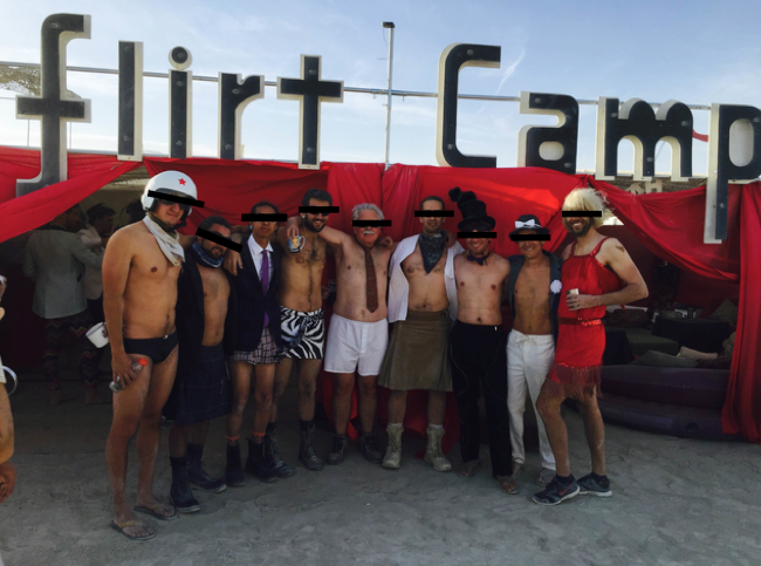
The only known photograph of Merlin and the team of world-leading physicists and engineers,
cleverly disguised in ceremonial Rosicrucian attire

Slide 20
One of the Dream Team physicists (or was it an engineer?) thinking he worked with a Shannon, told her the story he had heard, to which she blurted out “There’s a story in my family about that hat after my ancestor Philip Broke died”.
It has been determined Shannon <redacted> is in the family of last surviving descendants of Philip B. V. Broke.

Slide 21
Shannon <redacted> now denies all knowledge of Broke, and upon repeated requests for an interview shrieks
“Leave me alone.”

Slide 22
Insert picture of Shannon blocking the camera’s view of her face with her hand.
(note pink font)

Slide 23
Road Map
(every real project has one)
December grant proposal to Burning Man Arts
scaling determination
clock works selection
March prototype
June clock works
July dust integration tests
August deployment
September Burn baby, burn!

Slide 24
“For the love of humanity,
The Playa is the only safe place to assemble and operate H6.”
-- Merlin

Slide 25
This concludes the public portion of our broadcast. For additional information, please take a blood oath of secrecy on Shannon’s pink tool box.

Slide 26
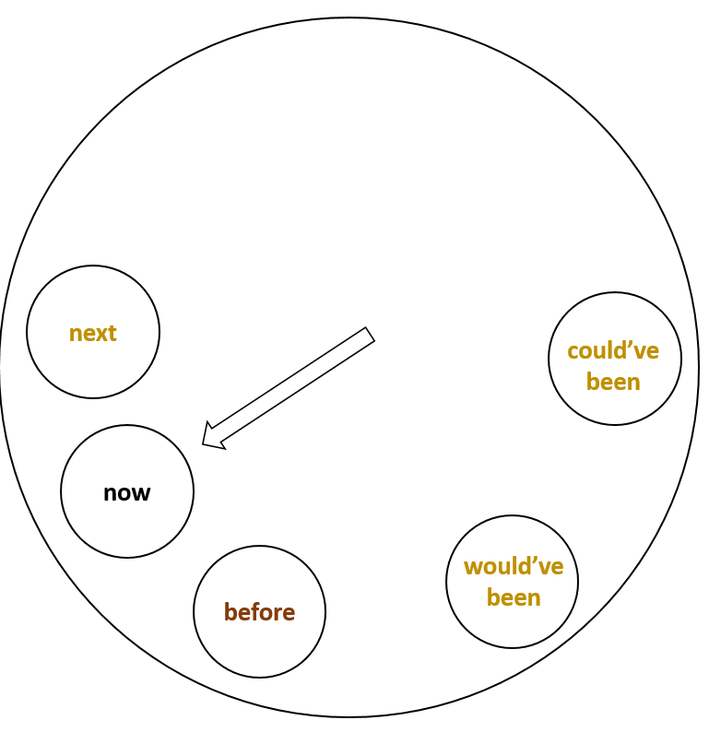

Slide 27
next
could’ve been
now
would’ve been
before

