Slide 1
CPT_S 421_Project_ENG_DATA
Justin Moos, Jim Kino, Jacob Madison

Slide 2
Sprint Objectives
Completing the de-identification tool
  Essential for the corpus website

Slide 3
Feature Implementation
Jacob
  Base prototype with basic functionalities (select files, basic redaction logic)
Jim
  Destination selection and cross-platform
Justin
  Several edge cases regarding redaction

Slide 4
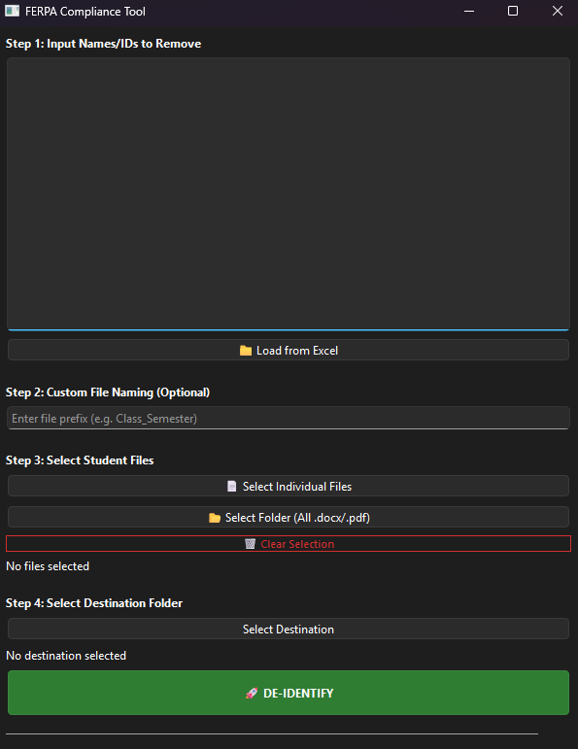
Figma prototype and client feedback
Name/ID inputs
File naming
Selecting files for redaction
Selecting destination directory
"DE-IDENTIFY"

Slide 5
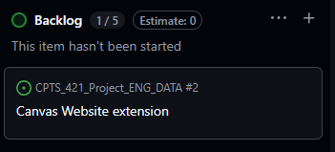
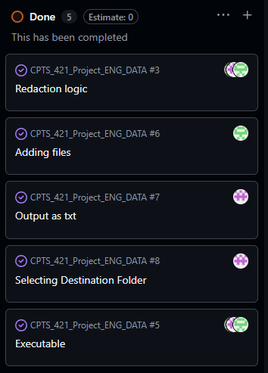
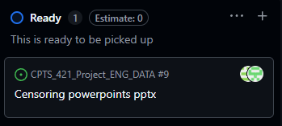
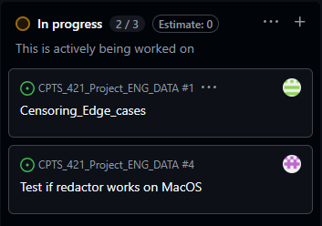
Kanban Overview & team contributions
Jim
Working on getting the tool running on MAC OS
Outputting files as Txt
Selecting Destination Folder
Jacob
Base prototype
File naming and organization
Adding files to the program for editing
Built the executable for the program
Justin
Working on edge cases for censoring content
Worked on redaction logic
Patches and other small errors in the code

Slide 6
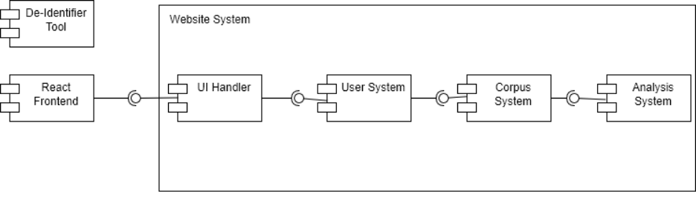
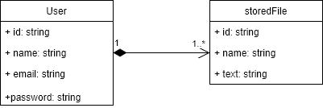
Documentation of system architecture, database, user interface, and testing plan docs
UI design
  Simple
  Only a few buttons

Slide 7
Use of AI
GenAI was used for brainstorming ideas and helping with code correction and implementation of key functions of the censoring tool

Slide 8
Sprint achievements and challenges
Accomplishments
  De-identification tool complete
  Solid idea/foundation for the corpus website
Challenges
  Making the application cross-platform has been a struggle
    Try to test/run it on VMs

Slide 9
Next Steps
Upcoming tasks
  Development of the corpus website
  Linking everything to WSU
  Figuring out the database/storage of the redacted student writings
Retrospective
  Good: completion of roughly 50% of the project (de-identification tool)
Client feedback taken
  Various features implemented that they wanted

Slide 10
Conclusion

