Slide 1
CPTS_421_Project ENG_DATA
Justin Moos, Jim Kino, Jacob Madison

Slide 2
Sprint Objectives
Collect client requirements and features
Build use cases, functional, and non-functional requirements
Decide on coding methods and tools
Start developing the program

Slide 3
Requirements Gathering Process
Asking the client to show us their existing process
6 meetings
Key requirements:
  De-identification tool
  Local Corpora web app
  Database

Slide 4
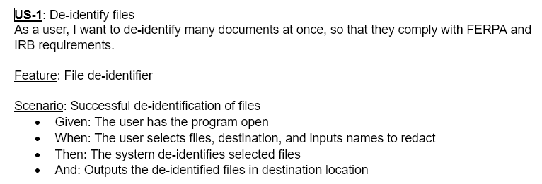
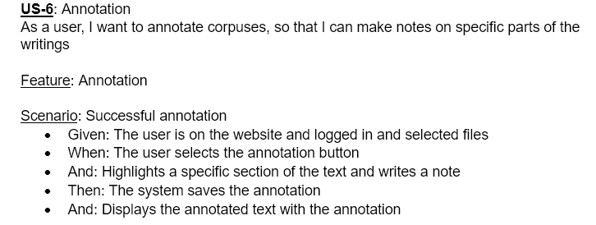
User Stories
US-1: De-identify files
Need to follow FERPA and IRB requirements
  Ensure files are anonymous
US-6: Annotation
Client request
  Creates notes and quick analysis from a glance

Slide 5
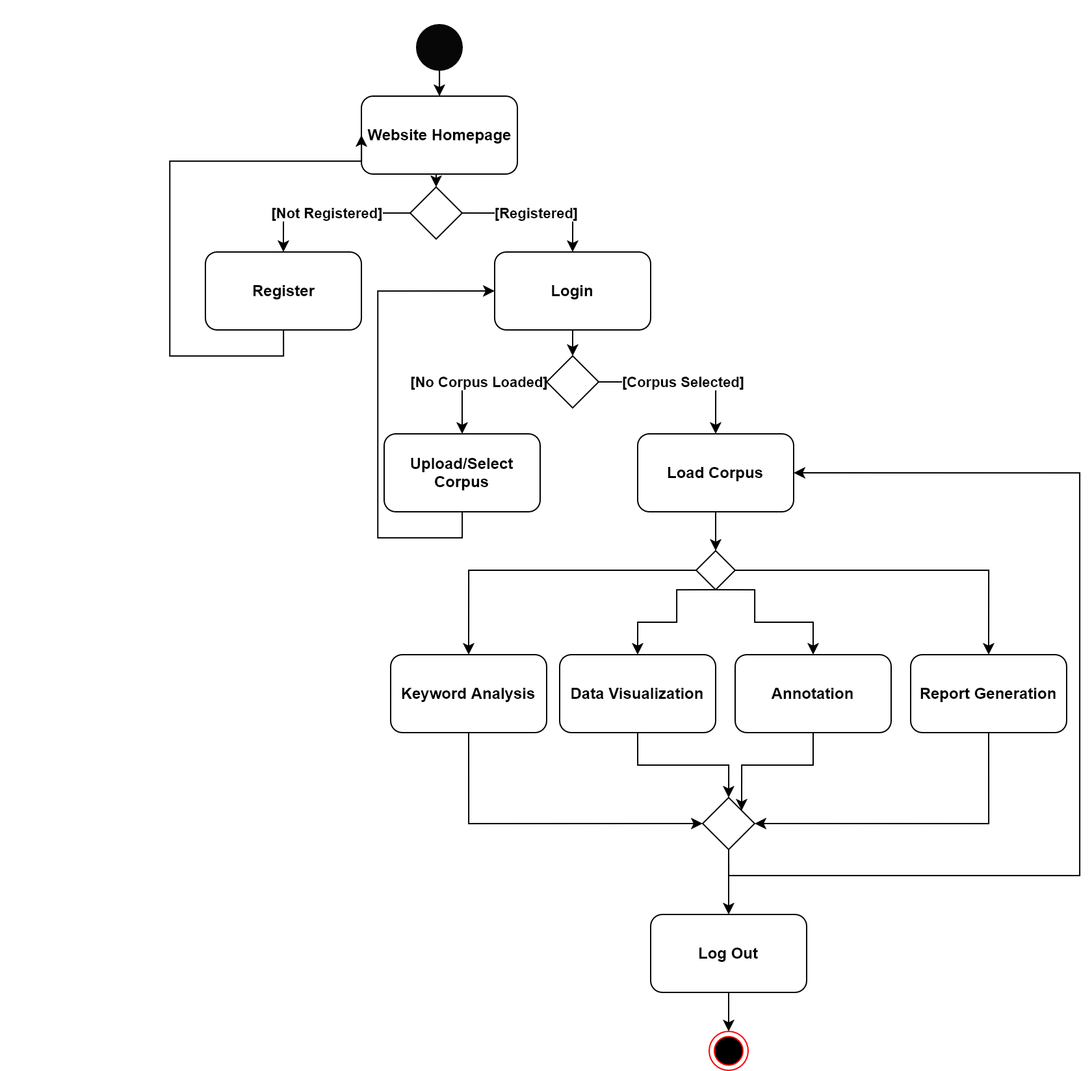
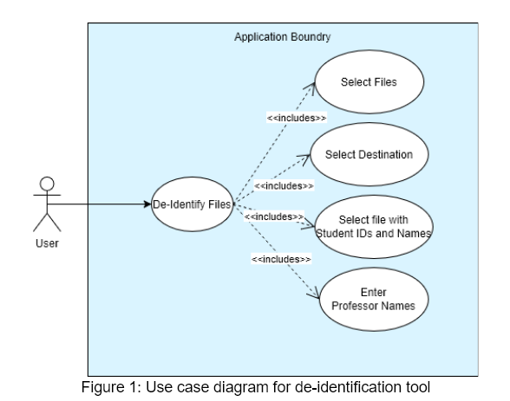
Use Cases, and UML Diagrams
De-identification Tool
One main function with many inputs
Website
Flow of how users can use each feature
  Register/Login
  Corpus
  Analysis

Slide 6
Installation and Evaluation of Existing Solution
Existing Solution:
  Manual deletion of student identity
  Online corpora
  AntConc

Slide 7
Skills Identification and Learning Process
Jacob:
  How to use AntConc
Justin:
  AntConc
Jim:
  AntConc

Slide 8
Sprint Achievements and Challenges
Requirements gathered
Sprint 1 documentation created
Challenges:
  Requirements were hard to grasp at first. After several meetings with the client, we understood what they wanted

Slide 9
Responsible Use of AI
Using AI in a way the benefits and accelerates the development of the application.
  Ideas for use cases
  Checking for possible coding mistakes
Asking questions and not asking for answers to every problem we run into.
  Hints to what may be missing
Not over-relying on AI to build the entire project
  Google problems and or functions(geeksforgeeks)
  Not needed for every single thing

Slide 10
Next Steps
Develop the de-identification application
Retrospective:
  Meetings happened very frequently
  Meetings were productive

Slide 11
Conclusion

