Slide 1
Local Learner Corpus and Analytics Web App
04-SP26-FA26-ENG-DATA
Team: Justin Moos, Jim Kino, Jacob Madison
Client: Michael F. Thomas
April 30, 2026

Slide 2
Project Overview
Client and Stakeholders
  Michael F. Thomas, and the WSU Department of English
Objectives
  De-identifier tool for student writings
  Corpus analysis website
Main Requirement
  FERPA and IRB Compliant
Technologies
  Python, PyQt, RapidFuzz for the de-identifier
  React frontend for the website
Notes:
Our client, Michael F. Thomas of the WSU Department of English and other members of the department would benefit from a way to easily analyze student writings, so a corpus analysis tool is needed, but because all existing tools do not have the desired features we have been tasked to create a website that analyzes corpuses with various desired features of the client. We need to be FERPA and IRB compliant, meaning all student works needs to remain anonymous. So, we were also tasked with creating a de-identification tool.

Slide 3
Functional/Non-Functional Requirements
Functional Requirements
  De-Identification Tool
    Input files and names to replace names with redaction
  Corpus Analysis Website
    Open and Load Corpus from OneDrive
    Manage Corpuses
    Keyword in Context Search
    Annotation Feature
    Data Visualization
    Report Generation
Non-Functional Requirements
  Performance
  Optimization
  Security
  Usability
  Navigation
Notes:
Our functional requirements for the deidentificaion tool was to be able to input student works on mass and names to redact and successfully redact them. While there are still some edge cases in the redaction that is missed, overall we have completed the de-identification feature.
For the corpus analysis website, we need to open corpuses from the client’s onedrive, being able to manage corpuses in the webste to comply with FERPA and IRB. For the actual analysis, we need features our client requested: keyword in context search, annotation, data visualizations, and report generation. We have started work on the website but all features are still rudimentary, so we still have to work on completing these features.
The non functional requirements include performance, optimization, usability, and navigation to ensure our tools are easy to use and responsive for anyone without any confusion. Security is a major concern to ensure we remain in compliance with FERPA and IRB.

Slide 4
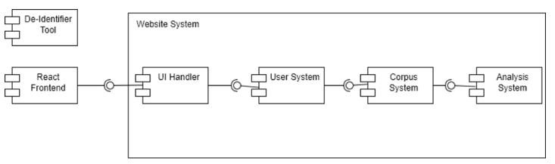
Overall Architecture of Systems
De-identification tool
  Separate program running on its own
  Input .docx/.pdf files and name list to return a redacted .txt file
  Need to access file systems and external metadata for names
Corpus Analysis Website
  Backend: Store and Load files through OneDrive
  Frontend: React UI, Corpus analysis systems
Notes:
The deidentification tool runs on its own independent local program, and requires selecting files to input for redaction, along with any names to redact. So File system access and external metadata is needed.
For the corpus analysis website, the website uses react as a front end, communicating with the corpus system backend loading files through onedrive. The corpus analysis features are part of the front end where it pulls the corpus to analyze from the backend and allows the user to analyze it, storing any new data back to the backend.

Slide 5
Sprint 3 Achievements
Goals and Accomplishments
  Start work on website features
    KWIC, Annotations, Data Visualizations, and Corpus Loading
  Get the De-identifier Mac version working
What went well
  Able to end off the semester in a good place
Challenges
  Trying to handle FERPA and IRB compliance with loading corpus to the website.
    Use OneDrive and don't store sensitive data

Slide 6
System Demonstration
Here we will go over what we currently have for the website and the application and how they will pair together

Slide 7
Testing
Application
Tested large amounts of student papers for redaction and edge cases with misspelling and for professor names
Website
Ran through several iterations of layout
Tested use of several different papers to check for errors and crashing.

Slide 8
Responsible AI Use
ChatGPT, Gemini, and Claude were tools used throughout the semester. They saved a lot of time by:
Brainstorming ideas
Generating skeleton code/prototype code
Scaffolding complex algorithms used in each tool

Slide 9
Plan and Deliverables for Next Semester
Plans for next semester:
Receive feedback on testing of the de-identification tool/make any modifications accordingly
Complete all functionalities of the website
Performance testing/ensure the website can handle several files
Timeline:
Beginning of semester: receive the feedback on de-identification tool
Middle of semester: website up with 80%-90% functionality
End of semester: Project complete
Deliverables:
Website and de-identification tool

Slide 10
Conclusion
Progress
  Completed De-identifier
  Started work on Corpus Analysis Website
    Keyword in Context Search
    Annotations
    Corpus Manager
Lessons Learned
  How to de-identify text
  How corpus managers work

Slide 11
Thank You

