Slide 1
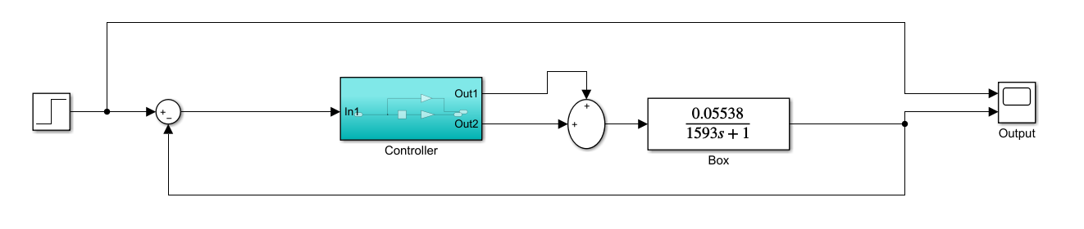
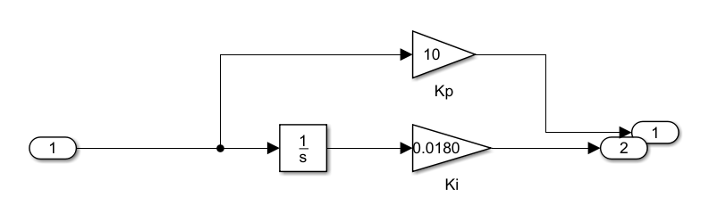
From the Simulink file System.slx

Slide 2
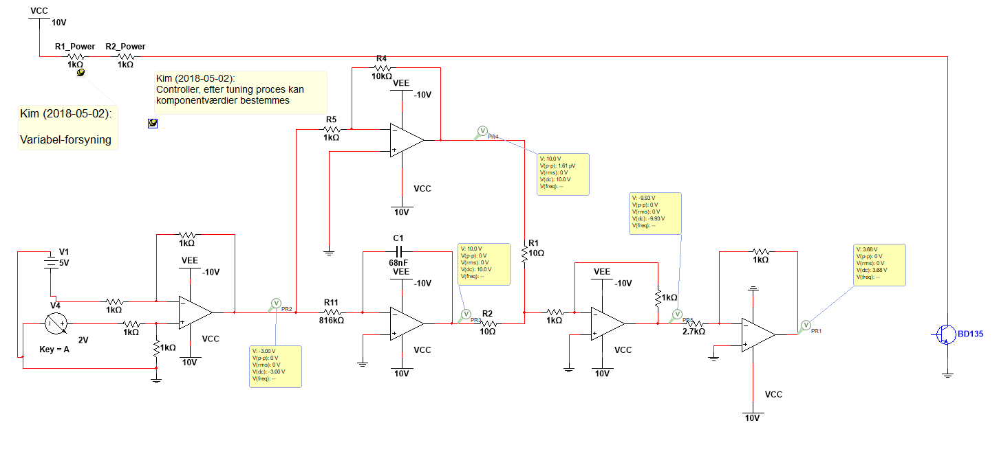
From the Multisim file Kredsløb V3.ms14

Slide 3
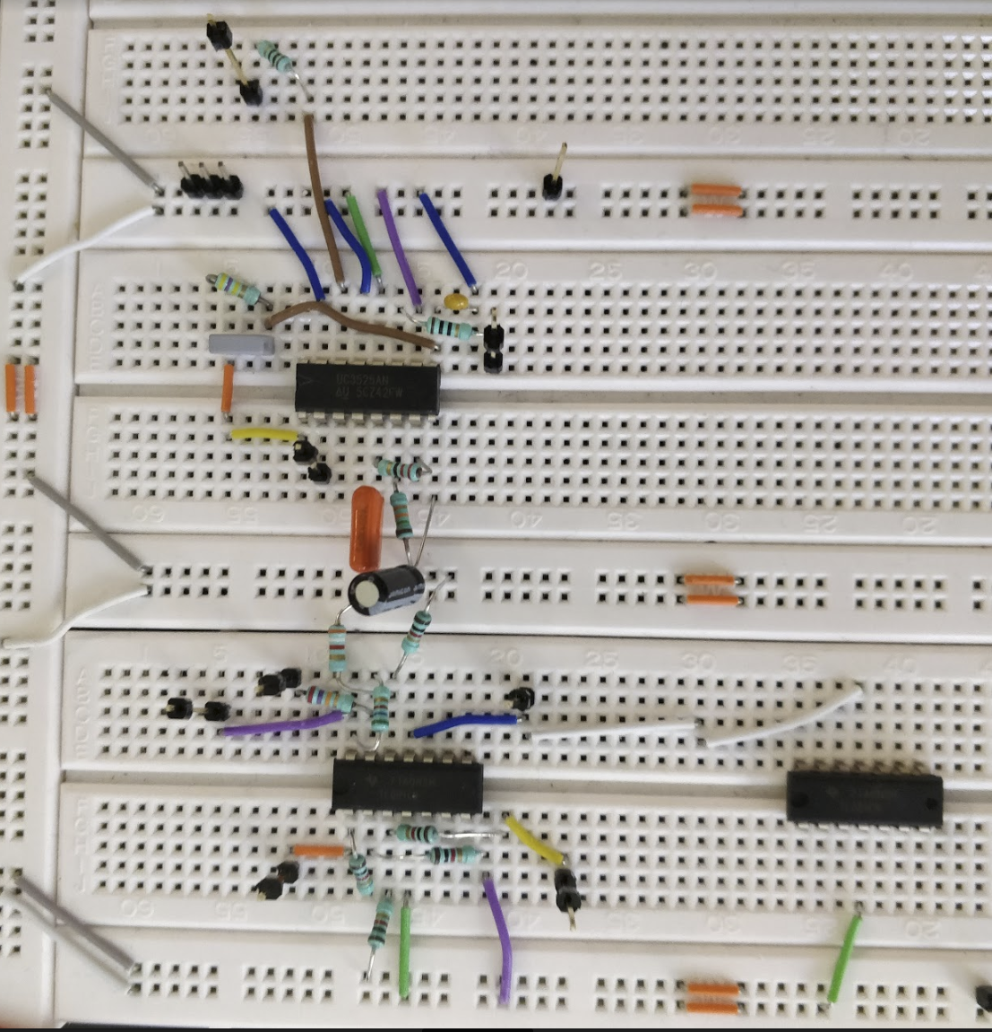
From the jpg file System_on_breadboard_v1_0_view01.jpg

