Slide 1
NATURAL LANGUAGE PROCESSING ANALYSIS WEBSITE USING PYTHON/DJANGO
PROJECT GUIDE:
Mr. K.KAJENDRAN, M.C.A., M.E.,
SUPERVISOR
ASSOCIATE PROFESSOR
TEAM MEMBERS:
NANTHAKUMAR J J (211417104159)
PRAVEEN K (211417104197)
NIRMAL KUMAR N (211417104166)

Slide 2
ABSTRACT
Reviews act as a valuable source of information for decision-making. Online e-commerce sites have provided their users to make their opinion about products and services.
A huge amount of such opinions are publicly available in the form of reviews. Manufacturers, retailers as well as customers have great interest in customer reviews.
Due to a large number of reviews available on the internet for analysis, it is not cost worthy to read these manually.
To optimize this time-consuming task there is a need for an automated system that provides the summarized result of user sentiments.
Opinion Mining (OM) in the field of study that analyzes people's sentiments or opinions from reviews or opinionated text.
Opinion Mining can be viewed as a natural language processing task, the task is to develop a system that understands the people's language. Opinion Mining is a difficult task due to the ambiguous nature of human languages( like English, etc).

Slide 3
INTRODUCTION
Natural Language Processing or NLP is a field of Artificial Intelligence that gives the machines the ability to read, understand and derive meaning from human languages.
It is a discipline that focuses on the interaction between data science and human language, and is scaling to lots of industries.
Today NLP is booming thanks to the huge improvements in the access to data and the increase in computational power, which are allowing practitioners to achieve meaningful results in areas like healthcare, media, finance and human resources, among others.
In simple terms, NLP represents the automatic handling of natural human language like speech or text, and although the concept itself is fascinating, the real value behind this technology comes from the use cases.

Slide 4
LITERATURE SURVEY
Year | Author Name | Title | Inference
2020 | Raktim Kumar Dey, Debabrata Sarddar | Sentiment Analysis Techniques Involving Social Media And Online Platforms | Sentiment Analysis is now by and large considered to be critical in terms of socio-economic standpoint.
2020 | Jugnesh Kumar | Sentiment Analysis of Twitter Data | Emotion analysis includes a variety of tasks,including emotion extraction.
2016 | Vishal Kharde | Sentiment Analysis of Twitter Data | With the advancement of web technology and its growth, there is a huge volume of data present in the web for internet users and a lot of data is generated too.

Slide 5
Year | Author Name | Title | Inference
2017 | Ankit Pradeep Patel | Sentiment Analysis of Twitter Data using Machine Learning Approaches | Twitter is taken into consideration to predict how people think about the popularity of day to day products.
2019 | Zulfadzli Drus, Haliyana Khalid | Sentiment Analysis in Social Media and Its Application | Social media contain a large amount of raw data that has been uploaded by users in the form of text. The data can be converted into valuable information by using sentiment analysis
2018 | Kanimozhi P Elavarasi D | Sentiment Analysis using Twitter Dataset | A sentence based opinion mining classify the document as positive, negative and neutral. Classification model gives the best accuracy among three models.

Slide 6
PROBLEM STATEMENT
Imagine you just launched a new product feature and notice a sharp increase in mentions on Twitter. Are customers tweeting more because they are delighted with the new feature? Or, are they actually complaining about the feature?
Going through each of these comments manually would take far too much time. You’d miss out on valuable feedback that could help you instantly improve a customers’ experience with the latest feature (bug issues, user experience).
By performing analysis with NLP, you can quickly understand the tone and context of social mentions on Twitter.

Slide 7
DEVELOPMENT ENVIRONMENT(H/W and S/W)
HARDWARE REQUIREMENTS
Processor - Intel Core i3
RAM - 4 GB
Hard Disk - 80 GB
SOFTWARE REQUIREMENTS
Operating System - Windows 7/8/10
Programming Language : Python 3.x
Django Framework , Tweepy, TextBlob
Twitter API Credentials

Slide 8
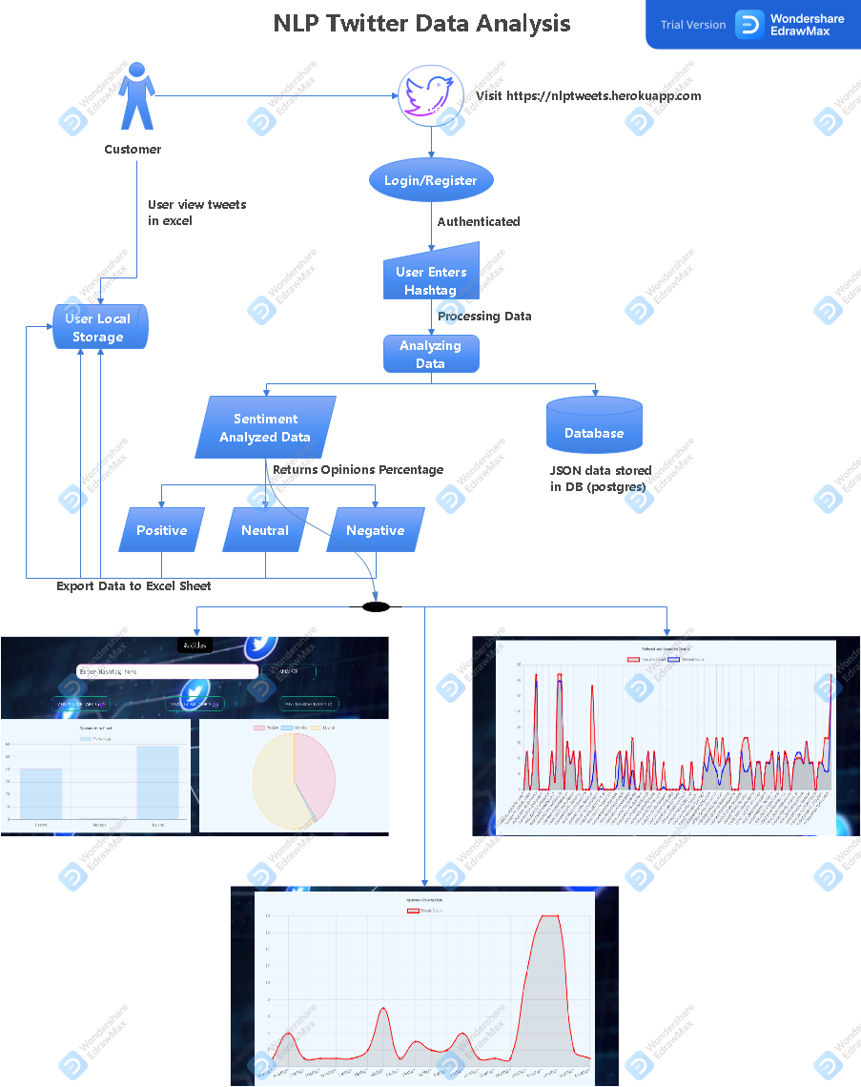
SYSTEM ARCHITECTURE

Slide 9
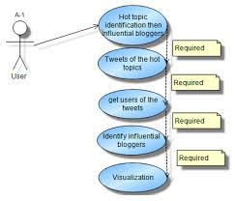
SYSTEM DESIGN
USE CASE DIAGRAM

Slide 10
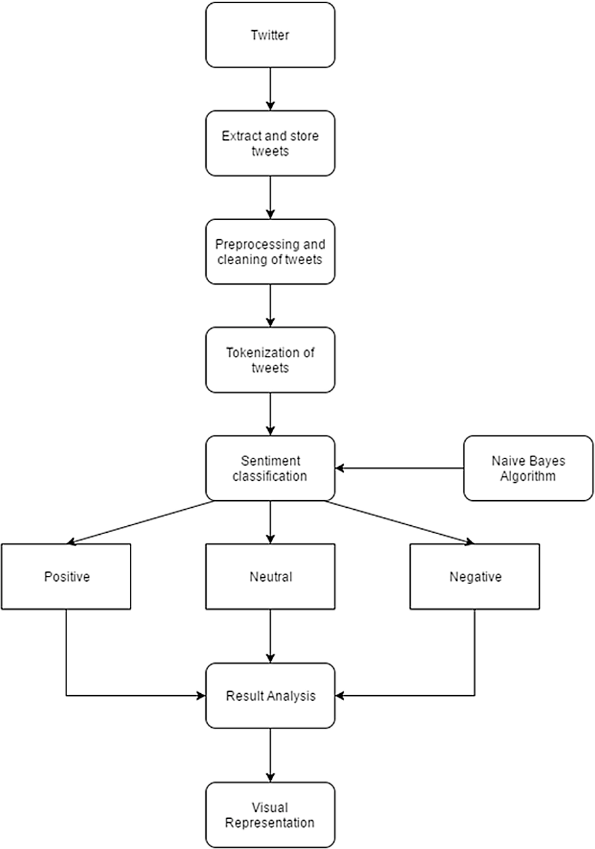
ACTIVITY DIAGRAM

Slide 11
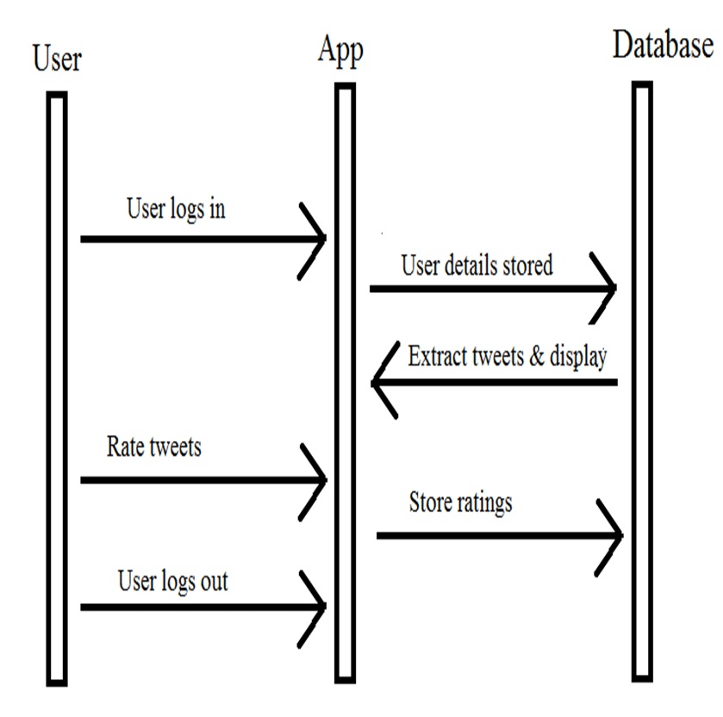
SEQUENCE DIAGRAM

Slide 12
MODULE DESCRIPTION
Basic Authentication
Object Data collection
Data Preprocessing
Data Visualization

Slide 13
Basic Authentication
The Django authentication system handles both authentication and authorization. Briefly, authentication verifies a user is who they claim to be, and authorization determines what an authenticated user is allowed to do. Here the term authentication is used to refer to both tasks.
The authentication system consists of:
Users
Permissions: Binary (yes/no) flags designating whether a user may perform a certain task.
Groups: A generic way of applying labels and permissions to more than one user.
A configurable password hashing system
Forms and view tools for logging in users, or restricting content
A pluggable backend system

Slide 14
Object Data Collection
Real-time data collected from Twitter. The collection of data is one of the major and most important tasks of any machine learning project. Because the input we feed to the algorithms is data. So, the algorithm's efficiency and accuracy depend upon the correctness and quality of data collected. So the data should be clear as possible for better results. Depending on the hashtag entered by the user we will get the most popular and recent tweets.

Slide 15
Data Preprocessing
Collection of data is one task and making that data as meaningful is another vital task. Data collected from various means will be in an unorganized format and there may be a lot of null values, invalid data values, and unwanted data.
Cleaning all those data and replacing them with appropriate or approximate data and removing null and missing data and replacing them with some fixed alternate values are the basic steps in pre-processing of data.
Even data collected may contain completely garbage values. It may not be in the exact format or the way that is meant to be.
All those cases should be verified and replaced with some other alternate values to make the data meaningful and useful for further processing. Data must be kept in an organized format. So here we have used some regex expressions to clean data.

Slide 16
Data Visualization
Data visualization is the practice of translating information into a visual context, such as a map or graph, to make data easier for the human brain to understand and pull insights from. The main goal of data visualization is to make it easier to identify patterns, trends and outliers in large data sets.
Data visualization is one of the steps of the data science process, which states that after data has been collected, processed and modeled, it must be visualized for conclusions to be made.
Data visualization is also an element of the broader data presentation architecture (DPA) discipline, which aims to identify, locate, manipulate, format and deliver data in the most efficient way possible.
When a data scientist is writing advanced predictive analytics or machine learning (ML) algorithms, it becomes important to visualize the outputs to monitor results and ensure that models are performing as intended.

Slide 17
TESTING
Testing is a process of executing a program with the intent of finding an error. A successful test is one that uncovers an as-yet- undiscovered error. System testing is the stage of implementation, which is aimed at ensuring that the system works accurately and efficiently as expected before live operation commences.
The software testing process commences once the program is created and the documentation and related data structures are designed. Otherwise the program or the project is not said to be complete. A good test case design is one that as a probability of finding an yet undiscovered error. A successful test is one that uncovers an yet undiscovered error. Any engineering product can be tested in one of the two ways:
Black Box testing - without knowledge of internal structure
White Box testing - with knowledge of internal structure

Slide 18
APPLICATIONS
Social media monitoring
Social media posts often present some of the most truthful points of view about products, services, and businesses because users offer their opinions unsolicited. They are simply compelled to tell the world how they feel.
Customer feedback
Sentiment analysis can also be used to gain insights from the troves of customer feedback available (online reviews, social media, surveys) and save hundreds of employee hours.
Customer support
Customer support management presents many challenges due to the sheer number of requests, varied topics, and diverse branches within a company – not to mention the urgency of any given request.

Slide 19
FUTURE ENHANCEMENTS
1) Emotion Detection
This sentiment analysis model detects the emotions that underlie a text. It makes associations between words and emotions like anger, happiness, frustration, etc. For example,
•'Hubspot makes my day a lot easier :)' → Happiness
•'Your customer service is a nightmare! Totally useless!!' → Anger
2) Aspect-based Sentiment Analysis
This type of sentiment analysis focuses on understanding the aspects or features that are being discussed in a given opinion. Product reviews, for example, are often composed of different opinions about different characteristics of a product, like Price, UX-UI, Integrations, Mobile Version, etc.

Slide 20
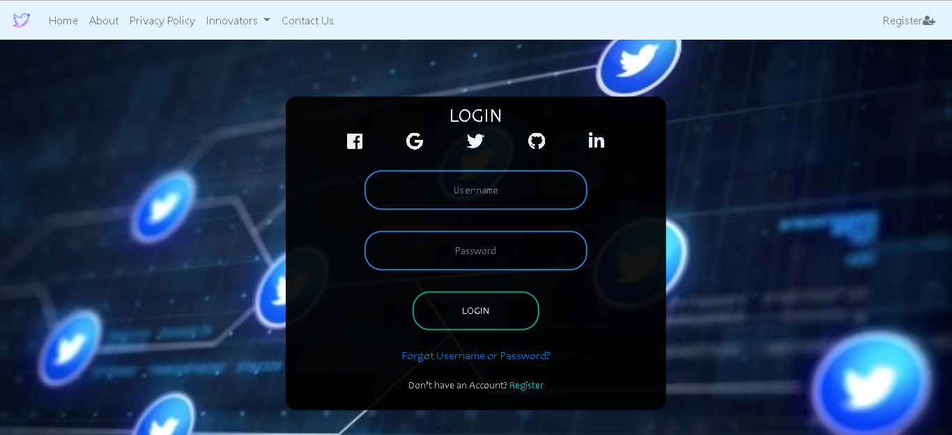
USER LOGIN SCREEN

Slide 21
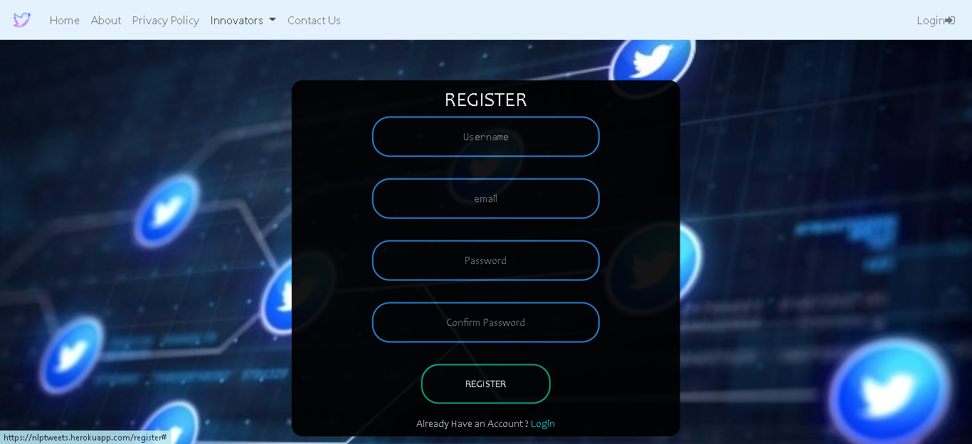
USER REGISTRATION SCREEN

Slide 22
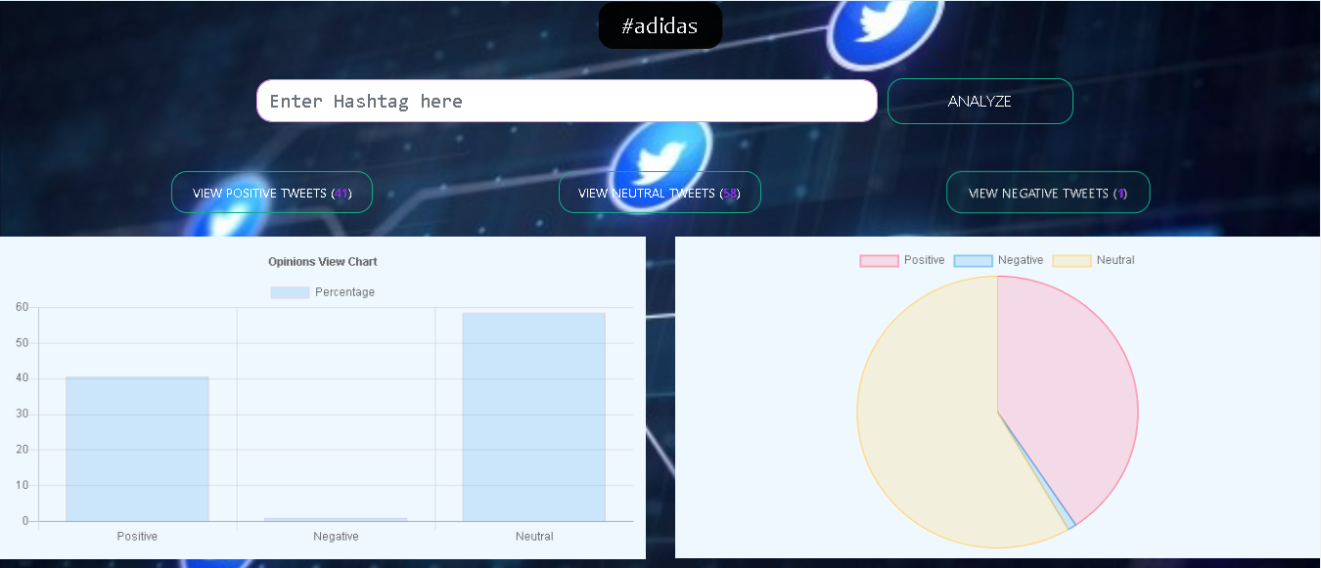
OPINIONS VISUALIZATION

Slide 23
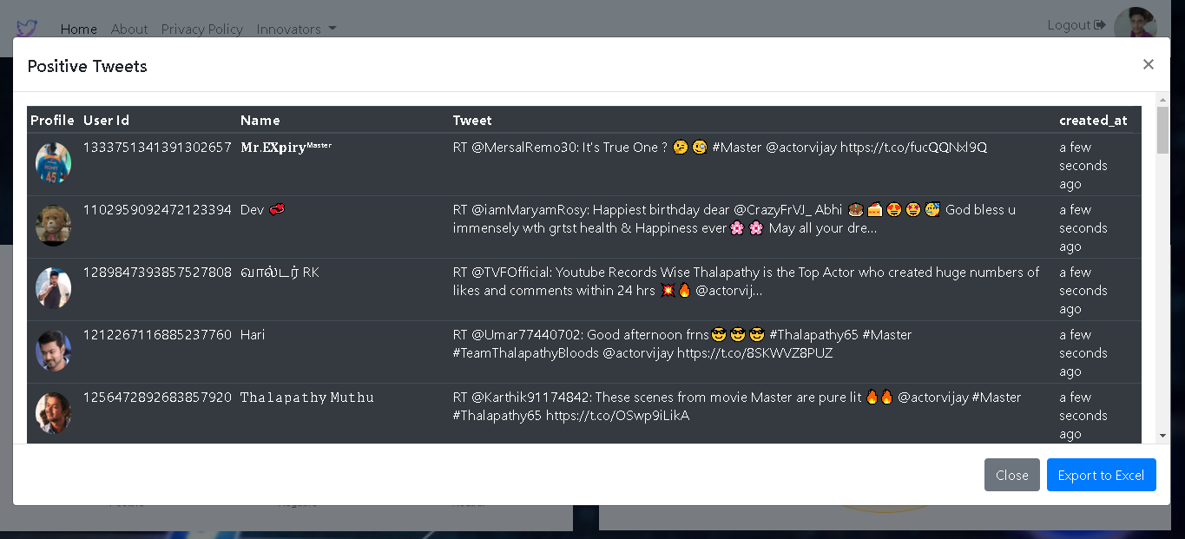
VIEW TWEETS

Slide 24
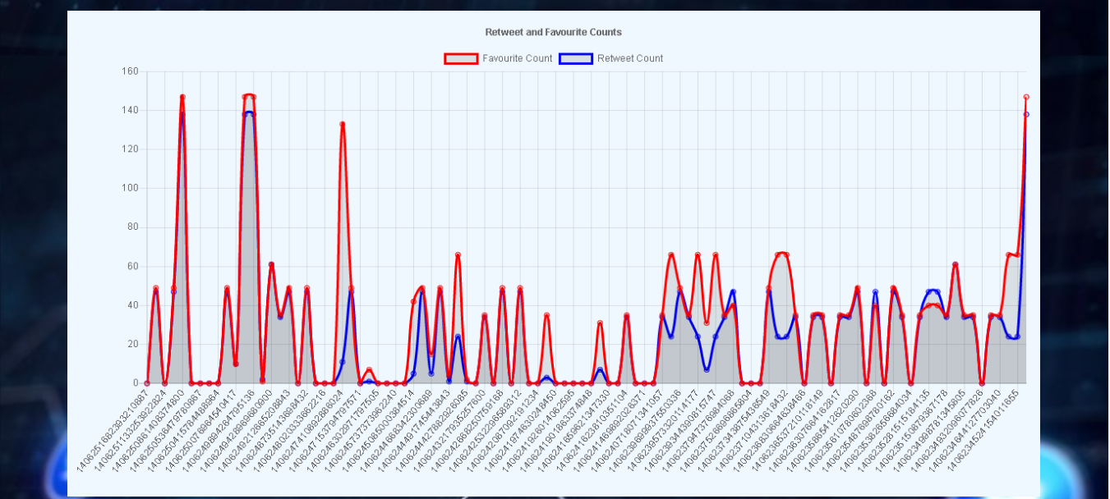
RETWEET AND FAVOURITE COUNTS

Slide 25
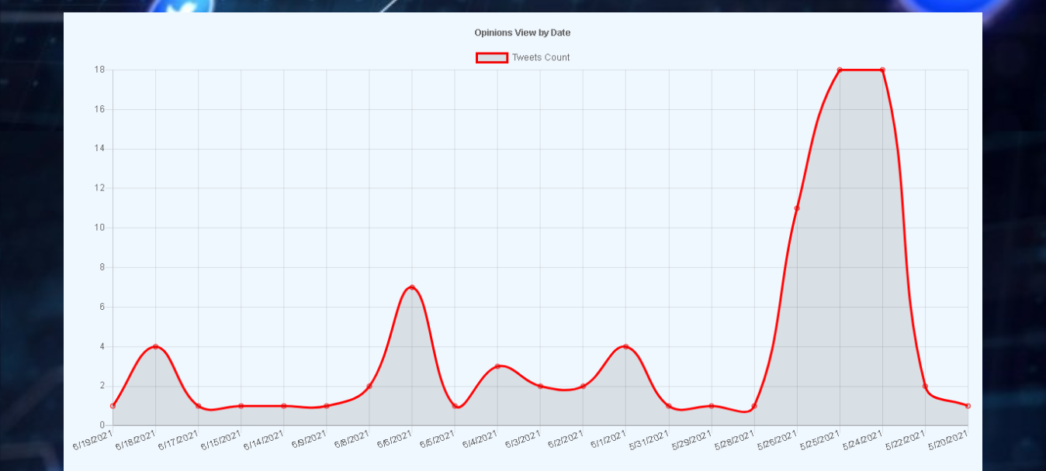
TWEETS COUNT BY DATE

Slide 26
REFERENCES
[1] G.Vinodhini and RM.Chandrasekaran, “Sentiment Analysis and Opinion Mining: A Survey”, Volume 2, Issue 6, June 2012 ISSN: 2277 128X International Journal of Advanced Research in Computer Science and Software Engineering
[2] Zhongwu Zhai, Bing Liu, Hua Xu and Hua Xu, “Clustering Product Features for Opinion Mining”, WSDM’11, February 9–12, 2011, Hong Kong, China. Copyright 2011 ACM 978-1-4503- 0493- 1/11/02...$10.00
[3] Singh and Vivek Kumar, ―A clustering and opinion mining approach to socio-political analysis of the blogosphere”, Computational Intelligence and Computing Research (ICCIC), 2010 IEEE International Conference.
[4] Alexander Pak and Patrick Paroubek, “Twitter as a Corpus for Sentiment Analysis and Opinion Mining”
[5] Bing Liu. “Sentiment Analysis and Opinion Mining, Morgan & Claypool Publishers, May 2012.”
[6] V. S. Jagtap and Karishma Pawar, “Analysis of different approaches to Sentence-Level Sentiment Classification”, International Journal of Scientific Engineering and Technology (ISSN: 2277-1581) Volume 2 Issue 3, PP: 164-170 1 April 2013 Onam Bharti et al, International Journal of Computer Science and Mobile Computing, Vol.5 Issue.6, June- 2016, pg. 601-609 © 2016, IJCSMC All Rights Reserved 609

Slide 27
[7]. K. Bun and M. Ishizuka, “Topic extraction from news archive using TF*PDF algorithm”, In Proceedings of Third International Conference on Web Information System Engineering.
[8]. Jacques Savoy, Olena Zubaryeva, “Classification Based on Specific Vocabulary” published in 2011 IEEE/WIC/ACM International Conferences on Web Intelligence and Intelligent Agent Technology 978-0-7695-4513-4/11 2011 IEEE
[9]. Dengya Zhu, Jitian XIAO, “R-tfidf, a Variety of tf-idf Term Weighting Strategy in Document Categorization”, published in 2011 Seventh International Conference on Semantics, Knowledge and Grids.
[10]. Catherine Blake “A Comparison of Document, Sentence, and Term Event Spaces” published in IEEE 2010
[11]. Ying Chen, Wenping Guo, Xiaoming Zhao, “A semantic Based Information Retrieval Model for Blog”, Third International Symposium on Electronic Commerce and Security, 2010, IEEE
[12] Jalaj S. Modha, Prof & Head Gayatri S. Pandi Sandip J. Modha, “Automatic Sentiment Analysis for Unstructured Data”, International Journal of Advanced Research in Computer Science and Software Engineering , Volume 3, Issue 12, December 2013 [14] R M. Chandrasekaran, G.Vinodhini, “Sentiment Analysis and Opinion Mining: A Survey”, International Journal of Advanced Research in Computer Science and Software Engineering, Volume 2, Issue 6, June 2012 [15] Bing Liu., “Sentiment Analysis and Opinion Mining”, Morgan & Claypool Publishers, May 2012

Slide 28
THANK YOU!

