Slide 1
CV MASTER FIB · UPC
Computer Vision
Short Project
Guidelines, Phases & Project Types
Academic Year Spring 2026

Slide 2
CV Short Project
A hands-on group project where teams apply Computer Vision techniques to solve real problems, explore new ideas, or push creative boundaries.
CV Short Project
Teams
Scope
Output
1, 2 students
per group
(the old groups or new groups)
Computer Vision
project work
Analysis, report
& presentation
The short project is your chance to demonstrate applied Computer Vision skills, combining theory with practice in a focused, creative context.

Slide 3
FOUR PHASES
Your journey from idea to final presentation
01
02
03
Project Definition
Checkpoint 50%
Final Presentation
Short Project Definition
Mid-point Check-in
Project Showcase
Select a project type & topic
Define goals and scope clearly
Form your team
Submit project proposal
Present work progress
Preliminary results
Adjust scope if needed
Validate methodology
Present results & findings
Live Q&A
Submit final report & ppt
04
Peer to peer evaluation

Slide 4
PHASE 1
Short Project Definition
The starting point — define your vision before building it.
What to Submit
Tips
Project title and team members
Problem statement and motivation
Chosen project type
Proposed CV techniques/methods
Dataset(s) to be used
Expected outcomes and deliverables
Be specific — vague proposals are harder to evaluate
Choose a scope that is challenging but feasible
Align your topic with available datasets & CP
Discuss your idea with me
Consider novelty

Slide 5
PHASE 2
Checkpoint — 50%
Mid-point evaluation to validate progress and recalibrate direction.
0%
50% — You are here
100%
Present
Pipeline Design
Receive Feedback
Adjust
Intermediate results, partial implementation, and initial findings.
Project scheme, components, partial results...
Get actionable guidance to improve methodology, scope, or direction.
Refine goals, fix issues early, and plan the remaining 50% with confidence.

Slide 6
PHASE 3
Final Presentation
Showcase your full work — results, insights, and lessons learned.
Presentation Structure
Evaluation Criteria
1
Introduction & Motivation
What problem? Why?
Technical quality
35%
2
Methodology
Techniques, architecture, dataset
Clarity of presentation
20%
3
Results & Analysis
Metrics, visualisations, comparisons
Results & analysis depth
25%
4
Conclusions
Findings, limitations, future work
Creativity & novelty
20%
5
Demo & Q&A
Live showcase and questions

Slide 7
FOUR PROJECT TYPES
Choose the track that best fits your interests
⚙
Productivity
🔭
Exploration
📊
Analytic
🚀
Crazy Ideas
Build tools that work
Discover new frontiers
Understand through data
Push the boundaries
Use CV to extract insights from visual data. Combine quantitative analysis with visual understanding…
Take risk. Dream big and experiment boldly. Unconventional architectures, creative uses of Computer Vision...
Create CV systems that solve real-world efficiency problems. Focus on deployment, performance, and practical impact.
Investigate novel techniques, models, or datasets. Emphasise novelty, and understanding. Make the contribution understandable for us.

Slide 8
TYPE 1
⚙ Productivity
Productivity
Focus on building efficient, deployable CV systems with real-world impact.
Key Characteristics
Project Ideas
Performance-oriented: speed, accuracy, and reliability matter
Real or realistic datasets that reflect deployment conditions
End-to-end pipeline: preprocessing → model → output
Clear metric definition and evaluation protocol
Optional: web demo, API, or integration with other systems
….?

Slide 9
Face Recognition
for Access Control
A real-time Computer Vision system for secure, contactless identity verification.
Image Acquisition
Face
Face Recognition
Processing
Detection
Acces
Computer Vision Short Project · Master FIB UPC

Slide 10
Gesture based HCI
for camera point of view control
A real-time Computer Vision system for POV control in 3D virtual scenarios
Hand and face
detection
Gesture
POV Control
Processing
Detection and tracking
3D Rendering
Computer Vision Short Project · Master FIB UPC

Slide 11
TYPE 2
🔭 Exploration
Exploration
Investigate, benchmark, and understand novel methods or emerging research directions.
Key Characteristics
Ideas
Research-oriented: reproduce, extend, or compare papers
Educational materials for teaching, facilitating the learning process
Exploration of new architectural choices
Well-documented findings and reproducible code
IEEE/CVF Conference on Computer Vision and Pattern Recognition
IEEE/CVF International Conference on Computer Vision
Are you missing any important and new CV concepts that were not explained in the subject?

Slide 12
TYPE 3
📊 Analytic
Analytic
Use Computer Vision to extract meaningful insights from visual data through deep analysis.
Key Characteristics
Project Ideas
Data-driven: strong quantitative evaluation is central
Visual analytics: combine vision models with data insights
Results presented with statistical rigour
Interpretability and explainability valued
Convolution filters weights analysis
Features for classification vs features for image autoencoding
Explainable NN: a "heatmap" over an image, highlighting the regions that were most important for a specific classification.

Slide 13
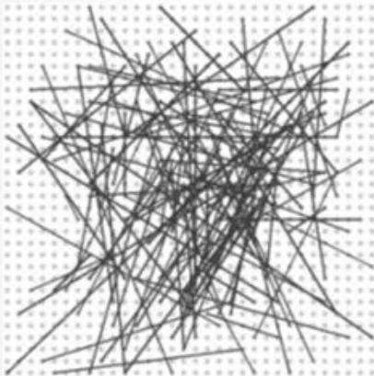
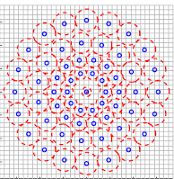
🚀 Crazy Ideas
TYPE 4
Crazy Ideas
Unconventional, creative, or artistic applications that explore the unexpected side of CV.
Key Characteristics
Wild Project Ideas
Originality is the primary evaluation criterion
Failure is acceptable — boldness is rewarded
Why is this idea compelling?
Technical rigour still expected despite creativity focus
New NN architectures
Random Convolutional Filters
Random NN connections
Atrous NN

Slide 14
SUMMARY & TIMELINE
Start
Phase 1
Phase 2
Phase 3
Phase 4
Form teams,
choose type
Project
Definition
Checkpoint
50%
Presentation Q&A
16 or 18 June
Final grade
Form teams,
choose type
Delivery 1
Next Week
Delivery 2
May 26 or 28
Delivery 3
June 15 or June 17
Report
PPT
Video
Peer to peer grading
June 22
Choose your path:
⚙ Productivity
🔭 Exploration
📊 Analytic
🚀 Crazy Ideas

Slide 15
AI coding tools are allowed
Transformers can be used but cannot form the central part of the project.
Computer Vision Short Project · Master FIB UPC

Slide 16
Good luck!
Build something you're proud of.
Pick a project type → Define your idea → Hit your checkpoints → Present with confidence
Computer Vision Short Project · Master FIB UPC

