Slide 1




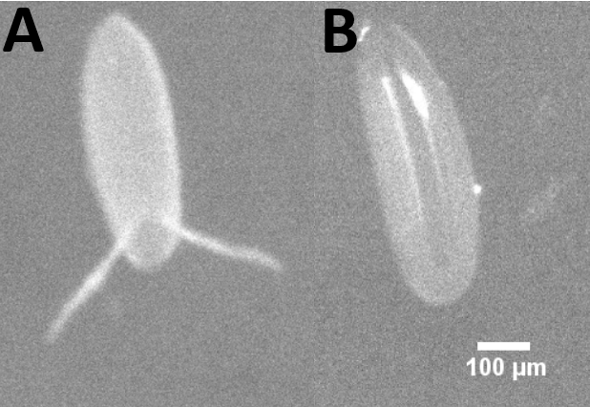
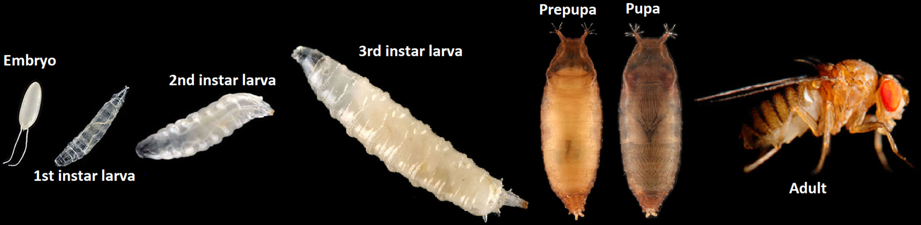
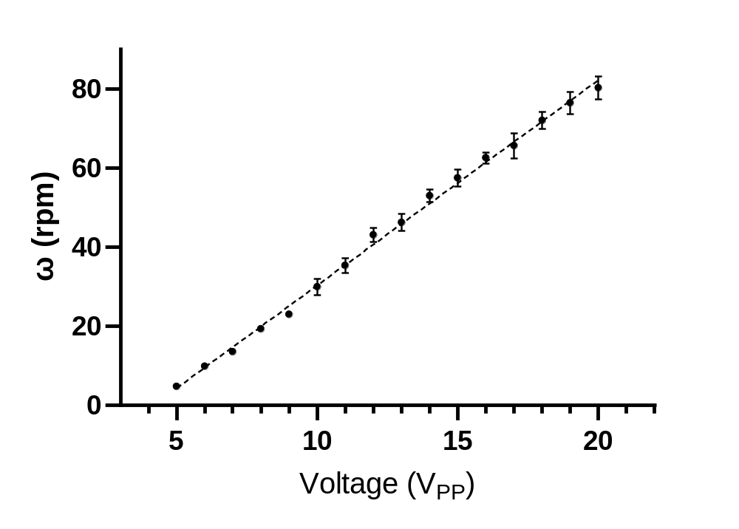
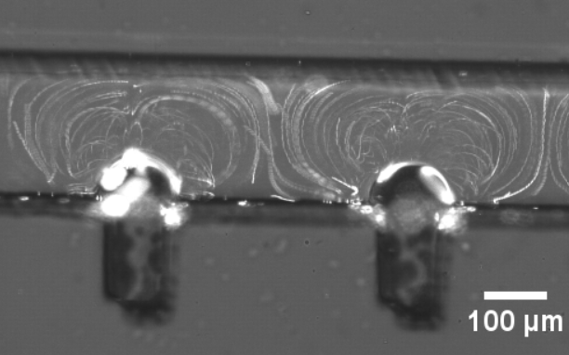
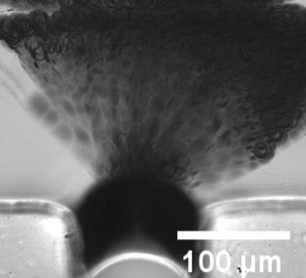
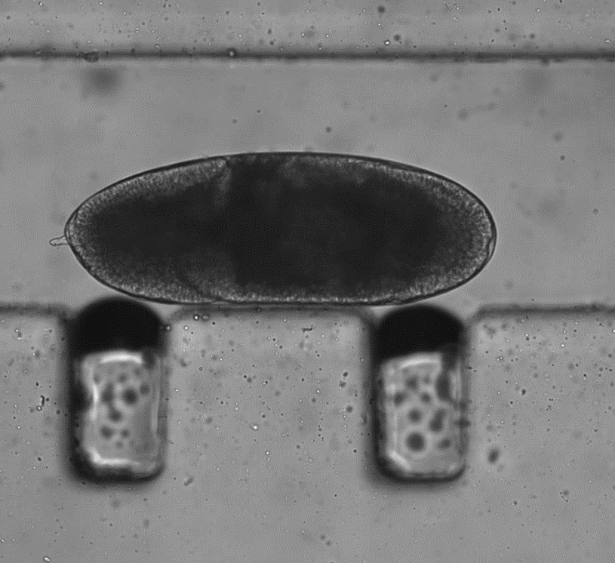
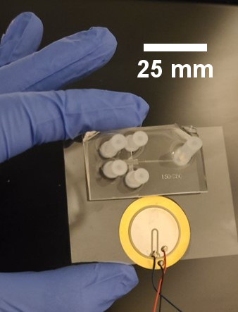
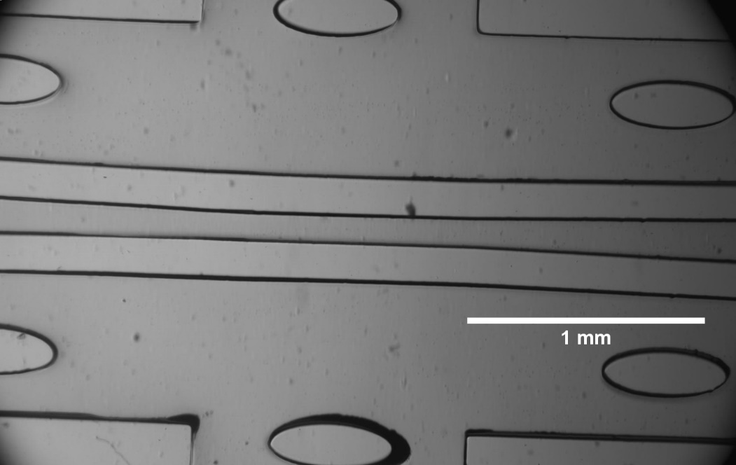
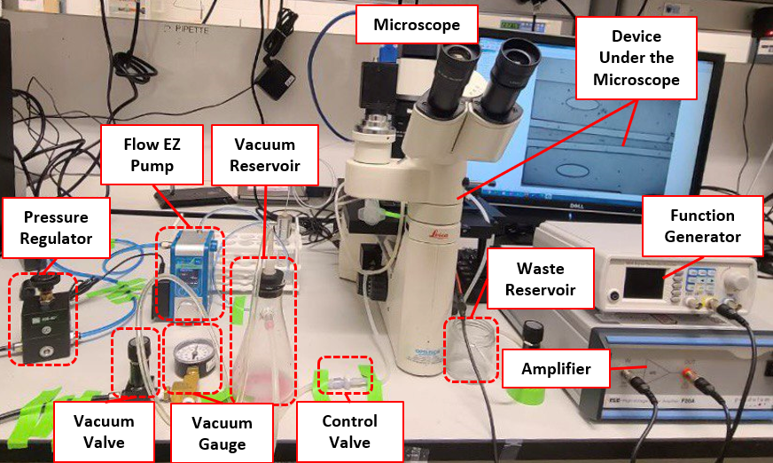
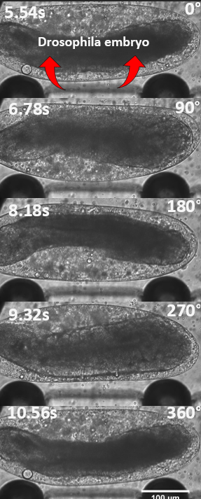
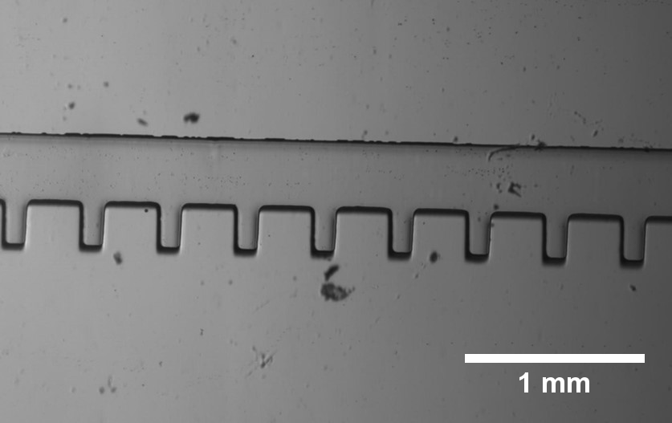
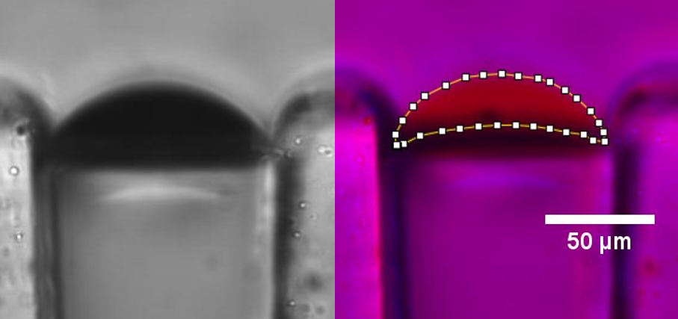
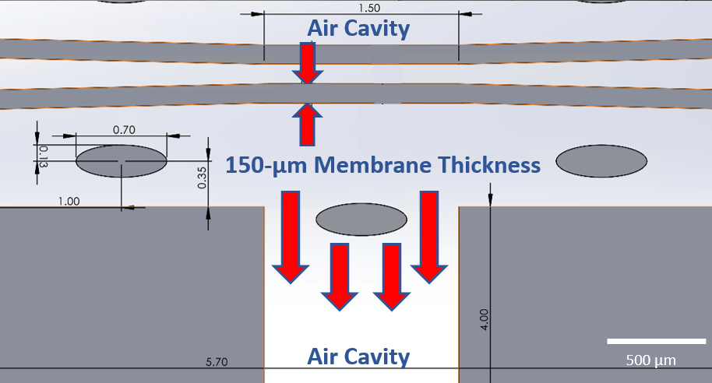
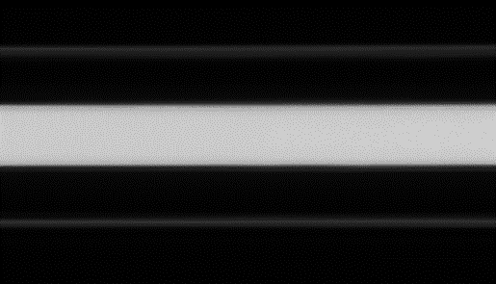
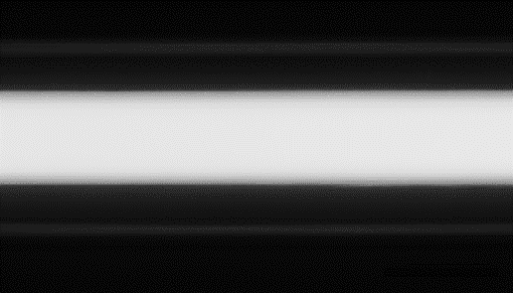




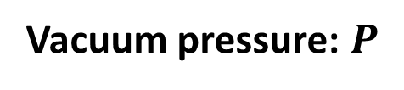
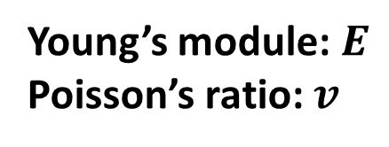
ACOUSTOFLUIDIC ROTATIONAL MANIPULATION OF DROSOPHILA EMBRYOS IN A MICROFLUIDIC DEVICE
Alireza Zabihihesari, Joaquin Ramirez-Medina, and Pouya Rezai
Department of Mechanical Engineering, York University, Toronto, ON, Canada, E-mail: prezai@yorku.ca
INTRODUCTION
RESULTS
Drosophila melanogaster (fruit fly) embryonic studies require monitoring spatiotemporal dynamics of pattern formation and morphogenesis in large numbers of embryos(Fig. 1 and 2) [1].
Conventional Drosophila embryo handling and manipulation techniques are labor-intensive and time-consuming [1].
Precise rotational manipulation techniques are essential for in-vivo multidirectional imaging.
  Effect of negative pressure on membrane deflection
  Effect of voltage amplitude and excitation frequency
The deflection of the membrane increased linearly by increasing the negative pressure through air channels (Fig. 7)
A vacuum pressures of -60 kPa was sufficient to open microchannel wide enough for passage of embryos
In-plane (Fig. 8A) vortices were achieved at several frequencies in the range of 0-150 kHz while out-of-plane (Fig. 8B) vortices were achieved only at 5 kHz and 90 kHz.
Out-of-plane vortices were much stronger at 5 kHz. Therefore, this frequency was chosen for embryo rotation (Fig. 8C).
Embryos were rotated at 5 kHz and the effect of voltage amplitude was investigated at this frequency (Fig. 8D)
Our goal
Drosophila Life Cycle
Developing an acoustofluidic microfluidic device for rotational manipulation of Drosophila embryos
)
)
Drosophila Life Cycle
A)
B)
C)
D)
Figure 1. Embryos A) before and B) after dechorionation
Figure 2. Drosophila life cycle
100 µm
THEORY AND EXPERIMENTAL METHODS
Figure 7. Linear correlation between the channel width and the amplitude of the vacuum pressure
Figure 8. Demonstration of in-plane vortices at 33 kHz - 10 Vpp (A) and out-of-plane vortices at and 5 kHz – 10 Vpp (B) using microparticles. C) Out-of-plane rotation of Drosophila embryo at 5 kHz-10 Vpp in the microfluidic device. D) The embryos’ angular velocity increased by increasing the voltage amplitude.
``
The microfluidic chip (Fig. 3A) consisted of 3 modules, a pneumatic embryo trapping and releasing module with deflectable PDMS walls (Fig. 3B), a straight microchannel (30mm-long, 280µm-wide, 330µm-thick) with sidewall microcavities (90 µm-wide) to trap microbubbles (Fig. 3C), and a piezoelectric transducer that generated acoustic waves (Fig. 3A).
A)
B)
PDMS membrane
  Effect of upstream pressure on growth rate of acoustically excited microbubbles
  Step-wise out-of-plane rotation of embryos
When the piezoelectric transducer is on, bubble growth occurs due to rectified diffusion.
Increasing the upstream pressure reduces the growth rate of the microbubbles.
Within the range of 4.5 kPa to 5.5 kPa a constant bubble growth was recorded. At this range, the microbubble size was stable enough for embryo rotation. Therefore, all embryos were rotated at 4.5 kPa.
For high resolution multidirectional imaging of embryos, step-wise rotation of embryos was investigated by applying pulses with different durations (pulse width)
Smallest increment recorded was 2.3­° per pulse at a pulse width of 20 ms.
PDMS membrane
100 μm
C)
Microbubble traps
Transducer
Fig. 3. A) Microfluidic device. B) Pneumatic embryo trapping and releasing module. C) acoustofluidic module
Figure 4. Experimental setup
A)
Microbubbles were trapped in pre-designed cavities (Fig. 3C) within the microchannel and their growth rates were measured at different upstream pressures (hydrostatic pressures within the microchannel).
PDMS membrane deflection in Fig 3.B, was estimated using Eq. 1 and verified experimentally to determine how much deflection was required for embryo passage. When a negative pressure (-60 kPa) was applied, a single embryo was released and pushed towards the acoustofluidic module.
The piezoelectric transducer shown in Fig 3.A, was actuated at 0 to 150 kHz frequencies and 0 to 20 V_{pp} amplitude to achieve out-of-plane vortices.
Figure 9. A) Microbubble growth rate in the microchannel decreased by increasing the upstream pressure. B) ImageJ was used for bubble growth analysis
B)
Figure 10. Plot of rotational angle as a function of pulse width in stepwise rotation for embryos
Figure 11. The step-wise rotation of an embryo by the microbubble oscillations
A)
$$W^{′}=W−\left(\frac{Ph^{4}\left(1−v^{2}\right)}{16Et^{3}}\right)×\left(1+\frac{4t^{2}\left(12+11v\right)}{\left(5h^{2}\right)}\right) (Eq. 1)$$
CONCLUSION
Height: $h$
[3]
A microfluidic device was designed and fabricated for acoustofluidic rotational manipulation of Drosophila embryos.
The device provided embryo trapping, single embryo release, and step-wise rotation of embryos with 2.3­° resolution per pulse.
Membrane thickness: $t$
A)
B)
Young’s module: $E$
Poisson’s ratio: $v$
channel width:$W$
channel width: $W^{′}$
REFERENCES
Vacuum pressure: $P$
300 µm
300 µm
[1] A. Zabihihesari, A. J. Hilliker, and P. Rezai, Integr. Biol., vol. 11, no. 12, pp. 425–443, 2020.
[2] K. Chung, Y. Kim, J. S. Kanodia, E. Gong, S. Y. Shvartsman, and H. Lu, Artic. Nat. methods, vol. 8, no. 2, 2011.
[3] A. Z. Shorr, U. M. Sönmez, J. S. Minden, P. R. LeDuc, Lab Chip. 19(7), 1141, 2019.
Figure 5. Schematic of the trapping & releasing module
Figure 6. The microchannel was filled with fluorescent dye and microchannel width was measured before (A) and after (B) applying negative pressure

