Slide 1

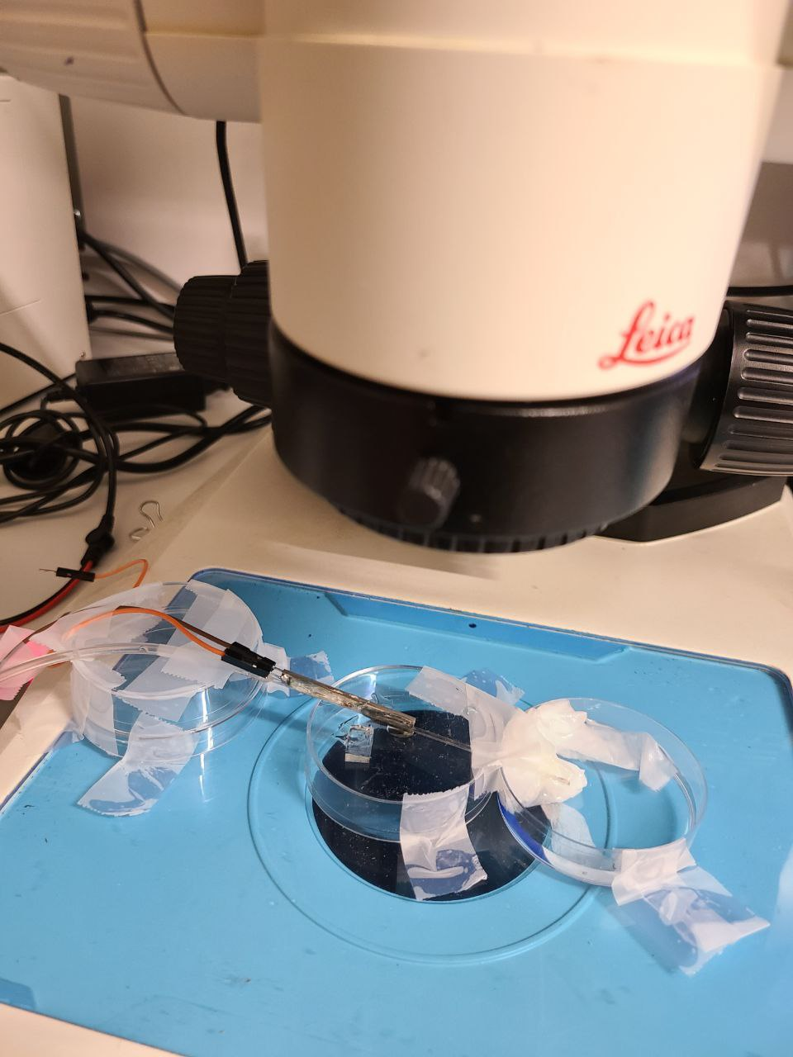
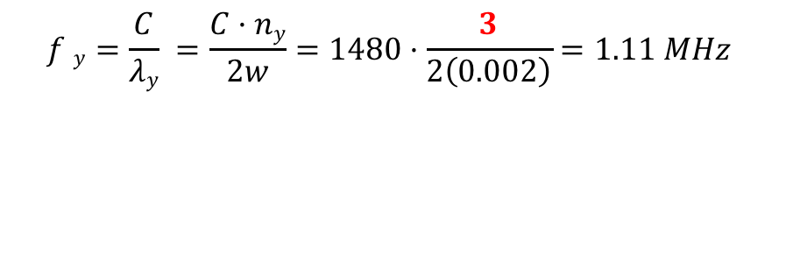
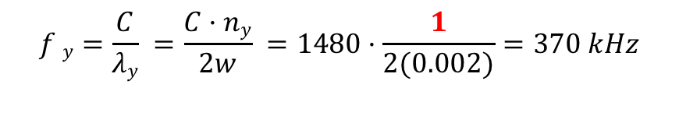
Experiments on glass capillary and piezo transducers
Generating 3 acoustic pressure nodes at the center was doable across the width of the glass capillary
Glass capillary dimension: 2mm x 2mm
$$f y=\frac{C}{λy} =\frac{C·ny}{2w} =1480·\frac{1}{2(0.002)}=370 kHz$$
$$f y=\frac{C}{λy} =\frac{C·ny}{2w}=1480·\frac{3}{2\left(0.002\right)}=1.11 MHz$$
Microscope
Flow cell
pzt
Petri dish

Slide 2
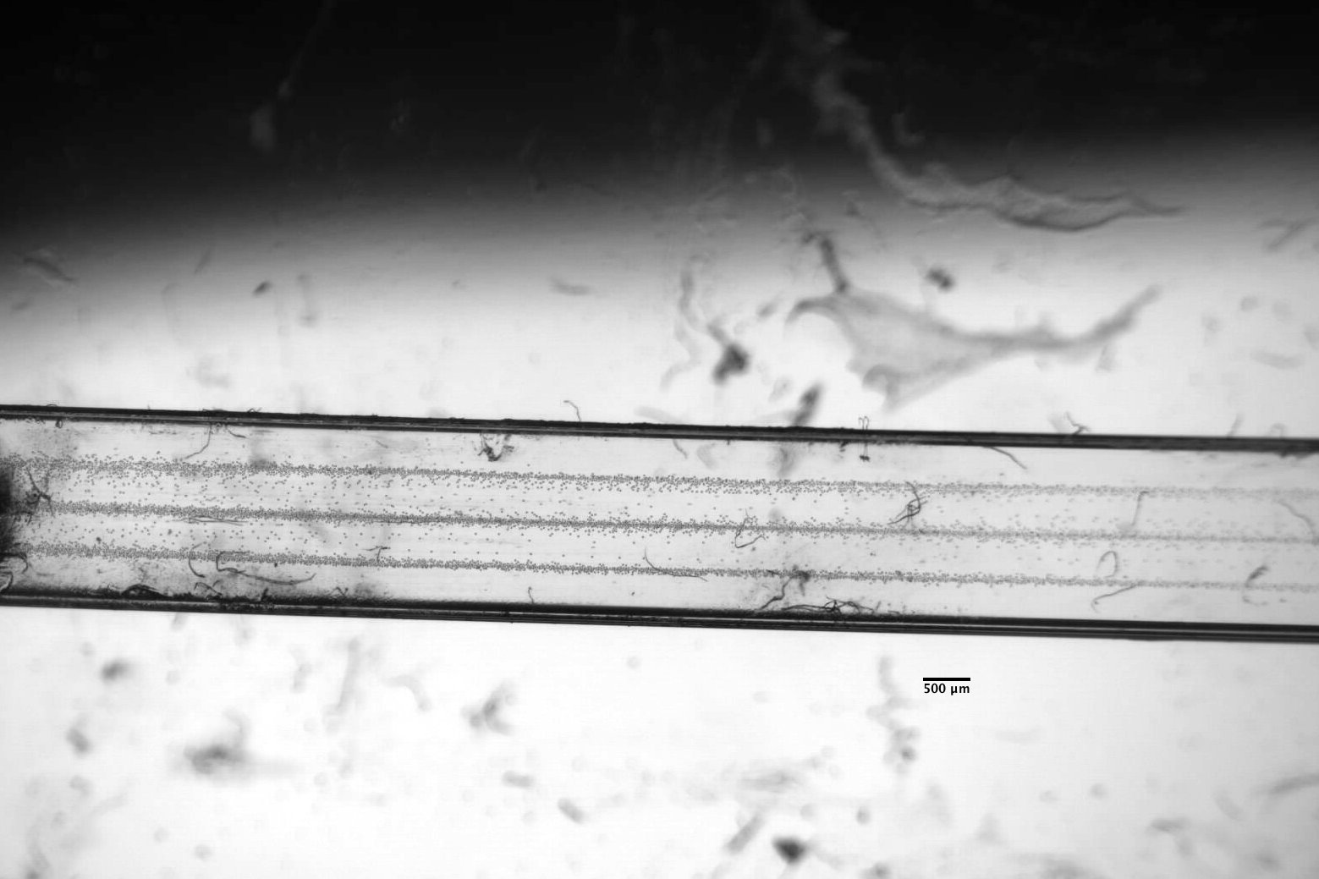
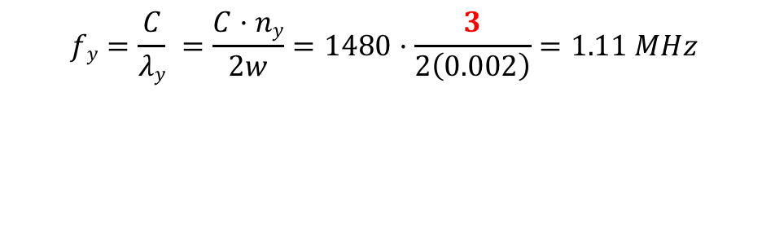
Experiments on glass capillary and piezo transducers
$$fy=\frac{C}{λy} =\frac{C·ny}{2w}=1480·\frac{3}{2\left(0.002\right)}=1.11 MHz$$
Particle Size = 22 µm
Flow rate = 1 ml/min
Frequency = 611.5 kHz
Voltage = 200 Vpp

