Slide 1

Battle of the electronics stores
Capstone project
Jose E. Jobel

Slide 2
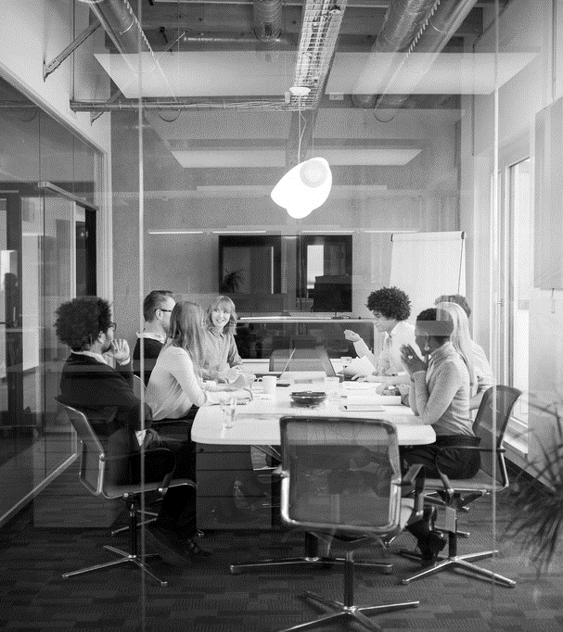
Agenda
INTRODUCTION
DATA ACQUISITION & CLEANING
ANALYSIS
RESULTS
SUMMARY

Slide 3
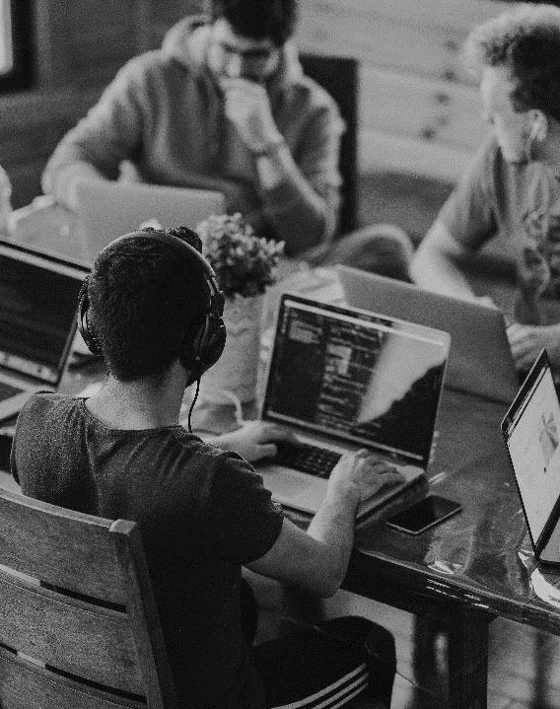
INTRODUCTION
Business Problem
This project is geared toward stakeholders particularly interested in identifying an optimal location for a computer electronics store business in Los Angeles, California. The business is aimed at computer enthusiast and professional online gamers, thus providing a large variety of computers, computer parts, electronics, softwares, and gaming supplies.
Three optimal locations will be recommended to stakeholders.

Slide 4
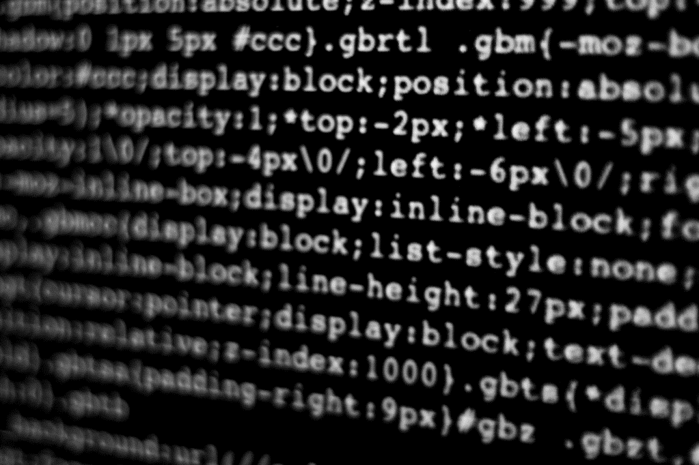
Data Acquisition and cleaning
Let’s Dive In
`la_venues` provides us information about the businesses within a neighborhood. We have business names, geographical coordinates, and the category a given business falls in.
`elec_neigh` provides similar information as `la_venues` with the exception that businesses represented in this dataframe are strictly electronics stores.
`la_clean` also derived from the `la_venue` dataframe. `la_clean` provides information on all other businesses that are not electronics stores. The information in this dataframe will be used to make our recommendation later in the analysis.

Slide 5
Data Visualization
Analysis

Slide 6
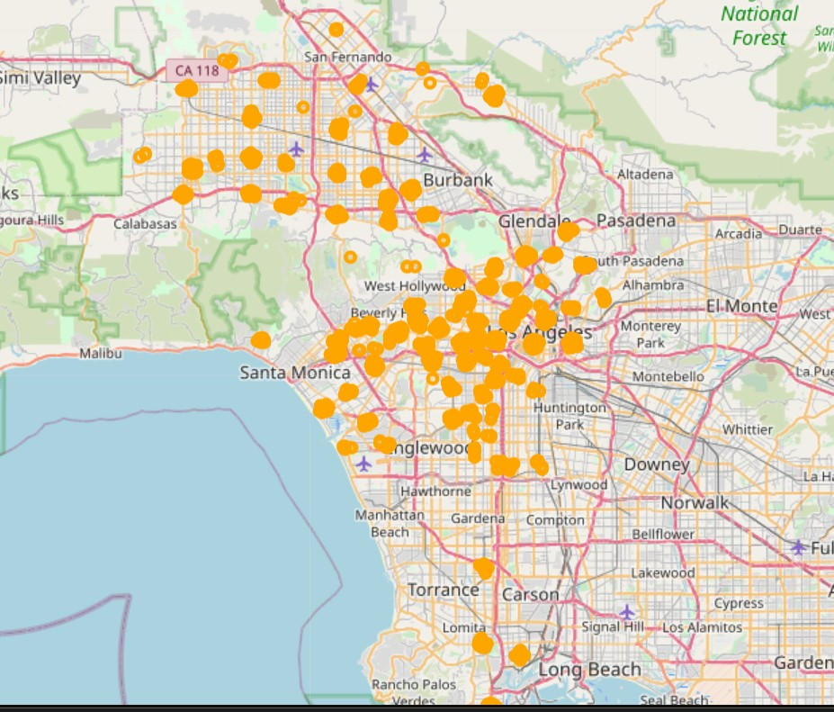
Venues in 105 LA Neighborhoods

Slide 7
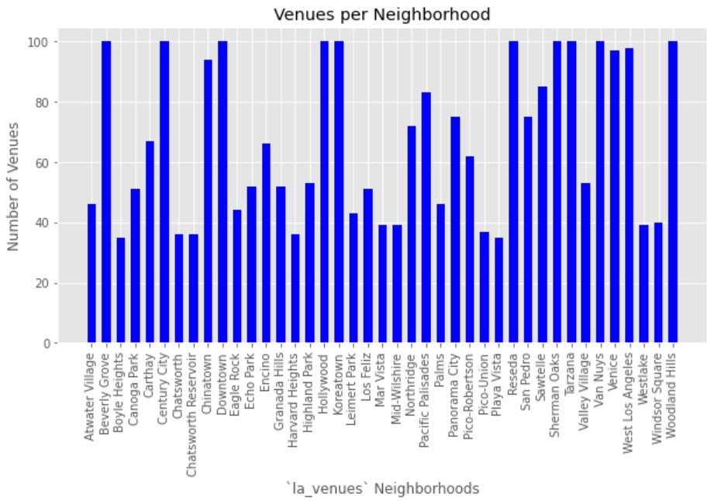
41 out of 105 LA Neighborhoods

Slide 8
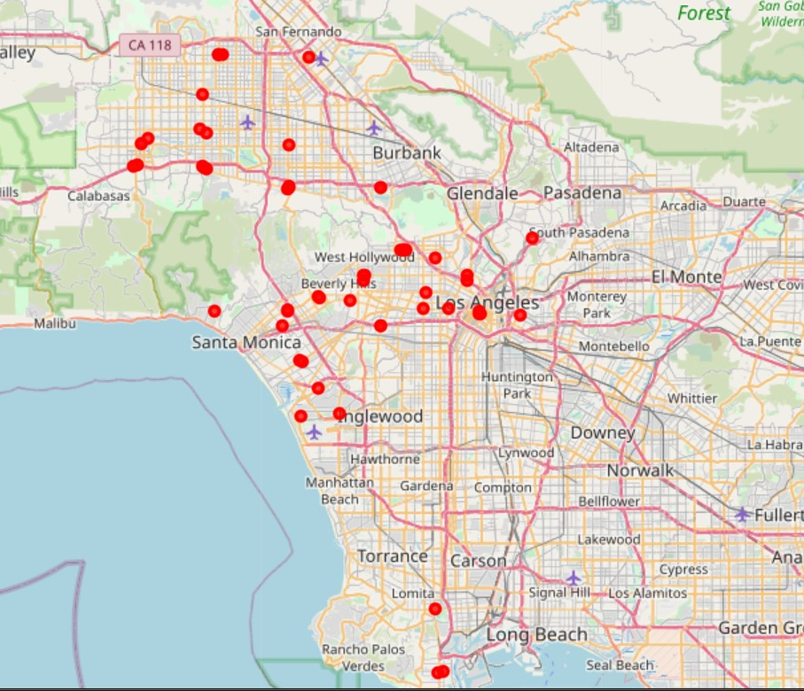
Electronics Stores in 33 LA Neighborhoods

Slide 9
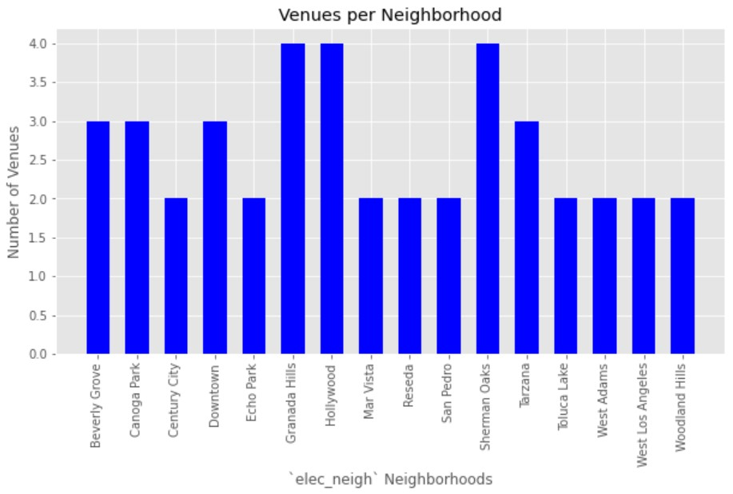
16 out of 33 LA Neighborhoods

Slide 10
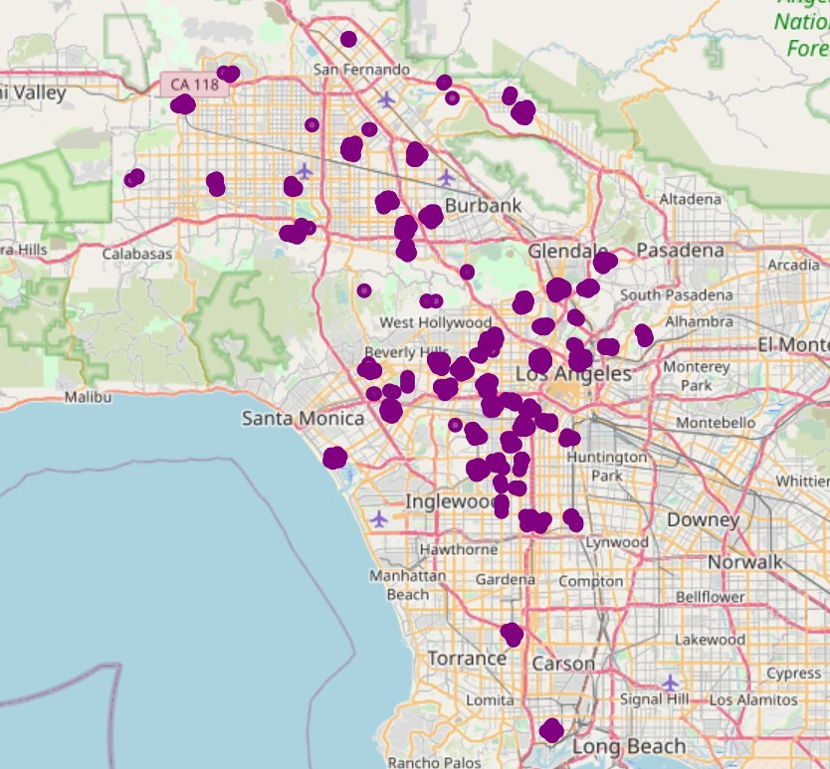
All Other Venues in 72 LA Neighborhoods

Slide 11
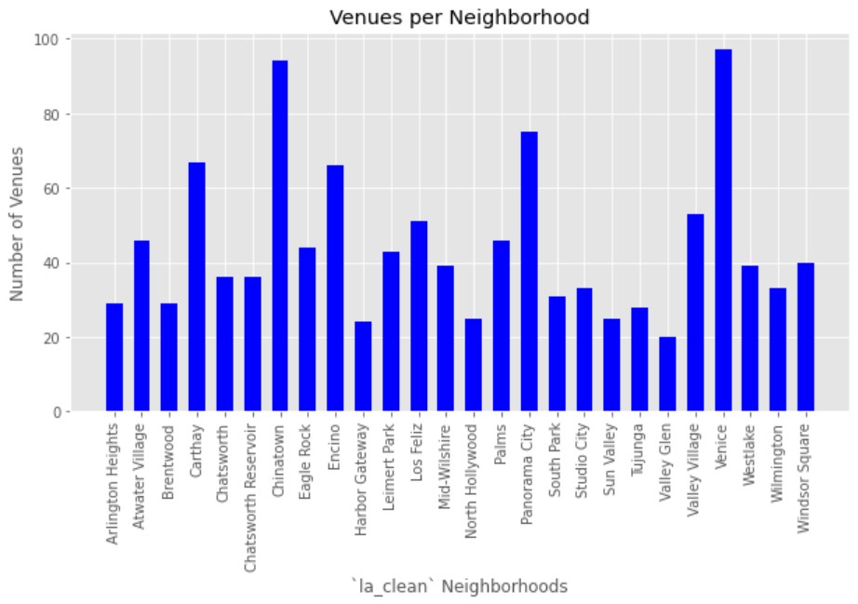
26 out of 72 LA Neighborhoods

Slide 12
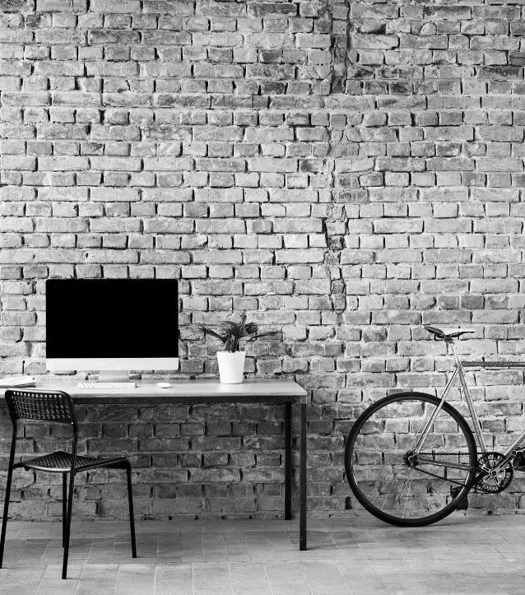
Results
LOOKING AHEAD

Slide 13
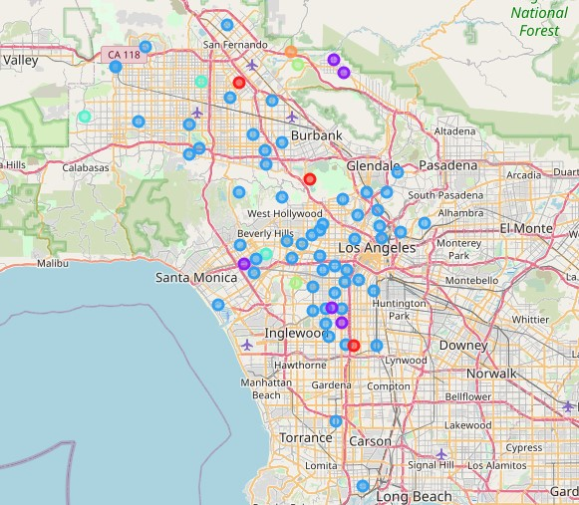
6 neighborhood clusters
Venice – Cluster 2
Chinatown – Cluster 2
Panorama City – Cluster 2s

Slide 14
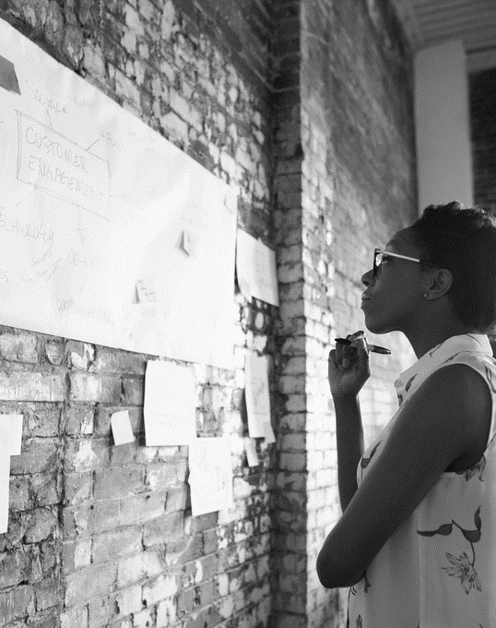
SUMMARY
BUSINESS PROBLEM
Recommend three locations for a computer electronics store
DATA ACQUISITION & CLEANING
Data scaped online and preprocessed using Foursquare.
ANALYSIS
Seperated data into three separate Pandas Dataframes. Visualized locations of neighborhoods and venues on a map. K-means clustering used to group similar neighborhoods.
Results
Recommended locations are Venice, Chinatown, and Panorama City

Slide 15



THANK YOU
JOSE E. JOBEL
+1 (***) - *** ****
Jjobel.elias@gmail.com
IBM DATA SCIENCE COURSERA PROJECT

