Slide 1
Predicting the Price of Housing in San Diego County
Jordan Jobes
Data Science Intensive Capstone Project, September 3rd Cohort

Slide 2

The Problem
Housing prices have many factors affecting them
It is difficult to understand if a house is overpriced or not due to a ‘tribe’ costing mentality
“if my neighbor got that much for his house, I can too”
What factors correlate to housing prices?
How closely can we predict what houses sold for? Then use that model to look at house values for currently listed houses?

Slide 3
Who might care?
Sellers
Real Estate Brokers
Banks (Lenders)
County Officials
Sellee’s
You reading this PPT
Me writing this PPT
Anyone who may purchase a house

Slide 4

Data Information
url: http://www.mls.com/
Number or loans: 111,427
Number of Fields: 127
The data was gathered from exporting csv files from the MLS website with a current Real Estate Agent’s login. A for-loop brought all the files together in one dataframe. The data is only being shared with my student advisor and the Real Estate Agent.

Slide 5

Data Cleaning
Import data
Remove duplicate rows
Remove columns with >85% NaN values
Remove non-contextual columns
Replace missing values with applicable values
Review numeric feature distributions and remove non-real outliers

Slide 6
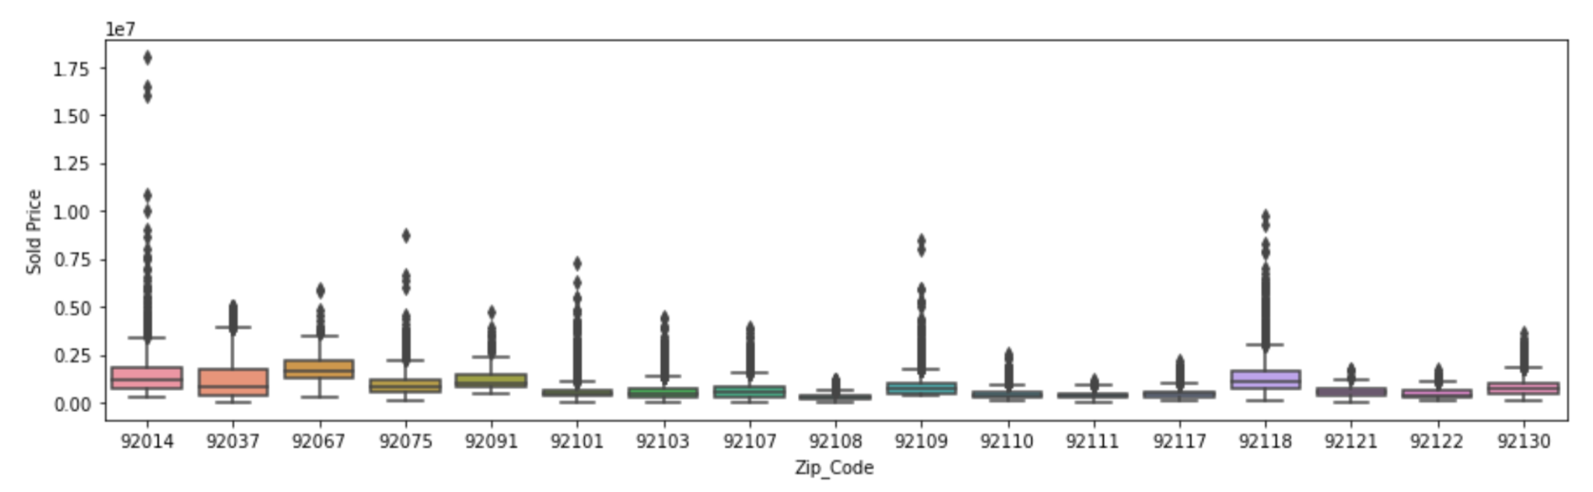
EDA - Zip Code Distribution

Slide 7
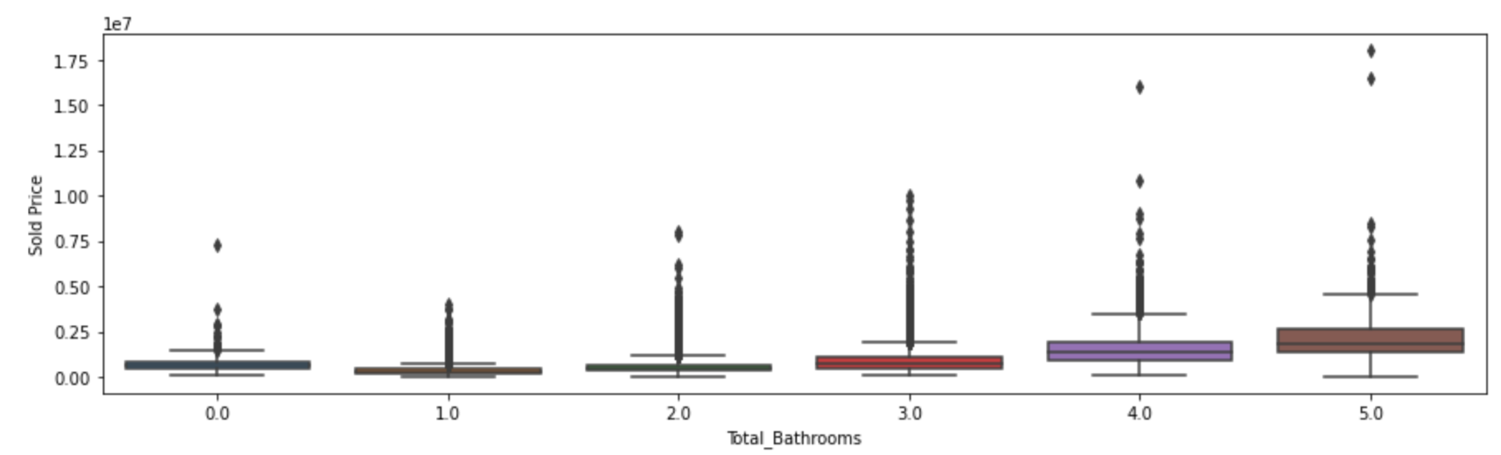
EDA - Bedroom Distribution

Slide 8
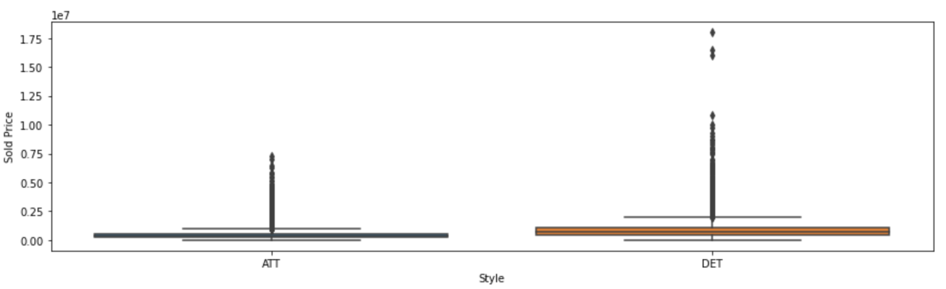
EDA - House vs Condo Distribution

Slide 9
Pre-Model Data Processing
The dataset from EDA was split by categorical and numeric features, transformed, then merged back together
MLS # was set as the index so no data was misplaced
Categorical feature transformation:
pd.get_dummies()
Numeric features:
Not transformed - Not needed in tree based models
This analysis will focus only on tree based models

Slide 10
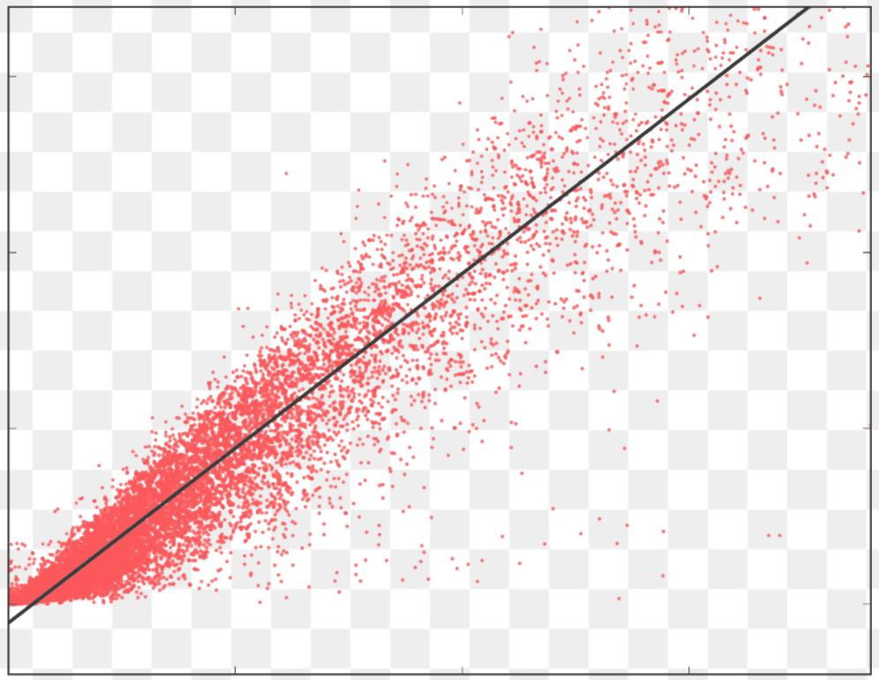
Modeling – Overview
Type – Supervised Learning
Regression
Tools – ScikitLearn, Jupyter Notebook

Slide 11
Modeling – Performance Comparison
RMSE and MAE are the key metrics used for this regression analysis
RMSE → 35,873 (5.4% of mean)
MAE → 10,261 (1.5% of mean)
Chosen Model: XGBoost
I performed research on what type of models performed best on real estate based models. XGBoost is overwhelmingly the best model on average.
The EDA boxplots show a lot of high outliers in all zip codes. This is shows San Diego is a growing market. Tree based models work well with outlier and thus why XGBoost was chosen.

Slide 12
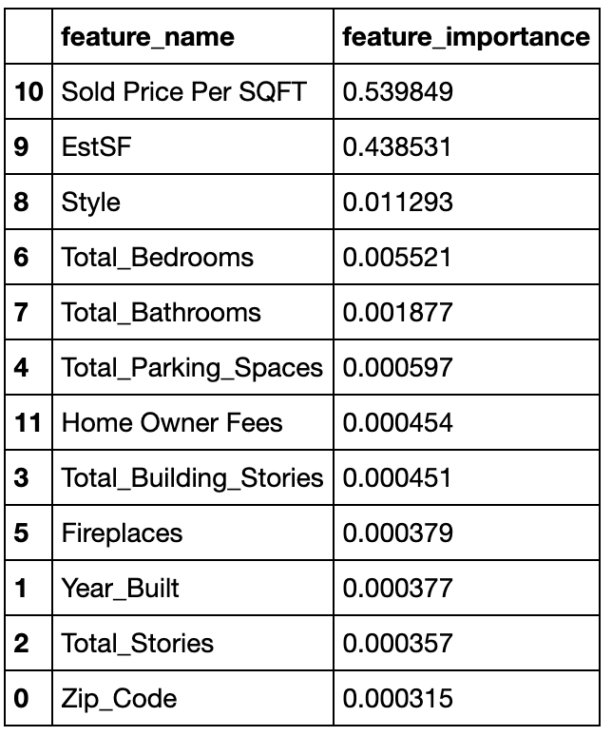
Key Features in Catboost Model

Slide 13
Key Takeaways
Based on the key features with this analysis, home owners should:
Consider increasing housing square footage before selling. Adding a roof deck, creating a second floor, etc. will have a significant increase in housing price
San Diego County market is so prized that the location (zip code) is almost irrelevant.
For higher prices homes (>1 million), adding a fireplace would be a good investment
Bedrooms are more prized than standard rooms. Converting an office or smaller room into a bedroom would be a good investment.

Slide 14
Future Investigations
Add more complex features - import google map API to determine driving distances to schools, beach, grocery store, etc
Add a ‘Ocean View’ feature - add in direction of front door and altitude. This has a large impact on price
Create different models for different housing prices - higher priced homes are almost an entirely different market. They may dilute the coefficients of lower priced homes causing a greater RMSE for more average priced homes.

Slide 15
Thank You!

