Slide 1
Problem Identification
Big Mountain Resort feels their current pricing strategy is preventing them from being as profitable as they can be
Their current pricing strategy is set as slightly above the national average for similar resorts
Current price → $81
Market average → $64
The goal is to quantify the value each resort provides to its customers, determine if their ticket prices are above or below the competitor average, and provide Big Mountain Resort with better insight on their pricing strategy

Slide 2
Recommendations and Key Findings
Raise ticket prices between $7-15
Replace least popular run with:
New run at higher altitude
New chair lift to reach higher altitude
Our model shows this one run and chair lift addition would could justify a ticket price increase of over $25 which would bring the overall ticket price to $96.
This results in a revenue increase with the provided assumptions of $43,750,000!

Slide 3
Modeling Results and Analysis
The price predicted by the model is accurate to +/- $9.50
The biggest contributing factors are:
Total number of 4-person chair lift (fast quads)
Total number of runs (runs)
Total amount of snow making area (snow_making_ac)
Total vertical drop (vertical_drop)
Total skiable area (skiable_terrain_ac)
This makes sense: Most customers will pay more for a larger skiing area regardless of weather (items 2, 3, and 5) and less chain lift lines (items 1 and 4)

Slide 4
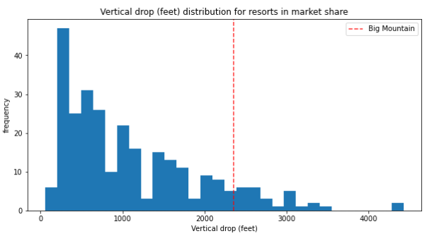
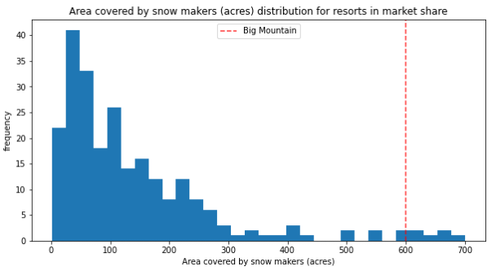
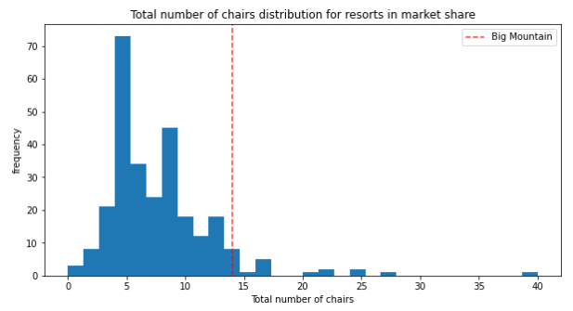
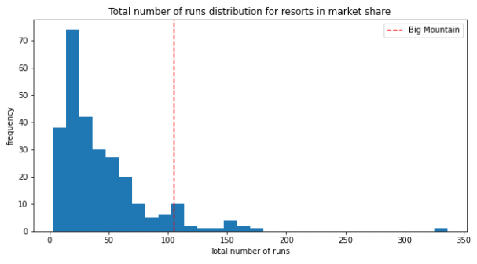
Modeling Results and Analysis
Big Mountain Resort is above average in all the important resort characteristics:

Slide 5
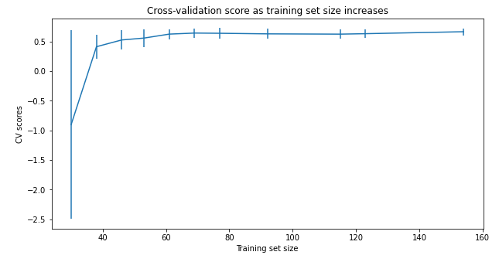
Modeling Results – Robustness of Model
These results are will be very similar regardless of more data being added to the model
This shows us the relationships between characteristics and its respective contributing factor to the price is consistent over most of the resorts analyzed
This means this model can be used for the foreseeable future without re-modeling!

Slide 6
Summary and Conclusion
Big Mountain Resort is in a great position for success. The infrastructure is there and now its time to reap the benefits for the hard work!
The only concern moving forward with ticket increases is that it is already the highest ticket price in Montana. With that, it is the best resort on paper per our value model until you get into Colorado and California so we feel this is a justified increase
We suggest a crawl-walk-run approach to making changes to the business model. This will reduce public perception of the resort ‘gouging’ its guests. Then, slowly replacing the least popular runs with higher chair lifted runs will yield success

