Slide 1
Next-Generation Data & Workflow
Orchestration Platform
GTREASURY · ENGINEERING MANAGER CASE STUDY
A phased path to an elastic, resilient, AI-augmented orchestration platform on AWS
Presented by John Jo • October 2026

Slide 2
Agenda
1
The Opportunity
Phase 1
Simple, single-instance MVP
Why GTreasury's scheduled-jobs model needs to become true data & workflow orchestration.
2
Technical Approach & Architecture
A two-phase build — simple MVP to enterprise platform — plus a new AI agentic automation layer.
Phase 2
Enterprise-grade, elastic, multi-region
3
Operational Excellence
Scalability, availability, resiliency, observability, and disaster recovery.
4
Engineering Excellence
Quality, incident management, and a high-bar development lifecycle.
+ AI Agentic Layer
Ops/Recovery & Scaffolding copilots
5
Execution & Delivery
Capacity planning, team structure, milestones, and how we show progress.

Slide 3
One Pane of Glass, Built on Thousands of Scheduled Jobs
THE OPPORTUNITY
GTreasury aggregates data across every bank and ERP a customer uses — imagine 100+ global bank accounts — into a single view. Today that's powered by scheduled jobs that pull, transform, and push data. As the business scales, that model is showing its age.
Five Personas, One Platform
Customer: Wants jobs to complete — and a way to act when they don't.
!
Operations timing out
Transient failures with no automatic self-healing.
Professional Services: Configures unique workflows at onboarding.
!
Connectivity issues
Customer Support: Bridges customers and Platform Ops today.
Bank/ERP endpoints are flaky by nature, at global scale.
Platform Operations: Owns durability and advanced recovery.
!
Corrupt or erroneous data
A single bad record can block an entire batch.
Engineering: Builds the platform and the components on it.

Slide 4
The Vision: True Data & Workflow Orchestration
THE OPPORTUNITY
Fault tolerance, scalability, resiliency
A catalog of composable components
The explicit top priority — scaling elastically with load, not failing silently.
Scripted and compiled, contributed by any GTreasury engineering team.
Self-service recovery
Continuously improving developer productivity
Customers and Customer Support can recover from failure without Engineering.
Operational excellence and velocity are not a trade-off — both matter.

Slide 5
Strategy: Deliver Incrementally, Never Throw Away Work
TECHNICAL APPROACH
A walking-skeleton approach: ship the real workflow/component model on the smallest reasonable footprint first, validate it with real customers, then harden the same model — not a different one — into the enterprise design.
PHASE 1
PHASE 2
+ AGENTIC LAYER
Simple, Single-Instance MVP
Enterprise-Grade Platform
AI-Augmented Automation
Airflow on one EC2 instance. Prove the DAG/component model with real customers in weeks.
▶
Step Functions, Lambda/Fargate catalog, multi-region. Elastic, resilient, self-service.
▶
Bedrock Agents triage failures and scaffold components — added once Phase 2 is grounded in real history.

Slide 6
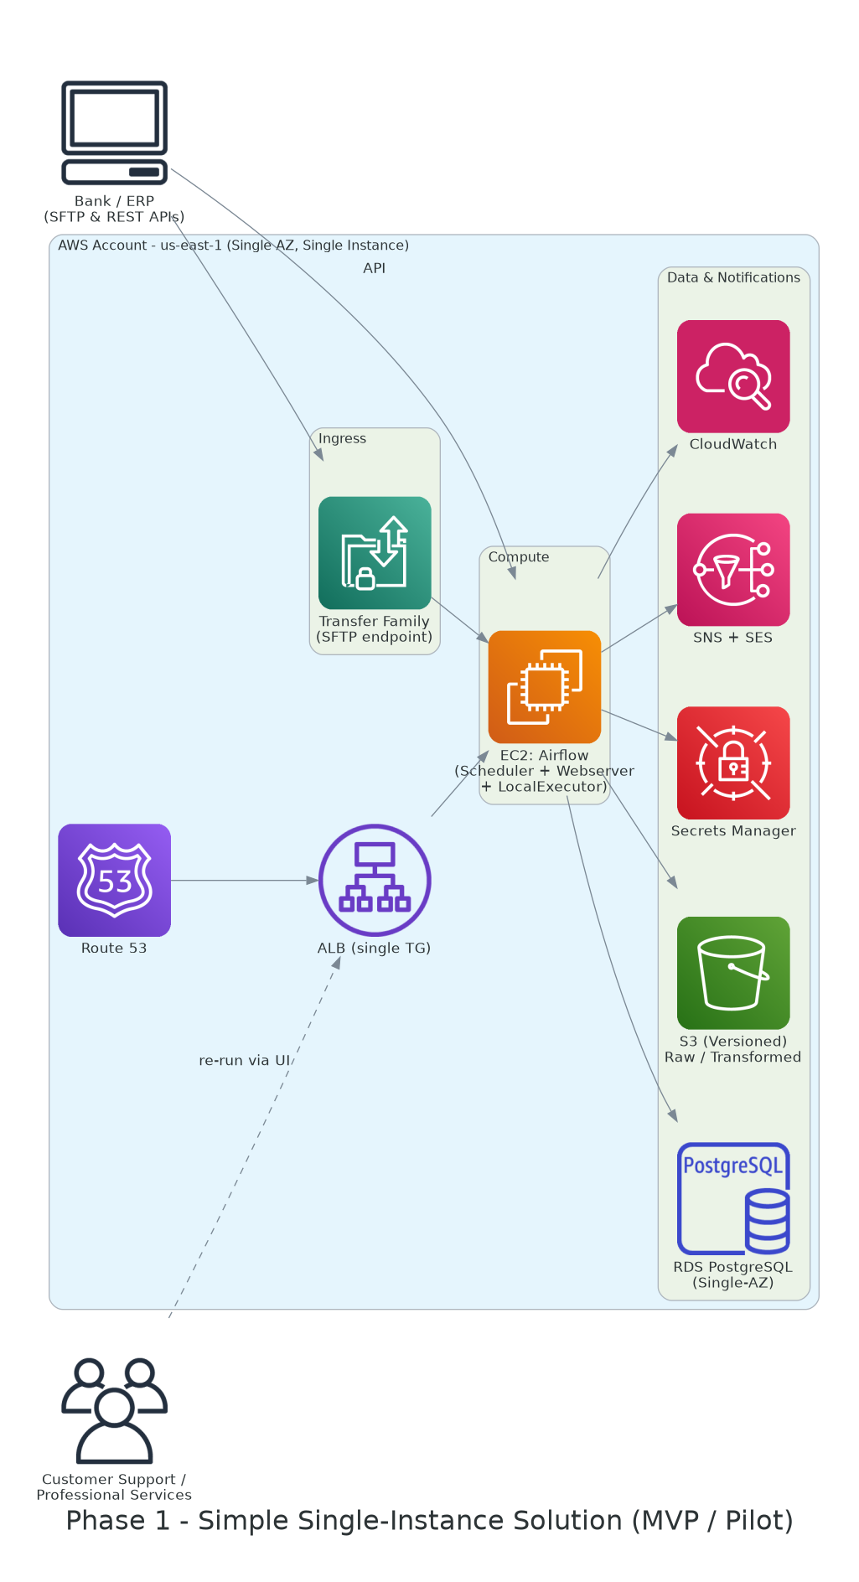
Phase 1 Architecture: Simple, Single-Instance MVP
TECHNICAL APPROACH
Built to Validate, Not to Throw Away
Apache Airflow on a single EC2 instance — DAGs of reusable operators, the same model Phase 2 scales up.
AWS Transfer Family for managed SFTP; Secrets Manager for bank/ERP credentials from day one.
S3 (versioned) for every file; RDS PostgreSQL for metadata and job history.
CloudWatch + SNS/SES from day one — observability and notifications are never deferred.
Deliberately limited: single AZ, no cross-region DR, manual recovery only — all solved in Phase 2.

Slide 7
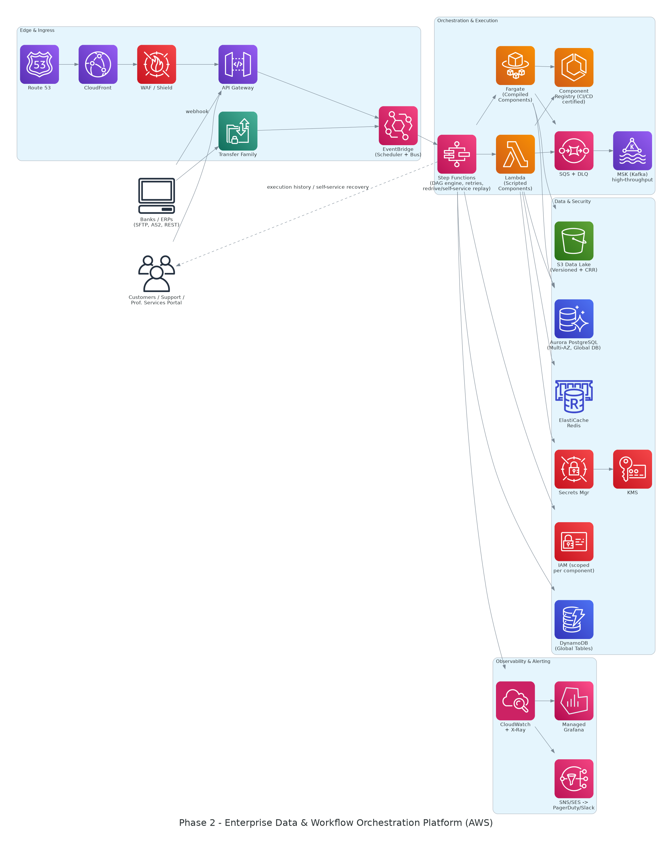
Phase 2 Architecture: Enterprise-Grade Platform
TECHNICAL APPROACH
Elastic, Governed, Self-Service
AWS Step Functions is the orchestration control plane — serverless, versioned, Redrive-based recovery.
Component Catalog: Lambda (scripted) + Fargate (compiled), governed by a CI/CD certification pipeline.
Aurora + DynamoDB + ElastiCache + S3, each used for what it's best at — relational, high-volume state, caching, data lake.
Multi-AZ, multi-region, self-service recovery portal for customers and Customer Support.

Slide 8
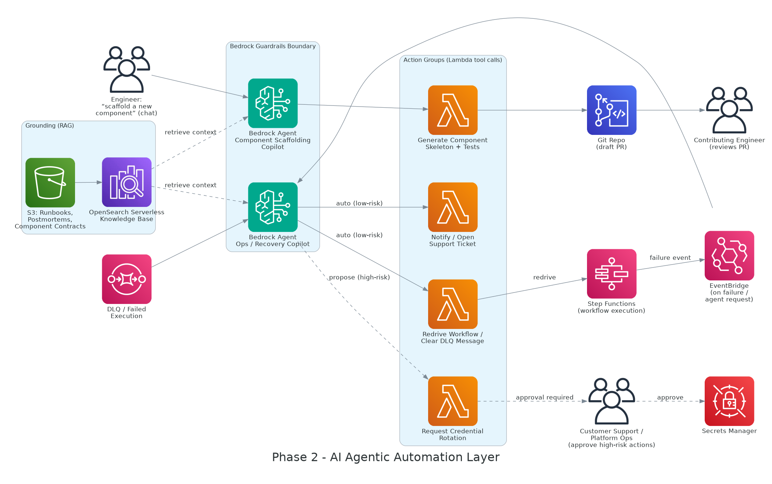
AI Agentic Automation Layer
TECHNICAL APPROACH · NEW
Phase 2 adds an agent that reasons over failures and acts — within guardrails — instead of only giving a human a button to click.
Ops / Recovery Copilot
Tiered Autonomy
Component Scaffolding Copilot
Triggered on failure; grounded on runbooks & postmortems via a Bedrock Knowledge Base.
Low-risk actions auto-execute (redrive, notify); high-risk actions need one-click human approval.
Generates a contract-compliant component skeleton + tests as a draft PR for any contributing team.

Slide 9
Key Technology Decisions — Chosen vs. Considered
TECHNICAL APPROACH
ORCHESTRATION
COMPONENT COMPUTE
DATA LAYER
Step Functions
Lambda + Fargate
Aurora + DynamoDB
vs. Airflow (MWAA) / Temporal
vs. EKS for everything
vs. one store for everything
Serverless elastic scaling + native Redrive for self-service recovery.
Right runtime per workload shape, zero fleet operations.
Relational control plane and high-volume state, each at its best.
AI AGENT PLATFORM
DISASTER RECOVERY
DELIVERY GOVERNANCE
Bedrock Agents + Guardrails
Warm standby (Tier 1/2)
IaC + CI/CD certification
vs. self-hosted LangChain stack
vs. pilot light / active-active
vs. manual (“ClickOps”)
Managed reasoning/tool-calling inside our existing AWS security boundary.
Single-digit-minute RTO without full duplicate production cost.
Reproducible, and the only way to safely govern multi-team contributions.

Slide 10
End-to-End System Flow
TECHNICAL APPROACH
1
Trigger
4
Move & transform data
Schedule, file arrival, webhook, or manual re-run.
Transfer Family / API Gateway, business rules, write to S3/Aurora/DynamoDB.
2
Normalize & start
5
Emit events
EventBridge starts the Step Functions execution.
Metrics, logs, and traces correlated by a single execution ID.
3
Execute the DAG
6
On failure — agent triages first
Catalog components run with per-step retry/catch policy.
Bedrock Ops Copilot auto-resolves or proposes a fix; unresolved items still reach a human via the self-service portal.

Slide 11
Scalability & Availability
OPERATIONAL EXCELLENCE
Scalability
Availability
Serverless-first compute scales automatically — no fleet to pre-provision for month-end treasury close.
SQS decouples triggers from execution; tenant-aware queues prevent one customer's volume from starving another's.
Every component proves 3x its peak load in staging before it is certified into the catalog.
Multi-AZ by default: Aurora Multi-AZ, Fargate across ≥2 AZs, per-AZ NAT gateways.
Route 53 health checks + Global Accelerator shed a failing AZ/region in seconds, not minutes.
Self-healing by default — ECS/Fargate and EC2 auto-recovery replace unhealthy tasks without paging a human.
99.95%
3x
≥2 AZs
Seconds
Availability target, control plane
Required load headroom before certification
Minimum spread for every stateful component
Failover time via Global Accelerator

Slide 12
Resiliency & Observability
OPERATIONAL EXCELLENCE
1
Retry + Catch, by default
Three observability pillars, one execution ID:
Every workflow step declares backoff and a fallback state.
Metrics — CloudWatch + Managed Grafana, persona-specific dashboards.
2
DLQs + idempotency keys
Logs — Structured JSON, searchable in OpenSearch across a failed run.
Poison messages are isolated; retries are always safe to run twice.
Traces — X-Ray end-to-end across every hop, call, and retry.
3
Circuit breakers & bulkheads
One struggling bank or bad actor can't exhaust shared capacity.
Chaos, on a schedule
Quarterly AWS Fault Injection Simulator game days kill an AZ, throttle Lambda, and force an Aurora failover — so resiliency claims are exercised, not assumed.

Slide 13
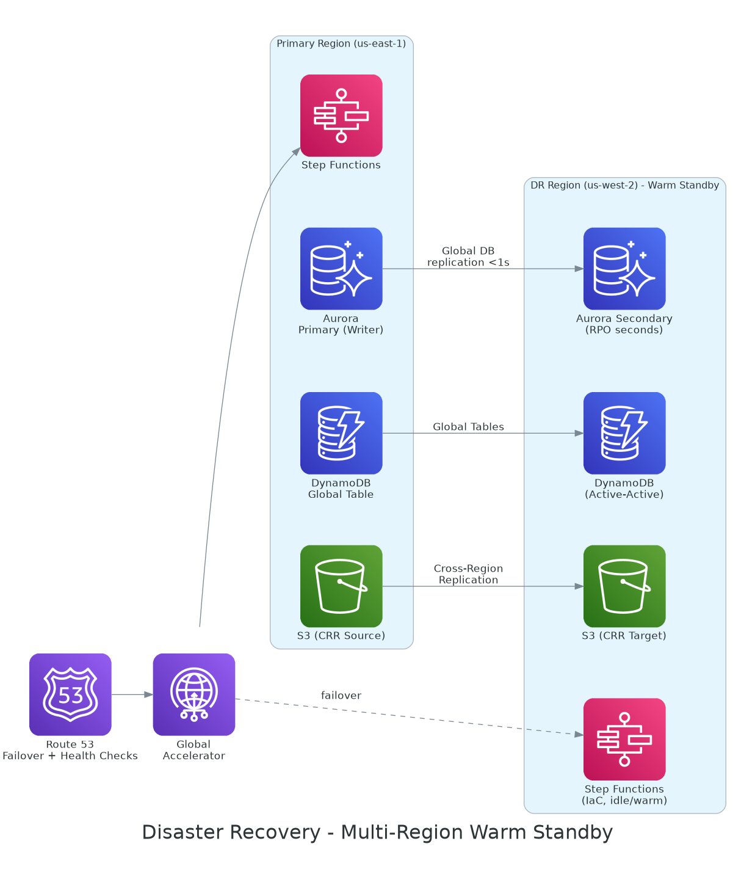
Disaster Recovery: Multi-Region Warm Standby
OPERATIONAL EXCELLENCE
Aurora Global Database and DynamoDB Global Tables replicate continuously; infrastructure is deployed to both regions by the same pipeline, so the DR region is always warm — and tested quarterly, not just documented.
Tier | RPO | RTO
Tier 1 — critical | ≤ 1 min | ≤ 15 min
Tier 2 — standard | ≤ 15 min | ≤ 1 hour
Tier 3 — internal | ≤ 24 hrs | ≤ 4 hours
Why warm standby
Strong RTO without paying for full duplicate production capacity at all times — the right balance for time-sensitive, bank-cutoff-driven jobs.

Slide 14
Principles & KPIs
OPERATIONAL EXCELLENCE
Principles
KPIs That Matter
Reliability by design — Well-Architected reviews at every milestone, not once at the end.
SLOs and error budgets decide the features-vs-reliability trade-off, not debate.
Blameless postmortems: every incident produces action items, never blame.
Self-service tooling: the third time Ops solves a problem by hand, it becomes automation.
Shift-left observability: instrumentation is part of the definition of done.
99.95%
≤ 15 min
Availability target
MTTR target, Tier 1
New KPI
DORA
% incidents resolved by the AI agent
Deploy frequency & change failure rate
Plus: self-service recovery rate, error-budget consumption, alert-to-action ratio, DR test cadence, cost per tenant.

Slide 15
Engineering Excellence Practices
ENGINEERING EXCELLENCE
Full testing pyramid, plus contract tests for the Component Contract itself.
Static & security scanning gate every merge and every catalog certification.
Progressive delivery: canary/blue-green for both workflows and components.
RFC/design review before any new pattern; ADRs capture the “why” long-term.
Standing tech-debt allocation (~15–20% of sprint capacity), not an afterthought.
AI-Assisted, Human-Reviewed
The Component Scaffolding Copilot generates a new component's handler, schema, tests, and IAM stub as a draft pull request. Every merge still goes through the same human code review and CI gates as any other change — the agent raises the floor on starting quality, it never bypasses review.

Slide 16
Capacity Planning & Team (Illustrative: 8 Engineers)
EXECUTION & DELIVERY
Team Composition
Platform pod (5–6 engineers) — Owns the new orchestration build: Step Functions, catalog, CI/CD, observability.
Legacy/KTLO pod (2–3, rotating 4–6 wks) — Keeps today's platform stable; feeds lessons back into the new design.
SRE/DevOps engineer (1, floats) — Owns CI/CD, IaC, and observability across both platforms.
Agentic layer (1–2 from Platform pod, later) — Picked up once the catalog is live — not a new permanent sub-team.
Capacity is a hypothesis, re-baselined at every milestone — not a one-time estimate.

Slide 17
Delivery Roadmap: M0 → M7
EXECUTION & DELIVERY
M0
Discovery & spike
M4
Enterprise hardening
2–3 wks
6–8 wks
M1
Phase 1 MVP live
M5
Multi-region DR + portal
6–8 wks
8 wks
M2
Dual-run & validation
M6
AI agentic automation layer
4–6 wks
6–8 wks
M3
Component catalog + CI/CD
M7
Progressive migration
6 wks
Ongoing

Slide 18
Showing Progress — and Why This Works
EXECUTION & DELIVERY
How We Show Progress
Why This Architecture Wins
Two metric sets, always visible: legacy stability and new-platform adoption.
Working-software demos every sprint, on real pilot data — never mockups.
Concrete before/after evidence as workflows migrate (MTTR, self-service wins).
A Now/Next/Later roadmap stakeholders can see for themselves, reviewed monthly.
Never throwaway work
Every Phase 1 contract and primitive carries forward into Phase 2 unchanged.
Guardrailed automation
Elastic scale and AI agents operate inside explicit, auditable boundaries.
Self-service by design
Recovery and component contribution both route around Engineering as a bottleneck.

Slide 19
Questions & Discussion
Full architecture analysis, technology rationale, and Q&A detail available in the accompanying document.
John Jo • jjodev@gmail.com

