Slide 1
Project

Slide 2
Outline
Adversarial Example Generation
Inspection of Model Robustness against adv_ex
Defense on Trained model against adv_ex

Slide 3
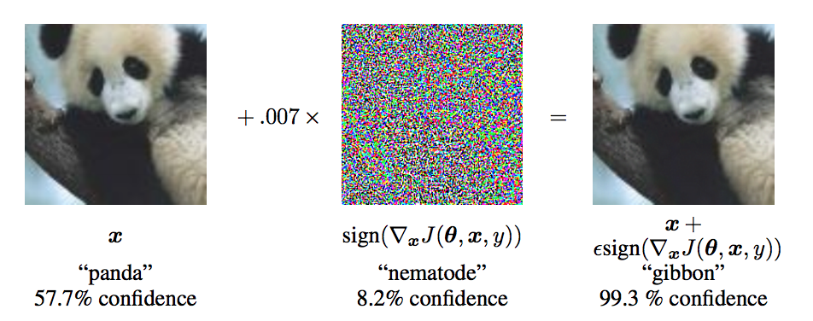
Adversarial Example

Slide 4
Toolbox
Cleverhans
Foolbox
Adversarial Robustness Toolbox
Focus more on attack
More choice on defense

Slide 5
Supported framework
 | Cleverhans | ART | Foolbox
Tensorflow |  |  | 
Keras |  |  | 
Pytorch |  |  | 
Caffe
Theano |  |  | 
MXNet |  |  | 
Lasagne |  |  | 

Slide 6

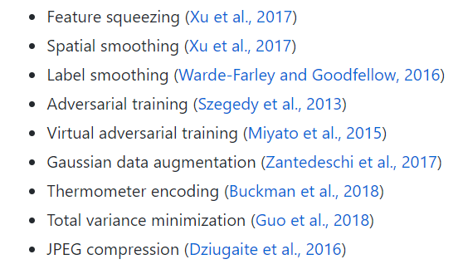
Defense Method
Cleverhans & Foolbox
ART

Slide 7
Foolbox

Slide 8
Attack Method
Gradient-based attacks
ex: FGSM、PGD
Score-based attacks
ex: SinglePixelAttack、LocalSearchAttack
Decision-based attacks
ex: BoundaryAttack、SpatialAttack、SaltAndPepperNoiseAttack
Other attacks
ex: BinarizationRefinementAttack、PrecomputedImagesAttack

Slide 9
Criteria
Untargeted
Misclassification
TopKMisclassification
OriginalClassProbability
ConfidentMisclassification
Targeted
TargetClass
TargetClassProbability

Slide 10
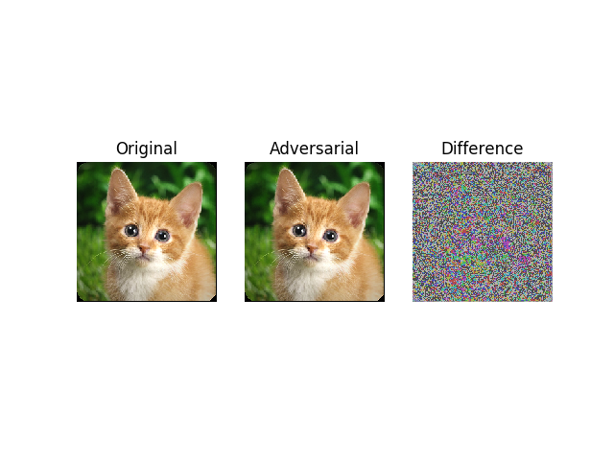
Untargeted attack
FGSM
tiger_cat
(282)
tabby
(281)

Slide 11
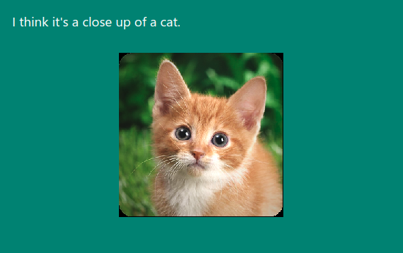
Microsoft Captionbot

Slide 12
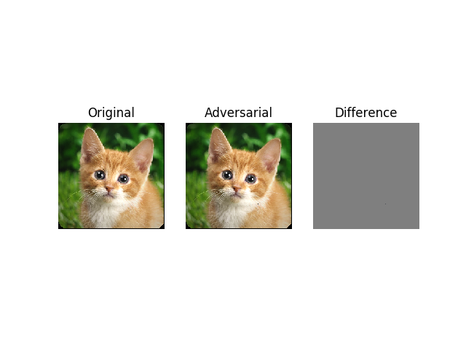
Untargeted attack(cont.)
Salt & pepper (10% ConfidentMisclassification)
tiger_cat
tabby
(282)
(281)

Slide 13

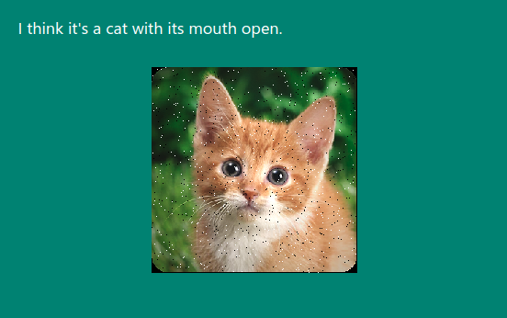
Salt & pepper (80% ConfidentMisclassification)
tiger_cat
window screen
(282)
(904)

Slide 14
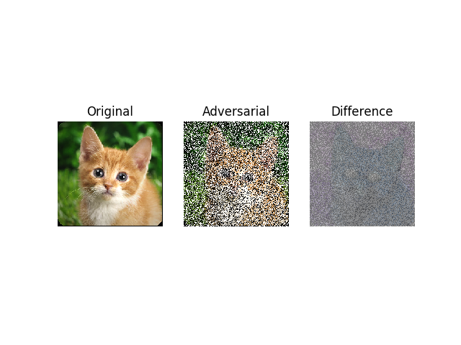
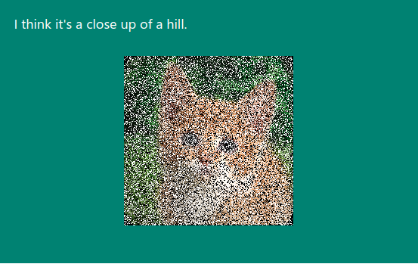
Salt & pepper (99% ConfidentMisclassification)
tiger_cat
window screen
(282)
(904)

Slide 15
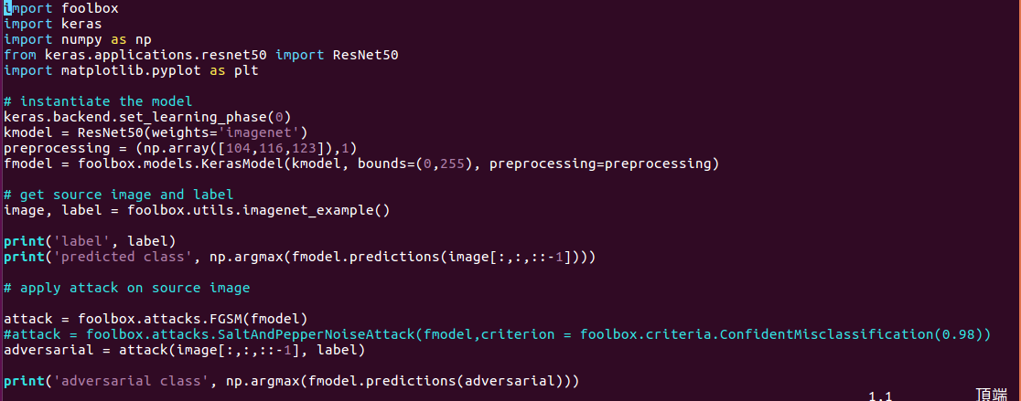
Code

Slide 16
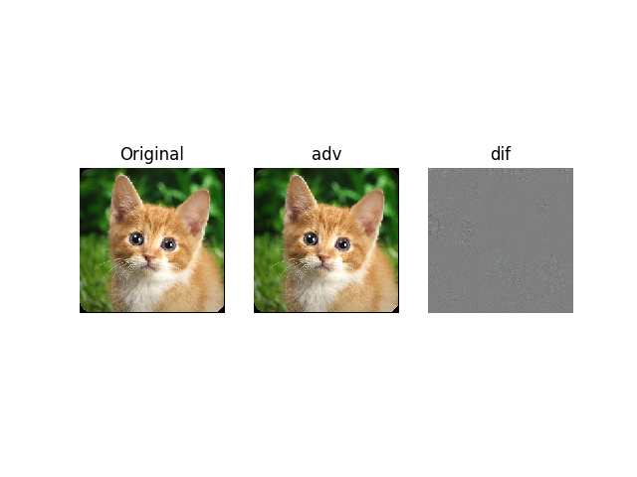

Targeted attack
LBFG – target 789
tiger_cat
(282)
“Shogi”
79% confidence
(789)
Adv_label
Top probability after softmax
Top 5 prediction

Slide 17
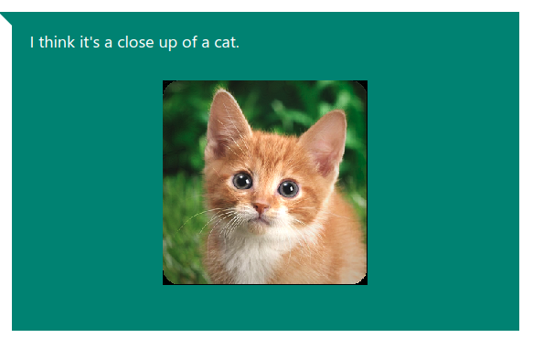
LBFG on captionbot

Slide 18
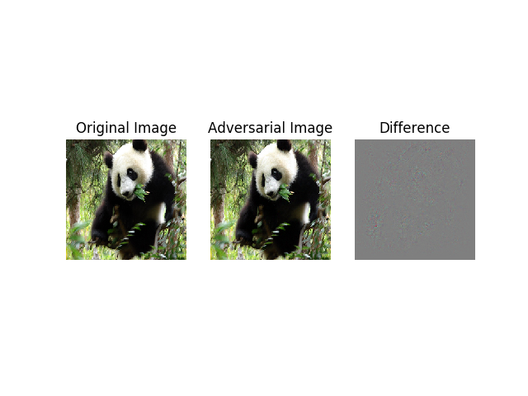
Inception V3 Test(LBFG)

Slide 19
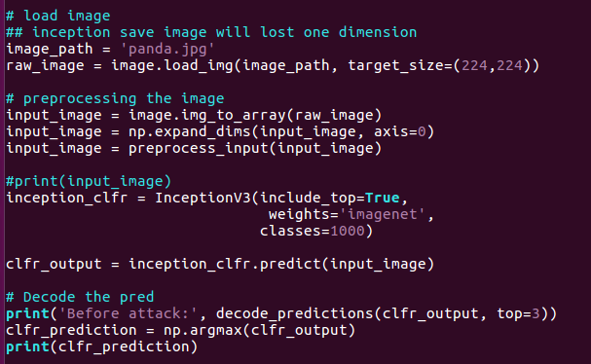
Before attack prediction

Slide 20
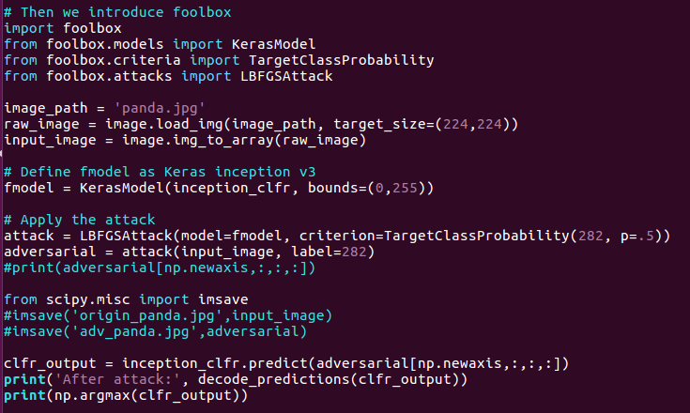
Adversarial Prediction

Slide 21
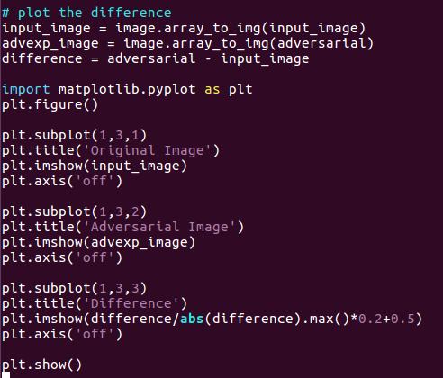
Plot the difference

Slide 22
Transferability Test (Salt & Pepper)
Implement a salt & pepper adversarial example and then store it
(Generated from ResNet50 model)
implement an new inceptionV3 model
Implement a new ResNet50 model
Predict the salt & pepper cat image stored above

Slide 23
Transferability Test (cont.)

Slide 24
Some Problems need to be solved

Slide 25

About Image
The format to store the image
(i.e. cat.jpg-281 & cat.png-282)
The way you load your adversarial image( guess )
Origin cat(ResNet50): 282 -> 282
Adversarial(ResNet50): 287->282
Origin cat(ResNet50): 282 -> 287
Adversarial(ResNet50): 287->287

Slide 26
About Transferability
Easy Gradient Attack can’t transfer to another model
(FGSM: ResNet50 -> InceptionV3)
Salt & Pepper work & successfully cheat the Vision Service API, but the image is not like original one at all

Slide 27
ImageNet

Slide 28
ImageNet
image database organized according to the WordNet hierarchy
useful resource for researchers, educators, students
has 14,197,122 images with 21841 synsets indexed

Slide 29

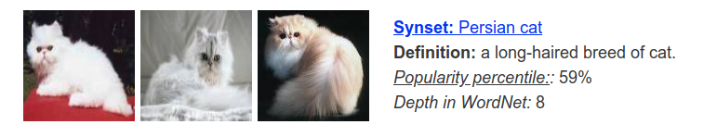
Step 1
Gather the id of the synsets you need
1
2

Slide 30
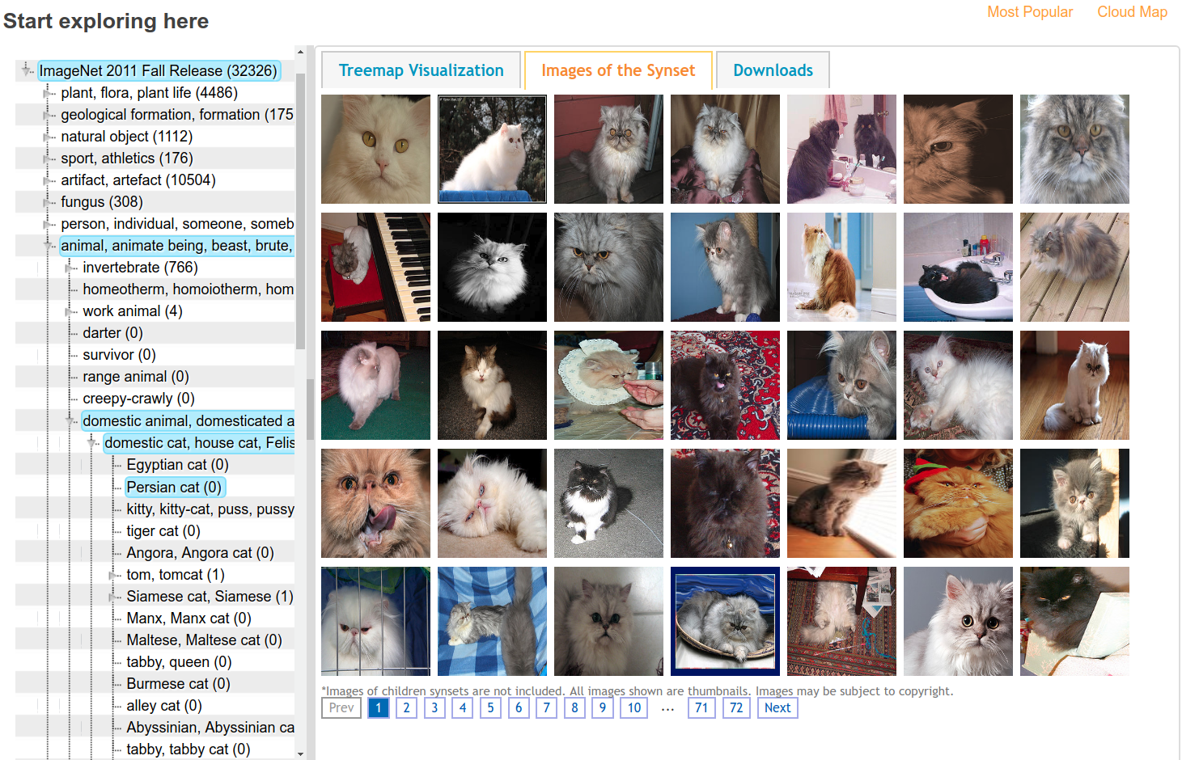
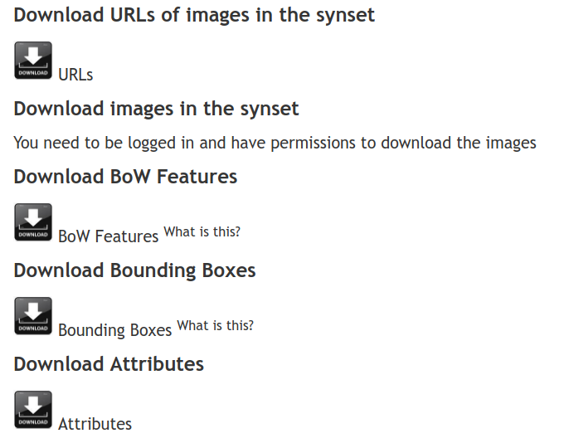
3
4

Slide 31
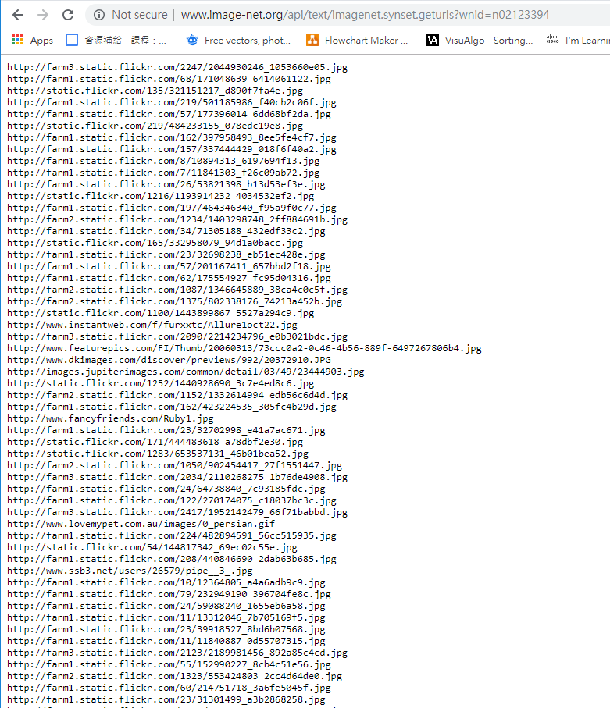
5
n02123394 is wnid of perisan cat

Slide 32
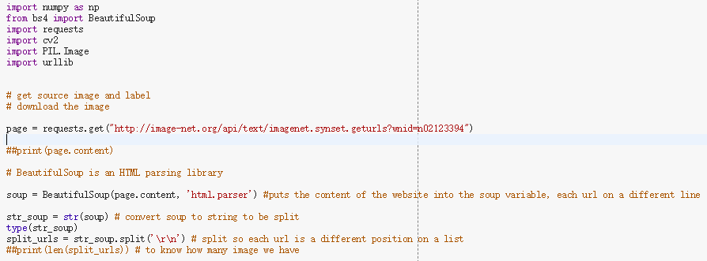
Step 2
Parse the URLs

Slide 33

Step 3
Make train & test directory

Slide 34
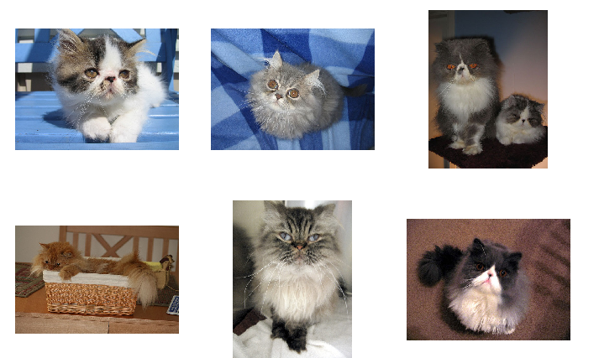
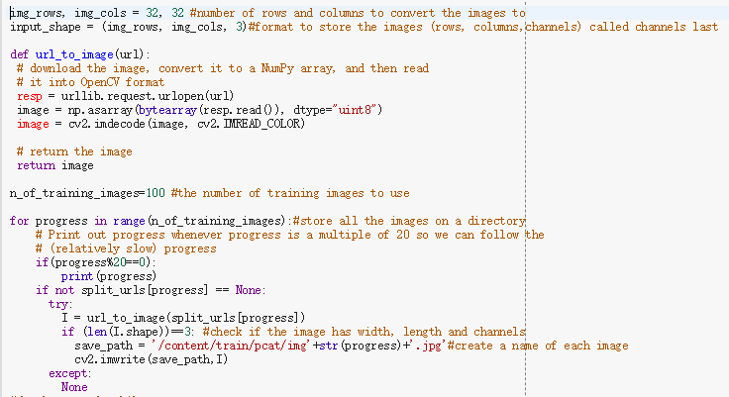
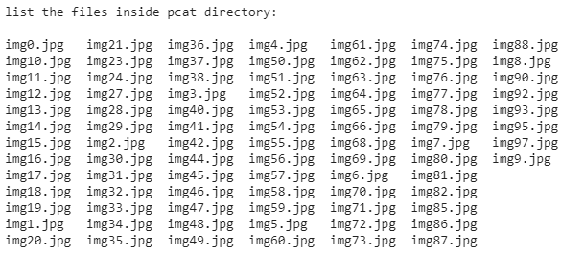
Step 4
Download the image

