Slide 1

Data Science Skills Analysis
Data Acquisition and Management
Joby John
Peter Kowalchuk
October 2018
DATA 607 – Project 3

Slide 2
Agenda Data Science Skills Analysis
Data Science Skills Analysis
Data Selection
Analysis details
Conclusions
Project details
Collaboration tools
Technical tools
Division of work
Challenges
Further Analysis

Slide 3
Data Skill Analysis Statement Questions to answer with our analysis
1) What are the most important skills in Data Science?
2) What Data Science job tittles require the most skills?
3) What other job titles have similar skills to Data Science?
4) What percentage of people have the skills to be a Data Scientist?

Slide 4
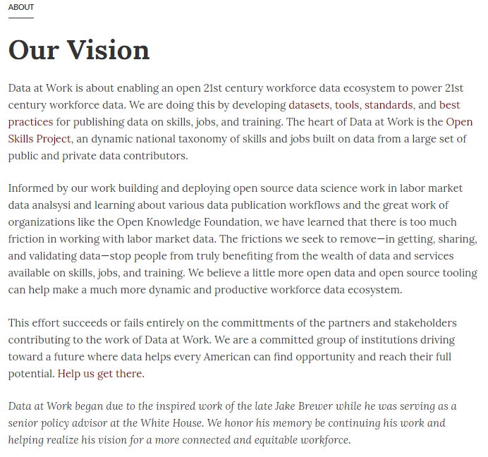
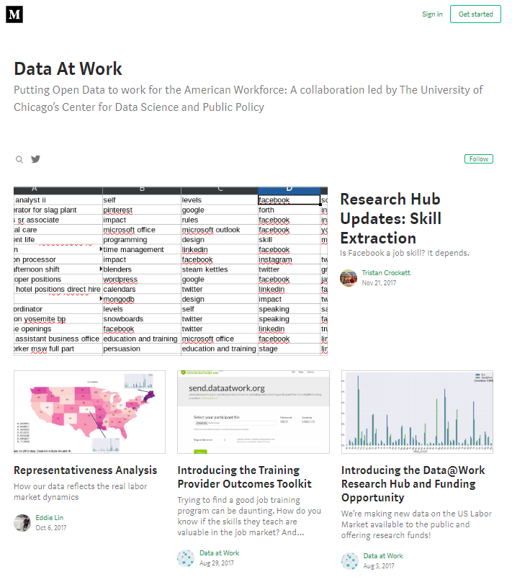
Dataset Selection Data At Work

Slide 5
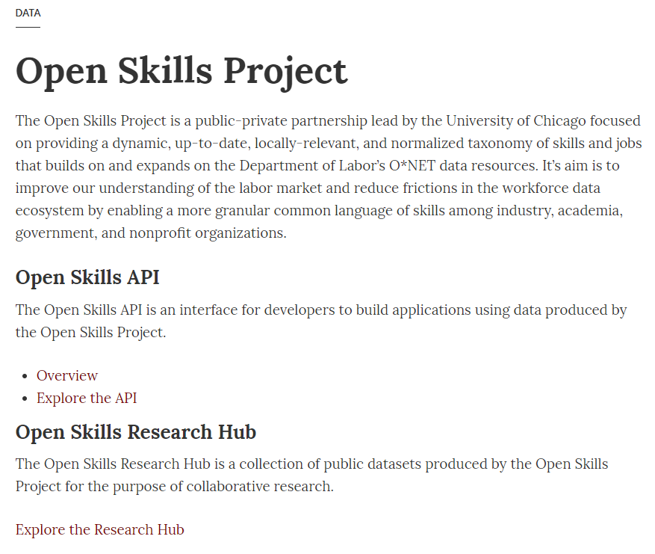
Dataset Selection Data At Work – Open Skill Project

Slide 6
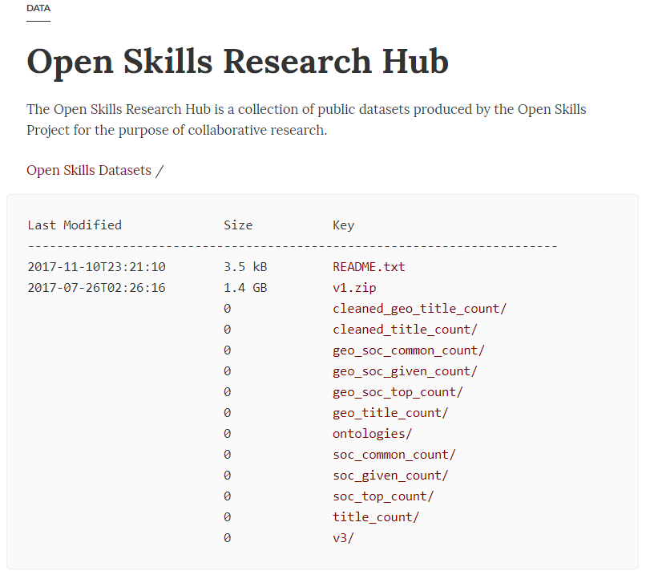
Dataset Selection Data At Work – Open Skill Project - Data

Slide 7
Dataset Selection Data At Work – Open Skill Project - Data

Slide 8
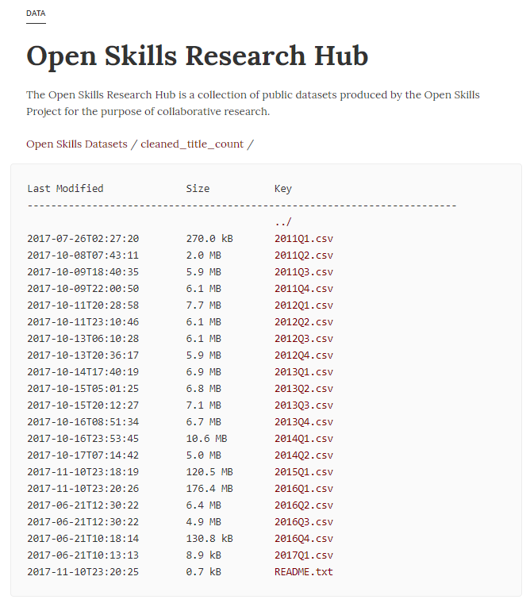
Dataset Selection Data At Work – Open Skill Project - Data

Slide 9
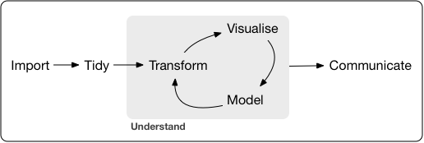
Data Analysis Tidy workflow

Slide 10
Data Analysis Tidy workflow
Import last 1 year of data

Slide 11
Data Analysis Tidy workflow
Tidy data to long format
Import last 1 year of data
Save and read from SQL dB

Slide 12
Data Analysis Tidy workflow
Tidy data to long format
Transform to answer questions 1, 2, 3 and 4
Import last 1 year of data
Save and read from SQL dB

Slide 13
Data Analysis Tidy workflow
Tidy data to long format
Transform to answer questions 1, 2, 3 and 4
Visualize to answer questions 1, 2, 3 and 4
Import last 1 year of data
Save and read from SQL dB

Slide 14
Data Analysis Tidy workflow
Tidy data to long format
Transform to answer questions 1, 2, 3 and 4
Visualize to answer questions 1, 2, 3 and 4
Model to answer question 4
Import last 1 year of data
Save and read from SQL dB

Slide 15
Data Analysis Tidy workflow
Communicate with this presentation
Tidy data to long format
Transform to answer questions 1, 2, 3 and 4
Visualize to answer questions 1, 2, 3 and 4
Model to answer question 4
Import last 1 year of data
Save and read from SQL dB

Slide 16
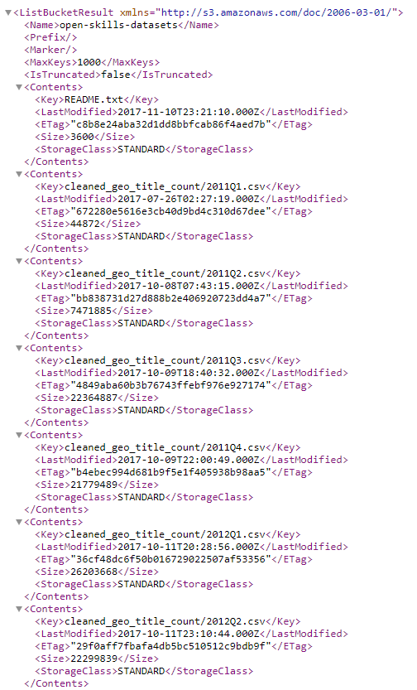
Import Scrape list of csv files
csv file names could not be scrapped from site since they are in AJAX
Underlying AWS XML file was used instead

Slide 17
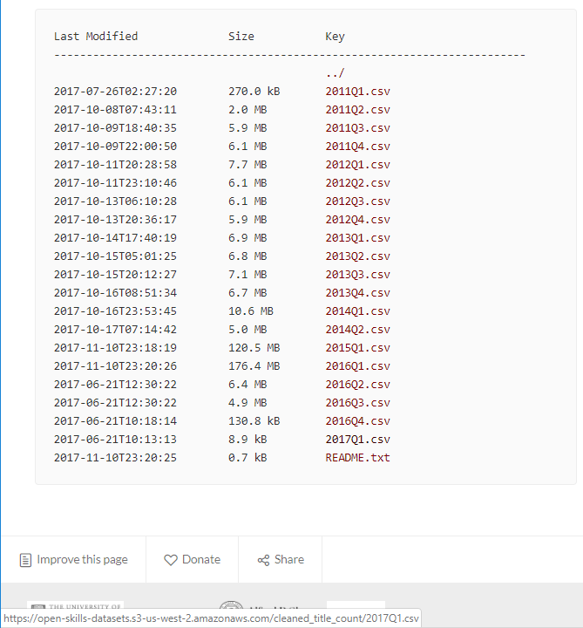
Import Scrape list of csv files
Four last csv files read using csv file list vector and a for loop
Each loop read from the csv file address

Slide 18
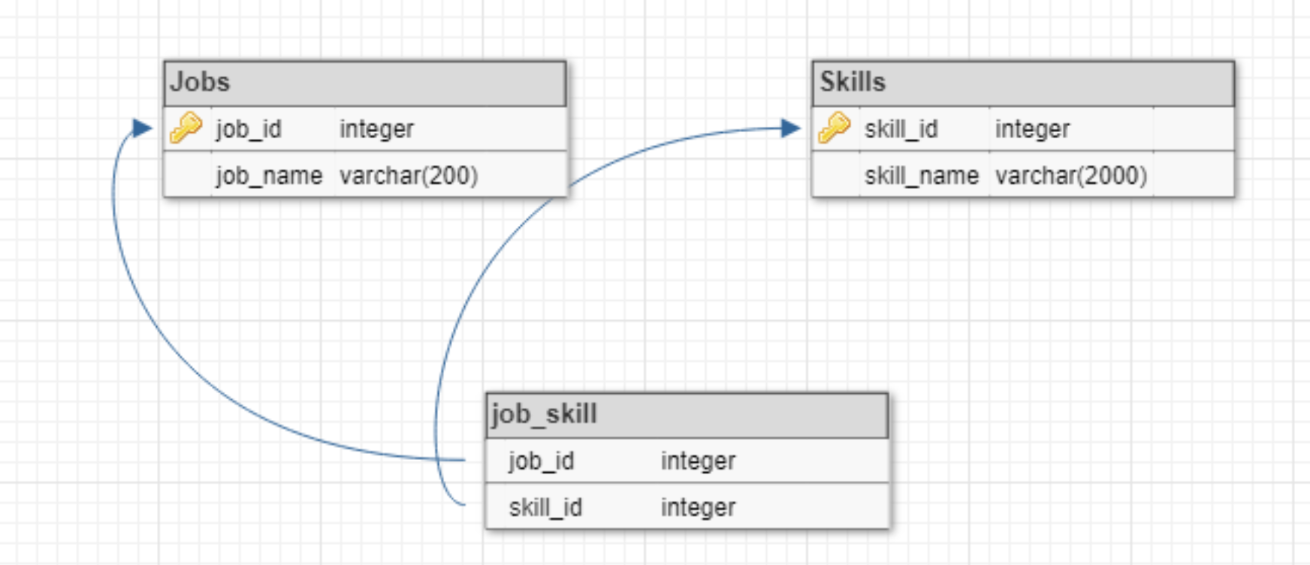
Normalized tables Schema for SQL dB

Slide 19
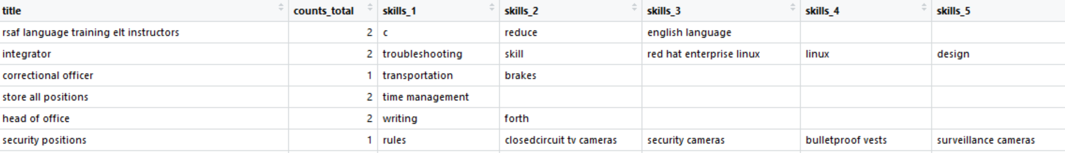
Tidying Data Wide data
Wide format data.
Tidy and transform data before saving to normalized tables.

Slide 20
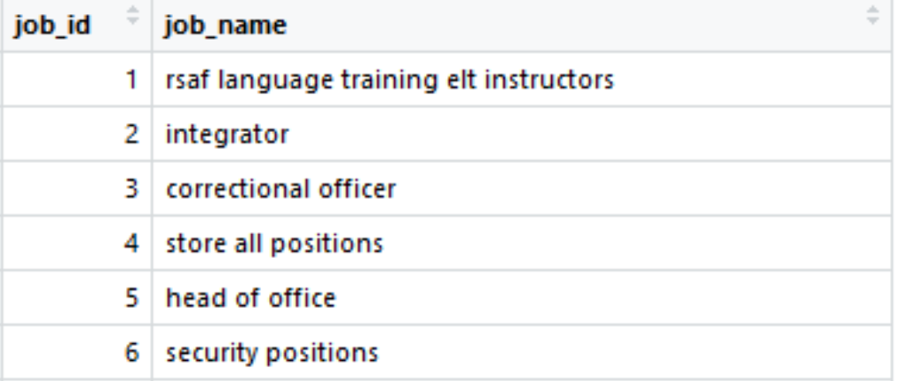
Tidying Data Extract job titles and save to jobs table.

Slide 21
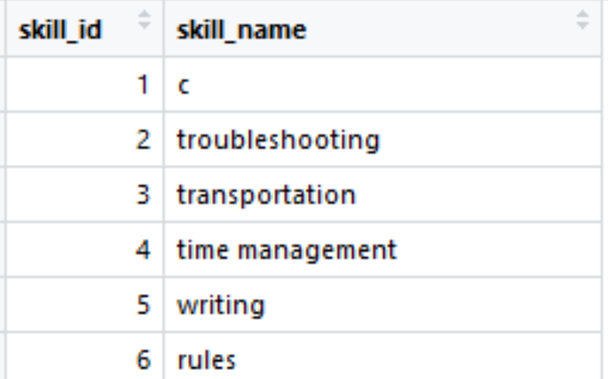
Tidying Data Extract skills and save to skills table.

Slide 22
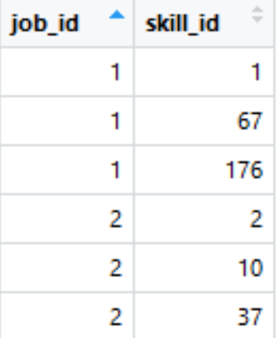
Tidying Data Extract skills for each job and save to job skills mapping table

Slide 23
Tidying Data Extract skills for each job and save to job skills mapping table

Slide 24
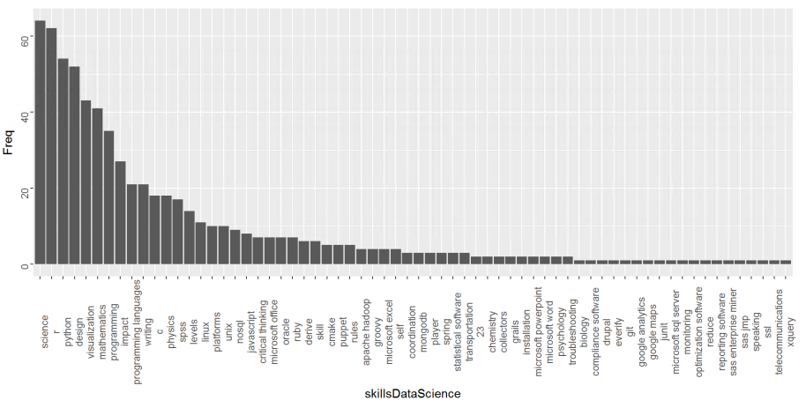
Question 1 - What are the most important skills in Data Science? Transform and visualize
Filter table for data science titles only
Create a vector with all skills
Science, r and python

Slide 25
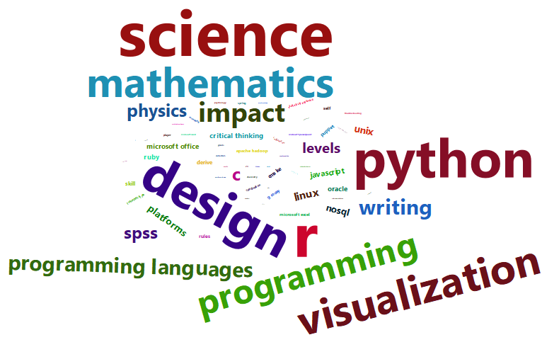
Question 1 - What are the most important skills in Data Science? Transform and visualize
Filter table for data science titles only
Create a vector with all skills
Science, r and python

Slide 26
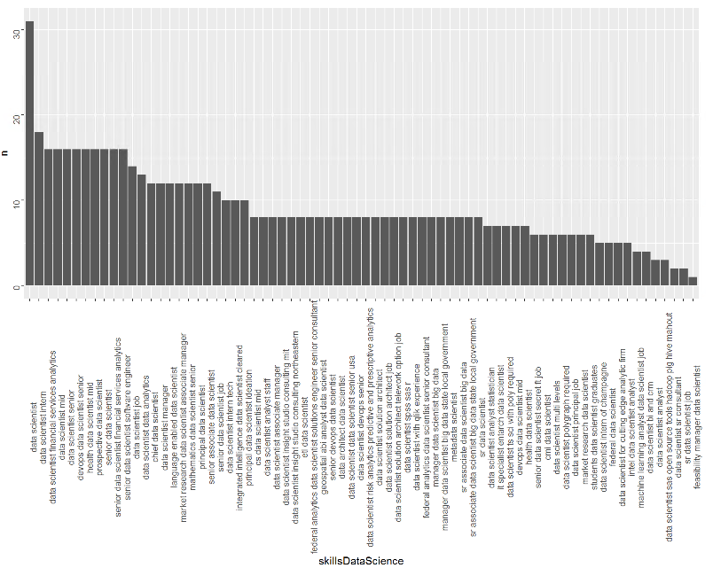
Question 2 - What Data Science job tittles requires the most skills? Transform and visualize
Filter table for data science titles only
Create a vector with all skills
Group by job
Data scientist, data science intern and data scientist financial services analysis

Slide 27
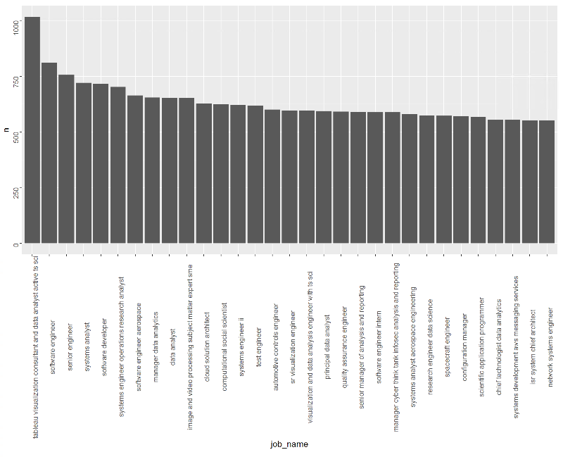
Question 3 - What other job titles have similar skills to Data Science? Transform and visualize
Filter table for data science titles only
Create a vector with all skills
Do a join with all job names and skills
Tableau viz consultant, software engineer and senior engineer

Slide 28
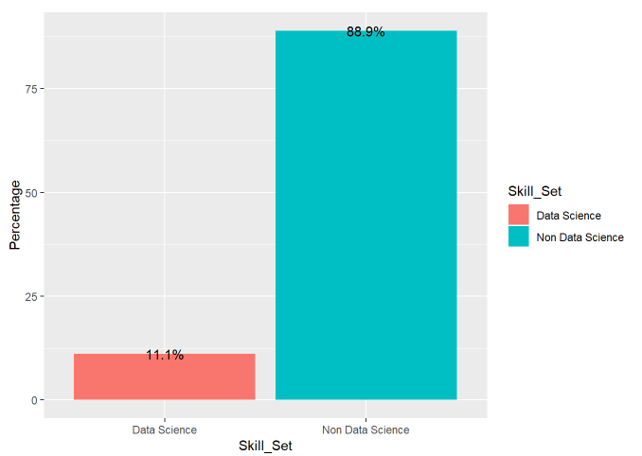
Question 4 - What percentage of people have the skills to be a Data Scientist? Transform, model and visualize
Filter table for data science titles only
Create a vectors with all skills and data science only
Build model for population
Calculate percentage from model
On this model simulation 11.1% of the population has skills to be a Data Scientist

Slide 29
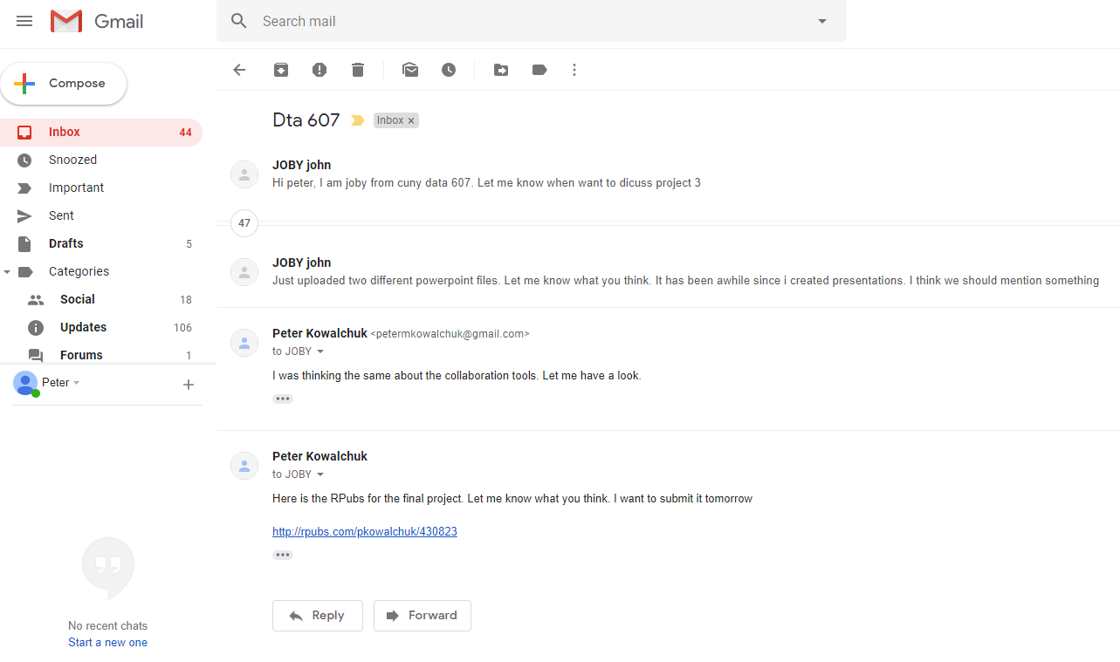
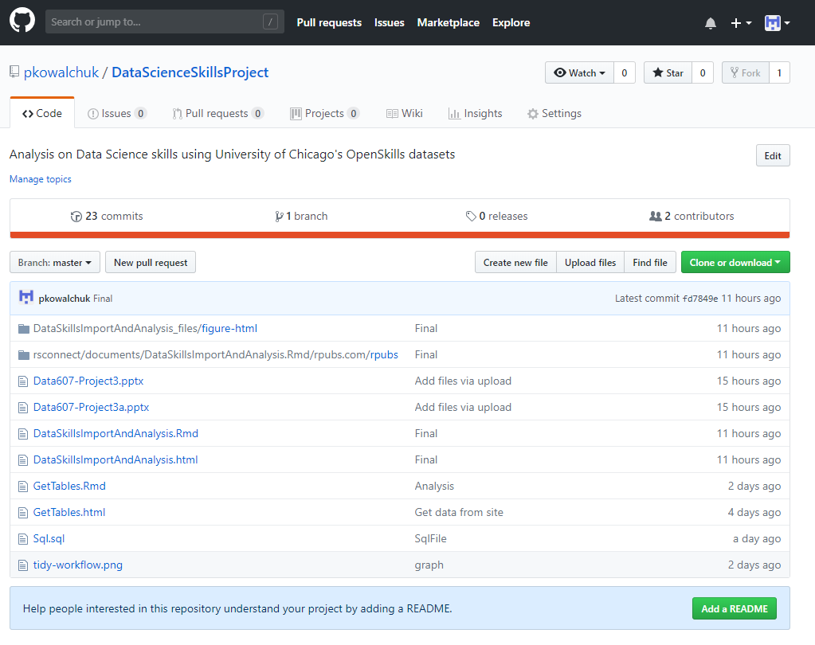

Collaboration tools Project details

Slide 30


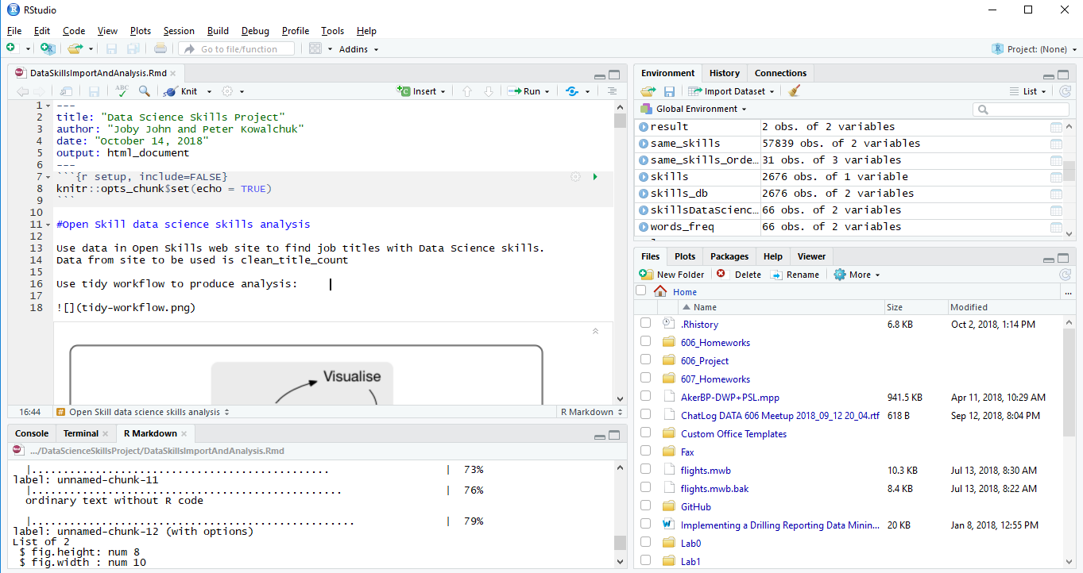
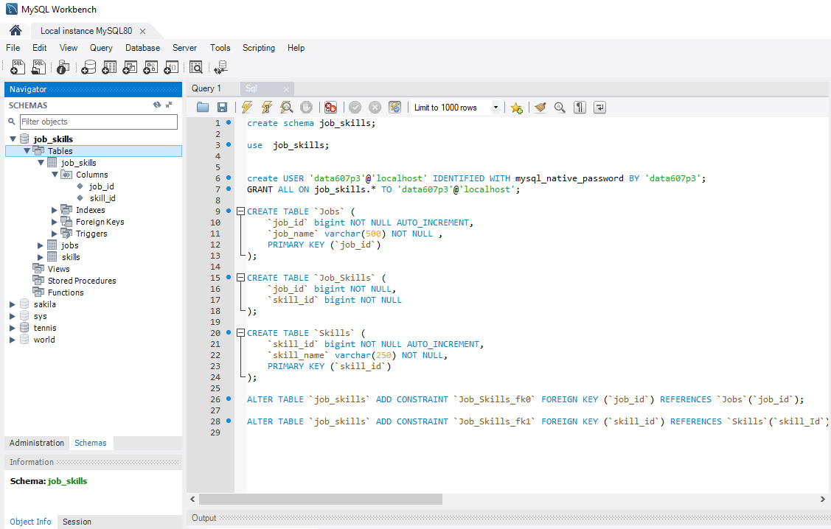
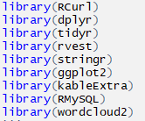
Technical tools Project details

Slide 31
Division of work Project details
Data Selection
Joint effort
Data Tidying & SQL dB
Joby John
Data Analysis
Peter Kowalchuk
Presentation
Joint effort

Slide 32
Challenges Project details
csv files in AJAX

Slide 33
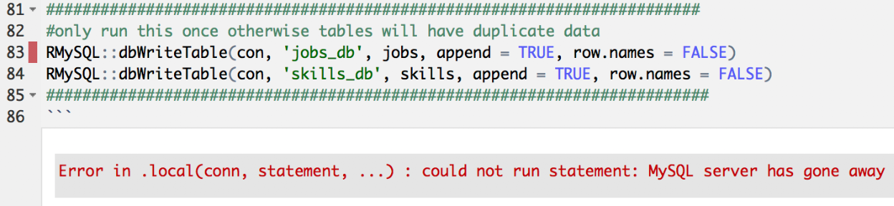
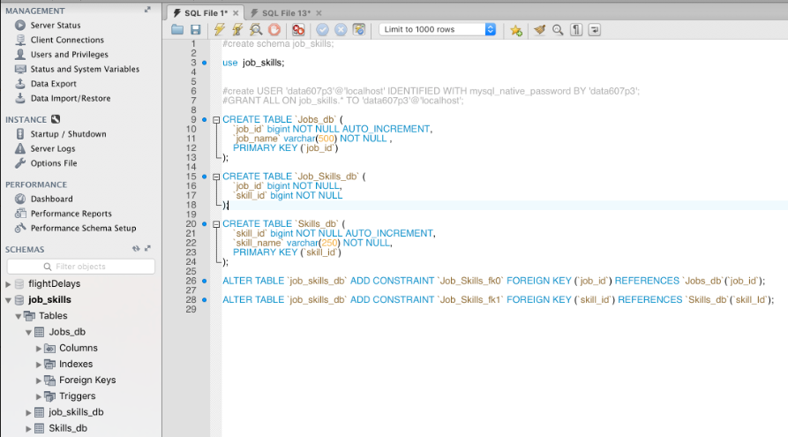
Challenges Project details
MySQL bug on Mac?

Slide 34
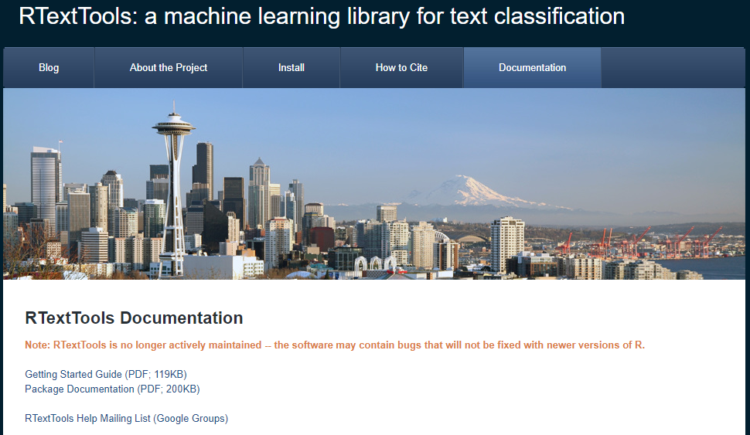
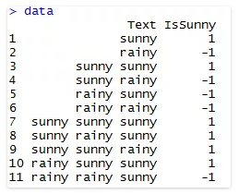
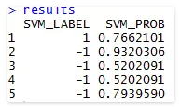
Further Analysis Project details
Train Classifier to determine Data Science competence based on skills

Slide 35
Thank You!
Questions?

