Slide 1

Data Science Skills Analysis
Data Acquisition and Management
Joby John
Peter Kowalchuk
October 2018
DATA 607 – Project 3

Slide 2
Data Skill Analysis Statement Questions to answer with our analysis
1) What are the most important skills in Data Science?
2) What Data Science job tittles requires the most skills?
3) What other job titles have similar skills to Data Science?

Slide 3
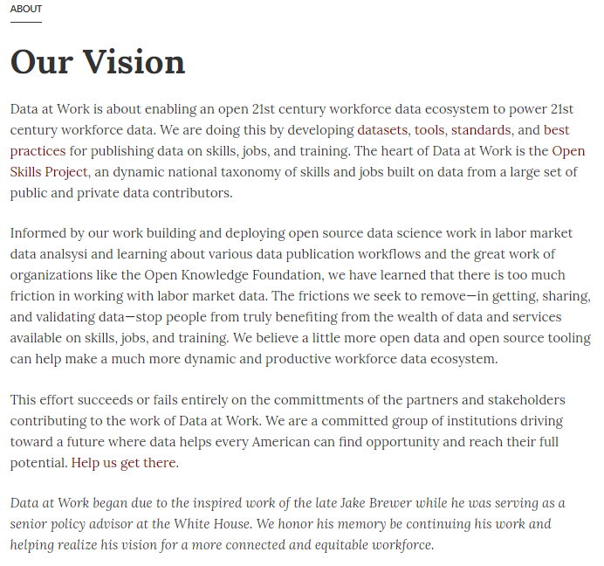
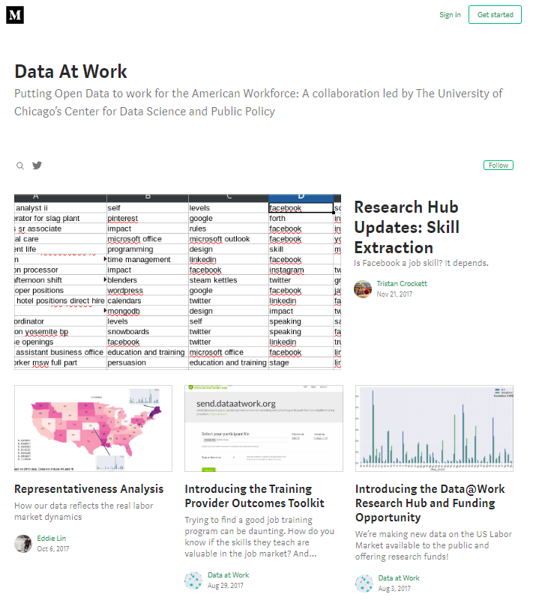
Dataset Selection Data At Work

Slide 4
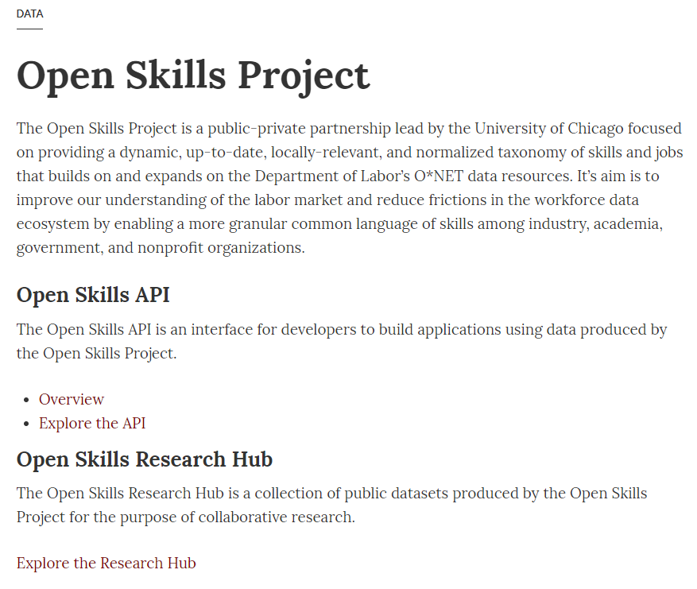
Dataset Selection Data At Work – Open Skill Project

Slide 5
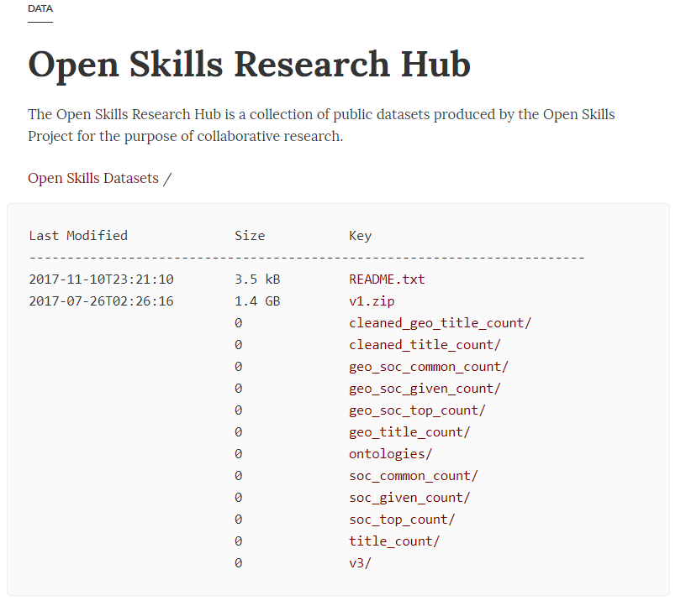
Dataset Selection Data At Work – Open Skill Project - Data

Slide 6
Dataset Selection Data At Work – Open Skill Project - Data

Slide 7
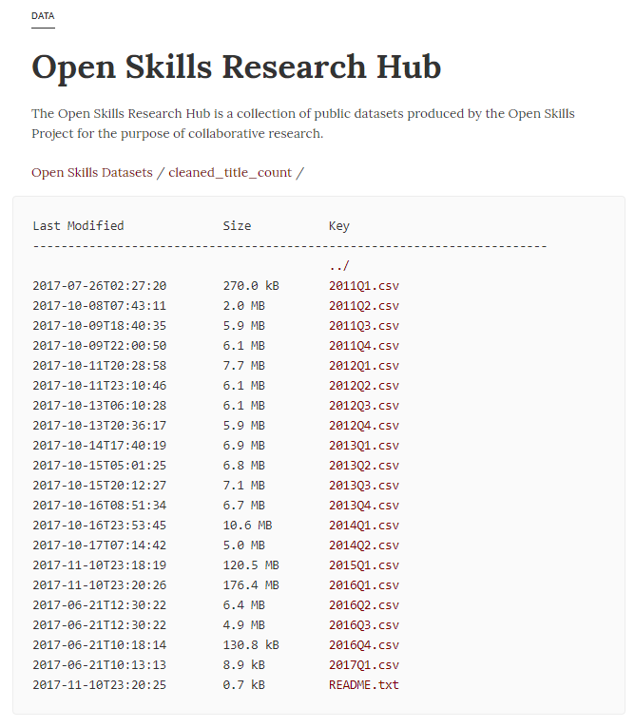
Dataset Selection Data At Work – Open Skill Project - Data

Slide 8
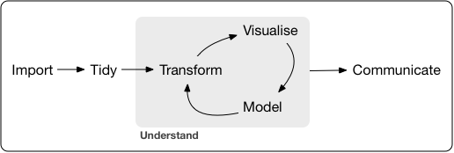
Data Analysis Tidy workflow

Slide 9
Data Analysis Tidy workflow
Import last 1 year of data

Slide 10
Data Analysis Tidy workflow
Tidy data to long format
Import last 1 year of data
Save and read from SQL dB

Slide 11
Data Analysis Tidy workflow
Tidy data to long format
Transform to answer questions 1) and 2)
Import last 1 year of data
Save and read from SQL dB

Slide 12
Data Analysis Tidy workflow
Tidy data to long format
Transform to answer questions
Visualize to answer questions 1) and 2)
Import last 1 year of data
Save and read from SQL dB

Slide 13
Data Analysis Tidy workflow
Tidy data to long format
Transform to answer questions
Visualize to answer questions 1) and 2)
Model to answer question 3)
Import last 1 year of data
Save and read from SQL dB

Slide 14
Data Analysis Tidy workflow
Communicate with this presentation
Tidy data to long format
Transform to answer questions
Visualize to answer questions 1) and 2)
Model to answer question 3)
Import last 1 year of data
Save and read from SQL dB

Slide 15
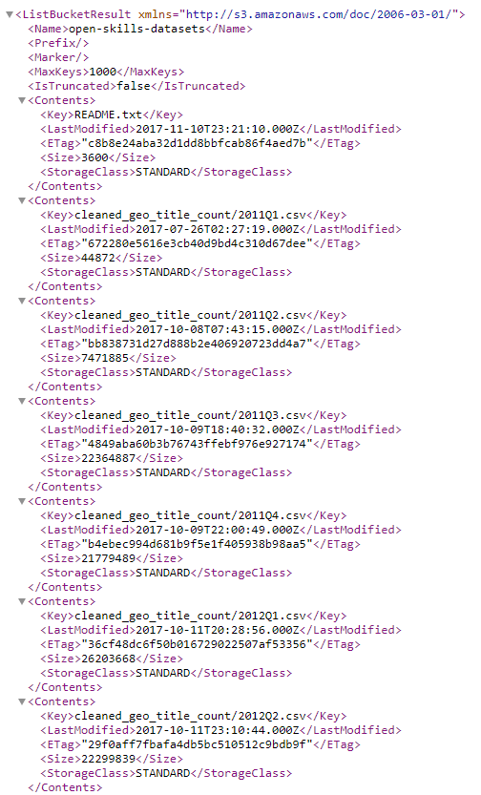
Import Scrape list of csv files
csv file names could not be scrapped from site since they are in AJAX
Underlying AWS XML file was used instead

Slide 16
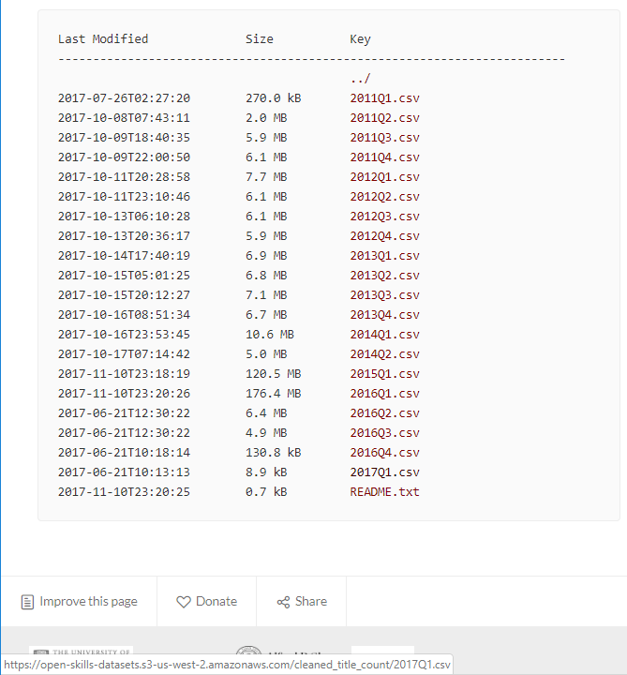
Import Scrape list of csv files
Four last csv files read using csv file list vector and a for loop
Each loop read from the csv file address

Slide 17
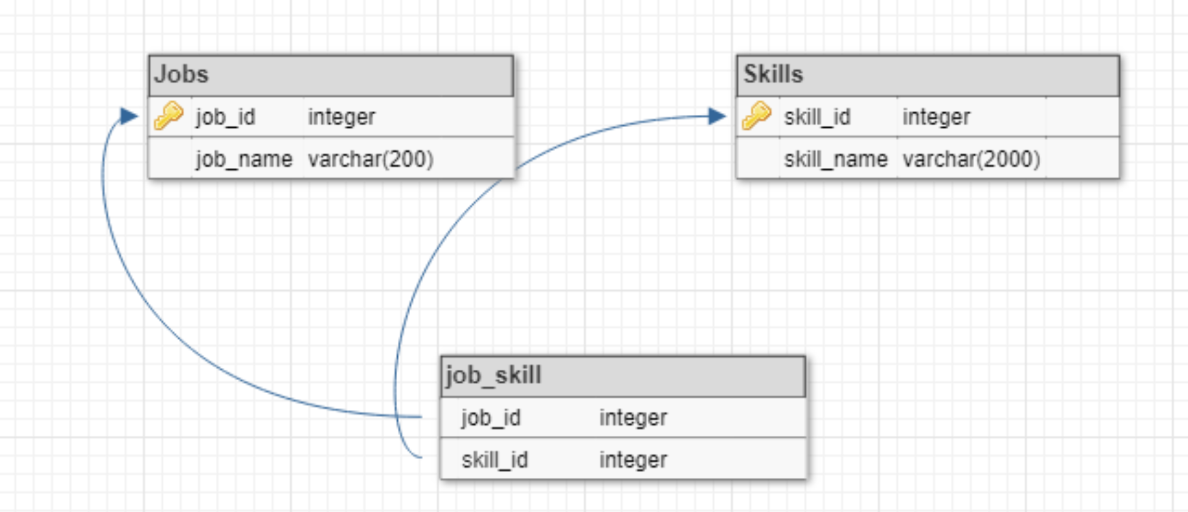
Normalized tables

Slide 18
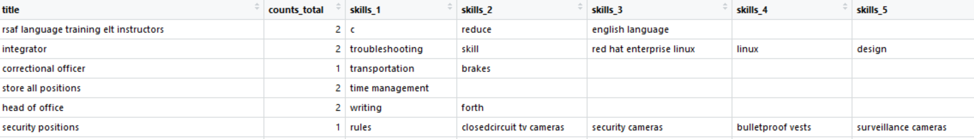
Wide data
Wide format data.
Tidy and transform data before saving to normalized tables.

Slide 19
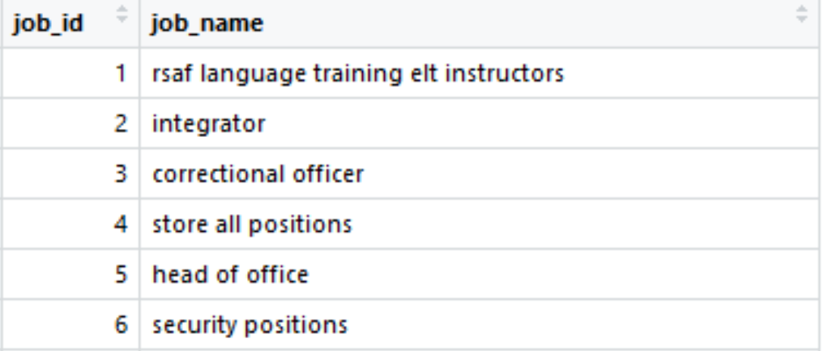
Transform Extract job titles and save to jobs table.

Slide 20
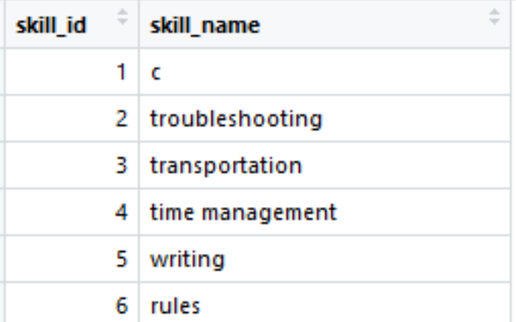
Transform Extract skills and save to skills table.

Slide 21
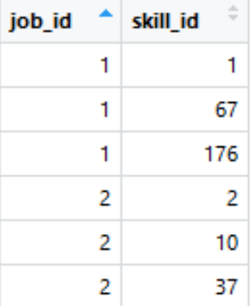
Transform Extract skills for each job and save to job_skills mapping table

Slide 22
Transform Extract skills for each job and save to job_skills mapping table

Slide 23
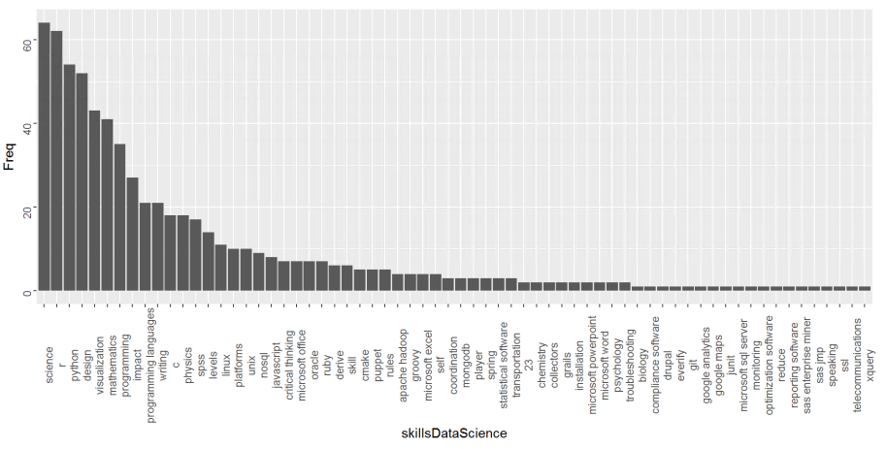
Question 1 - What are the most important skills in Data Science? Transform and visualize
Filter table for data science titles only
Create a vector with all skills
Science, r and python

Slide 24
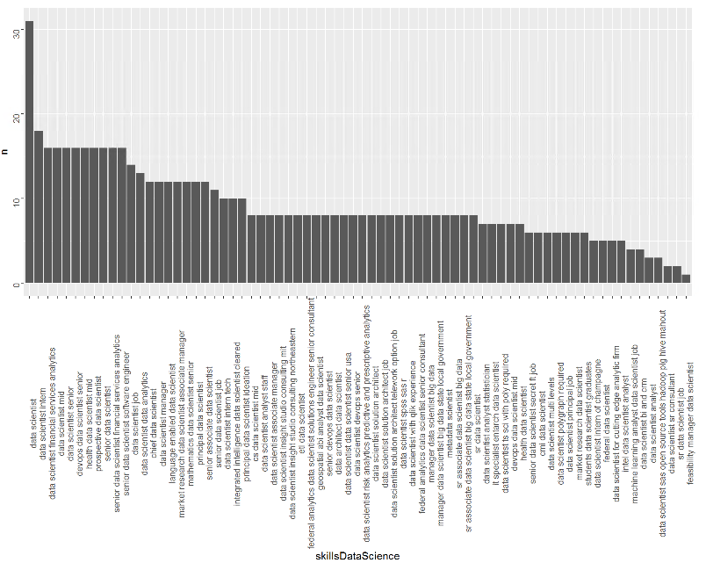
Question 2 - What Data Science job tittles requires the most skills? Transform and visualize
Filter table for data science titles only
Create a vector with all skills
Group by job
Data scientist, data science intern and data scientist financial services analysis

Slide 25
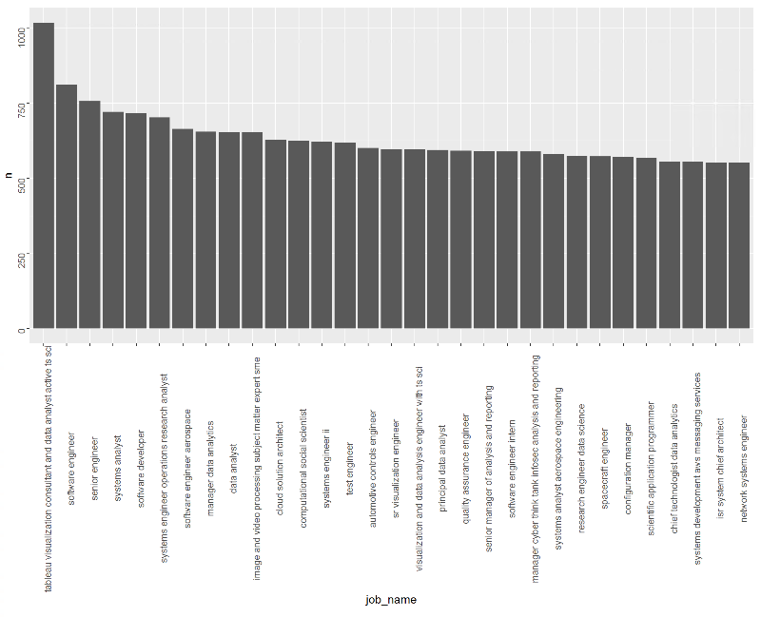
Question 3 - What other job titles have similar skills to Data Science? Transform and visualize
Filter table for data science titles only
Create a vector with all skills
Do a join with all job names and skills
Tableau viz consultant, software engineer and senior engineer

