Slide 1

Final Project Elections and the Economy
Data Acquisition and Management
Joby John
Peter Kowalchuk
December 2018
DATA 607 – Final Project

Slide 2
Analysis Statement Elections and the Economy
Given the Party composition of Congress:
1) Can we predict the economic out look for 2019?
3) Does this composition predict economic state of the Nation?

Slide 3
Agenda Elections and the Economy
Workflow
Import
Electoral Data
Economic Data
Tidy and Transform
Visualize
Model
2019 Predictions
Congress Economy predictor
Reticulate: Python and R
Challenges - Communicate
Conclusions - Communicate

Slide 4
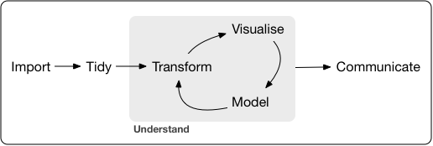

Analysis Workflow Tidy workflow

Slide 5


Data Analysis Tidy workflow
Electoral Data
Economic Data

Slide 6

Data Analysis Tidy workflow
Electoral Data
Economic Data

Slide 7
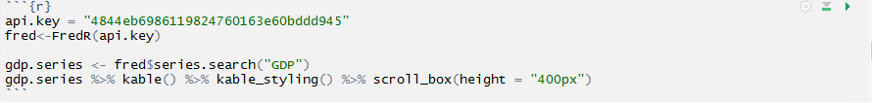
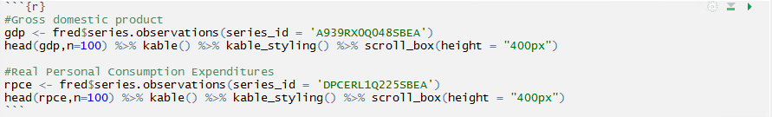
Economic Data Import - API Calls
API allows to browse though multiple indicators
Two economic indicators selected
Two economic indicators fetched using API

Slide 8
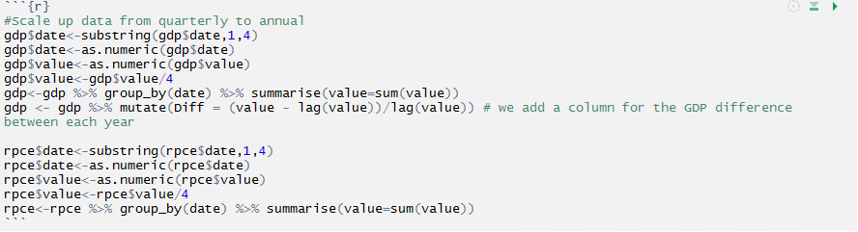
Economic Data Tidy and transform – Mutate and scale down data

Slide 9
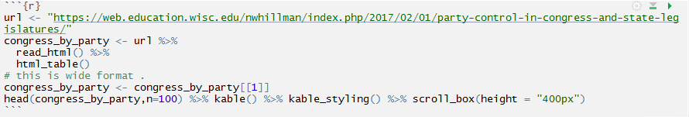
Electoral Data Import - Web Scrapping
Congressional party composition scrapped from web page table

Slide 10
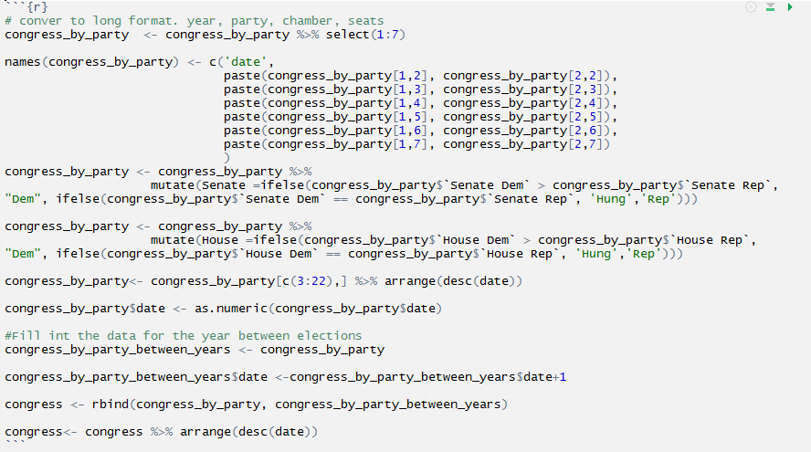
Electoral Data Tidy and Transform – convert to long format

Slide 11
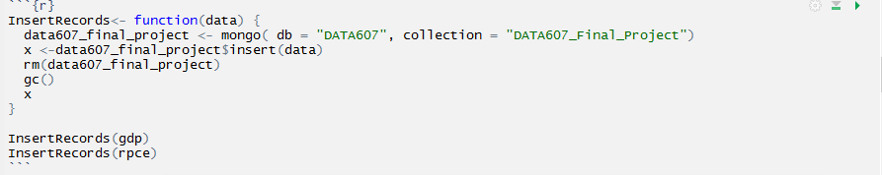
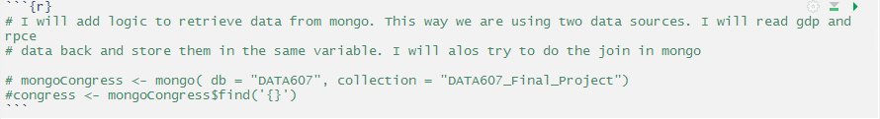
Electoral and Economic Data Store and read data to MongoDB
Save Data
Read Data

Slide 12
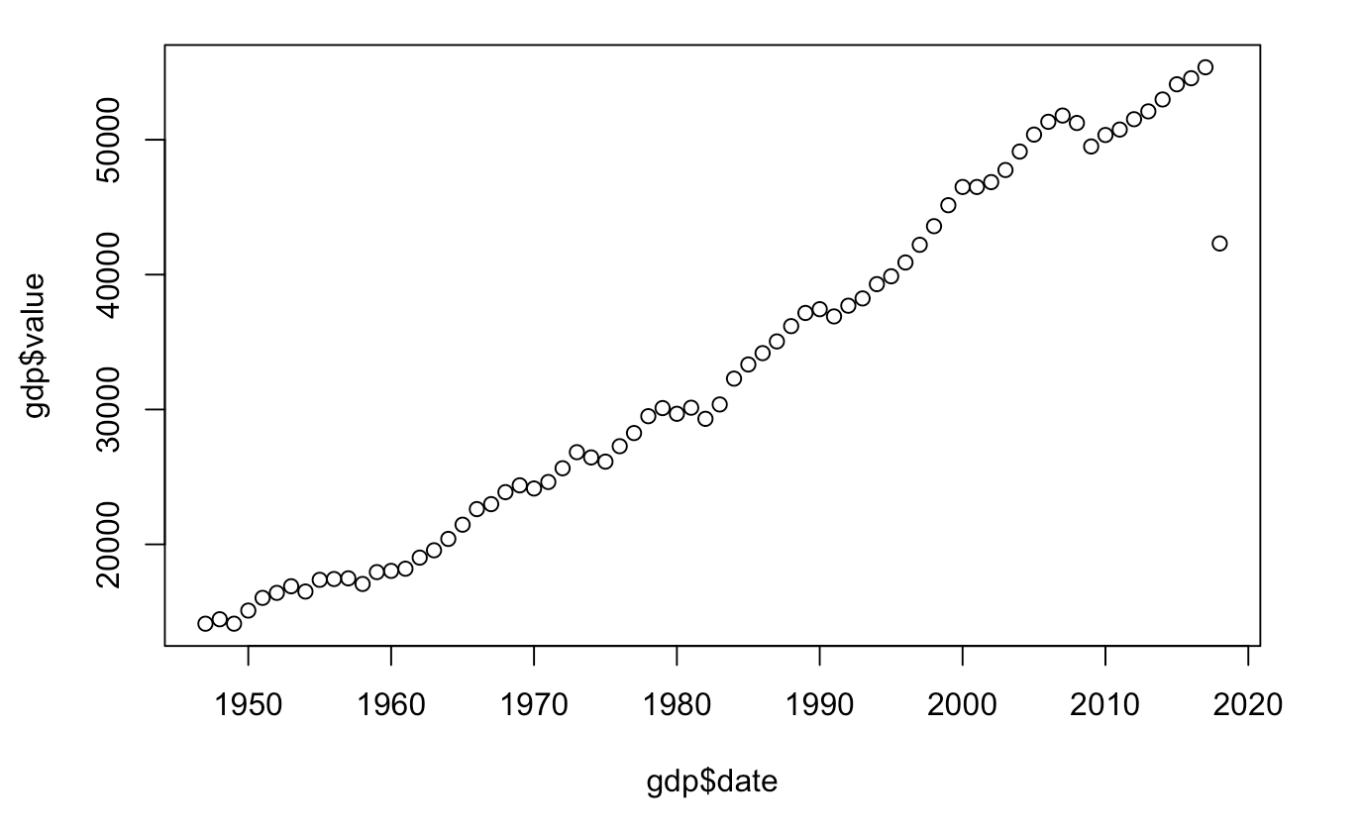
Visualize Economic Data
GDP
Increases annually due to population growth, inflation and other factors

Slide 13
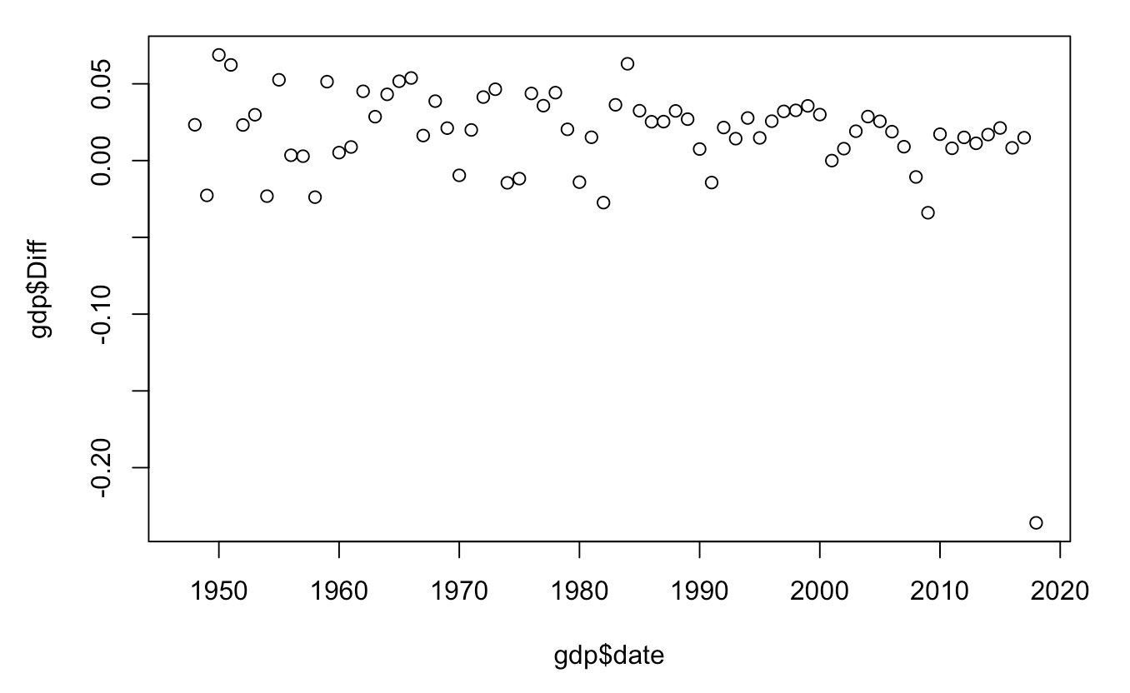
Visualize Economic Data
Normalized GDP year on year difference
A more stable economic indicator

Slide 14
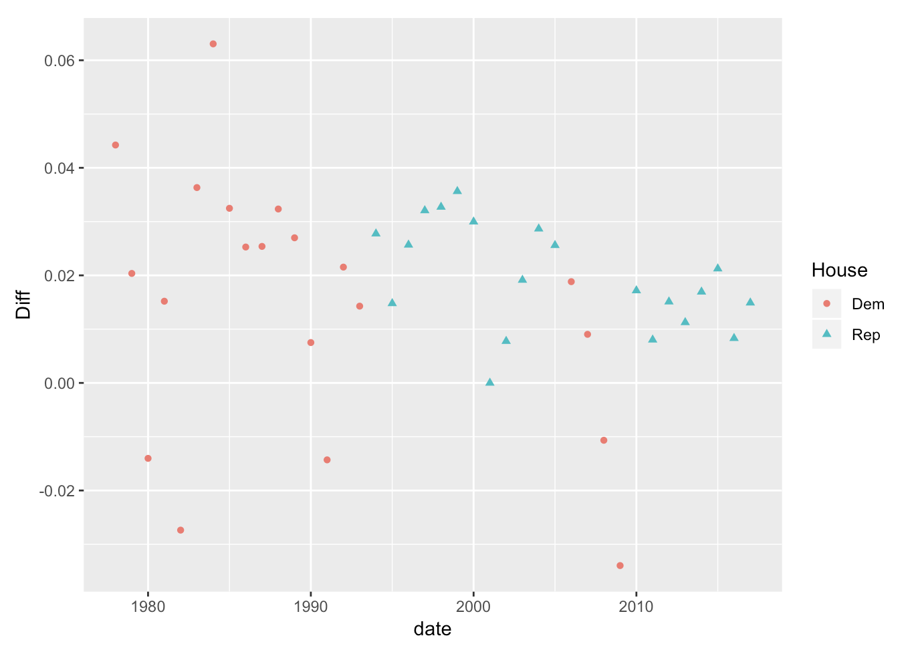
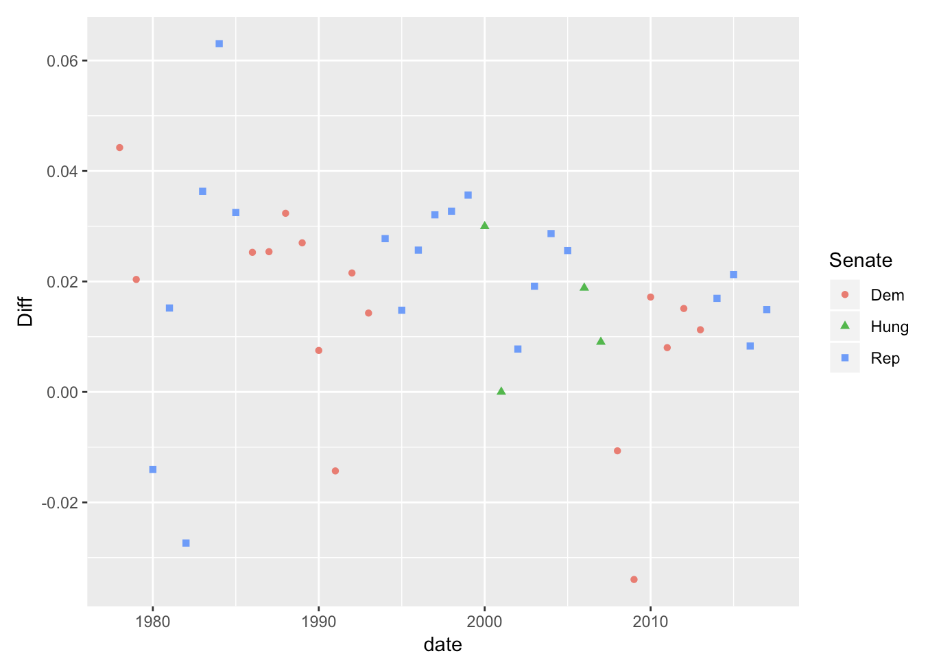
Visualize Economic and Electoral Data
Normalized GDP year on year difference and Congress composition

Slide 15
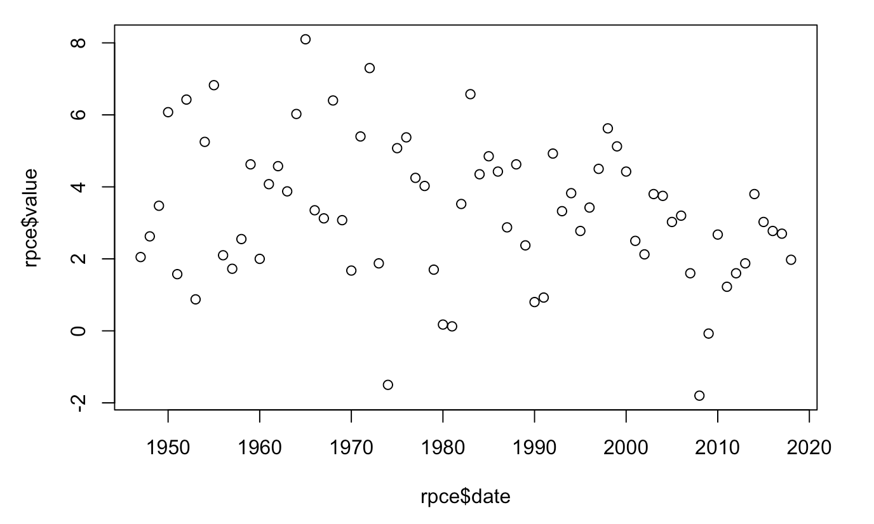
Visualize Economic Data
RPCE
A stable economic indicator year on year

Slide 16
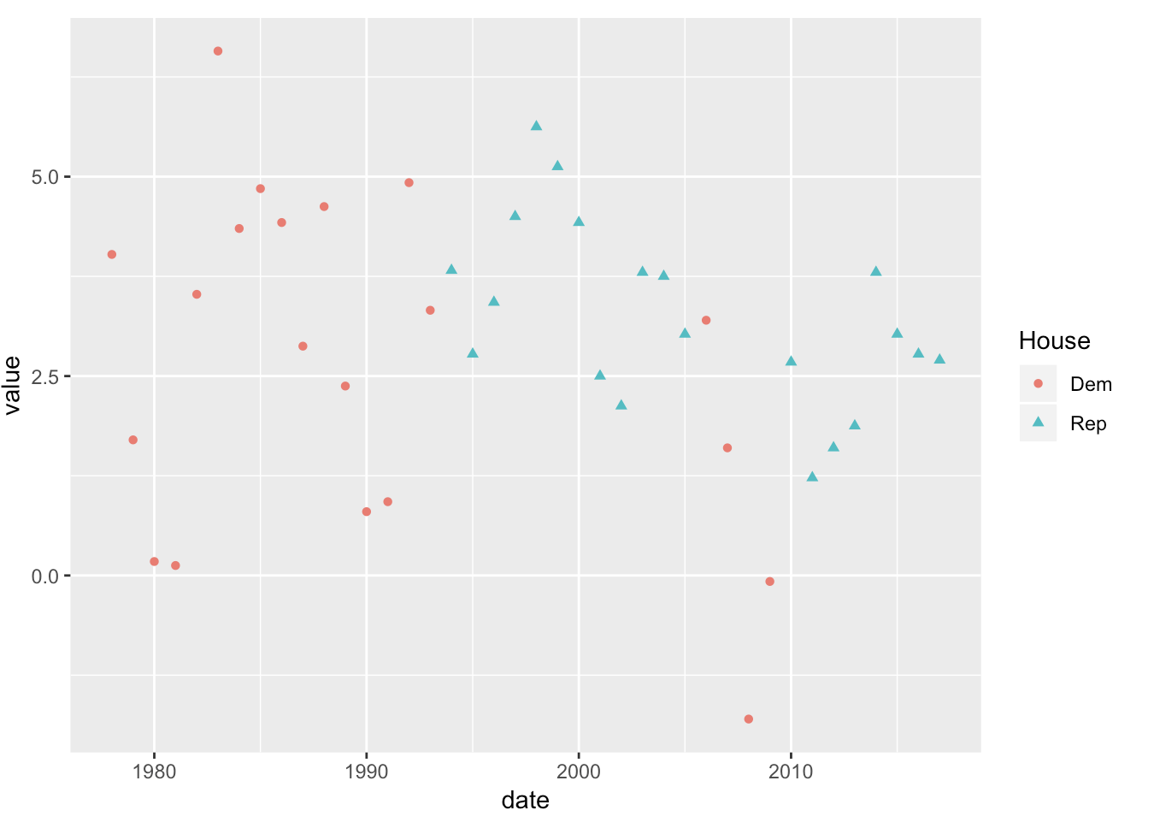
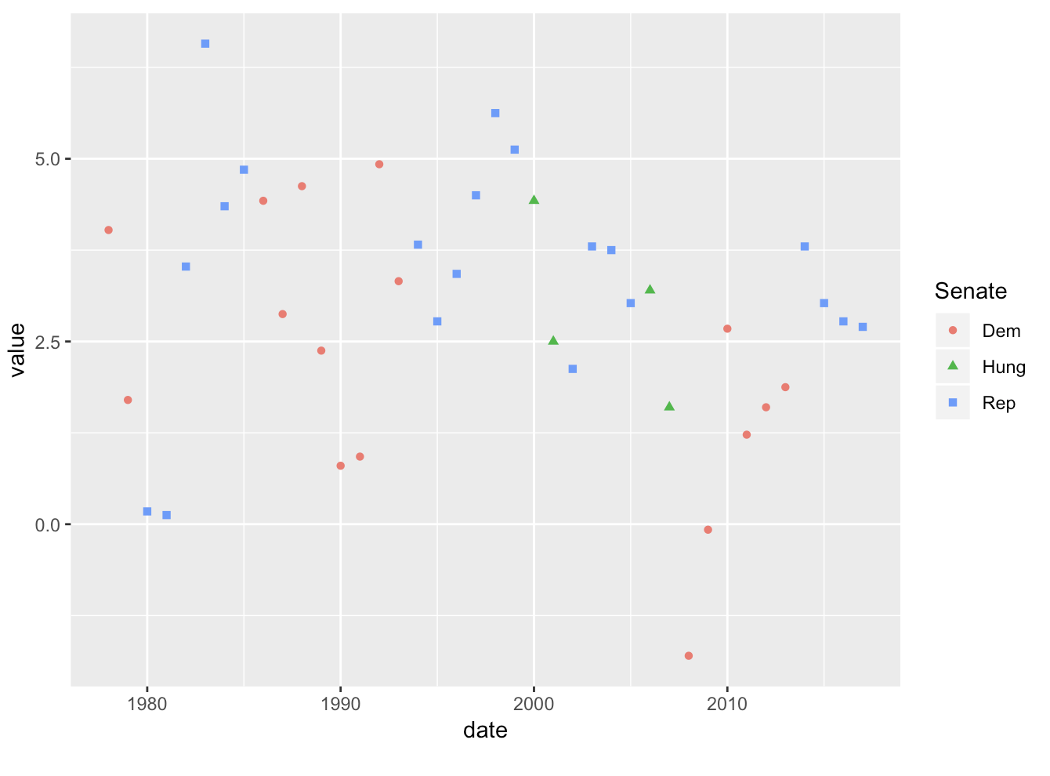
Visualize Economic and Electoral Data
Normalized GDP year on year difference and Congress composition

Slide 17
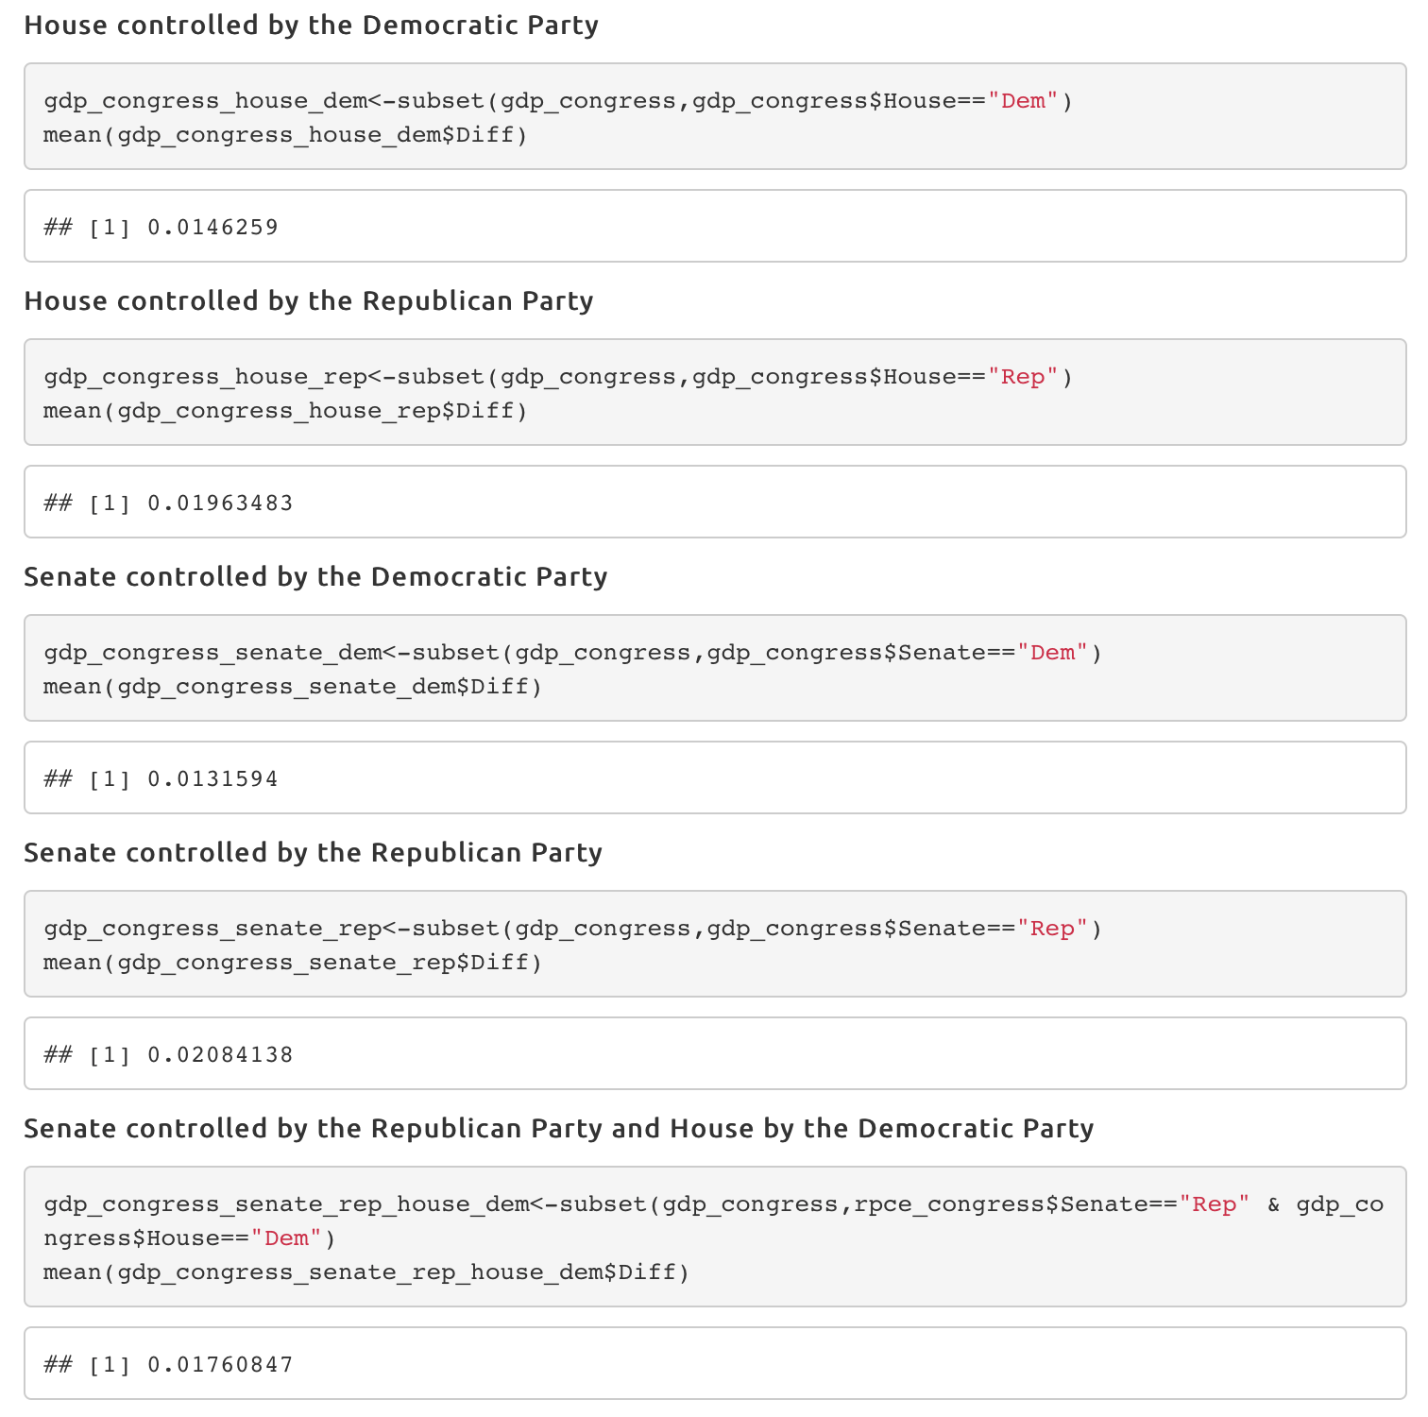
Model GDP Models

Slide 18
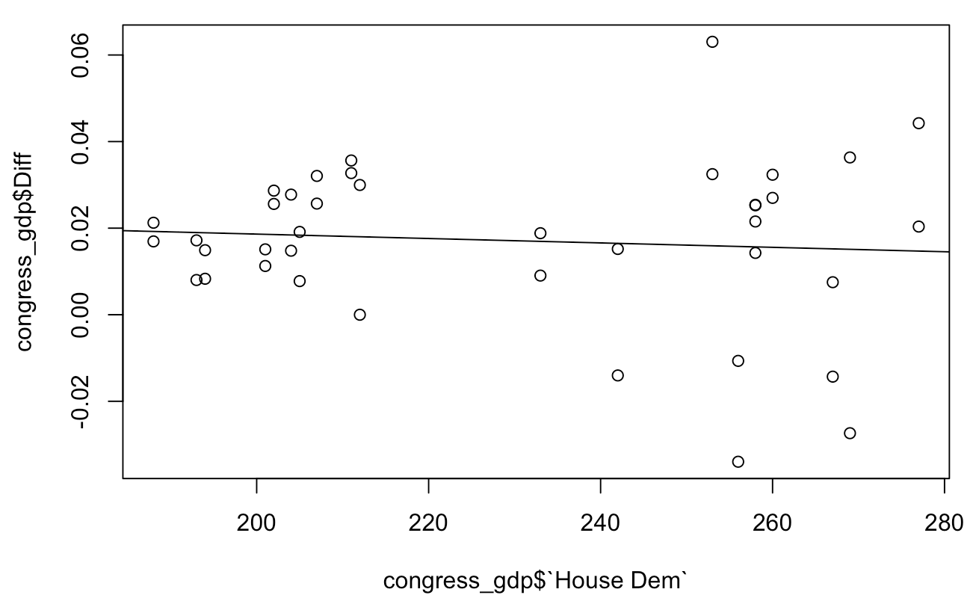
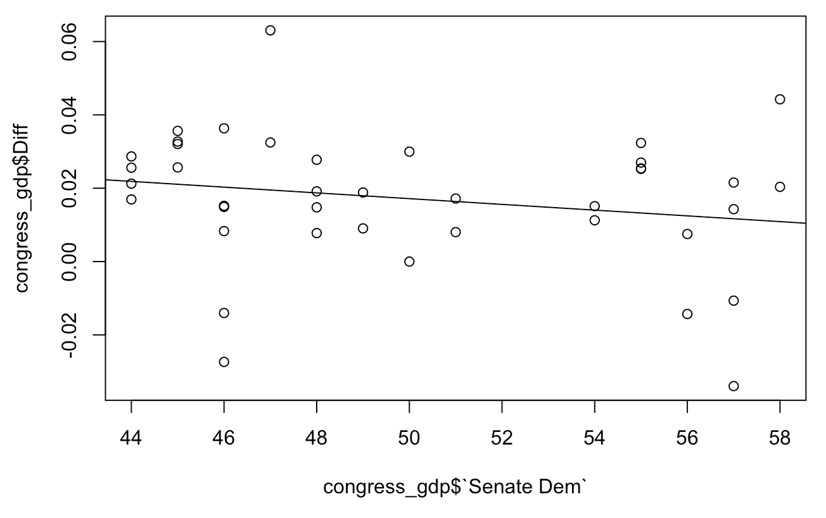
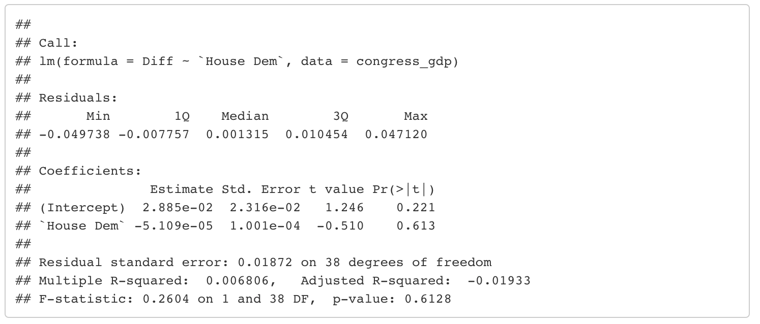
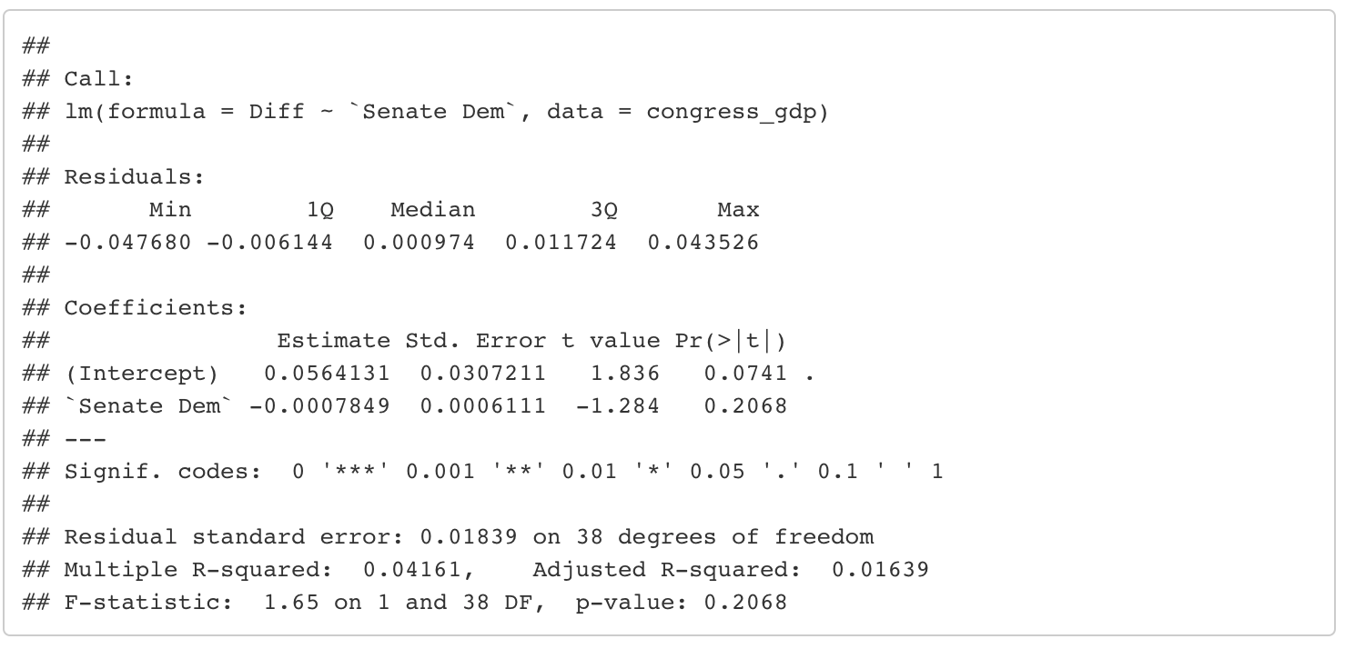
Model GDP Models

Slide 19
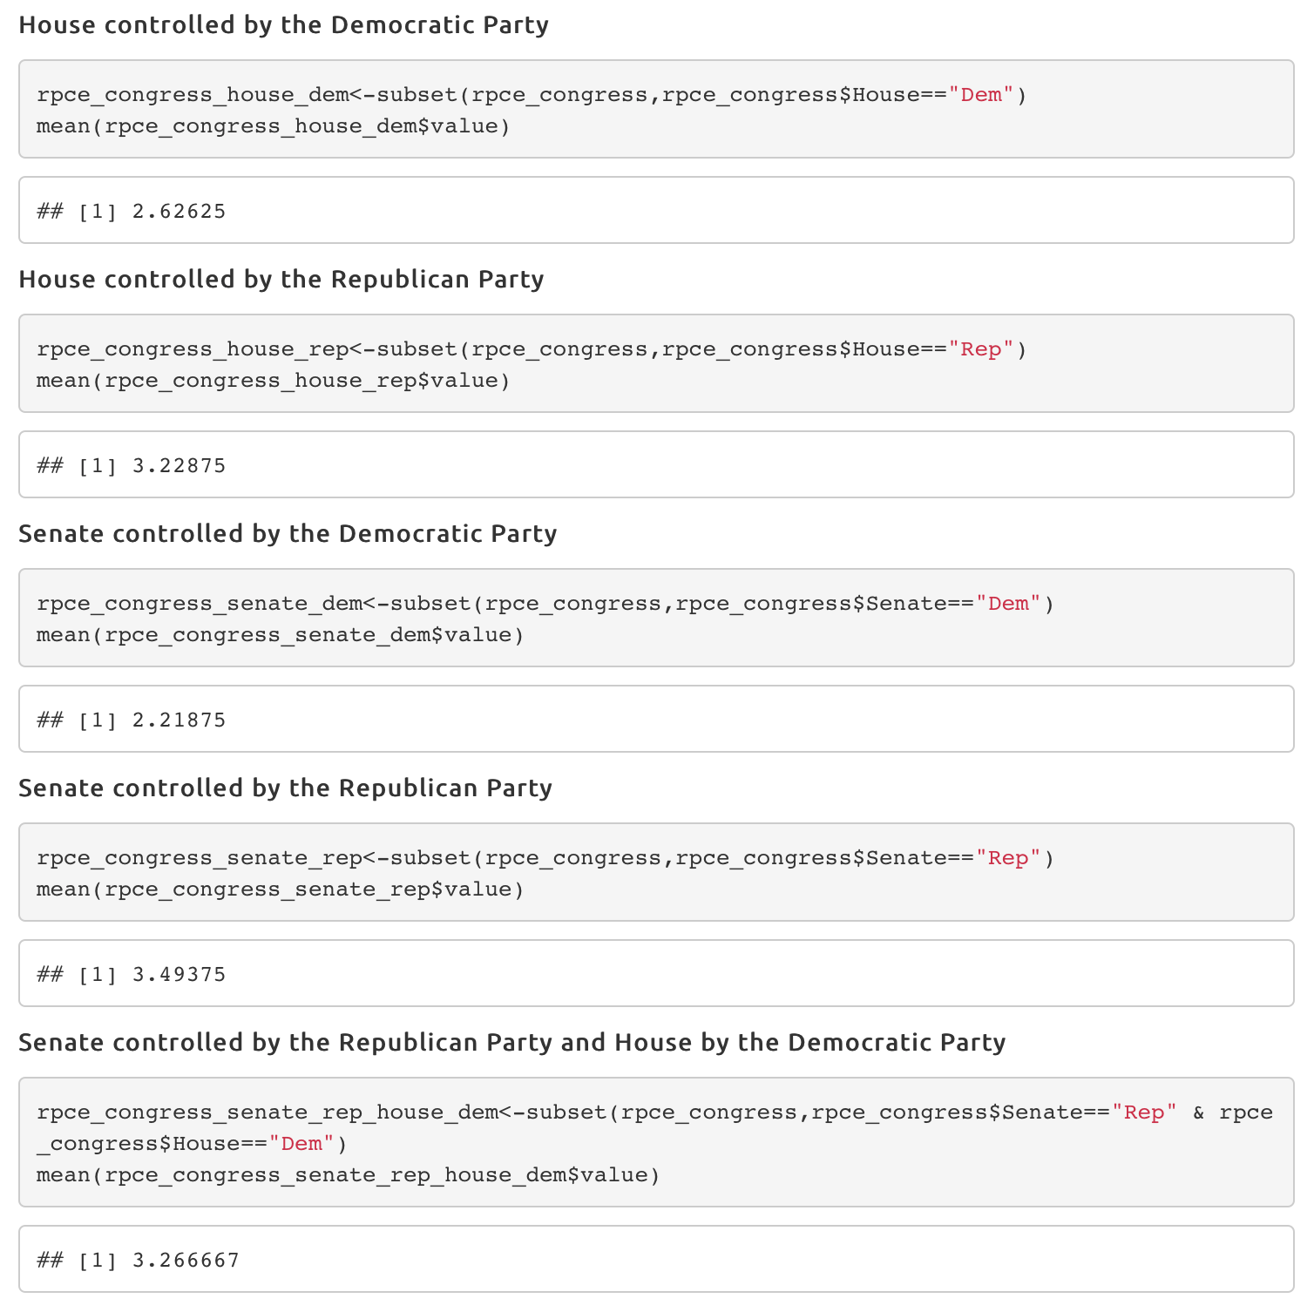
Model RPCE Models

Slide 20
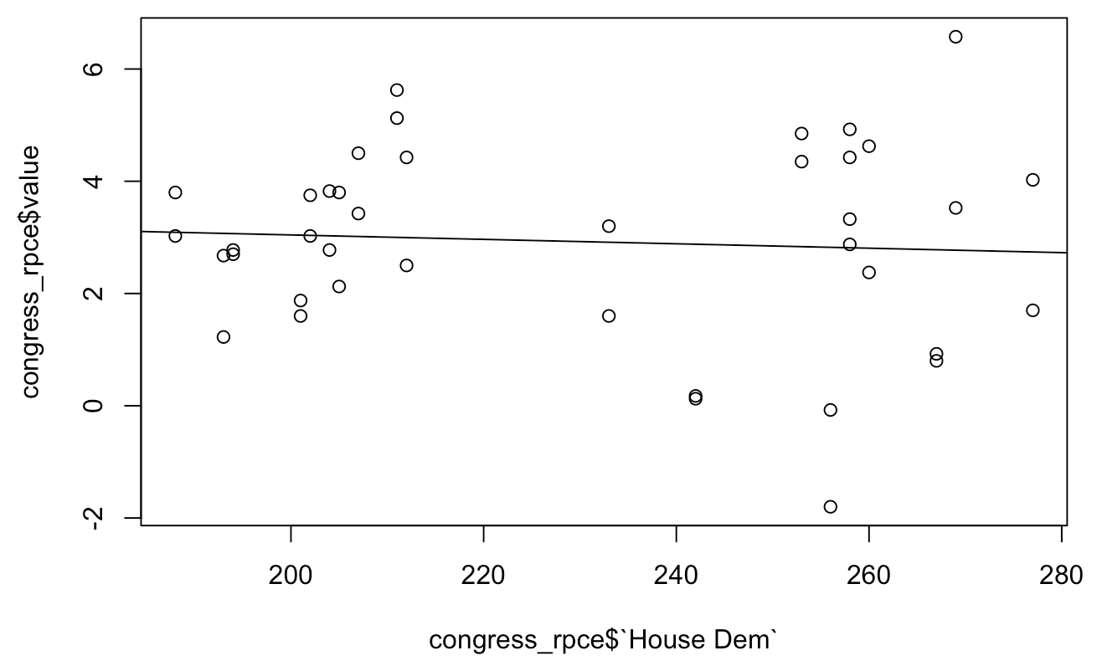
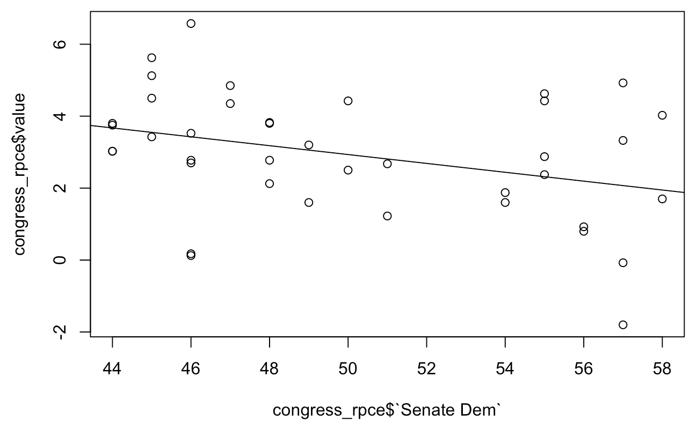
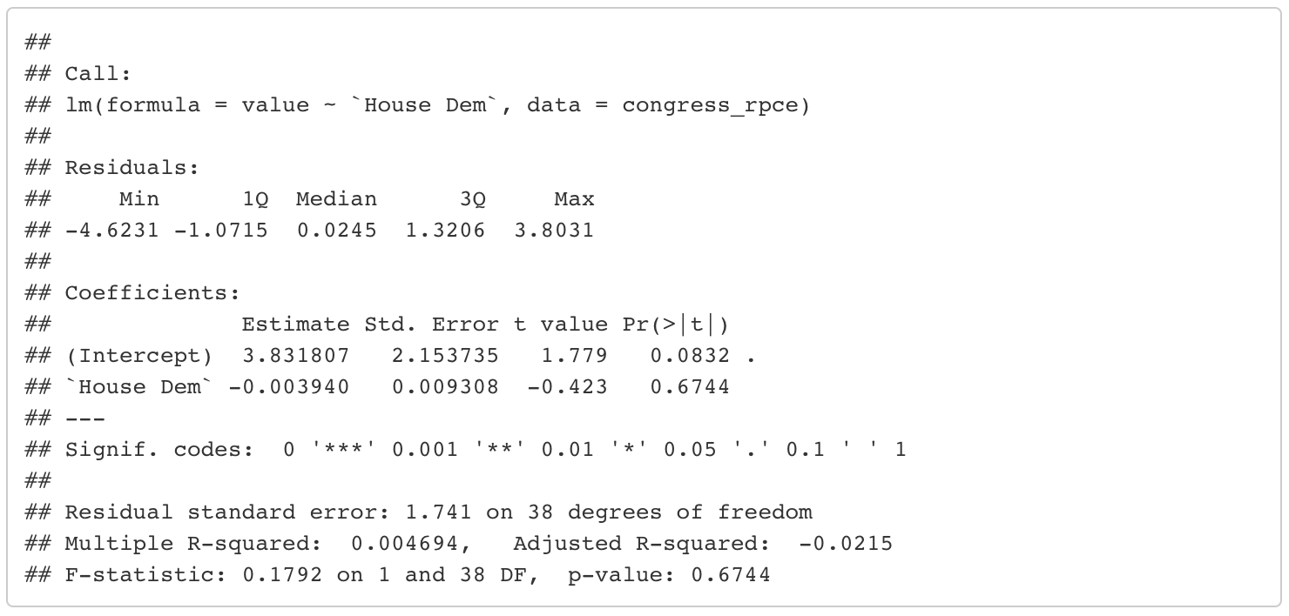
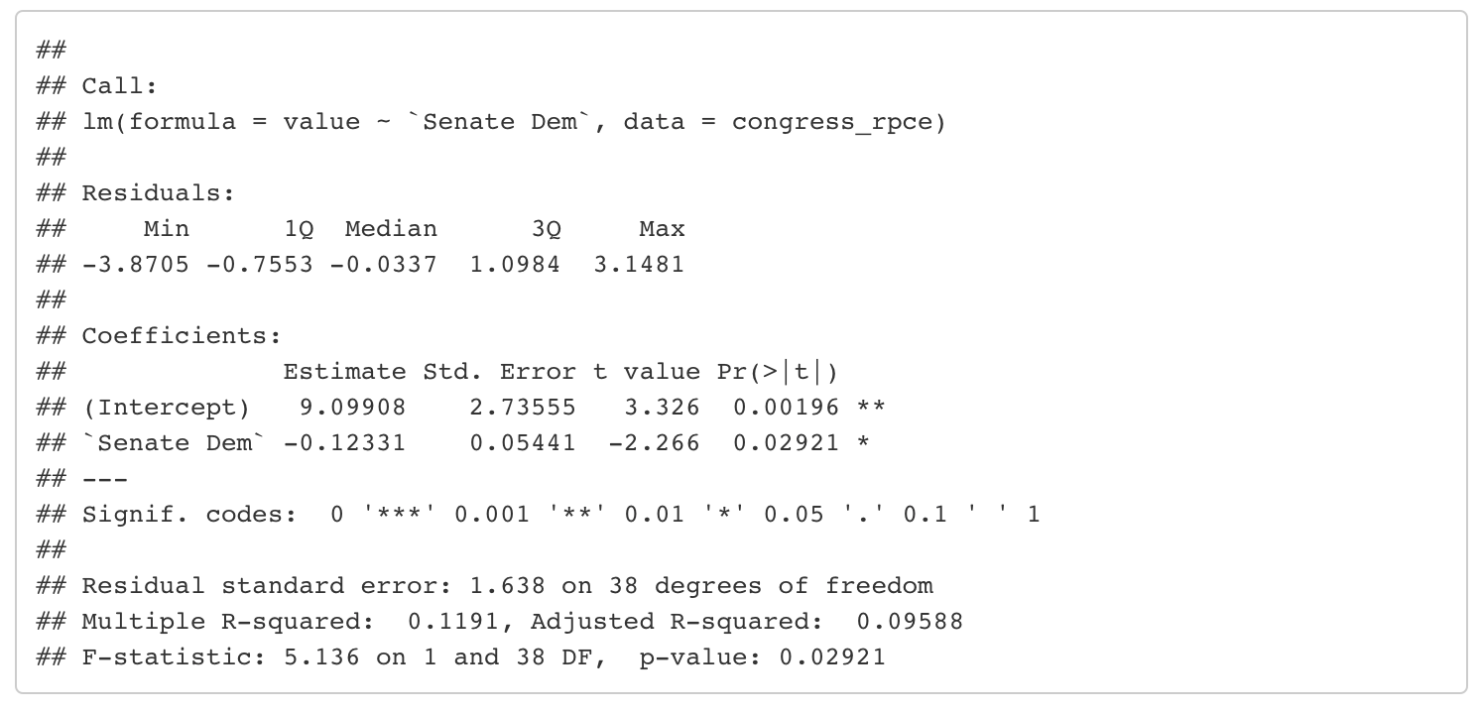
Model RPCE Models

Slide 21
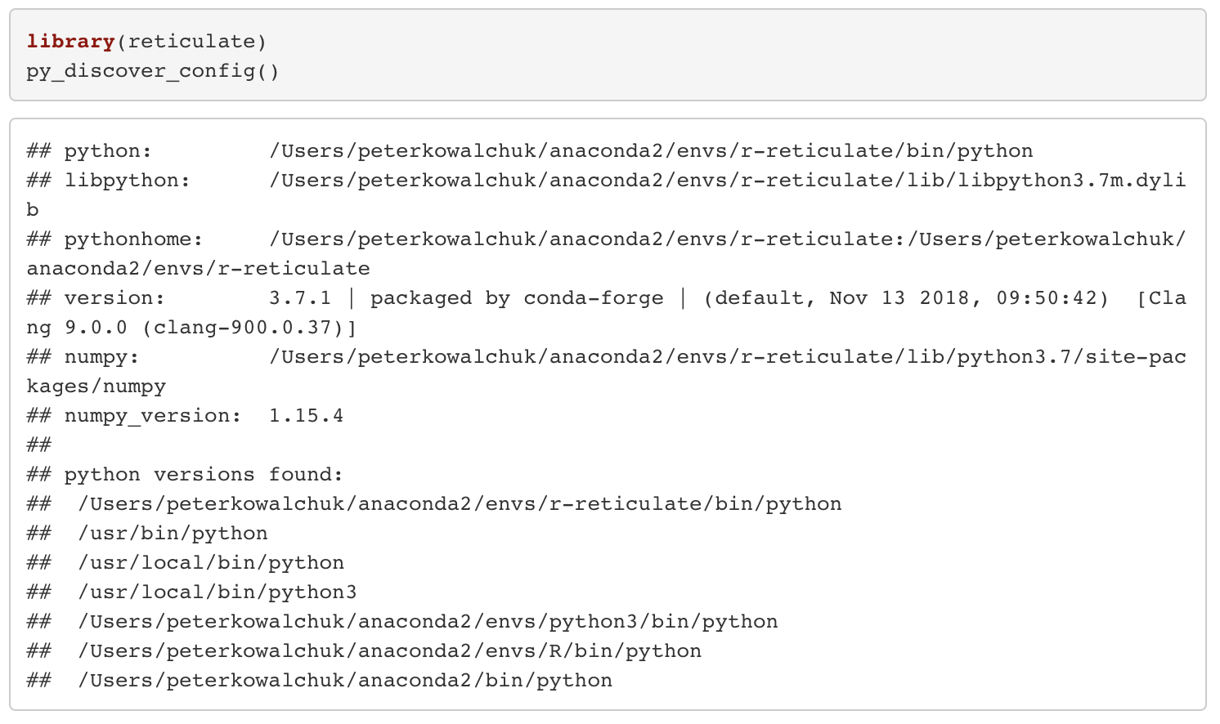
Model Python Scikit-Learn
Reticulate running on a conda environment with Python and Scikit-Learn

Slide 22
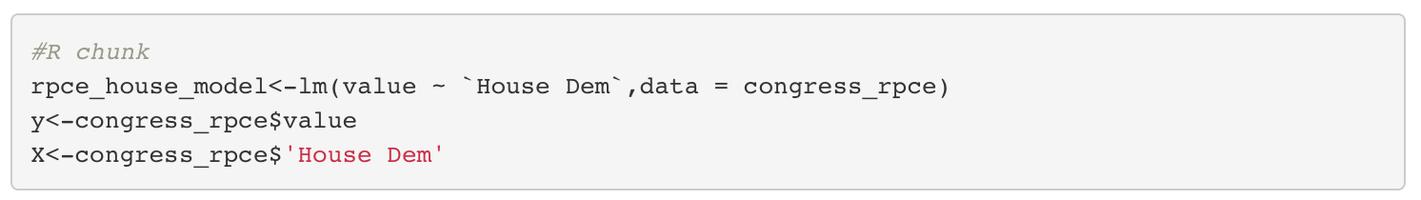
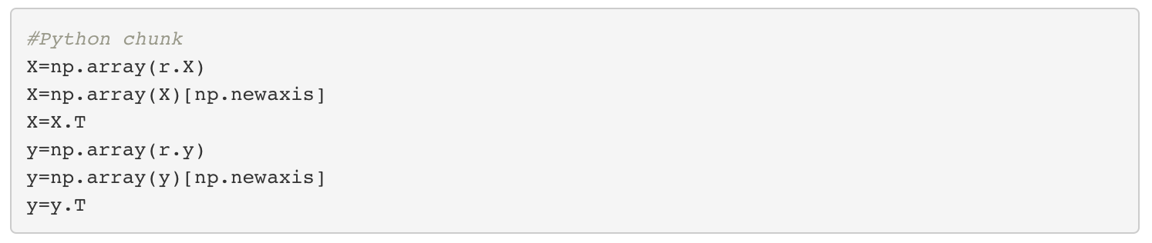
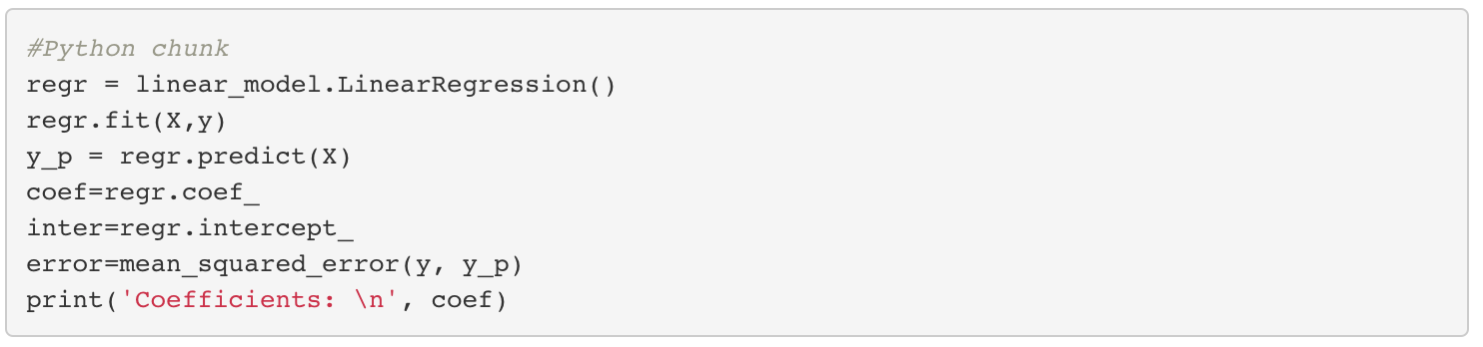
Model Python Scikit-Learn

Slide 23
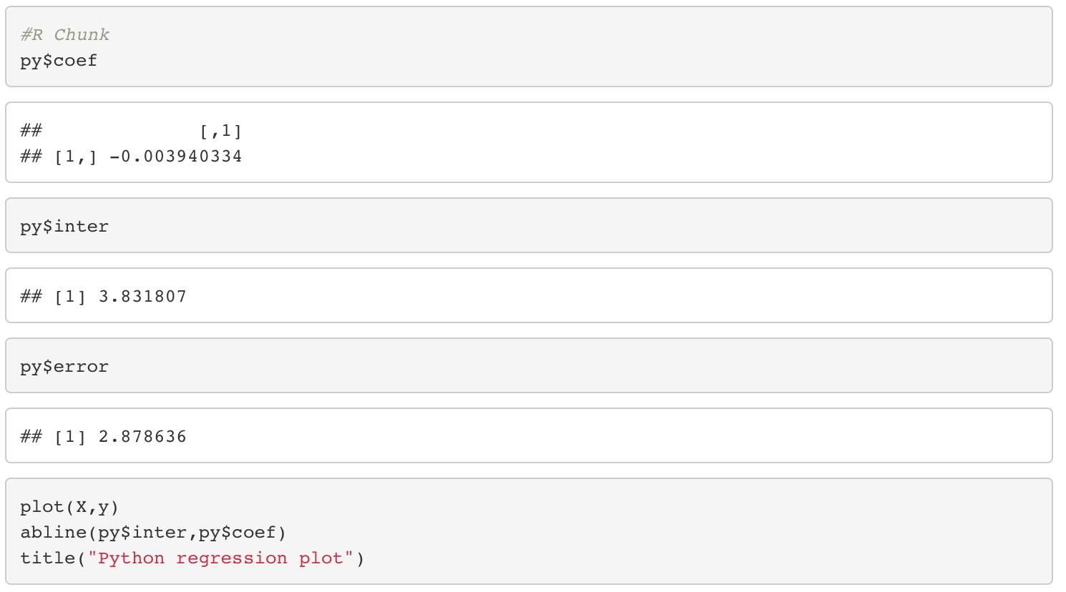
Model Python Scikit-Learn

Slide 24
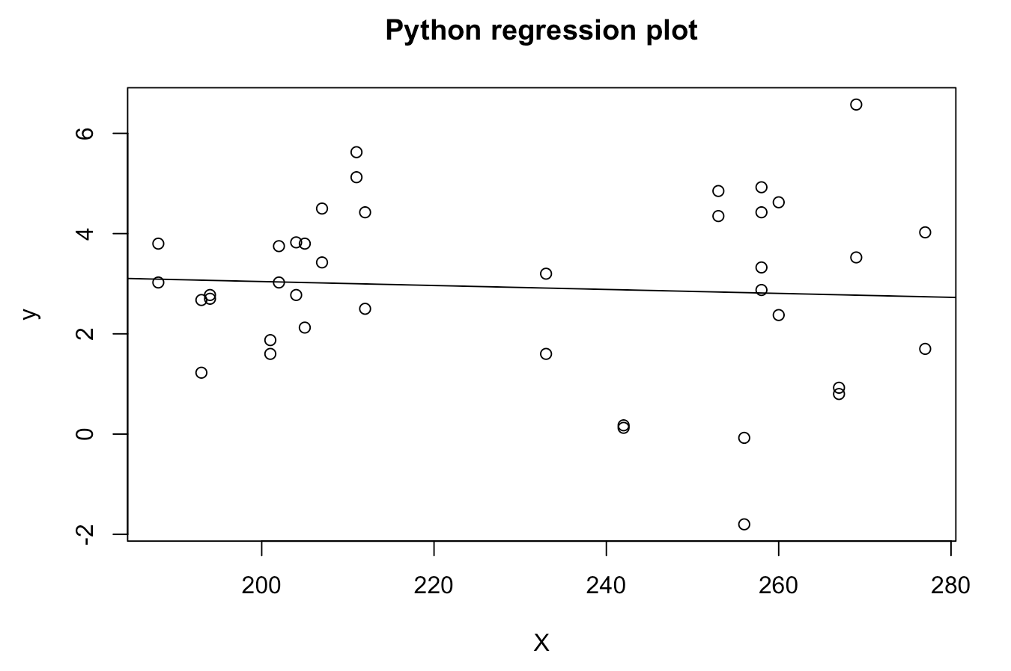
Model Python Scikit-Learn

Slide 25
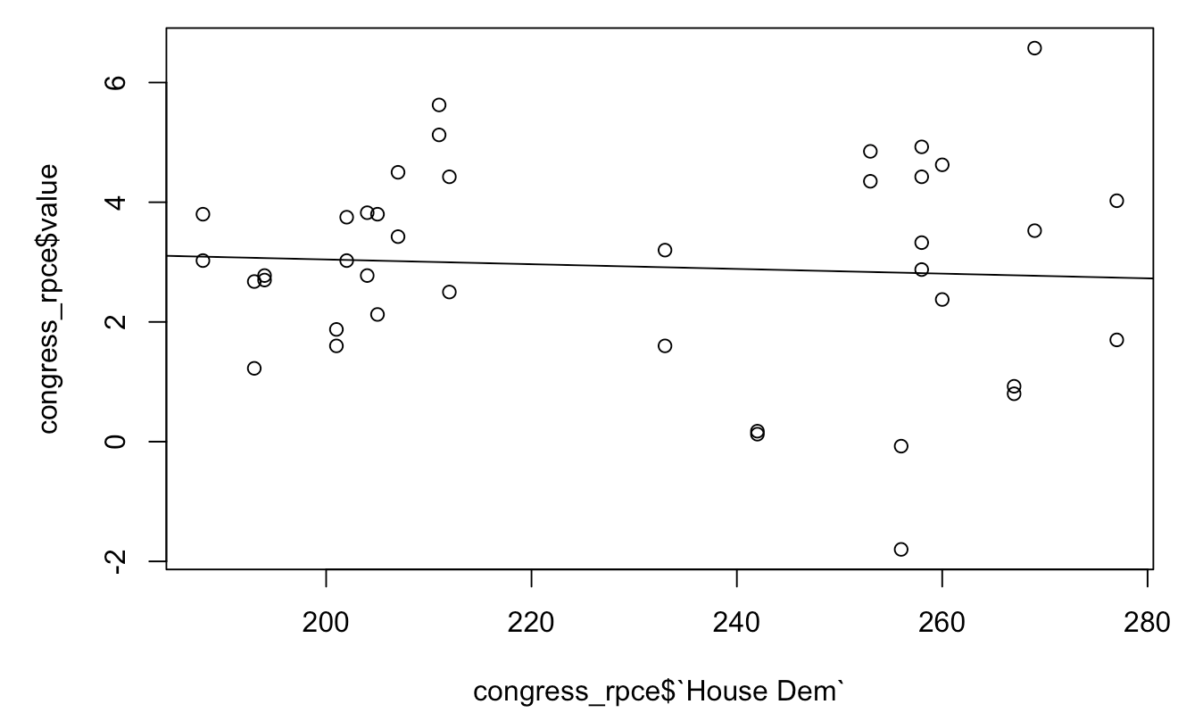
Model Python Scikit-Learn
R regression plot

Slide 26
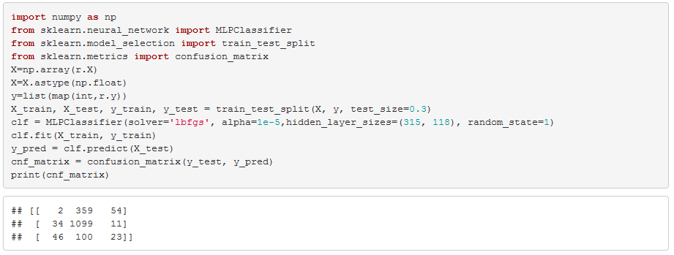
Model Congress Economy Predictor - Python
Classifier Performance

Slide 27
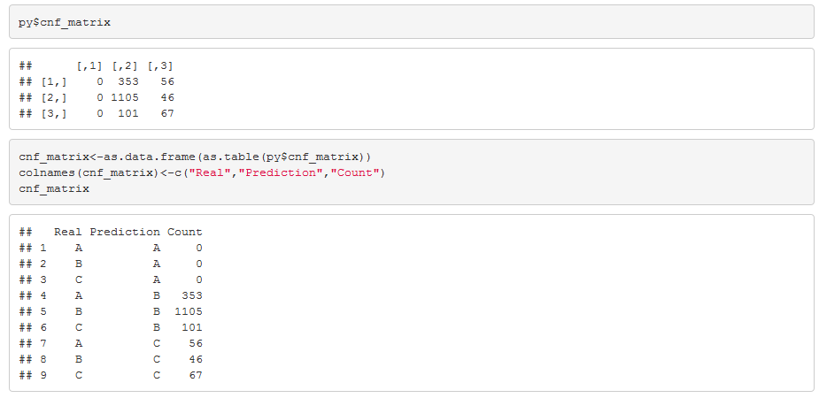
Model Congress Economy Predictor - R
Confusion Matrix in R

Slide 28
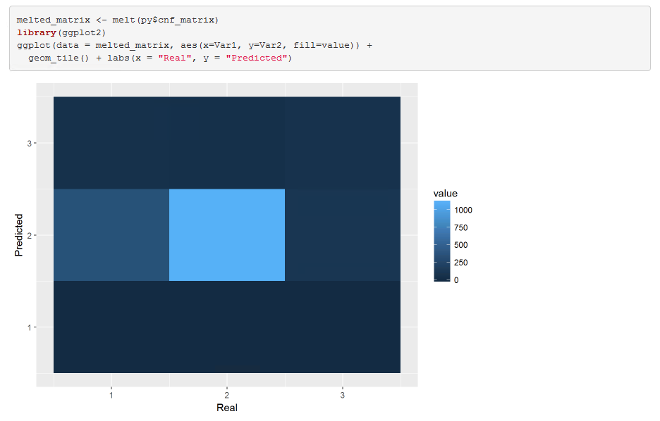
Model Congress Economy Predictor - R

Slide 29
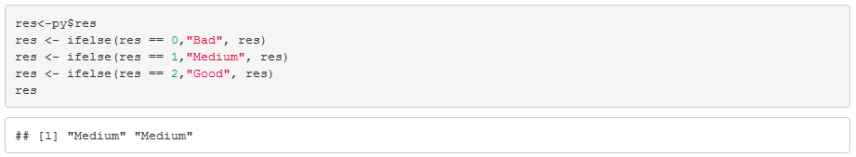
Model Congress Economy Predictor - R
2018 to 2019 Prediction

Slide 30
Challenges Communicate
Regression models are not always possible
Reticulate only works with Knit
Matplotlib has issues when running with Reticulate in R, need to plot in R

Slide 31
Conclusions Communicate
Data Science
GDP growth expected in 2019: 0.01760847
RPCE expected in 2019: 3.266667
Economic indicator modeling using linear regression: congress composition not a good estimator
2018 to 2019 prediction using a Neural Network classifier does not show any change in the state of the economy
Data Engineering
Python modeling is possible in R using Reticulate library

