Slide 1
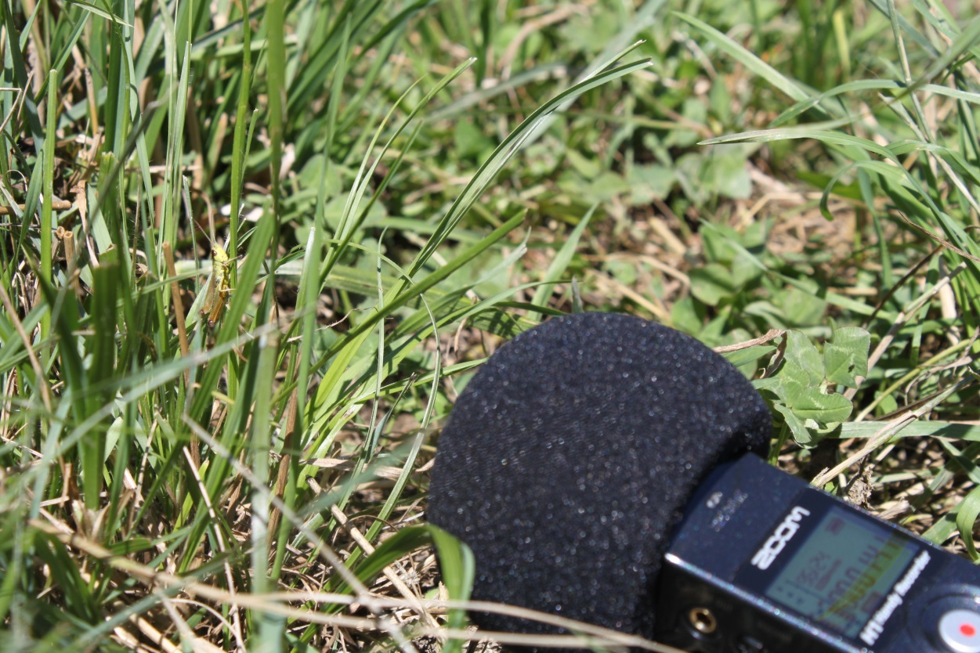
Automated recording system to monitor grasshopper abundance in natural environments

Slide 2
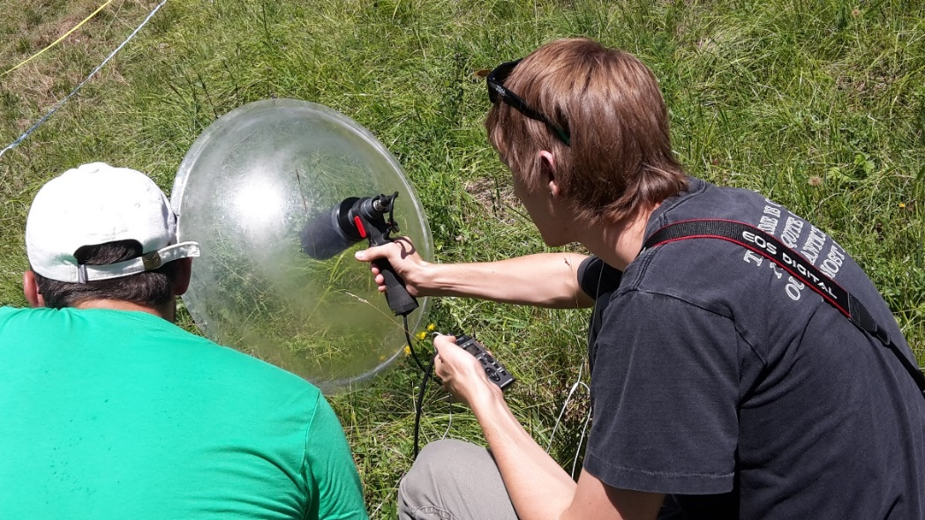
Introduction: long-term goal
Monitoring data to study change on biodiversity.
Embedded recording system
Goal : do an algorithm that recognise from sound orthoptera in Swiss landscape
Notes:
- Manual samplig: take time, time is money… So have an embedded system that records the species will be interesting
- Explain what is manual sampling : have to catch the insects by hand, then an entomologist have to recognize it by hearing…

Slide 3
Introduction: this project
First implementation based on a published paper (Ganchev, 2007)
Two methods to extract the features :
Variable length frame size
Fixed frame size
Features used :
Main frequency
23 first LFCC
Time duration (in case of variable length)
Classifier : GMM

Slide 4
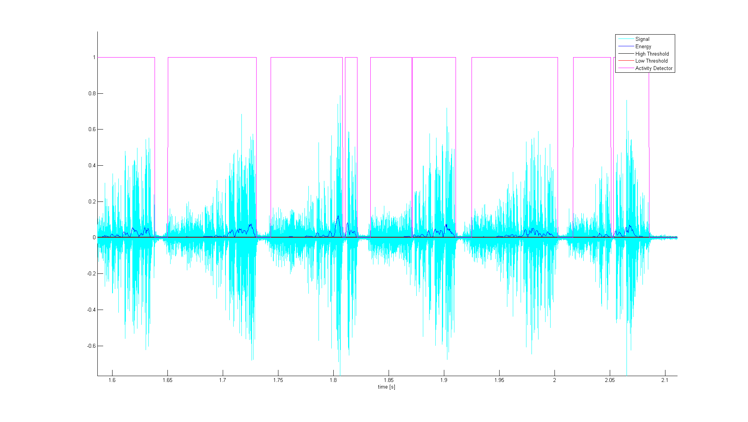
Variable VS Fixed frame size
Variable length frame
Activity detector based on energy and threshold
Fixed frame size
Cut the signal every e.g.100 m
Threshold to select most significant frames
Notes:
Two different ways to extract the frame that contains the features

Slide 5
Data
Test files recorded on the field, 03.08.15
Recognized “by hearing” (C. Roesti)
Our study focus only on the 7 species recorded that day
Database of songs from “Die Stimmen der Heuschrecken”, Christian Roesti
Data was processed to keep files containing only calling songs recorded with standard recorder
Finally : we have 3 to 10 files per species
Notes:
We selected 7 species, recorded on the field

Slide 6
Classification
Training data
Features
Extraction
GMM Species Models
From database
Classifier
Record to identify
Features
Extraction
Search for similarity
From database
or field recordings
Decision
Notes:
- First we have to train a model
- Then we can classify a new signal, coming from the field for example

Slide 7
Training / Testing methods
Data must be separate into a training and a testing set
There is different ways to chose the testing set :
All versus all
Cross-validation
One versus all
It leads to different results depending on the method chosen

Slide 8
All versus all
File 1
File 2
Training set
File 3
File 4
…
File N
File i
Testing set
i = 1 … N
All the files are used to train, then each file is used to test

Slide 9
Cross validation (e.g. 5-fold)
File 1
Vector 42
Vector 2
File 2
Training set
Vector 1205
File 3
Vector 13
Vector 1
grouped by species
File 4
Vector …
…
File N
Vector 3
Testing set
Vector 21
grouped by file
All the features vector from all files are blend, then 4/5 is for training, 1/5 for testing
Five different data-splits
Ganchev 2007 uses 2-fold cross-validation (having only one file per individual)

Slide 10
One versus all
File 2
File 3
Training set
File 4
File 5
File 6
File …
File 1
Testing set
A file is retired from training set and tested after
Done for each file
More representative of the real system
Notes:
We put aside one file and take the remaining to train
Real world condition

Slide 11
Todor Ganchev’s paper
«Automatic acoustic identification of singing insects», Ganchev & Potamitis, 2007
Method
Fixed frame size & variable length size
Time duration, main frequency, 23 LFCC
GMM & PNN classifier
Accuracy ~ 95% (warning !)
Database source: SINA, ISW, NAVIS
307 species to detect
One file per species
½ for training, ½ for testing
Notes:
Our principal guideline is this paper…
SINA : Singing insects of north America
ISW : Insect sound world - Japan
NAVIS : Natural Audio and Video Documentation of Slovenia

Slide 12
Previous Results : bad hope
Core of the naive Bayes classifier code
~ 75% of good classification
Core of the discriminant analysis code
~ 80-90% of good classification
Cross validation method was used
The same file was used to train and test, but not the same features vectors

Slide 13
Results
 | All VS All | Cross Validation | One VS All
Fixed Frame | 94.44 % 97.22 % * | 95.55 % 96.11 % * | 36.11 % 44.44 % *
Variable Length |  | 94.6 % | 55.55 %
* Using resampling to have the same features vector ratio among each species
Using 13 field recording files : 30.7 %
Accuracy decreases drastically when we’re implementing the “one versus all”
Lack of data, we would need at least 10 files per species!
Notes:
Considering the confusion matrix, we see that the species which contain more files are easier to predict

Slide 14
Conclusion
Results can be distorted depending on the choice of the test methodology
A large amount of files per individuals is preferred (~ 15)
If we have 2 files for an individual, that mean one files would be used for training and one for testing…
The differences between individuals within a species are not “averaged out” and removed
One versus all is the “real condition” method, which shows the generalization ability of our system
Notes:
Distorted / Biased

Slide 15
Future work
More clean, labelled data should be obtained
Study other methods
Sound parametrization:
Time & frequency parameters (e.g. OpenSmile)
Filter banks or wavelets
Classifier: PNN, HMM

Slide 16
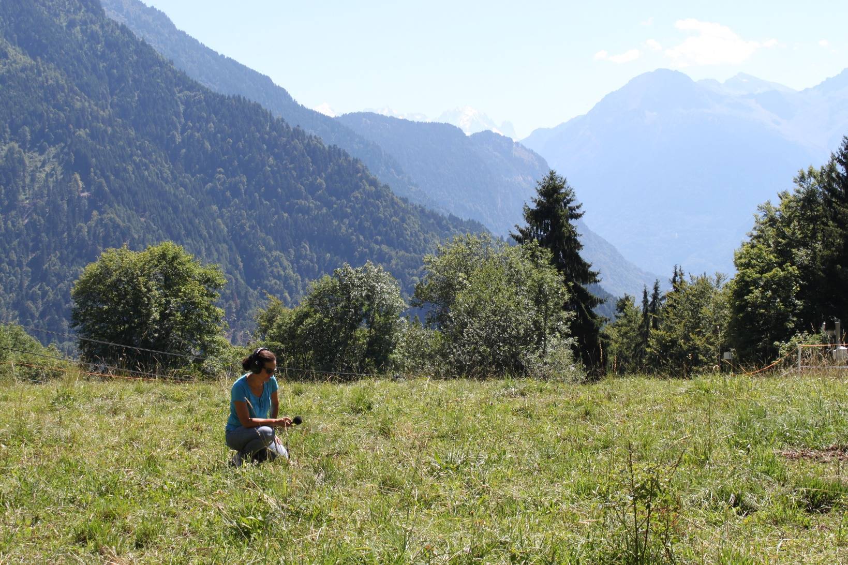
Thank you for your attention

