Slide 1
2022-2 Big Data Project Final Report Cafe data Analysis, Recommendation system
Team 13
Minsoo Cho
Sangjin Lee
Jaemin Kim

Slide 2
Table Of Contents
Project Overview
Difference from previous approaches
Data Processing
Analysis & Visualization
Demo
Q & A

Slide 3
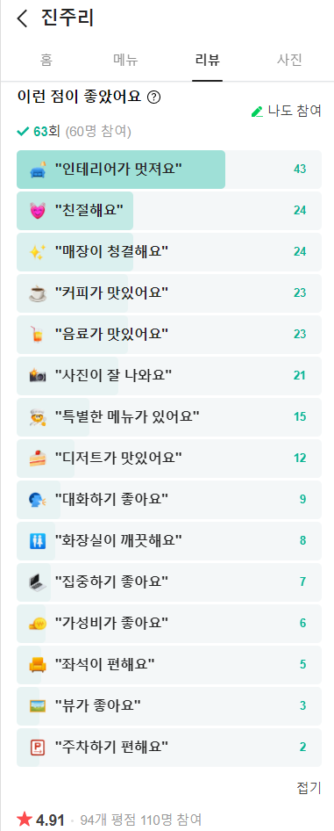
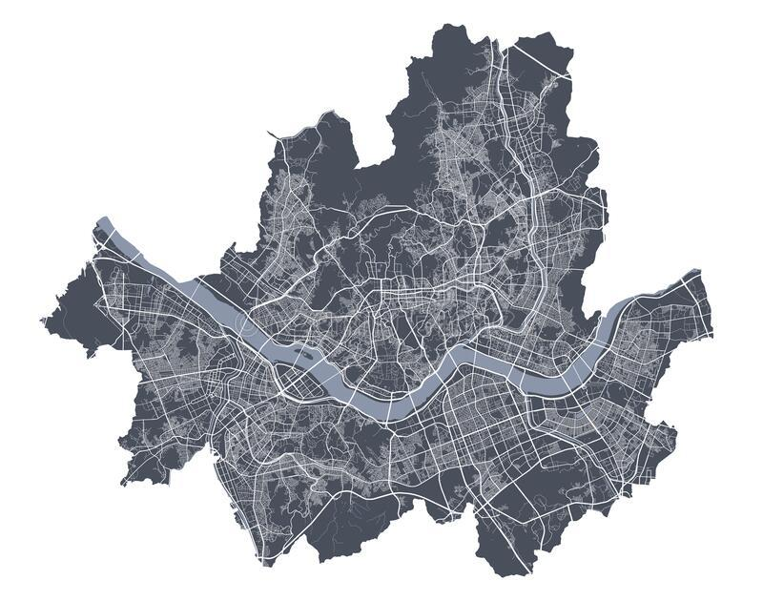
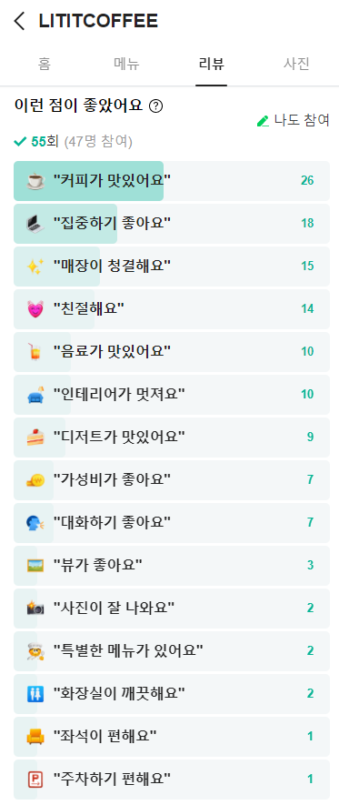
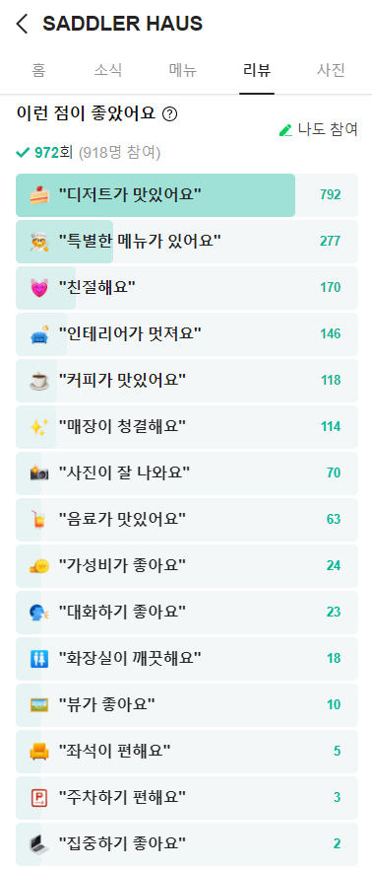
Project OverviewData Selection
Target area
Collect cafe data from Naver map
About 15 features
More than 20,000 data

Slide 4
Project Overview Data Selection
Why crawling?
No matching data with our subject in Kaggle 😥
Try to meet each process of data collecting from scratch 😌
Gathering
Storing
Clean up
Reorganize
Verify
We want to exploit up-to-date data 😊

Slide 5
Project Overview Improving System
By initial data we’ll select cafes with good indicators.
cafe with a quiet atmosphere, nice atmosphere, a lot of menus, signature menu, etc.
avoid cold-start problems.
Collect data by requesting users to review the cafes they visited.
Increase the accuracy of the system through newly acquired data.
Recommend customized cafes, store user data, and uses it for collaborative filtering later.

Slide 6
Difference from previous Approaches
Common approach used previously
Hybrid filtering through word Embedding and image embedding
Hybrid filtering = content-based filtering + collaborative filtering
Common algorithm used previously
KNN collaborative filtering
Content-based filtering
Collaborative filtering(item based, user based)
DCNN;Deep Convolutional Neural Network(image processing & tagging)
LightFm

Slide 7

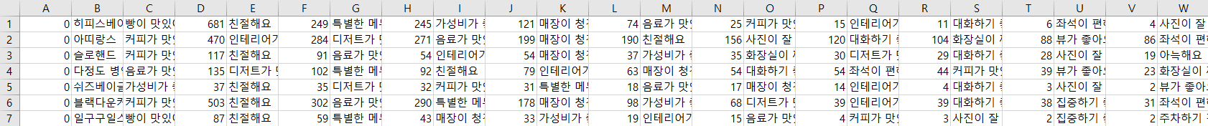
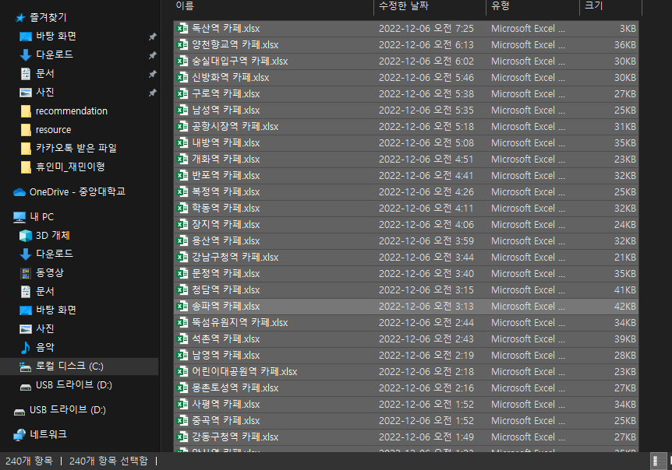
Data Processing
around subway station
100+ features

Slide 8
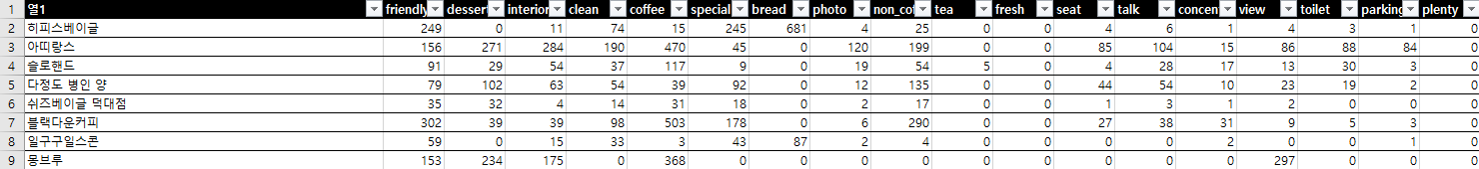
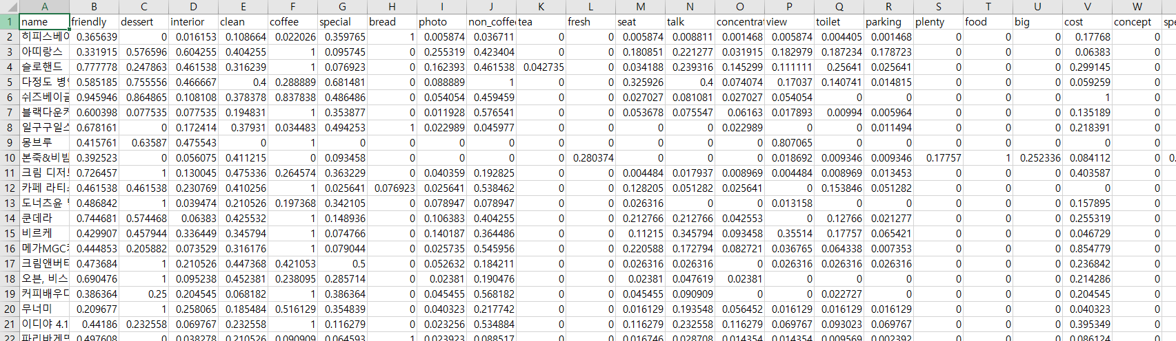
Data Processing
Redesign dataframe
~ to apply to learning model
Normalization

Slide 9
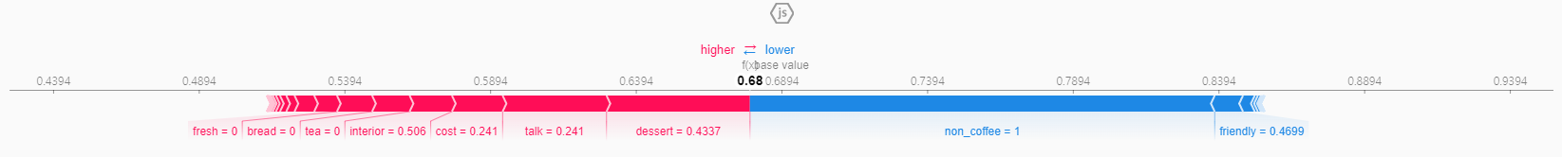
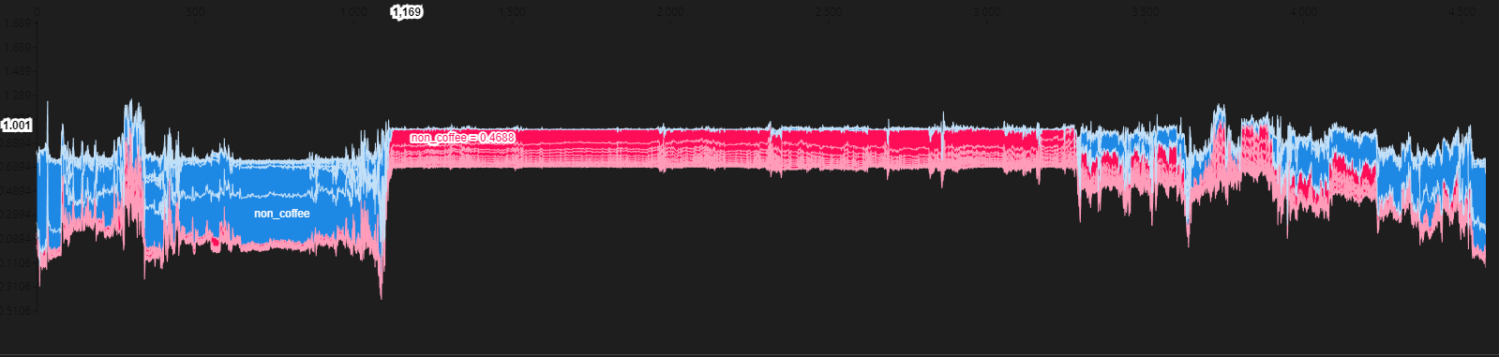
Analysis & Visualization

Slide 10
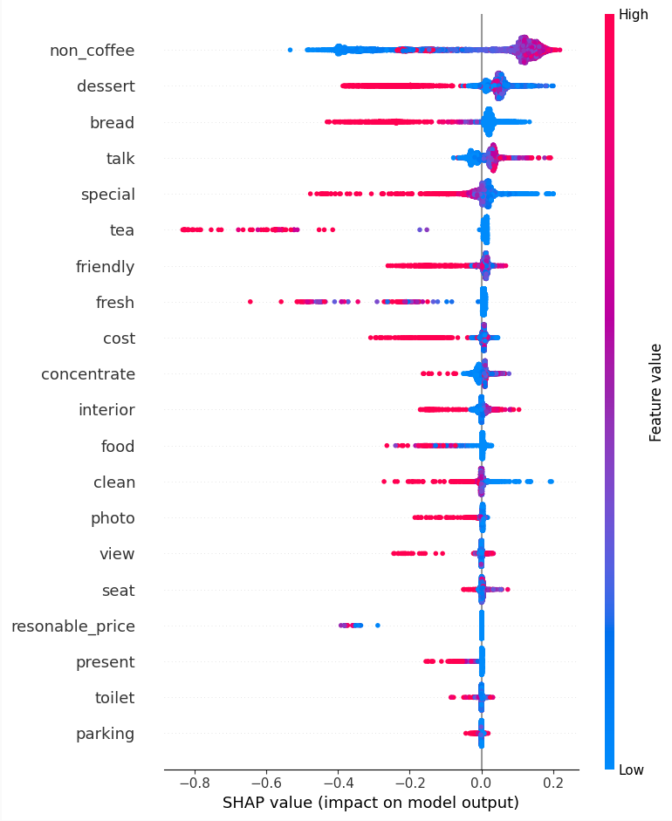
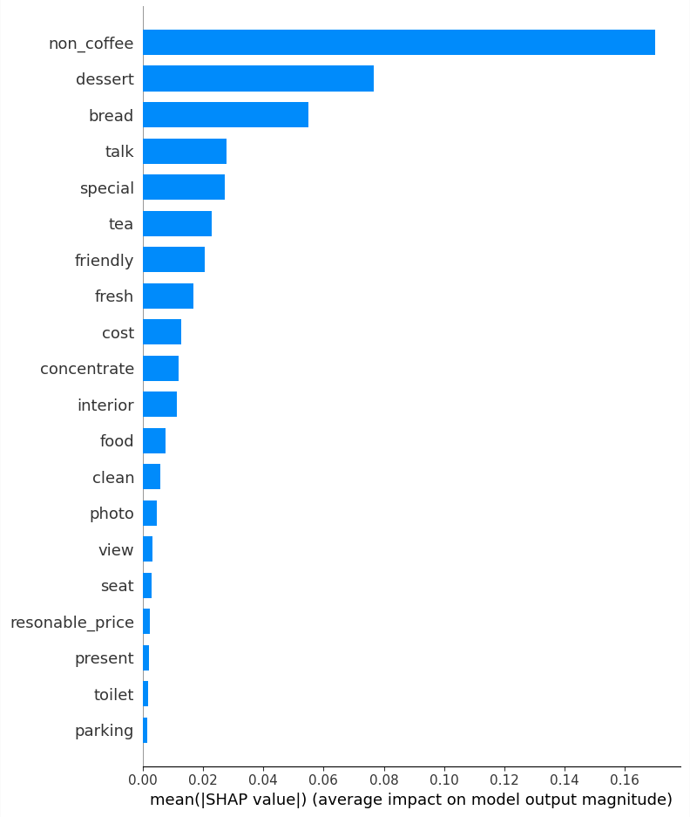
Analysis & Visualization
Summary
Feature Importance
non_coffee is most affective..
red : positive correlation
blue : negative correlation

Slide 11
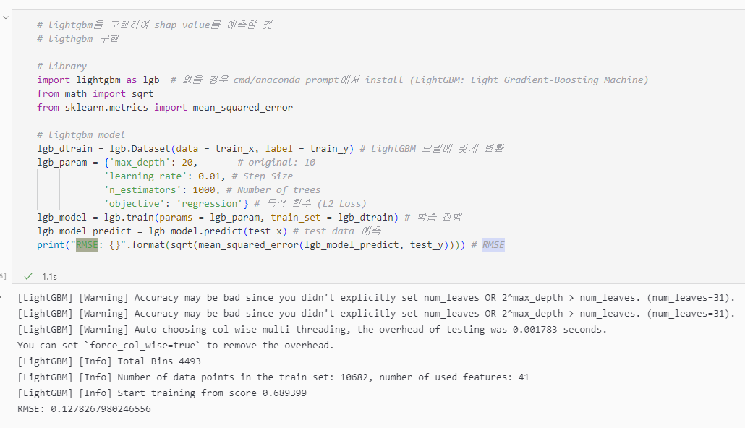
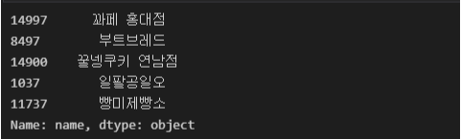
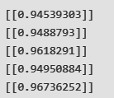
+Result
Execute Recommendation System(left)
Print Cosine Similarity(right)
Prediction Accuracy from RMSE(about 12~13 percentage)

Slide 12
Demo

Slide 13
Q & A
Questions?

Slide 14
Thank You

