Slide 1
2022-2 Big Data Project Proposal Cafe data analysis, recommendation system
Team 13
Minsoo Cho
Sangjin Lee
Jaemin Kim

Slide 2
Table Of Contents
Topic & Motivation
Project Overview
Modeling & Approach

Slide 3
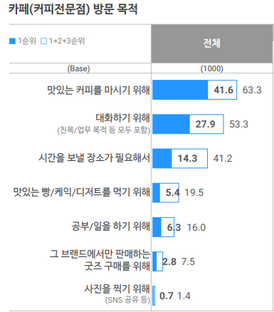
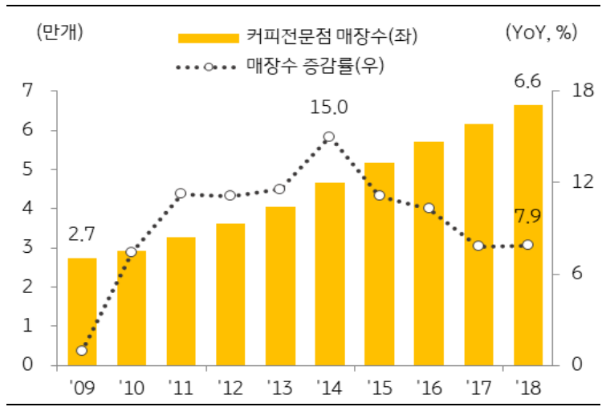
Topic & Motivation
Rapid growth of coffee industry
Varying user needs for café

Slide 4
Topic & Motivation
Meet the needs of the user
by recommending the best cafe
for consumption in the form the user want.
Meeting
To-Go
Price
Location
Study
Parking
Interior

Slide 5
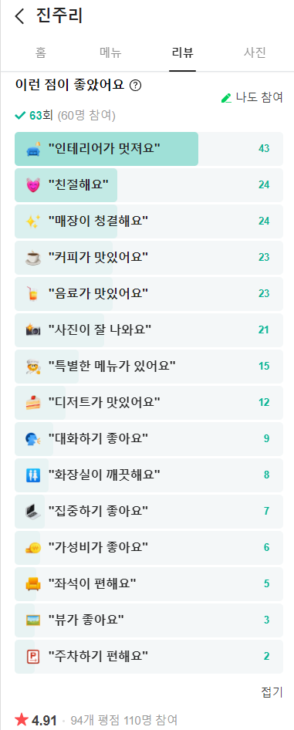
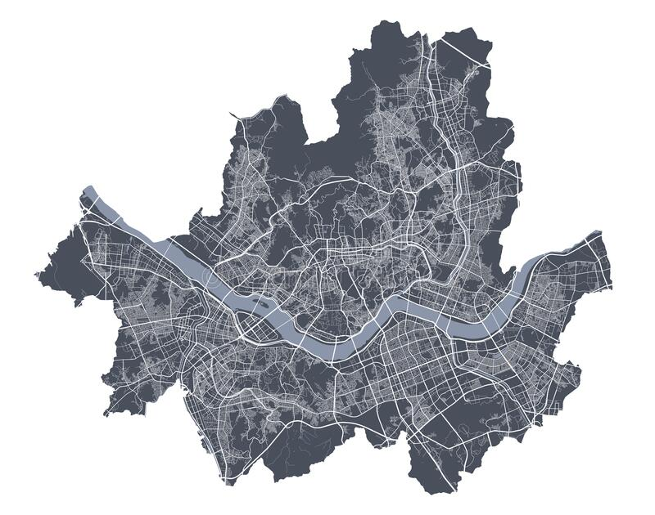
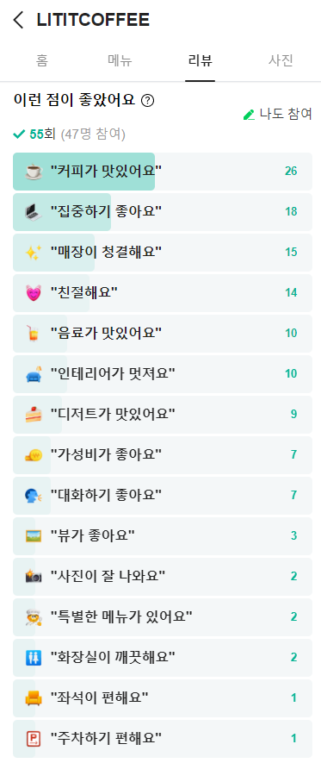
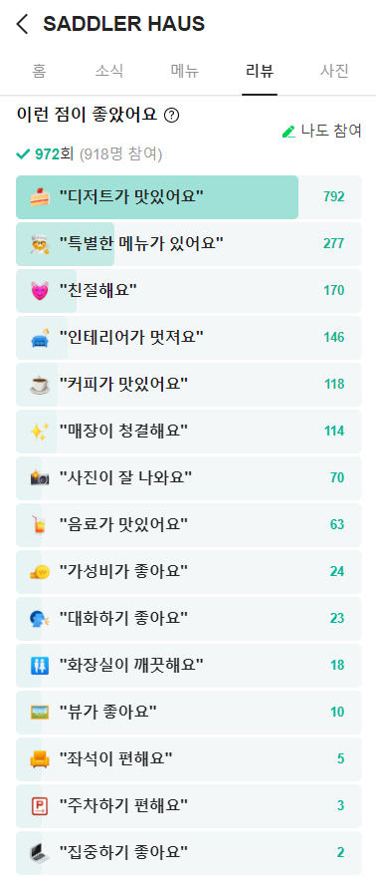
Project OverviewData Selection
Target area
Collect cafe data from Naver map
About 15 features
More than 20,000 data

Slide 6
Project Overview Data Selection
Why crawling?
No matching data with our subject in Kaggle 😥
Try to meet each process of data collecting from scratch 😌
Gathering
Storing
Clean up
Reorganize
Verify
We want to exploit up-to-date data 😊

Slide 7
Project Overview Improving System
By initial data we’ll select cafes with good indicators.
cafe with a quiet atmosphere, nice atmosphere, a lot of menus, signature menu, etc.
avoid cold-start problems.
Collect data by requesting users to review the cafes they visited.
Increase the accuracy of the system through newly acquired data.
Recommend customized cafes, store user data, and uses it for collaborative filtering later.

Slide 8
Modeling & Approach Candidates
Classic statistics
K-means, PCA
Logistic Regression
KNN
SVM
Gaussian Naïve Bayes
Random Forest
Decision Tree
Gradient Boost
MLP
Stochastic Gradient Descent
Contents based filtering
Collaborative filtering (item based, user based)
LightFm

Slide 9
Thank You

