Slide 1
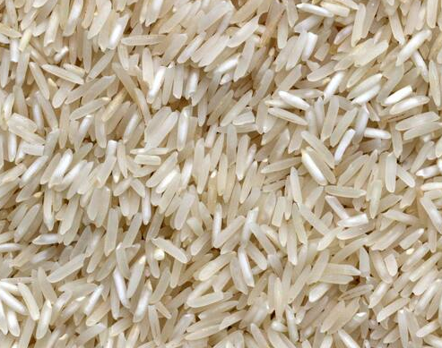
Machine Learning Models for Detecting Rice
By: David Jones

Slide 2
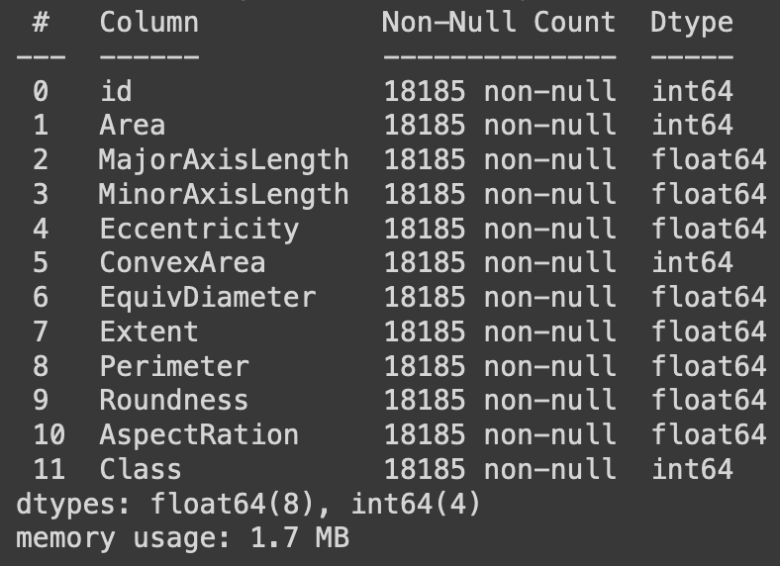
Dataset
Kaggle Rice Type Classification
18185 samples per column
11 total columns
No missing values
Goal is to predict Class which is a binary value of 0 or 1 representing two different types of rice.

Slide 3
Features
id:
Area
MajorAxisLength
MinorAxisLength
Eccentricity
ConvexArea
EquivDiameter
Extent
Perimeter
Roundness
AspectRation
Class

Slide 4
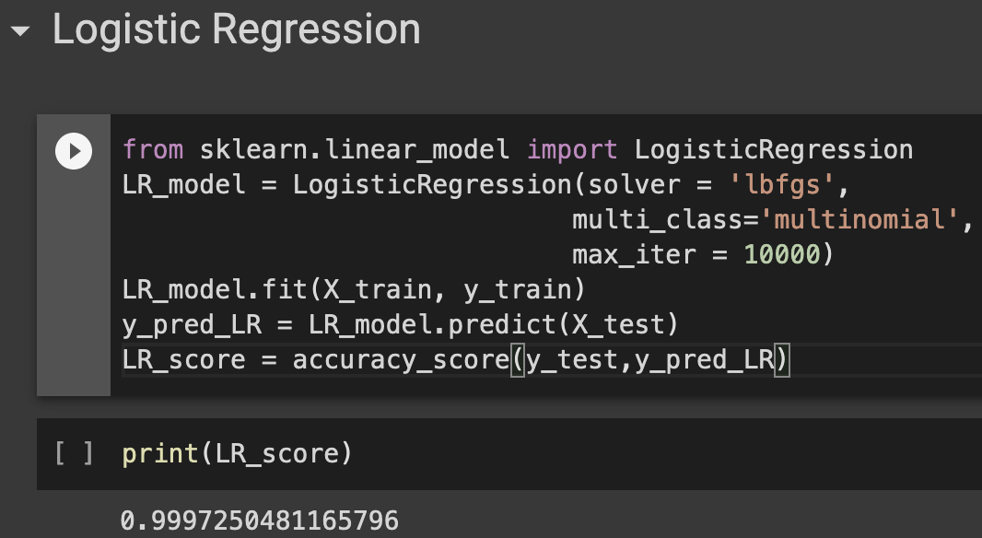
Logistic Regression
The parameters used for Logistic Regression were:
Solver: lbfgs
Multi_class: multinomial
Max_iter: 10000

Slide 5
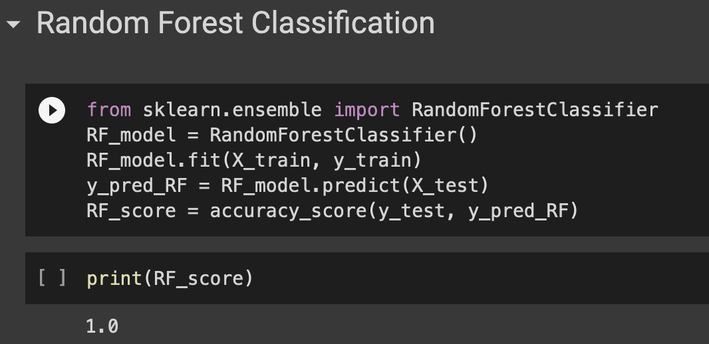
Random Forest Classification

Slide 6
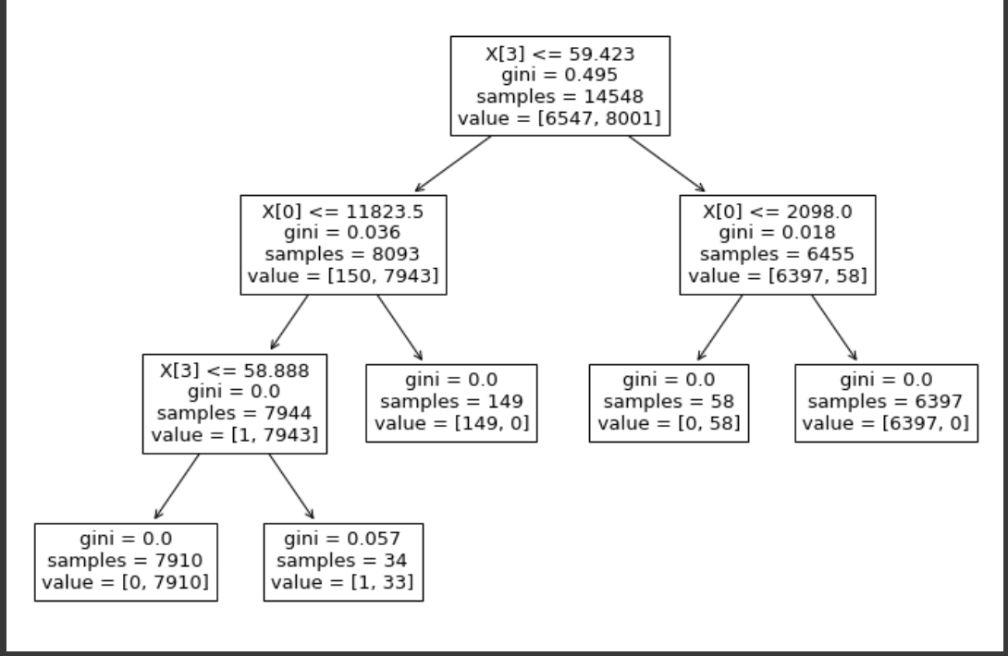
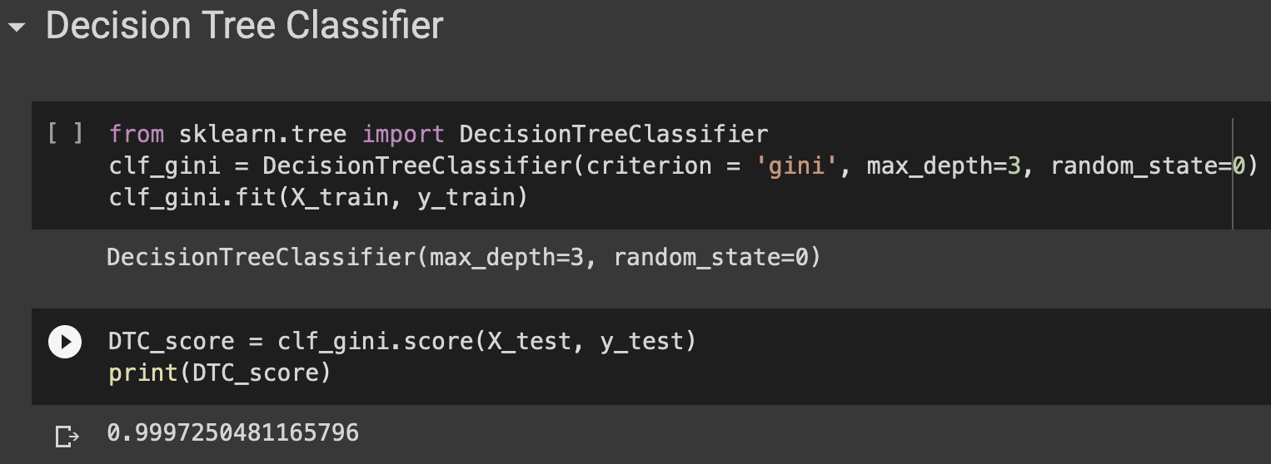
Decision Tree Classifier

Slide 7
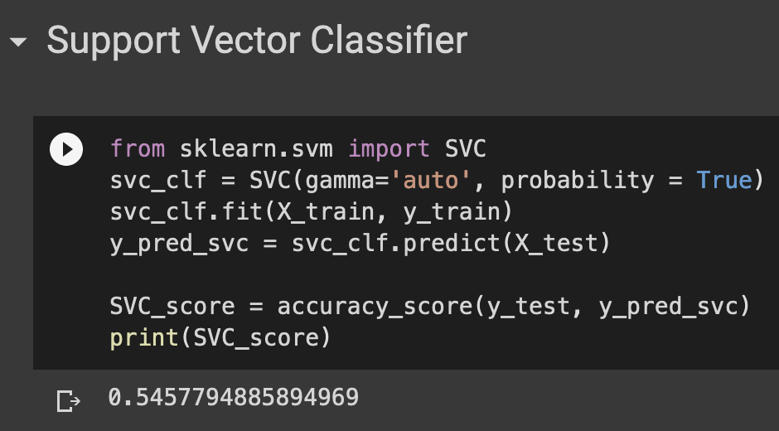
Support Vector Classifier

Slide 8
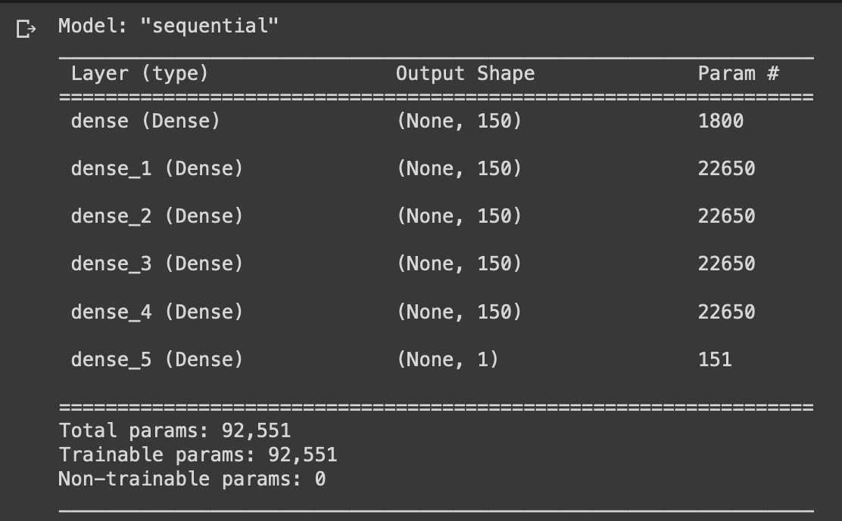
ANN
6 total layers
92,551 total parameters

Slide 9
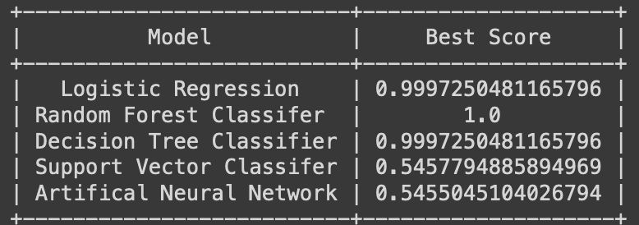
Results
Decision Tree and Logistic Regression tied for the best score excluding overfitting

