Slide 1
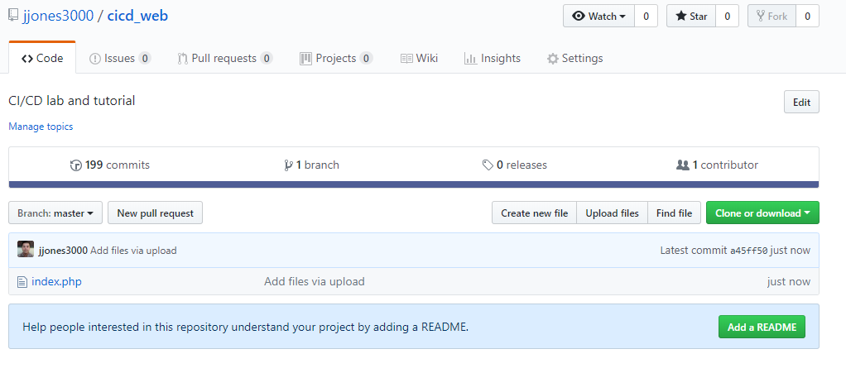
Continuous Deployment with Github Jenkins and AWS – POC Example

Slide 2
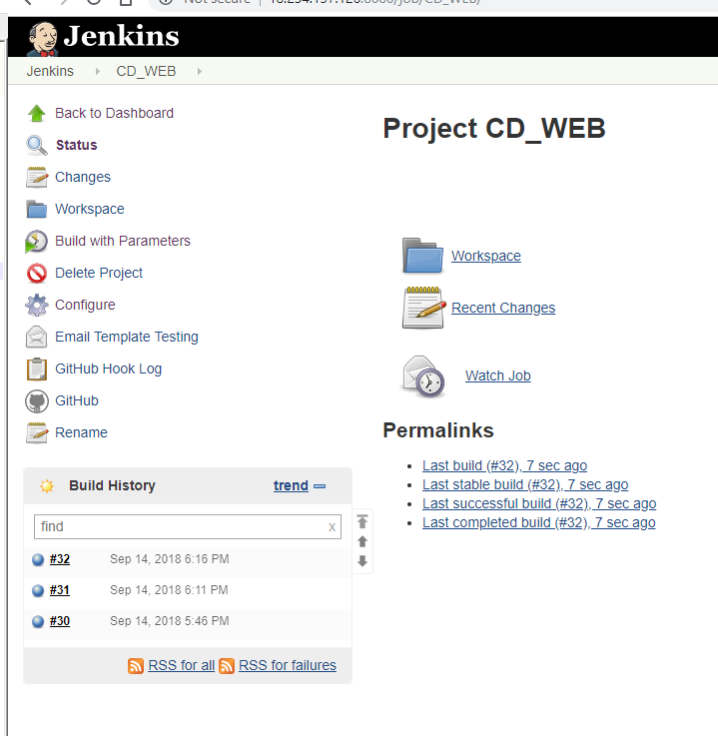
Jenkins Install on AWS EC2 Instance

Slide 3
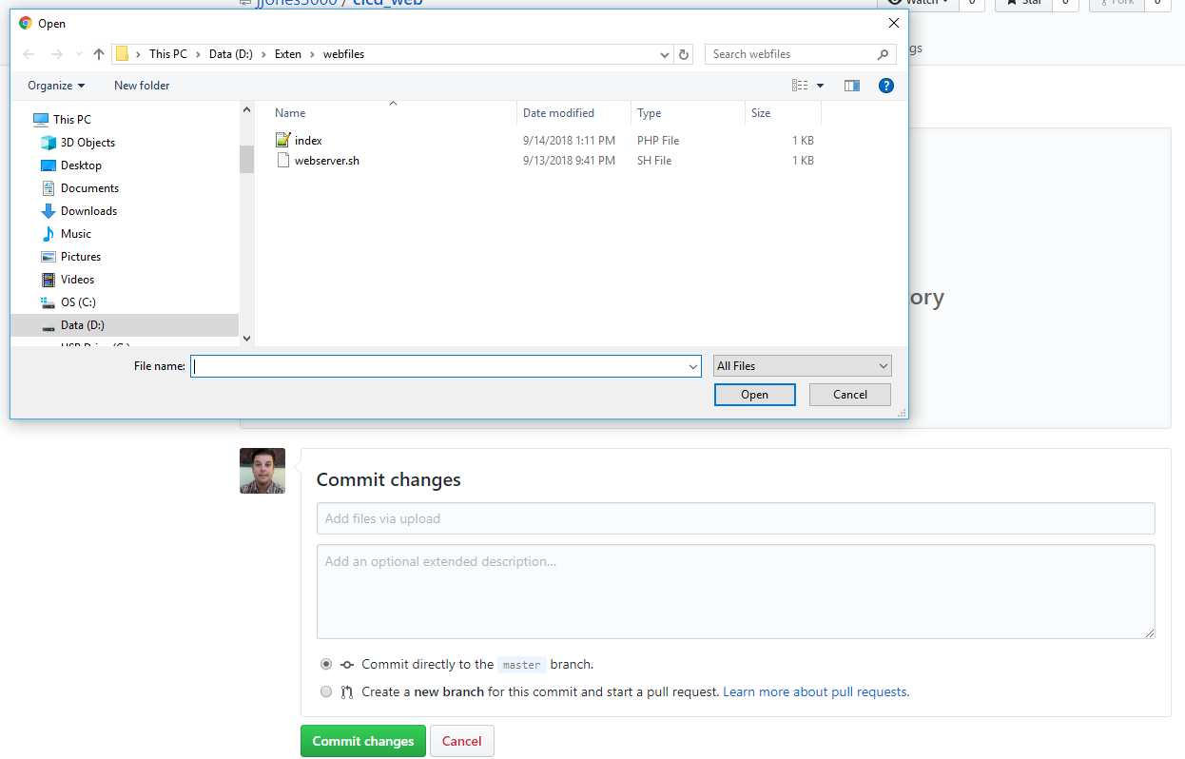
Upload Files to Repo and Commit reminder: This is proof of concept. In real life commits would be pushed via local branch and command line.

Slide 4
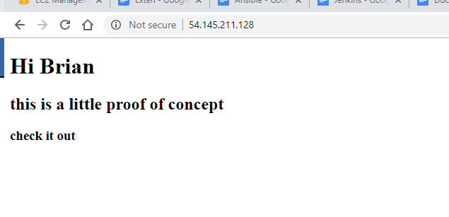
Two Things Happen When a Commit is Made: 1. An email notification gets sent to recipients 2. A Jenkins job builds the project and automatically deploys it to a web server
Lets start with what we have

Slide 5
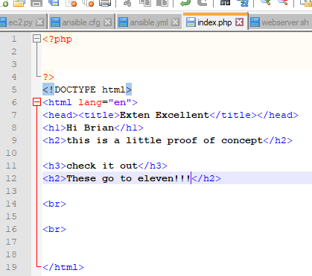
We’ll make a change: see below

Slide 6
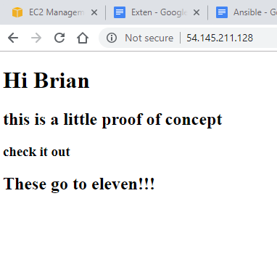
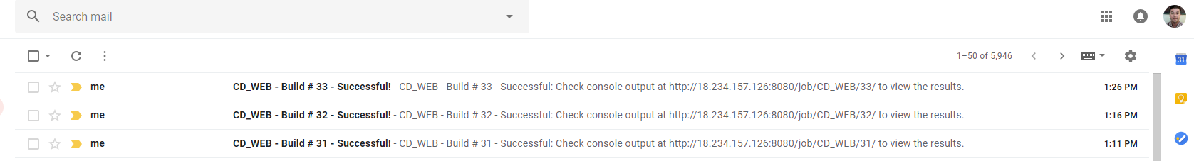
We’ll make a commit and see that it is automatically deployed and that we get an email notice.
Looks like it worked
Looks like we got an email notifying us as well

Slide 7
The End
Thanks,
Jeff

