Slide 1
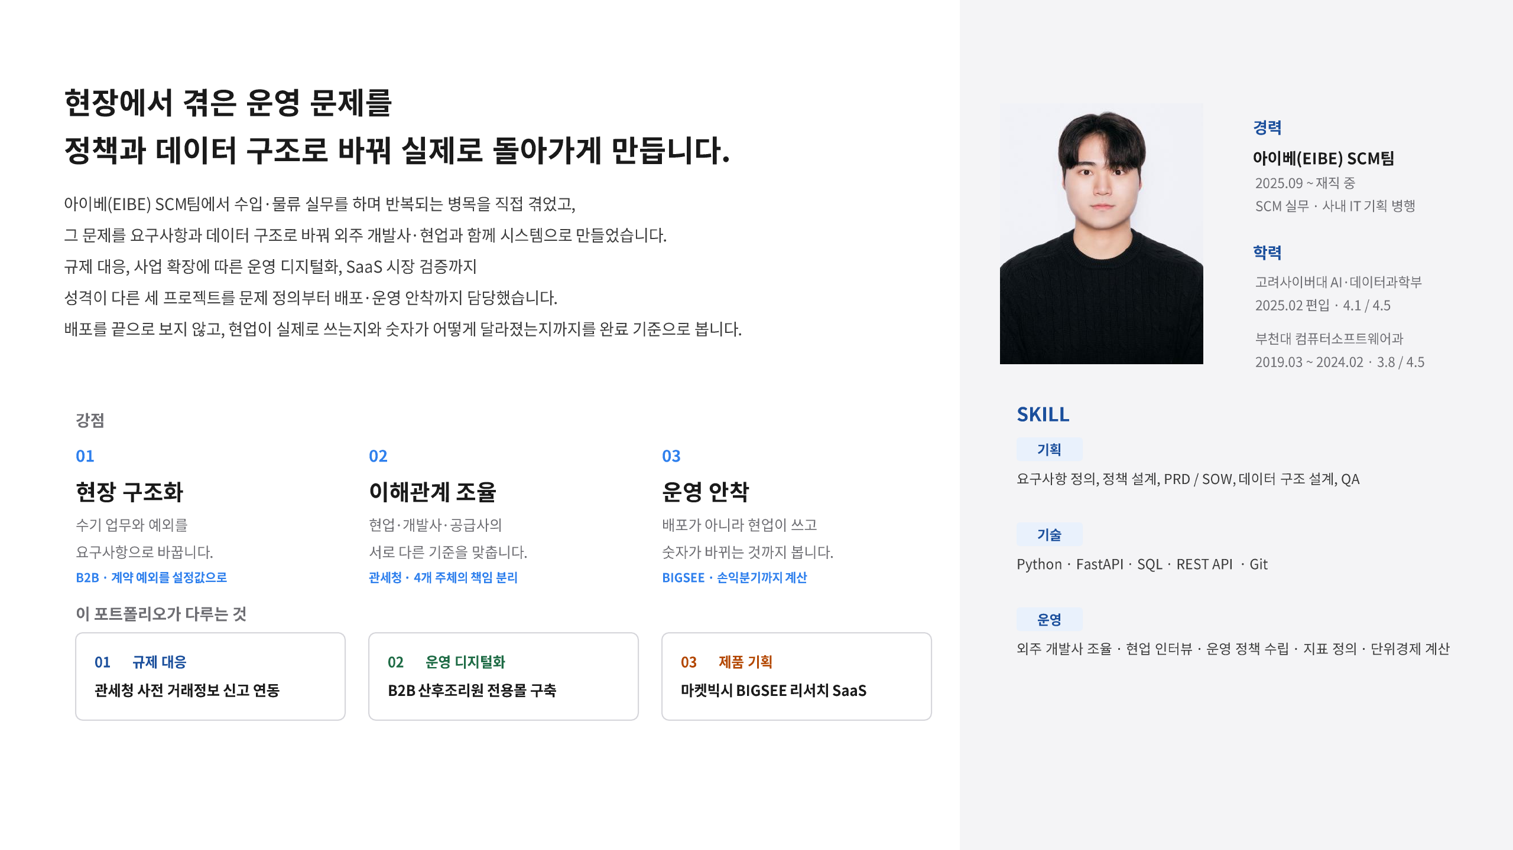
Notes:
[Sources]
- C:/MyMain/main/resume/박종혁_PM_포트폴리오.pdf, page 1, user-provided source, accessed 2026-08-28
[/Sources]

Slide 2
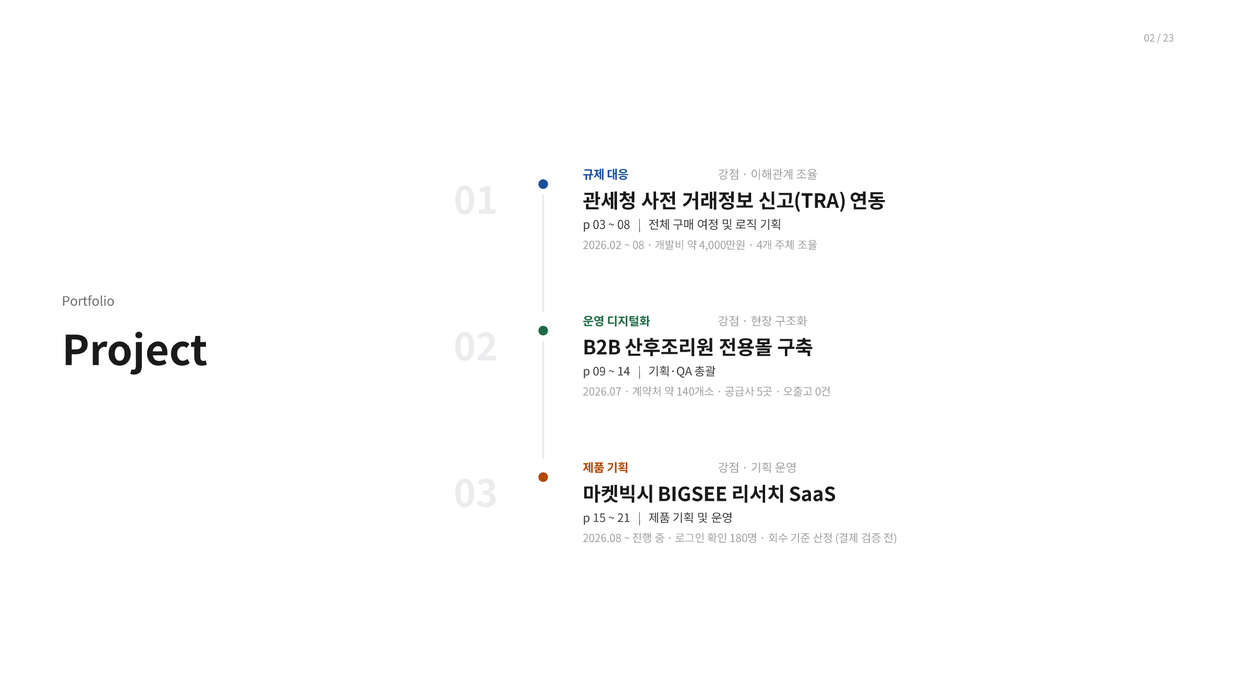
Notes:
[Sources]
- C:/MyMain/main/resume/박종혁_PM_포트폴리오.pdf, page 2, user-provided source, accessed 2026-08-28
[/Sources]

Slide 3
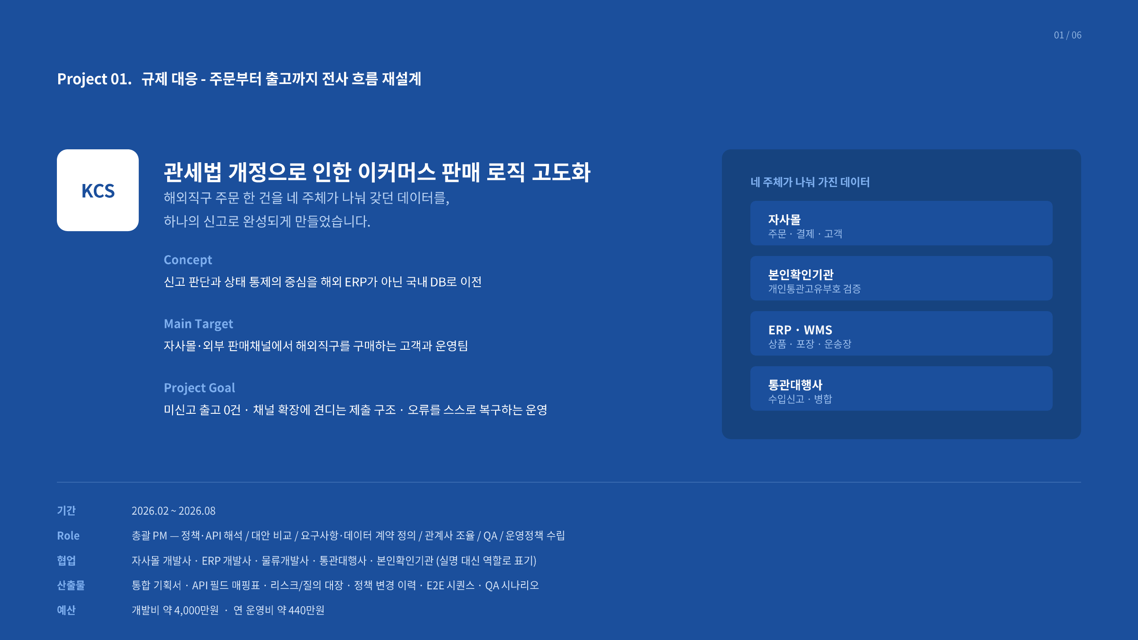
Notes:
[Sources]
- C:/MyMain/main/resume/박종혁_PM_포트폴리오.pdf, page 3, user-provided source, accessed 2026-08-28
[/Sources]

Slide 4
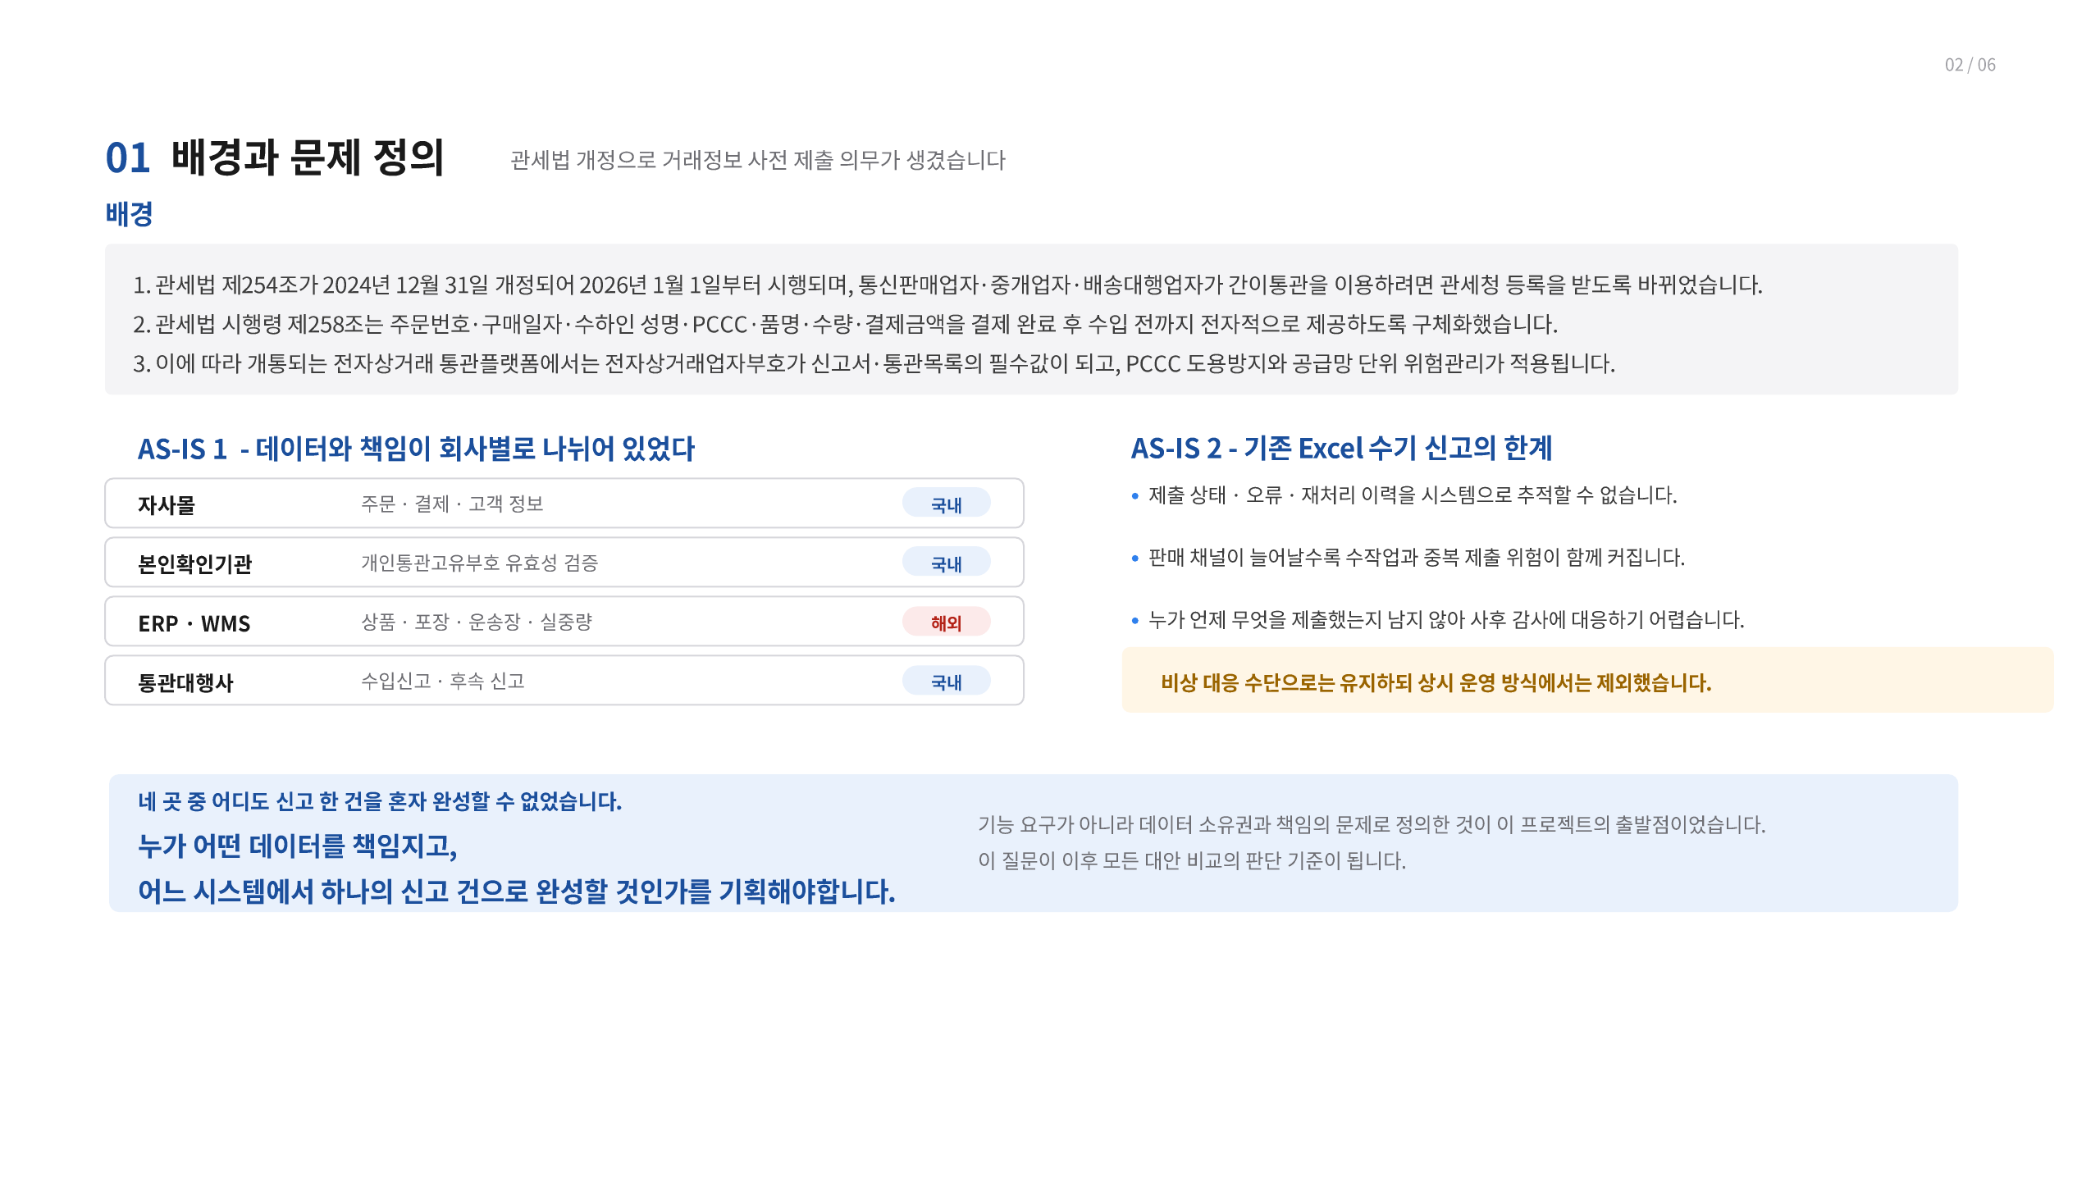
Notes:
[Sources]
- C:/MyMain/main/resume/박종혁_PM_포트폴리오.pdf, page 4, user-provided source, accessed 2026-08-28
[/Sources]

Slide 5
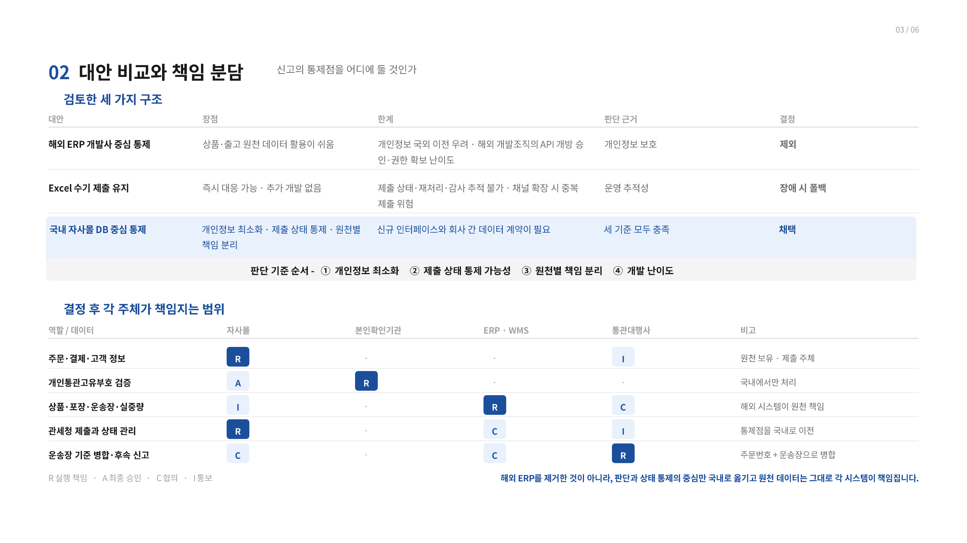
Notes:
[Sources]
- C:/MyMain/main/resume/박종혁_PM_포트폴리오.pdf, page 5, user-provided source, accessed 2026-08-28
[/Sources]

Slide 6
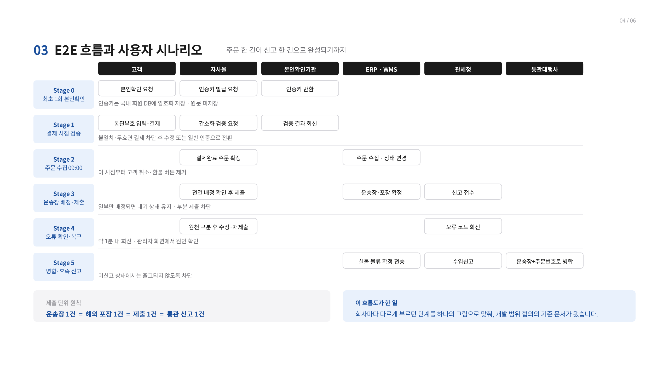
Notes:
[Sources]
- C:/MyMain/main/resume/박종혁_PM_포트폴리오.pdf, page 6, user-provided source, accessed 2026-08-28
[/Sources]

Slide 7
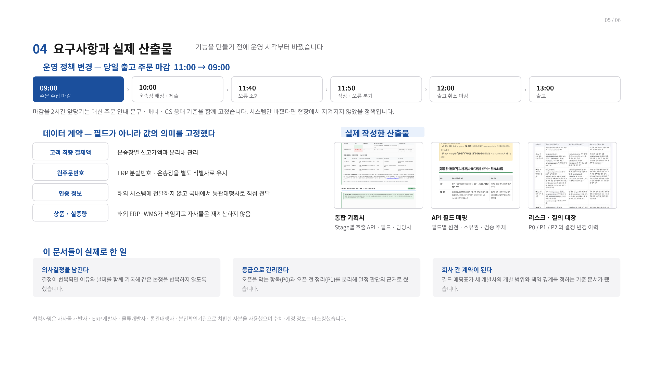
Notes:
[Sources]
- C:/MyMain/main/resume/박종혁_PM_포트폴리오.pdf, page 7, user-provided source, accessed 2026-08-28
[/Sources]

Slide 8
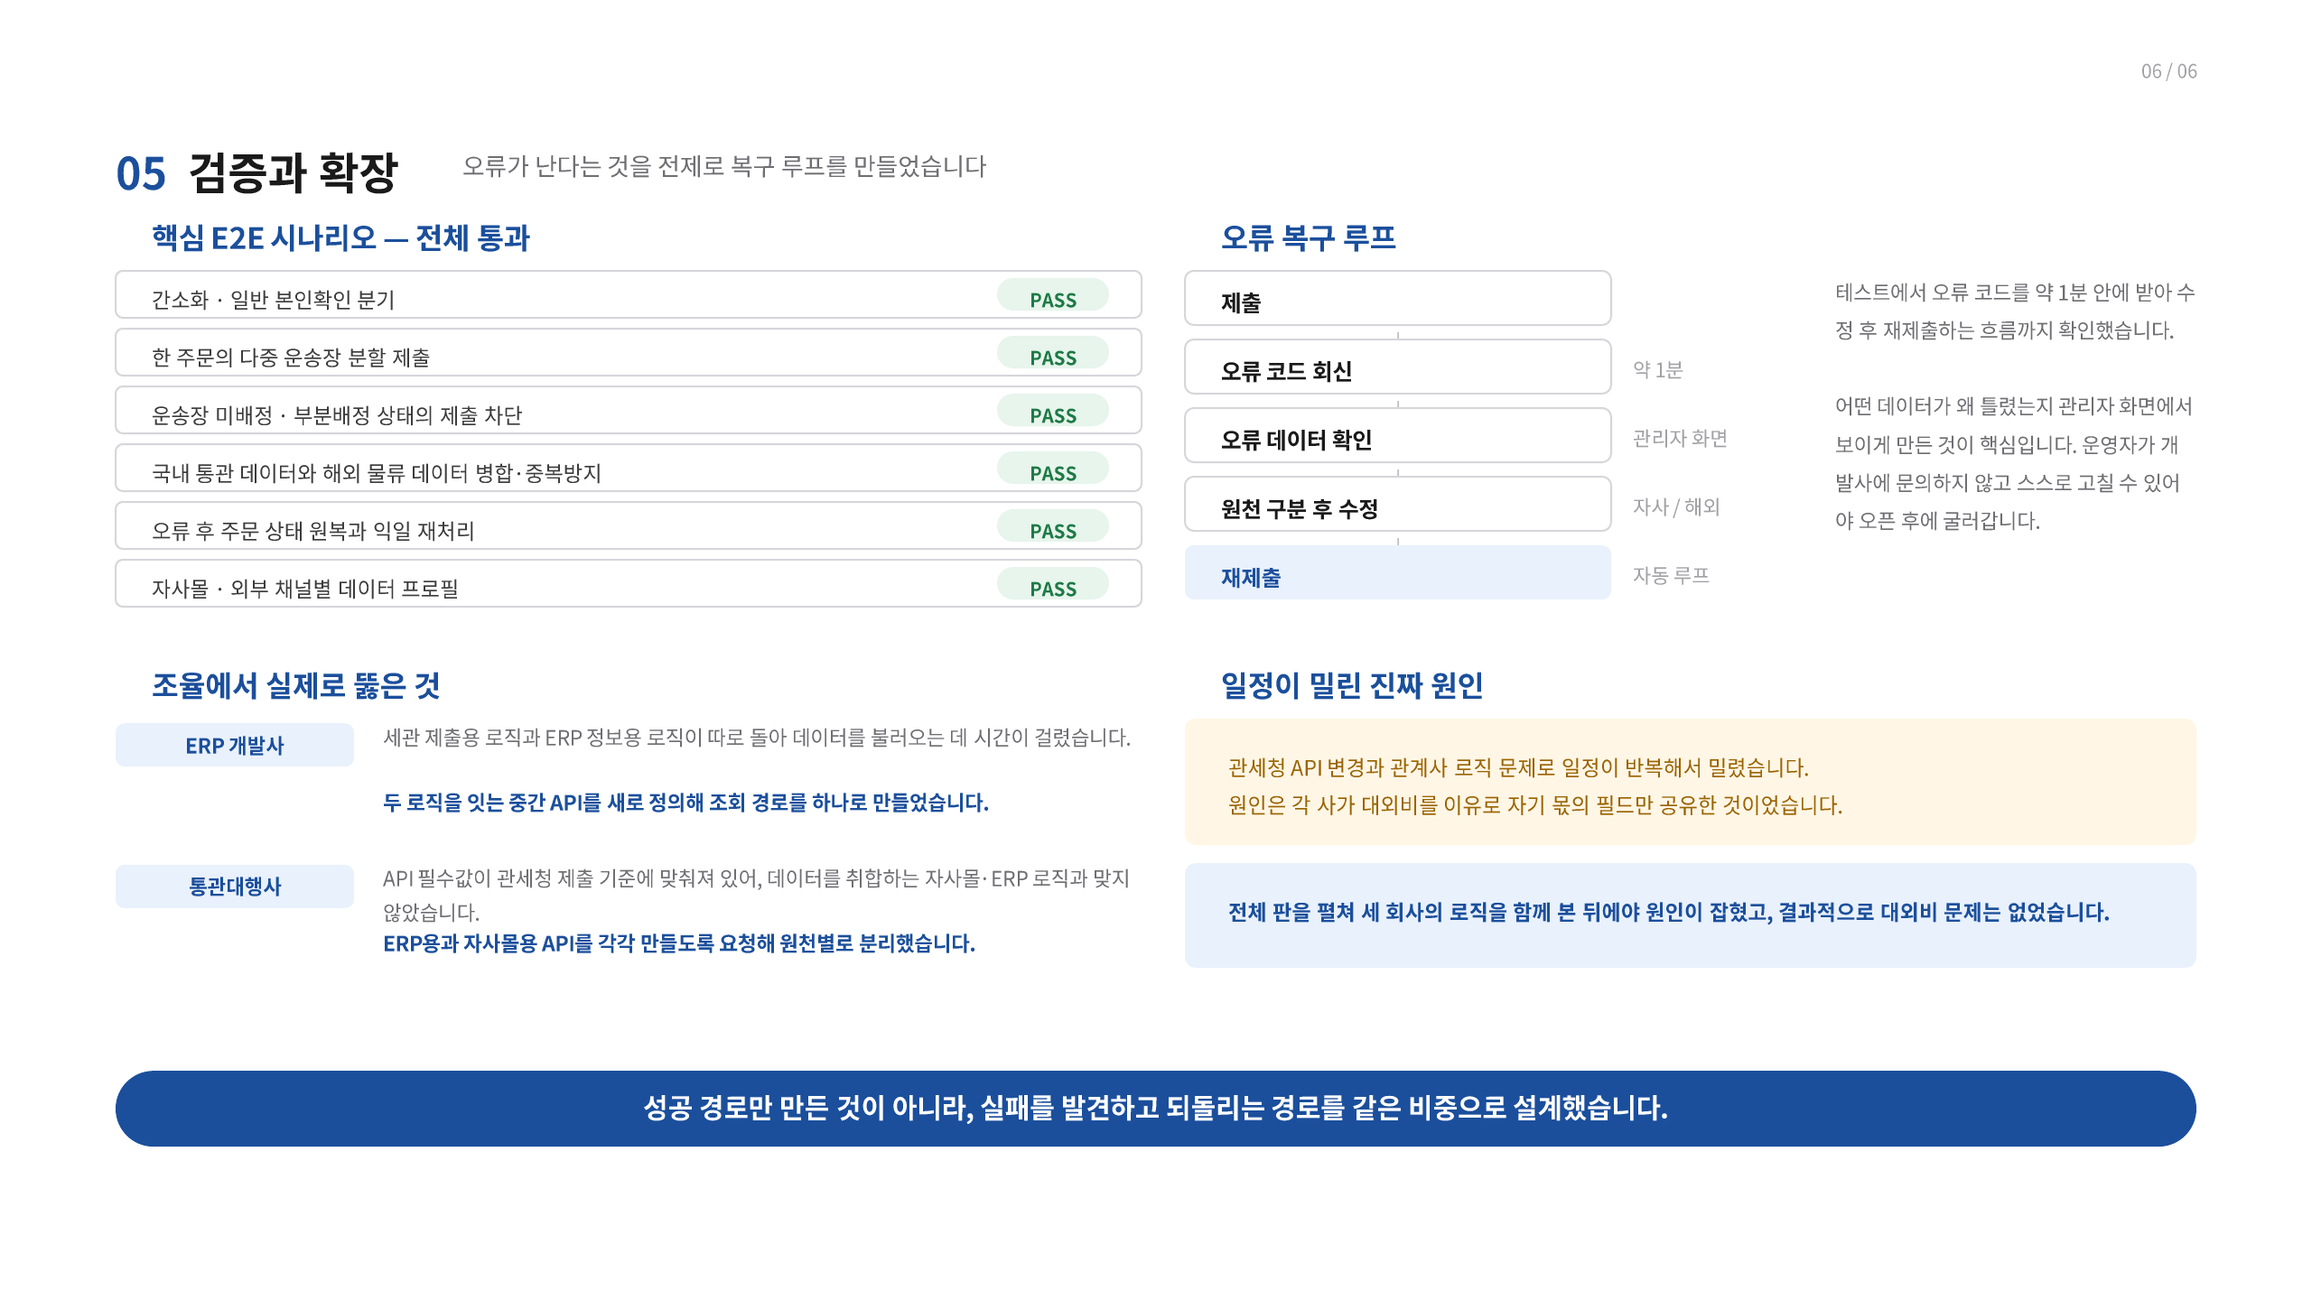
Notes:
[Sources]
- C:/MyMain/main/resume/박종혁_PM_포트폴리오.pdf, page 8, user-provided source, accessed 2026-08-28
[/Sources]

Slide 9
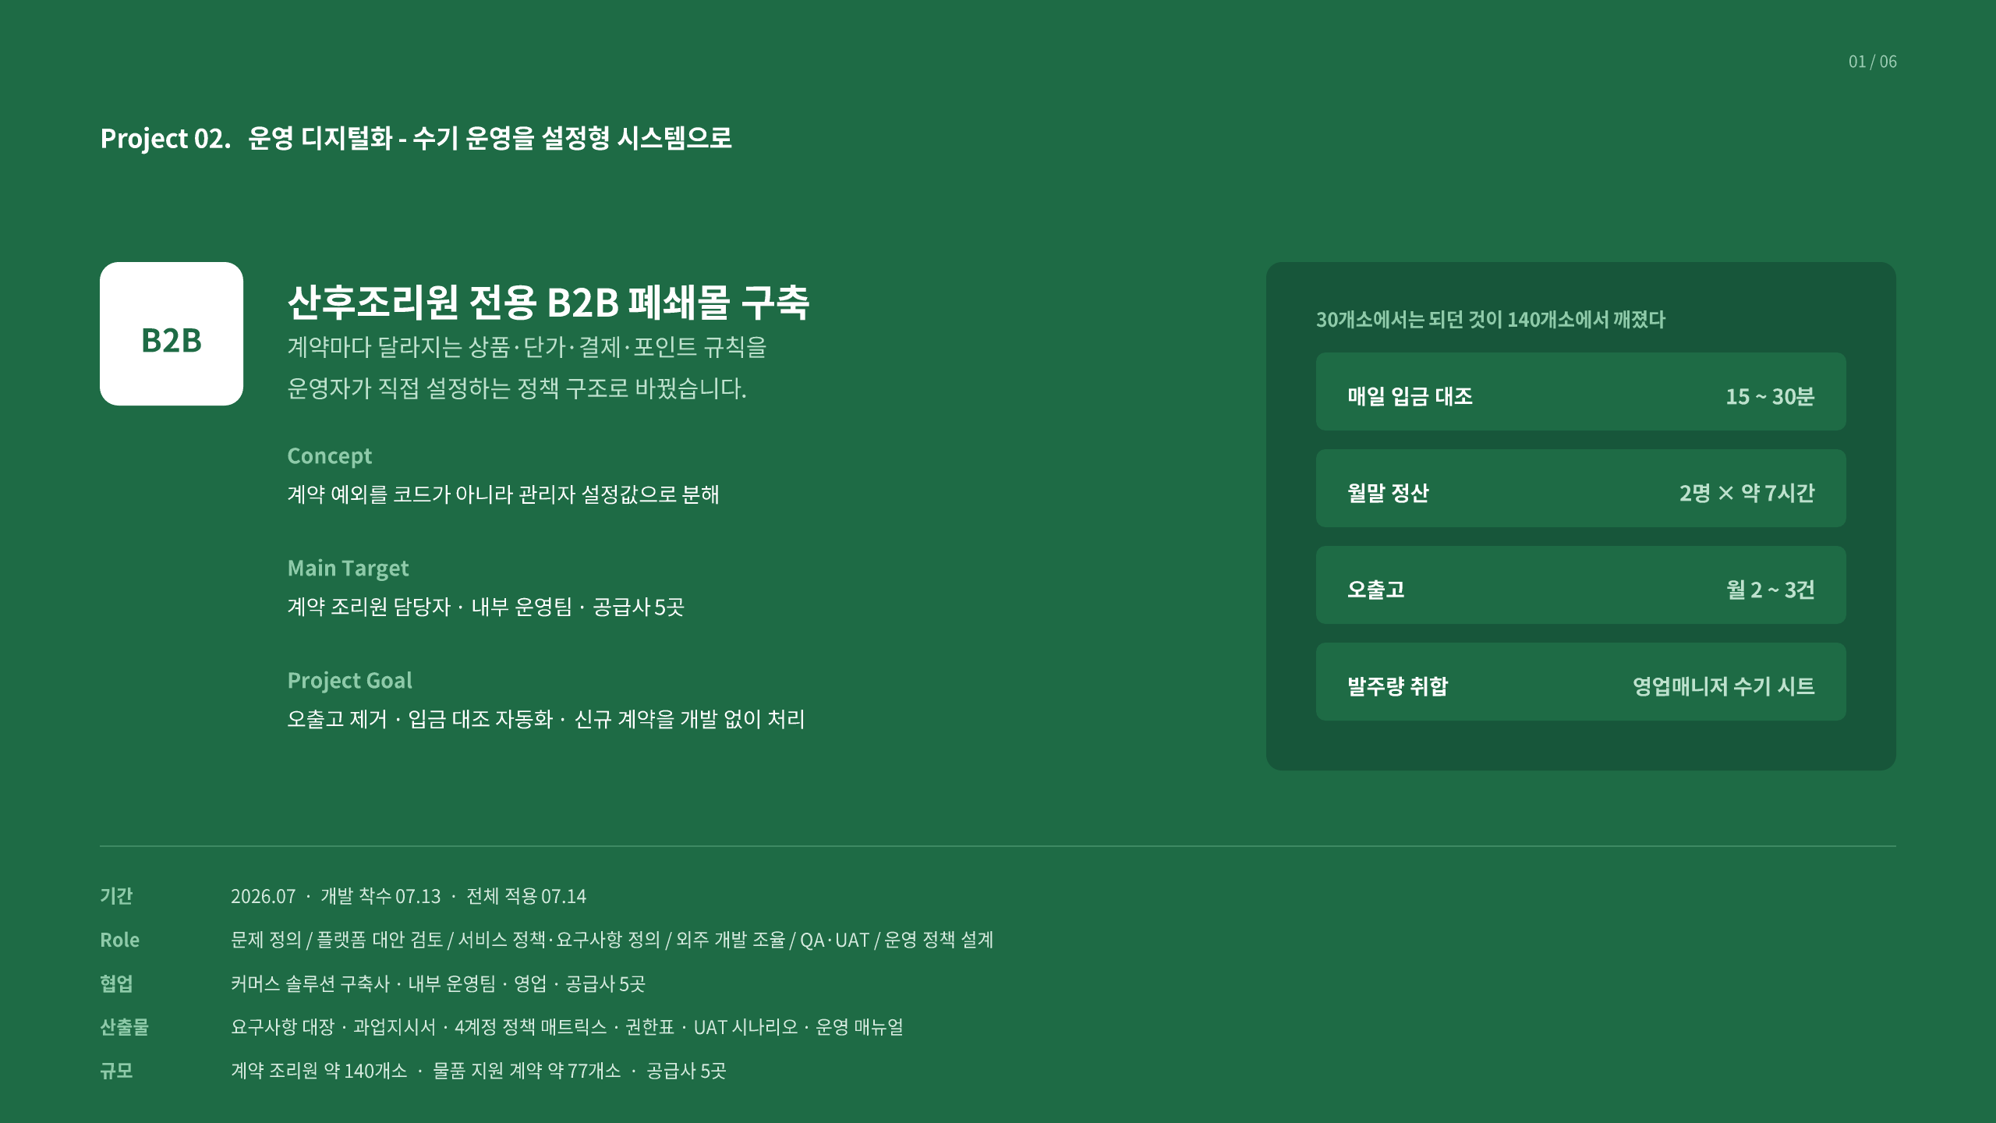
Notes:
[Sources]
- C:/MyMain/main/resume/박종혁_PM_포트폴리오.pdf, page 9, user-provided source, accessed 2026-08-28
[/Sources]

Slide 10
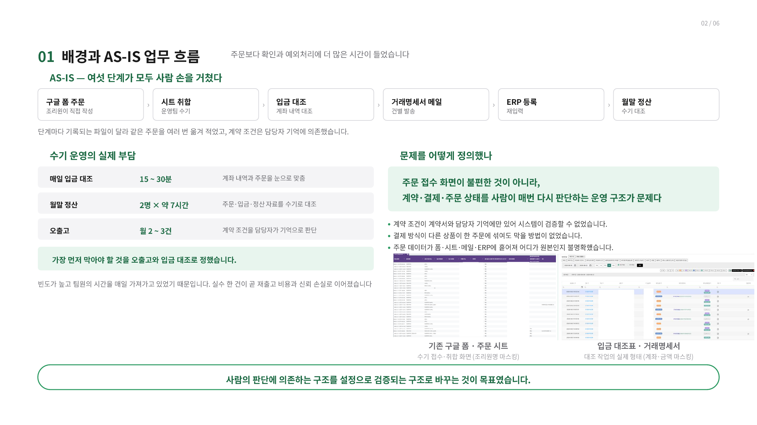
Notes:
[Sources]
- C:/MyMain/main/resume/박종혁_PM_포트폴리오.pdf, page 10, user-provided source, accessed 2026-08-28
[/Sources]

Slide 11
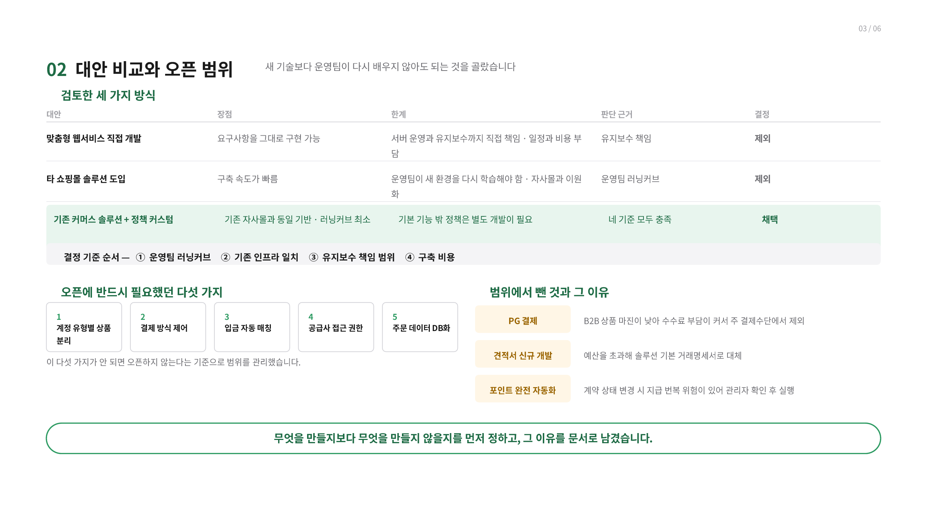
Notes:
[Sources]
- C:/MyMain/main/resume/박종혁_PM_포트폴리오.pdf, page 11, user-provided source, accessed 2026-08-28
[/Sources]

Slide 12
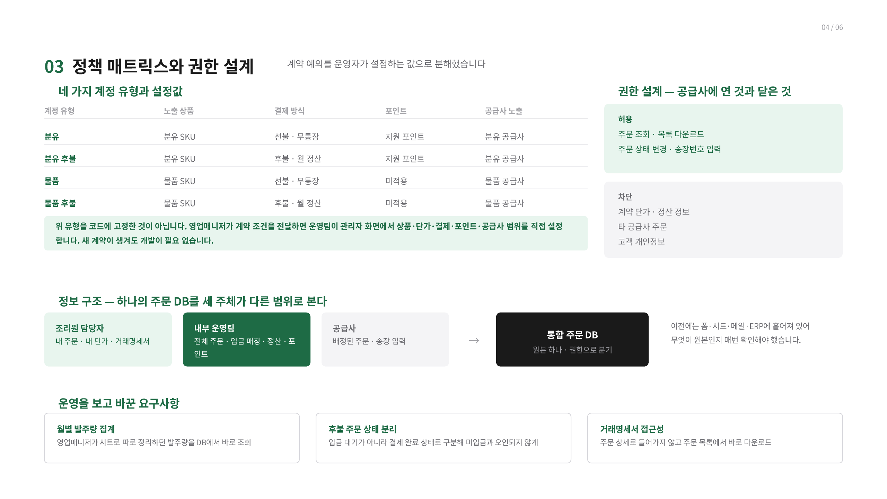
Notes:
[Sources]
- C:/MyMain/main/resume/박종혁_PM_포트폴리오.pdf, page 12, user-provided source, accessed 2026-08-28
[/Sources]

Slide 13
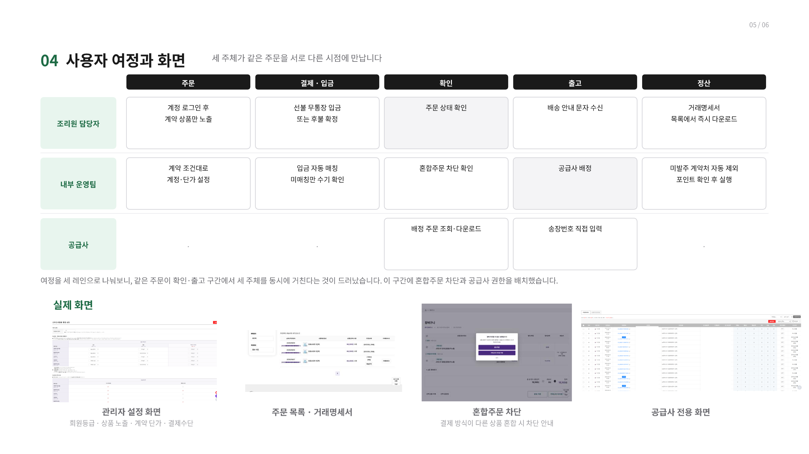
Notes:
[Sources]
- C:/MyMain/main/resume/박종혁_PM_포트폴리오.pdf, page 13, user-provided source, accessed 2026-08-28
[/Sources]

Slide 14
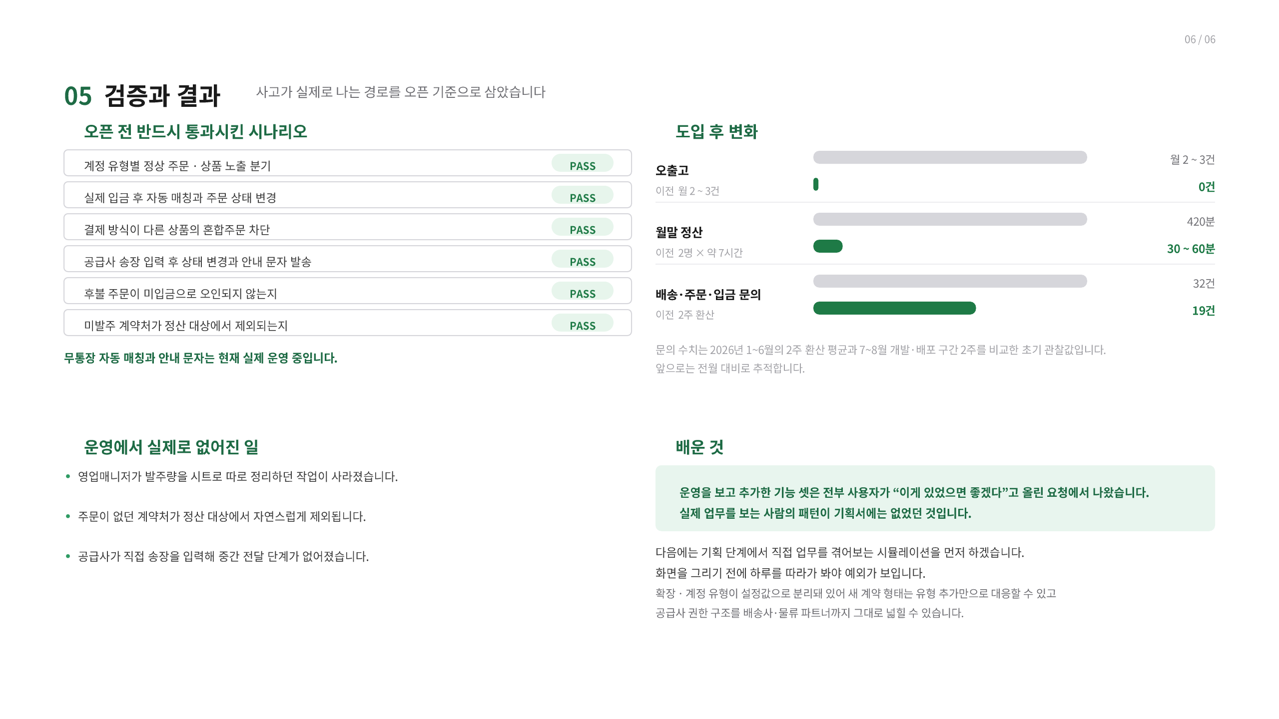
Notes:
[Sources]
- C:/MyMain/main/resume/박종혁_PM_포트폴리오.pdf, page 14, user-provided source, accessed 2026-08-28
[/Sources]

Slide 15
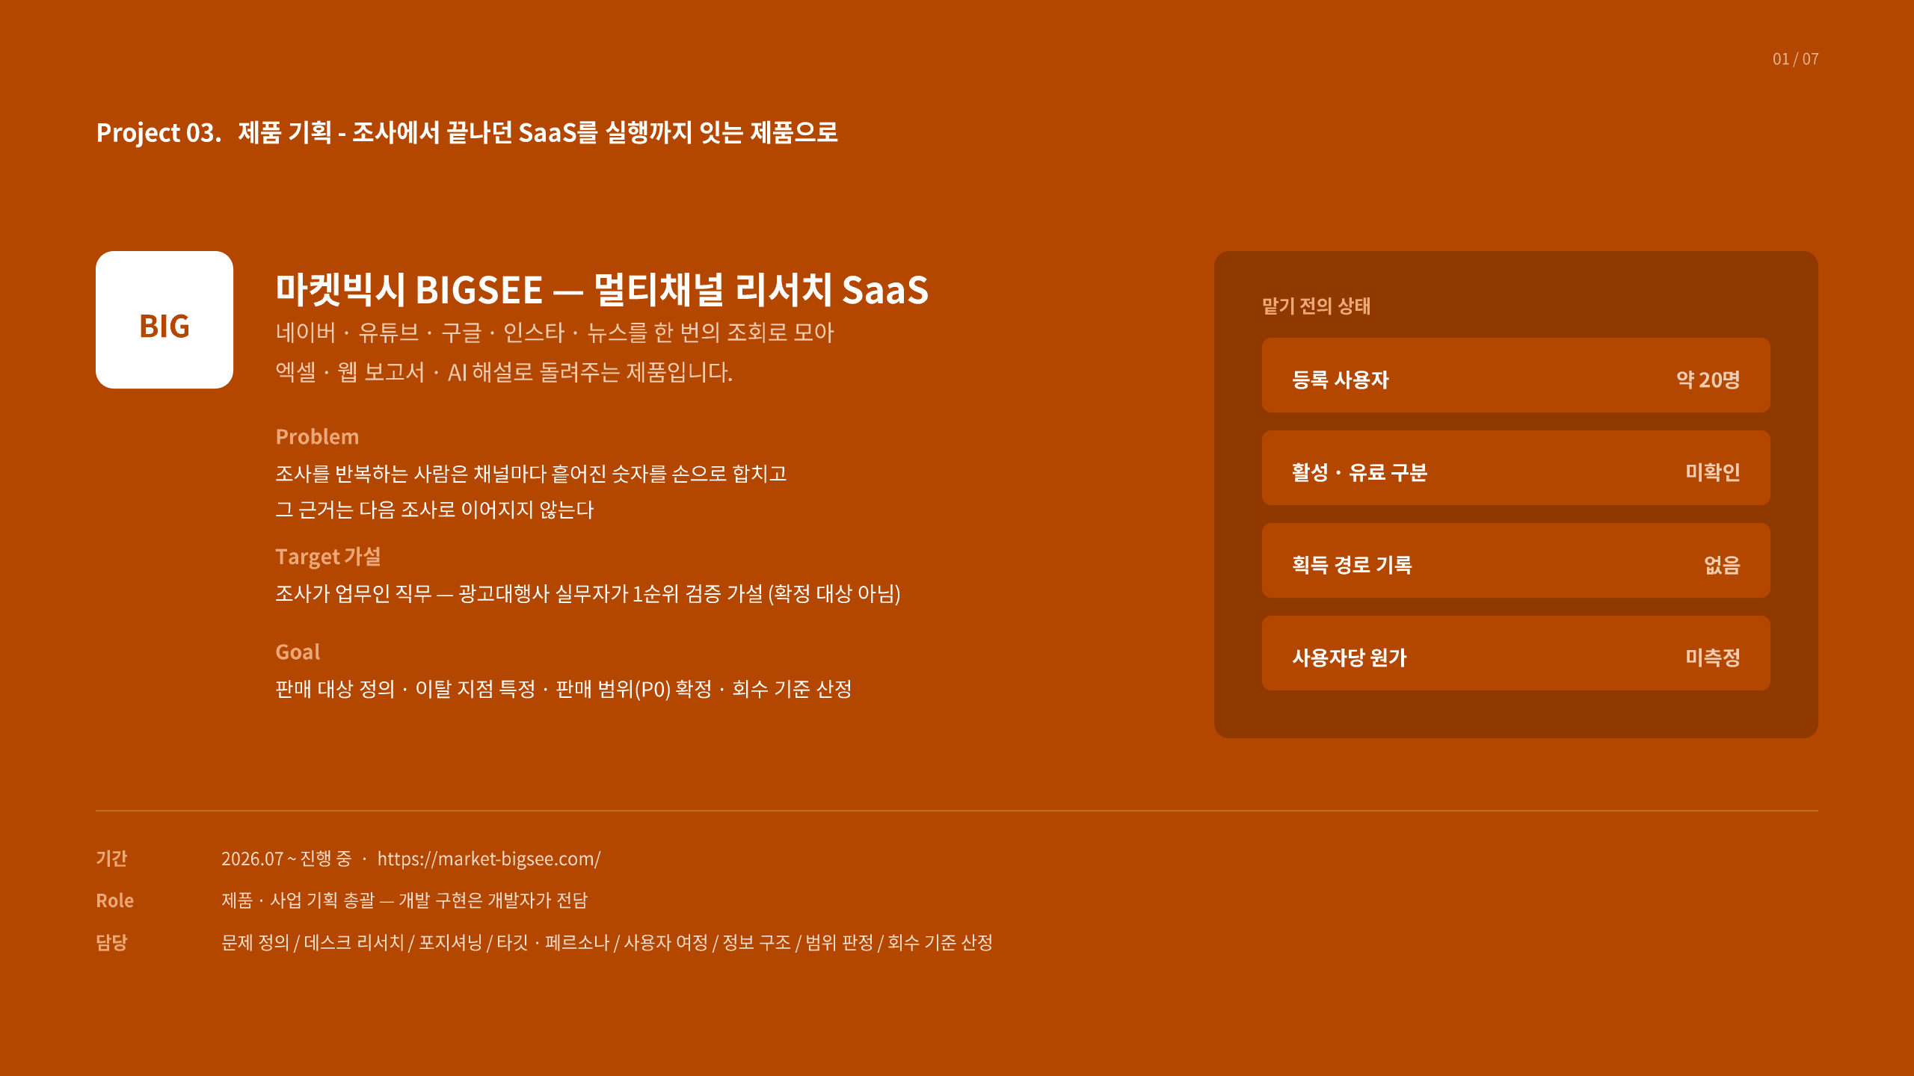
Notes:
[Sources]
- C:/MyMain/main/resume/박종혁_PM_포트폴리오.pdf, page 15, user-provided source, accessed 2026-08-28
[/Sources]

Slide 16
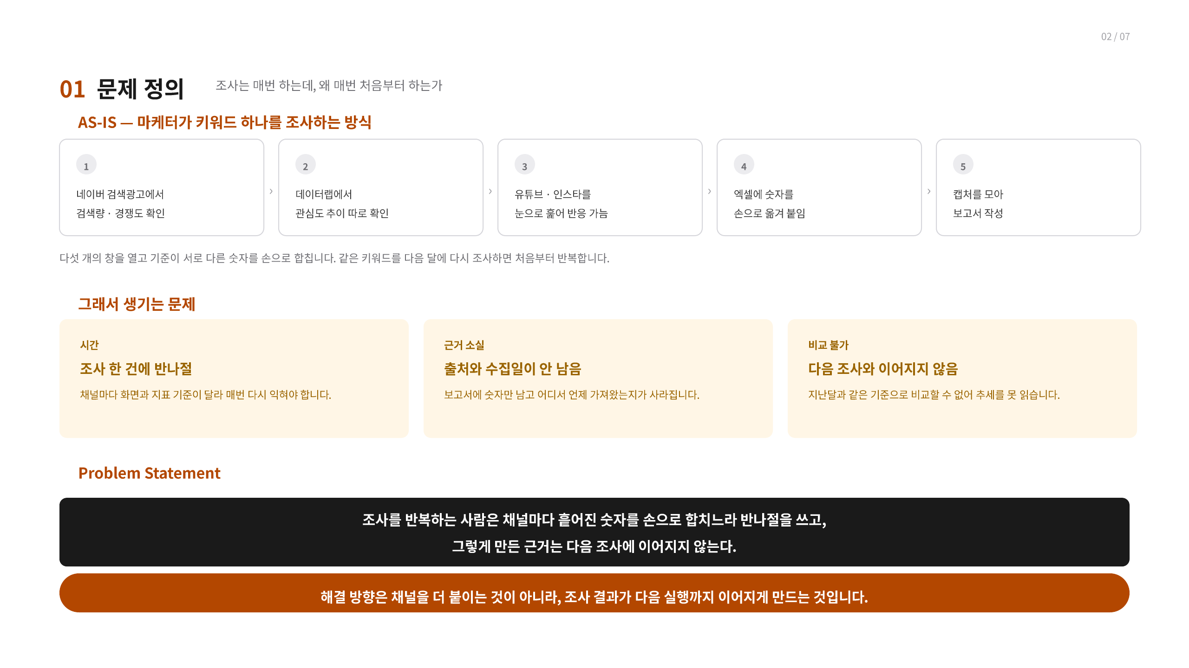
Notes:
[Sources]
- C:/MyMain/main/resume/박종혁_PM_포트폴리오.pdf, page 16, user-provided source, accessed 2026-08-28
[/Sources]

Slide 17
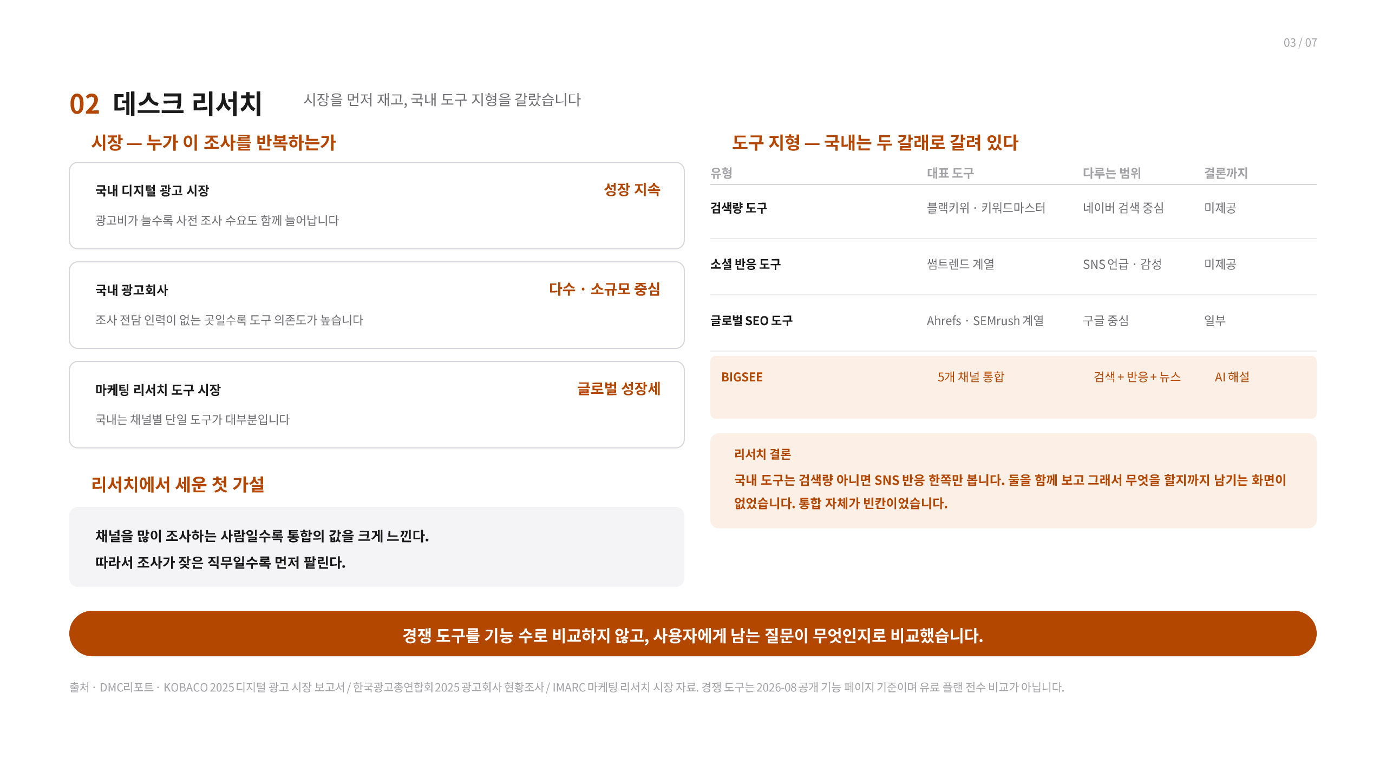
Notes:
[Sources]
- C:/MyMain/main/resume/박종혁_PM_포트폴리오.pdf, page 17, user-provided source, accessed 2026-08-28
[/Sources]

Slide 18
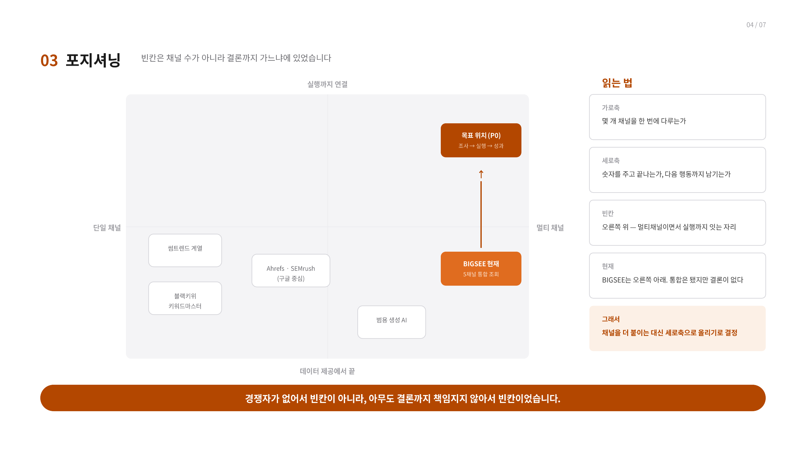
Notes:
[Sources]
- C:/MyMain/main/resume/박종혁_PM_포트폴리오.pdf, page 18, user-provided source, accessed 2026-08-28
[/Sources]

Slide 19
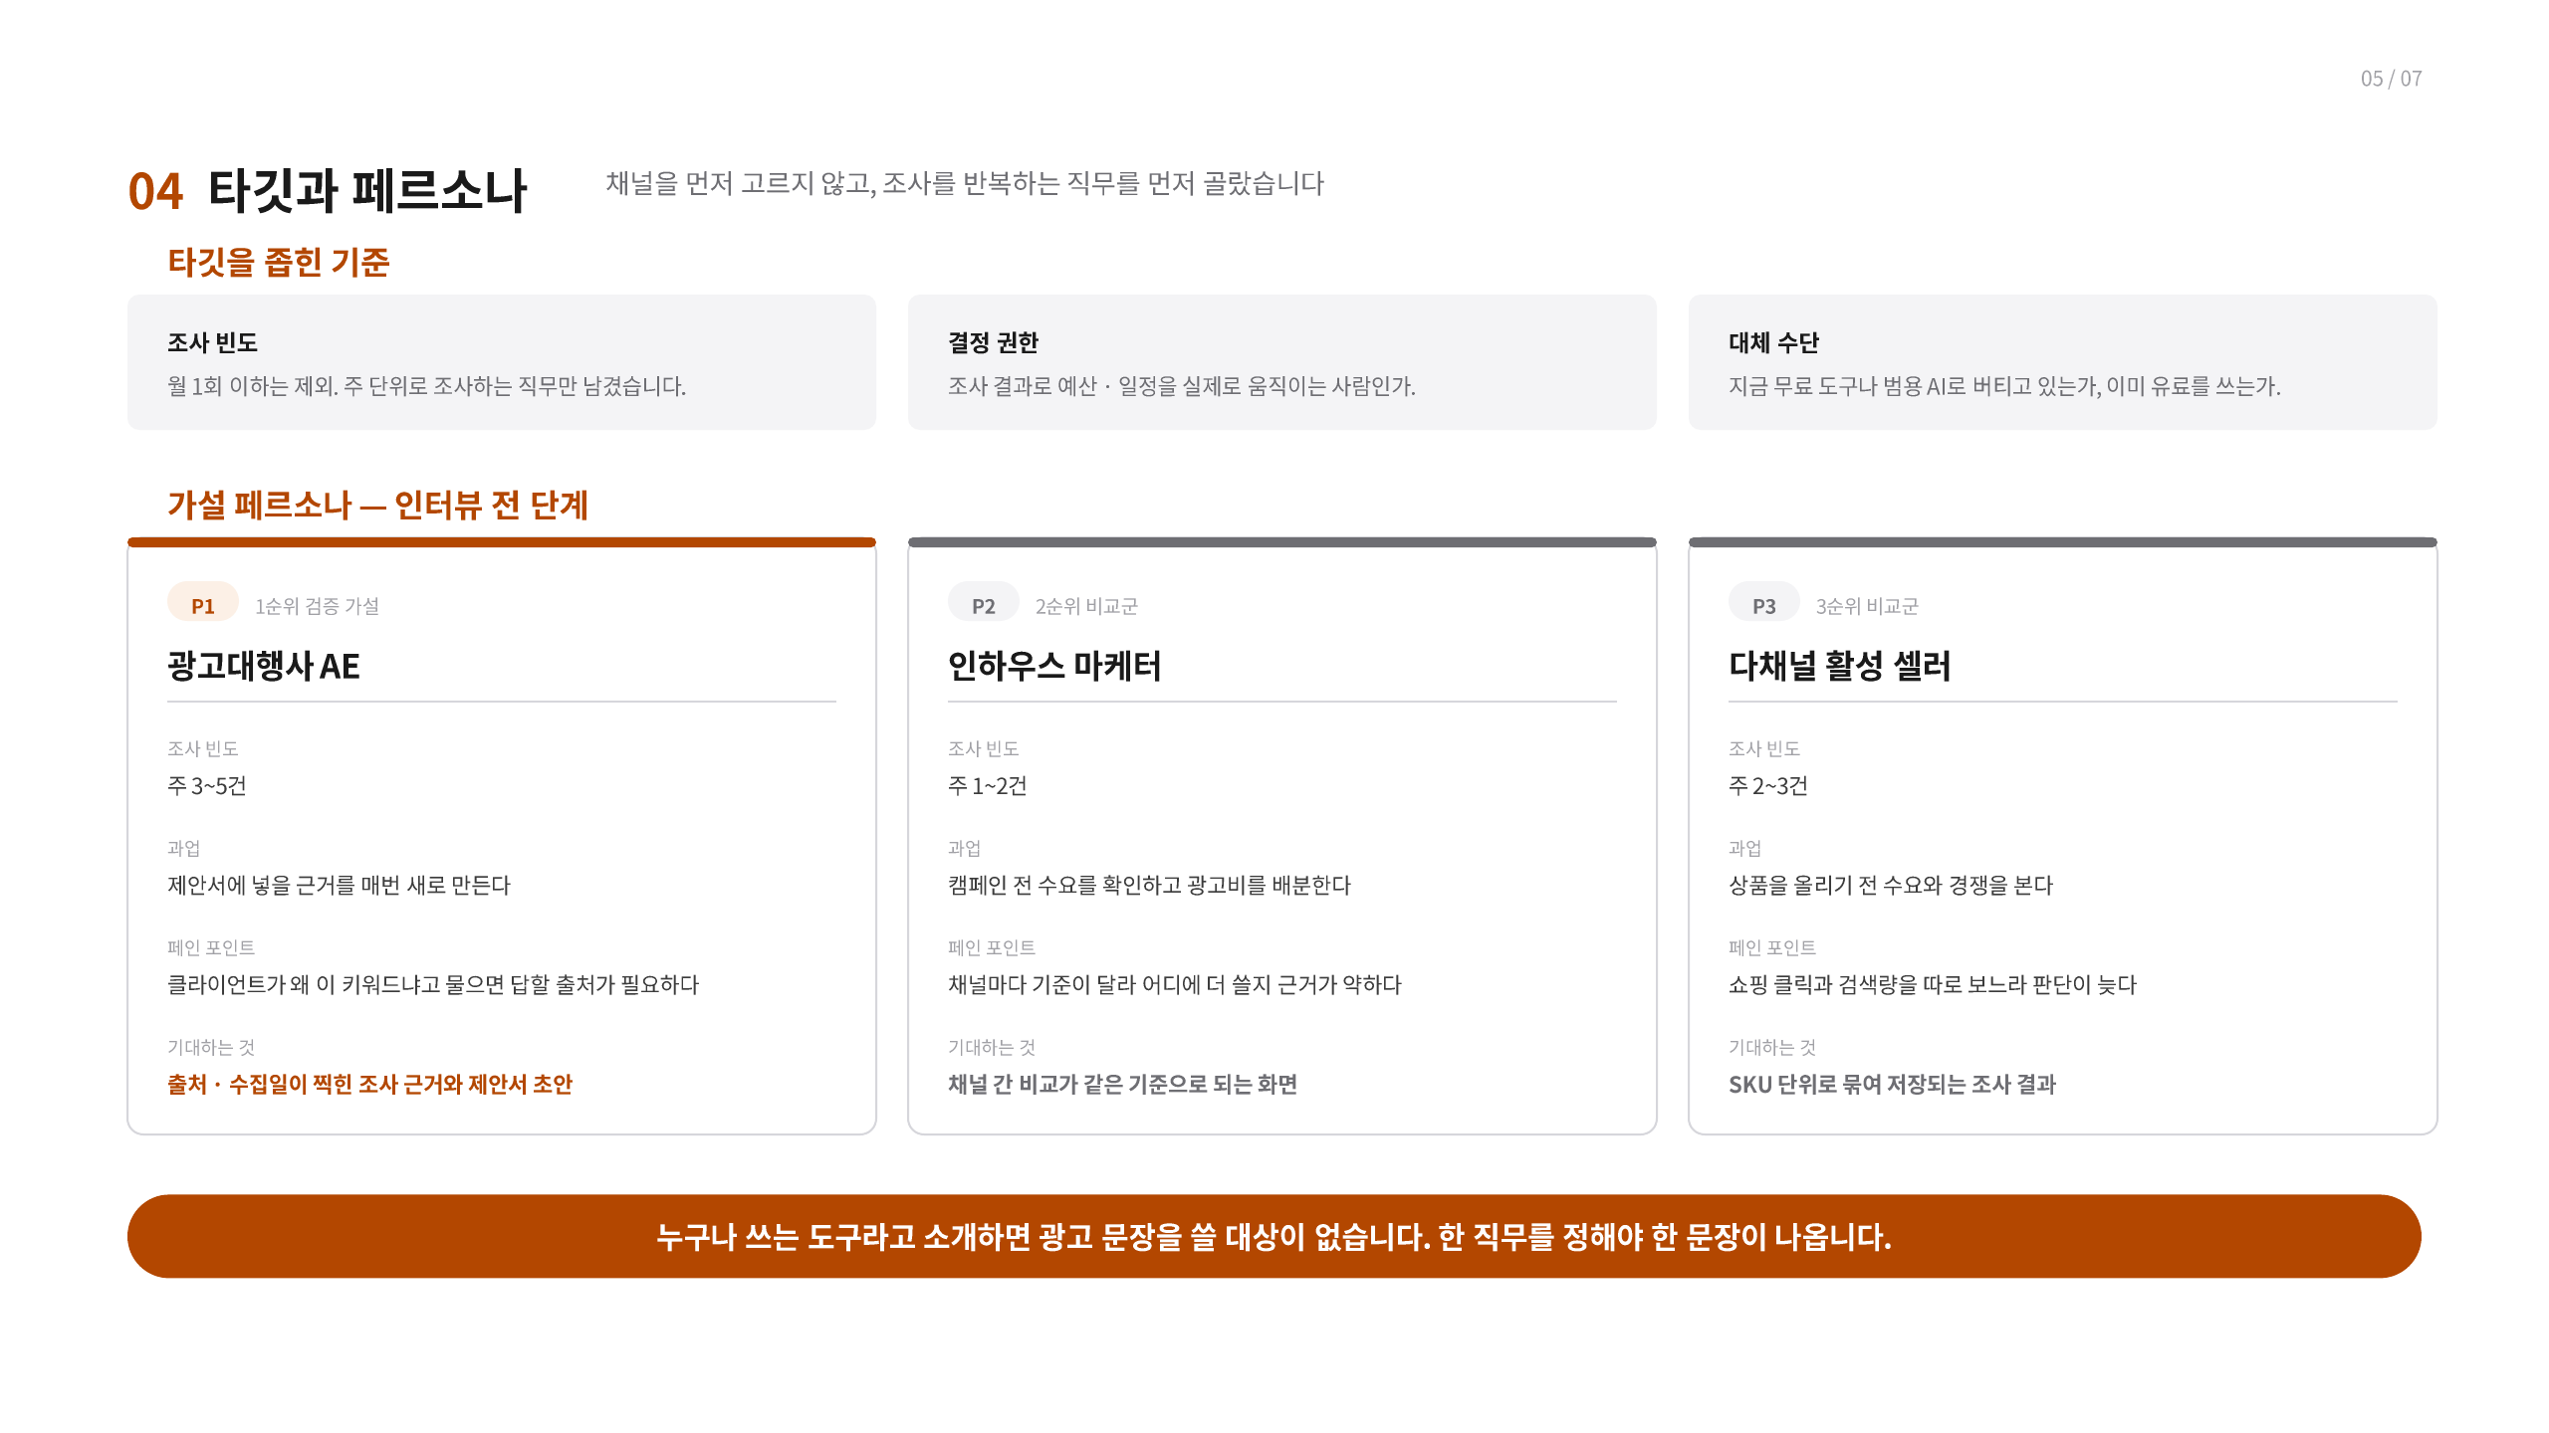
Notes:
[Sources]
- C:/MyMain/main/resume/박종혁_PM_포트폴리오.pdf, page 19, user-provided source, accessed 2026-08-28
[/Sources]

Slide 20
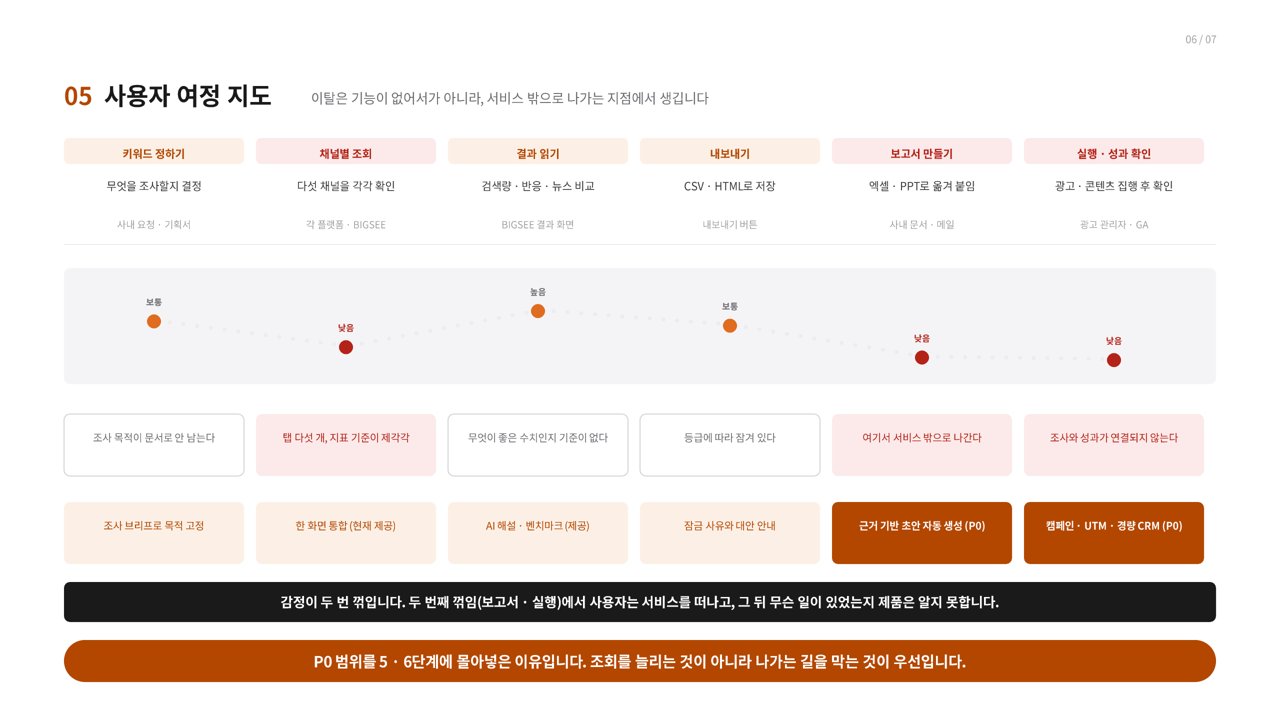
Notes:
[Sources]
- C:/MyMain/main/resume/박종혁_PM_포트폴리오.pdf, page 20, user-provided source, accessed 2026-08-28
[/Sources]

Slide 21
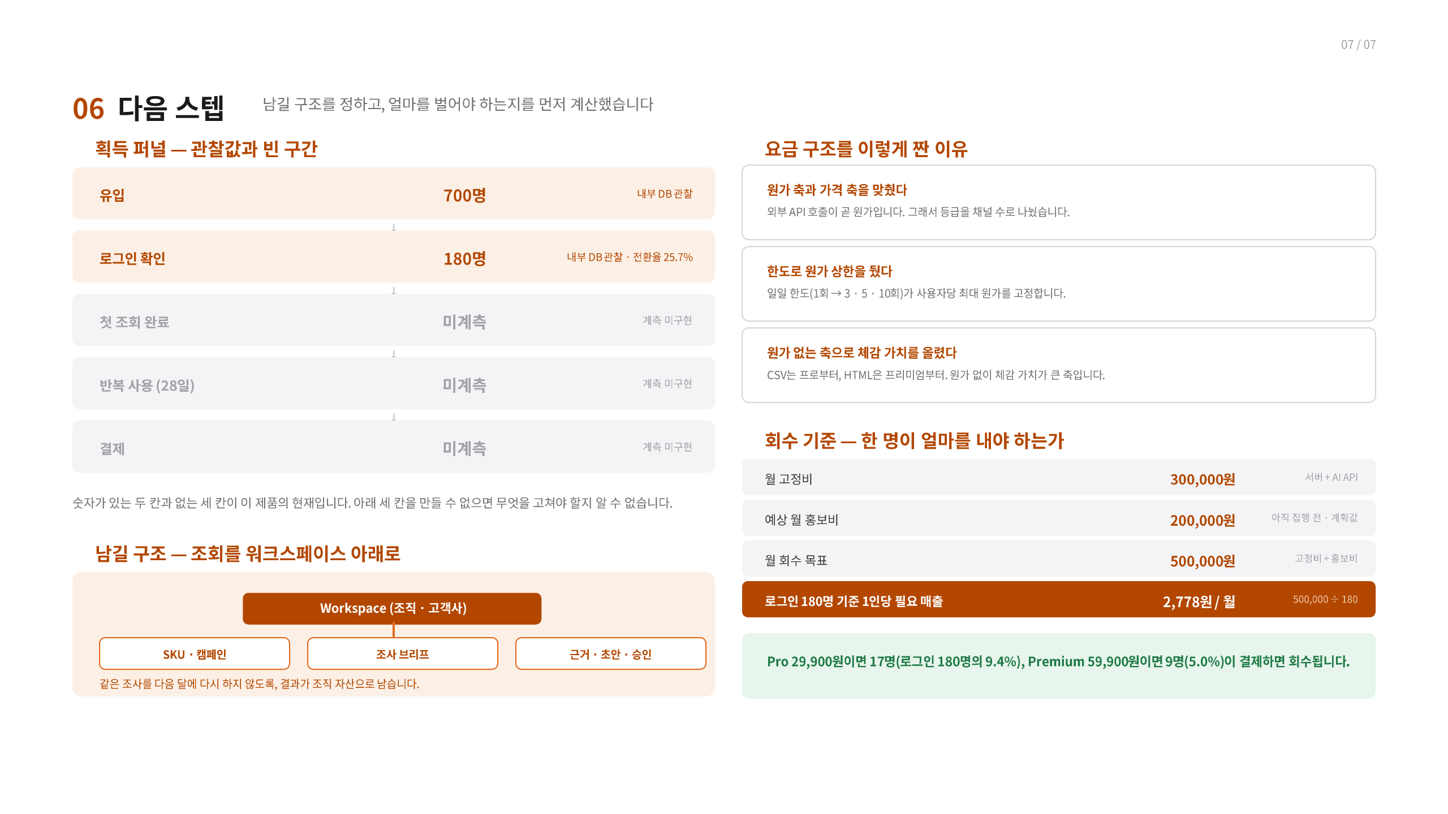
Notes:
[Sources]
- C:/MyMain/main/resume/박종혁_PM_포트폴리오.pdf, page 21, user-provided source, accessed 2026-08-28
[/Sources]

Slide 22
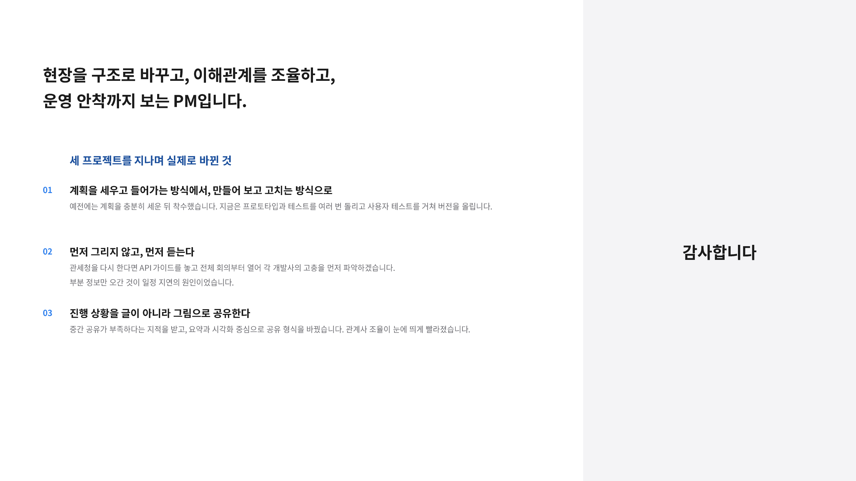
Notes:
[Sources]
- C:/MyMain/main/resume/박종혁_PM_포트폴리오.pdf, page 22, user-provided source, accessed 2026-08-28
[/Sources]

