Slide 1
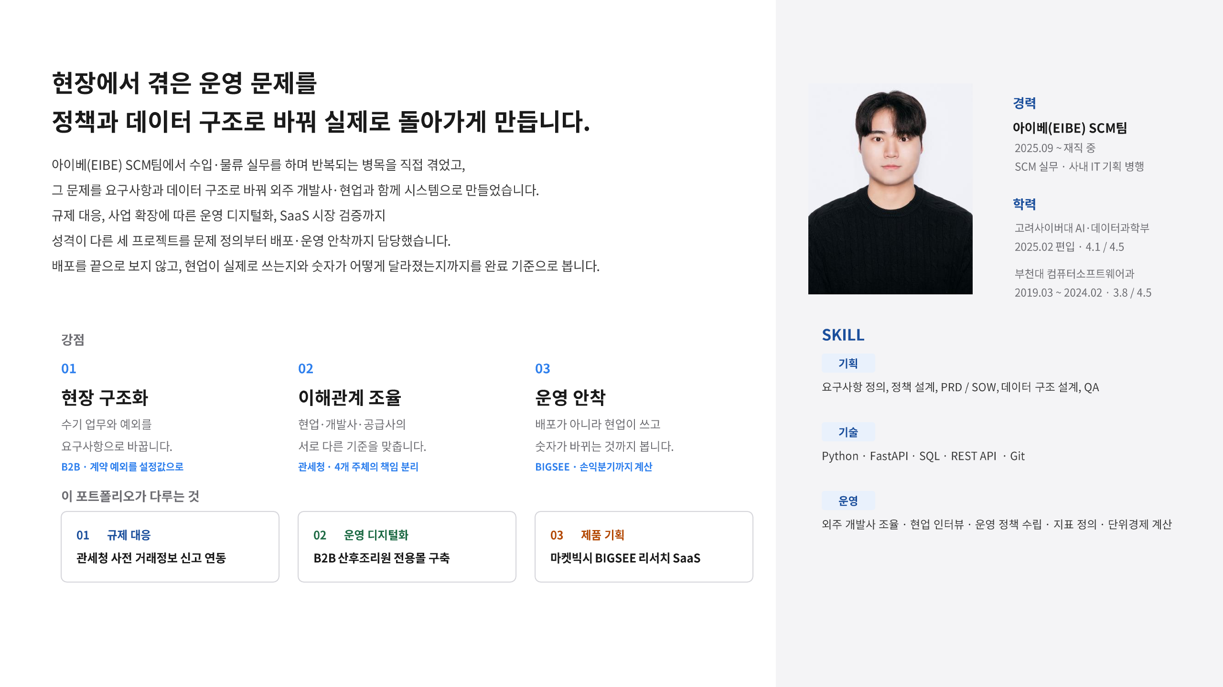
Notes:
[Sources]
- C:/MyMain/main/resume/박종혁_PM_포트폴리오.pdf, page 1, user-provided source, accessed 2026-08-28
[/Sources]

Slide 2
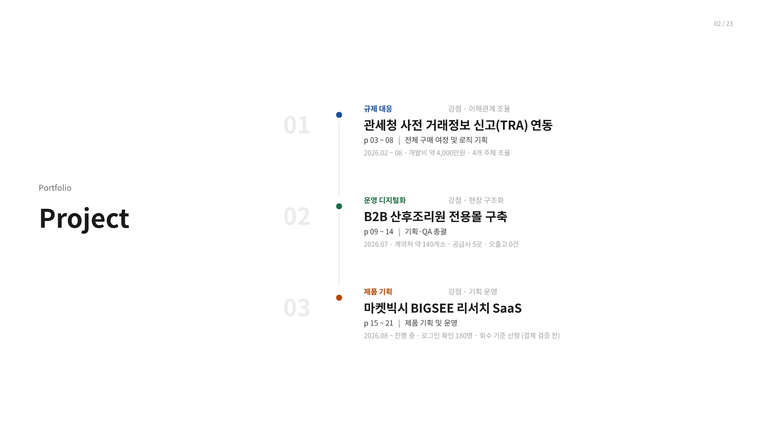
Notes:
[Sources]
- C:/MyMain/main/resume/박종혁_PM_포트폴리오.pdf, page 2, user-provided source, accessed 2026-08-28
[/Sources]

Slide 3
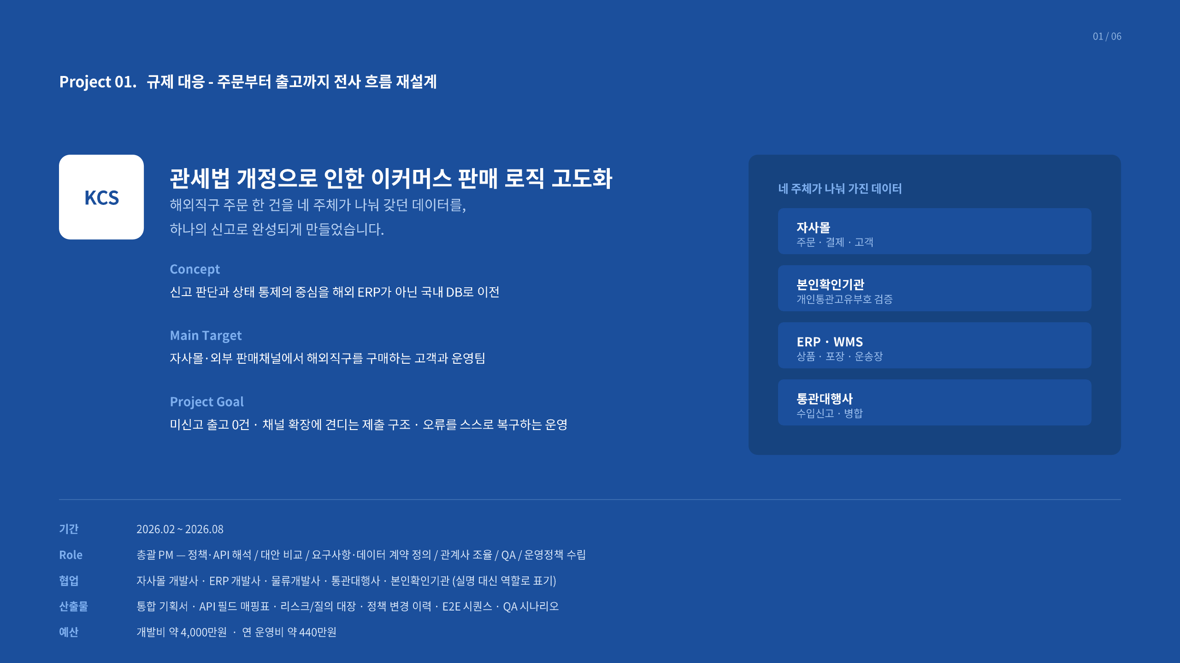
Notes:
[Sources]
- C:/MyMain/main/resume/박종혁_PM_포트폴리오.pdf, page 3, user-provided source, accessed 2026-08-28
[/Sources]

Slide 4
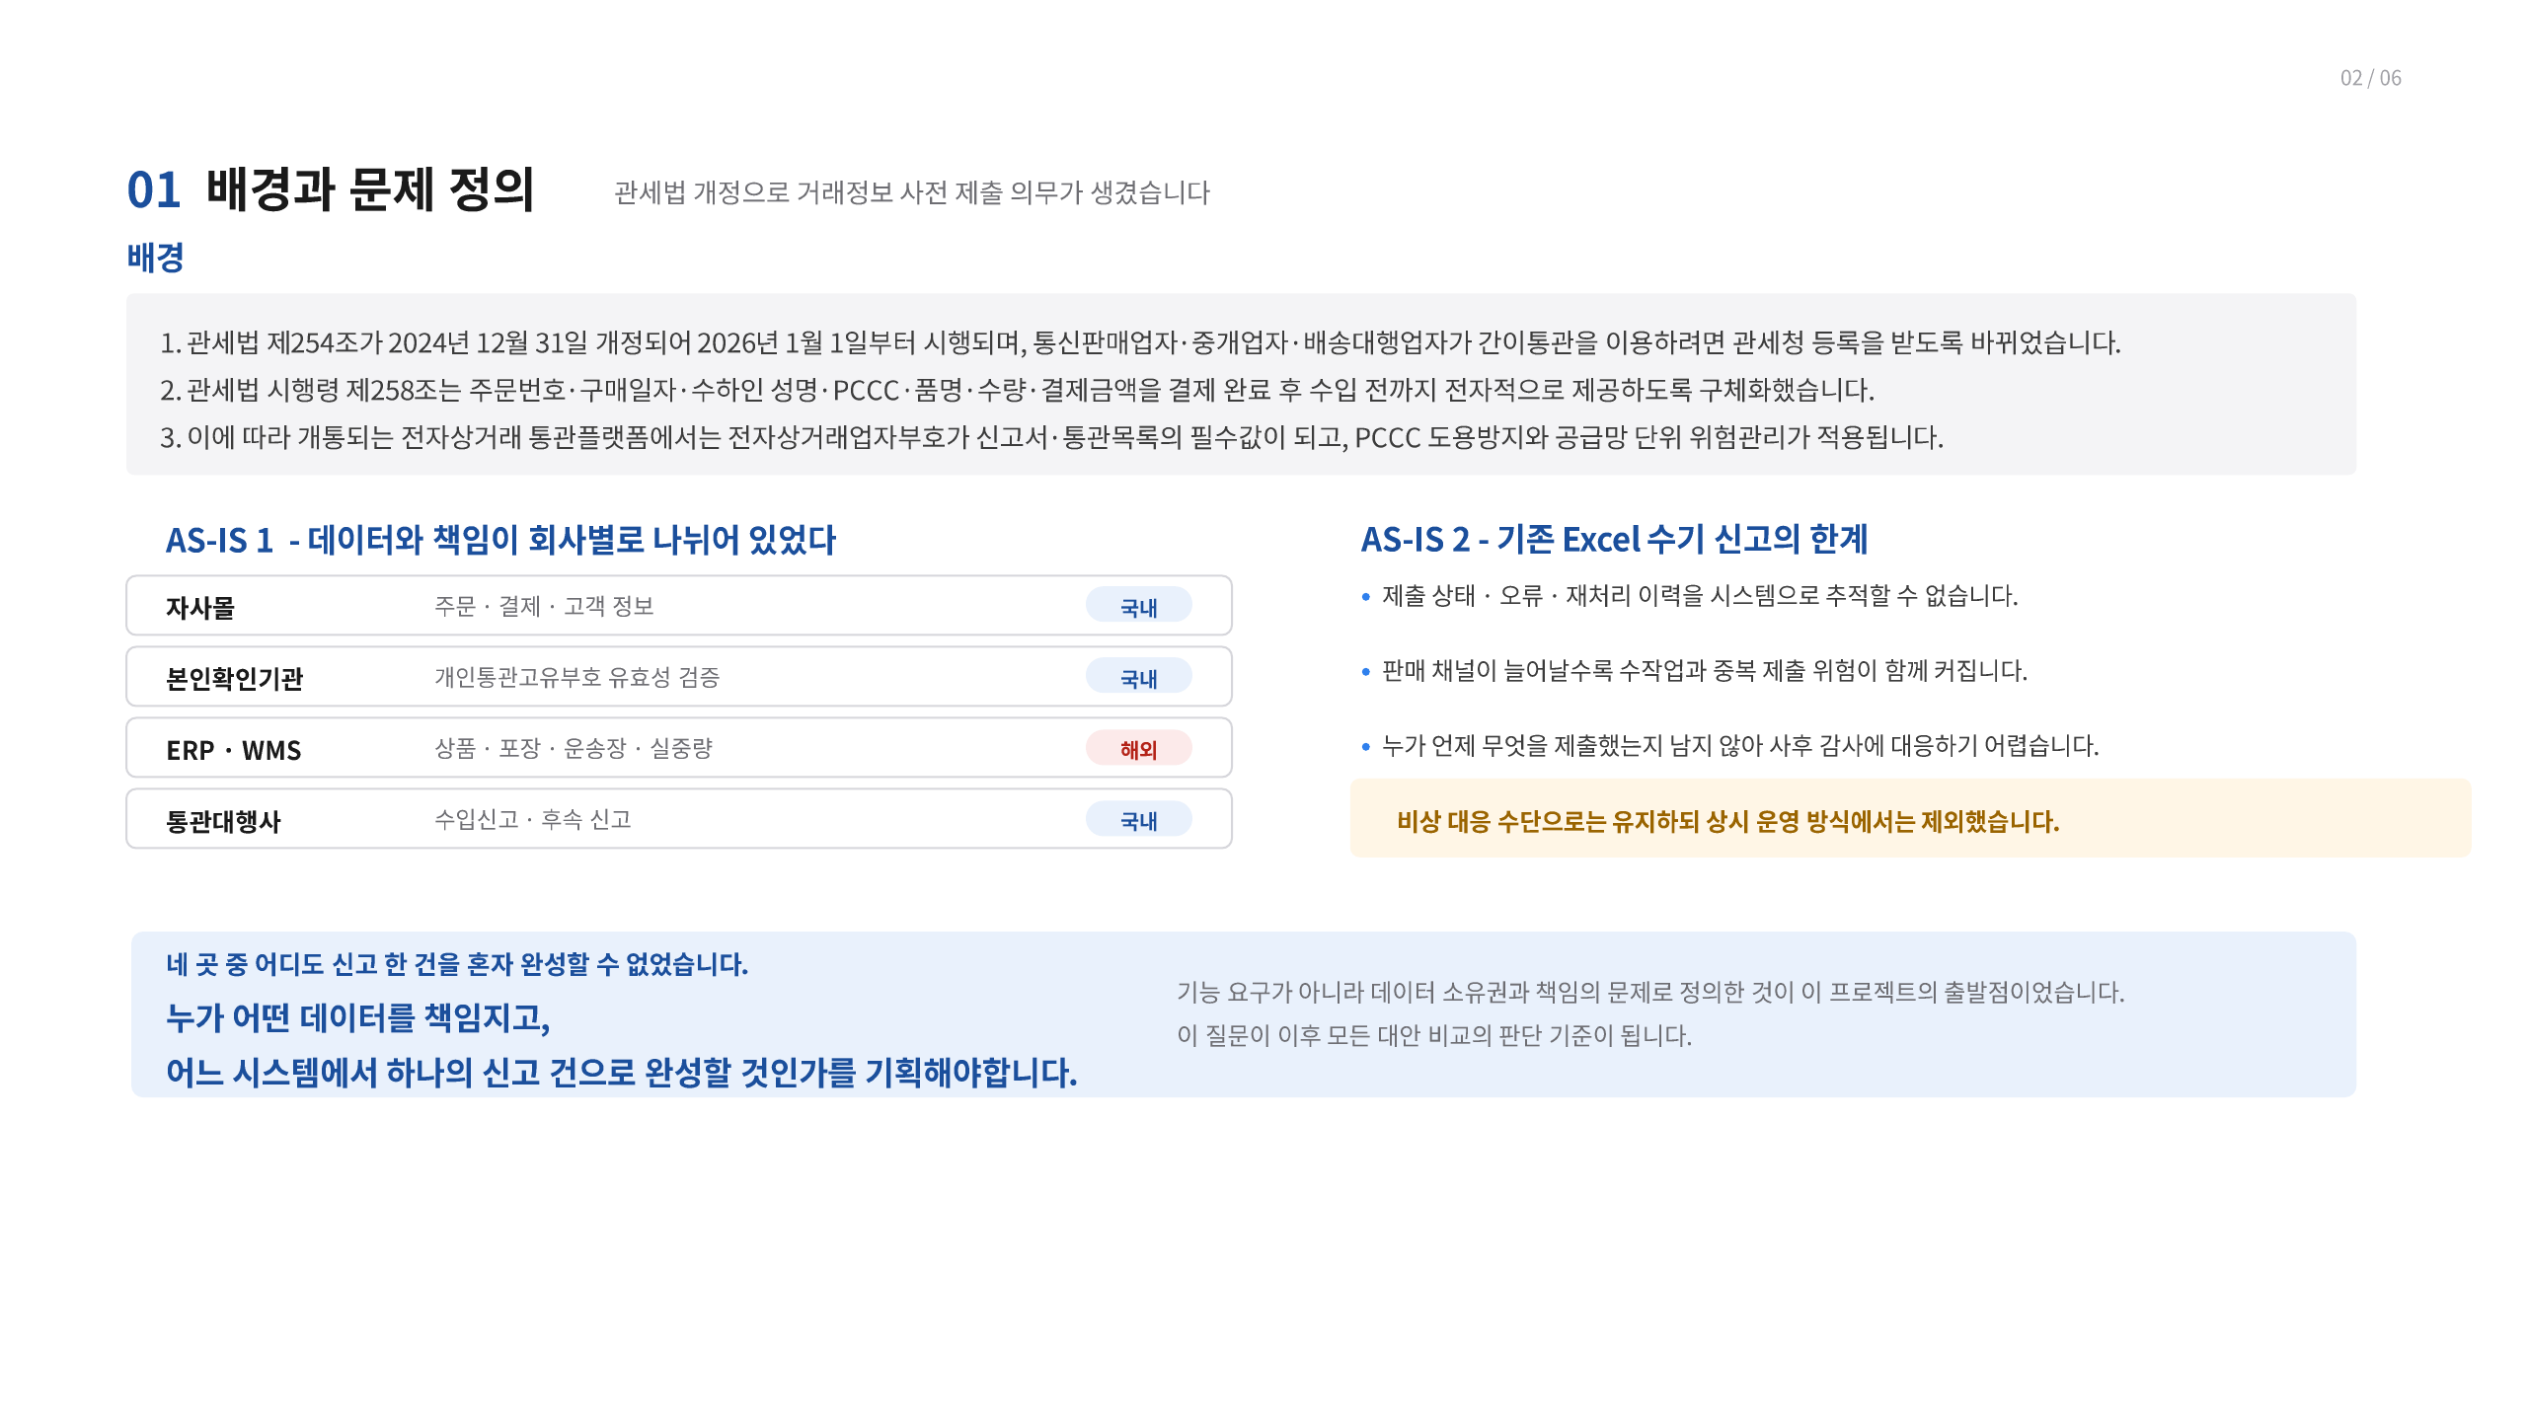
국내
국내
해외
국내
Notes:
[Sources]
- C:/MyMain/main/resume/박종혁_PM_포트폴리오.pdf, page 4, user-provided source, accessed 2026-08-28
[/Sources]

Slide 5
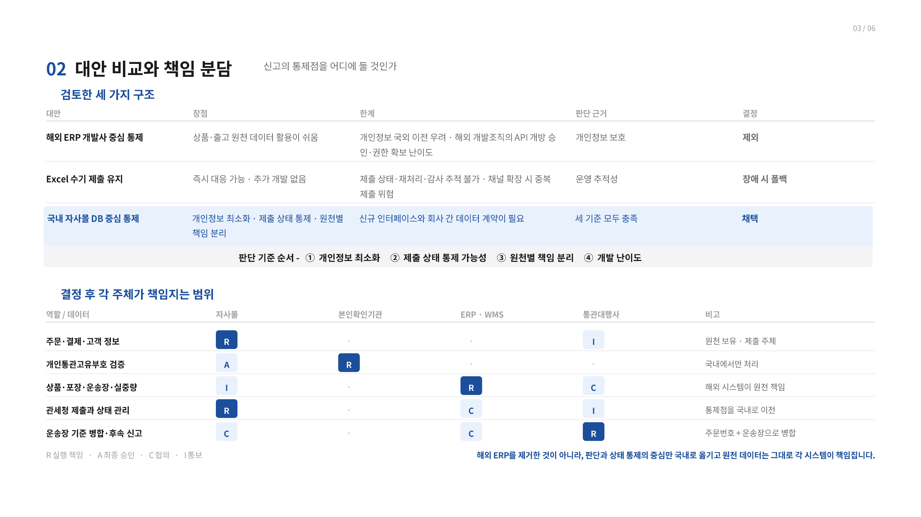
R
I
A
R
I
R
C
R
C
I
C
C
R
Notes:
[Sources]
- C:/MyMain/main/resume/박종혁_PM_포트폴리오.pdf, page 5, user-provided source, accessed 2026-08-28
[/Sources]

Slide 6
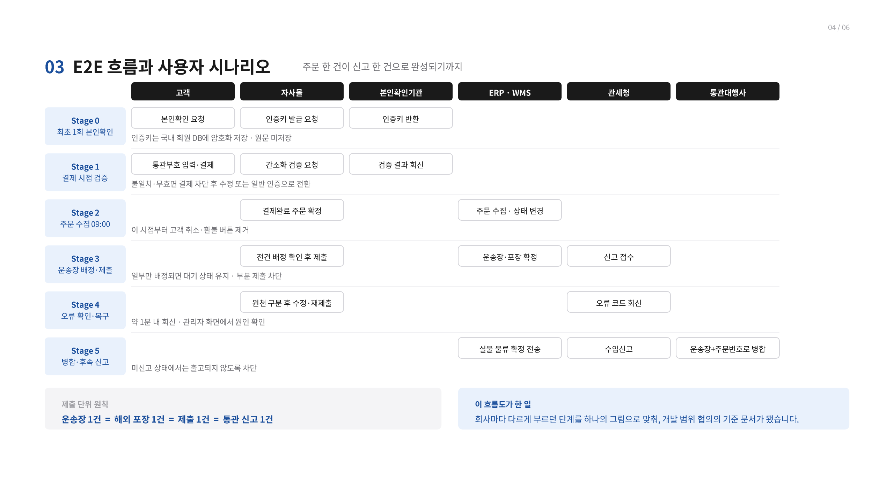
Notes:
[Sources]
- C:/MyMain/main/resume/박종혁_PM_포트폴리오.pdf, page 6, user-provided source, accessed 2026-08-28
[/Sources]

Slide 7
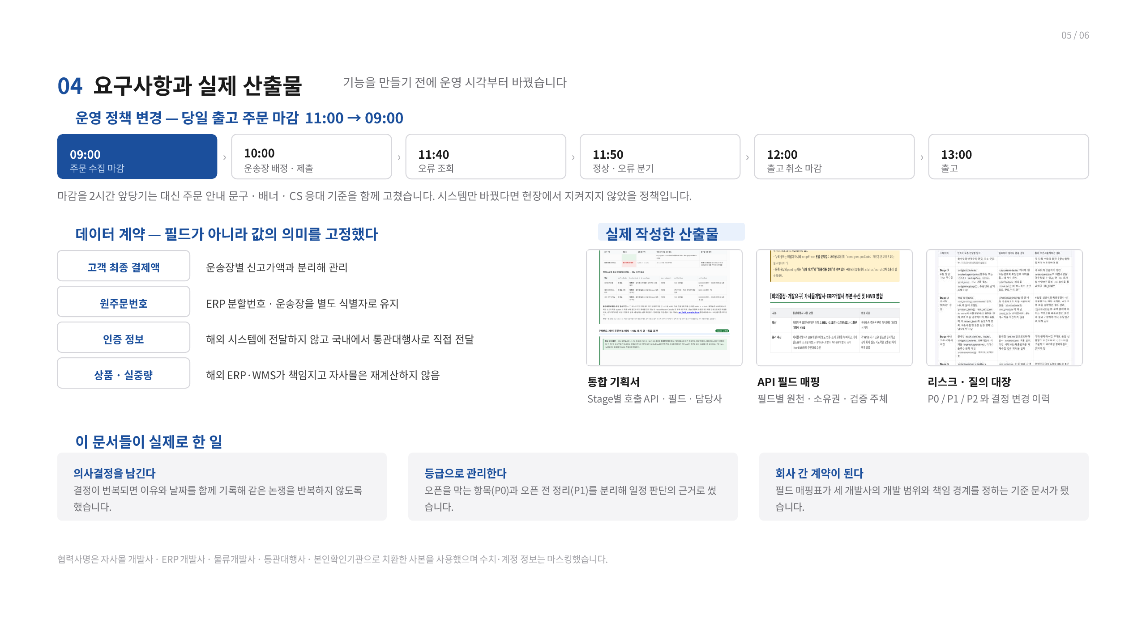
Notes:
[Sources]
- C:/MyMain/main/resume/박종혁_PM_포트폴리오.pdf, page 7, user-provided source, accessed 2026-08-28
[/Sources]

Slide 8
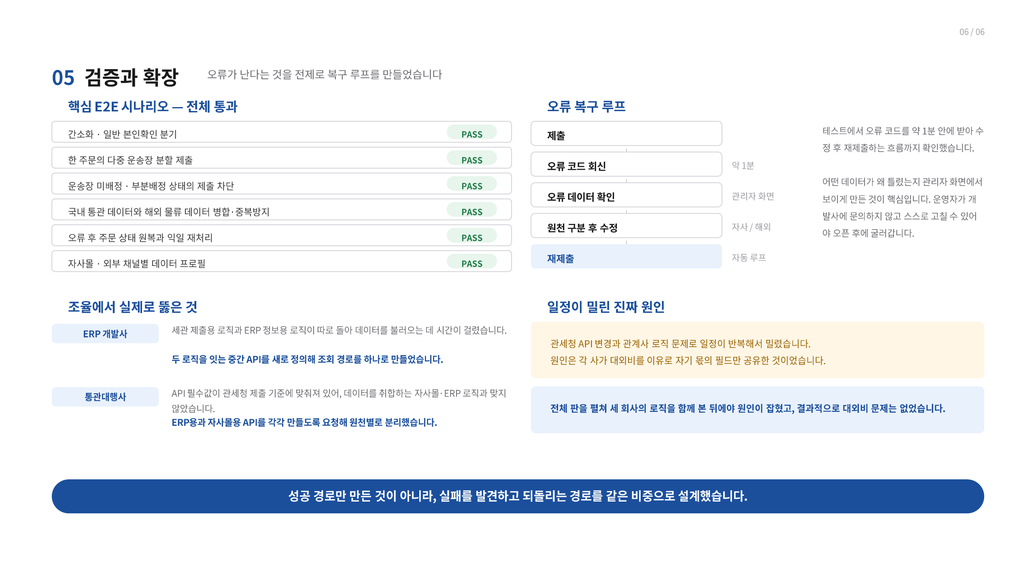
PASS
PASS
PASS
PASS
PASS
PASS
Notes:
[Sources]
- C:/MyMain/main/resume/박종혁_PM_포트폴리오.pdf, page 8, user-provided source, accessed 2026-08-28
[/Sources]

Slide 9
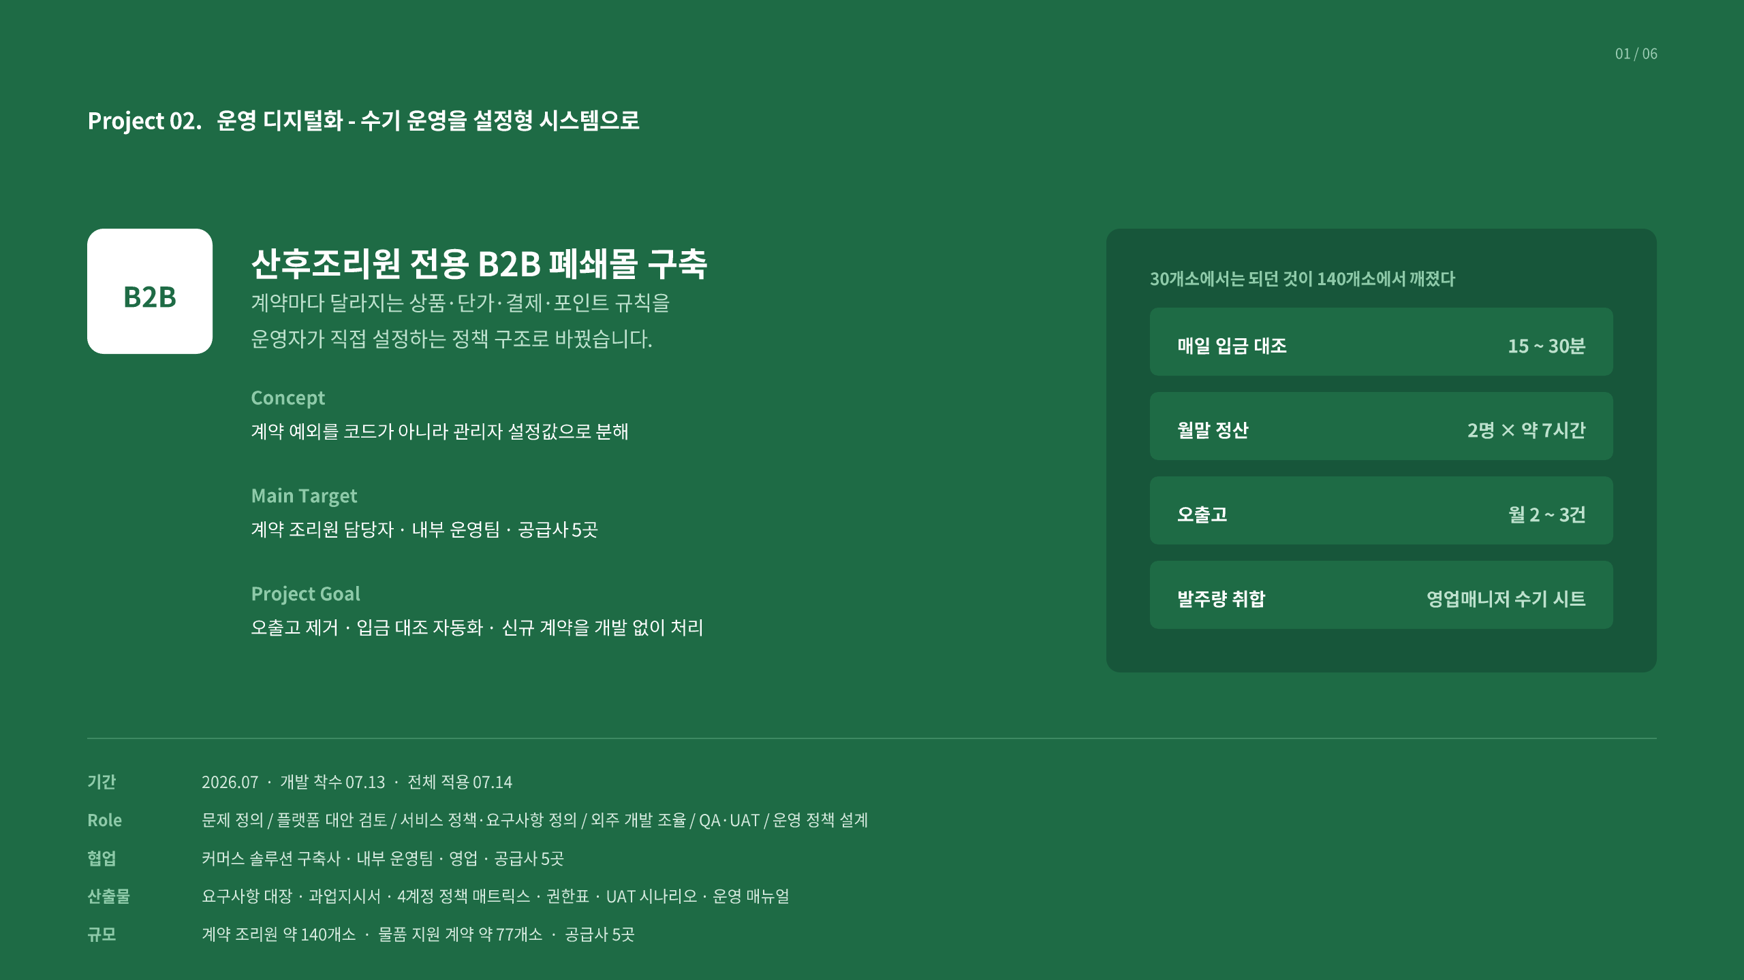
Notes:
[Sources]
- C:/MyMain/main/resume/박종혁_PM_포트폴리오.pdf, page 9, user-provided source, accessed 2026-08-28
[/Sources]

Slide 10
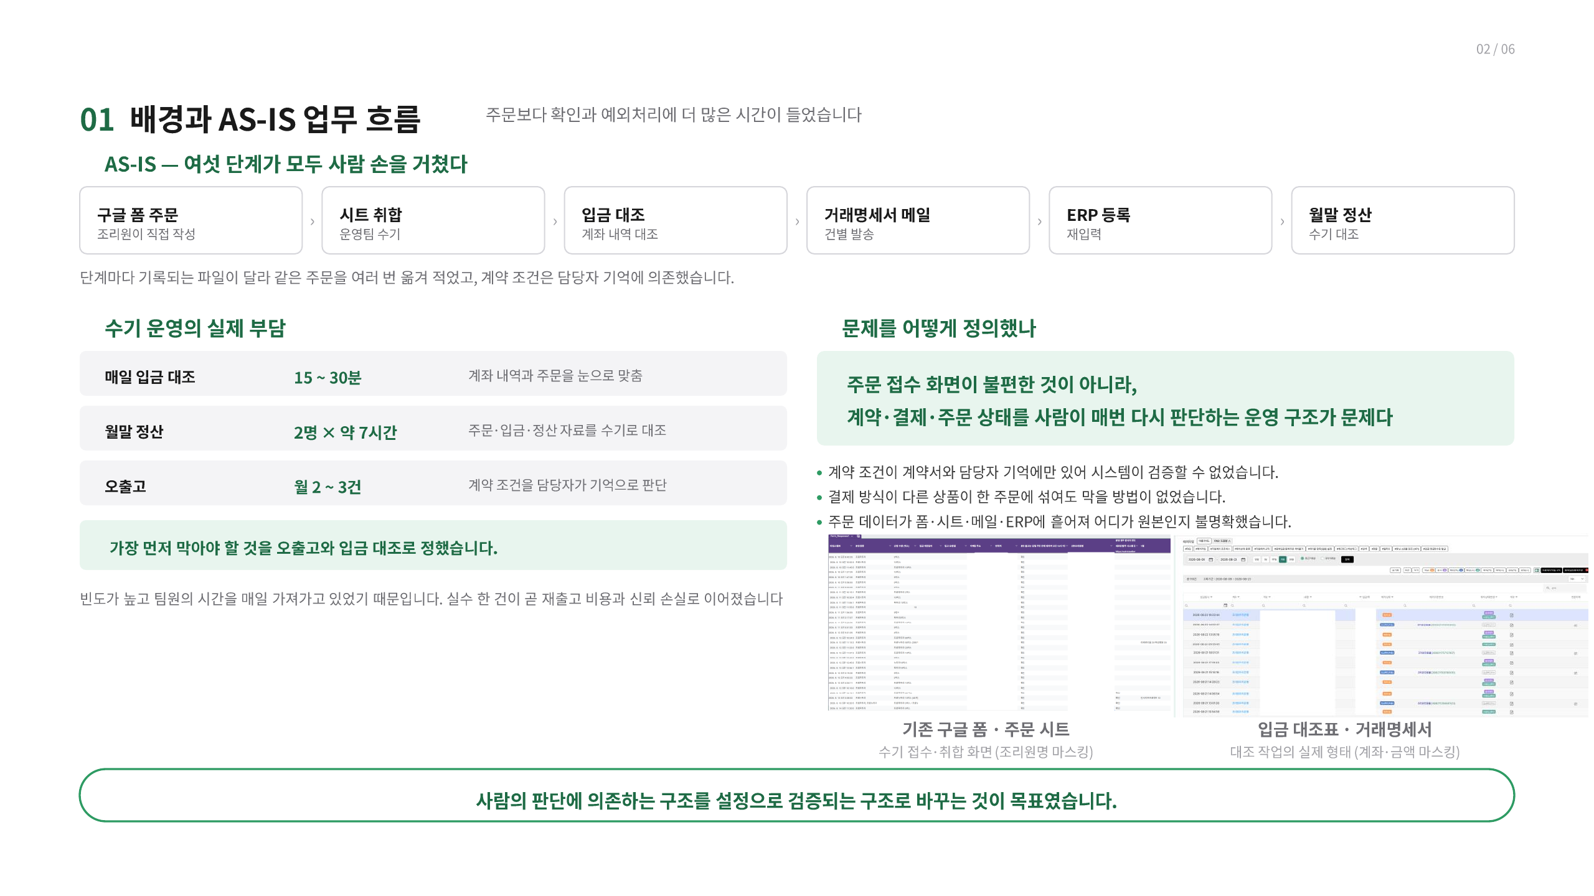
Notes:
[Sources]
- C:/MyMain/main/resume/박종혁_PM_포트폴리오.pdf, page 10, user-provided source, accessed 2026-08-28
[/Sources]

Slide 11
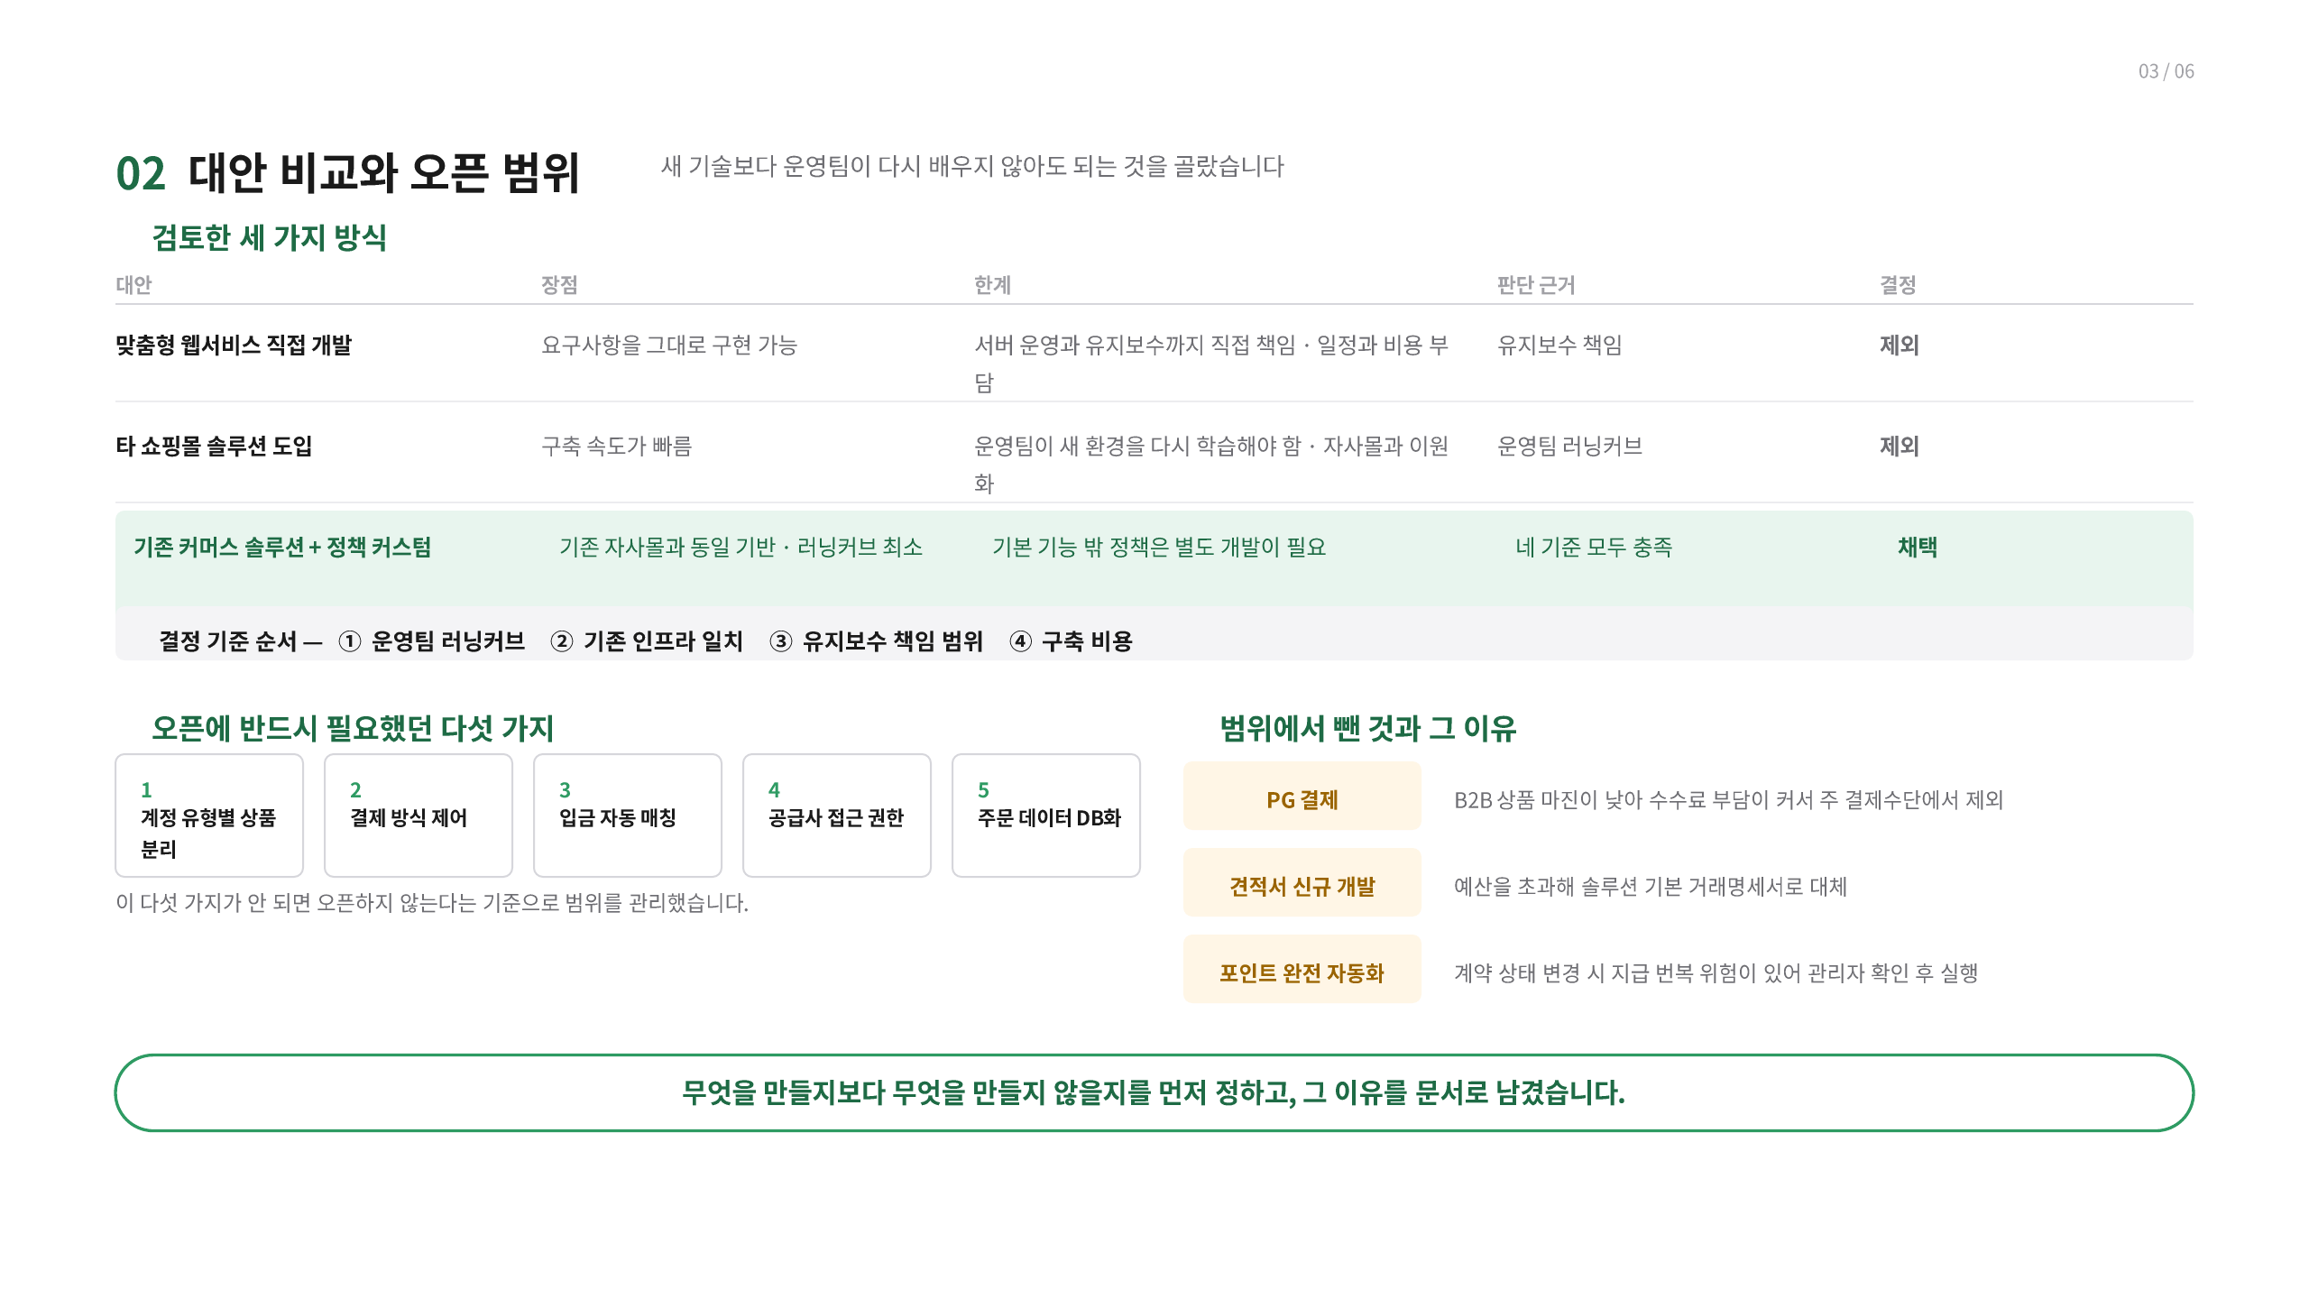
Notes:
[Sources]
- C:/MyMain/main/resume/박종혁_PM_포트폴리오.pdf, page 11, user-provided source, accessed 2026-08-28
[/Sources]

Slide 12
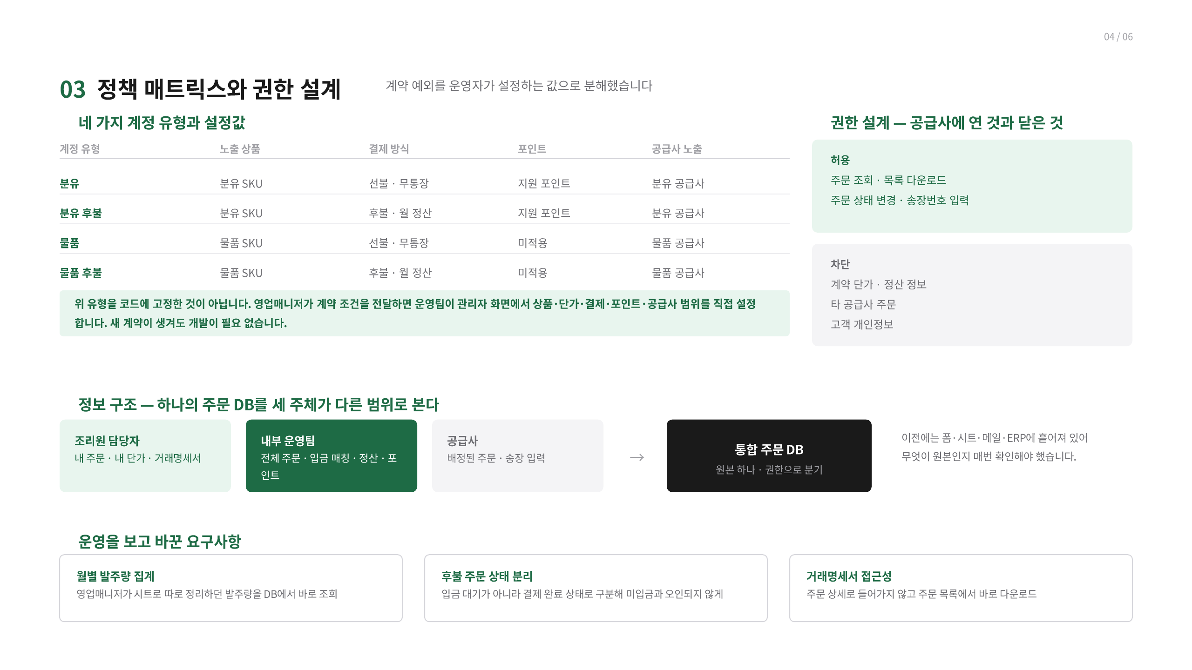
Notes:
[Sources]
- C:/MyMain/main/resume/박종혁_PM_포트폴리오.pdf, page 12, user-provided source, accessed 2026-08-28
[/Sources]

Slide 13
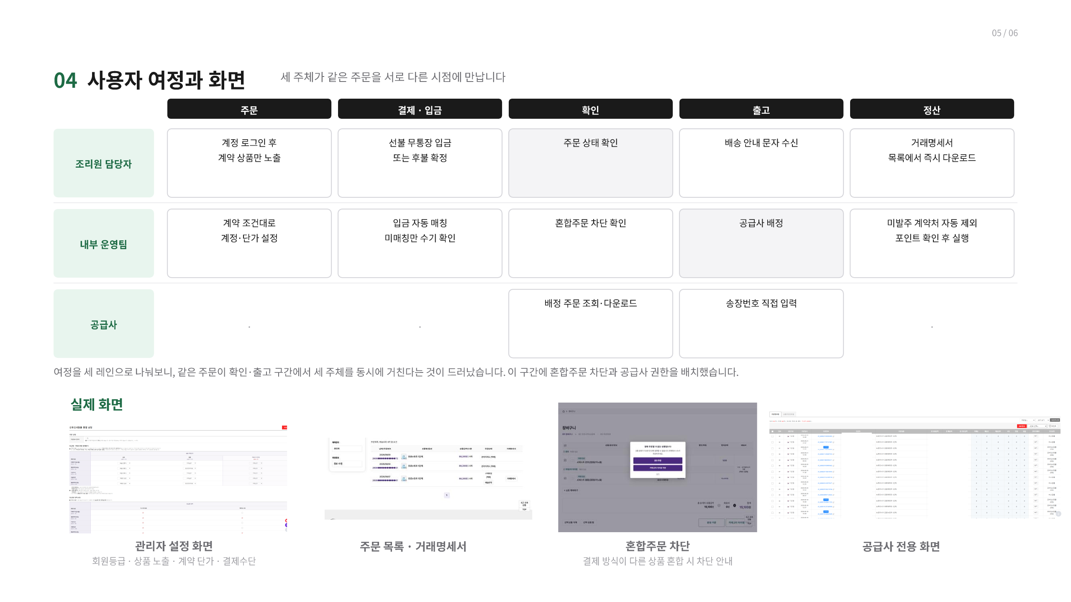
Notes:
[Sources]
- C:/MyMain/main/resume/박종혁_PM_포트폴리오.pdf, page 13, user-provided source, accessed 2026-08-28
[/Sources]

Slide 14
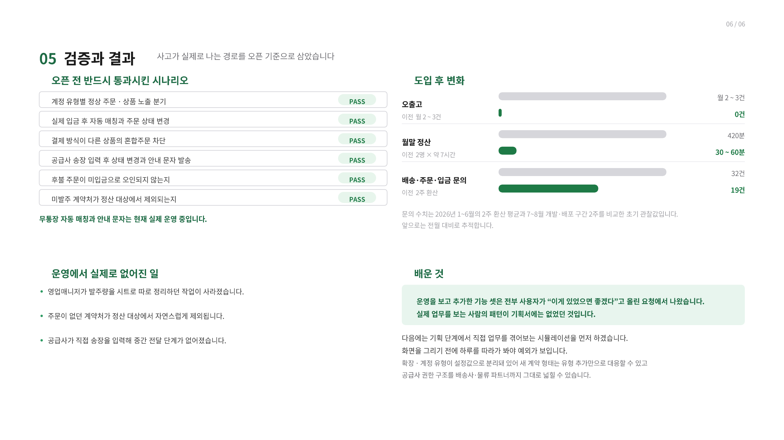
PASS
PASS
PASS
PASS
PASS
PASS
Notes:
[Sources]
- C:/MyMain/main/resume/박종혁_PM_포트폴리오.pdf, page 14, user-provided source, accessed 2026-08-28
[/Sources]

Slide 15
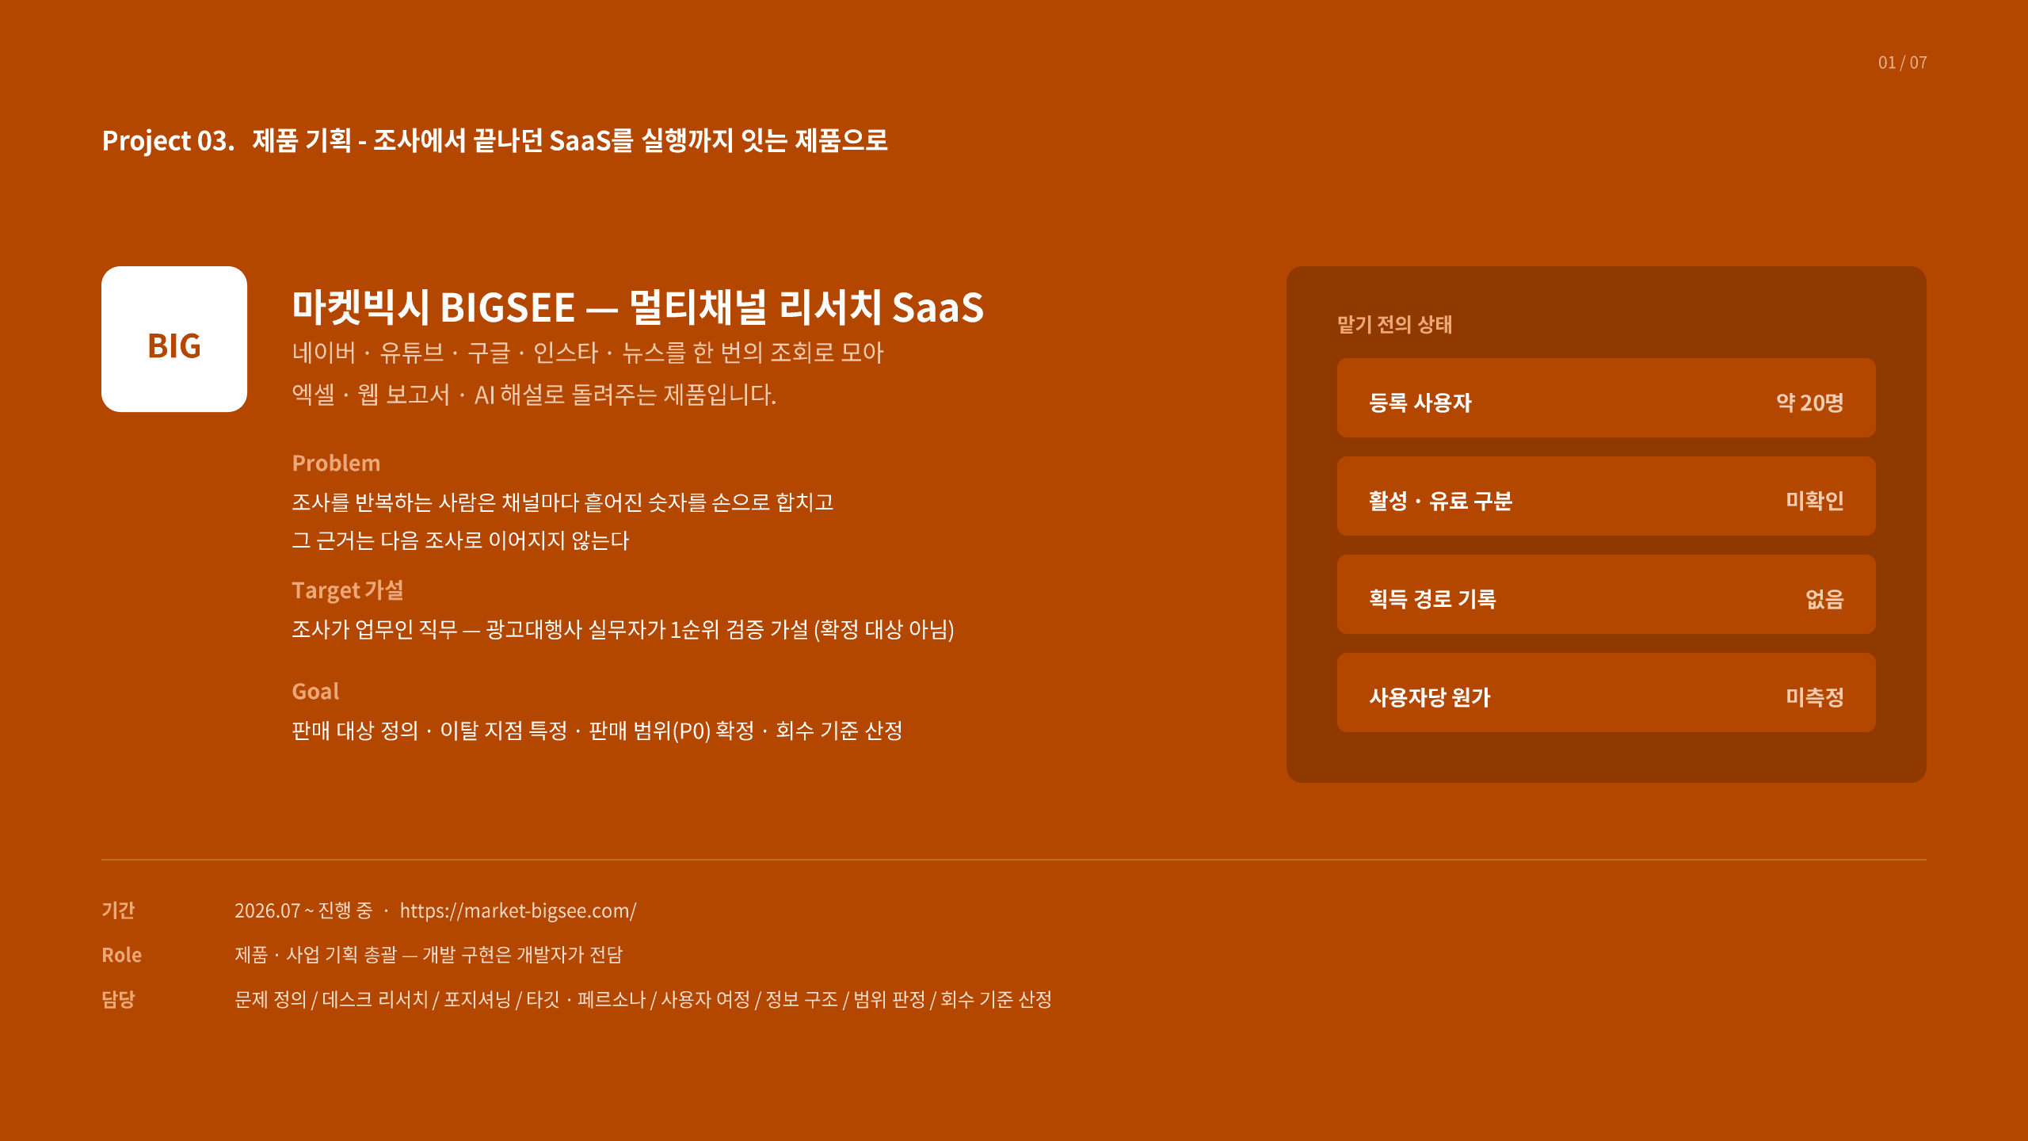
Notes:
[Sources]
- C:/MyMain/main/resume/박종혁_PM_포트폴리오.pdf, page 15, user-provided source, accessed 2026-08-28
[/Sources]

Slide 16
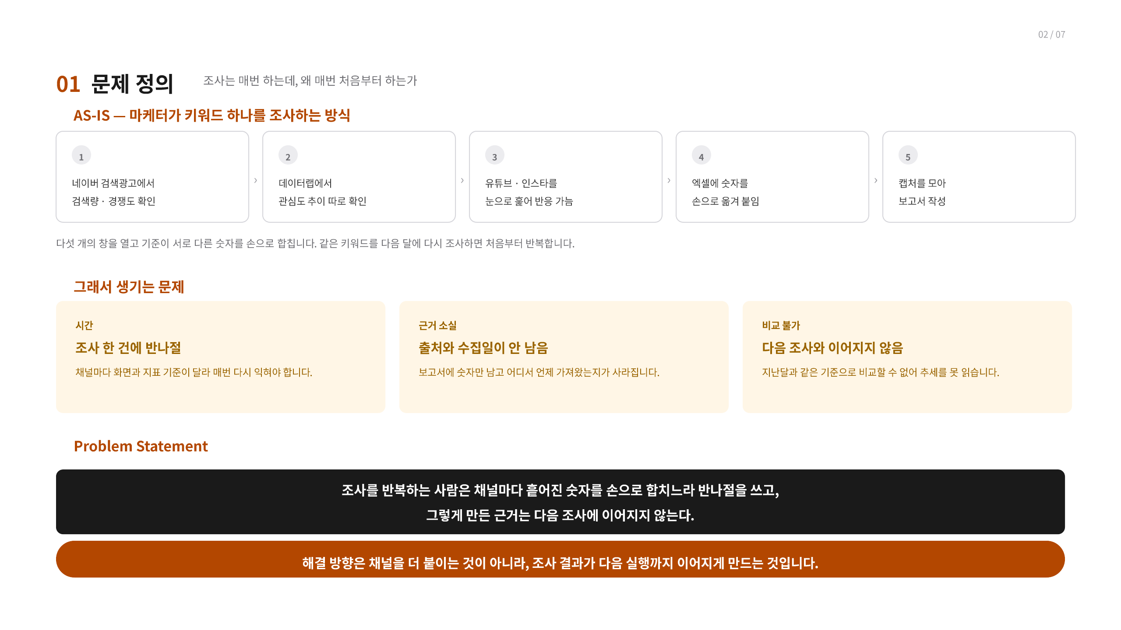
1
2
3
4
5
Notes:
[Sources]
- C:/MyMain/main/resume/박종혁_PM_포트폴리오.pdf, page 16, user-provided source, accessed 2026-08-28
[/Sources]

Slide 17
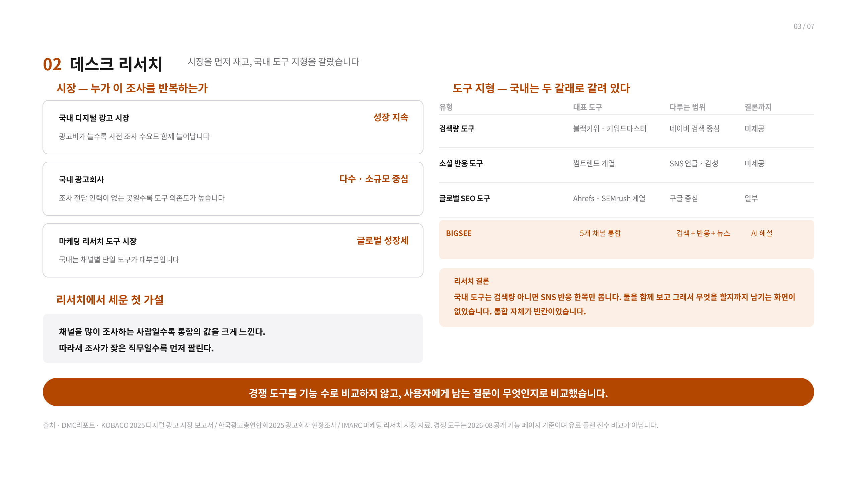
Notes:
[Sources]
- C:/MyMain/main/resume/박종혁_PM_포트폴리오.pdf, page 17, user-provided source, accessed 2026-08-28
[/Sources]

Slide 18
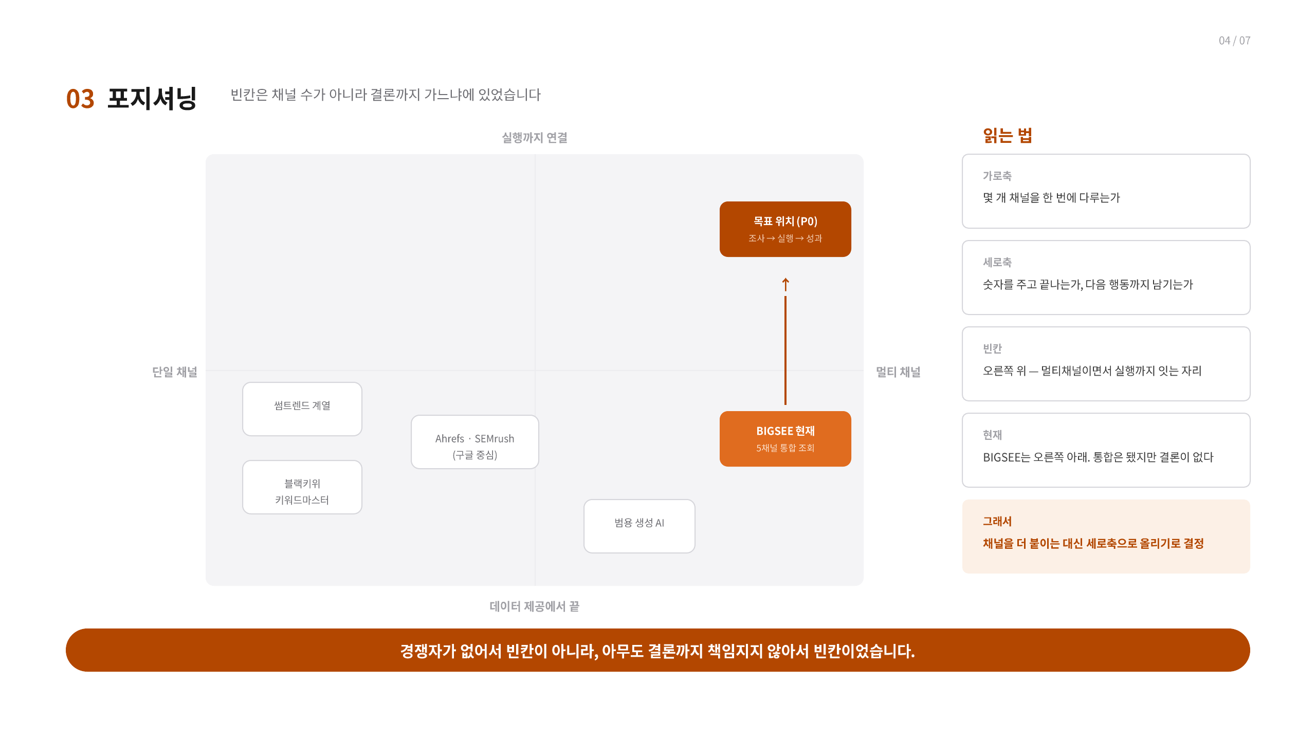
Notes:
[Sources]
- C:/MyMain/main/resume/박종혁_PM_포트폴리오.pdf, page 18, user-provided source, accessed 2026-08-28
[/Sources]

Slide 19
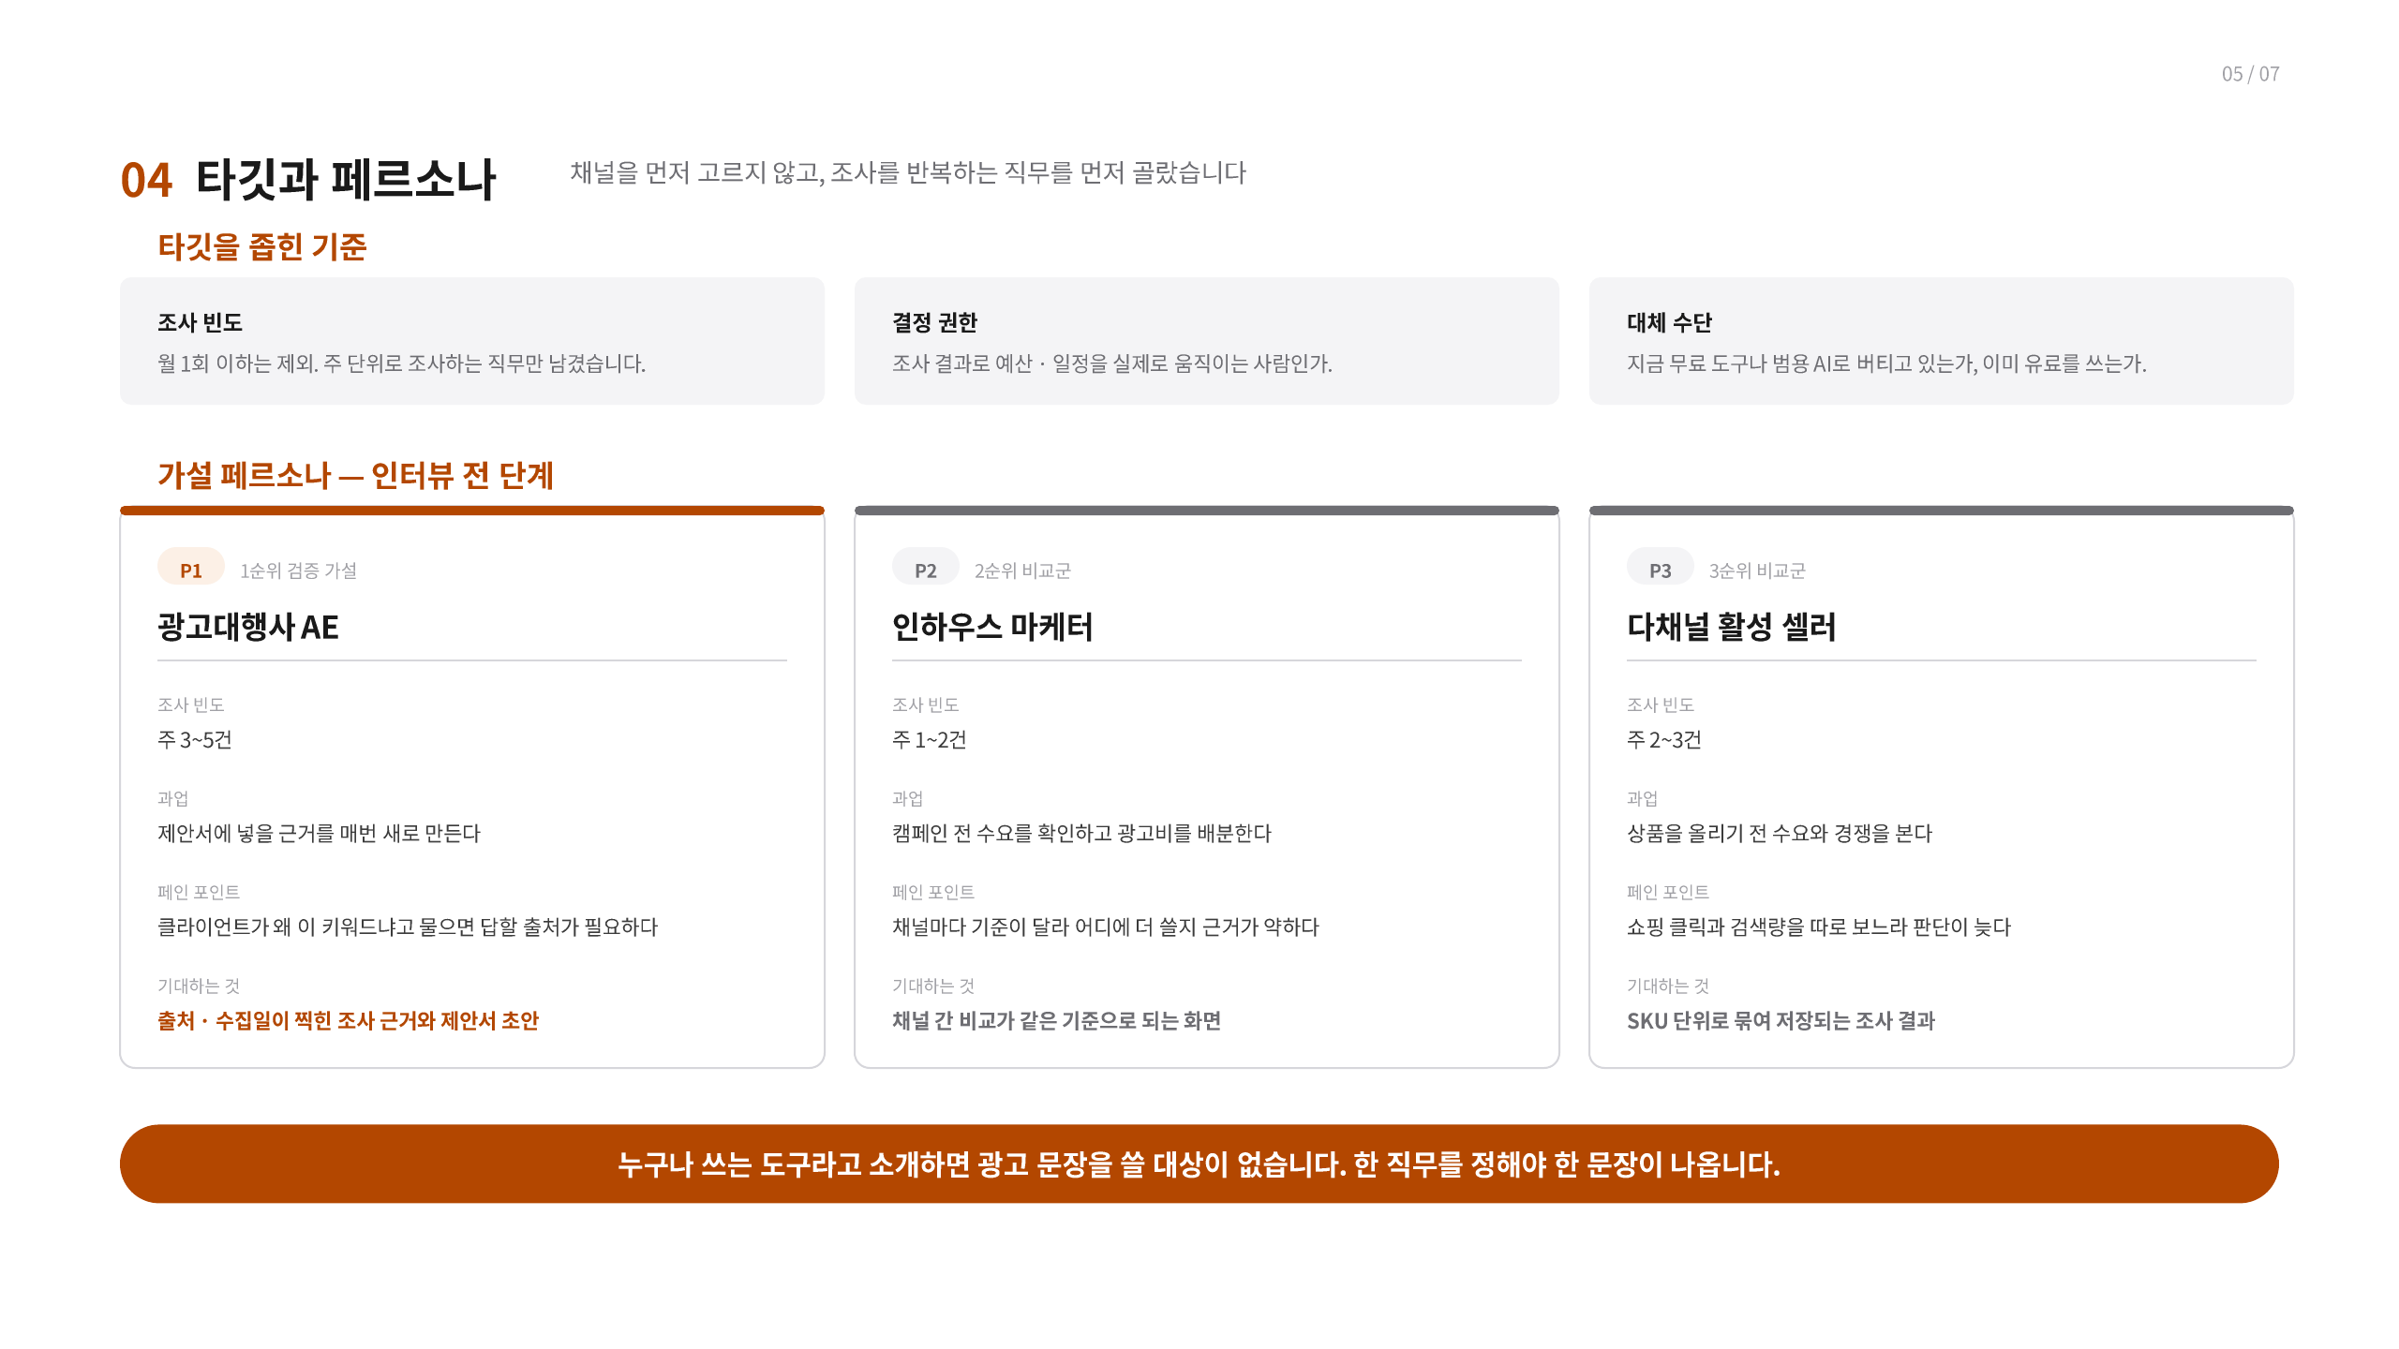
P1
P2
P3
Notes:
[Sources]
- C:/MyMain/main/resume/박종혁_PM_포트폴리오.pdf, page 19, user-provided source, accessed 2026-08-28
[/Sources]

Slide 20
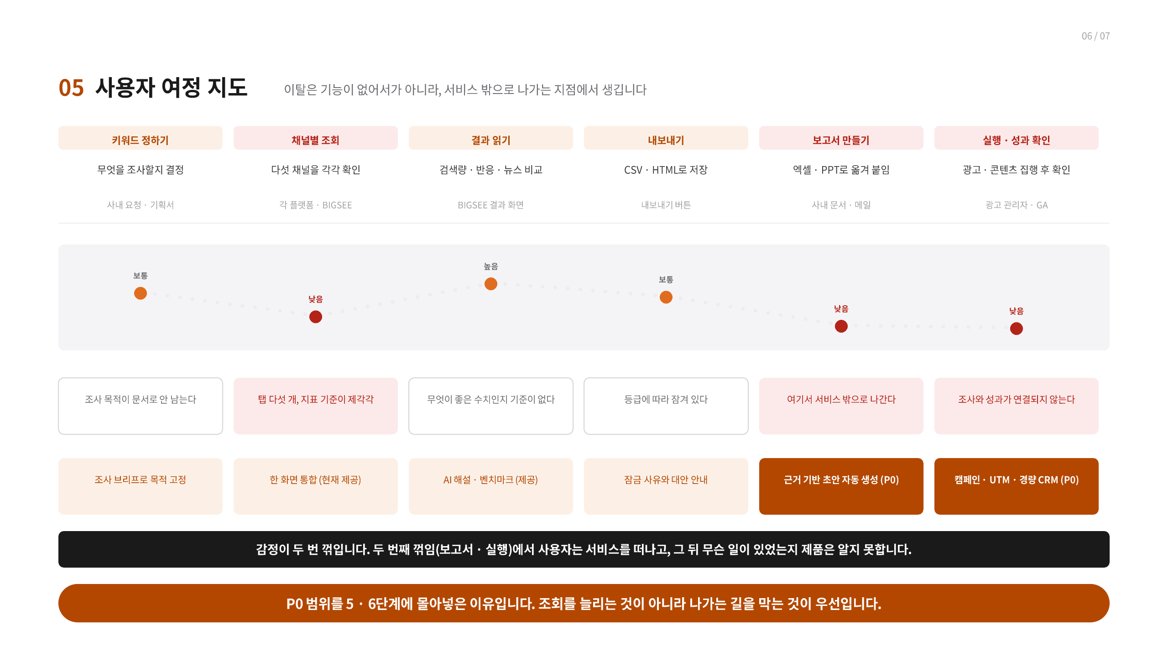
키워드 정하기
채널별 조회
결과 읽기
내보내기
보고서 만들기
실행 · 성과 확인
Notes:
[Sources]
- C:/MyMain/main/resume/박종혁_PM_포트폴리오.pdf, page 20, user-provided source, accessed 2026-08-28
[/Sources]

Slide 21
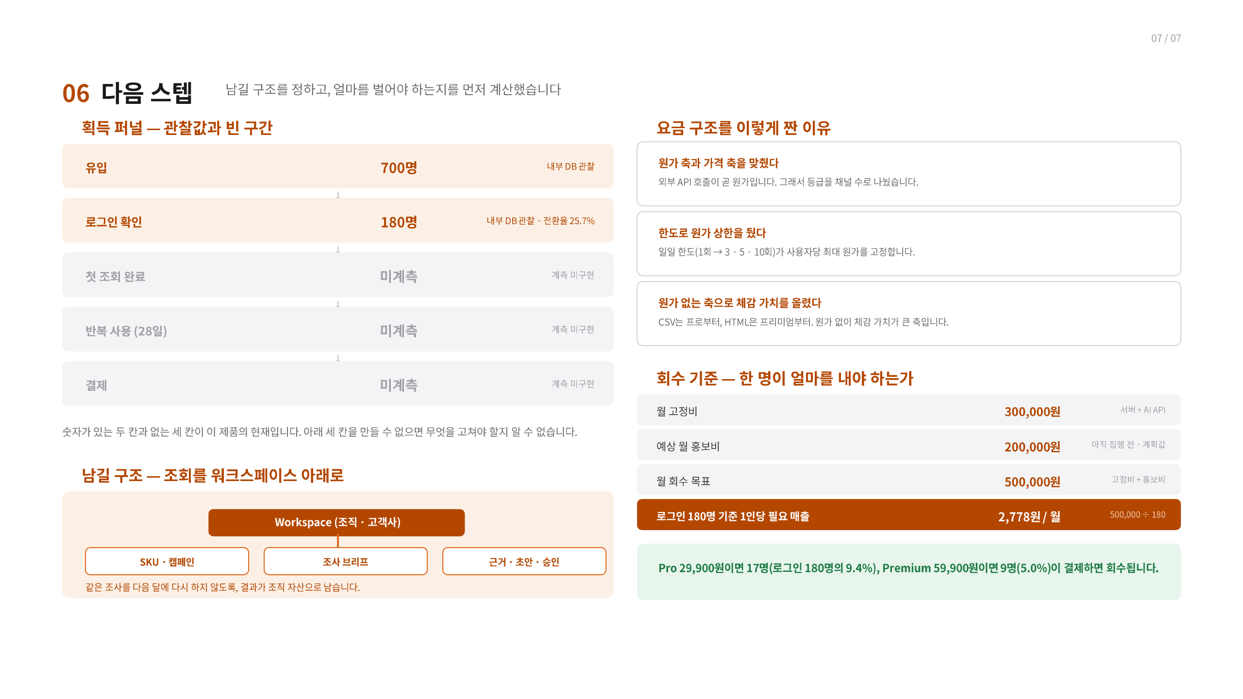
Notes:
[Sources]
- C:/MyMain/main/resume/박종혁_PM_포트폴리오.pdf, page 21, user-provided source, accessed 2026-08-28
[/Sources]

Slide 22
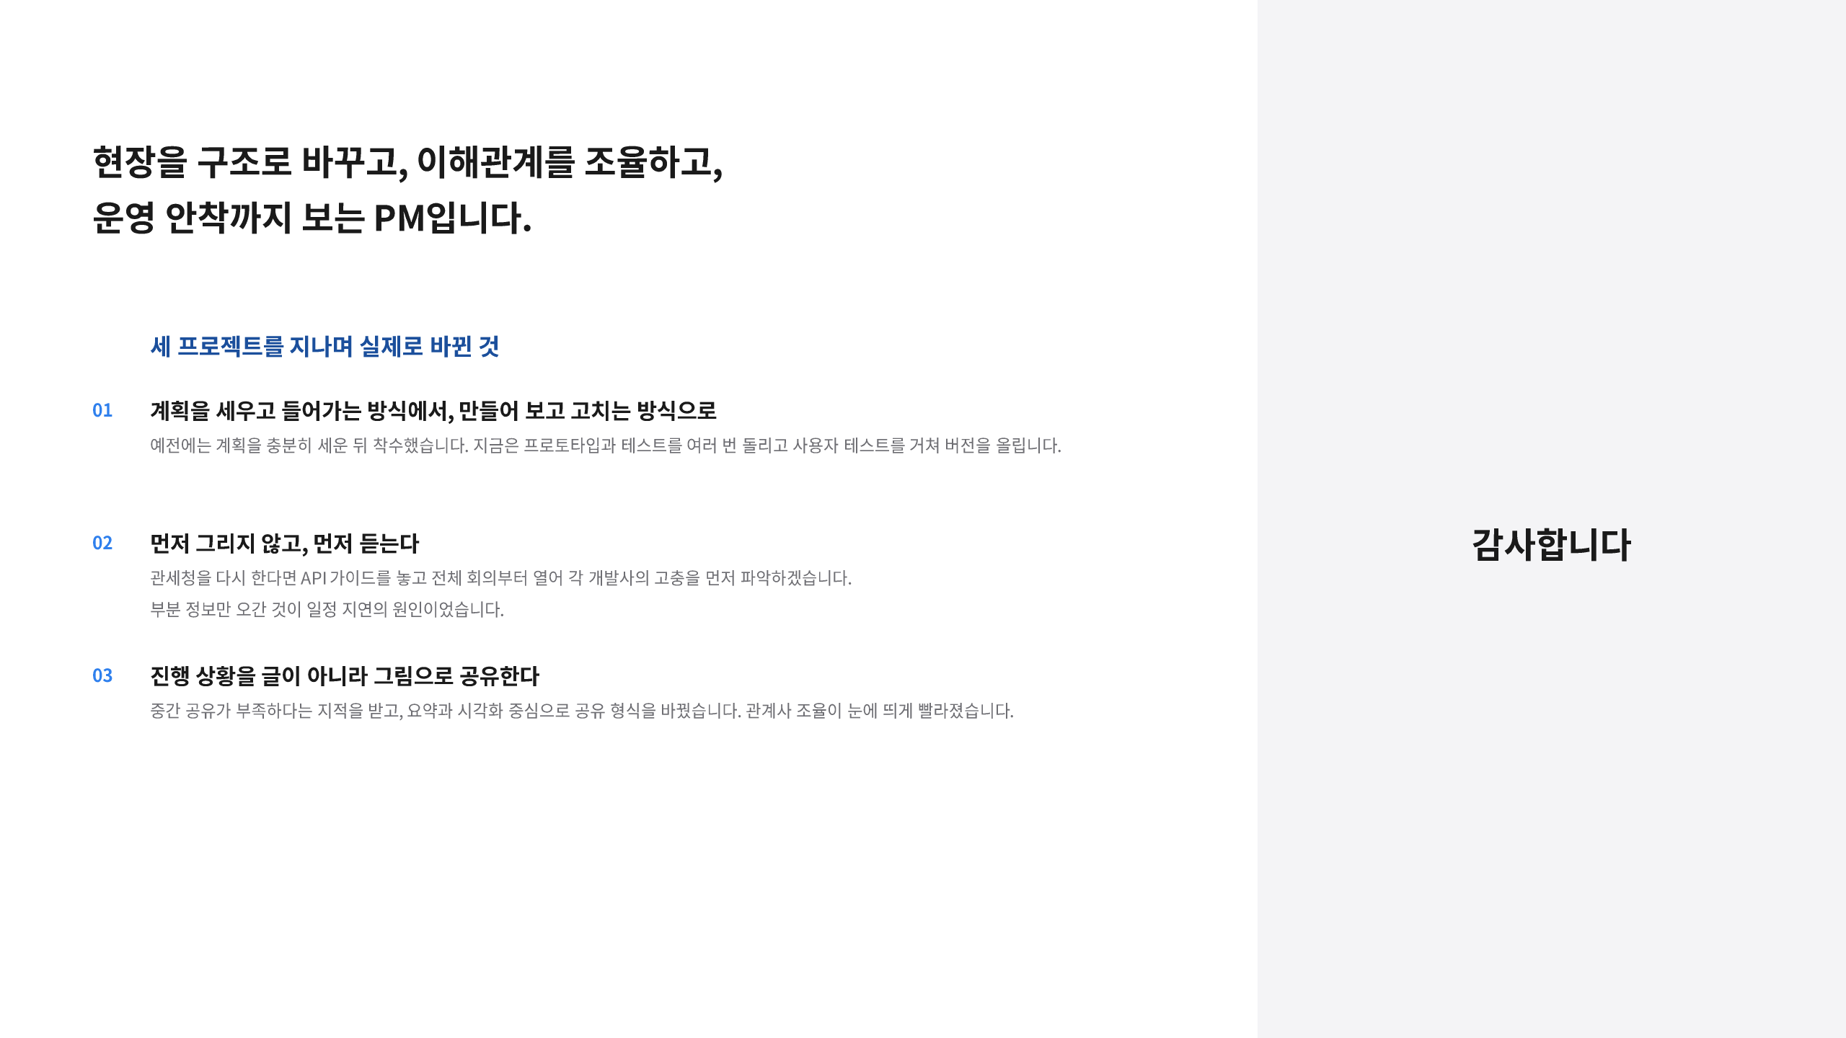
Notes:
[Sources]
- C:/MyMain/main/resume/박종혁_PM_포트폴리오.pdf, page 22, user-provided source, accessed 2026-08-28
[/Sources]

