Slide 1
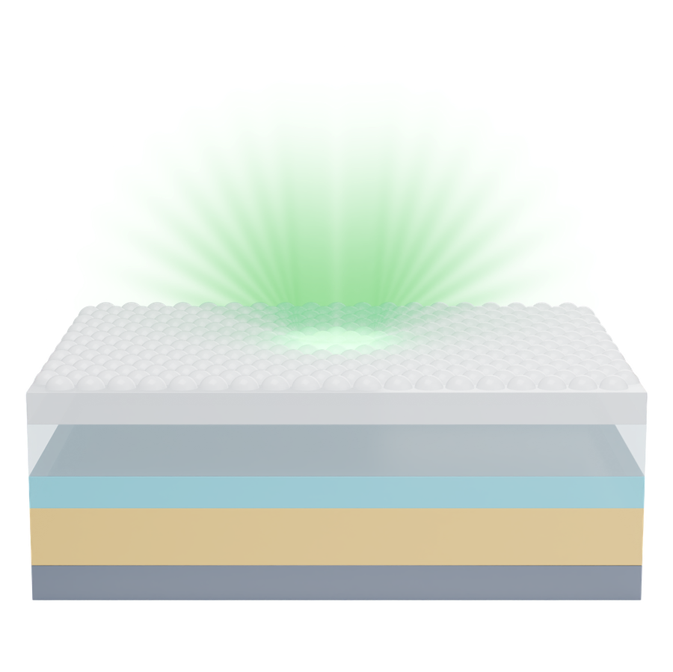
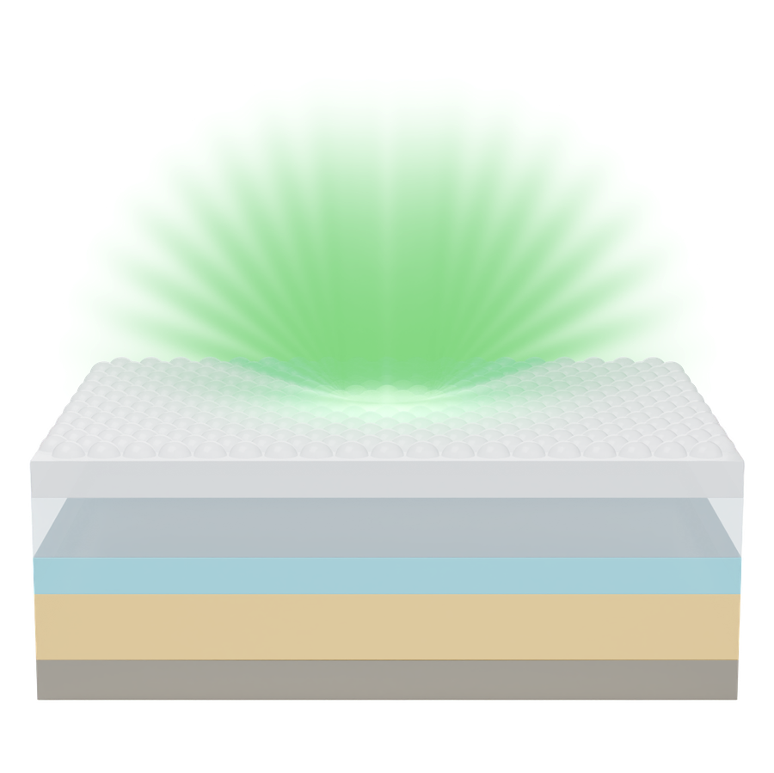
a
Outcoupling structure
Glass
Transparent conductive oxide (TCO)
Organic layer
Conventional metal electrode
Outcoupling structure
Glass
Low loss TCO
Organic layer
Low loss metal electrode
Light ray
Exciton emission
Absorption loss (Joule dissipation at the metal or absorption in the TCO)
b
c
1.0
1.0
0.4
0.8
0.8
0.3
A'
0.6
p = 0.6
Escaped per pass
p = 0.4
0.02
Cumulative extraction
Extraction efficiency (η_{sta})
0.2
0.10
0.6
0.15
0.4
A' = 0.15
Conventional
A' = 0.02
0.1
0.4
p = 0.4
Low loss
0.2
0.0
0.0
0.2
p = 0.25
0
1
2
3
4
5
6
7
8
9
10
0.0
0.2
0.4
0.6
0.8
1.0
Number of round trips
Round-trip reflectance, R_{LED} = 1 − A'

