Slide 1
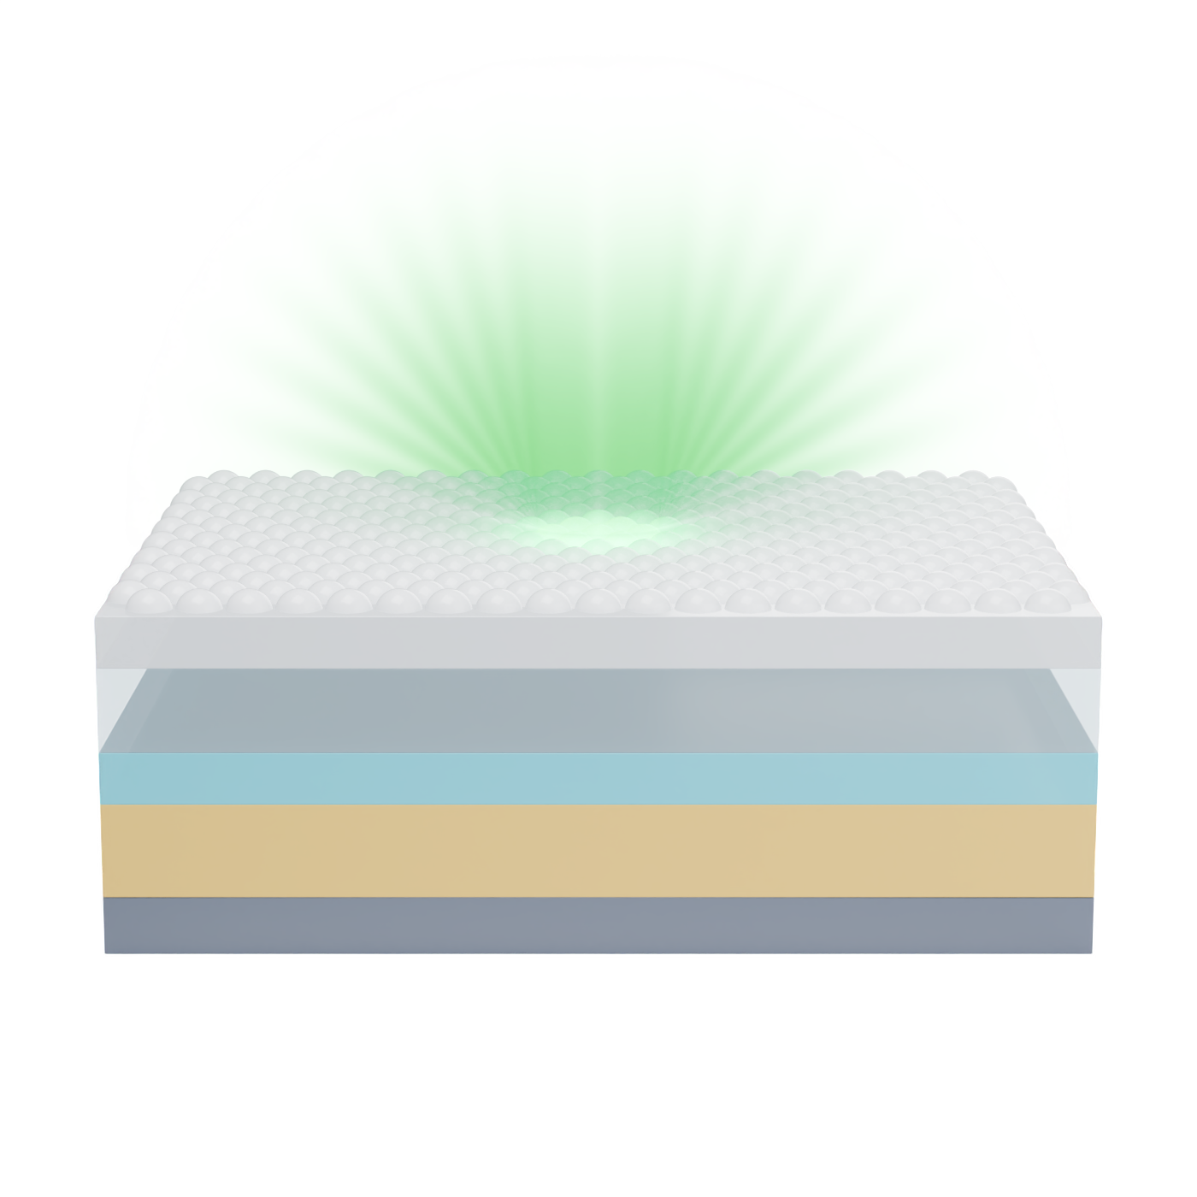
Outcoupling structure
Glass
Transparent conductive oxide (TCO)
Organic layer
Conventional metal electrode

Slide 2
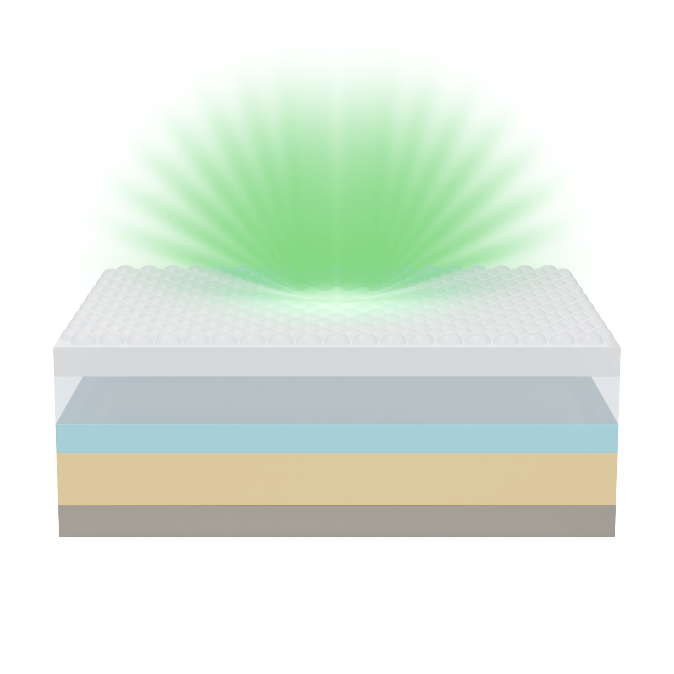
Outcoupling structure
Glass
Low loss TCO
Organic layer
Low loss metal electrode

