Slide 1




Displays without image distortion - Hybrid Auxetic Metamaterial Platforms
Kim, S.-B.†, Kim, J.† et al., Nature Communications 17, 7389 (2026) · doi:10.1038/s41467-026-74141-6 († equal contribution)
Junho Kim
(e-mail : junho.kim@uni-koeln.de / jhk4733@gmail.com)

Slide 2
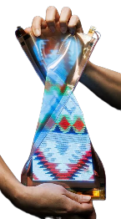

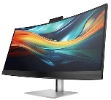
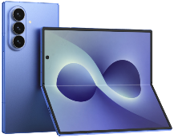

Display form factor
Stretchable
Flat
Curved (2013)
Rollable (2020~)
Flexible (2013~)
Foldable (2019~)
Product images: manufacturers' press materials

Slide 3
Stretchable display

Slide 4
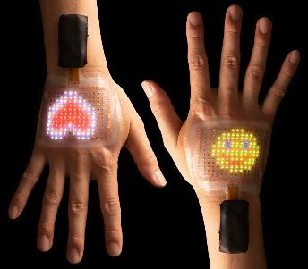
Stretchable electronics applications
Soft robotics
Wearable / Skin display
Bioelectronics
Interactive surface
IEEE Spectrum, vol. 58, no. 6, pp. 38-43, June 2021

Slide 5
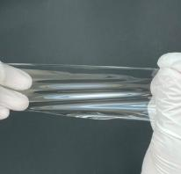
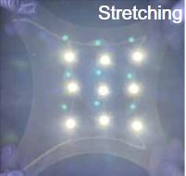
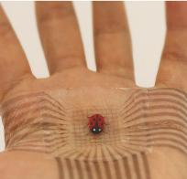

Introduction
Substrate of stretchable electronics
Poisson’s ratio
PDMS
Ecoflex
Poisson’s ratio (ν)
$$v=−\frac{dεtrans}{dεaxial}=−\frac{dεy}{dεx}$$
ε_{axial}
y
x
ε_{trans}
SEBS
Poisson’s ratio of material
Rubber | 0.5 | PET | 0.43
PDMS | 0.45~0.5 | Glass | 0.18~0.3
Gold | 0.42 | Foam | 0.1~0.5
Copper | 0.33 | Ice | 0.33

Slide 6
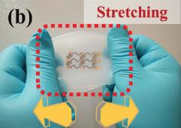
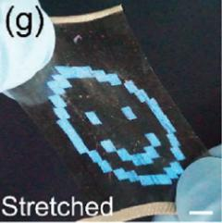
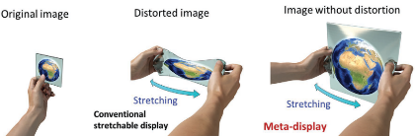
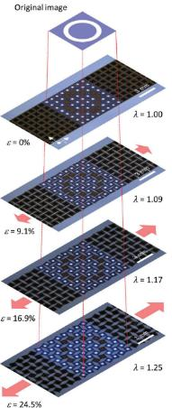
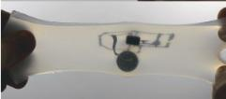
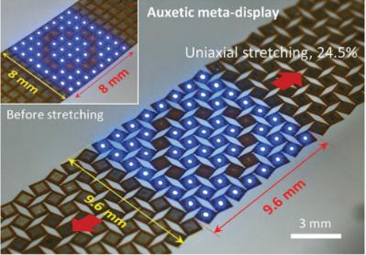
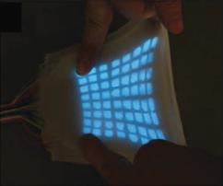
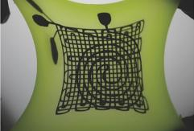
Research issues in stretchable displays
[1]
[2]
[5]
[3]
[4]
Using intrinsically stretchable materials as a substrate, image distortion is unavoidable.
Although a LED with a stretchable auxetic structure was implemented, substrate selection options were limited and the distortion-free area was restricted.
[1] A kirigami-inspired island-chain design for wearable moistureproof perovskite solar cells with high stretchability and performance stability†
[4] Highly stretchableelectroluminescent skin for opticalsignaling and tactile sensing
[3] 3D-Printed Liquid Metal Interconnects for Stretchable Electronics
[2] Shi, Xiang, et al. "A self-healing and stretchable light-emitting device." Journal of Materials Chemistry C 6.47 (2018): 12774-12780.
[5] Muth, J.T.; Vogt, D.M.; Truby, R.L.; Mengüç, Y.; Kolesky, D.B.;Wood, R.J.; Lewis, J.A. Embedded 3D printing of strain sensors
within highly stretchable elastomers. Adv. Mater. 2014, 26, 6307–6312. [CrossRef] [PubMed]

Slide 7
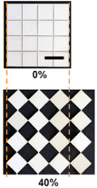
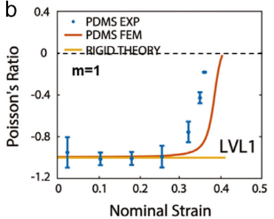
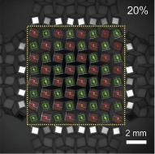
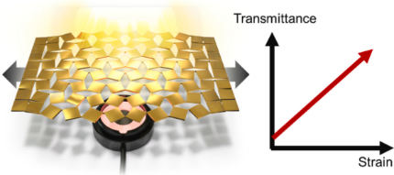
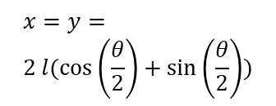

Utilization of auxetic structures
Auxetics are structures for materials that have a negative Poisson’s ratio. When stretched, they become thicker perpendicular to the applied force
Various auxetic structures
dy
from wikimedia
dx
$$x=y= \\ 2 l(\cos\left(\frac{θ}{2}\right)+\sin\left(\frac{θ}{2}\right))$$
θ
l
θ +dθ
$$v=−\frac{dy}{dx}=−1$$
(ideal, rigid theory)
Re-entrant type, honeycomb
Chiral type, tetrachiral
Rotating unit type, square
Mechanical characteristics of rotating square unit
Extrem. Mech. Lett. 2017, 12, 77–85
Adv. Funct. Mater. 2022, 32 (22), 2113299.
Nano Energy 2021, 89 (Part B), 106447.

Slide 8
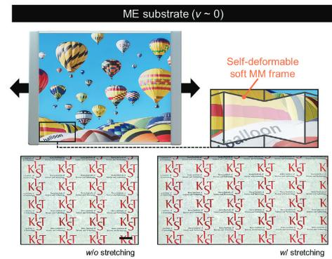
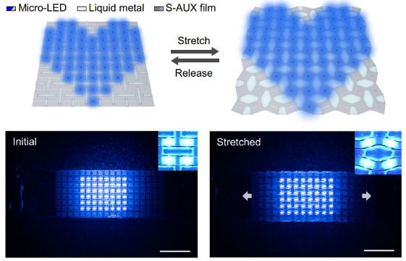
Recent research & limitations
Bidirectional auxetic substrate with Poisson’s ratio of 0
Auxetic substrate with Poisson’s ratio of -1
Adv. Funct. Mater. 2024, 34, 2406725
Nat Commun 15, 7146 (2024)
Even an ideal ν = 0 does not preserve the aspect ratio — the stretched axis still elongates the image by (1+ε); only ν = −1 preserves it.
In practice the Poisson's ratio is not exactly zero, and local non-uniformity induces additional image distortion inside the substrate.
Promising, but distortion-free behavior is limited to the centers of the rotating squares — the rest of the substrate is still distorted.

Slide 9

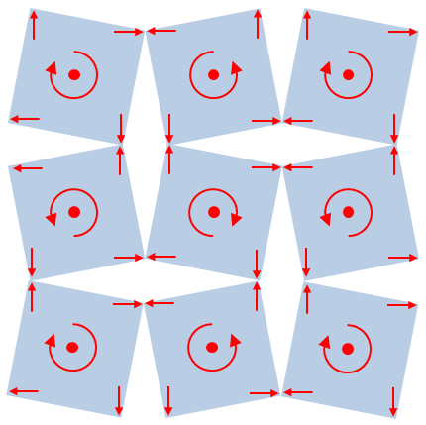
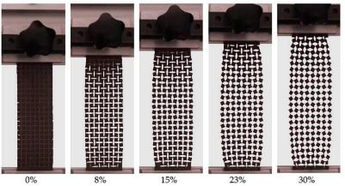

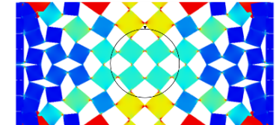
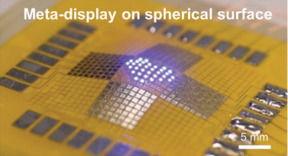
Limitations of rotating square based auxetic structures
Uniaxial strain applied to rotating square unit
F”_{handle}
F’_{handle}
Von Mises Stress (N/m²)
: Detector area
F_{handle}
Polymers (Basel). 2019, 11 (6).
Nano Energy 2021, 89 (Part B), 106447.
The handles suppress the rotation of nearby squares: rotation is reduced near the handles and only gradually recovers toward the interior — spatial uniformity is inherently limited.
A_{active}/A_{total} ~12%
A_{active}
To prevent image distortion in LED applications, it's crucial to ensure not only a simple strain uniformity but also an effective area where uniformity is maintained.
A_{total}

Slide 10
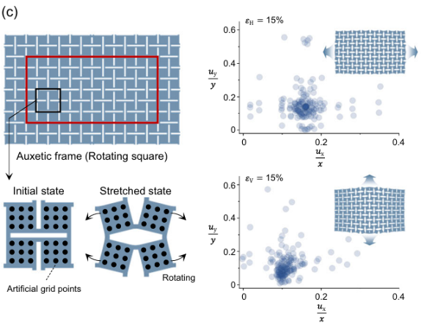
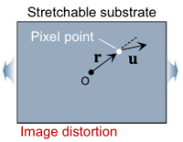
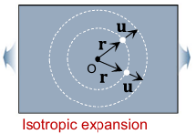
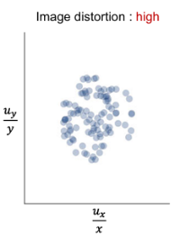
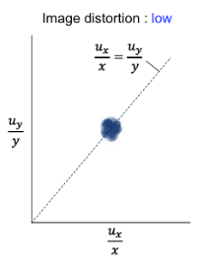
Isotropic expansion
The rotation-based unit-cell kinematics are not locally isotropic — even when the outer boundary exhibits ν = −1, interior points expand anisotropically. Gripping parts add further non-uniformity, addressed separately in the framework optimization.

Slide 11
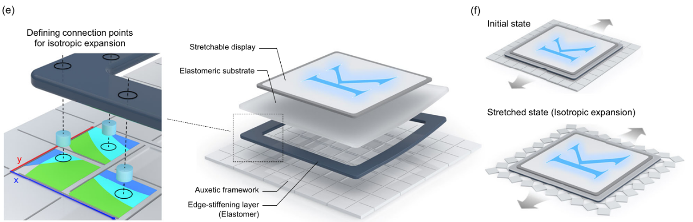
Hybrid auxetic metamaterial platform
Optimized auxetic framework
Defining optimized connection points

Slide 12
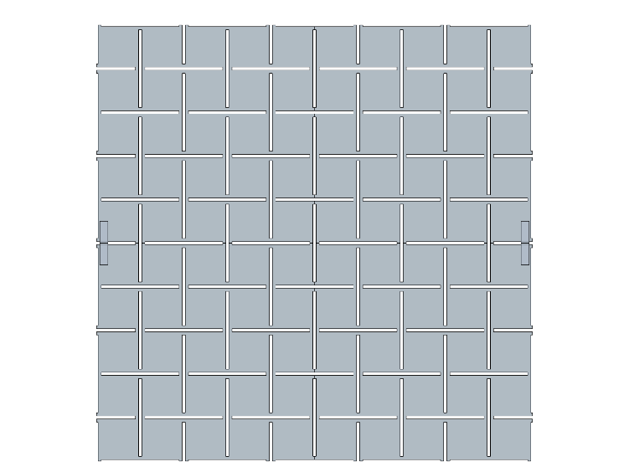
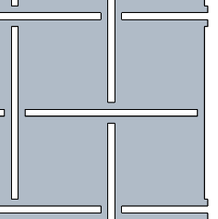





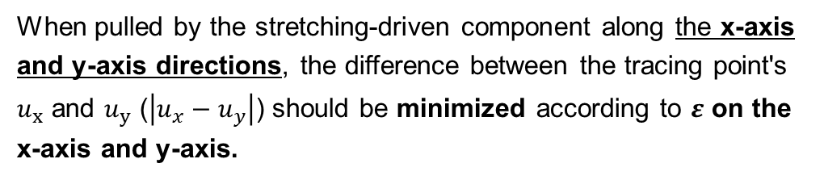

Simulation model of auxetic framework
$$u_{y}$$
$$D$$
$$W$$
Tracing points (a, b)
$$u_{x}$$
$$ε$$
$$L$$
Stretching-driven component
Two tracing points a, b are placed where the k-value (k = u·r/|r|²) is most affected by the grips. For each uniaxial stretching direction (horizontal / vertical), Δk_ab(ε) = |k_a − k_b| is evaluated over ε = 0–15%, and the geometry (W, L, D) is chosen to minimize S = max(Γ_H, Γ_V). [Nat. Commun. 17, 7389, Eq. 2–3]

Slide 13
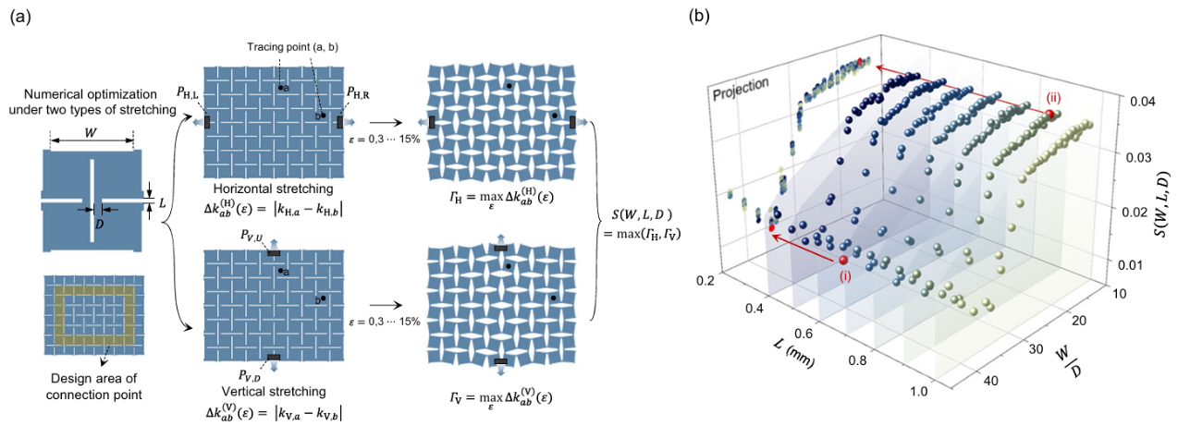
Optimization of the auxetic frameworks
(i) Best case / (ii) Worst case

Slide 14
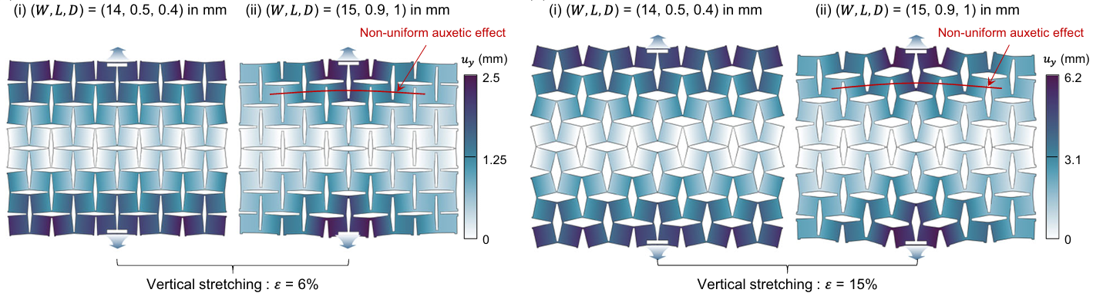
Uniform auxetic effect — best case (i) vs worst case (ii)

Slide 15
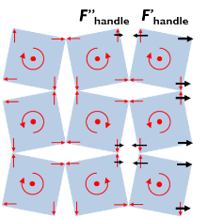
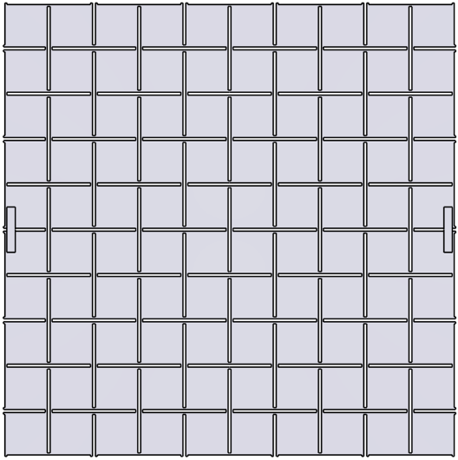



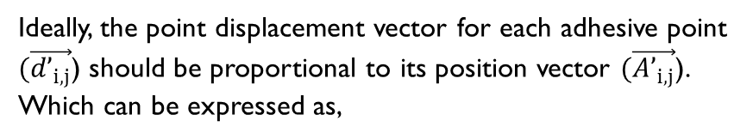


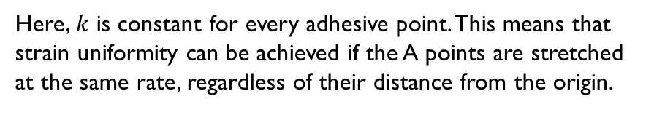
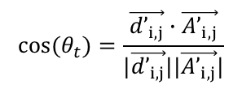
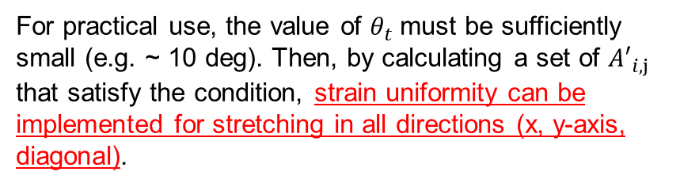


Determination of adhesive point position
Displacement vector for uniform strain
Point displacement vector
$$\vec{{d’}_{i,j}}$$
$$\vec{{A’}_{i,j}}$$
Position vector
$${A′}_{i,1}=\left({x^{′}}_{i,1}+∆{x′}_{i,1}, {y^{′}}_{i,1}+∆{y′}_{i,1}\right)$$
$θ_{t}$
Ideally, the point displacement vector for each adhesive point $(\vec{{d’}_{i,j}}$) should be proportional to its position vector $(\vec{{A’}_{i,j}}$). Which can be expressed as,
$${A′}_{i,1}$$
$$\vec{{d’}_{i,j}}=k \vec{{A’}_{i,j}} (i=1…m, j=1…4)$$
$(k$ : Proportional constant)
Here, $k$ is constant for every adhesive point. This means that strain uniformity can be achieved if the A points are stretched at the same rate, regardless of their distance from the origin.
For practical use, the value of $θ_{t}$ must be sufficiently small (e.g. ~ 10 deg). Then, by calculating a set of ${A′}_{i,j}$ that satisfy the condition, isotropic expansion can be implemented for stretching along both the x- and y-axes (diagonal: extension beyond the published paper).
$$\cos{(θ_{t})=\frac{\vec{{d’}_{i,j}}∙\vec{{A’}_{i,j}}}{|\vec{{d’}_{i,j}}||\vec{{A’}_{i,j}}|}}$$
For pratical use (handle)

Slide 16
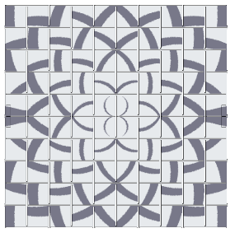
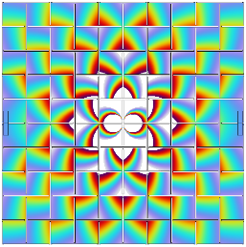
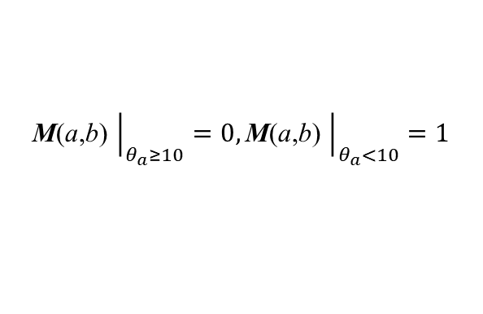
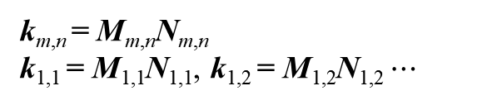

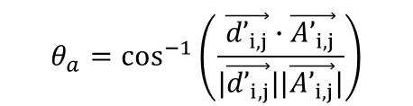



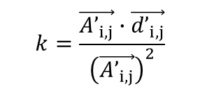

Defining a position of adhesive point in matrix region
$$ε_{x}=15\%$$
$$θ_{a}=\cos^{−1}\left(\frac{\vec{{d’}_{i,j}}∙\vec{{A’}_{i,j}}}{|\vec{{d’}_{i,j}}||\vec{{A’}_{i,j}}|}\right)$$
$$\vec{{d’}_{i,j}}=k \vec{{A’}_{i,j}} (i=1…m, j=1…4)$$
$$k=\frac{\vec{{A’}_{i,j}}∙\vec{{d’}_{i,j}}}{{\left(\vec{{A’}_{i,j}}\right)}^{2}}$$
$θ_{a}<10°$ → Region at x-y space
$$k$$
0.25
0.12
0
Binary spatial distribution: M(x,y)
Spatial distribution matrix : N(x,y)
$${\left.\text{M}\text{(}\text{a}\text{,}\text{b}\text{)} \right|}_{θ_{a}≥10}=0,{\left.\text{M}\text{(}\text{a}\text{,}\text{b}\text{)} \right|}_{θ_{a}<10}=1$$
k_{m,n} = M_{m,n}N_{m,n}
k_{1,1} = M_{1,1}N_{1,1}, k_{1,2} = M_{1,2}N_{1,2} $⋯$
$θ_{a}$ : Angular separation between $\vec{{d’}_{i,j}}$ and $\vec{{A’}_{i,j}}$
Published notation: Mᵢⱼ = 𝟏[α < 10°], Nᵢⱼ = u·r/|r|, Kᵢⱼ = MᵢⱼNᵢⱼ — paper evaluates Kᴴ at ε = 3% (worst case, H) and Kᵛ at ε = 15%.

Slide 17
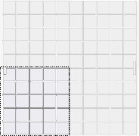









Defining the adhesion point using our fundamental basis
$$ε_{x}=15\%$$
Possible zone for adhesive point sets
$$\cos{(θ_{dis})=\frac{\vec{{d’}_{i,j}}∙\vec{{A’}_{i,j}}}{|\vec{{d’}_{i,j}}||\vec{{A’}_{i,j}}|}}$$
$$\vec{{d’}_{i,j}}=k_{x}\vec{{A’}_{i,j}} \\ \left(i=1…m, j=1…4\right))$$
x-direction
$θ_{a}<10°$, where
$$k_{x} \left(x_{1},y_{1}\right)=k_{x} \left(x_{2},y_{2}\right)=k_{x} \left(x_{3},y_{3}\right)⋯=k_{x} \left(x_{7},y_{7}\right)$$
1
Center
y-direction
$$k_{x}$$
0.25
2
$$k_{y}\left(x_{1},y_{1}\right)=k_{y}\left(x_{2},y_{2}\right)=k_{y}\left(x_{3},y_{3}\right)⋯=k_{y}\left(x_{7},y_{7}\right)$$
$$k_{x} \left(x_{7},y_{7}\right)$$
3
4
5
6
7
$k_{x} \left(x_{m},y_{m}\right)$, $k_{y}\left(x_{m},y_{m}\right)$at the same position are superposed into a single map using both data sets, and the common valid region is identified as candidate anchor sites.
y
0.12
z
●
x
1 cm
Published pipeline: Kᴴ at ε = 3%, Kᵛ at ε = 15% → superposition → 10% tolerance (next slide).
Notes:
같은 위치에서 3개의 값은 다른 데이터로 구분되어 합쳐져야 하고, 합쳐진 결과는 가시적으로 보여져야 한다.

Slide 18

Optimized connection points

Slide 19

Isotropic expansion factor

Slide 20



FEA vs DIC: u = k·r realized — isotropic expansion with ρ ≈ 0.99
Digital image correlation (DIC) analysis
DIC matches FEA: on the proposed platform |u| grows linearly with |r| in all directions (u = k·r), unlike the fully bonded case. Right (Fig. 4b): isotropic expansion factor ρ ≈ 0.99 for the proposed platform vs ≈ 0.95 fully bonded, consistently over ε = 3–15%.

Slide 21




Image distortion analysis
Conventional scheme (Fully bonded)
DIC measurement
Stretched (ε=15%)
Tensile strain
Initial state (ε=0%)
Proposed scheme
Tensile property measurements
Initial state (ε=0%)
Stretched (ε=15%)

Slide 22






LED demo: distortion-free operation under stretching
Initial state (ε = 0%, emission)
Initial state (ε = 0%, ambient)
Stretched (ε = 18%)
10 × 8 array
10 × 10 array
Extended demonstration beyond the published paper (paper: 7 × 5 array and 10 × 10 passive-matrix array, ε up to 15–20%; <2% luminance drop after 500 stretch cycles at 15%).

Slide 23
Summary
Stretchable is the first form factor in which the screen area itself grows
Image distortion becomes a first-order problem: an elastomer (ν ≈ +0.5) skews the aspect ratio by ~1.24× at 15% strain — and a global ν = −1 alone does not guarantee local isotropy (rotation-based kinematics, gripping effects).
1
Hybrid auxetic platform: grip-aware framework design + selective bonding
Optimize the framework with the grips inside the objective, S(W, L, D) = max(Γ_H, Γ_V) → W/D ≈ 35; then bond the continuous elastomer only where u = k·r holds (superposed Kᴴ/Kᵛ maps, 10% tolerance).
2
Isotropic expansion factor ρ quantifies image distortion field-wide
ρ = Cov(R, U)/σ_R·σ_U; the proposed platform sustains ρ ≈ 0.99 (DIC, ε = 3–15%) vs ≈ 0.95 fully bonded, and LED arrays operate distortion-free up to 20% strain.
3
Kim, S.-B., Kim, J. et al. Hybrid auxetic metamaterial platforms enabling multiscale isotropic expansion for distortion-free stretchable displays. Nat. Commun. 17, 7389 (2026).

Slide 24
Thank you

Slide 25











Experimental steps : Rotating square auxetic framework
Fabrication process
1. SAM treatment on 3D-printed mold
2. Pouring of Dragon-skin10 onto the mold
3. Delamination of Dragon-skin soft mold
4. SAM treatment on Dragon-skin soft mold
Scraper
8. Free standing auxetic frameworks
7. Delamination of Dragon-skin soft mold
6. Scraping out the residual Smooth-cast to form flat surface
5. Pouring of Smooth-cast 61D onto the Dragon-skin soft mold
Auxetic framework geometry
Master mold
Soft mold
Rotating square

Slide 26













Experimental steps : Band/Substrate/Adhesive
Form-preserving component fabrication
Band
1. Pouring of Dragon-skin onto petri dish
2. Degassing & curing at RT overnight
3. Cutting through Band-shape mold
4. Delamination of band from the petri dish
Band-substrate structure
1. Spin-coating of substrate material
2. Putting the band onto the surface of uncured substrate
3. After curing at RT overnight, cutting the outside of the band
4. Delamination of band-substrate structure
Silicone adhesive masking
FP-coated metal mask
Silicone adhesive
1. Alignment of FP-coated metal mask onto the auxetic framework
2. Coating of silicone adhesive onto the hole of the metal mask
3. Scraping the residual adhesive & lifting the metal mask
4. Alignment of band-substrate structure onto the uncured silcone adhesive

Slide 27

Simulation results analyzed by algorithm (D variation)
D = 0.4 mm
$$Max\{Γ_{α,i},Γ_{β,i},Γ_{γ,i}\}$$
D = 0.6 mm
$$Max\{Γ_{α,i},Γ_{β,i},Γ_{γ,i}\}$$
0.86
1.6
L (mm)
L (mm)
0.67
1.2
0.48
0.8
W (mm)
W (mm)
D = 0.8 mm
$$Max\{Γ_{α,i},Γ_{β,i},Γ_{γ,i}\}$$
D = 1.0 mm
$$Max\{Γ_{α,i},Γ_{β,i},Γ_{γ,i}\}$$
2.4
3.0
L (mm)
1.2
L (mm)
2.8
1.6
2.4
W (mm)
W (mm)

Slide 28
Simulation results analyzed by algorithm (L variation)
L = 0.4 mm
$$Max\{Γ_{α,i},Γ_{β,i},Γ_{γ,i}\}$$
L = 0.6 mm
$$Max\{Γ_{α,i},Γ_{β,i},Γ_{γ,i}\}$$
2.88
2.96
D(mm)
D (mm)
1.7
1.74
0.47
0.51
W (mm)
W (mm)
L = 0.8 mm
$$Max\{Γ_{α,i},Γ_{β,i},Γ_{γ,i}\}$$
L = 1.0 mm
$$Max\{Γ_{α,i},Γ_{β,i},Γ_{γ,i}\}$$
3.03
3.07
D (mm)
1.79
D (mm)
1.83
0.55
0.59
W (mm)
W (mm)

Slide 29







Mechanically engineered adhesive position
Strain distribution (Fixed point)
Adhesive point engineering (Biaxial strain)
|ε | (%)
ε_{trans}
y
400
θ_{FP}
300
x
200
ε_{axial}
ε_{axial}
100
y
ε_{trans}
0
z
x
2 mm
●
y
w/o fixed points
w/o fixed points
ν at (0,0,0)
ν at (0,0,0)
To obtain a Poisson's ratio of -1, an adhesive point should be perpendicular to its symmetric point. (θ_{FP} = 0)
x
ε_{axial} = 20%
$$v=−\frac{dεtrans}{dεaxial}=−\frac{dεy}{dεx}$$
ε_{axial} =ε_{trans, y} = 20%

Slide 30







Initial concept: Strain transfer by low Young’s modulus substrate
Would it be possible to minimize the suppression of the torque of the rotating square if there is a significant difference in Young's modulus?
Auxetic + Elastomer
Elastomer only
In-plane displacement
($\sqrt{{(∆x)}^{2}+{(∆y)}^{2}}$ )
Elastomer (E=5kPa) (e.g. Silbione)
16 mm
12
8
4
Rotating square type auxetic struture (E=110MPa) (e.g. Smooth-cast 61D)
Exaggerated by 300% in the z-axis direction
y
0
z
x
●
2 cm
Assuming that Young's modulus of the substrate is very low, if the substrate is attached to the entire surface of the square island, it acts as a fixed point and inhibits rotation.
However, due to its uneven stretching from the origin, image distortion cannot be avoided.
Poisson’s ratio(ν ) ~ 1

Slide 31






Flow chart for simulation & experiment
Single elastomer (Fixed points/ Biaxial strain by $k_{1}, k_{2}, θ$)
Parameter optimization of auxtic structures in all directional stretching
Integration of simulation sets & determination of the adhesive position sets
Parameter optimization for entire structure in all directional stretching
Fabrication of auxetic framework
Material selection / mold design
Parameter measurement
Fabrication of band/substrate structure
Alignment of adhesive point
Adhesive force test for silicone adhesive & each interface
Mold design

