Slide 1
Empowering Small-Scale Farmers with Decentralized Finance (DeFi) via Ethereum Smart Contracts
Team Members
S. ROHIT SURYAA – RA2011027020052 S. SHARAN – RA2011027020060 J. JOVAN TITUS – RA2011027020035

Slide 2
Agenda
Abstract
Scope and Motivation
Introduction
Objective
Problem Statement
Proposed Work
Architecture Diagram/Flow Diagram/Block Diagram
Novel idea
Module & Description
Algorithm
Software & Hardware Requirements
Implementation (Complete Demo to be shown)
Results and Discussion
Conclusion
Future Work
Outcome

Slide 3
ABSTRACT
The agricultural sector, especially within small-scale farming, faces significant hurdles due to complex supply chains, fragmented information systems, and limited access to financial services. This study presents a novel framework leveraging decentralized finance (DeFi) and Ethereum smart contracts to empower small-scale farmers by enhancing supply chain transparency, traceability, and financial inclusivity. By implementing a decentralized ledger technology, our approach mitigates issues related to data opacity and inefficient stakeholder engagement, facilitating a seamless and transparent digital record of transactions, inputs, and product movements. Unlike conventional systems that depend on centralized financial intermediaries and data repositories, our DeFi model, enabled by Ethereum smart contracts, introduces an innovative mechanism for financial transactions, credit access, and equitable participation in the supply chain. Our findings indicate the potential of DeFi and intelligent contracts in transforming agricultural supply chains by offering small-scale farmers improved access to markets, financial services, and real-time data for decision-making. Challenges remain in technical implementation, farmer education, and adapting regulatory frameworks to accommodate these decentralized solutions. The study highlights the transformative potential of Ethereum smart contracts in reshaping the agricultural landscape and fostering greater efficiency, transparency, and financial empowerment for small-scale farmers.

Slide 4
Scope and Motivation
Supply chain management manages the total flow of a distribution channel from the supplier to the ultimate user. Although most of the new supply chain management systems are complex and expensive, they are considered one of the most essential elements for many disciplines of the economy. It works to handle the growing capacity and enhance the effectiveness of the product flow. A thriving global supply chain management hinges upon the cohesive and harmonized management of four main flows: product flow, processes, information, and cash. Moreover, it stops any possible threats and ensures industry alignment. This motivates us to develop this project.

Slide 5
Introduction
Empowering small-scale farmers with decentralized finance (DeFi) via Ethereum smart contracts revolutionizes the agricultural supply chain by addressing key challenges of communication, traceability, and quality assurance. By utilizing blockchain's transparent, immutable ledger, every product's journey from farm to consumer is securely traceable, enhancing product quality evaluation and supply chain transparency. This not only boosts consumer trust but also reduces management costs and improves information reliability. Ethereum smart contracts further streamline operations, making the supply chain more efficient and resilient, ultimately benefiting farmers and consumers alike by ensuring the integrity and safety of food products.

Slide 6
Objective
This project’s primary goal is to address and overcome the prevalent challenges faced by small-scale farmers within the agricultural supply chain, particularly those related to inefficiencies in traceability, transparency, and financial accessibility. By harnessing the potential of decentralized finance (DeFi) and Ethereum smart contracts, the initiative aims to foster a more efficient, transparent, and financially inclusive environment for small-scale farmers, thereby enhancing their productivity, profitability, and sustainability in the long term.

Slide 7
Problem Statement
Large-scale farmers are critically hindered by numerous obstacles affecting their operational efficiency and economic viability. Key issues include inadequate traceability mechanisms, which make it difficult to verify the origin and quality of agricultural products; a lack of transparency within the supply chain, leading to diminished consumer trust and market competitiveness; and limited access to financial services and credit, restricting the farmers' ability to invest in growth and improve their livelihoods. These challenges not only affect the farmers' ability to thrive but also impact the overall integrity and resilience of the food supply chain.

Slide 8
Proposed Work
The proposed project entails developing and deploying a comprehensive system based on Ethereum smart contracts and decentralized finance solutions explicitly tailored to the needs of small-scale farmers. This system will automate and secure transactions across the agricultural supply chain, from production to sale, ensuring traceability and transparency at every step. By recording every transaction on the Ethereum blockchain, the project guarantees the authenticity and quality of agricultural products, thereby rebuilding consumer trust and opening new market opportunities for farmers. Moreover, integrating DeFi into the farming sector will provide farmers with more direct and equitable access to financial services, including loans and credit, at more favorable terms than traditional banking systems. A pilot project will be conducted with a select group of small-scale farmers to test and refine the system, focusing on its capacity to improve supply chain management, enhance transparency, and boost financial access. This pilot's outcomes will inform the initiative's scaling and further development, with the ultimate aim of creating a more sustainable and equitable agricultural ecosystem.

Slide 9
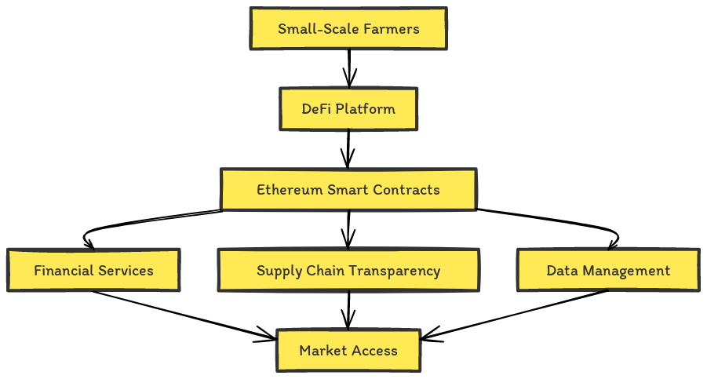
Proposed Work - Architecture

Slide 10
Proposed Work – Novel Idea
Blockchain technology heralds a new era for agriculture, offering unprecedented traceability that revolutionizes the industry. It enables precise tracking of agricultural products from their source to the consumer's table, ensuring every detail, including using fertilizers and pesticides, is meticulously recorded. This technological leap promises to enhance supply chain management with digital identities for products, thereby driving transparency and efficiency in community farming and reducing reliance on intermediaries. Although blockchain integration comes with initial costs, scalability, security concerns, and environmental impacts due to energy usage, innovative solutions like multi-chain structures and sophisticated consensus methods are being developed to mitigate these issues. These solutions aim to strike a balance between decentralization and the practical demands of operation. Furthermore, there is a global call to action for standardizing legal frameworks and fostering interoperability among various blockchain platforms, setting the stage for a sustainable, secure, and technologically empowered agricultural landscape.

Slide 11
Proposed Work – Module & Description
Our study designs a DeFi system using Ethereum's blockchain to elevate small-scale farming. The approach includes:
DeFi Client Interface: This user-friendly application allows farmers to manage transactions, secure loans, and handle payments. Activities are recorded on Ethereum for full network synchronization.
Smart Contract Deployment: Contracts on Ethereum manage financial operations like credit, direct payments, and insurance with transparent terms, ensuring clarity from start to finish.
Transaction Processing: Ethereum is utilized to securely and efficiently process financial activities, cutting operational costs and removing banking middlemen.
Supply Chain Integration: Smart contracts record the journey of produce from farm to consumer, logging inspections and quality measures, providing stakeholders with trusted data throughout the product's lifecycle.
The goal is to implement a DeFi framework that improves financial control and supply chain transparency for small-scale farmers, fostering empowerment and integrity within the agricultural sector.

Slide 12
Proposed Work – Algorithm
To empower small-scale farmers with decentralized finance (DeFi) via Ethereum smart contracts, you can follow these high-level steps:
Identify Farmer Needs: Understand the financial needs and challenges faced by small-scale farmers. This could include access to credit, insurance, transparent markets, and fair prices for their produce.
Design Smart Contracts: Develop Ethereum smart contracts tailored to meet the identified needs. This could involve creating contracts for lending, insurance, crop futures, or decentralized marketplaces.
Decentralized Lending: Implement smart contracts for decentralized lending platforms where farmers can borrow funds without the need for traditional financial intermediaries. These contracts can be designed to offer fair interest rates and collateral requirements.
Insurance Contracts: Create smart contracts for crop insurance to protect farmers against yield losses due to adverse weather conditions, pests, or other unforeseen events. These contracts can automatically trigger payouts when predefined conditions are met.
Tokenization of Assets: Tokenize agricultural assets such as land or crops to enable fractional ownership and investment. This can provide farmers with access to additional capital while allowing investors to diversify their portfolios.

Slide 13
Software & Hardware Requirements
Hardware Requirements:
Processor: At least an i3 Dual Core processor is required.
Connectivity: An Ethernet connection (LAN) or a wireless adapter (Wi-Fi) is necessary.
Storage: A minimum of 100 GB of hard drive space is required, with 200 GB or more recommended.
Memory (RAM): At least 8 GB of RAM is needed, though 32 GB or more is preferable.
Software Requirements:
Frontend Development: Utilize HTML5, CSS3, and JavaScript.
Backend Programming: Python is essential.
Development Environment: PyCharm IDE is recommended.
Web Development: Flask framework should be used.
Blockchain Deployment: Ganache is required.
Bridging Python and Ganache: Web3.py facilitates the connection.

Slide 14
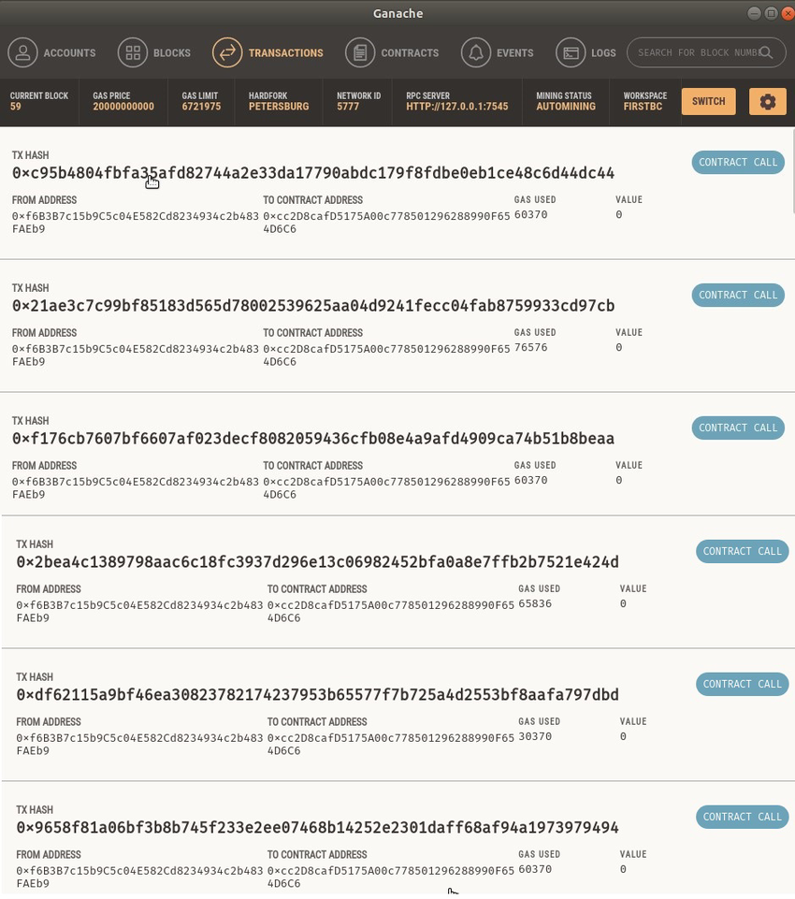
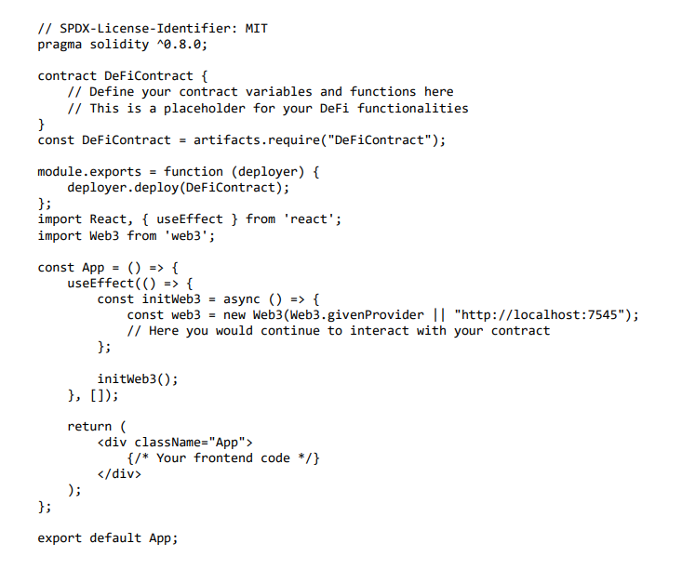
Implementation

Slide 15
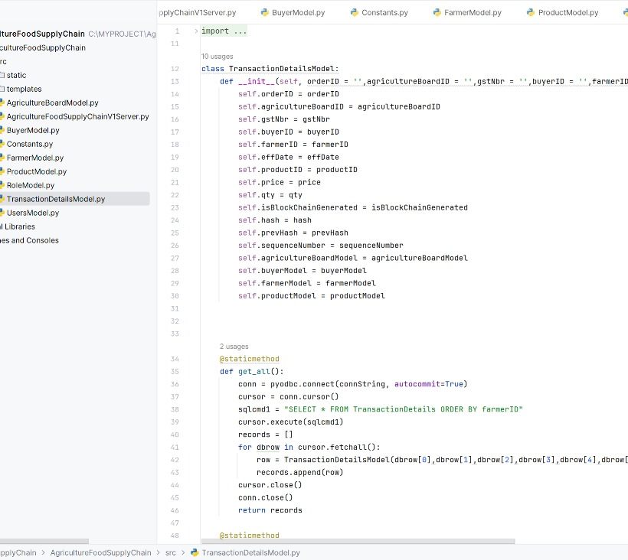
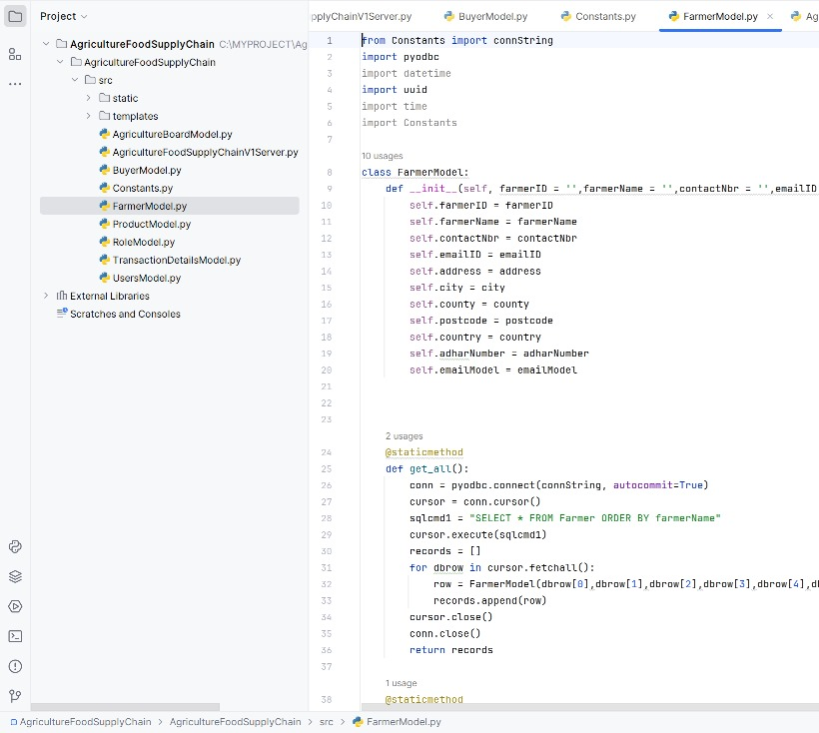
Implementation

Slide 16
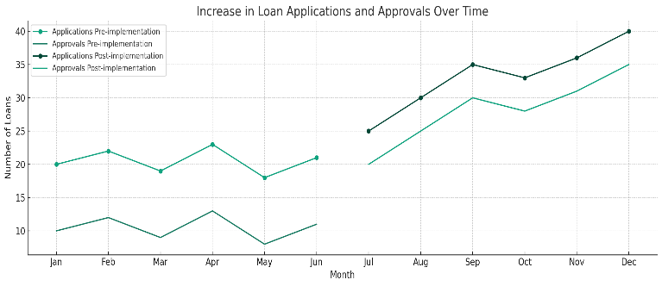
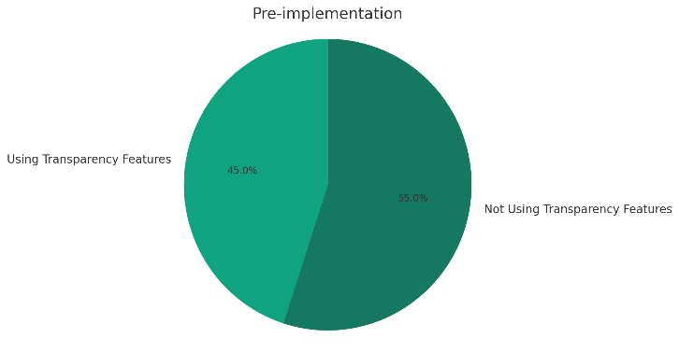
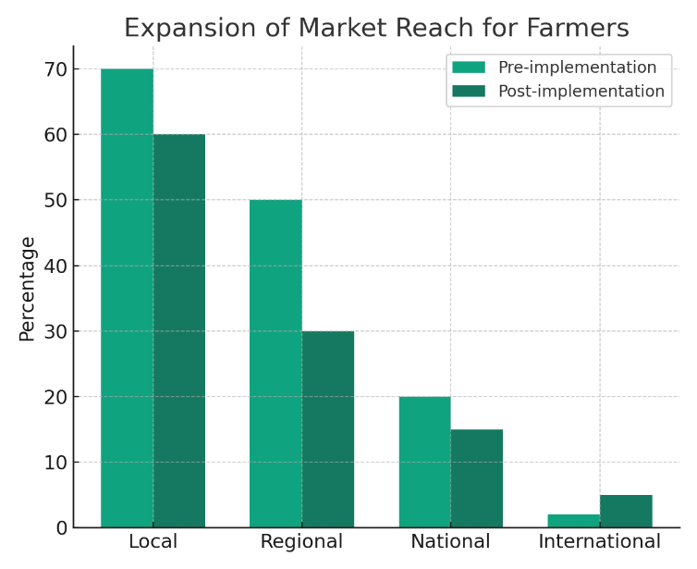
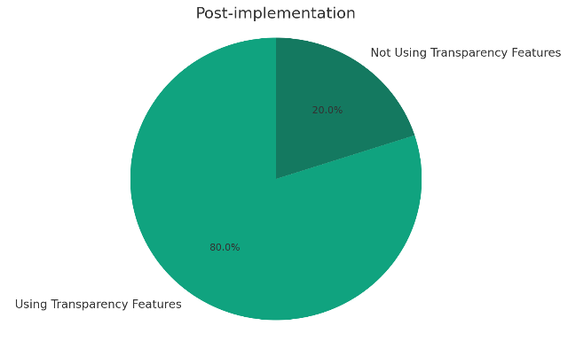
Results & Discussion

Slide 17
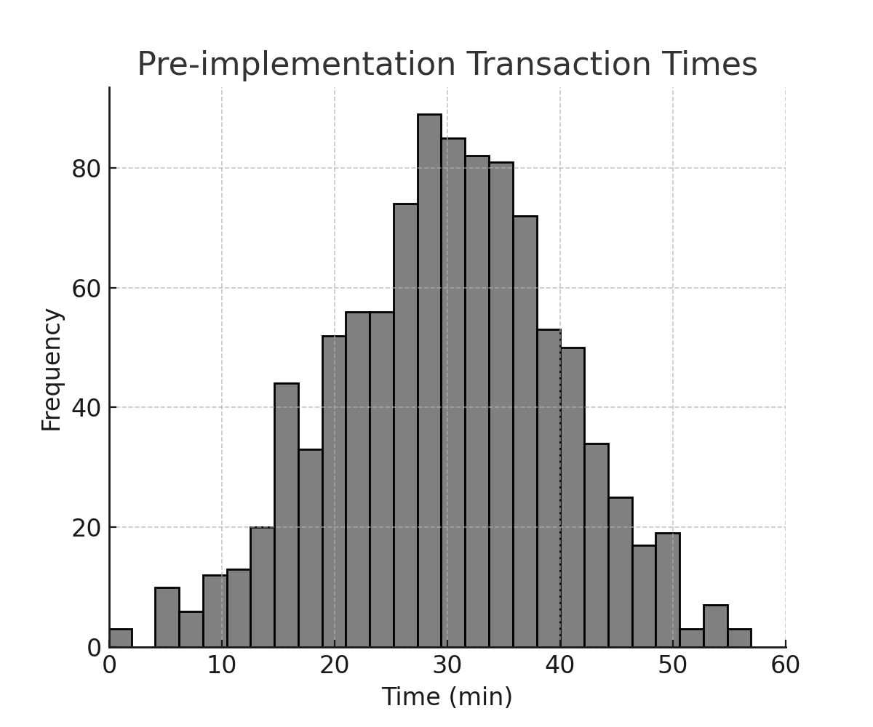
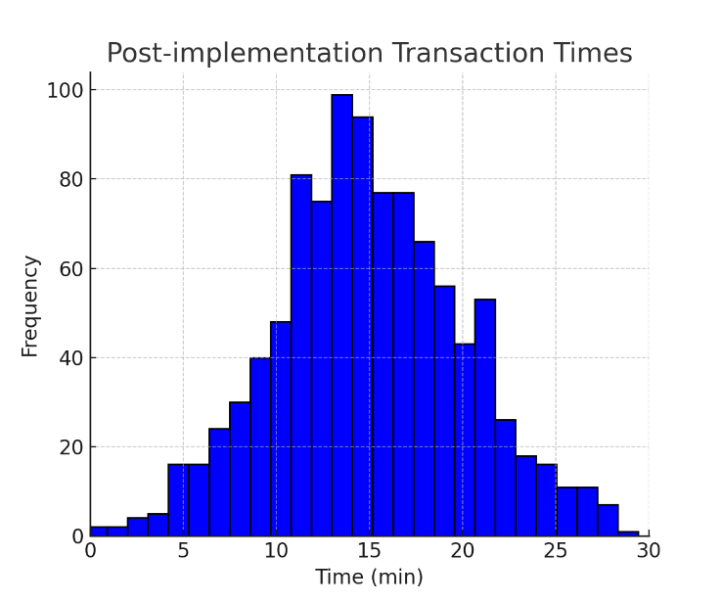
Results & Discussion

Slide 18
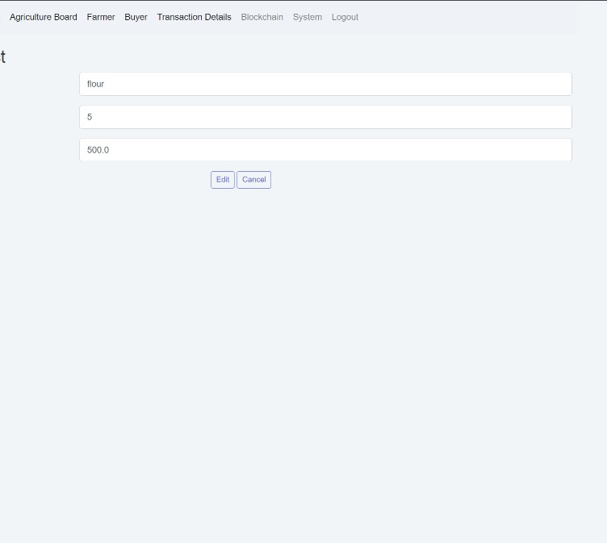
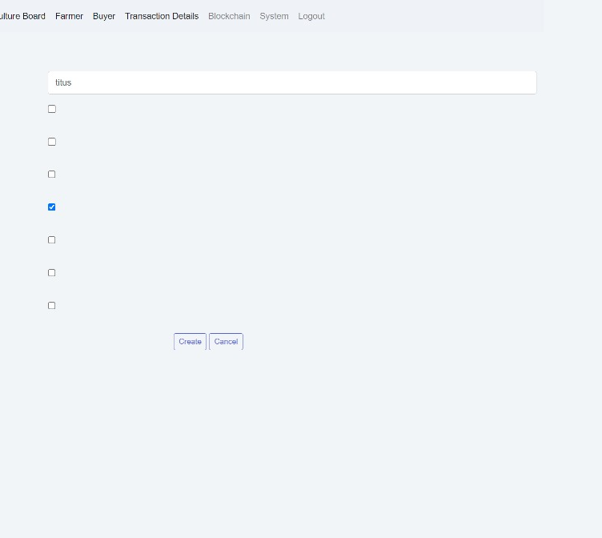
Results & Discussion

Slide 19
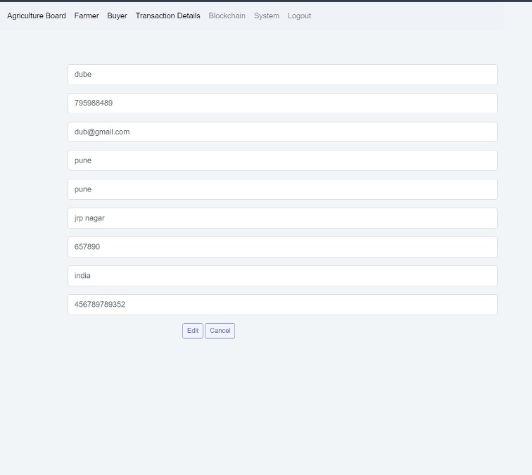
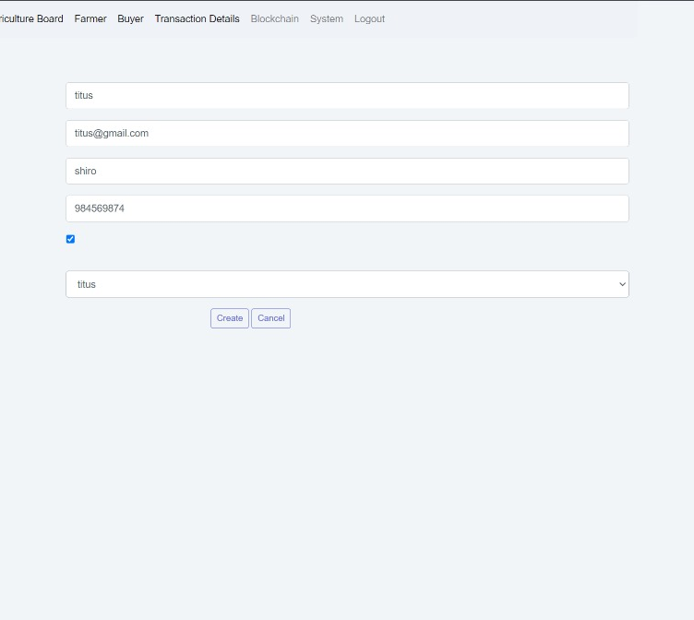
Results & Discussion

Slide 20
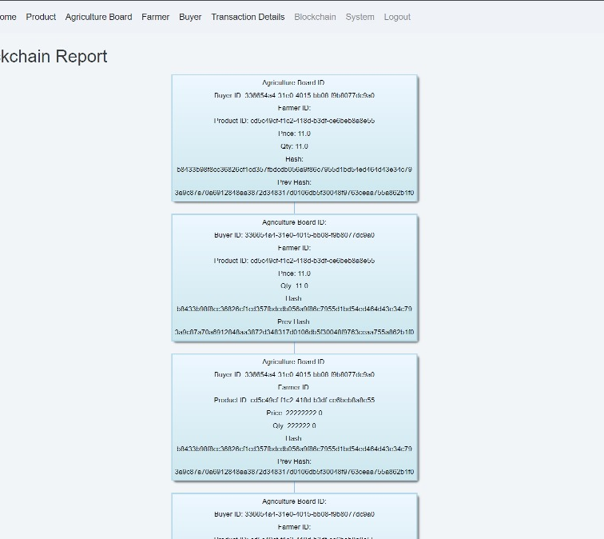
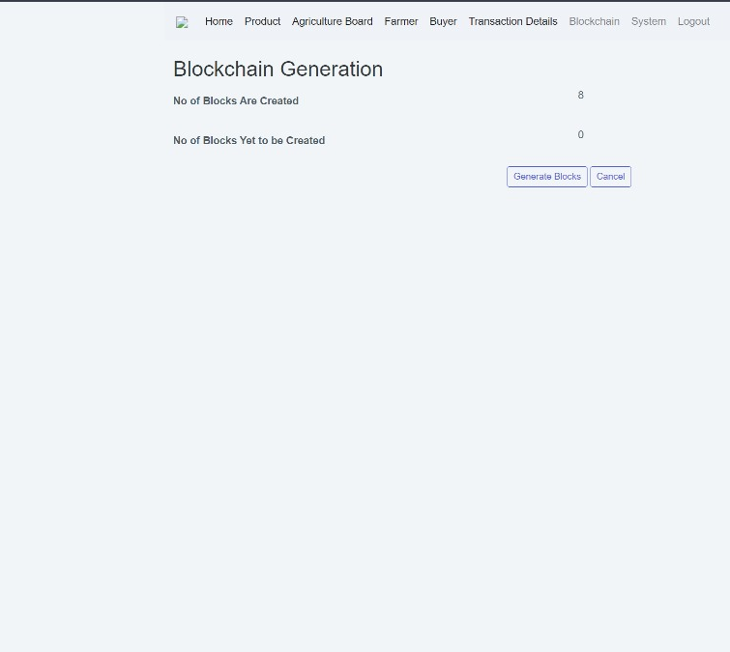
Results & Discussion

Slide 21
Conclusion
Small-scale farmers can gain unprecedented access to financial services and markets by harnessing decentralized finance (DeFi) through Ethereum intelligent contracts. By addressing key challenges like credit accessibility and market transparency, DeFi solutions empower farmers to secure loans, obtain crop insurance, tokenize assets, and participate in decentralized marketplaces. These smart contracts facilitate direct peer-to-peer interactions, eliminating the need for intermediaries and ensuring fair and efficient transactions. Integration with decentralized oracles guarantees real-world data reliability, further enhancing these systems' trustworthiness. Farmers can readily adopt and leverage DeFi tools through user-friendly interfaces and community engagement initiatives to improve their financial resilience and prosperity. However, ongoing security, auditing, and education efforts are paramount to mitigating risks and building confidence in these innovative solutions. Ultimately, DeFi via Ethereum smart contracts has the potential to revolutionize small-scale farming, promoting greater inclusivity, efficiency, and sustainability in agricultural ecosystems worldwide.

Slide 22
Future Work
Future work in empowering small-scale farmers with decentralized finance (DeFi) via Ethereum smart contracts should focus on several key areas:
Scalability and Efficiency: Enhance the scalability and efficiency of Ethereum and DeFi protocols to accommodate a larger volume of transactions and users without compromising speed or cost-effectiveness.
Interoperability: Explore interoperability solutions to facilitate seamless interaction between different blockchain networks and DeFi platforms, enabling farmers to access a wider range of financial services and markets.
Risk Management: Develop sophisticated risk management tools and mechanisms within smart contracts to help farmers mitigate risks associated with price volatility, weather-related events, and other uncertainties inherent in agricultural production.
Tokenization of Agricultural Assets: Expand the tokenization of agricultural assets beyond land and crops to include livestock, machinery, and other farm-related assets, unlocking additional liquidity and investment opportunities for farmers.

Slide 23
Outcome
We have been working on forging a more efficient, traceable, and transparent food supply chain in agriculture by applying Ethereum smart contracts. Our approach has successfully elevated product journey visibility from the farm to the consumer, guaranteeing product authenticity and quality. Utilizing the Ethereum blockchain, our system has streamlined transactions, ensuring they are secure, transparent, and cost-effective, thereby reducing dependency on intermediaries. We are delighted to announce that the insights from our research have been distilled into a detailed research paper, which has been published at the International Research Conference on Computing Technologies for Sustainable Development (IRCCTSD’24). This publication offers significant contributions to the discourse on blockchain applications in agriculture.

