Slide 1
Movie Recommendation System
Jithin Joyson

Slide 2
Problem
Movie Recommendation
Featurization
Different Classifiers
Interaction/ Evaluation
Transparency

Slide 3
Motivation
Familiar Problem
Good Datasets

Slide 4
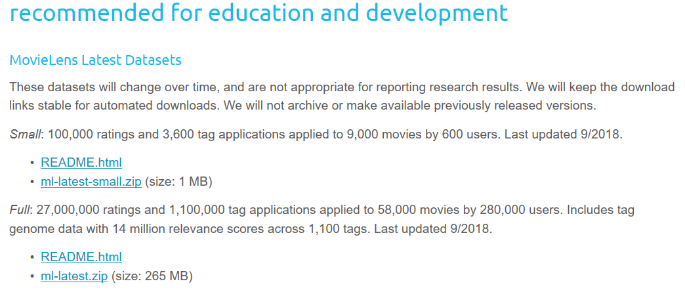
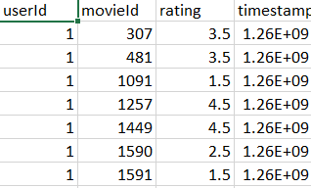
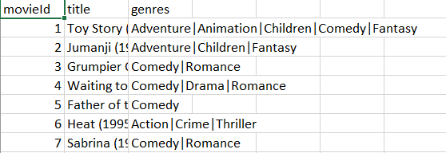
Data
Dataset
Movie Lens (Latest)
Movie
User

Slide 5
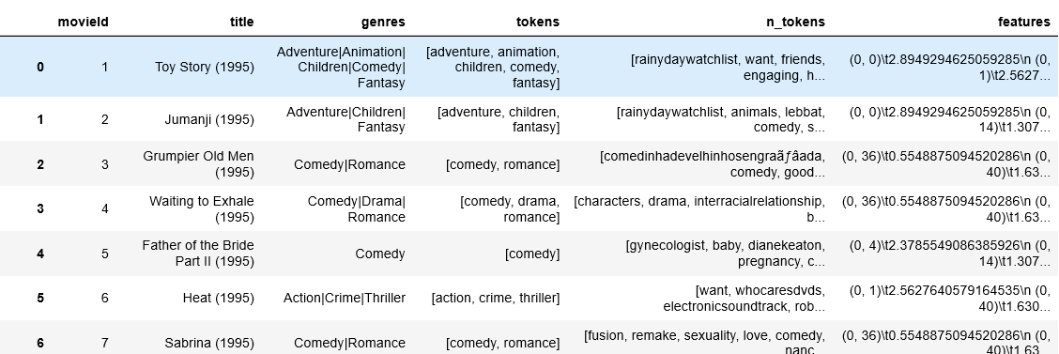
Data - Features
Genre
Actors?
Dataset limitations
What about not important ones?
Tags
Normalizations
Occurrence

Slide 6
Methodology
Classifiers
Logistic Regression
Naïve Bayes
Target Class Spread
Active Learning

Slide 7
Interaction
Movie Lens!
User = 138483
Threshold = 4
Ratings/ Threshold
User Input

Slide 8
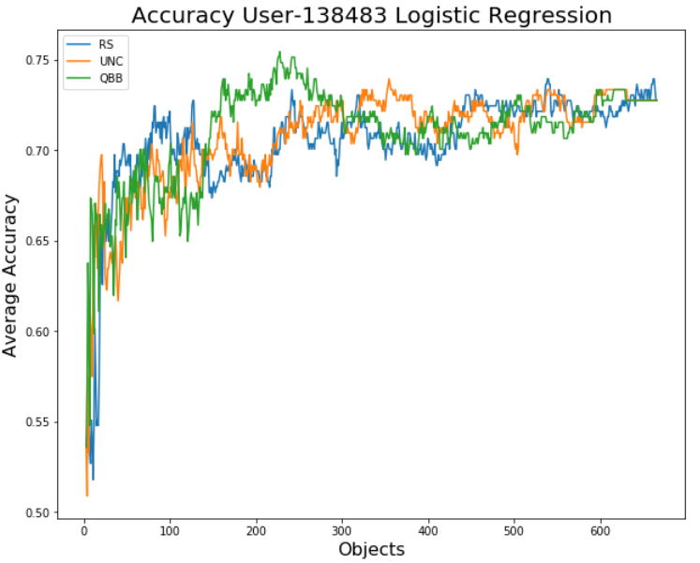
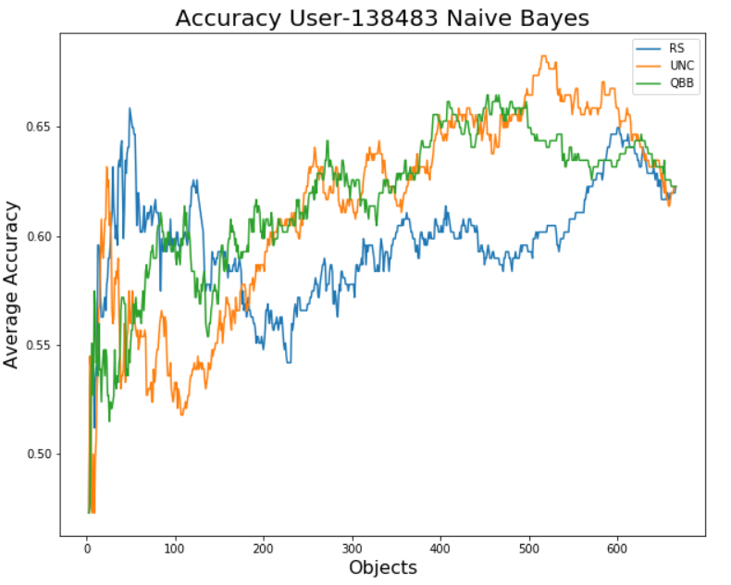
Active Learning
Logistic Regression
Naïve Bayes

Slide 9
Evaluation
Content Based
Cosine Similarity
Collaborated Filtering
Pearson Similarity
Interaction
 | User 1 | User 2 | User 3 | User 4 | User 5
Movie 1 | 5 | 4 | ?
Movie 2 | 1 |  | 2 |  | 2
Movie 3
Movie 4 | 4 |  | 3 | 5

Slide 10
DEMO
Jupyter Notebook

