Slide 1
Connect Four AI
Jason Pearson

Slide 2
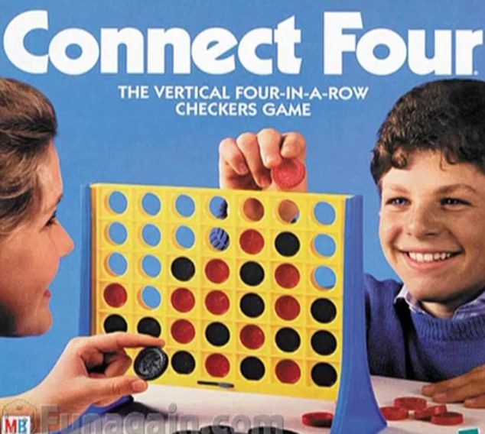
What Is Connect Four
Turn Based Game
Line 4 pieces in a row
Horizontally
Vertically
Diagonally

Slide 3
Why Connect Four
Simple Game (or so we thought)
Solved Game

Slide 4

First Moves
Winner
P2
P2
Tie
P1
Tie
P2
P2

Slide 5
Calculating Next Move
Adjacent Blank Space = 1 point
Adjacent Enemy Space = 2 points
Adjacent Friendly Space = 4 points
Enemy Wins with move = -max int points
Our move wins = max int points

Slide 6
Lesser Bot vs Greater Bot
Lesser bot calculates only its current moves and what it’s optimal move is
Greater bot calculates the best move considering the best move for the opponent with the move that Greater boot made

Slide 7
Nega-Max Lesser Bot
Max = 12
+1
+8
+7
+7
+1
+7
+12

Slide 8
13
11
7
9
12
13
3
6
-8
-7
-6
-7
-9
-9
-9
-5
-7
-2
-1
-4
-1
-4
-1
-3
-1
-1
-1
-4
-1
-8
-4
-6
-7
-8
-1
-8
-6
-2
-6
-6
-9
-6
-6
-7
1
-2
-3
-7
-9
-7
-8
-7
-6
-3
-8
-8
-9
-1
-5
-3
-5
-5
-1
-1

Slide 9
5
3
0
3
5
4
-6
-3
-8
-7
-6
-7
-9
-9
-9
-5
-7
-2
-1
-4
-1
-4
-1
-3
-1
-1
-1
-4
-1
-8
-4
-6
-7
-8
-1
-8
-6
-2
-6
-6
-9
-6
-6
-7
1
-2
-3
-7
-9
-7
-8
-7
-6
-3
-8
-8
-9
-1
-5
-3
-5
-5
-1
-1

Slide 10
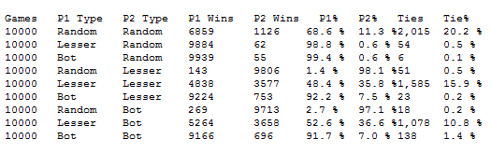
Results of Runs

